Slide 1
Diabetes Investment Analysis:
Allocation Scenarios
Promotion Response Analytics
Commercial Analytics & Decision Sciences
April 2013

Slide 2
Objectives
Analysis Objective: For the diabetes product family, leverage advanced analysis to recommend a more optimal investment mix across promotion types to maximize incremental revenue.
  Use competitive insights, historical brand investments and performance, and promotion response curves by promotion type to create optimization scenarios.
Today’s Agenda:
  Introduce the overall optimization approach/process, key inputs to the process, and results of draft optimization scenarios run to-date.
  Solicit input from Marketing team to position Commercial Analytics to be able to refine the optimization process and scenarios based on expert input.
  This is meant to begin an ongoing conversation that may need to be continued over the next couple of weeks. There may be some iteration and deeper discussion needed.
  After any required iteration, the next step is to share results and recommendations with Rick Hartz and Graeme Bell.

Slide 3
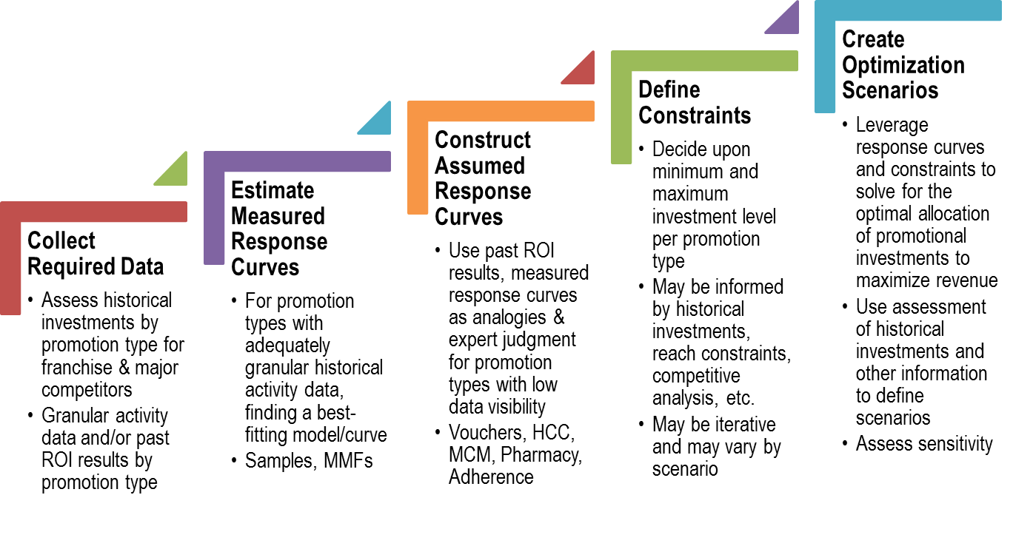
Optimization Process Steps
Marketing Collaboration Needed

Slide 4
Summary of Optimization Scenarios To-Date
Initial draft scenarios show expected incremental revenue contributions ranging from $139MM to $407MM. These are subject to change and refinement based on the Marketing input being solicited today/over the next several days.
Current expected revenue contribution of promotion is $742MM (based on after-tax three-year net present value per incremental new patient). It is likely that this can be improved by more optimal allocation of investments as these draft scenarios show:
Across these scenarios, optimization consistently results in increased investment in Samples and HCC media and in reductions in Adherence, Vouchers and Pharmacy programs. MMF and MCM recommendations vary between increasing and decreasing depending upon the scenario.
Scenario Description | Incremental Investment | Expected Increase in Incremental Revenue Contribution of Promotion
Base Case: Redistribution of current planned spend | $ -- | $139MM (19%)
Competitive: Allow total spend to increase to approximately match Tradjenta’s 2012 spend for Samples & Meetings | $10MM | $187MM (25%)
Historical: Set total spend similar to 2012-1Q (recent best NRx performance) | $36MM | $407MM (55%)

Slide 5
Analyzed Promotion Types &
Promotion Response Curves

Slide 6
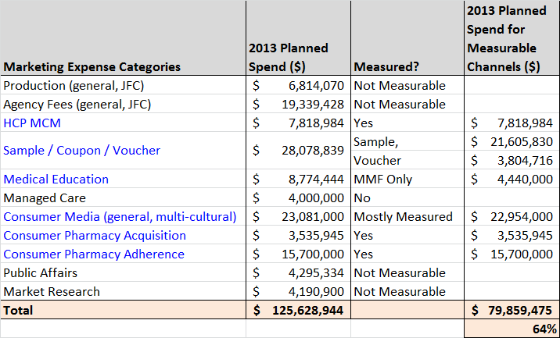
Measured Marketing Expense Categories
About 64% of the marketing expense categories that are measurable were accounted in the analysis
Measurable promotion types are MCM, Sample, Voucher, Medical Education (MMF only), Consumer Media (HCC), Pharmacy Acquisition and Adherence programs.
Measured promotion types account for about $80MM [64%] of the $125MM planned spend.
Marketing spends were initially obtained from GMC team. Some line items like acquisition programs were updated with later versions got from marketing team.
Data Source: Merck GMC
Notes:
Managed Care may be considered “Phase 2”...but understand what is in this expense category...

Slide 7
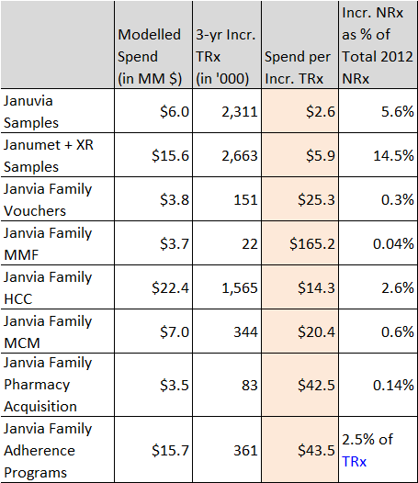
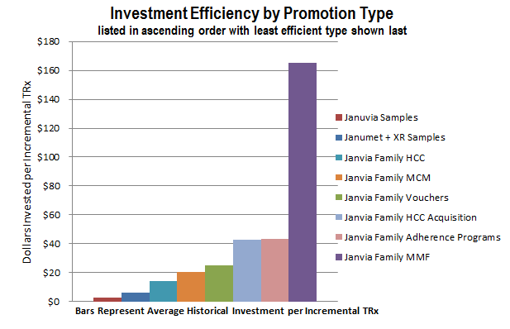
Impact Summary by Promotion Type
Spend for one Incremental TRx is lowest for samples* and highest for MMF. Optimal budget allocation for each promotion type is guided by this impact.
* Samples are requested and received by prescribers for use by and benefit of patients. Samples provide the opportunity to gain experience with a product. The sample-related values shown here reflect the association between samples and new patient starts rescaled into TRx terms for comparability to other investment types; this applies to vouchers as well, which are treated as an alternative mechanism to provide samples to patients. (vs. “samples” left by Field personnel).

Slide 8
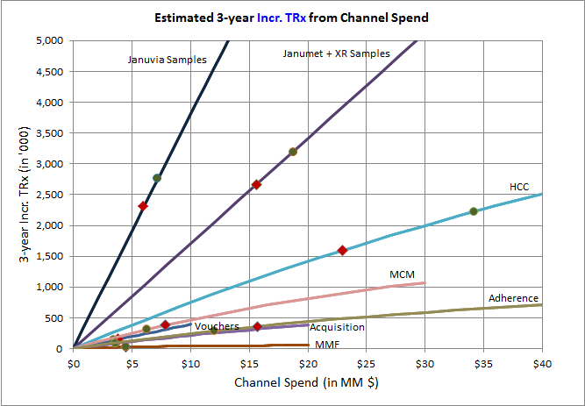
Combined Promotion Response Curves
High Impact: Samples, HCC programs.
Medium Impact: MCM, Vouchers and Adherence programs.
Low Impact: Pharmacy Acquisition programs and MMF
Red square points on each curve represents the impact at currently planned spend
Green circles illustrates the optimal allocation for each curve
In general, promotion types could be grouped into High, Medium and Low impact (in terms of incr. TRx per $ spent)
  High: Samples, HCC
  Medium: MCM, Vouchers,
  Low: Pharmacy Acquisition, Adherence programs and MMF
Investments would be first prioritized for High Impact promotion types followed by medium and then low impact promotion types.
Minimum & maximum allocation constraints are specified for each promotion type.
Possible Optimal
Allocation
Currently
Planned Spend
Incremental TRxs are realized in 3 years. The spends are in pre-tax scale
* Samples are requested and received by prescribers for use by and benefit of patients. Samples provide the opportunity to gain experience with a product. The sample-related values shown here reflect the association between samples and new patient starts rescaled into TRx terms for comparability to other investment types; this applies to vouchers as well, which are treated as an alternative mechanism to provide samples to patients. (vs. “samples” left by Field personnel).

Slide 9
Optimal Allocation of Spend by Promotion Type:
Case Studies

Slide 10
Scenarios Considered for Budget Allocation
Scenarios considered for allocation: Standard +or-20%, Standard +or-30% and Custom
Two Standard Scenarios
  Total budgets change in the increment of $5MM (from $-15MM to $+15MM).
  Standard ±20%: Promotion types are allowed to vary their budgets by ±20% of current level.
  Standard ±30%: Promotion types are allowed to vary their budgets by ±30% of current level.
Custom Scenario
  Total spend is similar to 2012-S2 (Jul-2011 to Dec-2011) projected level of about $90 MM.
    Projection for samples considers Days of Therapy of samples in supply as Janumet XR was not launched in 2011..
  Allowed minimum and maximum budgets are based on balance between inputs from brand team, comparison to historic growth period (2011-S2) and some considerations to competitor spends.
    Samples: + or – 20% from current.
    Vouchers: + or – 10% from current.
    HCC: Current spend of ~$23MM to $36.8MM (2011-S2 equivalent)
    MCM: -20% to +10% of current.
    Acquisition: Current spend of ~$3.5MM to $5.0MM
    Adherence: $12MM to $16.5MM
    MMF: Current spend of ~$4.4MM to $6.3MM (2011-S2 equivalent)

Slide 11
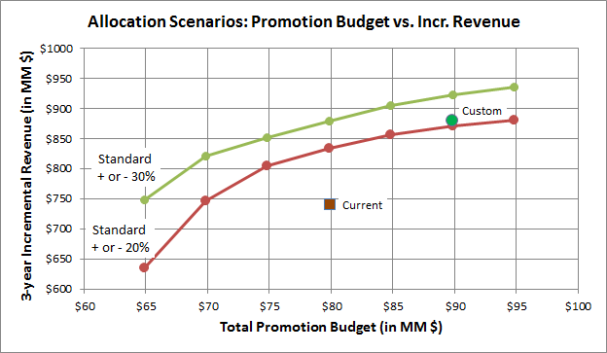
Optimal Allocation Summary
In custom scenario, a $90 MM investment results in about $140MM increase in 3-year incremental revenue when compared to current allocation..
Current $80MM investment results in $741MM 3-year incr. revenue. About 34% could be realized in year 1.
Custom Scenario with $90MM investment results in $881MM in incr. revenue. This is slightly above the corresponding contribution from Standard + or – 20% scenario.

Slide 12
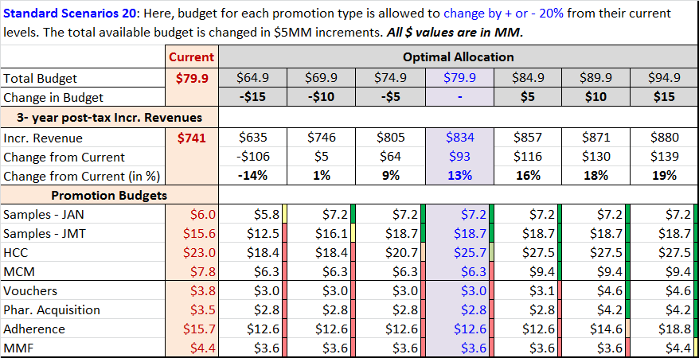

Optimal Allocation: Standard Scenario ±20%
By increasing the total budget by $10MM and allowing a ±20% budget change for each of the promotion type, the optimal reallocation results in an increase of $130MM in 3-year incremental revenue.
Current $80MM investment results in $741MM 3-year incr. revenue. About 34% could be realized in the first year.
  Reallocation of $80MM may yield an additional $93 MM incr. revenue.
Optimal allocation with $90MM spend may increase incr. revenue by $130 MM.
* Samples are requested and received by prescribers for use by and benefit of patients. Samples provide the opportunity to gain experience with a product. The sample-related values shown here reflect the association between samples and new patient starts rescaled into TRx terms for comparability to other investment types; this applies to vouchers as well, which are treated as an alternative mechanism to provide samples to patients. (vs. “samples” left by Field personnel).

Slide 13
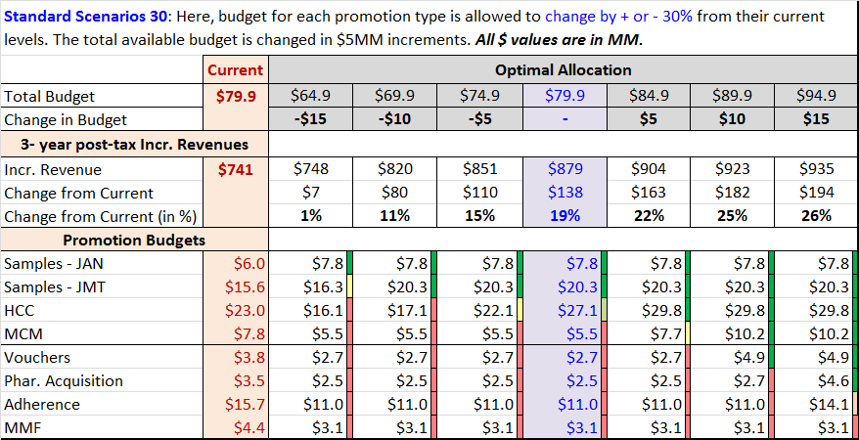
Optimal Allocation: Standard Scenario ±30%
By increasing the total budget by $10MM and allowing a ±30% budget change for each of the promotion type, the optimal reallocation results in an increase of $182MM in 3-year incremental revenue.
Current $80MM investment results in $741MM 3-year incr. revenue. About 34% could be realized in the first year.
  Reallocation of $80MM may yield an additional $138 MM incr. revenue.
Optimal allocation with $90MM spend may increase incr. revenue by $182 MM.
* Samples are requested and received by prescribers for use by and benefit of patients. Samples provide the opportunity to gain experience with a product. The sample-related values shown here reflect the association between samples and new patient starts rescaled into TRx terms for comparability to other investment types; this applies to vouchers as well, which are treated as an alternative mechanism to provide samples to patients. (vs. “samples” left by Field personnel).

Slide 14
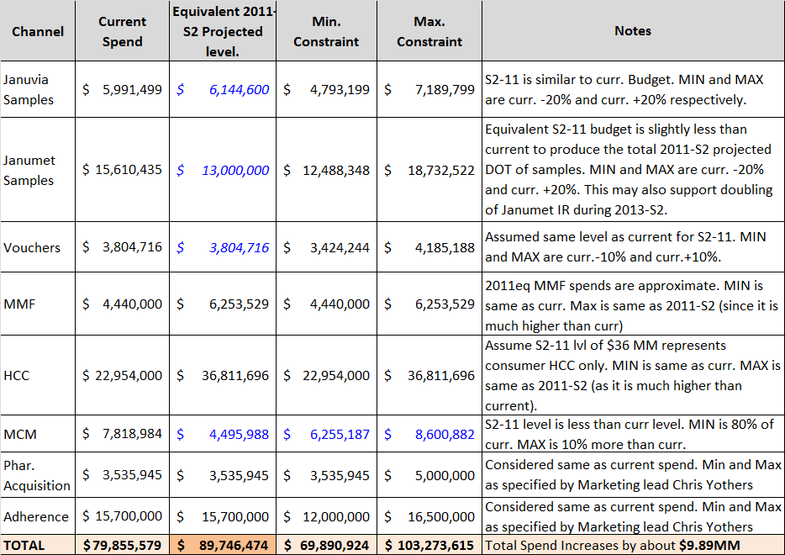
Optimal Allocation: Custom Case - Constraints
Custom Case is built based on inputs from brand team. Budgets are also compared to the investments during historic growth period (2011-S2). Some consideration to competitor spends are also incorporated (ex: samples).
Custom Case: Allowed minimum and maximum budgets are based on balance between inputs from brand team, comparison to historic growth period (2011-S2) and some considerations to competitor spends.
  Based on 2011-S2 projection, an additional spend of about $10MM may be required to maintain the right level of promotions (for samples, days of therapy is considered for comparison to 2011-S2).

Slide 15
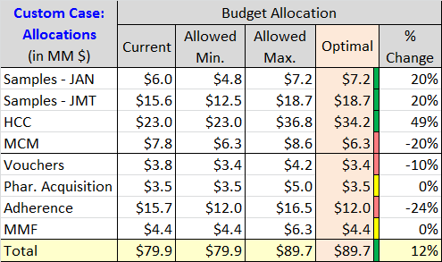
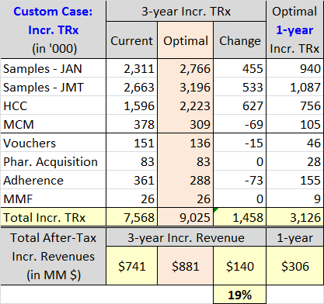
Optimal Allocation: Custom Case - Results
Samples and HCC programs get more allocation at the expense of other promotion type budgets. Acquisition and MMF retains their current budget. After-tax 3-year incremental revenues increases by an estimated $140 MM (19% increase)
Custom Case Results
  Total budget is up by $10MM. Budgets for Samples and HCC are increased. Acquisition and MMF budgets remains at current level. Budgets for all other promotion types are reduced.
  By optimal redistribution of budgets, incremental revenue increases by 19% to $881MM.
* Samples are requested and received by prescribers for use by and benefit of patients. Samples provide the opportunity to gain experience with a product. The sample-related values shown here reflect the association between samples and new patient starts rescaled into TRx terms for comparability to other investment types; this applies to vouchers as well, which are treated as an alternative mechanism to provide samples to patients. (vs. “samples” left by Field personnel).

Slide 16
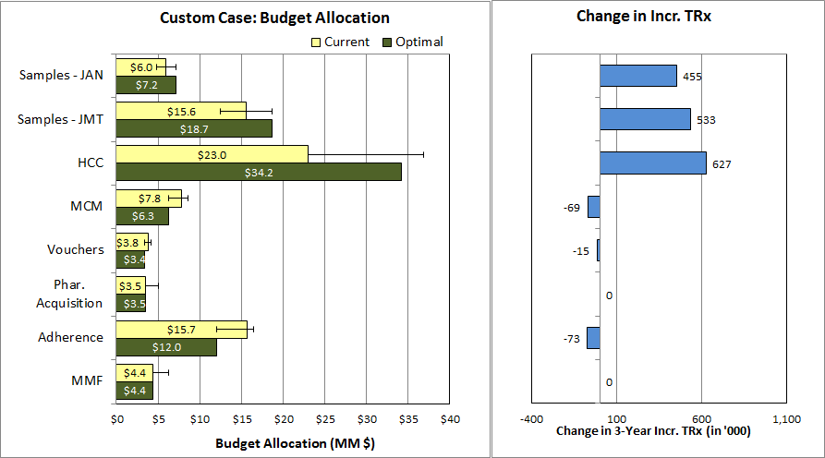
Optimal Allocation: Custom Case - Results
Samples and HCC programs gets more allocation . Acquisition and MMF remains same. Other promotion type budgets are reduced. After-tax 3-year incremental revenues increases by an estimated $140 MM (19% increase) when compared to the current allocation.
Total budget: $89.7 MM; 3-Year incr. revenue: $881 MM; 1-Year incr. revenue: $306 MM
* Samples are requested and received by prescribers for use by and benefit of patients. Samples provide the opportunity to gain experience with a product. The sample-related values shown here reflect the association between samples and new patient starts rescaled into TRx terms for comparability to other investment types; this applies to vouchers as well, which are treated as an alternative mechanism to provide samples to patients. (vs. “samples” left by Field personnel).

Slide 17
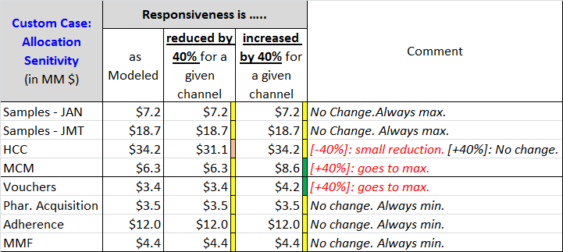
Allocation Sensitivity: Custom Case
Promotion types insensitive to large changes in responsiveness: Samples, Acquisition, Adherence and MMF
MCM, Voucher allocation increases if responsiveness is increased by 40% or more
HCC has a small reduction if responsiveness is reduced by 40% or more
Sensitivity Analysis
  A wide variation in responsiveness is used to determine allocation sensitivity.
  Samples always gets maximum allowed allocation and is not sensitive to changes in responsiveness.
  Acquisition, Adherence and MMF gets minimum allowed allocation and are not sensitive to change in responsiveness.
  Allocation of funds between HCC, MCM, and Vouchers vary according to the variation in responsiveness.
    MCM and Voucher allocation increases if their responsiveness is increased by 40% or more.
    HCC allocation decreases a little if their individual responsiveness is decreased by 40% or more.
NOTE: Same exact allocations as above are obtained when responsiveness is reduced by HALF or DOUBLED

Slide 18
Conclusion and Next Steps
Identify Marketing team member(s) to collaborate with Commercial Analytics to review and, if necessary, refine key optimization process assumptions (e.g., minimum and maximum investment level constraints by promotion type) and scenarios characteristics.
Produce refined scenarios and review with Marketing leadership.
Share recommendations for key scenarios with Rick Hartz and Graeme Bell (by mid-May).

