Slide 1
Januvia® Product Family Promotion: Budget Optimization
Promotion Response Analytics
Commercial Analytics & Decision Sciences
July 2013

Slide 2
Agenda
Executive Summary
Top Line Recommendation & Rationale
Current vs. Optimal Allocations
Confidence in Promotion Sensitivity
Method Overview
Process Steps
Scope by Promotion Expense Type
Response Curves by Promotion Type
Optimization Scenarios
Description of Scenarios
Optimal Allocation Summary
Custom Case Results
Allocation Sensitivity
Discussion

Slide 3
Executive Summary: Recommendation & Rationale
Recommendation: During the next 12 months, invest an incremental $10MM and reallocate the current¹ Januvia® product family promotion budget for an expected contribution of approximately $147MM of incremental revenue (based on 3-year after-tax NPV and Standard Scenario +/- 20%)².
Sources of incremental revenue contribution
71% ($104MM) of the expected incremental revenue contribution is due to reallocation of the current budget.
29% ($43MM) is due to the incremental $10MM investment assuming that this is optimally allocated.
Incremental revenue contribution by year if changes/additions implemented as of 1 July 2013
Rationale: Commercial Analytics conducted extensive analysis of revenue contributions and ROI of historical Januvia® product family promotion to construct promotion response curves for major promotion types. These were leveraged to recommend reallocation using an optimization algorithm.
Assessment of the competitive landscape, historical brand performance comparing promotion investment to product volume, and integration of expert input from Marketing were considered to define upper and lower constraints on promotion investments by type.
All optimization scenarios suggest that there is considerable opportunity to effectively reallocate existing investments and to increase investment in key promotion types with low risk of saturation.
Year 1 | Year 2 | Year 3 +
$50MM | $57MM | $40MM
(1) Assumes that the Januvia® product family promotion budget is approximately $124.7MM during the 12 months starting in July 2013. If allocated similarly to 2S2013 plans, the total 3-year NPV contribution would be $827MM.
(2) The optimization scenario leveraged to generate these estimates allows investment in each existing promotion type to vary up to 20% in either direction vs. current plans. Other scenarios with different constraints yield different estimates of the potential impact of incremental investment and reallocation.

Slide 4
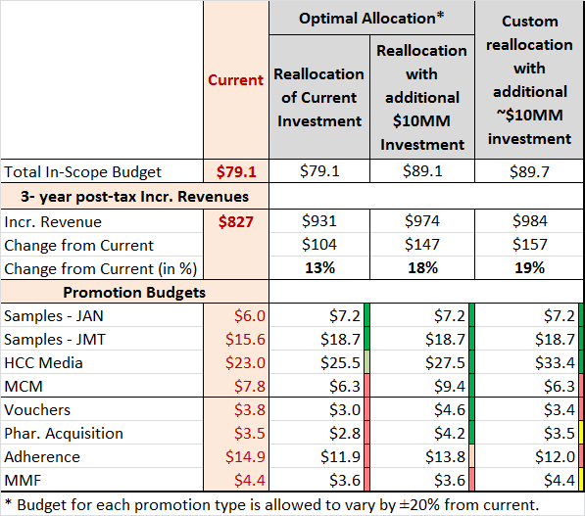

Executive Summary: Current vs. Optimal Allocations
Optimization consistently results in increased investment in Samples and HCC media, and reductions in Adherence. Vouchers, Pharmacy Acquisition, MMF and MCM recommendations vary between increasing, no change and decreasing.
1
2
2
2
(1) Out of scope expenses include: Production and Agency fees, Coupons, Managed Care, Public Affairs, Market Research.
(2) HCC Media, MCM and Vouchers exhibit promotion sensitivity in the middle of the observed range across studied promotion types for the Januvia® product family. An analysis of the sensitivity of the recommended allocations to bias in promotion responsiveness assumptions suggests increased investment in MCM and Vouchers if promotion sensitivity is substantially higher than historical levels. See Slide 12 for allocation sensitivity analysis.
Notes:
The first data row in this table should have “Total In-Scope Budget” in the first column.
Include callout box for HCC Media – Custom Reallocation only – that lower response may be in play.

Slide 5
Executive Summary: Confidence in Promo. Response
The resource allocations suggested by the optimization model depend upon promotion response curves. The level of confidence associated with these varies by promotion type and should be considered when making investment decisions.
Promotion Type | Response Assessment Method(s) | Data Sources [Supplier(s)]² | Level of Confidence
Samples | Statistical analysis¹ | 2012 HCP-level data [CA&DS] | Highest
MMF | Statistical analysis¹ |  | Highest
MCM | Statistical analysis¹ Arithmetic modeling | 2012 HCP-level data [CA&DS] Engagement metrics, Channel Choice Simulator³ [GMC&CS] | Medium
Vouchers | Use of samples response curves as a proxy for voucher response | 2012 HCP-level data analog [CA&DS] | Medium
Pharmacy Acquisition | Incremental pills and fills (test and control stores) | Outside suppliers [IMS/SDI, pharmacy chains] Merck oversight and valuation [FE&A]² | Medium
Pharmacy Adherence | Incremental pills and fills (longitudinal claims data for test and control patients) |  | Medium
HCC Media | Statistical analysis¹ Arithmetic modeling | 2012 HCP-level data [CA&DS] Survey measured conversion rates [comScore, Evolution Road (ER)] Engagement metrics [comScore, Evolution Road] Impressions and reach [Initiative] Pro forma ROI models [ER] | Medium
(1) Statistical analysis of in-market data studying the association between the promotion and NRx volume (as a proxy for new patient starts). Leverages multivariate models to control for potential confounding influences while isolating the effect of the promotion. May include use of a prospectively held out control group or retrospectively matched comparison group.
(2) All financial valuation carried out in accordance with Financial Evaluation & Analysis models.
(3) Pro forma ROI modeling tool created/maintained by CA&DS and used by GMC&CS Promotion and MCM managers.
Notes:
Need to complete this...

Slide 6
Method Overview: Process Steps
Collect Required Data
Estimate Measured Response Curves
Construct Calibrated Response Curves
Create Optimization Scenarios
Assess historical investments by promotion type for franchise & major competitors
Define Constraints
Granular activity data and/or past ROI results by promotion type
For promotion types with adequately granular historical activity data, finding a best-fitting model/curve
Samples, MMFs
Use past ROI results, measured response curves as analogies & expert judgment for promotion types with low data visibility
Vouchers, HCC, MCM, Pharmacy, Adherence
Decide upon minimum and maximum investment level per promotion type
May be informed by historical investments, reach constraints, competitive analysis, etc.
May be iterative and may vary by scenario
Leverage response curves and constraints to solve for the optimal allocation of promotional investments to maximize revenue
Use assessment of historical investments and other information to define scenarios
Assess sensitivity
Collaboration with Marketing

Slide 7
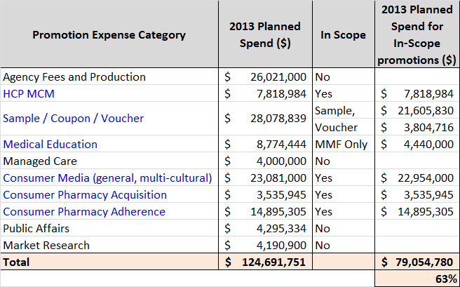
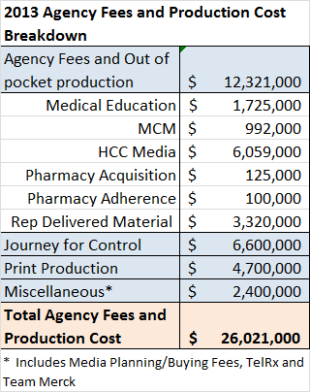
Method Overview: Scope by Promotion Expense Type
Approximately 63% of the promotion budget is for programs for which incremental Rx contributions can be measured & is in scope for this analysis. Agency/production costs, managed care, public affairs & market research are out of scope.
Coupons are not in-scope
1
2
3
Data Source: Merck GMC
(1) Congresses and society meeting expenses are out of scope.
(2) Consists of agency fees for managed care related resources/strategy ($1MM), journal ads, payer national meeting exhibits, and other managed care-funded items( e.g., Fingertip/Pinosault data, copay data, CoverMyMeds support for PAs, disease management programs, Quality Improvement Service Agreements).
(3) Journey for Control is out of scope.
Notes:
Requested David to subdivide agency & production by other promotion categories for clarity. Did David provide these costs yet?

Slide 8
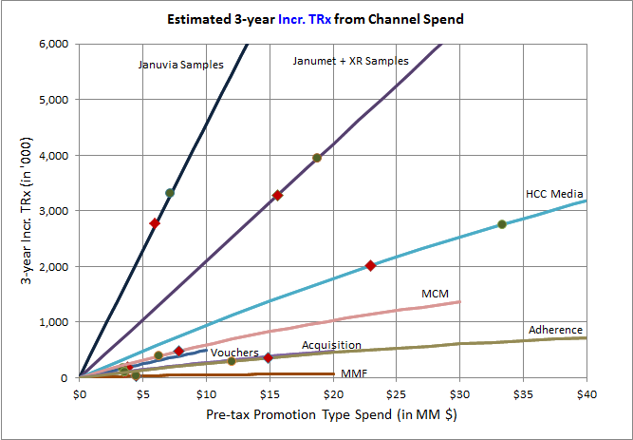
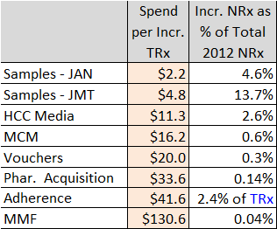
Method Overview: Response Curves by Promo. Type
Highest Impact: Samples¹, HCC media. Medium Impact: MCM, Vouchers and Pharmacy Acquisition programs. Lower Impact: Adherence programs and MMF.
Investments would be first prioritized for Highest Impact promotion types followed by Medium Impact and then Lower Impact promotion types.
Minimum & maximum allocation constraints are specified for each promotion type.
Curves are based on historical results and are not adjusted for future market events and marketplace changes. Detailed historical results are provided on slides 19 through 23.
Possible Optimal
Allocation
Currently
Planned Spend
(1) Samples are requested and received by prescribers for use by and benefit of patients. Samples provide the opportunity to gain experience with a product. The sample-related values shown here reflect the association between samples and new patient starts rescaled into TRx terms for comparability to other investment types; this applies to vouchers as well, which are treated as an alternative mechanism to provide samples to patients. (vs. samples left by Field personnel).

Slide 9
Scenarios: Overview of Optimization Cases
Three types of scenarios were considered for allocation: Standard +or-20%, Standard +or-30% (to enable comparison to other franchises when available) and Custom (to reflect specific considerations for the Januvia® product family).
Two Standard Scenario Cases
In-scope budget changed in increments of $5MM (from $-15MM to $+15MM).
Standard ±20%: Promotion type budgets are allowed to vary by ±20% of current level.
Standard ±30%: Promotion type budgets are allowed to vary by ±30% of current level.
Custom Scenario Case
In-scope spend is similar to 2011-S2 (Jul-2011 to Dec-2011) projected level of about $89 MM.
Projection for samples considers Days of Therapy of samples in supply (Janumet XR not in market in 2011).
Allowed minimum and maximum budgets are based on balance between inputs from brand team, comparison to historic growth period (2011-S2) and some consideration of competitor spends.
Samples: + or – 20% from current.
Vouchers: + or – 10% from current.
HCC media: Current spend of ~$23MM to $36.8MM (2011-S2 equivalent)
MCM: -20% to +10% of current.
Acquisition: Current spend of ~$3.5MM to $5.0MM
Adherence: $12MM to $16.5MM
MMF: Current spend of ~$4.4MM to $6.3MM (2011-S2 equivalent)

Slide 10
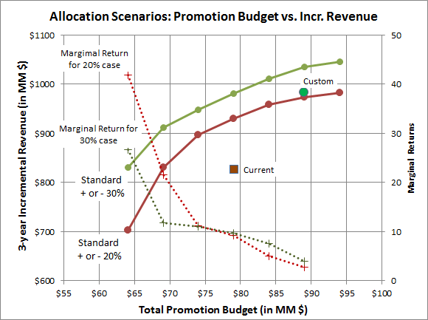
Scenarios: Optimal Allocation Summary
For the Custom scenario, an incremental $10MM investment (added to the current $79MM of in scope investment) results in an approximately $157MM increase in 3-year incremental revenue when compared to the current allocation.
The current in-scope investment of $79MM results in $827MM 3-year incremental after-tax revenue. Approximately 34% is expected to be realized in Year 1.
The Custom scenario with $89MM in-scope investment results in $984MM in incremental revenue. This is slightly above the corresponding contribution from the Standard + or – 20% scenario.
For the Marginal Returns, both incremental revenue and incremental cost are in post-tax scale.

Slide 11
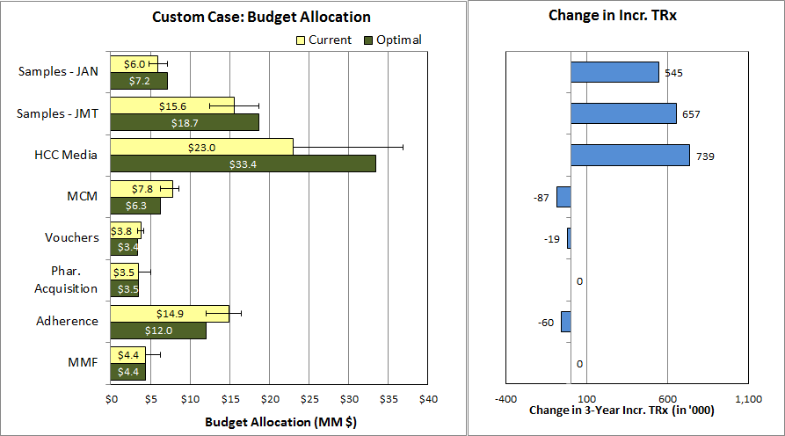
Scenarios: Custom Case - Results
Samples¹ and HCC programs increase, Acquisition and MMF remain similar, and other promotion types are reduced. After-tax 3-year incremental revenue increases by an estimated $157 MM (19%) vs. the current allocation.
Total budget: $88.9 MM; 3-Year incr. revenue: $984 MM; 1-Year incr. revenue: $341 MM
(1) Samples are requested and received by prescribers for use by and benefit of patients. Samples provide the opportunity to gain experience with a product. The sample-related values shown here reflect the association between samples and new patient starts rescaled into TRx terms for comparability to other investment types; this applies to vouchers as well, which are treated as an alternative mechanism to provide samples to patients. (vs. samples left by Field personnel).

Slide 12
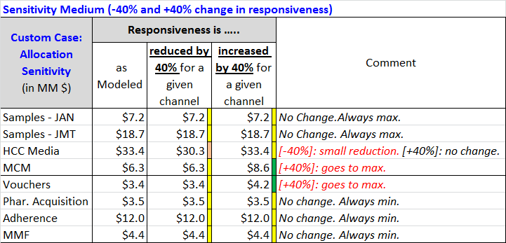
Allocation Sensitivity: Custom Case
Samples¹, Acquisition, Adherence and MMF are insensitive to large changes in responsiveness. MCM and Vouchers¹ in-
crease if responsiveness is increased by 40% or more. HCC reduces slightly if responsiveness reduced by 40% or more
Sensitivity Analysis
A wide variation in responsiveness is used to determine allocation sensitivity.
Samples always receive maximum allowed allocation and this result is not sensitive to changes in responsiveness.
Acquisition, Adherence and MMF get minimum allowed allocation and are not sensitive to change in responsiveness.
Allocation of funds between HCC, MCM, and Vouchers vary according to the variation in responsiveness.
MCM and Voucher allocation increases if their responsiveness is increased by 40% or more.
HCC allocation decreases a little if their individual responsiveness is decreased by 40% or more.
NOTE: Same exact allocations as above are obtained when responsiveness is reduced by HALF or DOUBLED
(1) Samples are requested and received by prescribers for use by and benefit of patients. Samples provide the opportunity to gain experience with a product. The sample-related values shown here reflect the association between samples and new patient starts rescaled into TRx terms for comparability to other investment types; this applies to vouchers as well, which are treated as an alternative mechanism to provide samples to patients. (vs. samples left by Field personnel).

Slide 13
Discussion Points
Risk of saturation is low: Promotion response assessments show the Januvia® product family is promotionally sensitive, and there is no evidence to suggest that an increase in the overall promotion budget of approximately $10MM would result in saturation/over-investment.
Recommendation is reallocation plus incremental investment: Although optimizing the current planned budget is likely to result in incremental revenue, this alone would still leave some key promotion types under-funded from an absolute perspective (based upon promotion response curves) and a relative perspective (compared to competitors).
Sensitivity of analysis to bias is low: Optimal allocations suggested by this analysis are...
...insensitive to bias in the promotion response curves at greater than +/- 40% for most studied promotion types.
...sensitive to bias for HCC Media (40% lower promotion response results in fewer dollars allocated), and MCM and Vouchers (for which 40% greater promotion response results in maximum allocation).
Fair balance and appropriate use: This analysis depends upon promotion response curves derived from historical performance. These response curves are not adjusted for future marketplace changes and events. Although the Custom Case includes expert input and consideration of the competitive landscape, additional considerations may be appropriate for adjusting the allocations prior to deployment, including expected marketplace changes/events as well as balancing risk that might be associated with over-investing in a single promotion type.

Slide 14
Backup

Slide 15
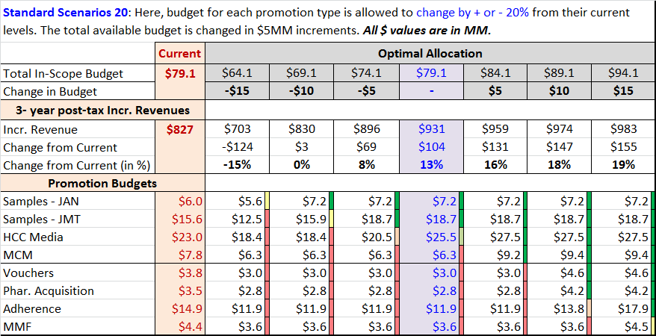
Optimal Allocation: Standard Scenario ±20%
By increasing the total budget by $10MM and allowing a ±20% budget change for each of the promotion types, the optimal reallocation results in an increase of $147MM in 3-year incremental revenue.
Current $79MM investment results in $827MM 3-year incr. revenue. About 34% could be realized in the first year.
Reallocation of $79MM may yield an additional $104 MM incr. revenue.
Optimal allocation with $89MM spend may increase incr. revenue by $147 MM.
* Samples are requested and received by prescribers for use by and benefit of patients. Samples provide the opportunity to gain experience with a product. The sample-related values shown here reflect the association between samples and new patient starts rescaled into TRx terms for comparability to other investment types; this applies to vouchers as well, which are treated as an alternative mechanism to provide samples to patients. (vs. “samples” left by Field personnel).

Slide 16
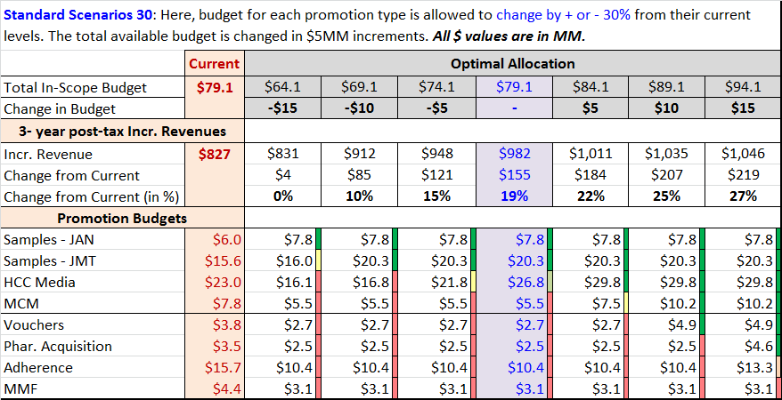
Optimal Allocation: Standard Scenario ±30%
By increasing the total budget by $10MM and allowing a ±30% budget change for each of the promotion type, the optimal reallocation results in an increase of $207MM in 3-year incremental revenue.
Current $79MM investment results in $827MM 3-year incr. revenue. About 34% could be realized in the first year.
Reallocation of $79MM may yield an additional $155 MM incr. revenue.
Optimal allocation with $89MM spend may increase incr. revenue by $207 MM.
* Samples are requested and received by prescribers for use by and benefit of patients. Samples provide the opportunity to gain experience with a product. The sample-related values shown here reflect the association between samples and new patient starts rescaled into TRx terms for comparability to other investment types; this applies to vouchers as well, which are treated as an alternative mechanism to provide samples to patients. (vs. “samples” left by Field personnel).

Slide 17
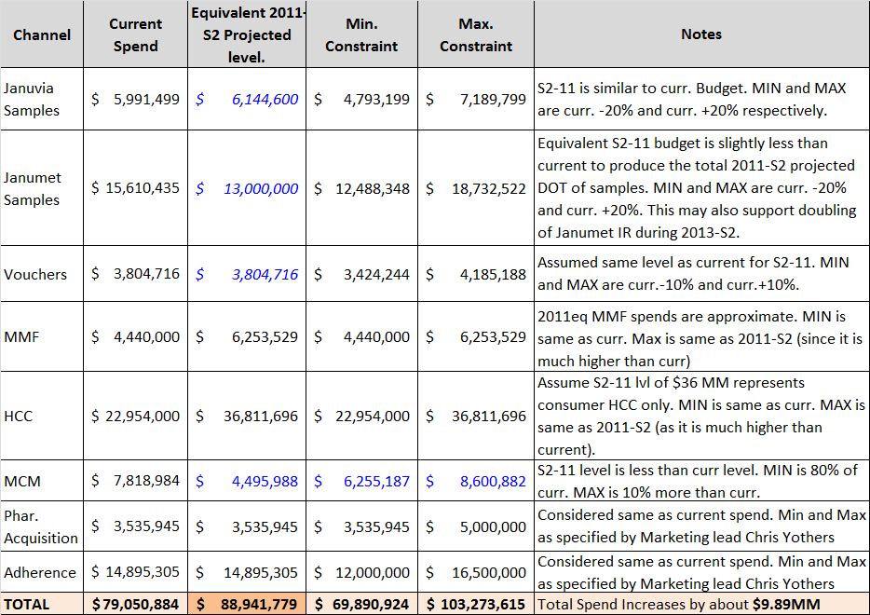
Optimal Allocation: Custom Case - Constraints
Custom Case is built based on inputs from brand team. Budgets are also compared to the investments during historic growth period (2011-S2). Some consideration to competitor spends are also incorporated (ex: samples).
Custom Case: Allowed minimum and maximum budgets are based on balance between inputs from brand team, comparison to historic growth period (2011-S2) and some considerations to competitor spends.
Based on 2011-S2 projection, an additional spend of about $10MM may be required to maintain the right level of promotions (for samples, days of therapy is considered for comparison to 2011-S2).

Slide 18
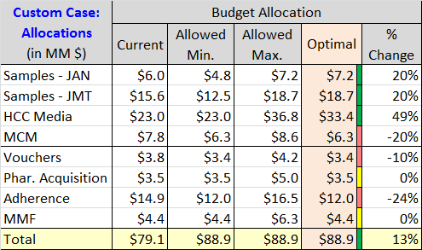
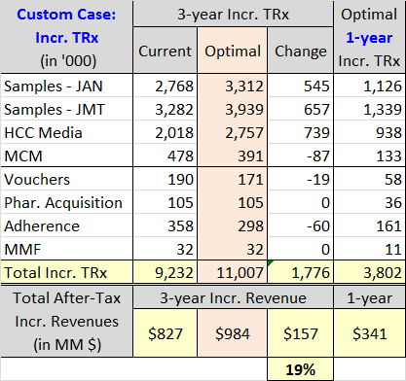
Optimal Allocation: Custom Case - Results
Samples and HCC programs get more allocation at the expense of other promotion type budgets. Acquisition and MMF retains their current budget. After-tax 3-year incremental revenues increases by an estimated $157 MM (19% increase)
Custom Case Results
Total budget is up by $10MM. Budgets for Samples and HCC are increased. Acquisition and MMF budgets remains at current level. Budgets for all other promotion types are reduced.
By optimal redistribution of budgets, incremental revenue increases by 19% to $984 MM.
* Samples are requested and received by prescribers for use by and benefit of patients. Samples provide the opportunity to gain experience with a product. The sample-related values shown here reflect the association between samples and new patient starts rescaled into TRx terms for comparability to other investment types; this applies to vouchers as well, which are treated as an alternative mechanism to provide samples to patients. (vs. “samples” left by Field personnel).

Slide 19
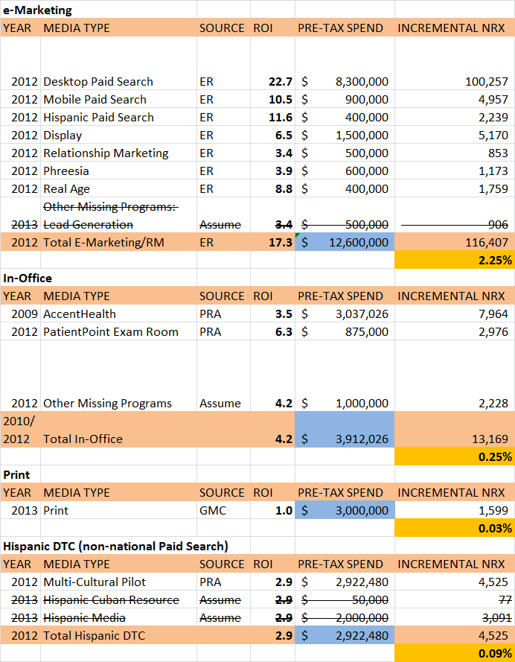
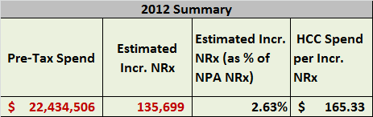
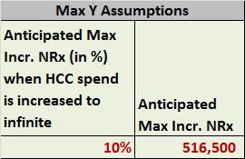

HCC Programs
Tactic ROIs are collected from various sources and summarized to get total HCC Spend and its impact. Summarized impact and a possible maximum of 10% impact in NRx from this promotion type are used to compute response curves.
A maximum of 10% impact in NRx is assumed to be attainable through this promotion type (i.e., when spends are drastically increased)

Slide 20
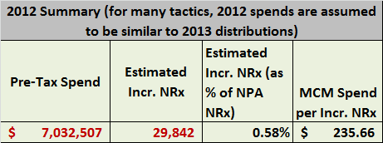
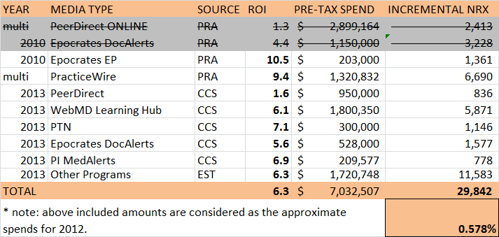
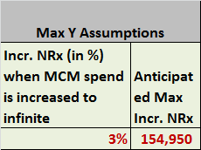

MCM Programs
Tactic ROIs are collected from various sources and summarized to get total MCM Spend and its impact. Summarized impact and a possible maximum of 3% impact in NRx from this promotion type are used to compute response curves.
A maximum of 3% impact in NRx is assumed to be attainable through this promotion type (i.e., when spends are drastically increased)

Slide 21
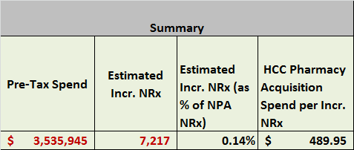
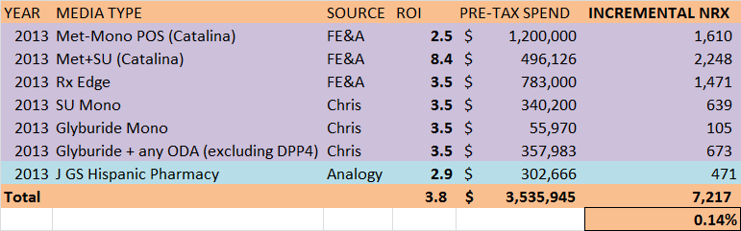
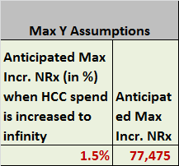

Pharmacy Acquisition Programs
Tactic ROIs are collected from various sources and summarized to get total Acquisition Spend and its impact. Summarized impact and a possible maximum of 1.5% impact in NRx from this promotion type are used to compute response curves.
A maximum of 1.5% impact in NRx is assumed to be attainable through this promotion type (i.e., when spends are drastically increased)

Slide 22
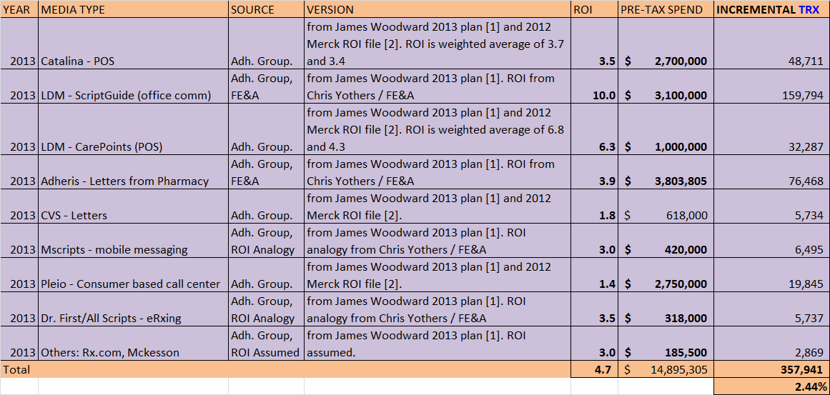
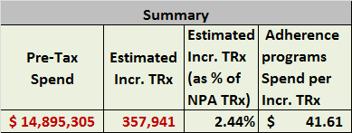
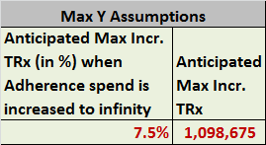
Adherence Programs
Tactic ROIs are collected from various sources and summarized to get total Adherence program Spend and its impact. Summarized impact and a possible maximum of 7.5% impact in TRx from this promotion type are used to compute response curves.
For Adherence programs, ROIs are calculated using Incr. TRx as the measurement scale.
A maximum of 7.5% impact in TRx is assumed to be attainable through this promotion type (i.e., when spends are drastically increased)

Slide 23
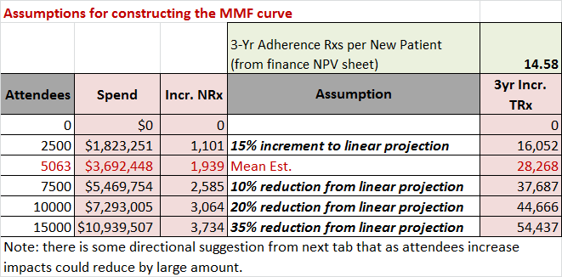
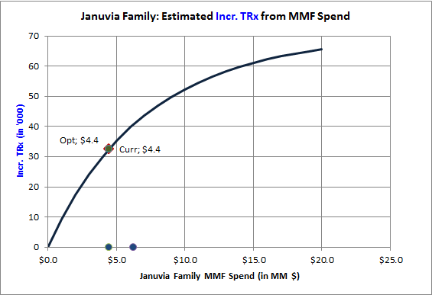
MMF Programs
Tactic ROIs are measured using 2012 HCP level attendee data through Test vs. Control statistical models. For the spends beyond the 2012 program spend, diminishing returns assumptions are made.

