Slide 1
2014 Diabetes Investment Analysis:
Market Trends
Promotion Response Analytics
Commercial Analytics & Decision Sciences
April 2013

Slide 2
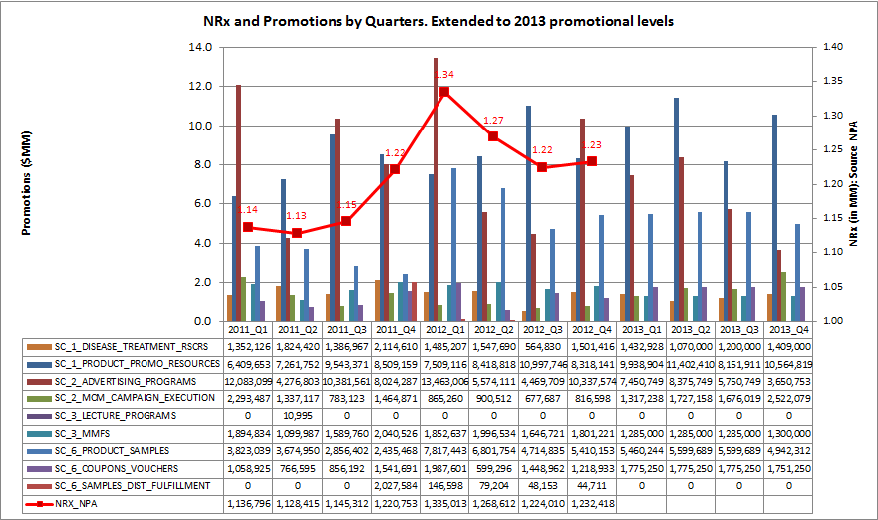
Januvia Family NRx and Historic Spend
Januvia® Family NRx grew between 2011-Q2 to 2012-Q1 then started dropping in 2012-Q2/Q3
2012-Q1 has the maximum spend and the maximum NRx as well.
Data Source: NPA audit

Slide 3
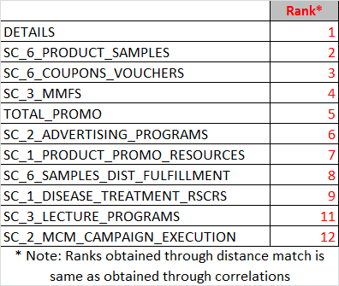
Matching trends between Spend Category and NRx
Spend on samples, voucher/coupons, MMF and DTC correlates with NRx Trend. Detail count also correlates well.
Trends of Detail count, Sample spend, Coupon/Voucher spend, MMF spend and DTC Spend correlate well with Januvia® Family NRx trend. This may not represent causation.
Part of product promotional resources spend is for materials in support of Sales Force detailing, however this spend does not seem to correlate well with NRx trend.
Spend Data Source: Merck

Slide 4
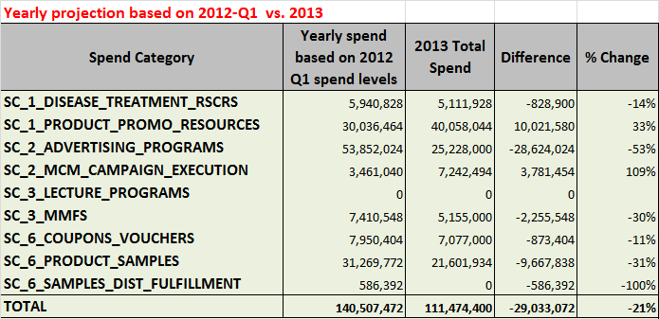
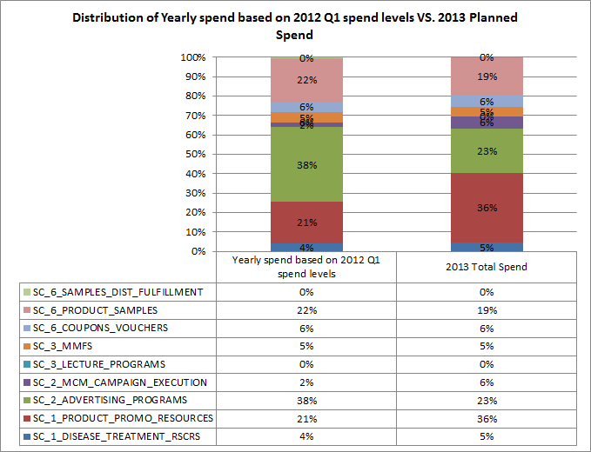
2013 Investment Plan vs. 2012 Q1 Investments
Comparing with best quarter (2012-Q1), there is a potential to increase 2013 spend by $29MM
2012-Q1 had best NRx. Projecting the spend in 2012-Q1 to full year level would result in $140 MM.
2013 planned spend of $111 MM is about 21% lower than the projected yearly spend based on 2012-Q1 spend.
Samples, DTC and Vouchers/Coupons are under-funded when compared to 2012-Q1 mix.
Spend Data Source: Merck

Slide 5
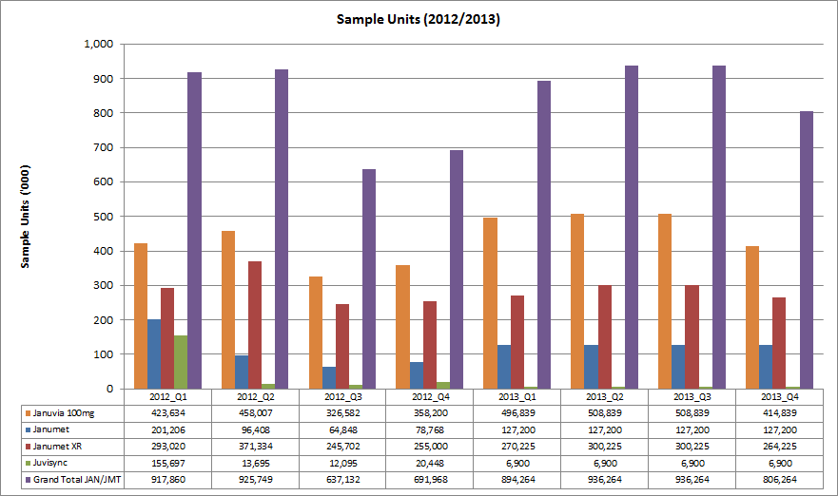
Trends in Sample Units
Janumet ® sample units fell drastically from 2012-Q2 to 2012-Q4.
Janumet ® Samples decreased substantially from 2012-Q2 to 2012-Q4. The next slide shows trends in sample units vs. NRx share.
Data Source: Marketing / Forecast (internal)

Slide 6
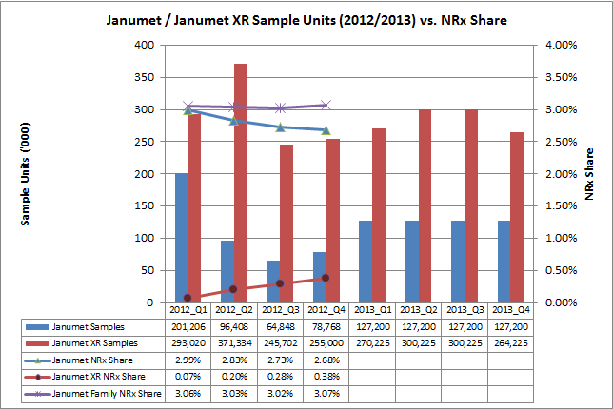
Janumet® Family Trends in Sample Units vs. NRx Share
Janumet ® sample units fell drastically from 2012-Q2 to 2012-Q4. Janumet ® Family NRx Share is flat in 2012.
Janumet ® Samples decreased substantially from 2012-Q2 to 2012-Q4. From the above chart, it appears that the fall in Janumet ® NRx share is compensated by increase in Janumet XR® NRx share.
Open question: Would it be possible to decrease the fall in Janumet® trend by increasing Janumet® samples but still retain the Janumet XR® sampling levels?
Data Source: Marketing / Forecast (internal)

Slide 7
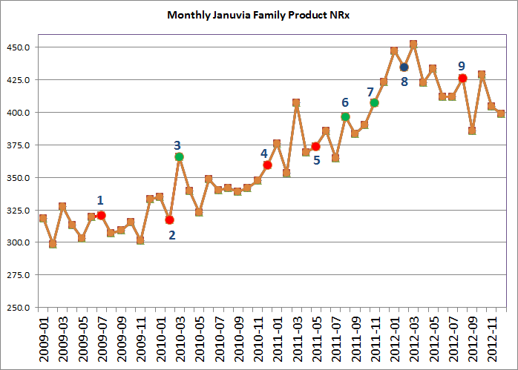
Events Chart
Various Market Events and Januvia Family NRx Trend
Onglyza launch [Jul-09]
Victoza launch [Feb-10]
Avandia off market FDA communication [Mar-10]
Kombiglyze launch [Dec-10]
Tradgenta launch [May-11]
Actos warning, Januvia promotion changes [Aug-11]
Juvisunc launch [Nov-11]
Janumet XR® launch, Jentaduetto launch, Bydureon launch [Feb-12]
Actos off patent [Aug-12]
Data Source: NPA audit

Slide 8
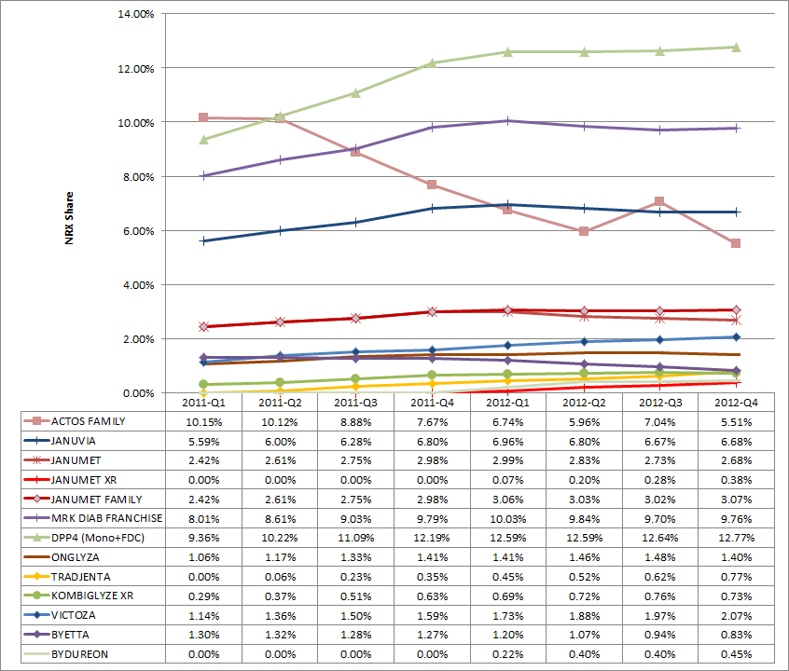
Quarterly NRx Share Chart
Tradjenta and Victoza are growing in 2012. All others are flat or decreasing in 2012.
DPP4 and GLP-1 Brands are growing in 2011
Most DPP4 brands are flat in 2012
Tradgenta (DPP4) and Victoza (GLP-1) are growing in 2012
  What do they do differently?
Janumet ® Family is flat in 2012.
  Janumet® keeps falling (due to drastic fall in samples?)
  Janumet XR ® grows slowly
Actos has a steep fall even in 2012-Q2 when Januvia® falls as well.
  Loss of business from Actos may not be the only reason for Januvia®’s fall.
Data Source: NPA audit

Slide 9
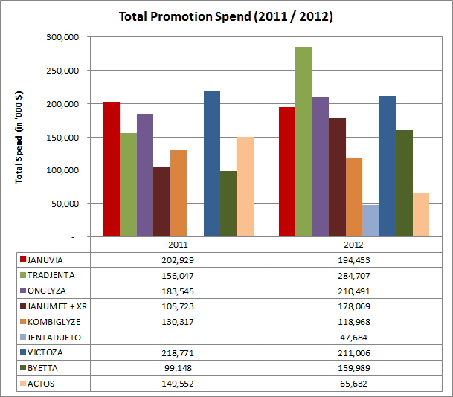
CSD Total Promotions Spend
In 2012, Tradjenta increased its total spend by a large margin. Onglyza and Victoza has similar spend like Januvia®. Janumet ® (+ XR) spend increase in 2012 is largely due to the spend associated with Janumet XR®.
Data Source is CSD. Channels measured by CSD are: Details, Samples, DTC (TV), Meetings, Mailings, Clinical Trials and Print.
Due to the nature of data collection (small panels), these spends are approximate and directional.
Januvia® 2011 and 2012 spends are similar.
Spend on Janumet® + XR increased in 2012. Large portion of this may be for Janumet XR®.
Tradjenta has increased its 2012 spend by a large amount. Onglyza also increased marginally in 2012.
Victoza has more or less same spend as Januvia®. Byetta’s spend increased in 2012.
JentaDueto was launched in 2012 and has noticeable spend.
Data Source: CSD audit

Slide 10
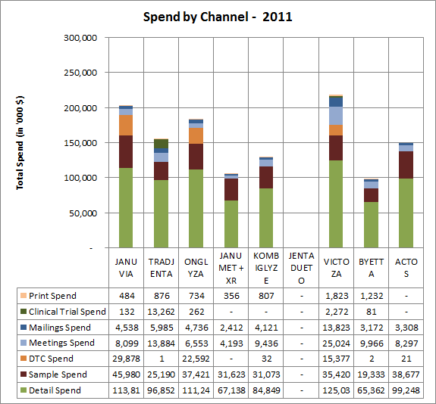
CSD Spend by Channel - 2011
Details are a bigger component of overall promotion spends captured by CSD. Januvia®’s Sample spend is comparable to other major brands .
Details are the bigger component of the total spend.
Tredjenta launched in May-2011, probably that is why its spend seems lower overall.
Relatively Januvia®’s sample spend is comparable to other products.
Kombiglyze has higher spend than Janumet® in 2011 (Janumet XR® not launched yet).
Details are more or less similar for Januvia®, Tradjenta, Onglyza and Victoza.
DTC here captures only TV (i.e., does not give a complete picture).
JentaDueto was not launched in 2011.
Data Source: CSD audit

Slide 11
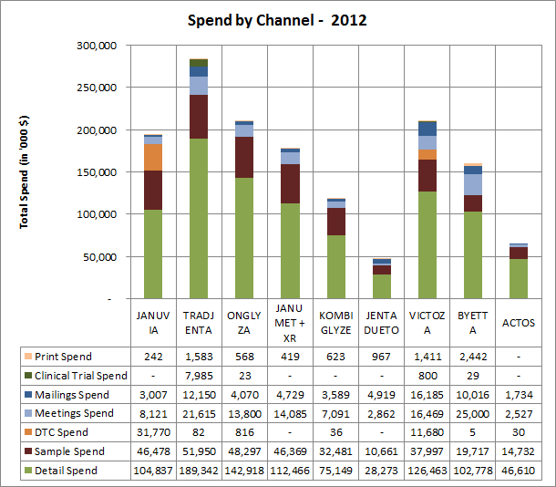
CSD Spend by Channel - 2012
In 2012, Tradjenta leads the market in terms of details and samples. Januvia® and Janumet® (+ XR) lags behind Tradjenta, Onglyza and Victoza. Janumet® (+ XR) leads in DPP-4 Combo market.
Tradjenta has a large spend in details and samples when compared to Januvia®.
Onglyza also has a larger detail spend.
Janumet XR® launched in early 2012.
In DPP-4 Combo class, Janumet® (+ XR) has a relatively larger overall spend. A large portion of the spend probably goes to Janumet XR®.
In terms of details. Januvia® and Janumet® lags behind Tradjenta, Onglyza and Victoza.
There is a potential for increasing samples for Januvia® and Janumet®.
  Competitors have larger presence in terms of samples.
Competitors have a significantly larger spend in meetings than Januvia® and Janumet® (+ XR).
Data Source: CSD audit

Slide 12
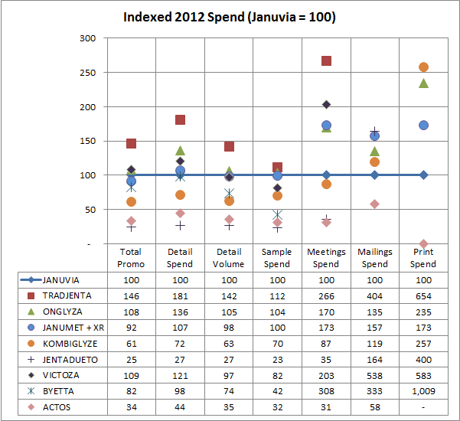
CSD Spend by Channel – 2012 Index Chart
Indexed chart depicts spend by competitors across different channels with respect to Januvia® (whose index equals 100 for each channel)
This chart indexes the Januvia®’s spend in each channel to 100 and compares the competitors in terms of the normalized indexes.
Growing brands like Tradjenta has larger spends in most important channels, particularly the meetings.
Other major brands like Onglyza and Victoza have similar spends like Januvia® and/or Janumet® (+ XR).
Chart is scaled to a maximum index value of 300. Data table shows some channels with much higher indices.
Data Source: CSD audit

Slide 13
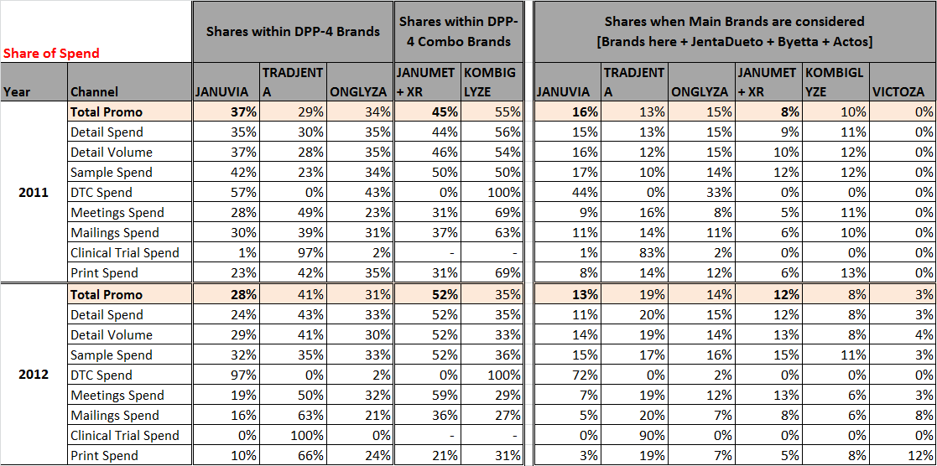

Share of Spend – 2011 vs. 2012
For most channels, Share of Spend for Januvia® and Janumet® (+ XR) in 2012 has decreased when compared to 2011.
Data Source: CSD audit

Slide 14
Observations, Next Steps & Timing
Januvia® product family promotion may be under-funded vs. competitors in important promotional channels.
  In 2012, Tradjenta had larger spends in most important channels. If this continues in 2013, it may disadvantage the Januvia® product family.
  Janumet® may benefit from additional product samples for the segment of customers who prefer this vs. the Janumat XR® formulation.
This competitive analysis was undertaken as a first step to developing recommendations to positively influence the Januvia® product family trend in 2013.
The next step is to develop promotion response curves for each major category of promotion (proposed categories to include are listed below) and to optimize the promotion budget based on these curves (illustrated on next slide).
  HCP MCM
  Sample/Voucher
  Medical Education
  Managed Care
  Consumer Media (general, multi-cultural)
  Consumer Pharmacy Acquisition
  Consumer Pharmacy Adherence
  Target completion date for first-pass promotion response curves and budget optimization: mid-April

Slide 15
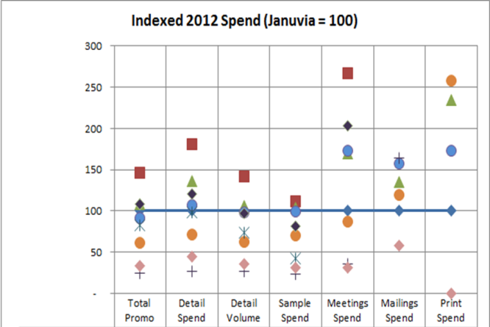
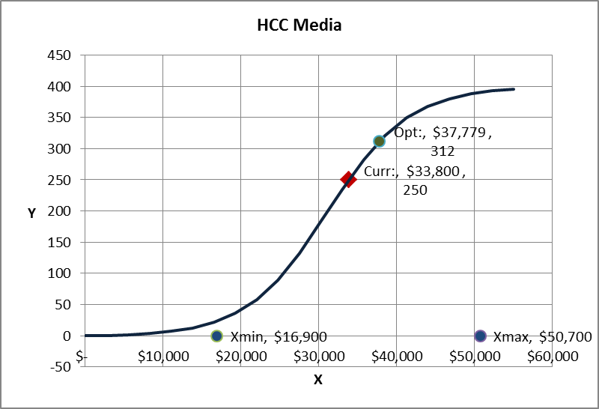
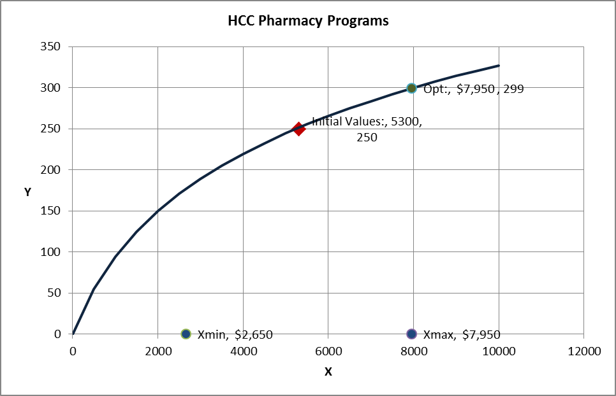

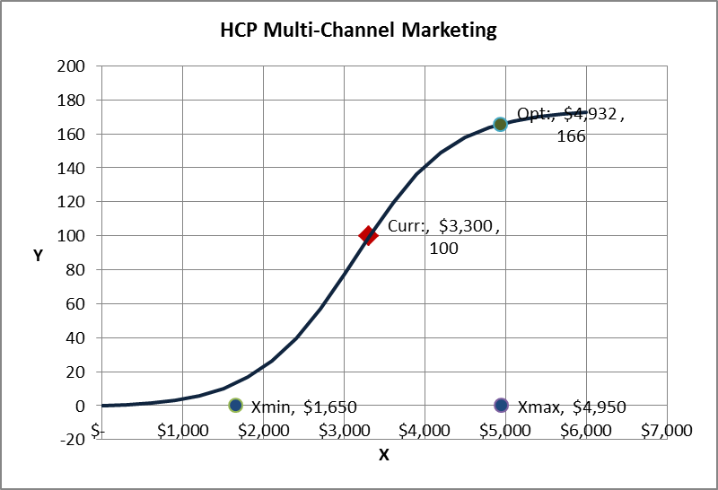
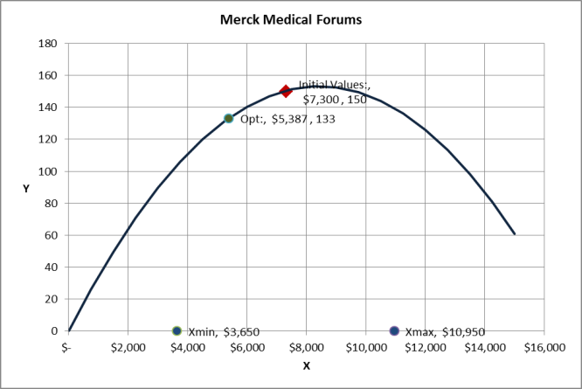
2013 Diabetes Promotion Optimization
Influence product trend via recommendations based on competitive analysis and optimization.
A thorough competitive analysis combined with promotion response curves by tactic type will provide insights into potential incremental investment opportunities for the diabetes product family.
CURVES ARE ILLUSTRATIVE – WORK IN PROCESS
Competitive Analysis
Optimization from Promotion Response Curves
OPTIMIZE

