Slide 1
Market Simulations
Data Science R&D
Data Science
Commercial Analytics Solutions
HHDDA
(01/11/2024)

Slide 2
Content
Overview
Opportunity
Solution
Stakeholders
Team
Next Steps

Slide 3










Overview
In simple terms, Agent based Modeling and Simulation can be thought of as creating a virtual world where individual agents, representing entities such as people, animals, or even ideas, interact with each other and their surroundings.
Think of it like building a flight simulator for pilot training.
With Agent Based Modeling and Simulation in marketing, we can safely observe and analyze the outcomes of multiple marketing strategies without the risk and cost of implementing them in real life scenarios.
SCENARIO 1
SCENARIO 1, 2, 3, 4…
FAILED
SCENARIO 2
SCENARIO N
PASSED
THE OBJECTIVE IS TO LEVERAGE AGENT BASED COMPUTER SIMULATIONS TO ADDRESS THE MACRO AND MICRO FINANCIAL OUTCOMES OF VARIOUS MARKETING STRATEGIES WITHIN A GIVEN BRAND ENVIRONMENT
Notes:
Brand sales depends on groups of entities that operate in a dynamic market environment with complex interactions among them. Examples of the entities are HCPs, Consumers, Government Policies, Brand efficacy and safety, Managed Care etc.
Our objective here is simulate these behaviors virtually in a computer, so that a marketer can observe the estimated sales trends arising from different marketing strategies applied within the dynamic environment. The learnings help to fine tune the marketing strategies at both macro and micro levels.

Slide 4
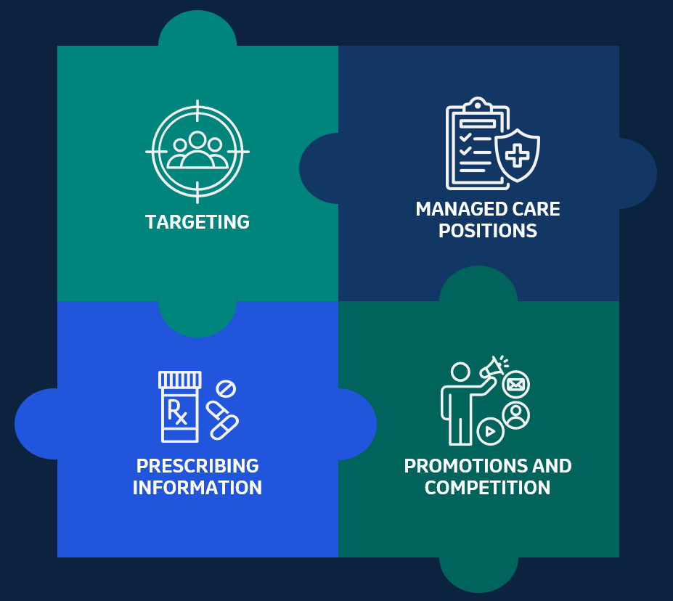
Opportunity
Controllable Internal
A brand’s sales is impacted by multiple factors.
While certain factors such as targeting and managed care positions can be controlled by a company, other elements like prescribing information and the impact of promotions/competition are beyond their direct control.
Estimating sales impact by these factors and the interactions between them will help in developing effective marketing strategies.
Non Controllable External
Notes:
Let us consider an example.
A brand’s market environment and its sales are impacted by multiple factors such as a) HCP and Consumer Targets b) Formulary Positions c) Brand Efficacy & Prescribing Information (PI) d) HCP and Consumer Promotions e) Competition etc.
Currently, we study and model the impacts of such factors on resulting sales independently by respective teams of experts. The interactions are not completely captured.
In reality, these factors depend on each other and a complex interaction among them defines the market environment and the resulting sales.
A clear opportunity exists to study sales trends and develop effective marketing strategies through analytical models that would incorporate such interactions along with individual factors.

Slide 5
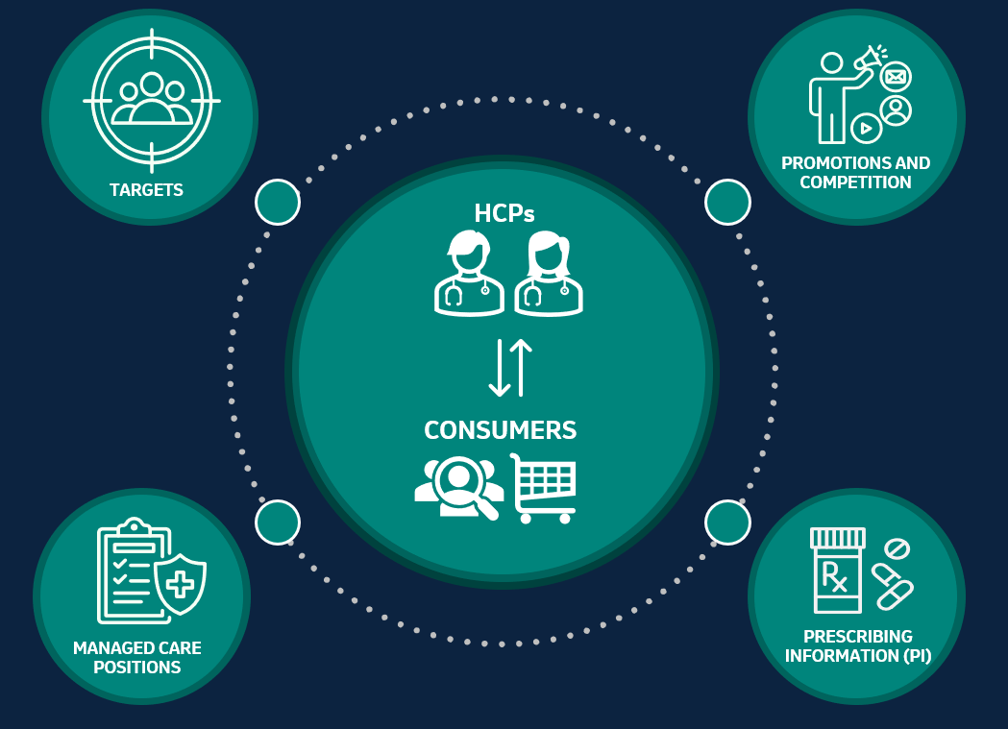
Solution – Agent Based Model
Computer based simulation of dynamic market environment of a brand can illuminate how complex marketing phenomena emerges from individual behaviors of various stakeholders
Agent Based Modeling is a simulation technique that mimics complex market environments and interactions between several factors.
Marketers can simulate multiple marketing strategies, study the sales outcomes, and select the most effective strategy to maximize sales!
Notes:
Agent Based Modeling is a simulation technique that could help in mimicking complex market environment.
Once modeled and validated, marketers then virtually simulate multiple marketing strategies and study the sales outcomes.
This enables the marketer to choose most effective strategy to maximize sales.
We start with creating thousands of virtual HCPs and Consumers.
Each HCP is assigned attributes such as Specialty, Group Practice, Geographic Location, Plans, Promotions, Targeting status etc. Consumer attributes such as age, gender, location, insurance plan, social network and promotions are assigned. Similarly, Brand profiles, Prescription policies, Managed Care plans, Competitions are defined as entities.
Then behaviors and interactions between them are specified and models are validated against available historical data.
We then simulate market dynamics of each week sequentially for say, up to one year.
During the process we summarize the brand sales trend at both national as well as defined sub-segments.

Slide 6
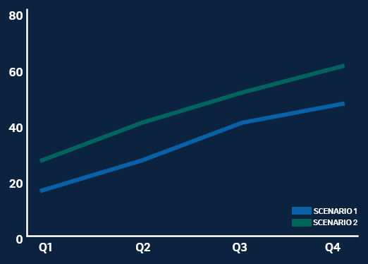
Outcomes – Agent Based Model
1
INPUTS
2
OUTPUT RESULTS: BRAND SALES TRENDS
SCENARIO 1
Spend: $X
SCENARIO 2
Spend: $1.4X
Top PCPs with a set of HCP Promotions
Top PCPs and Specialists with increased promotions
Consumers: Adult 50+ and a set of HCC Promotions
Consumers: Adult 50+ and a set of HCC Promotions
Commercial Plans:
Tier 2 Formulary: 20% Rx
Prior Authorization: 40% Rx
Commercial Plans:
Tier 2 Formulary: 35% Rx
Prior Authorization: 35% Rx
Heavy Competition
Heavy Competition
Spend is 40% more due to higher discounts and promotions, but estimated yearly sales for Scenario 2 is 25% more than first.
3
Conclusion: Considering future growth potential, Scenario 2 is preferred even though the spend is higher now.
Notes:
A marketer can run different scenarios and observe resulting sales. Here are two example scenarios:
Scenario 1:
Target top PCPs with a set of HCP promotions. Consumers who are Adults 50+ of age are targeted by set of Consumer promotions. 20% of commercial plans have preferred formulary position and 40% of plans need prior authorization. Competing brand is heavily promoted.
Scenario 2:
Scenario 1 with following changes - HCP targets are group practices with top Specialists and PCPs. 35% of commercial plans have preferred formulary position and another 35% of plans require prior authorization.
Estimate the sales trend during first year of launch from these two scenarios.
Results: Estimated yearly sales for second scenario is 25% more than first. Additional spend is about 40% more in terms of discount rates and promotions.
Conclusion: Considering future growth potential, scenario B is preferred even though the spend is higher now.

Slide 7








Stakeholders
TARGET AUDIENCES
BRAND MARKETERS
COMMERCIAL OPERATIONS AND ANALYTICAL TEAMS
Brand marketers benefit from insights into consumer behavior and the effectiveness of marketing strategies.
Commercial operations teams can optimize resource allocation based on simulated market dynamics. Analytics teams can analyze the simulated data to derive actionable insights for decision-making.

Slide 8



Agile Team
Success will be dependent on the tight integration between Brand and Simulation Teams
PROJECT OWNERS
CORE TEAM
EXTENDED TEAM
Simulation CoE Lead
Brand Marketing Director
Simulation Implementer(s)
Simulation CoE Lead
Brand Marketing Director
IT, DET, Media, Forecast team representatives
One representative each from
CAS Targeting
DS BU
CAS Managed Care
IA&IO
BEA
Notes:
A tight integration between brand and simulation team is needed for successful implementation.
The agile pod has Simulation CoE Leader and Brand leader as project owners.
To thoroughly understand and implement brand dynamics, a group of corresponding subject area experts are needed as core team members.
During initial and delivery stages, core team meets twice a week. During implementation phase it would be once a week.

Slide 9
Next Steps

Slide 10




Timeline and Next Steps – 2024 and Beyond
Q1
Q2
Q3
Q4
2025
V116 Launch Planning
Gardasil 9 Adult
1 Ex-US Market
Scale
Manual Implementation
Manual and Commercial Tool Implementation
A market with data limitations, Tool Implementation
Simulations UI and Executions for ~10 brands (US/Ex-US)
2024 – GROWTH PHASE
2025 - SCALE
Notes:
Year 2024 will be a growth phase with few implementations. Scaling to multiple brands is scheduled for 2025.
V116 US Launch Planning will be our first simulation exercise. V116 is likely to launch during mid-year.
First two quarters of this year will be the timeline for this analysis. Objective is to test, learn and adapt.
In Q3 of 2024, we plan to add US Gardasil9 Adult strategy planning to the portfolio. At this time both manual implementation and selection of commercial simulation tool will happen simultaneously.
During Q4, we would implement the market simulation for one Ex-US market. Simulation would be particularly useful when such markets have many data restrictions. Objective is to test and learn outside US. During this time usage of commercial tool will be explored in depth.
In 2025 we plan to scale the implementation to approximately 10 brands both in US and Ex-US markets.

Slide 11


Data Science R&D Simulation Team
Senthil Murugan
Sahil Poonatar
TBD
Lead / Director
Data Scientist
Data Scientist

Slide 12
Thank you
Merck & Co., Inc.
Tel: 01234 567 890
E-mail: name.surname@domain.com
Address: ABC, 123, XYZ, 789

Slide 13
Appendix

Slide 14









Solution – Agent Based Model
Agent Based Modeling is a simulation technique that mimics complex market environments and interactions between several factors.
Marketers can simulate multiple marketing strategies, study the sales outcomes and select the most effective strategy to maximize sales!
PROMOTIONS AND COMPETITION
TARGETS
HCPs
CONSUMERS
MANAGED CARE POSITIONS
PRESCRIBING INFORMATION (PI)
Notes:
Agent Based Modeling is a simulation technique that could help in mimicking complex market environment.
Once modeled and validated, marketers then virtually simulate multiple marketing strategies and study the sales outcomes.
This enables the marketer to choose most effective strategy to maximize sales.
We start with creating thousands of virtual HCPs and Consumers.
Each HCP is assigned attributes such as Specialty, Group Practice, Geographic Location, Plans, Promotions, Targeting status etc. Consumer attributes such as age, gender, location, insurance plan, social network and promotions are assigned. Similarly, Brand profiles, Prescription policies, Managed Care plans, Competitions are defined as entities.
Then behaviors and interactions between them are specified and models are validated against available historical data.
We then simulate market dynamics of each week sequentially for say, up to one year.
During the process we summarize the brand sales trend at both national as well as defined sub-segments.

Slide 15



Opportunity
A brand’s sales is impacted by multiple factors.
Estimating sales impact by these factors and the interactions between them will help in developing effective marketing strategies.
MANAGED CARE POSITIONS
TARGETING
PRESCRIBING INFORMATION
PROMOTIONS AND COMPETITION
Notes:
Let us consider an example.
A brand’s market environment and its sales are impacted by multiple factors such as a) HCP and Consumer Targets b) Formulary Positions c) Brand Efficacy & Prescribing Information (PI) d) HCP and Consumer Promotions e) Competition etc.
Currently, we study and model the impacts of such factors on resulting sales independently by respective teams of experts. The interactions are not completely captured.
In reality, these factors depend on each other and a complex interaction among them defines the market environment and the resulting sales.
A clear opportunity exists to study sales trends and develop effective marketing strategies through analytical models that would incorporate such interactions along with individual factors.

