Slide 1
Accounting for Missing Variables:
Fixed Effects Model for Longitudinal Data
Reference: Fixed Effects Regression Methods for Longitudinal Data by Paul D. Allison
Promotion Response Analytics
Investment Analytics and Decision Sciences
US Commercial Operations

Slide 2
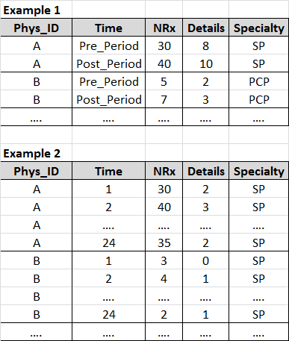
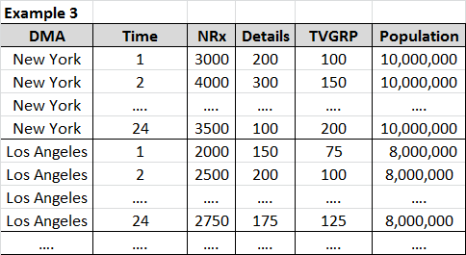
Background
Discuss one of the way to account for some of the missing variables in longitudinal data.
  Specifically, account for individual characteristics that do not change over time and are not-measured.
Longitudinal Data (or Panel Data):
  Has data that changes over time for each of the individuals in the data. Examples are listed:

Slide 3

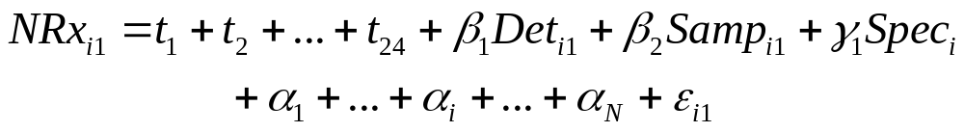
Fixed Effects Model
Let us consider following model structure:
  Y_{it,} X_{it} is response and time variant variables for individual i and time t. Z_{i} time-invariant variables in the model
  α_{i} is treated as a set of fixed constants, one for each individual. This allows it to be correlated with x, z.
  ε_{it} is random error with mean 0 and constant variance, uncorrelated with x and z. β, γ parameter estimates. Different intercepts at each time point, coefficients are same across times.
Example:
Fixed effects methods ignores between-person variation and focuses only on within-person variation.
  Disadvantage: Discarding between-person variation can yield standard errors that are considerably higher than those methods that use both within- and between-person variation.
  Advantage: Between-person variation is very likely to be contaminated by unmeasured personal characteristics that are correlated with dependent and/or other independent variables. By restricting ourselves to within-person variation, we eliminate that contamination and are much more likely to get unbiased estimates.
We are dealing with the trade-off between bias and sampling variability. For nonexperimental data, fixed effects methods tend to reduce bias at the expense of greater sampling variability.
Fixed effect methods do not provide an estimate for time-invariant variables. Interactions between time-invariant and time-variant vars could be estimated.

Slide 4
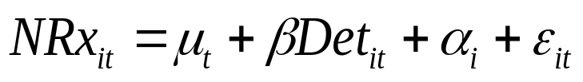
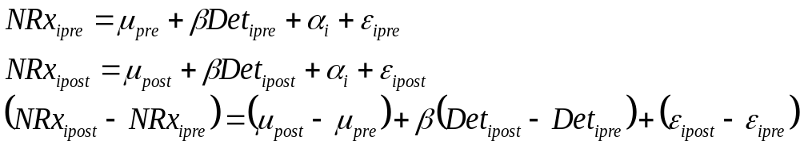
Fixed Effects Model – Estimation with two time periods
Consider a simple model with 2 time periods (Pre and Post):
Expanding and Differencing for each individual results in the elimination of the unobserved variable α_{i} .
Estimating change in NRx as a function of change in details produces detail estimate for the fixed effects model after controlling for all time invariant variables.

Slide 5
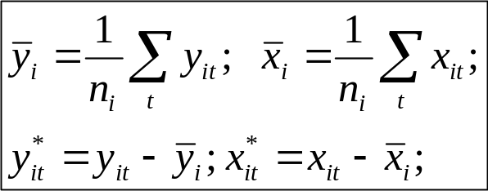
Fixed Effects Model – Estimation with more than two time periods
Consider the Fixed Effects model with more than two time points per individual:
Estimation is done by differencing the “mean across time” for each individual (i.e., centering the variables):
  One trick to simplify the estimation is to “condition out” the α_{i}’s. Conditioning out is achieved by centering the individual level variables across time for each individual. Then, regress the centered variables along with time indicators.
  This is automatically done using ABSORB statement in PROC GLM.
  PROC GLM DATA=abc;
  ABSORB phys_id;
  CLASS year_month;
  MODEL NRx = year_month Details / SOLUTION;

Slide 6
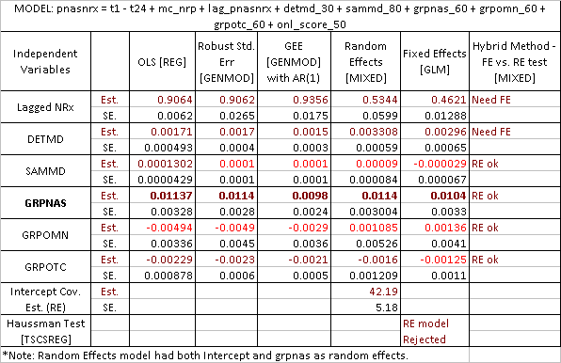
OLS / RE / FE Methods - Example
Note changes in Lagged NRx and Details (while non significant samples)
Stability differences in GRPNAS and GRPOTC

Slide 7
Backup Slides
Prof. Allison’s ideas on OLS, Random and Fixed Effects models
Reference: Fixed Effects Regression Methods for Longitudinal Data by Paul D. Allison

Slide 8
Concepts – Randomized Experiments vs. nonexperimental studies.
Randomized experiments have major advantages over observational studies in making causal inferences.
Randomization ensures treatment groups, on average, are identical with respect to all possible characteristics of the subjects, regardless of whether they could be measured or not.
In nonexperimental studies, we try to approximate random experiment by statistically controlling for other variables using methods such as linear regression, matching etc., This has two major drawbacks
  Its possible to leave out some crucial variables. Omission of a key covariate can lead to severe estimation bias for the variables that are included.
  Not all variables could be measured. Inaccuracies in measurement also causes estimation bias.
In practice, causal inference via statistical adjustment usually runs distant second to randomization. However, with certain kinds of nonexperimental data (ex: longitudinal repeated measures data) we can get much closer to the virtues of a randomized experiment.
Specifically, by using fixed effects method discussed in the reference, it is possible to control for all possible time-invariant characteristics of the individuals in the study (measured or not).

Slide 9
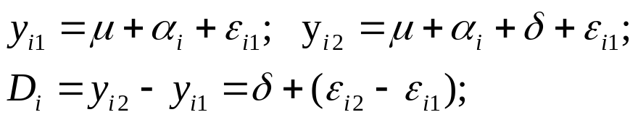
Concepts – Fixed Effects Methods
In essence, each individual serves as his or her own control in FE methods.
  This is accomplished by making comparisons within individuals and then averaging those differences across all individuals.
  Major attraction in nonexperimental data is the ability to control for all stable characteristics of the individuals in the study, thereby eliminating potentially large sources of bias.
Example: Paired-Comparison t-test.
Fixed effects methods ignores between-person variation and focuses only on within-person variation.
  Disadvantage: Discarding between-person variation can yield standard errors that are considerably higher than those methods that use both within- and between-person variation.
  Advantage: Between-person variation is very likely to be contaminated by unmeasured personal characteristics that are correlated with dependent and/or other independent variables. By restricting ourselves to within-person variation, we eliminate that contamination and are much more likely to get unbiased estimates.
We are dealing with the trade-off between bias and sampling variability. For nonexperimental data, fixed effects methods tend to reduce bias at the expense of greater sampling variability.
Fixed effect methods do not provide an estimate for time-invariant variables. Interactions between time-invariant and time-variant vars could be estimated.

Slide 10
Concepts – Fixed Effects Methods (cont’d)
Random effects methods do not control for unmeasured, stable characteristics of the individuals. This is because α_{i} terms are usually assumed to have a distribution that is uncorrelated with the measured variables in the model.
  They use both within and between individual variations and typically have less sampling variability than fixed effects methods.
DECISION to use Fixed or Random Effects methods depends on:
  Is it important to control for unmeasured characteristics of individuals to reduce bias in the estimates of interest? (use FE Methods)
  Is it important to estimate the effects of stable covariates? (use RE or Hybrid Methods)
  Whether one can tolerate the substantial loss of information that comes from discarding the between-individual variation (cannot tolerate → use RE methods)
WHY did we use this exploration for Nasonex DTC study?
  Mainly to understand and reduce the biasness of various parameter estimates of interest (particularly, TV DTC promotions)
  To see if our data supports using FE methods and still achieve reasonable significance levels.
  Compare how the biasness varies for various model structures (with an aim to find relatively appropriate structures)

Slide 11

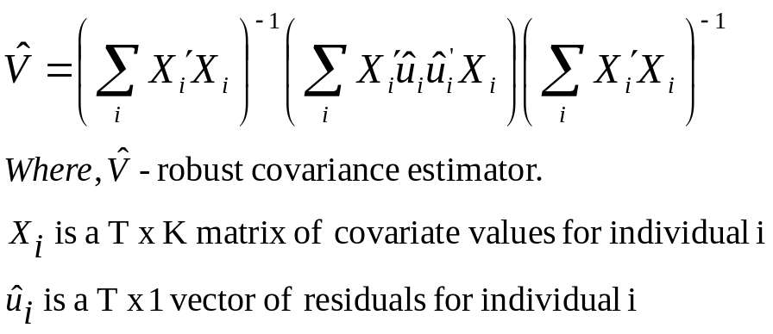
OLS / RE / FE Methods Exploration - 1
Basic Model
  Y_{it,} X_{it} is response and time variant variables for individual i and time t. Z_{i} time-invariant variables in the model
  ε_{it} is random error with mean 0 and constant variance, uncorrelated with x and z. β, γ parameter estimates. Different intercepts at each time point, coefficients are same across times.
OLS (PROC REG):
  Coefficients will be unbiased but NOT efficient (true standard errors will be larger than necessary)
  Estimated standard errors and p values will be too low because error covariance across time ≠ 0.
Solution 1 - Robust Standard Errors (PROC GENMOD):
The matrix V cap contains variances of the
coefficients on the main diagonal and between
coefficients off the diagonal.
The robust standard errors are the roots of the
main diagonal elements.
  Although coefficients are same as OLS,
  Robust standard errors are larger for vars
  with higher between individual variances.
  PROC GENMOD DATA=abc;
  CLASS dma yearmo;
  MODEL y = x1 x2 x3 z1 z2 z3;
  REPEATED SUBJECT=dma / TYPE = IND;

Slide 12
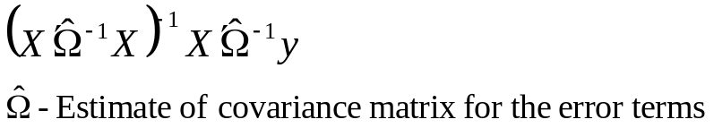
OLS / RE / FE Methods Exploration - 2
Solution 2: Generalized Estimating Equations (GEE) :
  It produces EFFICIENT estimates of the coefficients (i.e., true standard errors will be optimally small). GEE does this by taking the over-time correlations into account when producing the estimates.
  GLS estimates are obtained by the formula:
  Omega cap is not included in OLS estimates.
  Omega cap is typically block diagonal and user specified (UN, AR, EXCH, MDEP(m) etc.,).
  GEE estimates are accompanied by robust standard error estimates in GENMOD
  GEE with EXCH structure is technically same as Random Intercepts model.
  PROC GENMOD DATA=abc;
  CLASS dma yearmo;
  MODEL y = x1 x2 x3 z1 z2 z3;
  REPEATED SUBJECT=dma / TYPE = UN CORRW;

Slide 13

OLS / RE / FE Methods Exploration - 3
Extended Model
  α_{i} represents all differences between individuals that are stable over time and not otherwise accounted for by z’s. It can be said to represent “unobserved heterogeneity”.
Solution 3: Random Effects (Mixed) Models (PROC MIXED):
  α_{i} is assumed as N(0,Τ²) and is UNCORRELATED with x, z, and error term.
  Random effects models do not really control for unobservable variables because of the above assumptions.
  One advantage is to test whether variance of α is 0, which is equivalent to testing for dependence among the observations.
  Can be extended to allow for random coefficients.
  Use TSCSREG to do Haussman test to verify if we need to consider FE model (i.e., RE vs. FE model).
  EMPIRICAL option below provides robust standard errors.
  PROC MIXED DATA=abc COVTEST EMPIRICAL;
  CLASS dma yearmo;
  MODEL y = x1 x2 x3 z1 z2 z3 / SOLUTION;
  RANDOM INTERCEPT / SUBJECT=dma;

Slide 14
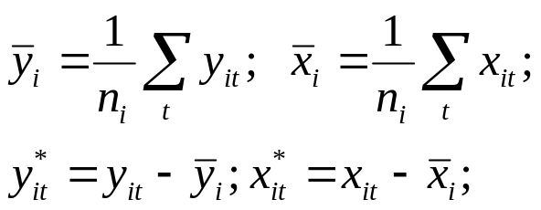
OLS / RE / FE Methods Exploration - 4
Extended Model
  α_{i} is treated as a set of fixed constants, one for each individual. This allows it to be correlated with x, and z.
Solution 4: Fixed Effects Models (PROC GLM):
  Fixed effects methods not only produce standard errors that adjust for dependence, they also control for all stable characteristics of the individuals, whether observed or unobserved.
  Conventional Fixed Effects will NOT produce coefficient estimates for time-invariant predictors (since α_{i} is perfectly collinear with z_{i}).
  One trick to simplify the estimation is to “condition out” the α_{i}’s. Conditioning out is achieved by centering the individual level vars across time for each individual. Then, regress the centered variables along with time indicators.
  This is automatically done using ABSORB statement in PROC GLM.
  PROC GLM DATA=abc;
  ABSORB dma;
  CLASS yearmo;
  MODEL y = yearmo x1 x2 x3 / SOLUTION;

Slide 15

OLS / RE / FE Methods Exploration - 5
Solution 5: Fixed Effects Models (cont’d)
  Fixed effects methods use only variation within individuals to estimate the coefficients.
  A consequence is that standard errors tend to be larger for FE models than for RE or GEE.
  Each individual serves as his or her own control.
  In sum, FE methods reduce bias but at the expense of increased standard errors.
  If there’s very little variation within individuals, FE methods are not useful.
Solution 6: Hybrid method (PROC MIXED)
  Extends the virtues of FE and RE methods. Produces FE estimates for time-varying predictors and RE estimates for time-invariant predictors.
  Provides a test of FE vs. RE models for each of the time-varying parameters.
  Can be extended to allow for random coefficients and more complicated error structures.
  Basic Idea:
    Decompose each time-varying predictor into within and between individual values.
    Put both parts in RE model along with z and time indicators.
    Test whether coefficients for the two parts are same (using CONTRASTS).

Slide 16
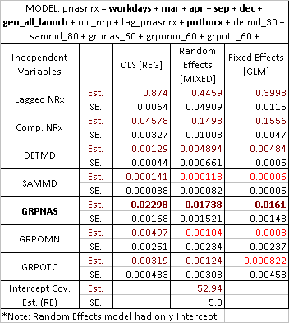
OLS / RE / FE Methods - Example
Note changes in Lagged NRx and Details (while non significant samples)
Stability differences in GRPNAS and GRPOTC in both tables
A very different values for GRPNAS across two tables (a possible pointer to model structure issues)

