Slide 1
Singulair Going Generic:
Discussion regarding MCM Campaign Program Design
DRAFT
Commercial Analytics
June/27/2011

Slide 2
Agenda
Discuss and brainstorm the following topics:
  Present possible test to determine if MCM campaign programs leveraging non-Sales Force channels are sufficient for maintaining business performance late in the product lifecycle at a lower cost.
  How many targets and regions are required to implement a pilot?
  Identify best regions (i.e., that are most similar to the nation) for the pilot.
  Access business risk and the revenue contribution by the field force activities in these regions.
  Next steps

Slide 3
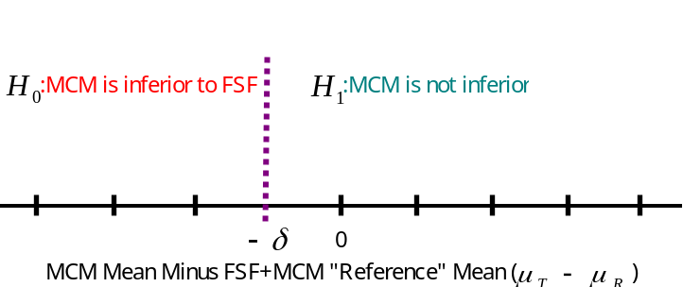
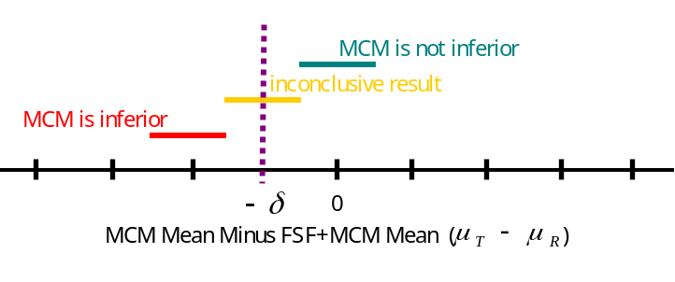
Method: Perform Non-inferiority Test that the MCM mean is not appreciably lower than the Field Sales Force + MCM mean.
The test and comparison groups will receive the following promotion touch points:
 | Promotion Touch Points
Group | Pre-period | Post-period
Test | Field Sales Force +MCM Channels | Non-Sales Force MCM Channels
Comparison | Field Sales Force + MCM Channels | Field Sales Force + MCM Channels
The non-inferiority test compares a TEST group of MCM-only Best Potential HCPs to a matched COMPARISON group of Field Sales Force + MCM Best Potential HCPs in terms of NRx
  It tests that the MCM mean is not appreciably lower than the FSF + MCM mean.
  The largest mean difference allowed for MCM to be considered non-inferior (δ) must be identified and agreed to by business decision-makers and may be expressed in terms of NRx or NRx share points. This value is known as the “equivalence margin” and defines precisely what is meant by “appreciably lower”.
Hypotheses to be tested
Possible findings

Slide 4
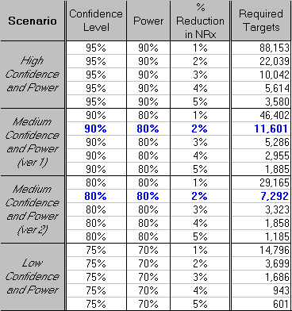
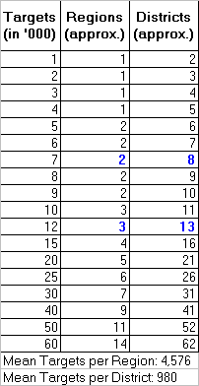
At 90% confidence level, 80% power and 2% reduction in NRx as Equivalence Margin, we need about 11.6K targets or about 3 TEST Regions.
Number of Regions or Districts needed for given number of Targets.
Assumptions / Definitions:
MCM program would run for 6 months, say, from Dec-2011 to May-2012.
All prescribers reached by field force currently will be potential targets for MCM program
Confidence level: A 90% confidence level represents that there is a 10% chance that we incorrectly conclude MCM is equivalent to better than or FSF + MCM.
Power: A power of 80% represents that there is a 20% chance that we incorrectly conclude MCM is inferior to FSF + MCM.
Equivalence Margin: A margin of 2% Reduction in NRx assumes that the MCM is considered equivalent to FSF + MCM if the NRx reduced by less than 2% for MCM regions w.r.t. FSF + MCM regions.
Sample Size based on various Confidence levels, Power and % Change in NRx

Slide 5
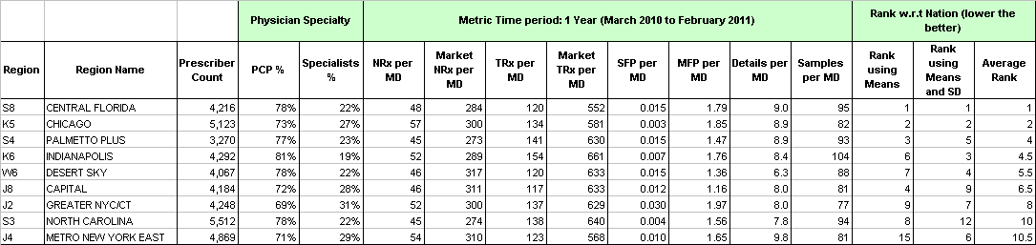
Recommended TEST Regions that are most similar to the characteristics of the Nation are listed. Top 3 are highlighted.
Regions were matched to nations using following criteria:
  % PCPs, % Specialists, % of Physician in top Category Ratings (A+ to B)
  Per MD Averages and Variances of : Singulair NRx and TRx, Rhinitis Market NRx and TRx, Details made during meetings and lunches, Office Details and Samples.
Top Test regions are listed in the order of their match rank.
Top 3 regions recommended for pilot are Central Florida, Chicago, and Palmetto Plus.

Slide 6
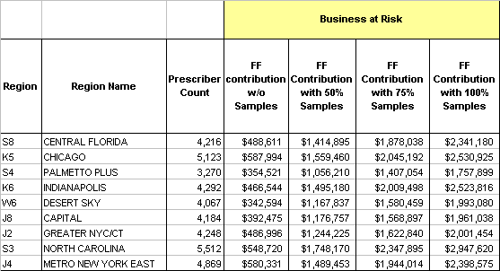
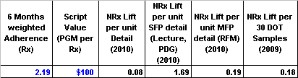
For the Top 3 Regions, assuming 50% of historic samples are delivered, the Field Force activities during the 6 month test period generate about $4 MM before patent expiry.
The FSF Contribution may be considered as the maximum risk to the business.

Slide 7
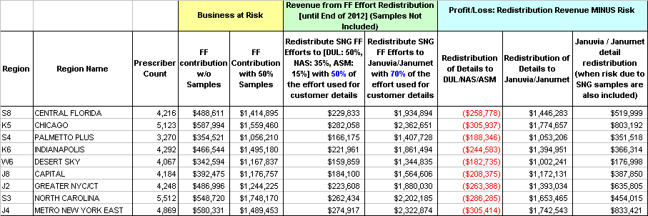
Redistribution of Singulair Details to Dulera, Nasonex and Asmanex may not breakeven. Redistribution to Januvia/Janumet details may be profitable.
Please note that due to several assumptions made during the calculation of financials, the reported numbers are only approximate and directional.
Two scenarios of redistribution of Singulair Details are considered:
  (A). Redistribute Singulair details to other PORT 1 products in a similar ratio seen between Nov-2009 to Apr-2010. The splits are, Dulera: 50%, Nasonex: 35%, Asmanex: 15%. In addition, it is assumed that 50% of the redistribution effort could be captured as effective customer details.
  (B). Add Januvia/Janumet to current PORT 1 and redistribute Singulair details to Januvia/Janumet. It is assumed Respiratory Specialists cannot be targeted in this manner and a 70% of the redistribution effort could be captured as effective customer details for Januvia/Janumet.
For top 3 recommended regions, Case A needs about 750K extra revenue to breakeven. Case B is above breakeven and is profitable.

