Slide 1

Video Compression and its storage benefits
SBI - Hackathon

Slide 2
Problem Statement:
1
With the advent of “ InVideo Object Identification Process” multiple use cases have been emerged for customer’s onboarding & servicing requests in a secure, paperless, cost-effective & friendly manner.
Storage / retrieval of those video files is the challenge, especially with the weighty of video files that are expected to be generated by extending more use-cases to our client base of over 45 crore customers.
Sorting the content of the video based on the client’s requirements in a effective way and fetch it as a final outcome and stores in a DB.

Slide 3
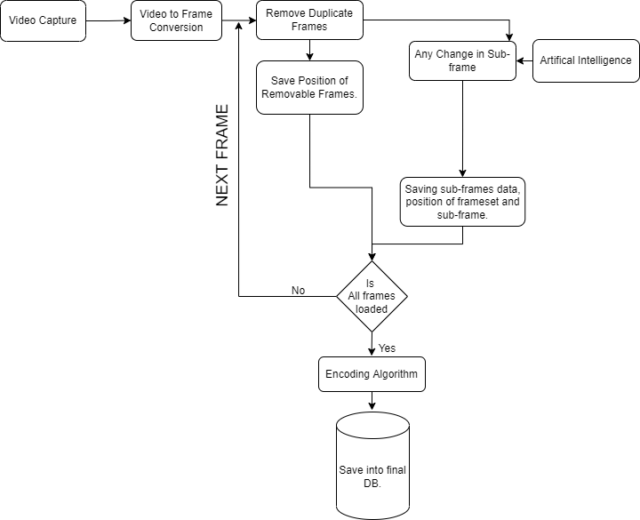
Proposed solution:
2
Storing the video in compressed set of Images

Slide 4
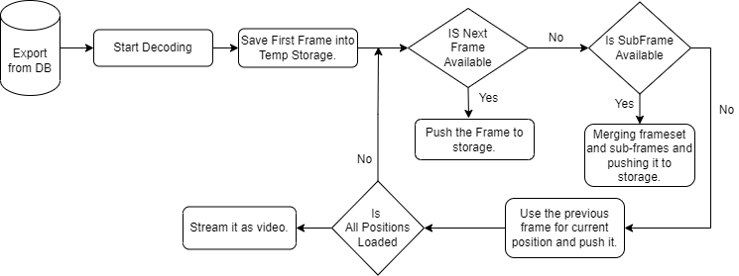
Proposed solution:
3
Retrieval of the compressed image and playing the video

Slide 5
Benefits from the solution:
4
Smaller overall file sizes.
Less storage demand.
Lower transmission bandwidth needs.
Easy transferring.
No loss of crucial data.
No risk of disruption while encoding.
Easy retrieval of data

Slide 6
Thank You

