Slide 1

Video Compression
SBI - Hackathon

Slide 2
Problem Statement & Solution Expected:
1
Problem Statement
With the advent of “ InVideo Object Identification Process” multiple use cases have been emerged for customer’s onboarding & servicing requests in a secure, paperless, cost-effective & friendly manner.
Storage / retrieval of those video files is the challenge, especially with the weighty of video files that are expected to be generated by extending more use-cases to our client base of over 45 crore customers.
Sorting the content of the video based on the client’s requirements in a effective way and fetch it as a final outcome and stores in a DB.
Expected Solution
Video files are already being generated and the prototype is expected to convert / compress the file and extend encryption / decryption for effective transmission & storage

Slide 3
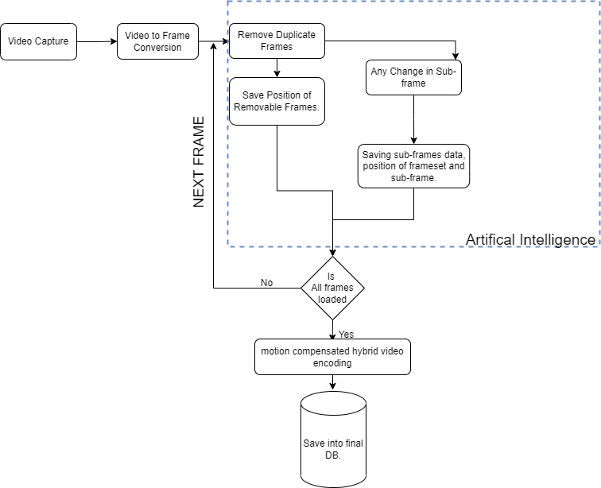
Proposed solution:
2
Storing the video in compressed set of Images

Slide 4
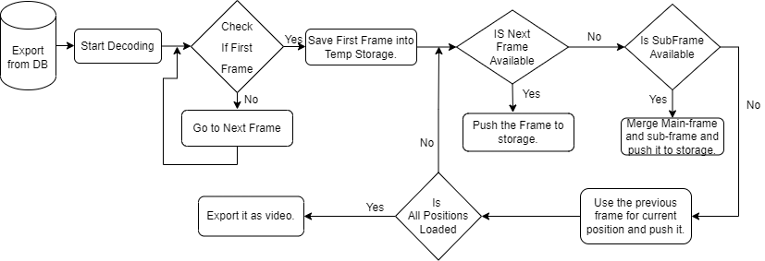
Proposed solution:
3
Retrieval of the compressed image and playing the video

Slide 5

Benefits of the solution:
4
Smaller overall file sizes.
Less storage demand.
Lower transmission bandwidth needs.
Easy transferring.
No loss of crucial data.
No risk of disruption while encoding.
Easy retrieval of data

Slide 6
Presented By: Team Everest
Team Member | E-Mail ID | Phone Number
Senthil kumar Bose | senthilkumarb4@hexaware.com | +91-9884946234
Chandran D | chandrand@hexaware.com | +91-8675906264
Surya Murugesan | suryam@hexaware.com | +91-6382353104
Aravindamoorthy D | aravindamoorthyd@hexaware.com | +91-7904109458

Slide 7
Thank You

