Slide 1


Semantic Analysis of textual data
Presented by team Tech_Tweakers,
Neethu Ninan-1502866
Senthil Arumugam Ramasamy-
Guided by,
Prof. Damir Dobric

Slide 2
Contents:
Objective
What is Semantic Similarity?
Why Open AI GPT?
Existing Methods
GPT Conceptual Breakdown
Block diagram of the model
Development and Unit Testing
Results
Conclusion
References

Slide 3
OBJECTIVE:
Develop a scalable framework for Semantic Analysis of Textual Data focusing on words/phrases and/or documents comparisons using OpenAI embeddings and Cosine Similarity Algorithms. The tool offers flexible preprocessing, ensuring contextually relevant similarity assessments. It demonstrates effectiveness in capturing semantic nuances with practical applications like resume filtering, admission categorization, and content classification. Visual tools enhance understanding of similarity metrics, promoting further research in natural language processing.

Slide 4
INTRODUCTION?
Lexical-based Similarity
If two words have a similar sequence of character, then lexically similar.
Text Similarity
Semantic-based Similarity
If two words are not similar , but have same meaning, then they are semantically similar
Hybrid Similarity
Hybrid combination of different similarity methods.

Slide 5
WHAT IS SEMANTIC SIMILARITY?
Semantic similarity is a measure that is defined across a collection of documents or phrases, unlike lexicographical similarity or the statistical similarity stated above. It relies the idea of distance between objects on the degree of semantic content or similarity between them. Semantic relations between the documents can be used to quantify and identify their direct and indirect relationships, which is the basis for similarity between them. Estimating the semantic similarity between text data is one of the most challenging and unsolved research problems in the field of natural language processing (NLP).
Information retrieval, clustering and recommendation systems are crucial NLP jobs
Evaluates similarity using meaning rather than just words
Assess both direct and indirect connections between texts

Slide 6
WHY CHOOSE OPEN AI’S GPT?
Open AI-GPT Model
Creates dynamic embeddings that are context sensitive
Efficiently conveys polysemous meanings.
Less fine- tuning due to robust pre-training.
Enhances generalization across different fields
Dedicated embedding model converts text into high dimensional vector space.
To use Open AI’ s GPT model, subscription is needed to use the key and is based on tokens.
Similarity calculation on the generated embeddings to yield the contextual similarity- Cosine Similarity is preferred.
Classical Methods:
LSA(Latent Semantic Analysis ) and ESA(Explicit Semantic Analysis )
Distributed Methods:
Word2Vec , GloVe.
Transformer-based Methods-
BERT/S-BERT, RoBERTa, OpenAI GPT Model, DeCLUTR

Slide 7
HOW DID WE START IMPLEMENTING?
Initial Research & Dataset Preparation
Classification by Domains:
Words classified into domains for meaningful analysis (e.g., Electricity, Energy → Power Sector).
Comparison intended to check if OpenAI Embedding captures contextual relevance.
Dataset Preparation:
50 to 60 words from various domains prepared for comparison.
Editable JSON format for dynamic data modification by developers.
Words Comparison Analysis
Objective:
Compare words from similar and different domains to evaluate contextual relevance.
Ensure comparison technique effectively identifies relatedness between words within domains.

Slide 8
Document Comparison Analysis
Objective:
Comparing documents to establish contextual relevance between them.
Example Use Case:
Source Document: JobRequirement.txt
Target Documents: Job Profile A, Job Profile B
Dynamic Document Comparison:
Allows users to add documents via File Manager or custom UI integration.
Application supports dynamic comparison for usability and research.
Threshold Management
Purpose:
Define a threshold for meaningful similarity measurement.
Allow application admin to manage thresholds for different use cases.

Slide 9
Embeddings & Similarity Calculation
Generating Embedding's:
Interface: CalculateEmbeddingAsync
Purpose: Processes text inputs & generates embeddings using OpenAI Embeddings.
Method: GenerateEmbeddingsAsync() returns embeddings as collections of size 3052.
Embedding Analysis:
Custom Method: PrintScalarValues(float[] embedding) for debugging and visualization.
Helps in understanding similarity score vs. scalar values.
Similarity Calculation:
Calculate Similarity(float[] embedding1, float[] embedding2)
Uses Cosine Similarity Algorithm:
1: Identical embeddings, 0: No similarity, -1: Complete dissimilarity.
Formula: Cosine Similarity = Dot Product / (Magnitude1 * Magnitude2).

Slide 10
Data Visualization & Graphical Representation
GitHub Release & Publishing
Publishing & Releasing:
Successfully published the application and created a release on GitHub.
Attached the release files for easier access by users and developers.
Purpose of Release:
Providing a stable version of the application for public use.
Enabling collaboration and feedback from other developers.
Benefits:
Streamlined access to the published version.
Facilitates version control and improvements over time.
Enhances collaboration through GitHub's release management features.
Purpose:
Understand Semantic Analysis through visual representation.
Correlate similarity scores to real-time use cases.
Python Integration:
Python used as an external tool to generate graphical charts from CSV outputs.
Current limitation: Manual placement of CSV files in the Python app’s root directory.
Future scope: Automating CSV file placement.
Types of Plots:
Comparison Plot:
X-Axis: Document/Phrase Comparisons (User-designed datasets).
Y-Axis: Similarity Scores.
Similarity vs. Scalar Plot:
X-Axis: Scalar Values (Ranges between 0-3052).
Y-Axis: Similarity Scores.
Visualize how contextual relevance is generated.
Visualization Purpose:
Helps developers and users comprehend how embeddings map to similarity scores.
Provides insights for improving the similarity analysis approach.

Slide 11
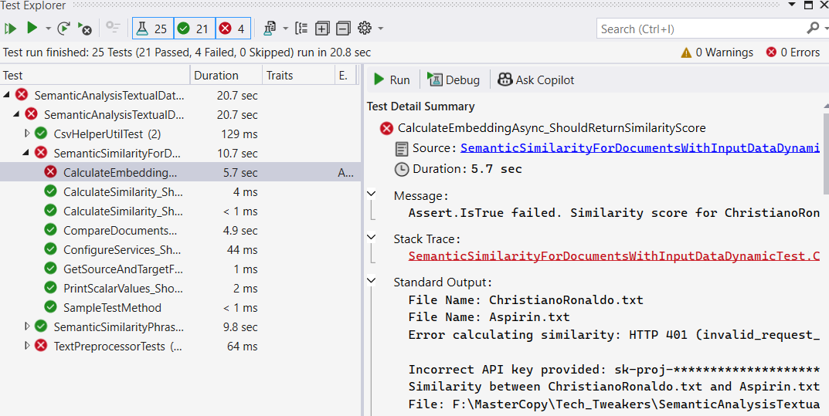
Test Cases & Code Coverage
Test Case Categories:
Basic Test Framework Validation: Verifies test setup.
Exception Handling in Document Comparison: Tests CompareDocumentsAsync for null handling & exception.
Validity of Similarity Score Calculation: Ensures CalculateEmbeddingAsync returns valid scores.
Service Provider Configuration Validation: Validates ConfigureServices for correct service retrieval.
Source & Target File Retrieval: Verifies GetSourceAndTargetFiles returns correct files.
Scalar Value Printing Validation: Ensures PrintScalarValues outputs as expected.
Accuracy of Similarity Score Calculation: Checks similarity scores are correctly calculated.
Handling of Different Length Embeddings: Ensures zero score for embeddings of varying lengths.
Handling of Empty Inputs: Ensures CalculateEmbeddingAsync returns 0 for empty strings.
Handling of Invalid File Paths: Validates error handling for non-existent files.
Phrase Processing & Result Saving: Verifies saving of Phrase Similarity objects using CsvHelperUtilTest.
CSVHelperUtilTest.cs: Validates CSV & JSON saving for further analysis & sharing.
Purpose:
Ensure robustness of application by validating various functionalities through test cases.
Maintain high code coverage by testing positive, negative, and edge case scenarios.
Test Framework:
Implemented using Microsoft.VisualStudio.TestTools.UnitTesting.
Tests run via Visual Studio Test Explorer.
Test classes created for each service based on business functionalities.
Test Results:
All test cases successfully passed.
Coverage maintained by including different scenarios.
Future Improvements:
Implementing mock data for unit tests.
Automating the testing process to reduce manual effort.
Test Case Results

Slide 12
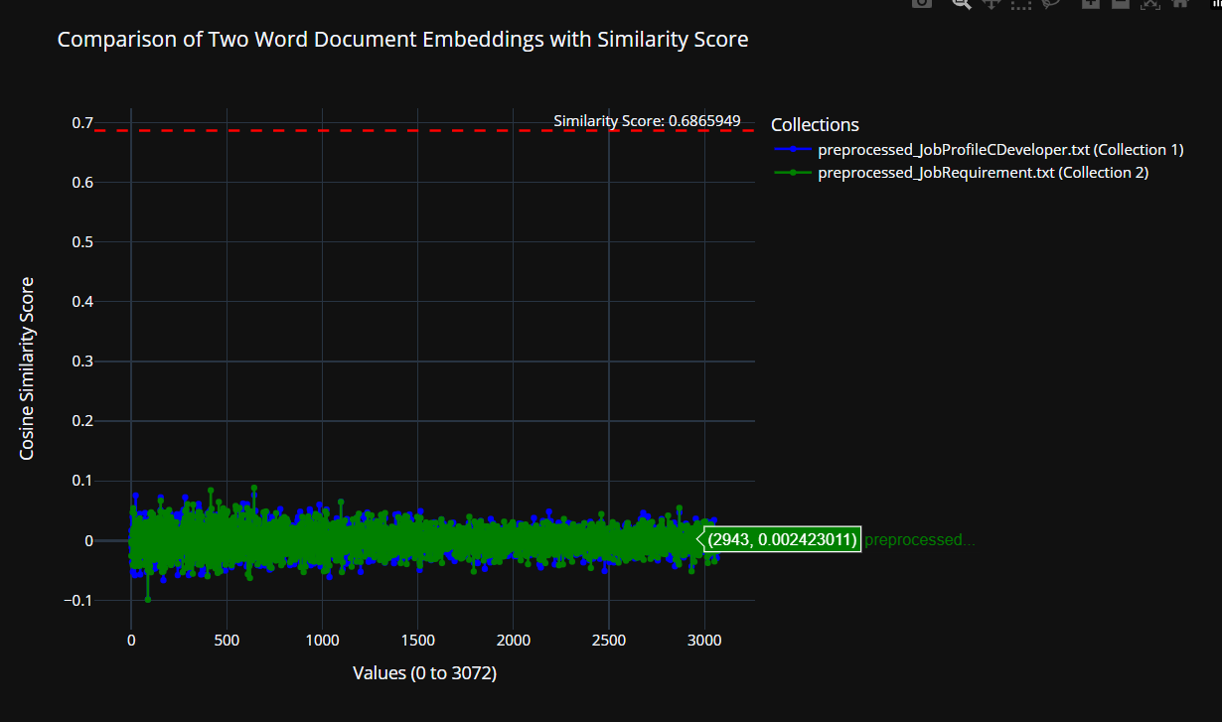
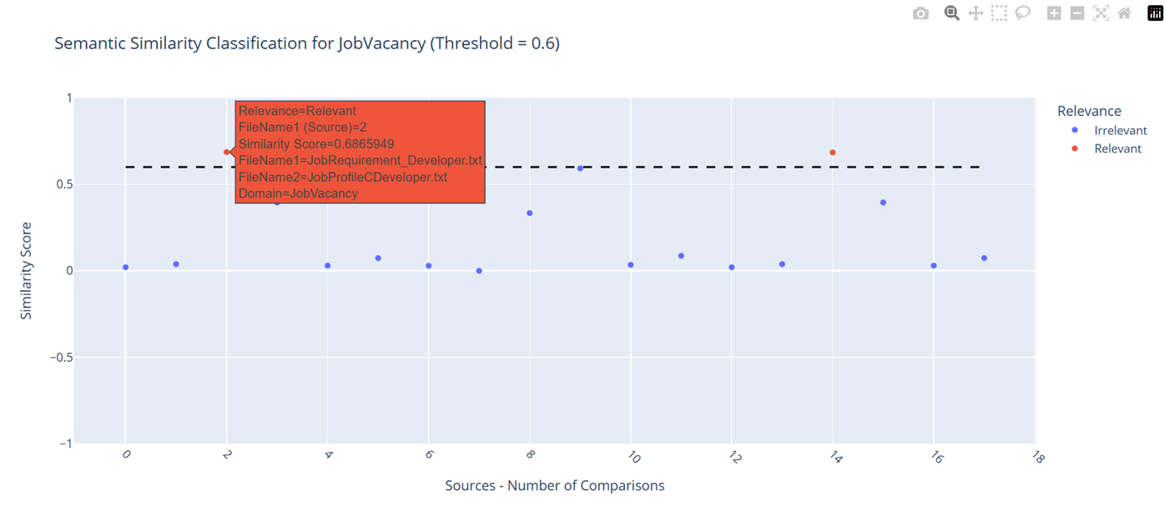
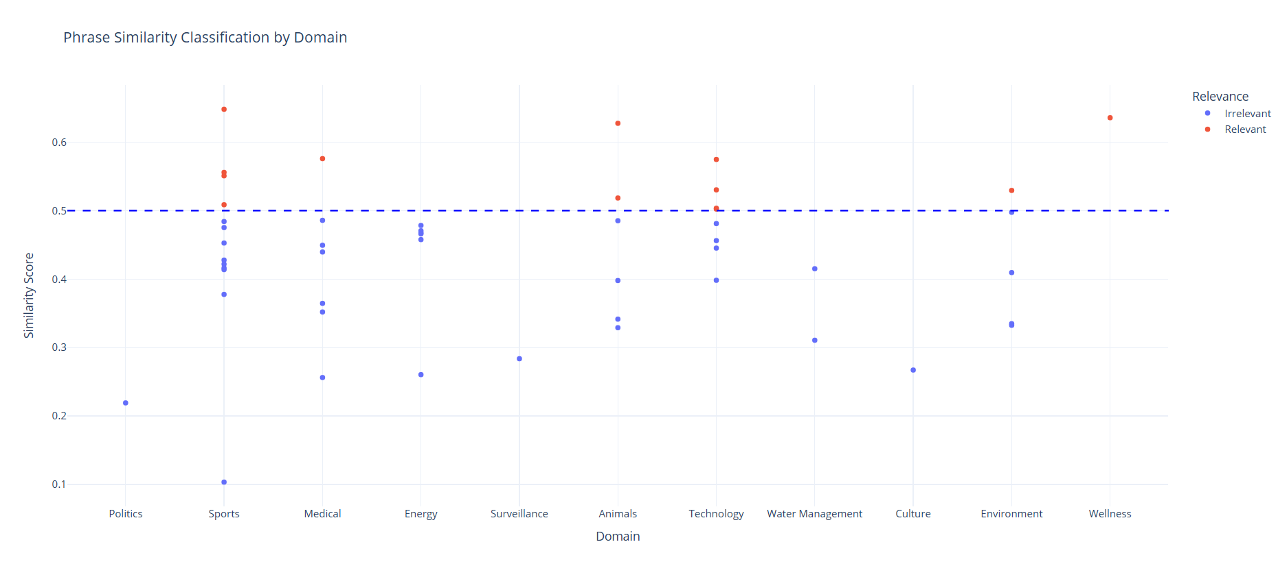
Results and Visualization
Phrase Comparison Output CSV Path - bin\Release\net9.0\data\output_datasetphrases.csv
Document Comparison Output CSV Path - bin\Release\net9.0\data\output_dataset.csv
Phrase Comparison Results:
https://senthilmasters2024.github.io/Tech_Tweakers/PhrasesSimilarityClassficationByDomainsPlots.html
Document Comparison Results:
https://senthilmasters2024.github.io/Tech_Tweakers/SemanticSimilarityLatestPlot.html
Scalar Values of Embedding vs. Similarity Score:
https://senthilmasters2024.github.io/Tech_Tweakers/ScalarValuesVsSimilarityScorePlotForOneComparsion.html
Scalar vs. Similarity Score
No of Documents Compared vs. Similarity Score
Phrases Compared vs. Similarity Score

Slide 13
Overcoming Limitations & Future Scope
Limitations:
Dependency on External Libraries: Changes in Plotly.NET and Microsoft.VisualStudio.TestTools.UnitTesting may affect functionality.
Text Preprocessing Scope: Limited handling of complex text variations like HTML tags and nested URLs.
Performance: Inefficiencies in processing large datasets.
Customization: Preprocessing rules are hardcoded, limiting user flexibility.
Proposed Solutions:
Regular updates, adapter patterns, and compatibility tests for external libraries.
Advanced preprocessing techniques and modular functions for customization.
Implementation of parallel processing and memory-efficient algorithms.
Providing user-defined configuration files and settings for more adaptability.

Slide 14
Conclusion:
Bridging the gap between theoretical concepts and real-world applications.
Visualizations demonstrate contextual alignment of texts and similarity scores.
Application adaptability for job profiles, student profiles, and document comparison.
Future Enhancements:
Automating CSV file integration.
Expanding dataset support.
Improving user interface for better usability.
Contribution to NLP applications and potential for future research.

Slide 15
REFERENCES?

