Slide 1


Semantic Analysis of textual data
SEMANTIC SIMILARITY ANALYSIS OF TEXTUAL DATA
Presented by team Tech_Tweakers,
Neethu Ninan-1502866
Senthil Arumugam Ramasamy-1565724
Guided by,
Prof. Damir Dobric

Slide 2
JOURNEY THROUGH THE PRESENTATION
Objective
Introduction
Why Open AI GPT?
Building the Semantic Analysis Framework
Document Comparison Analysis
Embedding and Similarity Calculation
Visualization
Test Execution Method
Overcoming Limitations & Future Scope
Conclusion
References

Slide 3

OBJECTIVE
Develop a scalable framework for Semantic Similarity Analysis of Textual Data using OpenAI’s GPT for embeddings and Cosine similarity algorithm for distance calculation.
Enhanced accuracy of analysis through a flexible preprocessor.
Visual tools enhance understanding of similarity metrics, promoting further research in natural language processing (NLP) tasks.
Practical applications includes resume filtering, admission categorization, and content classification.

Slide 4
INTRODUCTION
A) Types of textual similarity :
Lexical-based Similarity
If two words have a similar sequence of character, then lexically similar.
Text Similarity
Semantic-based Similarity
If two words are not similar , but have same meaning, then they are semantically similar
Hybrid Similarity
Hybrid combination of different similarity methods.

Slide 5


B) What is semantic similarity?
Measures similarity based on semantic content, not just word matching.
Uses distance between objects to assess similarity.
Identifies direct and indirect relationships between documents or phrases.
A key challenge in Natural Language Processing (NLP).Information
retrieval, clustering and recommendation systems are crucial NLP jobs
Evaluates similarity using meaning rather than just words
Assess both direct and indirect connections between texts

Slide 6
WHY OPEN AI GPT?
Classical Methods:
LSA(Latent Semantic Analysis ) and ESA(Explicit Semantic Analysis )
Open AI-GPT Model
Creates dynamic embeddings that are context sensitive
Efficiently conveys polysemous meanings.
Less fine- tuning due to robust pre-training.
Enhances generalization across different fields
Dedicated embedding model converts text into high dimensional vector space.
To use Open AI’ s GPT model, subscription is needed to use the key and is based on tokens.
Similarity calculation on the generated embeddings to yield the contextual similarity- Cosine Similarity is preferred.
Distributed Methods:
Word2Vec , GloVe.
Transformer-based Methods-
BERT/S-BERT, RoBERTa, OpenAI GPT Model, DeCLUTR

Slide 7

BUILDING THE SEMANTIC ANALYSIS FRAMEWORK
Preprocessor: Preforms initial first stage operation on raw data- upper case to lower case, removal of html/url tags, normalization, stemming/lemmatization and storage.
Embedding: Embeddings capture the meaning of words, phrases and/or documents based on their context . Words that have similar meanings or appear in similar contexts are placed closer together in the vector space.
Cosine method: Calculates the Cosine Similarity between two text embeddings by comparing their vector representations. This function is essential for determining semantic similarity between sentences, documents, or phrases.
How preprocessor impact the analysis?
Accuracy
Token usage optimization
Determine contextual similarity variation between documents

Slide 8
PHRASE COMPARISON ANALYSIS
Initial Research & Dataset Preparation:
Classification by Domains:
Words classified into domains for meaningful analysis (e.g., Python→ Technology) Ex: Python~Programming
Comparison intended to check if OpenAI Embedding captures contextual relevance.
Dataset Preparation:
50 to 60 words from various domains prepared for comparison.
Editable CSV format file for dynamic data modification by developers.
Words Comparison Analysis
Objective:
Compare words from similar and different domains to evaluate contextual relevance.
Ensure comparison technique effectively identifies relatedness between words within domains.

Slide 9
DOCUMENT COMPARISON ANALYSIS
Objective:
Comparing documents to establish contextual relevance between them.
Example Use Case:
Source Document: JobRequirement.txt
Target Documents: Job Profile A, Job Profile B
Dynamic Document Comparison:
Allows users to add documents via File Manager or custom UI integration.
Application supports dynamic comparison for usability and research.
Threshold Management
Purpose:
Define a threshold while visualization for meaningful similarity measurement.
Allow application admin to manage thresholds for different use cases.

Slide 10
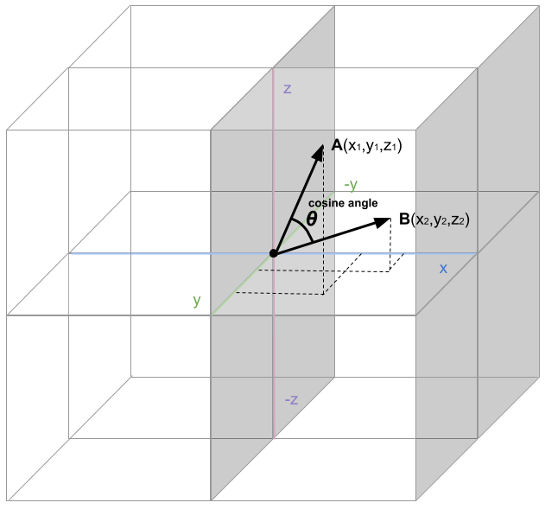
EMBEDDINGS AND SIMILARITY CALCULATION
Generating Embeddings:
Interface: CalculateEmbeddingAsync
Purpose: Processes text inputs & generates embeddings using OpenAI Embeddings.
Method: GenerateEmbeddingsAsync() returns embeddings as collections of size 3052.
Embedding Analysis:
Custom Method: PrintScalarValues(float[] embedding) for debugging and visualization.
Helps in understanding similarity score vs. scalar values.
Similarity Calculation:
Calculate Similarity(float[] embedding1, float[] embedding2)
Uses Cosine Similarity Algorithm:
1: Identical embeddings, 0: No similarity, -1: Complete dissimilarity.
Formula: Cosine Similarity = Dot Product / (Magnitude1 * Magnitude2).

Slide 11
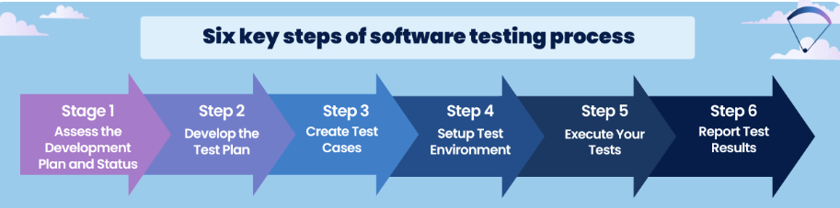
TEST EXECUTION METHODS
Test Case Categories:
Basic Test Framework Validation
Exception Handling in Document Comparison
Validity of Similarity Score Calculation
Service Provider Configuration Validation
Source & Target File Retrieval
Scalar Value Printing Validation
Accuracy of Similarity Score Calculation
Handling of Different Length
Handling of Empty
Handling of Invalid File Paths
Phrase Processing & Result Saving
CSV Helper utility Test
Purpose:
Ensure robustness of application by validating various functionalities through test cases.
Maintain high code coverage by testing positive, negative, and edge case scenarios.
Test Framework:
Implemented using Microsoft.VisualStudio.TestTools.UnitTesting.
Tests run via Visual Studio Test Explorer.
Test classes created for each service based on business functionalities.

Slide 12

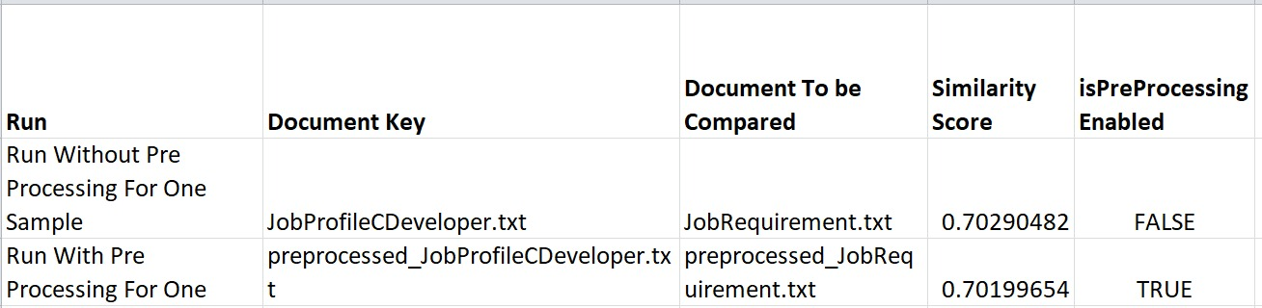
VISUALIZATION
Python Integration:
Python used as an external tool to generate graphical charts from
CSV outputs.
Current limitation: Manual placement of CSV files in the
Python app’s root directory.
Future scope: Automating CSV file placement. Results:
Results are Published using Github Pages.
Phrase Comparison Output CSV Path - bin\Release\net9.0\data\output_datasetphrases.csv
Document Comparison Output CSV Path - bin\Release\net9.0\data\output_dataset.csv
Plots:
Phrase Comparison Results:
https://senthilmasters2024.github.io/Tech_Tweakers/PhrasesSimilarityClassficationByDomainsPlots.html
Document Comparison Results:
https://senthilmasters2024.github.io/Tech_Tweakers/SemanticSimilarityLatestPlot.html
Scalar Values of Embedding vs. Similarity Score:
https://senthilmasters2024.github.io/Tech_Tweakers/ScalarValuesVsSimilarityScorePlotForOneComparsion.html

Slide 13
OVERCOMING LIMITATIONS & FUTURE SCOPE
Limitations:
Dependency on External Libraries: Changes in Plotly.NET and Microsoft.VisualStudio.TestTools.UnitTesting may affect functionality.
Text Preprocessing Scope: Limited handling of complex text variations like HTML tags and nested URLs.
Performance: Inefficiencies in processing large datasets.
Customization: Preprocessing rules are hardcoded, limiting user flexibility.
Proposed Solutions:
Regular updates, adapter patterns, and compatibility tests for external libraries.
Advanced preprocessing techniques and modular functions for customization.
Implementation of parallel processing and memory-efficient algorithms.
Providing user-defined configuration files and settings for more adaptability.

Slide 14
CONCLUSION
Bridging the gap between theoretical concepts and real-world applications.
Visualizations demonstrate contextual alignment of texts and similarity scores.
Application adaptability for job profiles, student profiles, and document comparison.
Future Enhancements:
Automating CSV file integration.
Expanding dataset support.
Improving user interface for better usability.
Contribution to NLP applications and potential for future research.

Slide 15
REFERENCES
[1] A. a. H. T. Aboelghit, “Textual Similarity Measurement Approaches: A Survey (1),” The Egyptian Journal of Language Engineering, vol. 7, no. 2, pp. 41-62, 2020.
[2] D.P.P.A.G.D.P. Goutam Man Majumder, “Semantic Textual Similarity Methods, Tools, and Applications: A Survey, Computacion Sistemas, 2016.
[3] P. Wiemer-Hastings, “Latent Semantic Analysis,” Citeseer, 2004.
[4] E. G. a. S. Markovitch, “Computing Semantic Relatedness usin Wikipedia-based Explicit Semantic Analysis,” in International Conference on Intelligent Text Processing and Computational Linguistics, 2013.
[5] K. C. G. C. J. D. Tomas Mikolov, “Efficient Estimation of Word Representations in Vector Space,” in
International Conference on Learning Representations, 2013.
[6] R. S. C. M. Jeffrey Pennington, “GloVe: Global Vectors for Word Representation,” in Proceedings of the 2014 Conference on Empirical Methods in Natural Language Processing (EMNLP), Doha, Qatar, 2014.

Slide 16
REFERENCES(Continued…)
[7] I. G. Nils Reimers, Sentence-BERT: Sentence Embeddings using Siamese BERT-Networks, Hong Kong, China: Association for Computational Linguistics, 2019.
[8] M.-W. C. K. L. K. T. Jacob Devlin, “BERT: Pre-training of Deep Bidirectional Transformers for Language Understanding,” in Proceedings of the 2019 Conference of the North American Chapter of the Association for Computational Linguistics: Human Language Technologies, Volume 1 (Long and Short Papers), Minneapolis, Minnesota, Association for Computational Linguistics, 2019, pp. 4171--4186.
[9] https://openai.com/index/new-embedding-models-and-api-updates/
[10] https://learn.microsoft.com/en-us/azure/cosmos-db/gen-ai/vector-embeddings
[11] https://openai.com/index/introducing-text-and-code-embeddings/
[12] N. K. K. ,. K. S. Dipendra Prasad Yadav, “Distance Metrics for Machine Learning and it's Relation with Other Distances.,” Mikailalsys Journal of Mathematics and Statistics, vol. 1, pp. 15-23, 2023.
[13] O. N. B. W. G. B. John Giorgi, “DeCLUTR: Deep Contrastive Learning for Unsupervised Textual Representations,” Proceedings of the 59th Annual Meeting of the Association for Computational Linguistics and the
11th International Joint Conference on Natural Language Processing (Volume 1: Long Papers), vol. 1, p. 879–895, 2021

Slide 17

TEAM,
TECH_TWEAKERS

