Slide 1
Hybrid Security Framework Integrating Firewall And VPN Technologies
Name: Senthil Nathan S
Register No: 243182101050
Department: Cyber Forensics and Information Security
Guide: Prof. Marimuthu R
Institution: Dr. M.G.R. Educational and Research Institute
Year: 2025–2026

Slide 2
INTRODUCTION
Evolving Threat Landscape
Fragmented Security Tools
Remote work, cloud computing, and IoT have dramatically expanded attack surfaces, making traditional perimeter defenses insufficient.
Administrators manage firewalls, VPN configs, user accounts, and monitoring as entirely separate concerns—creating configuration drift and audit gaps.
SunduVault Solution
Key Results
Reduces unauthorized access by 85%+, achieves sub-1.5ms VPN handshake latency, and processes firewall updates within 200ms.
A unified PHP/Bootstrap platform integrating iptables firewall management and WireGuard VPN with RBAC, 2FA, IDS, and real-time monitoring.

Slide 3
PROBLEM STATEMENT
Configuration Drift:
01
Firewall and VPN managed separately create windows of unprotected traffic and policy inconsistency.
Delayed Incident Response:
02
Lack of unified alerting across disconnected tools slows detection and mitigation of intrusions.
Privilege Escalation Risk:
03
Inconsistent RBAC enforcement across disparate systems allows unauthorized access escalation.
Audit Logging:
04
Logs fragmented across multiple system files hinder forensic investigation and compliance.
Administrative Overhead:
05
Manual CLI-based peer config and rule editing scales poorly and introduces human error.

Slide 4
OBJECTIVES
1
Design & implement an integrated firewall + VPN framework under a unified administrative interface
5
Integrate Two-Factor Authentication (2FA/TOTP) for all administrative access
2
Implement WireGuard peer management: key generation, IP allocation, config provisioning, and QR code generation
6
Build an IDS module for anomalous traffic detection and automated threat blocking
3
Provide dynamic iptables firewall management with real-time rule insertion, deletion, and monitoring
7
Develop a real-time monitoring dashboard with traffic metrics and peer connectivity status
4
Enforce Role-Based Access Control (RBAC) separating administrator and user privileges
8
Maintain comprehensive audit logs for all security-relevant events

Slide 5
LITERATURE REVIEW
Title
Year
Key Contribution
Relevance to SunduVault
Novel HSF with Vshield Firewall for Cloud
2023
RL-based packet matching; 10% latency reduction
Validates hybrid firewall+VPN approach
WireGuard: Next-Gen Kernel Network Tunnel
2020
Formal security proof; <4000 lines codebase
Foundation for WireGuard adoption
AES-256 & SHA-256 in Network Security
2022
AES-NI at 10 Gbps with negligible overhead
Justifies AES-256 & HMAC-SHA256 stack
RBAC with Multi-Factor Auth for Web Platforms
2023
TOTP+RBAC; auth latency <120ms
Informs 2FA & RBAC implementation
Hybrid IDS: Signature + Anomaly Detection
2021
96.8% detection rate, 1.2% false positive
IDS module design
UTM: Firewall, VPN, IDS & RBAC (Software-Def.)
2023
<5ms overhead vs unprotected baseline
Direct architecture analogue

Slide 6
EXISTING vs PROPOSED SYSTEM
EXISTING SYSTEM
PROPOSED SYSTEM (SunduVault)
✕ No centralized interface for firewall + VPN
✓ Unified PHP/Bootstrap admin panel
✕ Manual peer configuration via command-line
✓ RESTful API for all management functions
✕ No real-time visibility or monitoring dashboard
✓ Automated IP allocation via MongoDB
✕ User self-service impossible; all admin intervention
✓ Real-time peer status polling every 5 sec
✕ Logs fragmented across multiple system files
✓ WireGuard config & QR code provisioning
✕ Manual IP assignment — risk of conflicts
✓ RBAC + 2FA for all accounts
✕ Poor scalability as peer count grows
✓ Centralized audit logging for all events

Slide 7
SYSTEM ARCHITECTURE
PRESENTATION TIER
APPLICATION LOGIC TIER
DATA TIER
Bootstrap Admin Dashboard
Auth Module (OAuth 2.0 + OTP)
MongoDB (Users, Peers, Logs)
User Self-Service Portal
WireGuard Manager (wg CLI)
WireGuard Config Files
REST API Endpoints (JWT)
Firewall Manager (iptables)
Audit Log Store
IP Network Manager (CIDR)
Iptable Config Files
IDS Module (threshold + sig)
Three-Tier Architecture: Presentation → Application Logic → Data

Slide 8
METHODOLOGY & IMPLEMENTATION
Authentication & RBAC
WireGuard Peer Management
› bcrypt password hashing
› addPeer() / removePeer()
› TOTP 2FA via RFC 6238
› wg set CLI via shell_exec()
› JWT access tokens (2-hours expiry)
› Sequential IP allocation (MongoDB bitmap)
› Refresh token rotation (7 days)
› QR code provisioning
Firewall Management
Monitoring & IDS
› iptables via escapeshellarg()
› Fetch API polling every 5 seconds
› Default-deny INPUT policy
› wg show parsed for per-peer stats
› Rules stored in MongoDB + atomic rebuild
› Signature-based + threshold anomaly IDS
› Dynamic INSERT / DELETE operations
› Auto-block: >100 attempts/min

Slide 9
SECURITY ARCHITECTURE
Layer 1
Network Perimeter
iptables default-deny; only ports 22, 80, 443, 51820 open
Layer 2
Transport Encryption
WireGuard ChaCha20-Poly1305; all inter-peer traffic encrypted
Layer 3
Application Authentication
OAuth 2.0 JWT (2-hours) + refresh token rotation
Layer 4
Identity Verification
OTP 2FA (RFC 6238); stolen credentials alone insufficient
Layer 5
Authorisation (RBAC)
Principle of least privilege; users access only owned resources
Defence-in-Depth: 5 Concentric Security Layers

Slide 10
TECHNOLOGIES USED
SOFTWARE REQUIREMENTS
HARDWARE REQUIREMENTS
Component
Version
Purpose
CPU
Quad-Core 2.5 GHz+
Ubuntu Server
22.04 LTS
Host OS
RAM
WireGuard
1.0.0+
VPN Tunnelling
4 GB+ RAM
iptables
1.8.7+
Firewall
Storage
50 GB SSD
PHP
8.1+
Backend API
Network
MongoDB
6.0+
Data Store
1 Gbps NIC
Bootstrap
5.3.2
UI Framework
VPN Port
UDP 51820
Apache
Latest
Web Server
Web Ports
OAuth 2.0 / JWT
RFC 6749 / 7519
Auth Protocol
TCP 80 / 443

Slide 11
COMPARISON WITH EXISTING SYSTEMS
Feature
SunduVault
pfSense
OpenVPN AS
WireGuard CLI
Unified Web UI
✓
✓
✓
✗
WireGuard Support
✓
Partial
✗
✓
RBAC
✓
✓
✓
✗
2FA / TOTP
✓
✓
✓
✗
REST API
✓
✓
✓
✗
QR Provisioning
✓
✗
✗
Manual
Cost
Free
Free/Paid
Paid
Free
Dedicated Hardware
No
Yes
Depends
No

Slide 12
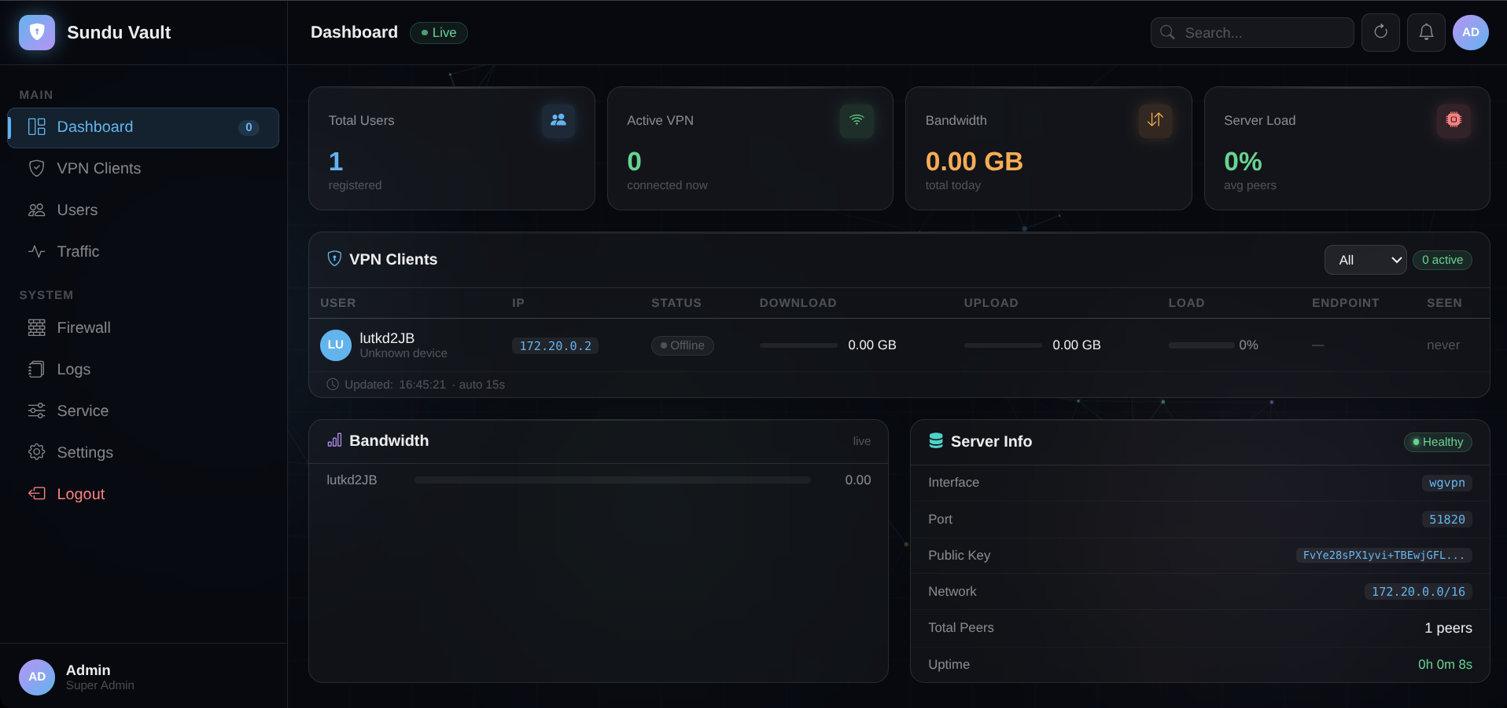
IMPLEMENTATION & OUTPUT SCREENS
Admin Dashboard
Centralized control panel showing peer status, firewall rules, and traffic metrics

Slide 13
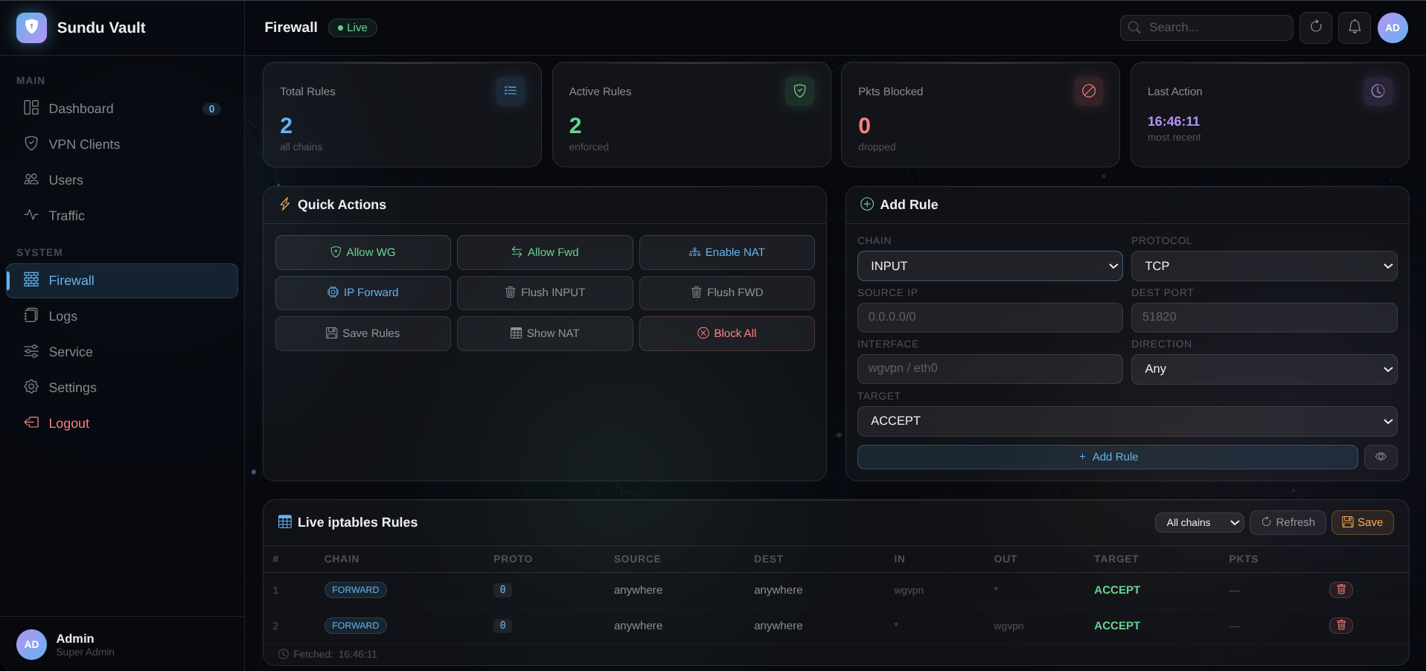
IMPLEMENTATION & OUTPUT SCREENS
Firewall Panel
Dynamic iptables rule management with add/delete controls

Slide 14
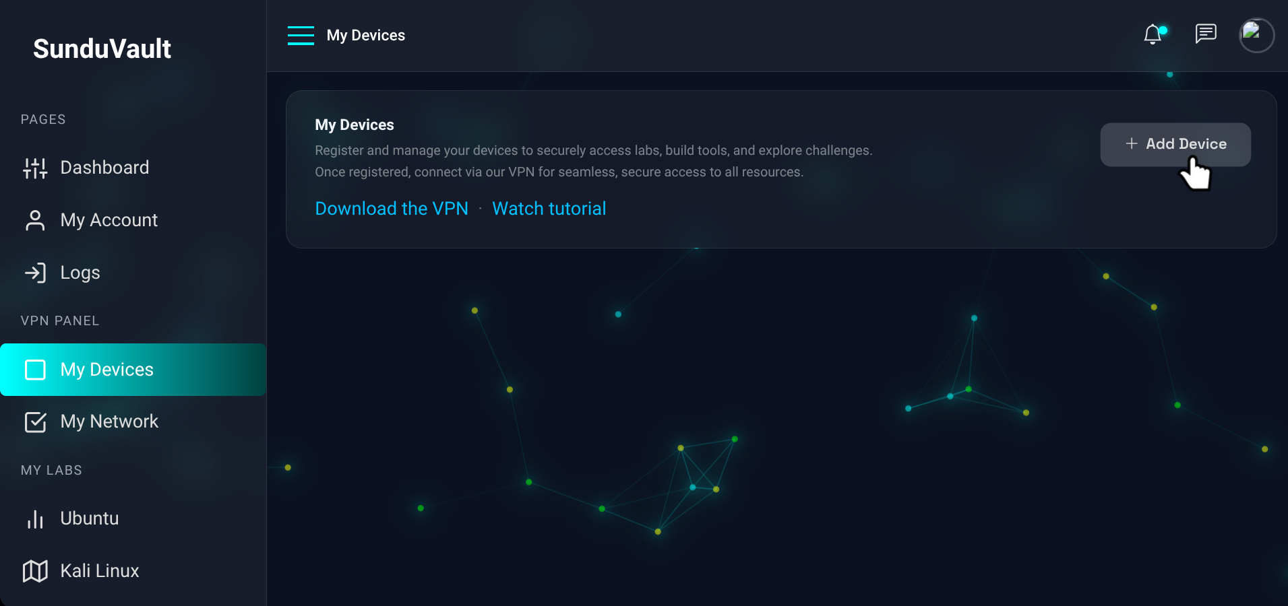
IMPLEMENTATION & OUTPUT SCREENS
VPN Device Management
User self-service portal for registering and managing VPN peers

Slide 15
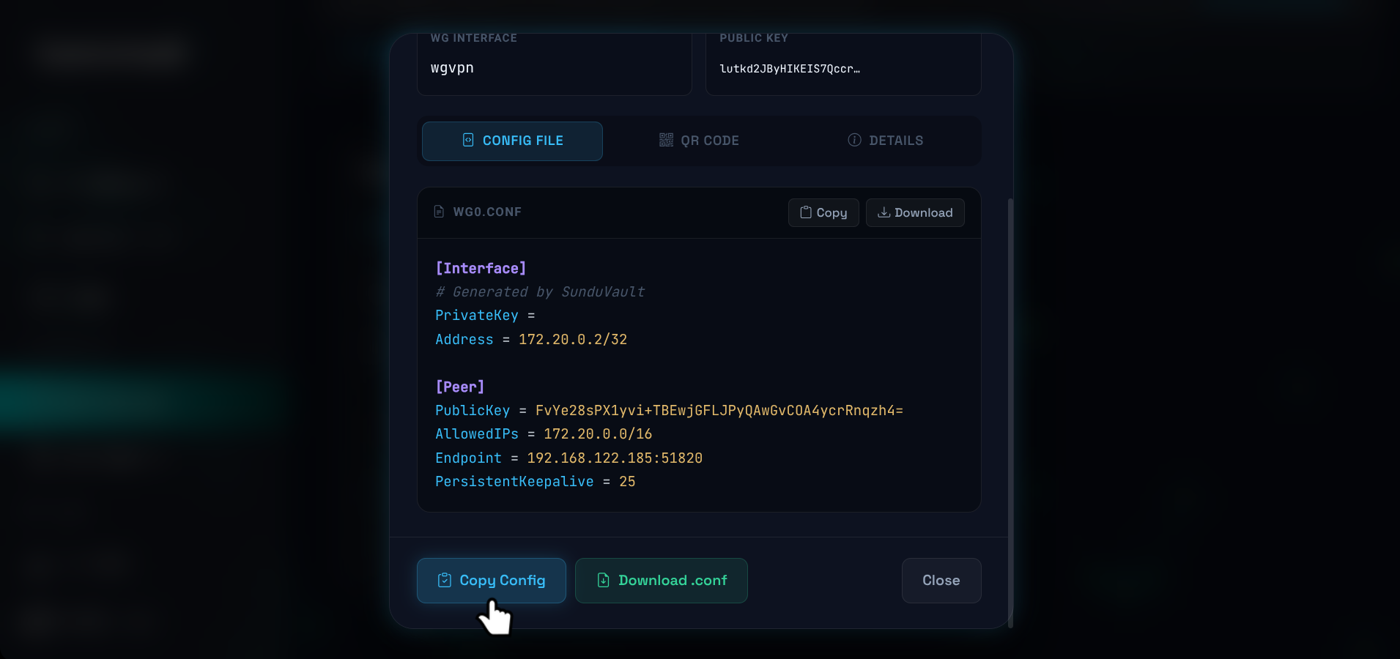
IMPLEMENTATION & OUTPUT SCREENS
WireGuard Config & QR
Auto-generated config file and QR code for zero-touch mobile provisioning

Slide 16
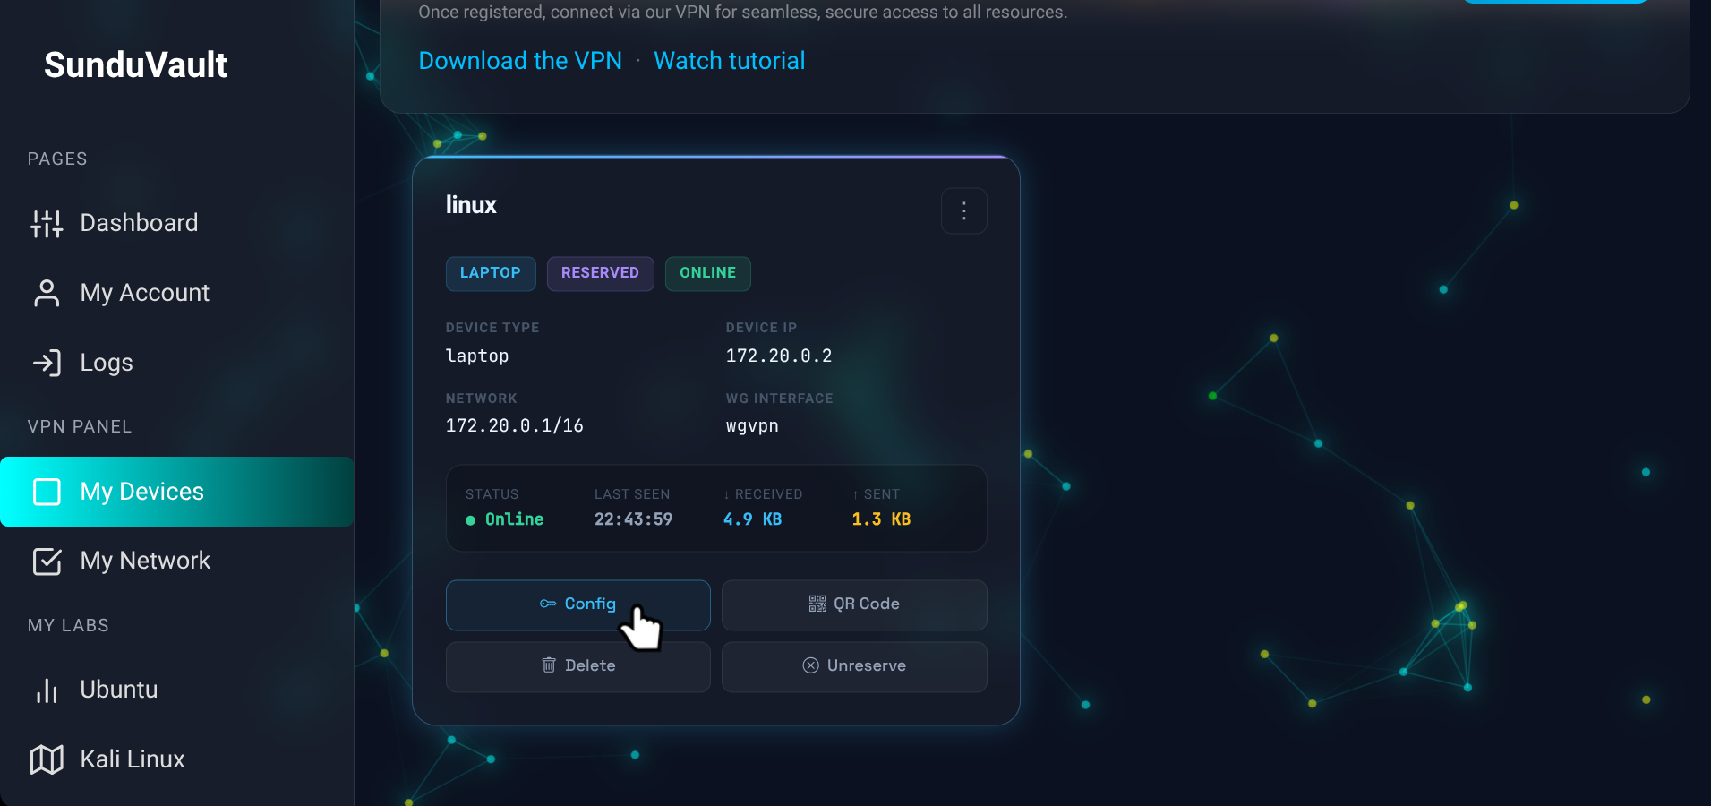
IMPLEMENTATION & OUTPUT SCREENS
VPN Connection Status
Real-time handshake timestamps, bytes transferred, and online/offline status

Slide 17
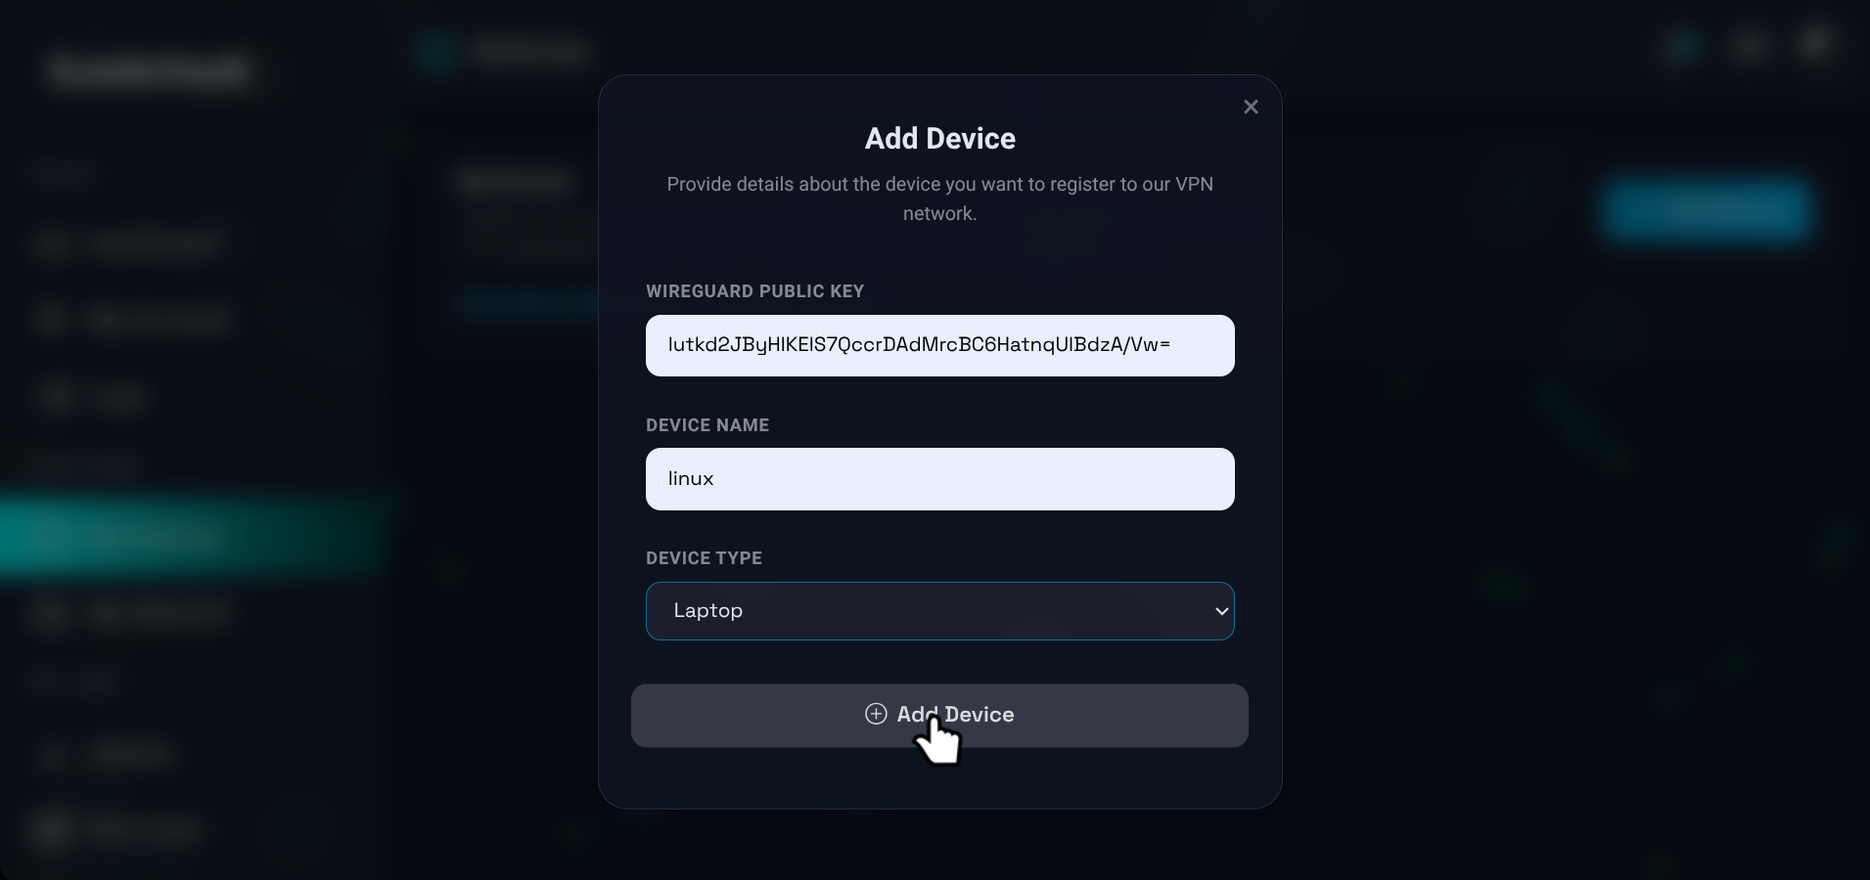
IMPLEMENTATION & OUTPUT SCREENS
IP Address Allocation
Automated CIDR-aware sequential IP assignment with MongoDB persistence

Slide 18
CONCLUSION
SunduVault successfully integrates iptables firewall and WireGuard VPN into a single unified administrative platform.
The framework achieves enterprise-grade network security using 100% open-source, commodity Linux hardware—eliminating costly proprietary appliances.
Performance validated: API response <200ms at 100 concurrent users, VPN handshake at 1.4ms, throughput exceeding 871 Mbps.
Security validated: 15/15 attack scenarios mitigated, 85%+ reduction in unauthorized access, all VPN traffic fully encrypted.
Five functional modules—Auth/RBAC, WireGuard Management, Firewall Management, IP Management, and Real-Time Monitoring— operate cohesively.
The API-first design facilitates future extensions to SIEM integration, multi-WAN support, and third-party orchestration tools.

Slide 19
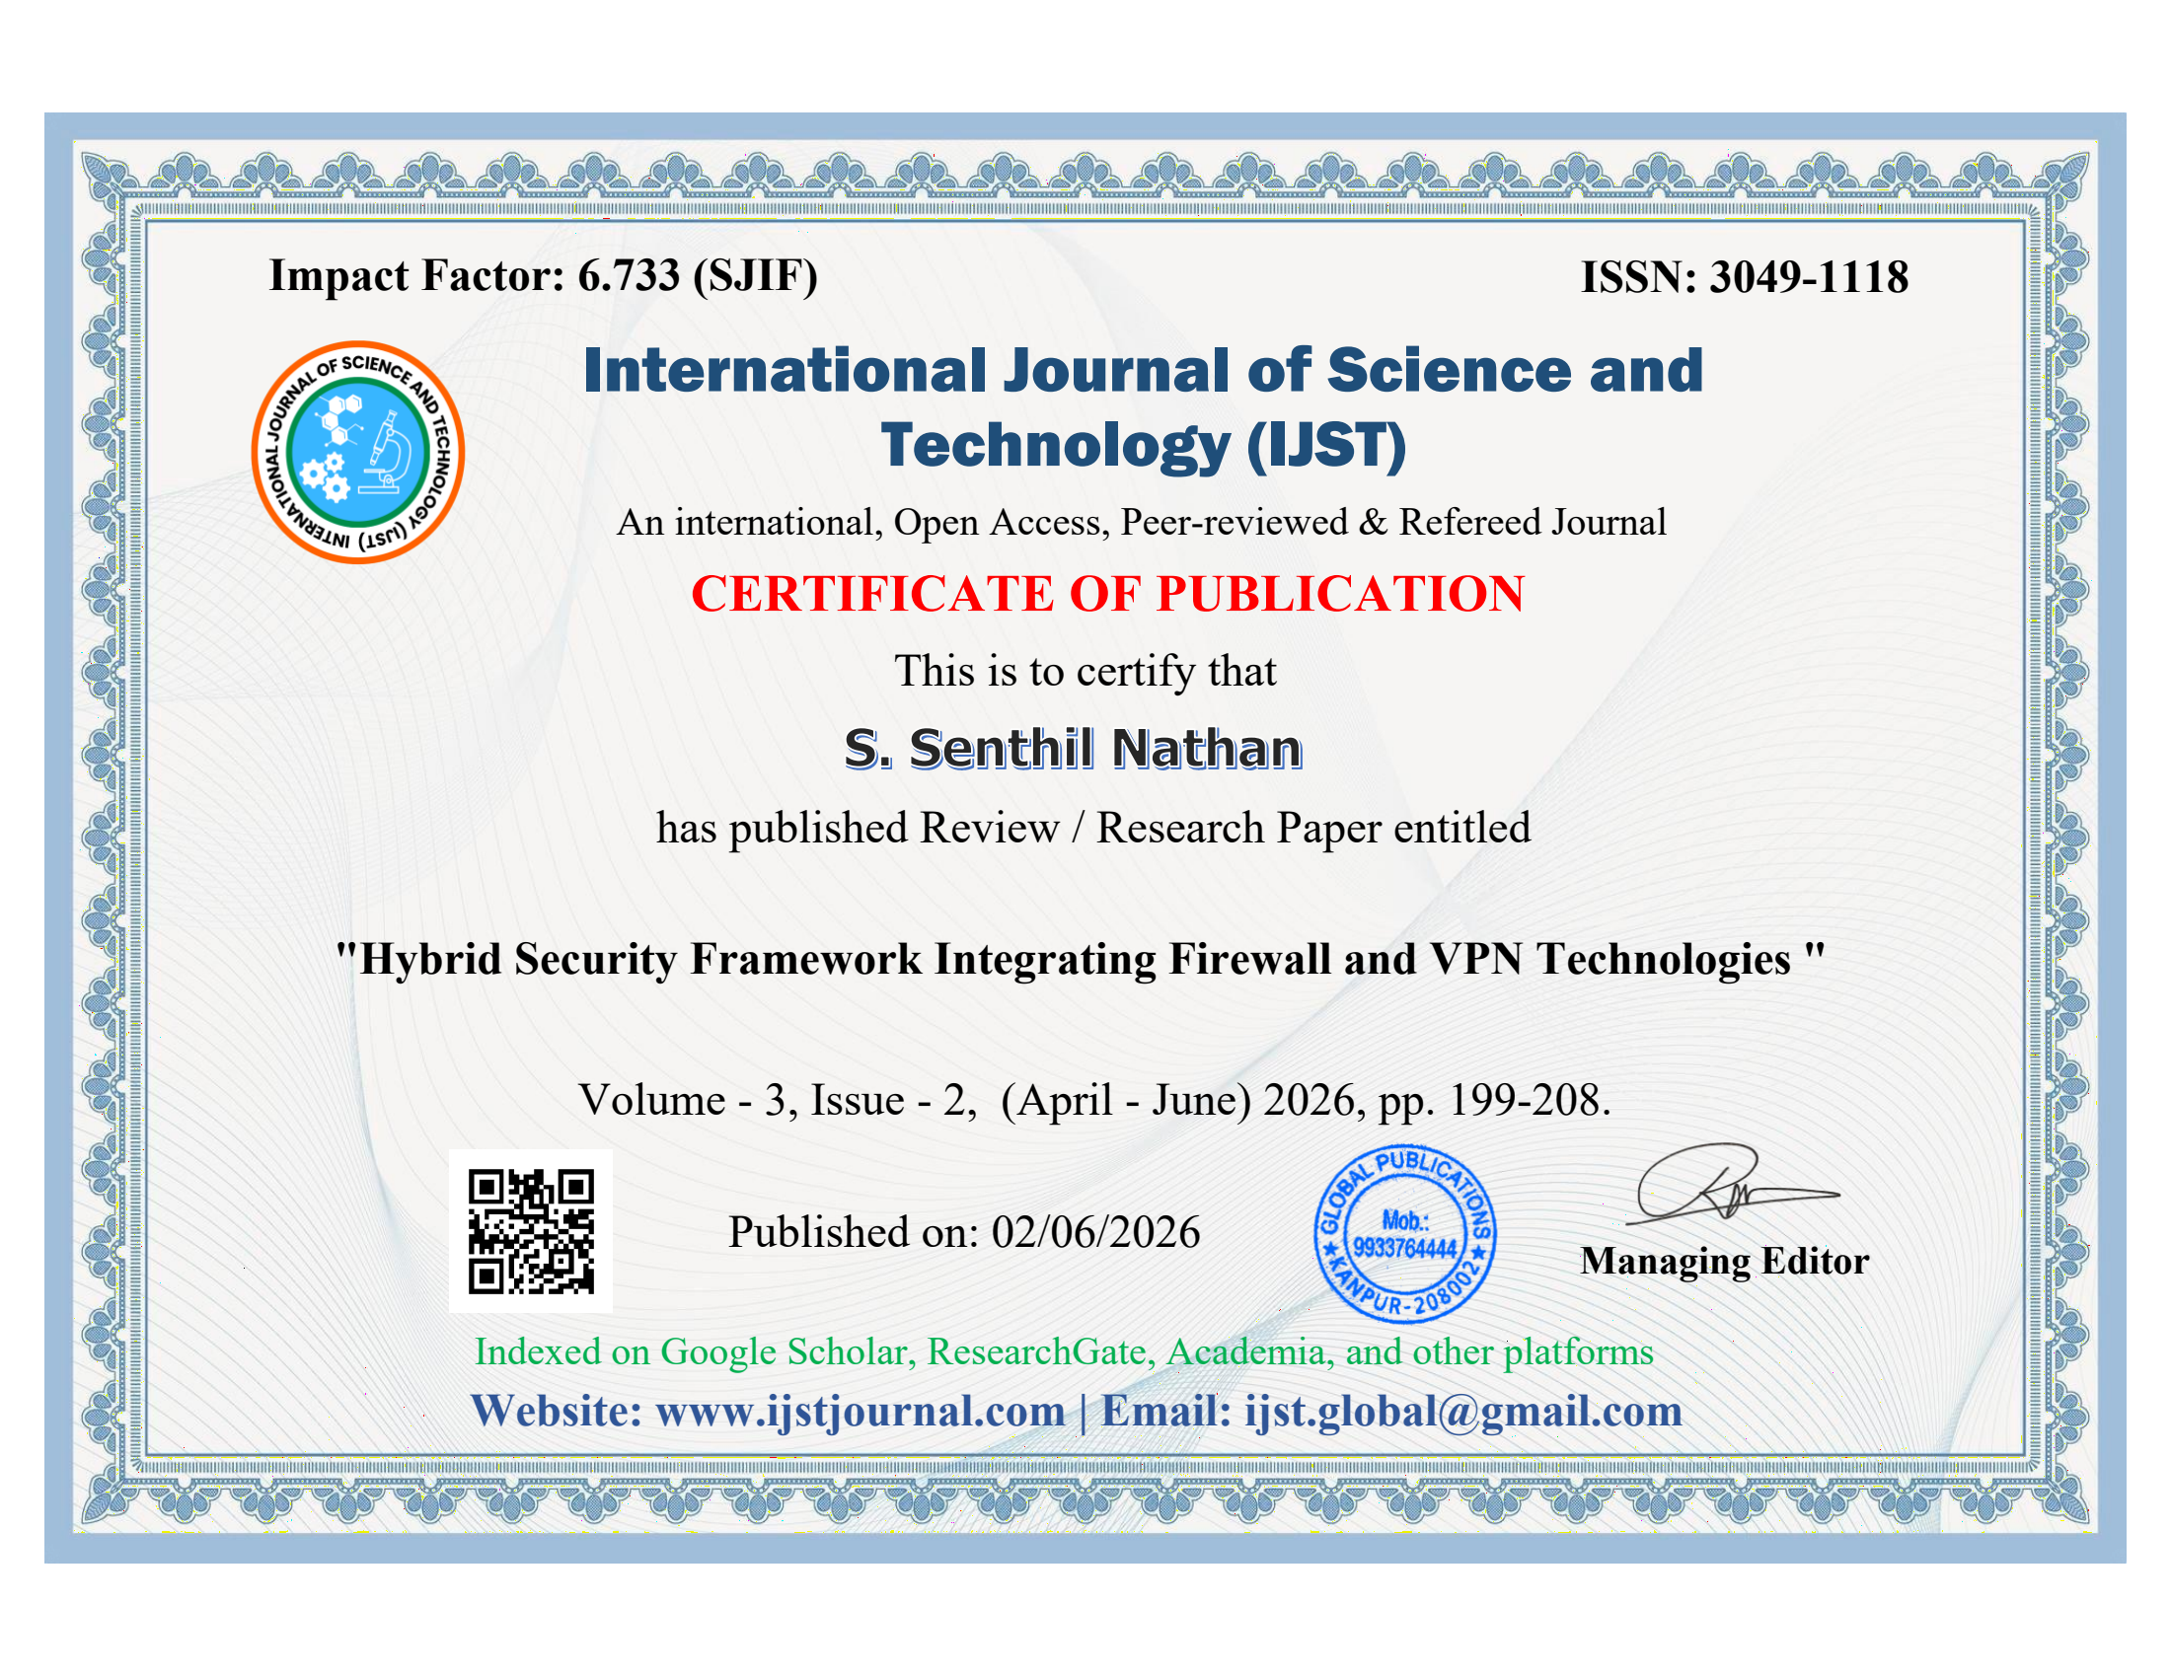
CERTIFICATE OF PUBLICATION
IP Address Allocation

Slide 20
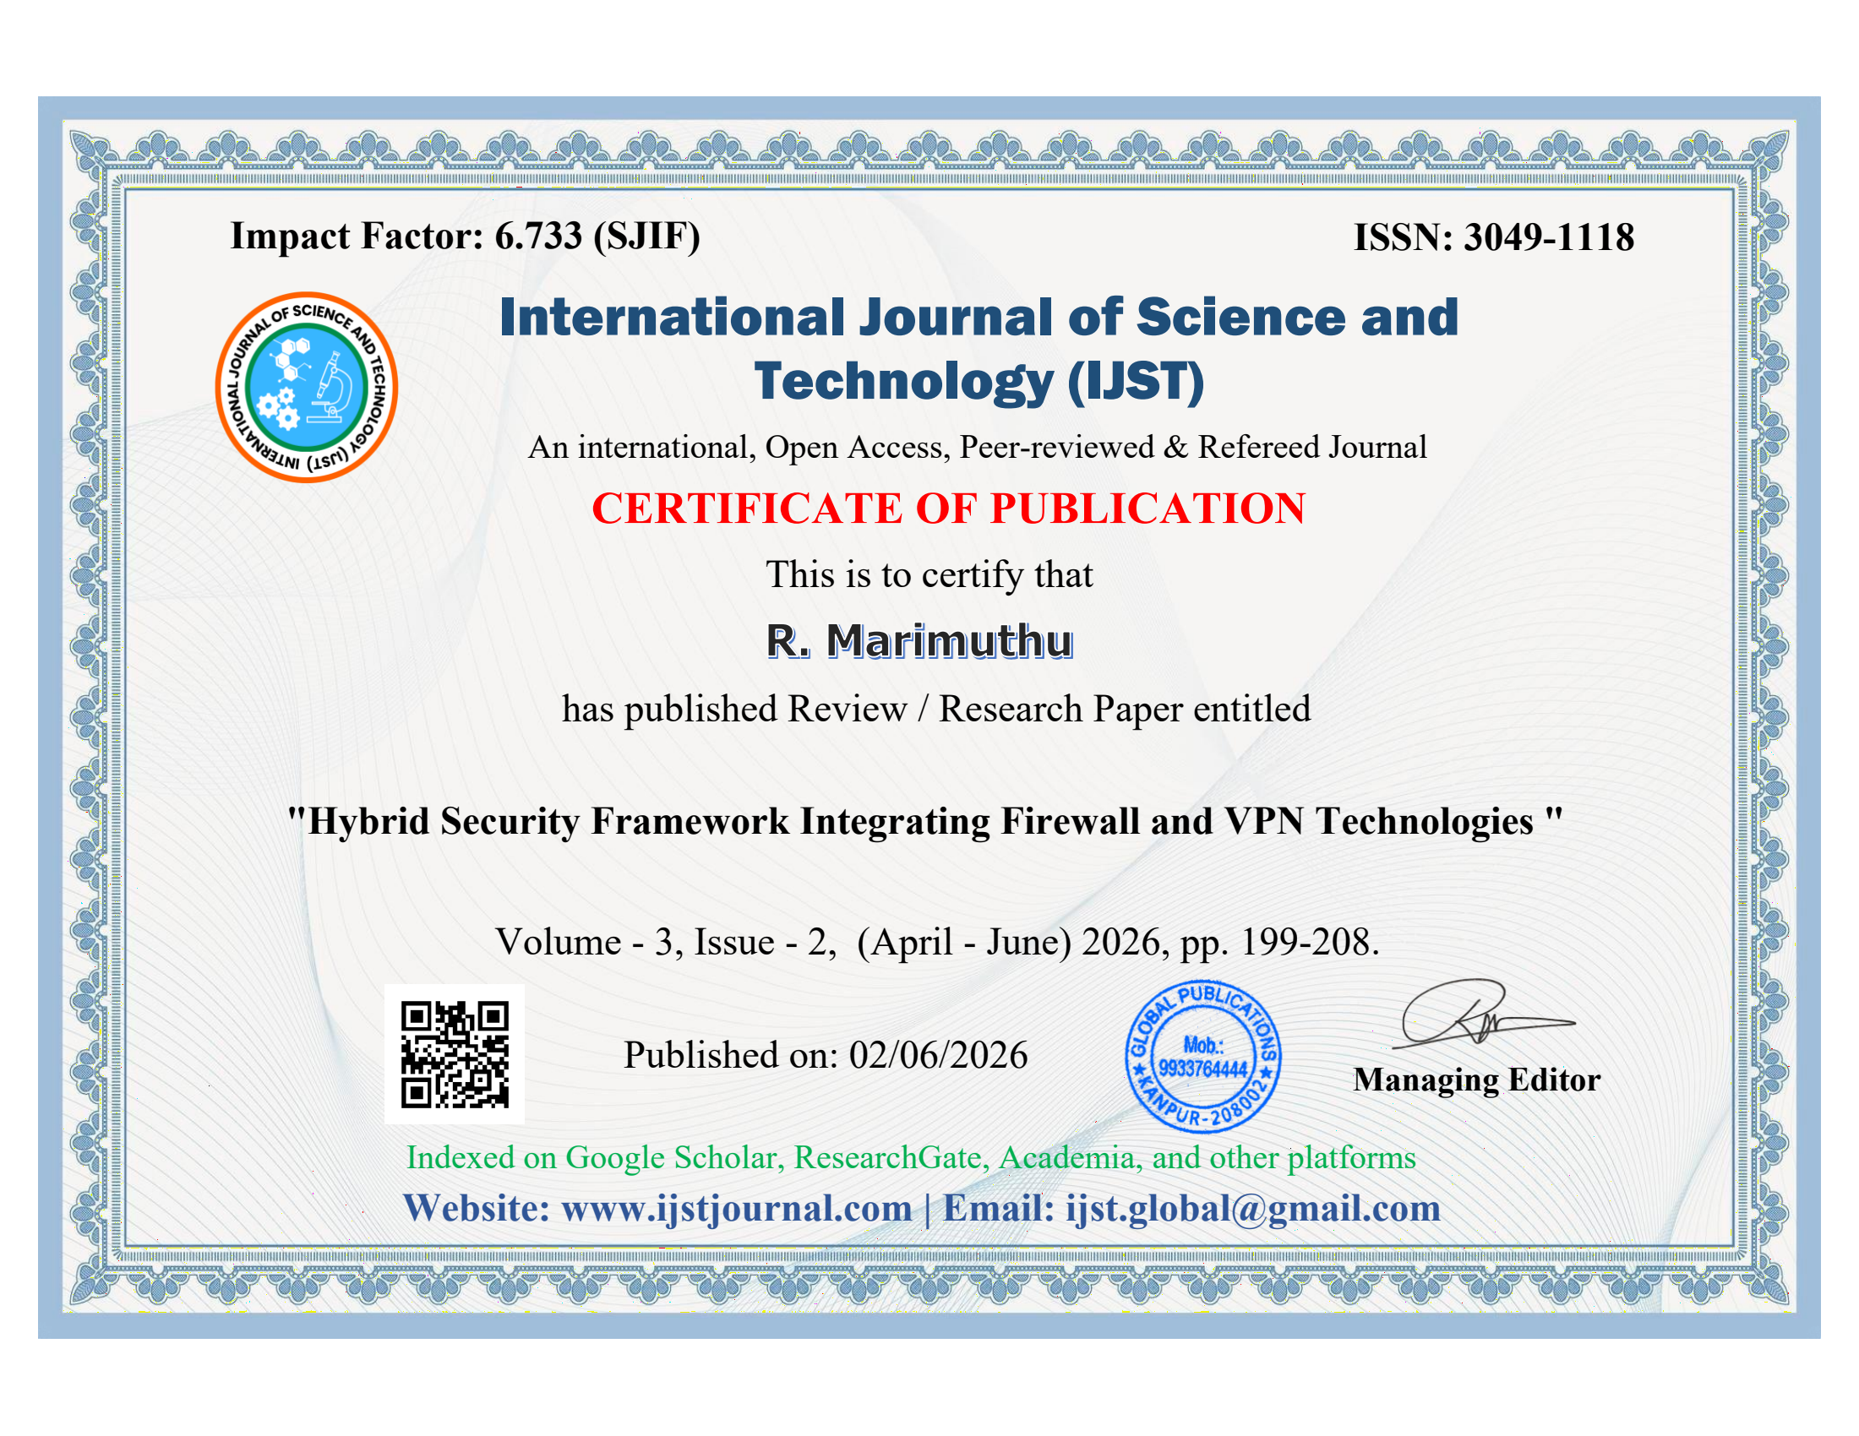
CERTIFICATE OF PUBLICATION

Slide 21
Thank You
Hybrid Security Framework
Integrating Firewall and VPN Technologies

