Slide 1
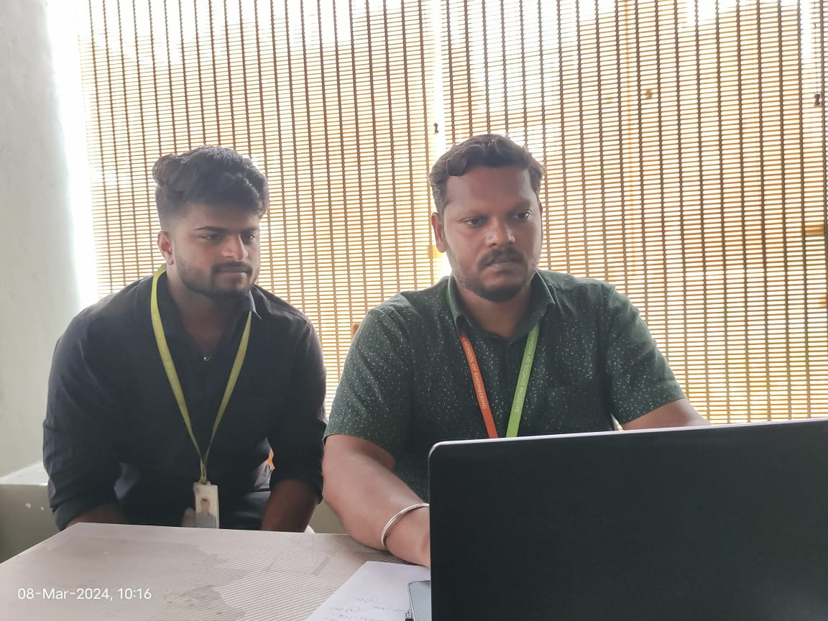
Name:Ajay
Register No:192011009
Department: CSE
Ajay doing NPTEL courses instead of his two subjects and he submitted all Assignments for that.
Ajay attending various placement drives to get his placement offer.
Total Course: 41 No of Core Course Completed:28 Total Credits completed:120 | No of Arrears: 2 CGPA:8.5 No of ongoing Courses: 1 +2 NPTEL

Slide 2
Respected Parents:
Ajay currently doing product based project design attendance percentage is 83%and his performance is good. Advise given to him come for classes regularly. Ajay has completed 28 core courses up to March 2024, He needs to complete 2 core courses. He is good enthusiastic learner. It is advised him to complete the 2 supplementary examination on this month February 2024 and also suggestions given to him convert his module based project in to core project. Suggestions given to him is to attend as many placements drives to get placement. Ajay undergoing two NPTEL courses to complete his elective papers.
Interest:He is very much interested in writing coding. Area of Improvement: He need to improve his Logical, analytical and communication skills for the upcoming placement drives. Suggestions given to him to study and practice logical and reasoning solved websites and books. Leet Code: Process shows that he is not performing leet code hence no improvement in ranking. Suggestions given to him to complete at least one code per day.

Slide 3

MENTEE RESPONSE
PARENT’S RESPONSE
text
text

