Slide 1
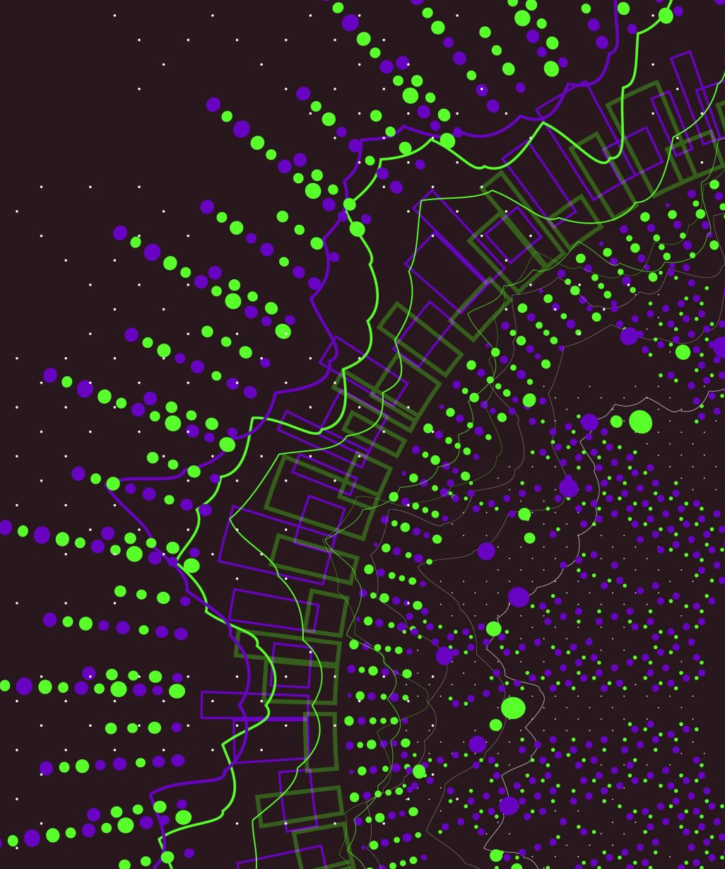
MealMatch
Name: Rohin Senthil
Advisor: Professor Nitin

Slide 2
Background
Previous Internships:
Kroger:
Data Engineer for Online Pick Up Order Team
Full Stack Software Engineer for In Stock Team
AtriCure:
- Data Analyst/Data Engineer team
School:
Major: Computer Science
Goals Post Grad:
Continue with my current team in In Stock and get a return offer!

Slide 3
Senior Design Project Overview
Problem Statement:
Food insecurity affects millions of people who struggle to find information about available meal programs, discounted food options, and shelter services in their area. Current solutions are fragmented across multiple websites, phone hotlines, and word-of-mouth, making it difficult for people in need to quickly find help. Additionally, restaurants and shelters lack a centralized platform to advertise their services to those who need them most.

Slide 4
Senior Design Project Overview Cont.
Overview:
MealMatch is a web-based platform designed to address food insecurity by connecting individuals in need with affordable meals, restaurant deals, and shelter services in their community. The platform serves as a bridge between three key user groups: individuals seeking assistance, restaurants offering discounted or free meals, and shelters providing meals and housing services.
Solution:
MealMatch provides a unified, location-based search platform where:
Individuals can search for free meals, discounted restaurant deals, and shelter services near their location
Restaurants can post time-limited meal deals and promotions to reduce food waste while helping the community
Shelters can advertise their services, update bed availability in real-time, and share meal schedules

Slide 5
Key Features
1. Location-Based Search
Users can search for meals and shelters within a specified radius using GPS or manual coordinates
2. Interactive Map Integration
Google Maps integration displays all available resources visually with color-coded markers
3. Real-Time Updates
Restaurants can post meal deals with time windows; shelters can update bed availability instantly
4. Role-Based Dashboards
Separate interfaces for individuals, restaurants, and shelters with relevant features for each
5. Comprehensive Information
Detailed listings include meal times, dietary options, services offered, contact information, and directions

Slide 6
Why build this?
Impact
MealMatch aims to reduce food insecurity by making it easier for people to find assistance when they need it, while helping restaurants and shelters maximize their community impact. The platform reduces the time and effort required to locate food resources from hours to minutes.
Expected Outcomes
Faster Access to Food: Reduce search time from hours to minutes
Reduced Food Waste: Help restaurants donate surplus food instead of discarding it
Increased Shelter Utilization: Connect people with available shelter beds in real-time
Community Connection: Bridge the gap between those in need and available resources
Data-Driven Insights: Enable better resource allocation based on usage patterns

Slide 7
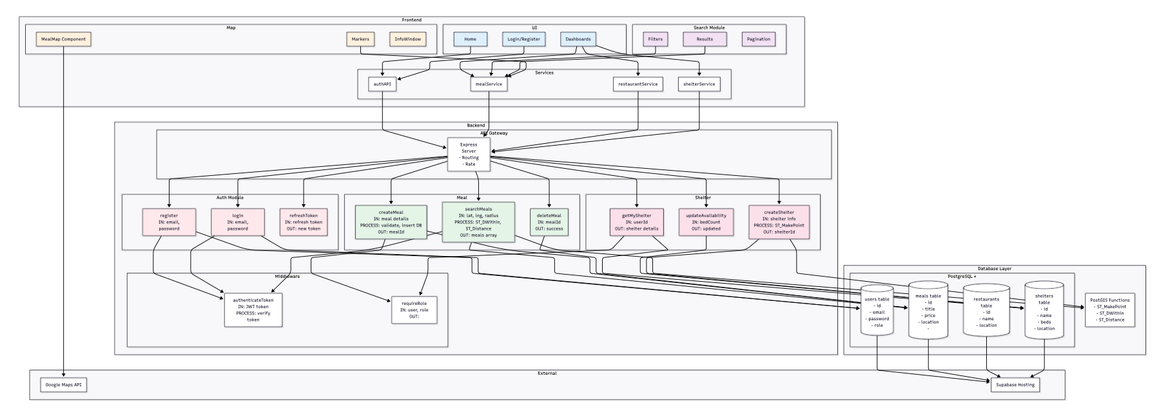
Design Diagram

Slide 8
End Goal
The end goal of this project is to successfully create a web application that we can deploy within the Cincinnati region to help lower-income individuals connect to good deals. We hope to foster an environment in Cincinnati that allows those in need to get the resources they need. I believe in this initiative to make Cincinnati a better place, and I believe you should, to!

