Slide 1


GLOBAL INDIAN BUSINESS EXCELLENCE AWARDS 2026
EVENT MOBILE APPLICATION
FEATURES & ARCHITECTURE
A Purpose-Built Digital Companion for 100 C-Suite Global Leaders
House of Commons, British Parliament • Oxford • Cambridge • Imperial College
🏛️ 5–9 NOVEMBER 2026 • 📱 iOS & ANDROID NATIVE COMPATIBLE
Parliament Security Clearance • 5-Day Logistics • Multi-Currency Payments • AI Matchmaking

Slide 2


GLOBAL INDIAN BUSINESS EXCELLENCE AWARDS 2026
Executive Rationale: Purpose-Built for UHNW Leadership
01. DIPLOMATIC PROTOCOL
British Parliament Access
The House of Commons requires rigorous advance identity accreditation. The platform secures passport KYC data and delivers anti-counterfeit digital passes.
02. MULTI-CITY TRANSIT
London, Oxford & Cambridge
Coordinates 100 VIP delegates across 3 world-renowned academic cities over 5 days, featuring coach GPS tracking and real-time itinerary prompts.
03. C-SUITE NETWORKING
Privacy-Preserved Corridors
Empowers high-level leaders to connect, chat, and schedule bilateral 1-on-1 meetings without exposing private phone numbers or personal emails.
04. COMPLIANT BILLING
Transparent Package Invoicing
Automates multi-currency payments and corporate B2B invoicing while maintaining the non-monetary invitation status of the Parliamentary ceremony.

Slide 3
SYSTEM ARCHITECTURE
Functional Architecture: The 4-Tier Operating Model
TIER 1: DELEGATE INTERFACE (iOS & Android) | VIP User Touchpoint
Dynamic Digital Pass (Apple/Google Wallet) • 5-Day Interactive Itinerary • 1-on-1 Meeting Scheduler • AI Face-Recognition Photo Gallery • Digital Business Card.
TIER 2: CORE OPERATIONAL SERVICES | Business Logic & Workflows
Parliament Security Accreditation Engine • Inter-City Transit Scheduling • Multi-Currency Gateway & B2B Invoicing • Travel & Visa Document Vault.
TIER 3: STAKEHOLDER & VENUE INTEGRATION | Institutional Interfaces
House of Commons Security Manifest Interface • University of Oxford & Cambridge Session Coordination • Gala Venue VIP Table Management.
TIER 4: SECRETARIAT COMMAND CENTER | Organiser Control Center
Gate Check-In Mobile Scanner App (<2s access) • Real-Time Attendance Monitoring • Segmented VIP Push Broadcast • 24/7 VIP Concierge Hotline.

Slide 4


FEATURE SPECIFICATION
Delegate Credentialing & Parliamentary Security
Accreditation Portal
Pre-event identity capture formatted to satisfy British Parliamentary security vetting. Verifies legal name matching passport, nationality, and photo.
Live Clearance Tracker
Real-time status indicators informing delegates when their accreditation moves from 'Submitted' to 'Police Cleared' and 'Pass Issued'.
Dynamic Anti-Fraud Pass
Time-synchronized revolving QR code that prevents screenshot sharing and guarantees verified identity at venue gates.
Apple & Google Wallet
One-tap pass installation directly to iPhone or Android lock screens, configured to automatically appear near Westminster.
Credential Tiers
Visual badges distinguishing Award Winners, Executive Delegates, Keynote Speakers, Advisory Committee, and Media.
Visa & Document Vault
Secure offline repository for official stamped IBN UK Visa Support Letters, hotel confirmations, and transfer vouchers.

Slide 5


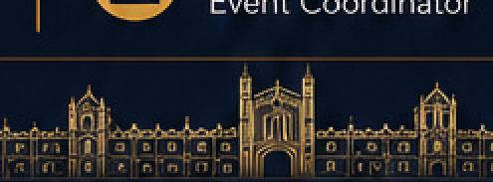
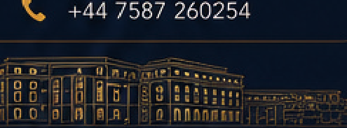
FEATURE SPECIFICATION
5-Day Event Logistics & Multi-City Navigation
DAY 1: 5 NOV
House of Commons
Awards & Reception
Cromwell Green gate guidance, security protocol check-in, and formal Parliamentary Awards agenda.
DAY 2: 6 NOV
Central London
Black Tie Gala
VIP table allocations, multi-course dining timeline, and Black Tie / Tuxedo attire guidance.
DAY 3: 7 NOV
Univ of Oxford
Leadership Forum
Oxford coach departure tracking, keynote panel schedule, and live interactive session Q&A/polls.
DAY 4: 8 NOV
Cambridge
Campus & Deep-Tech
Cambridge departure alerts, deep-tech research hub itinerary, and collegiate walking route guides.
DAY 5: 9 NOV
Imperial College
Innovation Showcase
AI venture presentations, enterprise showcase, networking luncheon, and official closing delegation.

Slide 6
FEATURE SPECIFICATION
Financial Management & B2B Invoicing Hub
Multi-Currency Checkout
Seamless checkout supporting British Pounds (£), US Dollars ($), Euros (€), and Indian Rupees (₹). Supports international corporate credit cards, Apple Pay, Google Pay, UPI, and Net Banking.
Automated B2B Tax Invoicing
Instant PDF generation of compliant commercial tax invoices including Corporate Name, GSTIN, and UK VAT details for corporate expense claims.
Regulatory Package Transparency
Itemizes packages exclusively for the 'IBN Business Leadership Programme' (academic sessions, gala hospitality, and transit), maintaining parliamentary non-commercial status.
Wire Transfer / SWIFT Flow
Enables corporate finance teams to upload official bank transfer or SWIFT/NEFT remittance receipts with automated secretariat verification.

Slide 7

FEATURE SPECIFICATION
Executive Networking & Business Matchmaking
Verified 100-Leader Directory
Private, searchable roster of attending CEOs, investors, and founders. Filterable by industry sector, geographical focus, and investment appetite.
1-on-1 Meeting Scheduler
Empowers delegates to request, schedule, and confirm 15-minute private meetings during designated summit networking breaks with built-in agenda sync.
Privacy-Protected In-App Chat
Facilitates direct executive messaging within the platform. Mobile numbers and personal email addresses remain shielded unless mutually shared.
Digital Business Card Exchange
Instant peer contact exchange via contactless phone tap (NFC) or badge QR scan, saving directly into mobile phone address books.

Slide 8

FEATURE SPECIFICATION
AI-Powered Photo Experience & Media Hub
SEAMLESS PERSONALIZED MEDIA DISTRIBUTION
• 1. Photographer Ingestion: Official summit media teams upload thousands of high-res event photos directly from the House of Commons, Gala, and Universities.
• 2. AI Facial Recognition: Delegates upload a single reference selfie during onboarding. The platform automatically indexes and isolates all images containing that delegate.
• 3. Private 'My Moments' Gallery: Delegates access a personalized, curated gallery containing exclusively their summit moments within hours of session completion.
• 4. High-Res PR Export: Single-tap download of press-ready, high-resolution RAW/JPEG assets ready for corporate communications and immediate LinkedIn sharing.
INSTANT ACCESS
Zero waiting for manual photographer sorting
PRESS-READY
Full-resolution original print quality
1-CLICK SOCIAL
Pre-formatted exports for LinkedIn & Instagram

Slide 9
OPERATIONAL ARCHITECTURE
Onsite Secretariat Operations & Control Center
Gate Check-in Scanner App
Dedicated staff mode for mobile phones and tablets to scan delegate QR codes at the House of Commons and Gala doors in under two seconds.
Live Headcount Dashboard
Real-time visibility into attendance counts inside the House of Commons, banquet halls, and passenger boarding for inter-city coach transfers.
Parliament Manifest Export
One-click export of the accredited guest manifest conforming exactly to British Parliamentary Security and Police format requirements.
Emergency VIP Concierge
Integrated one-touch hotline connecting delegates directly to the IBN Event Coordinator and secretariat leads for instant travel and venue support.

Slide 10
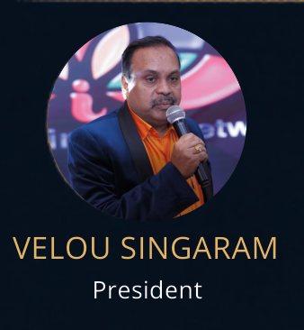
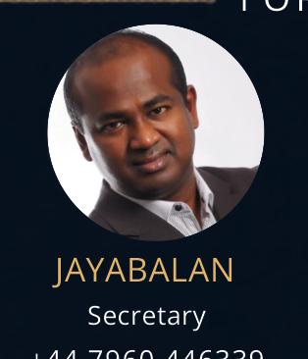
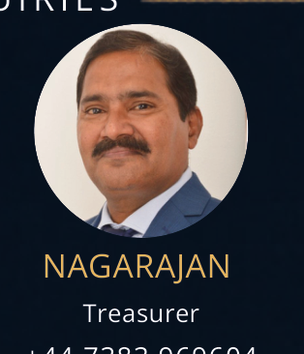

IBN LEADERSHIP
Organising Leadership & Secretariat Contacts
VELOU SINGARAM
President
Indian Business Network
Leading bilateral institutional relations and presidential summit addresses.
JAYABALAN
Secretary
+44 7960 446339
Parliamentary liaison, secretariat administration, and security protocol accreditation.
NAGARAJAN
Treasurer
+44 7383 969604
Financial governance, corporate partner relations, and delegate sponsorship management.
SUBHA AUSTALEKSHMI
Event Coordinator
+44 7587 260254
Delegate onboarding, UK visa support letters, accommodation booking, and itinerary concierge.

