Slide 1
The Importance of Mentorship for Academic Success
Constructing your mentorship network
CARP Spring 2024 Workshop

Slide 2






What is a mentor?
Career
tutor
Emotional support
Academic advisor
Mentor
Access to opportunities
Role model
Subject
Matter Expert

Slide 3

Dismantling barriers
The important of mentorship for academic success
Feeling out of place
Mentorship, specifically peer-mentorship, can be a promote community and belongingness.
Absence of support structure
Collaborating with faculty on research projects is a valuable source of mentorship and academic support for transfer students (Townsend and Wilson, 2009; Reyes, 2011).

Slide 4

Traditional concept of a mentor
The all-knowing sage
Career
tutor
Emotional support
Academic advisor
You
Access to opportunities
Role model
Subject
Matter Expert
Notes:
Issue
- One person cannot provide support for everything that you need.
- It is also a dependency model.
Even the best mentors can provide 80% advice aligned with what you need, whereas the other 20% can be their special flavor of how they think should be, and they may be the only person that holds those beliefs.

Slide 5
Re-thinking Mentoring
Constructing a network of mentors
Ask…
What do I need?
How can I get it?
Strategically choose mentors based on people that have what you want.
Look for the people that have what you want, especially those that just got it.
Notes:
Hyper-individualism - it’s a limiting belief. Just because you can figure it out yourself is not a good reason mean you shouldn’t ask anyone. By not asking, you are taking the slowest, most inefficient, and most ineffective path towards what you need.

Slide 6
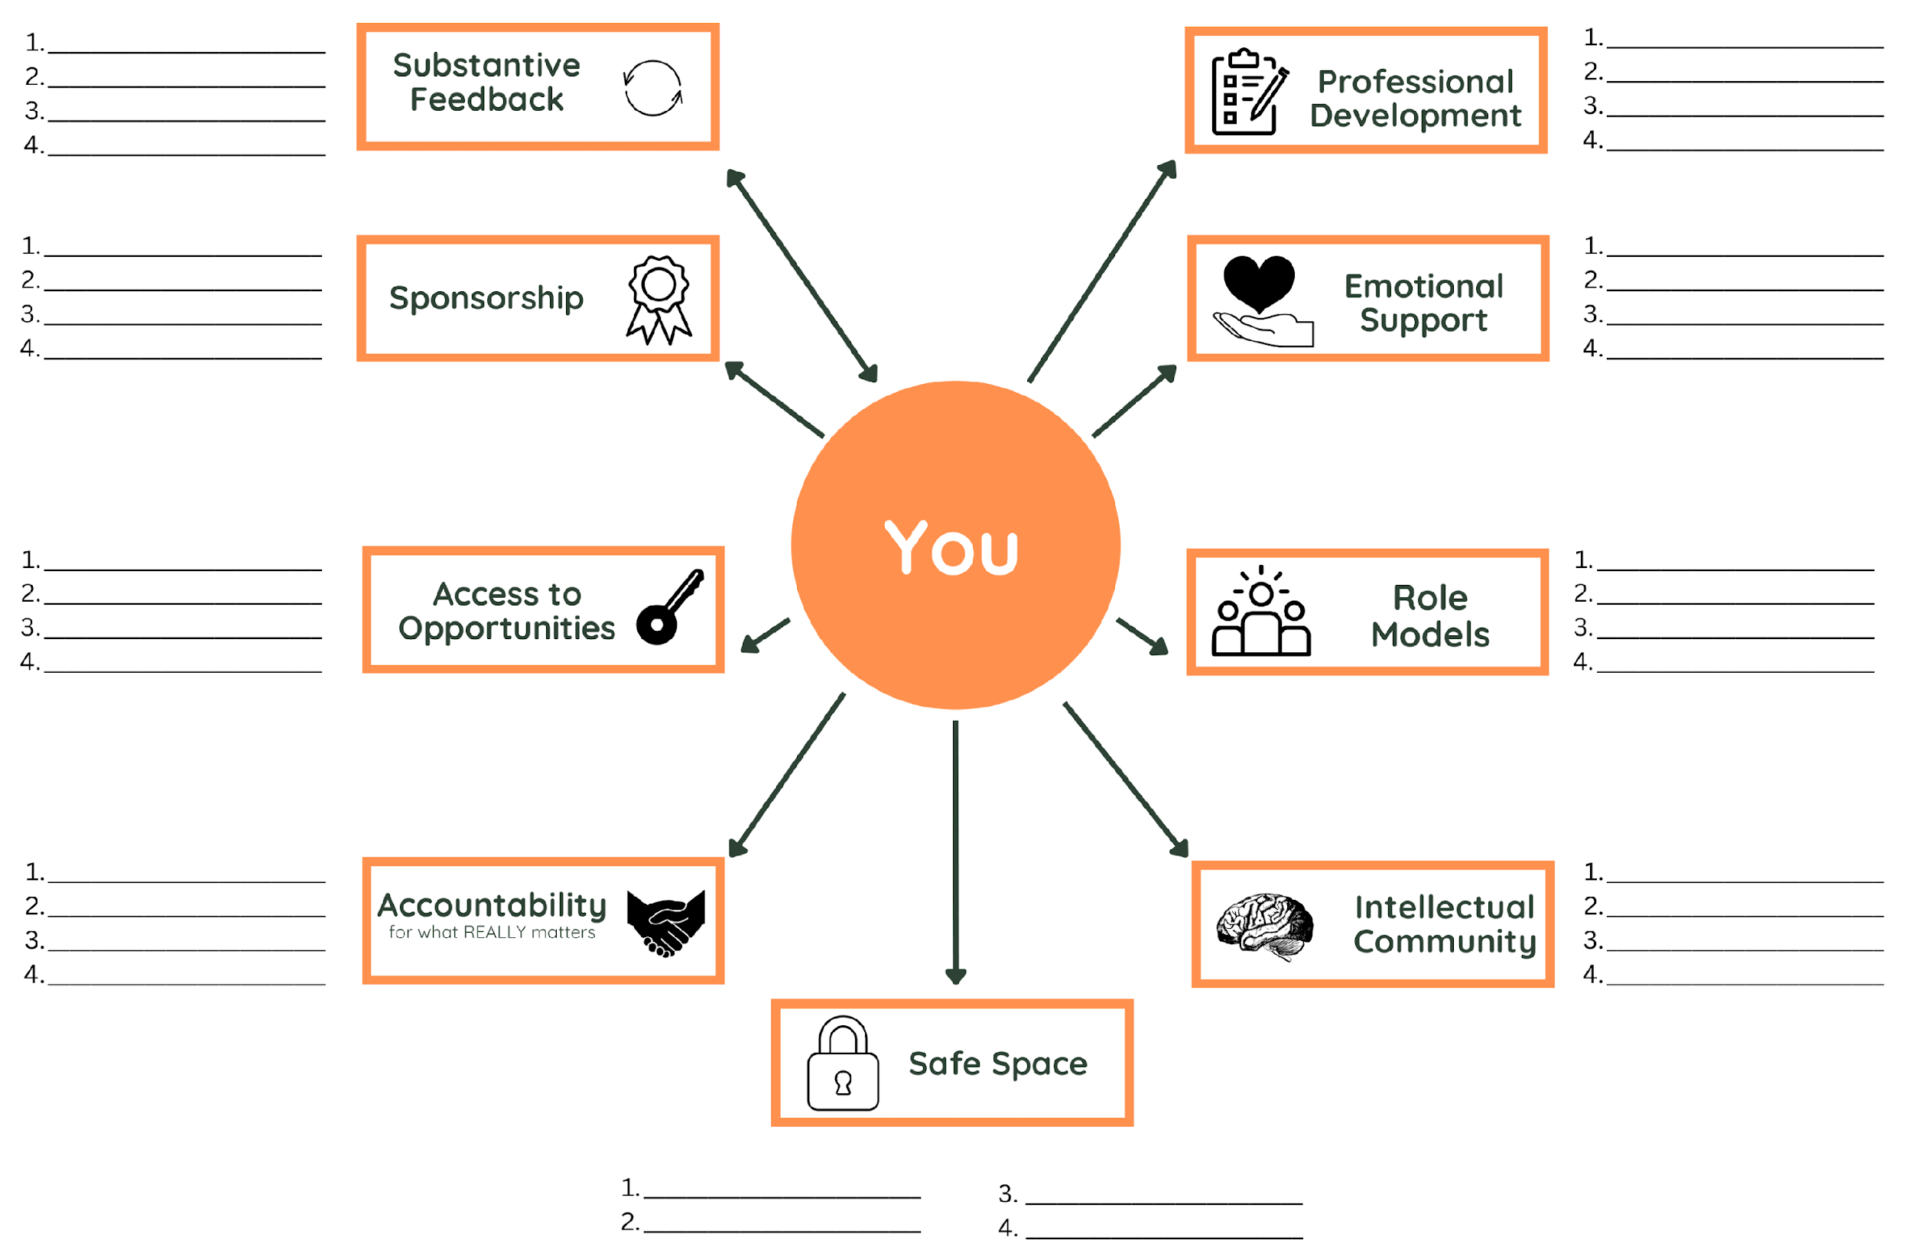

Someone that is willing to read your work — e.g., personal statements, scholarship essays, etc. — and give evaluative feedback.
Who and where you learn to do all of the things that you do not already know how to do professionally.
Someone to advocate for you (e.g., letter of recommendation writer).
These could be friends, family, and others that support you emotionally.
Someone with knowledge of professional opportunities — e.g., scholarships, summer research opportunities, internships, etc.
People that are doing academic or professional life in a way that you would like to achieve.
People that will ensure that you have accountability for your coursework, personal health, and wellness.
People that are doing academic or professional life in a way that you would like to achieve.
Place and person with whom you can speak your truth. It is confidential and they will not tell others what you said.
https://tinyurl.com/mentor-map
Notes:
Role model: People that are doing academic or professional life in a way that you would like to achieve.
Emotional support: These could be friends family and other.
Professional Development: Who and where you learn to do all of the things that you do not already know how to do professionally — e.g., how to build an effective resumé or CV.
Intellectual community: These could be subject matter experts that you can reach out to when you have specific questions. Regarding research, they can be folks that read your research paper that different stages of completion.
Safe Space: Place and person with whom you can speak your truth. It completely confidential, they will not judge you or tell others what you said.
Accountability: To ensure that you have accountability structures for your coursework, personal health and wellness.
Sponsorship: Someone to advocate for you (letter or recommendation writer)
Access to Opportunities: Someone with great knowledge about professional opportunities — e.g., scholarships, summer research opportunities, internships.
Substantive feedback: Someone that is willing to read your work — e.g., personal statements, scholarship essays, etc. — and give evaluative feedback.

Slide 7
Regroup & Share
Notes:
Let’s take a deep breath.
Like most people have blank spots. Many are surprised of how few people they have in their network or that they are overlying on a handful of people to meet a lot of needs.
Sometimes people feel sad that they don’t know many people.
It shows what actions you can take.
Identify where you have empty space or a cluster of empty spaces.
It’s okay if some spaces are blank. Most people have blank spaces when doing this exercise for the first time.
6-12 months to build capacity in your network.
These are people that are willing to take your call, answer an email, and answer specific questions.
They may not call themselves your mentor, but that doesn’t matter. You know what you need to move forward, and you have people in your network to help you get there.

Slide 8
Tips for acquiring new mentors
Access your network.
Identify your current needs.
Ask “how can I get my needs met?”
Alternatives to asking “will you be my mentor?”
Use a S.M.A.R.T ask:
Specific, measurable, attainable, realistic, and time-framed.
e.g., I would love to have a 20 minutes conversation with you about your recent internship.
Informal mentors are still mentors.
All that matters is that you know what you need to move forward, and you have people in your network to help you get there.
Notes:
They may not call themselves your mentor, but that doesn’t matter. You know what you need to move forward, and you have people in your network to help you get there.

Slide 9
🗝️ Key points
Mentorship can help us efficiency and effectively achieve our professional and academic goals.
Mentorship is best served with a network of individuals that are available to take your call, respond to your email or answer your specific questions.
Stay focused on what you need and how you can get it.
When constructing your network, strategically choose mentors based on people that have what you want.

