Slide 1
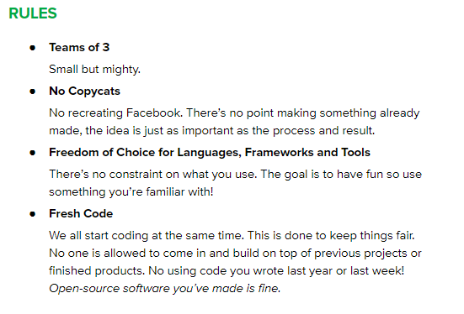

THIS IS A COMPLETELY ORIGINAL IDEA NEVER DONE BEFORE

Slide 2
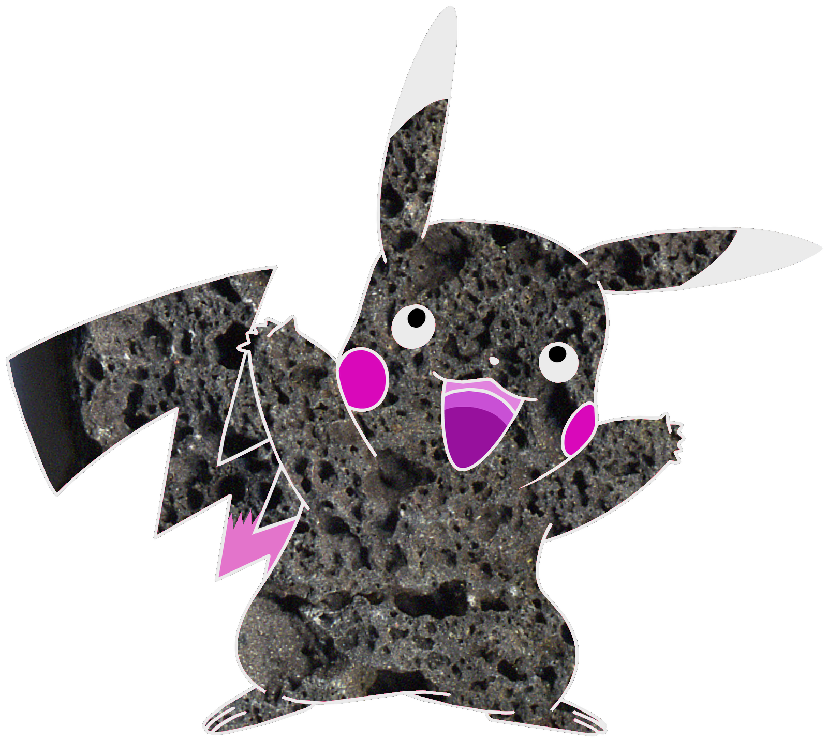
Introducing our mascot
Ignemouse
Clearly different from any existing character
Now time for a Demo!

Slide 3
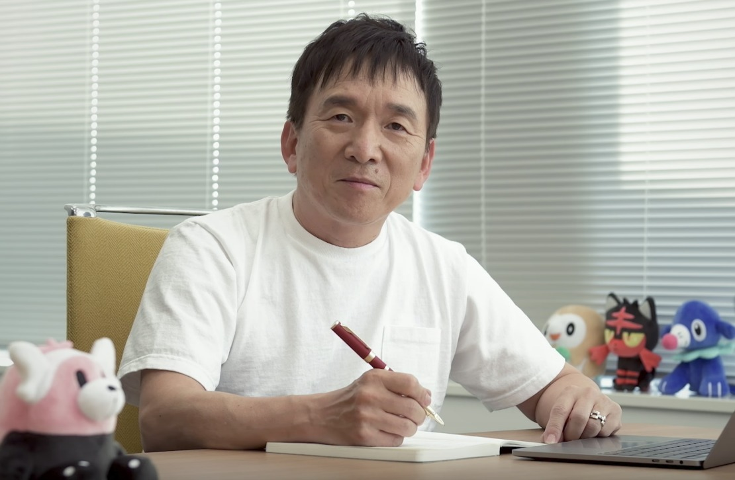
Game development is hard and takes money.
It is still a work in progress and we desperately need funds (£20 amazon voucher) to continue development.
In order to raise more funds we have implemented a Lootbox system.
Here is a demo of our loot box system.
Please don’t sue me Tsunekazu Ishihara, CEO of the Pokémon Company

Slide 4
THANK YOU FOR WATCHING

