Slide 1
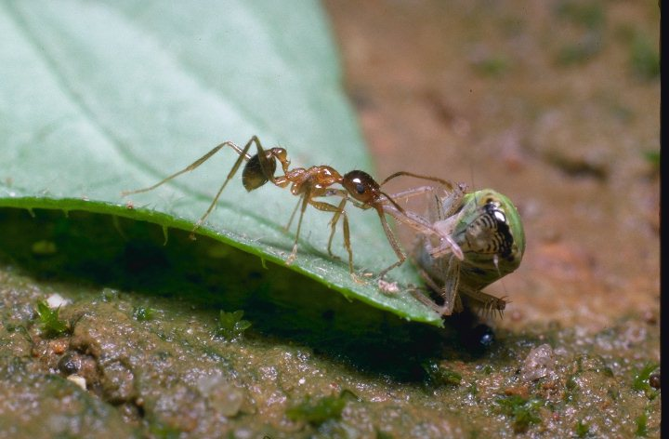
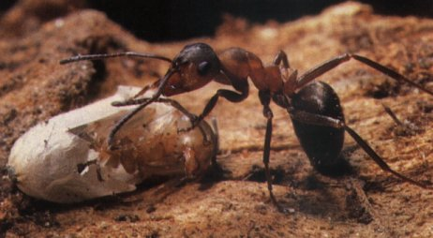
G5BAIM
Artificial Intelligence Methods
Graham Kendall
Genetic Algorithms

Slide 2
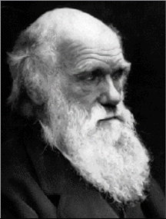
G5BAIM Genetic Algorithms
Charles Darwin 1809 - 1882
"A man who dares to waste an hour of life has not discovered the value of life"

Slide 3
Genetic Algorithms
Based on survival of the fittest
Developed extensively by John Holland in mid 70’s
Based on a population based approach
Can be run on parallel machines
Only the evaluation function has domain knowledge
Can be implemented as three modules; the evaluation module, the population module and the reproduction module.
Solutions (individuals) often coded as bit strings
Algorithm uses terms from genetics; population, chromosome and gene

Slide 4
GA Algorithm
Initialise a population of chromosomes
Evaluate each chromosome (individual) in the population
    Create new chromosomes by mating chromosomes in the current population (using crossover and mutation)
    Delete members of the existing population to make way for the new members
    Evaluate the new members and insert them into the population
Repeat stage 2 until some termination condition is reached (normally based on time or number of populations produced)
Return the best chromosome as the solution

Slide 5
GA Algorithm - Evaluation Module
Responsible for evaluating a chromosome
Only part of the GA that has any knowledge about the problem. The rest of the GA modules are simply operating on (typically) bit strings with no information about the problem
A different evaluation module is needed for each problem

Slide 6
GA Algorithm - Population Module
Responsible for maintaining the population
Initilisation
  Random
  Known Solutions

Slide 7
GA Algorithm - Population Module
Deletion
  Delete-All : Deletes all the members of the current population and replaces them with the same number of chromosomes that have just been created
  Steady-State : Deletes n old members and replaces them with n new members; n is a parameter
  But do you delete the worst individuals, pick them at random or delete the chromosomes that you used as parents?
  Steady-State-No-Duplicates : Same as steady-state but checks that no duplicate chromosomes are added to the population. This adds to the computational overhead but can mean that more of the search space is explored

Slide 8
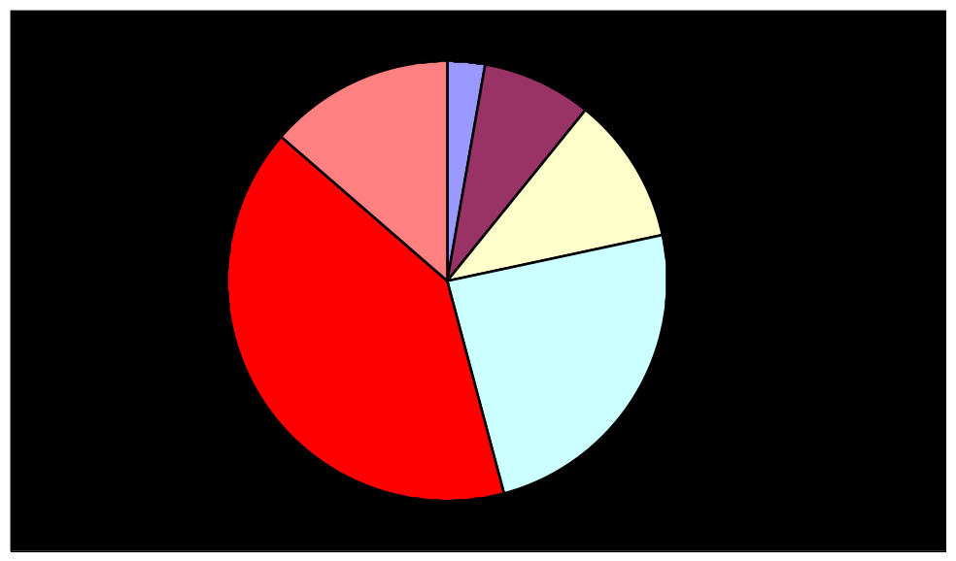
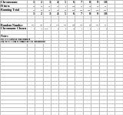
GA Parent Selection - Roulette Wheel
Sum the fitnesses of all the population members, TF
Generate a random number, m, between 0 and TF
Return the first population member whose fitness added to the preceding population members is greater than or equal to m
Roulette Wheel Selection

Slide 9
GA Parent Selection - Tournament
Select a pair of individuals at random. Generate a random number, R, between 0 and 1. If R < r use the first individual as a parent. If the R >= r then use the second individual as the parent. This is repeated to select the second parent. The value of r is a parameter to this method
Select two individuals at random. The individual with the highest evaluation becomes the parent. Repeat to find a second parent

Slide 10
GA Fitness Techniques
Fitness-Is-Evaluation : Simply have the fitness of the chromosome equal to its evaluation
Windowing : Takes the lowest evaluation and assigns each chromosome a fitness equal to the amount it exceeds this minimum.
Linear Normalization : The chromosomes are sorted by decreasing evaluation value. Then the chromosomes are assigned a fitness value that starts with a constant value and decreases linearly. The initial value and the decrement are parameters to the techniques

Slide 11
GA Population Module - Parameters
Population Size
Elitism

Slide 12
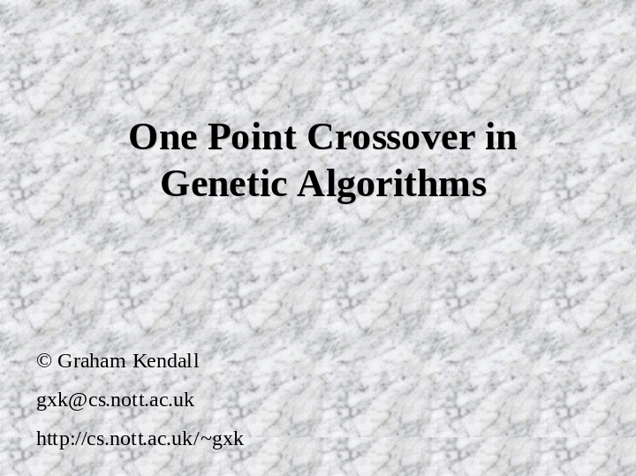
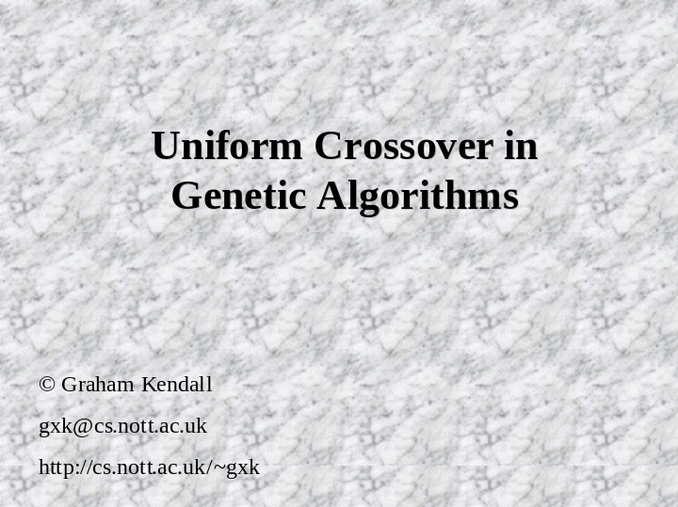
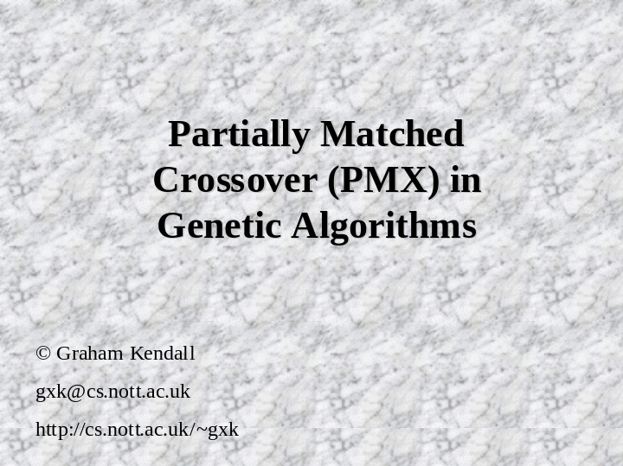
GA Reproduction - Crossover Operators
Order Based Crossover
Cycle Crossover

Slide 13
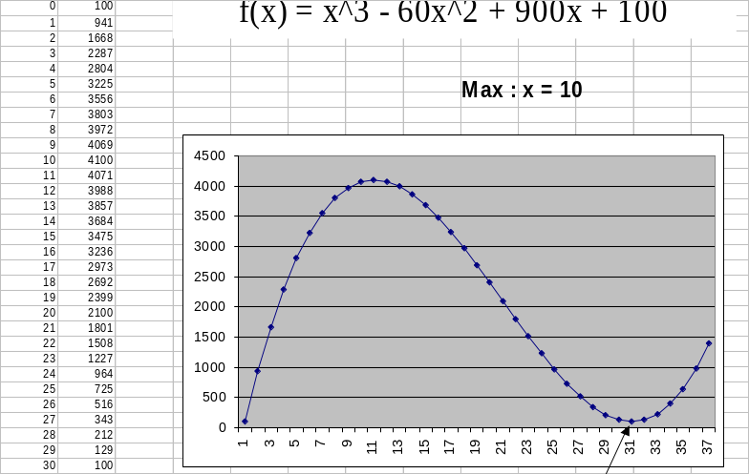
GA Example
Crossover probability, P_{C} = 1.0
Mutation probability, P_{M} = 0.0
Maximise f(x) = x³ - 60 * x² + 900 * x +100
0 <= x >= 31
x can be represented using five binary digits

Slide 14
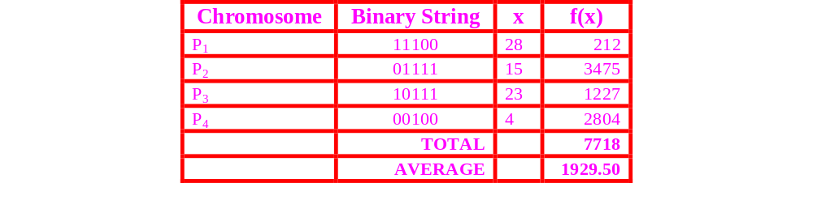
GA Example
Generate random individuals

Slide 15

GA Example
Choose Parents, using roulette wheel selection
Crossover point is chosen randomly

Slide 16
GA Example - Crossover
P₃
1
0
1
1
1
P₄
0
0
1
0
0
P₂
0
1
1
1
1
P₂
0
1
1
1
1
C₁
1
1
1
1
1
C₃
0
0
1
1
1
C₂
0
0
1
1
1
C₄
0
1
1
0
0

Slide 17
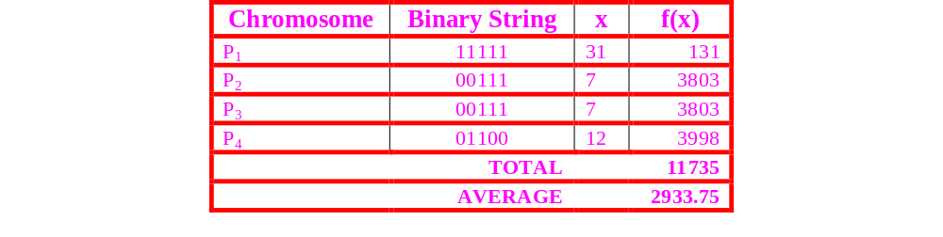
GA Example - After First Round of Breeding
The average evaluation has risen
P₂, was the strongest individual in the initial population. It was chosen both times but we have lost it from the current population
We have a value of x=7 in the population which is the closest value to 10 we have found

Slide 18
GA Example - Question?
Assume the initial population was 17, 21, 4 and 28. Using the same GA methods we used above (PC = 1.0, PM = 0.0), what chance is there of finding the global optimum?
The answer is in the handout - but try it first

Slide 19
GA Example - Mutation
A method of ensuring premature convergence does not occur
Usually set to a small value
Dynamic mutation and crossover rates

Slide 20
GA - Schema Theorem - Introduction
Developed by John Holland
Question : How likely is a schema to survive from one generation to the next?
Question : How many schema are likely to be present in the next generation?

Slide 21
GA - Schema Theorem - What is a Schema?
C₁
0
0
0
1
0
1
1
C₂
0
1
0
0
0
0
1
Schema
*
*
0
*
0
*
1
Another Schema
*
*
*
*
*
*
1

Slide 22
GA - Schema Theorem - Implicit Parallelism
If a chromosome is of length n then it contains 3^{n} schemata (as each position can have the value 0, 1 or *)
In theory, this means that for a population of M individuals we are evaluating up to M3^{n} schemata
But, bear in mind that some schemata will not be represented and others will overlap with other schemata
This is exactly what we want. We eventually want to create a population that is full of fitter schemata and we will have lost weaker schemata
It is the fact that we are manipulating M individuals but M3^{n} schemata that gives genetic algorithms what has been called implicit parallelism

Slide 23
GA - Schema Theorem - Definitions
Length : is defined as the distance between the start of the schema and the end of the schema minus one (Goldberg, 1989)
Order : is defined as the number of defined positions
Fitness Ratio : is defined as the ratio of the fitness of a schema to the average fitness of the population
Length = 6
Order = 3
*
*
0
*
0
*
1

Slide 24
GA - Schema Theorem - Intuition about length
The longer the length of the schema, the more chance there is of the schema being disrupted by a crossover operation
This implies that shorter schemata have a better chance of surviving from one generation to the next
In turn, this implies that if we know that certain attributes of a problem fit well together then these should be placed as close as possible together in the coding

Slide 25
GA - Schema Theorem - Intuition about order
This observation is also true for the order of the chromosome. If we are not worried about the number of defined positions (i.e. we allow as many ‘*’ as possible) then a crossover operation has less chance of disrupting good schemata
Intuitively, it would seem better to have short, low-order schema
This is only based on empirical evidence but it is widely believed that these assumptions are true and the following theory makes some sense of this

Slide 26
GA - Schema Theorem
Using a technique where we choose parents relative to their fitness (e.g. roulette wheel selection), fitter schema should find their way from one generation to another
Intuitively, if a schema is fitter than average then it should not only survive to the next generation but should also increase its presence in the population
If Φ is the number of instances of any particular schema S within the population at time t, then at t+1 we would expect
Φ(S, t +1) > Φ(S)
to hold for above average fitness schemata

Slide 27
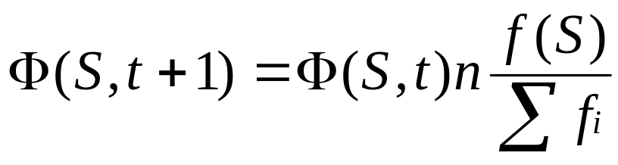
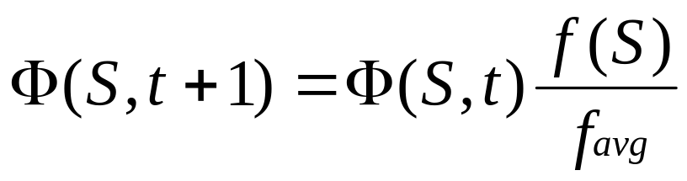
GA - Schema Theorem - Number of Schema
Going one stage further we can estimate the number of schema present at t +1
n is the size of the population
f(S) is the fitness of the schema
Σf_{i} is the fitness of the population
f_{avg} is the average fitness of the population

Slide 28
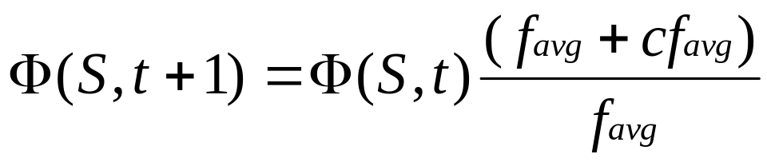
GA - Schema Theorem - Reproduction of Schema
If a particular schema stays a constant, c, above the average we can say even more about the effects of reproduction
= Φ(S, t)(1 + c)
Setting t=0
Φ(S, t) = Φ(S, t)(1 + c)^{t}
Notice that the number of schema rises exponentially

Slide 29
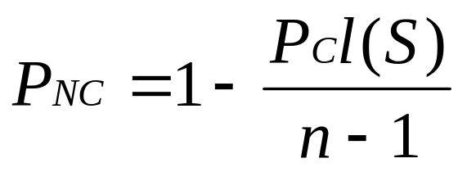
Probability of non-disruption through crossover
Given a schema, what is the probability of it not being disrupted by a crossover operation?
P_{C} is the probability of crossover,
l(s) is the length of the schema,
n is the length of the chromosome

Slide 30
Probability of non-disruption through crossover
0
1
1
1
0
0
1
0
0
1
1
l(s) = 4 and n = 11
Assume P_{C} = 1
The probability of the schema being disrupted by a crossover operation is 1- 1 x 4 / 10 = 0.6
We can easily confirm this by seeing that there are six crossover positions, of a possible ten (we assume we do not pick crossover points at the “outside”) that will not disrupt the schema

Slide 31
Probability of non-disruption through crossover
0
1
1
1
0
0
1
0
0
1
1
1
0
1
1
0
0
1
1
1
0
1
But what if we crossover this schema with one that is the same?

Slide 32
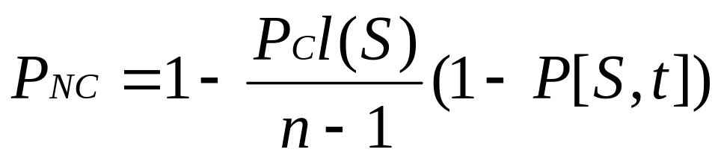
Probability of non-disruption through crossover
The probability that the schema in the other parent is an instance of a different schema is given by
(1-P[S,t])
where P[S, t] is the probability that the schema in the other parent is the same as the schema in the initial parent
We need to do is multiply our original definition of P_{NC} by the probability it is an instance of a different schema

Slide 33
Probability of non-disruption through crossover
0
1
1
1
0
0
1
0
0
1
1
P_{C} = 1
l(s) = 4
n = 11
P[S, t] = 1 (i.e. the other parent’s schema is the same as the initial parent – therefore we would expect the schema to appear in the next population)
= 1
P[S, t] = 0
= 0.6

Slide 34
Probability of non-disruption through mutation
0
1
1
*
*
0
1
0
0
1
1
As mutation can be applied to all the genes in a chromosome we do not need worry about the length of the chromosome, nor do we need worry about the length of the schema
We are concerned with the order
For example, a schema of length 4 but only of order 2. It is only the bits that are defined within the schema that are of concern to us. The “don’t care” (*’s) can be mutated without affecting the schema

Slide 35
Probability of non-disruption through mutation
0
1
1
*
*
0
1
0
0
1
1
The probability of a single bit within a schema surviving mutation is
1 - P_{M}
The probability of surviving mutation is
(1 - P_{M})^{K(S)}
which can be approximated to
1 - P_{M}^{K(S)} ≈ 1 – K(S)P_{M}

Slide 36
Probability of non-disruption through mutation
0
1
1
*
*
0
1
0
0
1
1
Assume P_{M} = 0.01 then the probability of the above schema surviving is
(1 - P_{M})^{K(S) =} (1 - 0.01)³ = 0.97
If the schema had a higher order, say K(S) = 100, then the probability of the schema surviving
(1 - P_{M})^{K(S) =} (1 - 0.01)¹⁰⁰ = 0.366
demonstrating that short schema have a better chance of surviving

Slide 37
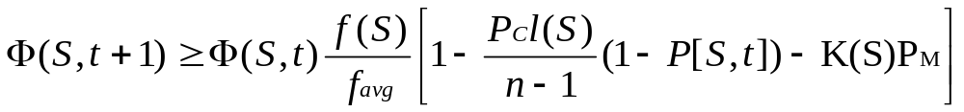
Schema Theory
Assume P_{M} = 0.01 then the probability of the above schema surviving is
Number of schema present at t
Probability of schema surviving mutation
Probability of schema surviving crossover

Slide 38
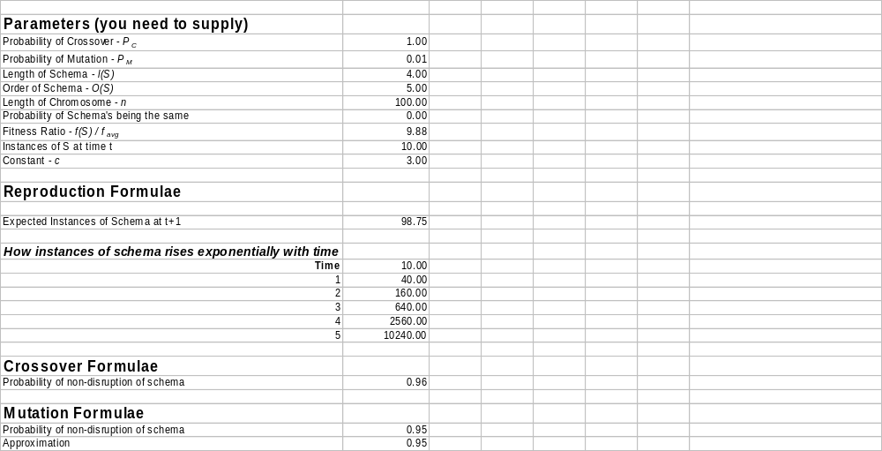
Schema Theory - Try it

Slide 39
Coding Schemes
When applying a GA to a problem one of the decisions we have to make is how to represent the problem
The classic approach is to use bit strings and there are still some people who argue that unless you use bit strings then you have moved away from a GA
Bit strings are useful as
  How do you represent and define a neighbourhood for real numbers?
  How do you cope with invalid solutions?
Bit strings seem like a good coding scheme if we can represent our problem using this notation

Slide 40
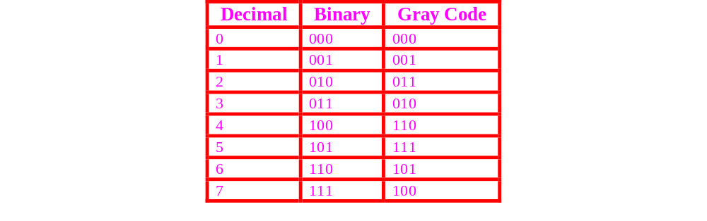
Coding Schemes
Gray codes have the property that adjacent integers only differ in one bit position. Take, for example, decimal 3. To move to decimal 4, using binary representation, we have to change all three bits. Using the gray code only one bit changes

Slide 41
Coding Schemes
Hollstien, 1971 investigated the use of GAs for optimizing functions of two variables and claimed that a Gray code representation worked slightly better than the binary representation
He attributed this difference to the adjacency property of Gray codes
In general, adjacent integers in the binary representaion often lie many bit flips apart (as shown with 3 and 4)
This fact makes it less likely that a mutation operator can effect small changes for a binary-coded chromosome

Slide 42
Coding Schemes
A Gray code representation seems to improve a mutation operator's chances of making incremental improvements. Why?
In a binary-coded string of length N, a single mutation in the most significant bit (MSB) alters the number by 2^{N-1}
In a Gray-coded string, fewer mutations lead to a change this large
1
1
0
0
1
1
= 51
2^{N-1} = 32
0
1
0
0
1
1
= 19

Slide 43
Coding Schemes
The use of Gray codes does pay a price for this feature. The "fewer mutations" which lead to large changes, lead to much larger changes
In the Gray code illustrated above, for example, a single mutation of the left-most bit changes a zero to a seven and vice-versa, while the largest change a single mutation can make to a corresponding binary-coded individual is always four
However most mutations will make only small changes, while the occasional mutation that effects a truly big change may allow exploration of a new area of the search space

Slide 44
Coding Schemes
The algorithm for converting between the Gray code described above (there are others) and the decimal binary representation is as follows
Label the bits of a binary-coded string B[i], where larger i's represent more significant bits
Label the corresponding Gray-coded string G[i]
Convert one to the other as follows
  Copy the most significant bit
  For each smaller i do G[i] = XOR(B[i+1], B[i]) (to convert binary to Gray)
  Or
  B[i] = XOR(B[i+1], G[i]) (to convert Gray to binary)

Slide 45
G5BAIM
Artificial Intelligence Methods
Graham Kendall
End of Genetic Algorithms

