Slide 1
Genetic Algorithms (GA)
The most widely known type of Evolutionary Algorithms
Chapter 3

Slide 2
GA Quick Overview
Developed: USA (Ann Arbor, Michigan) in the 1970’s
Early names: J. Holland (1962, 1975), K. DeJong, D. Goldberg
Typically applied to:
  discrete optimization
Attributed features:
  not too fast
  good heuristic for combinatorial problems
Special Features:
  Traditionally emphasizes combining information from good parents (crossover)
  many variants, e.g., representation forms (binary, integer, real-valued (floating point), permutation), reproduction models, operators
Notes:
A genetic algorithm can be considered an iterative search procedure / global optimization. ➔ not too fast
The algorithm processes a population of potential solutions (chromosomes) distributed over the entire search space.
John Holland (Teorema schemei - 1970)
1975 John Holland published Adaptation in Natural and Artificial Systems: An Introductory Analysis with Applications to Biology, Control, and Artificial Intelligence
• Considered by most to be the seminal work in the field
• Established formal, theoretical basis for evolutionary optimization with introduction of schemata (building blocks, partial solutions)
Keneth DeJong
1975 Kenneth De Jong’s thesis, under Holland, introduced a set of test functions with distinct properties, demonstrating the broad applicability of GAs
David Goldberg (1989 - Genetic algorithms in search, optimization, and machine learning. Addison-Wesley)
1983 - Computer-aided gas pipeline operation using genetic algorithms and rule learning, PhD thesis (under Holland), University of Michigan. Ann Arbor, MI.

Slide 3
GA Quick Overview (2)
  A genetic algorithm can be considered an iterative search procedure / global optimization. ➔ not too fast
  The algorithm processes a population of potential solutions (chromosomes) distributed over the entire search space.
John Holland (Schemata Theorem - 1970)
1975 J. Holland published Adaptation in Natural and Artificial Systems: An Introductory Analysis with Applications to Biology, Control, and Artificial Intelligence
• Considered by most to be the seminal work in the field
• Established formal, theoretical basis for evolutionary optimization with introduction of schemata (building blocks, partial solutions)
Keneth DeJong
1975 Kenneth De Jong’s thesis, under Holland, introduced a set of test functions with distinct properties, demonstrating the broad applicability of GAs
David Goldberg (1989 - Genetic algorithms in search, optimization, and machine learning. Addison-Wesley)
1983 - Computer-aided gas pipeline operation using genetic algorithms and rule learning, PhD thesis (under Holland), University of Michigan. Ann Arbor, MI.

Slide 4
GA Quick Overview (3)
First formulated by Holland for adaptive search and by his students for optimizations from mid 1960s to mid 1970s.
Binary strings have been used extensively as individuals (chromosomes).
Simulate Darwinian evolution.
Search operators are only applied to the genotypic representation (chromosome) of individuals.
Emphasize the role of recombination (crossover). Mutation is only used as a background operator.
Often use roulette-wheel (Monte Carlo) selection.

Slide 5
Genetic algorithms
Holland’s original GA is now known as the simple genetic algorithm (SGA)
Other GAs use different:
  Representations
  Mutations
  Crossovers
  Selection mechanisms

Slide 6
Genetic Algorithms (pseudocod I)
An Example of a Genetic Algorithm:
Procedure GA{
t = 0;
Initialize P(t);
Evaluate P(t);
While (Not Done)
{
Parents(t) = Select_Parents(P(t));
Offspring(t) = Procreate(Parents(t));
Evaluate(Offspring(t));
P(t+1)= Select_Survivors(P(t),Offspring(t));
t = t + 1;
}
Notes:
To solve a problem using a genetic algorithm is necessary to define a fitness function (F) to evaluate the performance of each chromosome.

Slide 7
Genetic Algorithms (pseudocod II)
P1: Choose a selection mechanism and a mechanism for scaling, if necessary.
P2: Set t = 0; and Initialize the population P(t).
P3: It evaluates the performance of each chromosome from P(t). It retains most powerful individual in the population P(t).
P4: Selection operator is applied n times (n – number of individuals). The selected chromosomes form an intermediate population P₁ (having also n members). In P₁, some chromosomes of P(t) can have more children (will appear more than once) and others have no copy.
P5: Apply crossover operator on the chromosomes of intermediate population P₁. The chromosomes obtained form a new population P₂. Deleted from the intermediate population P₁, the parents of chromosomes obtained by crossover. The remaining chromosomes from P₁ become members of the P₂ population.
P6: Apply mutation operator on the chromosomes of population P₂. The result is the new generation P(t+1).
P7: Set t = t + 1; If t≤N, where N is the maximum number of generation, then continues with step P3. Otherwise STOP.

Slide 8
SGA technical summary tableau
Representation | Binary strings
Recombination | N-point or uniform
Mutation | Bitwise bit-flipping with fixed probability
Parent selection | Fitness-Proportionate
Survivor selection | All children replace parents
Speciality | Emphasis on crossover

Slide 9
Representation
Representation - The most critical decision in any application, namely that of deciding how best to represent a candidate solution of the algorithm.
Phenotype space
Genotype space = {0,1}^{L}
Encoding
(representation)
10010001
10010010
010001001
011101001
Decoding
(inverse representation)
Notes:
Representation - The most critical decision in any application, namely that of deciding how best to represent a candidate solution of the algorithm.

Slide 10
SGA reproduction cycle
Select parents for the mating pool
(size of mating pool = population size)
Shuffle the mating pool
For each consecutive pair apply crossover with probability p_{c} , otherwise copy parents
For each offspring apply mutation (bit-flip with probability p_{m} independently for each bit)
Replace the whole population with the resulting offspring

Slide 11
SGA operators: recombination / crossover
One-point crossover
k-point crossover (k > 1), uniform vs. non-uniform
Uniform crossover
Crossover rate: The probability of applying crossover.
Notes:
In most recombination operators, two individuals are randomly selected and are recombined with a probability pc, called the crossover probability. That is, a uniform random number, r, is generated and if r ≤ pc, the two randomly selected individuals undergo recombination. Otherwise, that is, if r > pc, the two offspring are simply copies of their parents. The value of pc can either be set experimentally, or can be set based on schema-theorem principles (Goldberg, 1989b, 2002; Goldberg and Sastry, 2001).

Slide 12
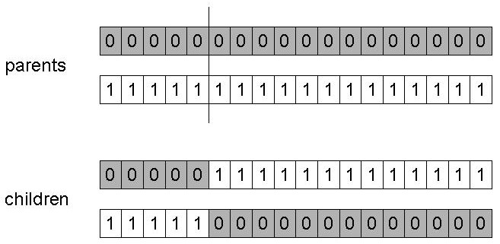
SGA operators: 1-point crossover
Choose a random point on the two parents
Split parents at this crossover point
Create children by exchanging tails
P_{c} typically in range (0.6, 0.9)

Slide 13
SGA operators: mutation (1)
Bit-flipping
Random bit assignment
Multiple bit mutations
Each gene of chromosomes in the population may suffer a mutation. In a chromosome there may be several positions undergoing mutation.
Mutation rate:
Note the difference between per bit (gene) and per chromosome (individual) mutation rates.

Slide 14
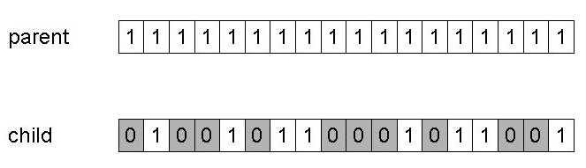
SGA operators: mutation (2)
Alter each gene independently with a probability p_{m}
p_{m} is called the mutation rate
  Typically between 1/pop_size and 1/ chromosome_length
  Order aprox. 10⁻³

Slide 15
Search Bias
When a search operator is used, some offspring tend to be more likely to be generated than others. We called such a tendancy as bias.
Crossover bias, e.g., 1-point crossover vs. uniform crossover
    For crossover operators which exchange contiguous sections of the chromosomes (e.g. k-point) the ordering of the variables may become important. This is particularly true when good solutions contain building blocks which might be disrupted by a non-respectful crossover operator.
Mutation bias, e.g., flipping 1 bit vs. flipping k bits
Notes:
Bias - tendinta, inclinare, directionare partinitoare

Slide 16
SGA operators: Selection
Main idea: better individuals get higher chance
  Chances proportional to fitness
  Implementation: roulette wheel technique
        Assign to each individual a part of the roulette wheel
        Spin the wheel n times to select n individuals
1/6 = 17%
B
fitness(A) = 3
A
C
fitness(B) = 1
3/6 = 50%
2/6 = 33%
fitness(C) = 2

Slide 17
Genetic Algorithms:
Proportionate Selection
In Proportionate Selection, individuals are assigned a probability of being selected based on their fitness:
  p_{i} = f_{i} / Σf_{j}
  Where p_{i} is the probability that individual i will be selected,
  f_{i} is the fitness of individual i, and
  Σf_{j} represents the sum of all the fitnesses of the individuals with the population.
This type of selection is similar to using a roulette wheel where the fitness of an individual is represented as proportionate slice of wheel. The wheel is then spun and the slice underneath the wheel when it stops determine which individual becomes a parent.

Slide 18
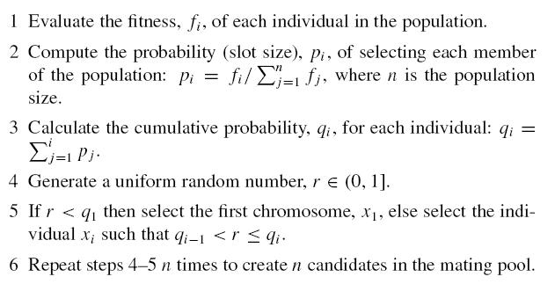
Genetic Algorithms:
Roulette wheel selection scheme

Slide 19
Genetic Algorithms:
Proportionate Selection
There are a number of disadvantages associated with using proportionate selection:
  Cannot be used on minimization problems,
  Domination of Super Individuals in early generations and slow convergence in later generations.
  Loss of selection pressure (search direction) as population converges.
Fitness scaling (linear, exponential, etc) has often been used in early days to combat the two problems.
Notes:
Dacă populația este foarte neomogenă și există un individ a cărui performanță este mult superioară mediei, acest individ va fi selectat de mai multe ori și astfel el va constitui aproape exclusiv populația următoare. În felul acesta, diversitatea populației se pierde și procesul de căutare nu mai explorează și alte regiuni ale spațiului, conducând la convergența prematură a procedurii de căutare.
Dacă există diferențe mici între performanțele indivizilor unei populații, atunci probabilitățile de selecție devin aproximativ egale. Rezultă că nu va mai avea loc o selecție veritabilă (selecția stagnează). Selecția obținută se va comporta mai degrabă ca o alegere pur aleatoare.
De evitat: dominanța unui individ performant și selecția cvasi-aleatoare.
Schimbarea de scală poate fi una statică (aceeași pentru toate generațiile) sau una dinamică (în care caz, scalarea funcției criteriu este repusă în discuție cu fiecare nouă generație).

Slide 20

Genetic Algorithms: Fitness Scaling (I)
Simple scaling:
The ith individual’s fitness is defined as:
f_{scaled}(t) = f_{original}(t) - f_{worst}(t),
  where t is the generation number and f_{worst}(t) the fitness of the worst individual so far.
  Sigma scaling:
The ith individual’s fitness is defined as:
where c is a constant, e.g., 2, f(¯t) is the average fitness in the current population, and σ_{f} (t) is the standard deviation of the fitness in the current population.
Notes:
Dacă populația este foarte neomogenă și există un individ a cărui performanță este mult superioară mediei, acest individ va fi selectat de mai multe ori și astfel el va constitui aproape exclusiv populația următoare. În felul acesta, diversitatea populației se pierde și procesul de căutare nu mai explorează și alte regiuni ale spațiului, conducând la convergența prematură a procedurii de căutare.
Dacă există diferențe mici între performanțele indivizilor unei populații, atunci probabilitățile de selecție devin aproximativ egale. Rezultă că nu va mai avea loc o selecție veritabilă (selecția stagnează). Selecția obținută se va comporta mai degrabă ca o alegere pur aleatoare.
De evitat: dominanța unui individ performant și selecția cvasi-aleatoare.
Schimbarea de scală poate fi una statică (aceeași pentru toate generațiile) sau una dinamică (în care caz, scalarea funcției criteriu este repusă în discuție cu fiecare nouă generație).
M(X)=(x₁+ x_{2,}+…+x_{n} )/n - media
σ² = M(X-M(X))²=Σ(x_{k} - M(X))²/n - square of standard deviation (also called variance)

Slide 21
Genetic Algorithms: Fitness Scaling (II)
Power scaling:
  The ith individual’s fitness is defined as:
f_{scaled}(t) = (f_{original}(t))^{k},
  where k > 0.
  Exponential scaling:
  The ith individual’s fitness is defined as:
f_{scaled}(t) = exp(f_{original}(t)/T )
where T > 0 is the temperature, approaching zero.
Notes:
Dacă populația este foarte neomogenă și există un individ a cărui performanță este mult superioară mediei, acest individ va fi selectat de mai multe ori și astfel el va constitui aproape exclusiv populația următoare. În felul acesta, diversitatea populației se pierde și procesul de căutare nu mai explorează și alte regiuni ale spațiului, conducând la convergența prematură a procedurii de căutare.
Dacă există diferențe mici între performanțele indivizilor unei populații, atunci probabilitățile de selecție devin aproximativ egale. Rezultă că nu va mai avea loc o selecție veritabilă (selecția stagnează). Selecția obținută se va comporta mai degrabă ca o alegere pur aleatoare.
De evitat: dominanța unui individ performant și selecția cvasi-aleatoare.
Schimbarea de scală poate fi una statică (aceeași pentru toate generațiile) sau una dinamică (în care caz, scalarea funcției criteriu este repusă în discuție cu fiecare nouă generație).

Slide 22
An example after Goldberg ‘89 (1)
Simple problem: max x² over {0,1,…,31}
GA approach:
  Representation: binary code, e.g. 01101 ↔ 13
  Population size: 4
  1-point xover, bitwise mutation
  Roulette wheel selection
  Random initialisation
We show one generational cycle done by hand
Notes:
Let’s use the simple EA to maximise the function f(x) = x² with x
in the integer interval [0; 31], i.e., x = 0; 1; … ; 30; 31.
The first step of EA applications is encoding (i.e., the representation of chromosomes). We adopt binary representation for integers. Five bits are used to represent integers up to 31.
Assume that the population size is n=4.

Slide 23
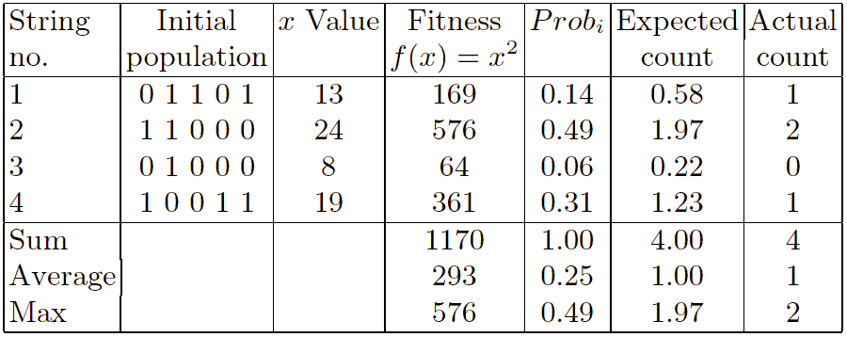

x² example: selection
Notes:
Generate initial population at random, e.g., 01101, 11000, 01000, 10011. These are chromosomes or genotypes.
Calculate fitness value for each individual.
(a) Decode the individual into an integer (called phenotypes),
01101 →13; 11000 →24; 01000 → 8; 10011 → 19;
(b) Evaluate the fitness according to f(x) = x²,
13 →169; 24 →576; 8 → 64; 19 → 361;
Select two individuals for crossover based on their fitness. If roulette-wheel selection is used, then: p_{i} = f_{i} / Σf_{j}
p₁(13) = 169/1170 = 0.14 p₂(24) = 576/1170 = 0.49
p₃(8) = 64 / 1170 = 0.06 p₄(19) = 361/1170 = 0.31
Deoarece operatorul de selecție se aplică de n ori, valoarea medie a numărului descendenților individului i este n_{i}=n*p_{i} (Expected count). Schema de selecție (Roulette Wheel) permite ca un cromozom să fie selectat de mai multe ori. Astfel, cei mai performanți cromozomi pot avea mai multe copii în populația intermediară deci mai mulți descendenți.

Slide 24
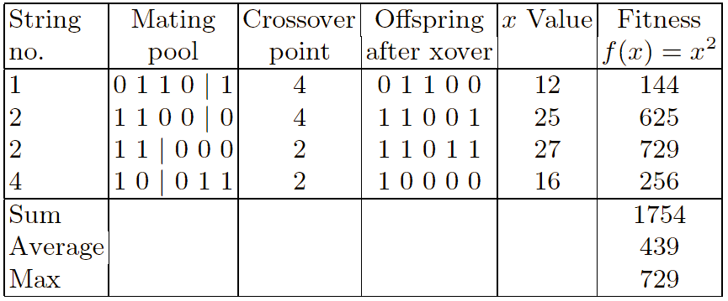
X² example: crossover
Notes:
Assume we have crossover(01101; 11000) and crossover(10011; 11000). We may obtain offspring 0110 0 and 1100 1 from crossover(01101; 11000) by choosing a random crossover point at 4, and obtain 10 000 and 11 011 from crossover(10011; 11000) by choosing a random crossover point at 2. Now the intermediate population is
01100; 11001; 10000; 11011

Slide 25
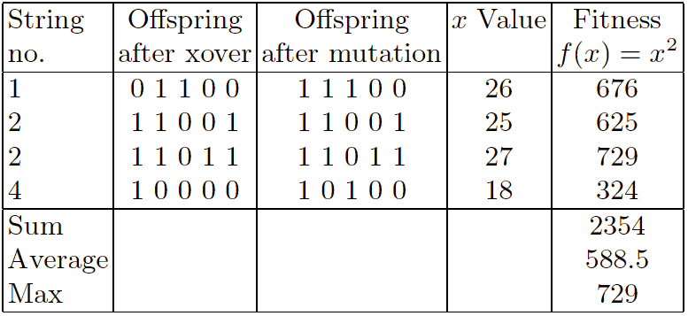
X² example: mutation
Notes:
Apply mutation to individuals in the intermediate population with a small probability. A simple mutation is bit-flipping. For example, we may have the following new population P(1) after random mutation:
11100; 11001; 11011; 10100
Goto Step 2 if not stop.

Slide 26
The simple GA
Has been subject of many (early) studies
  still often used as benchmark for novel GAs
Shows many shortcomings, e.g.
  Representation is too restrictive
  Mutation & crossovers only applicable for bit-string & integer representations
  Selection mechanism sensitive for converging populations with close fitness values
  Generational population model (step 5 in SGA repr. cycle) can be improved with explicit survivor selection

Slide 27
Alternative Crossover Operators
Performance with 1 Point Crossover depends on the order that variables occur in the representation
  more likely to keep together genes that are near each other
  Can never keep together genes from opposite ends of string
  This is known as Positional Bias
  Can be exploited if we know about the structure of our problem, but this is not usually the case
Disadvantage: using a 1-point crossover some combinations of genes cannot be obtained.
Let consider the following example: we have two performing scheme – S1 = (0 1 * * * * * * * 1 1)
– S2 = (* * * 1 0 1 * * * * * ). Combining the two chromosomes that represent these schemes will never lead to the scheme – S3 = (0 1 * 1 0 1 * * * 1 1).
Notes:
Holland's schema theorem is widely taken to be the foundation for explanations of the power of genetic algorithms. It was proposed by John Holland in the 1970s.
A schema is a template that identifies a subset of strings with similarities at certain string positions.

Slide 28
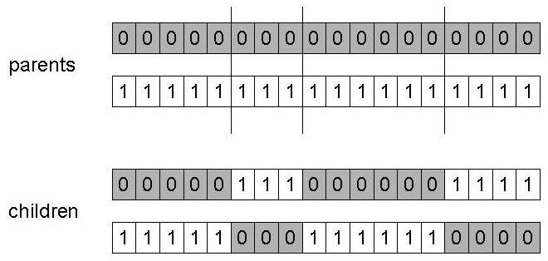
n-point crossover
Choose n random crossover points
Split along those points
Glue parts, alternating between parents
Generalisation of 1 point (still some positional bias)

Slide 29
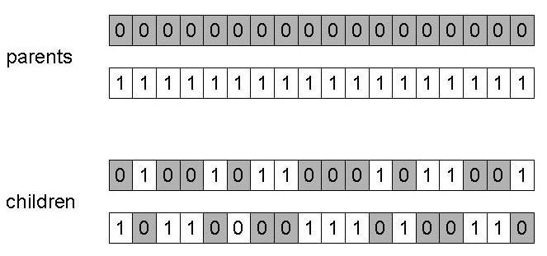
Uniform crossover
Do not use cut points
Assign 'heads' to one parent, 'tails' to the other
Flip a coin for each gene of the first child
Make an inverse copy of the gene for the second child
Inheritance is independent of position
For each gene of a descendant, a global parameter indicates the probability that this gene come from the first (or second) parent.
Notes:
Pentru fiecare gena a unui descendent, un parametru global va indica probabilitatea ca aceasta gena sa provina din primul (sau al doilea) parinte.

Slide 30
Hux (half uniform crossover )
In this operator, bits are randomly and independently exchanged, but exactly half of the bits that differ between parents are swapped.
The HUX operator ensures that the offspring are equidistant between the two parents. This serves as a diversity preserving mechanism.
The two parent individuals are combined to produce two new offspring. Exactly half of the non-matching bits in the parent individuals are swapped. This gives the number of differing bits which is divided by two. The resulting number is how many of the bits that do not match between the two parents are swapped.

Slide 31
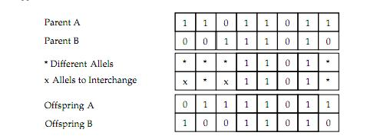
Example

Slide 32
Alternative Mutation Operators
Through mutation are introduced in the population individuals which could not be generated by other mechanisms.
  Strong Mutation
  Weak Mutation
  Single chromosome (individual) mutation
  Not uniform mutation
  Adaptive not-uniform mutation

Slide 33
Strong Mutation
In the strong form of the operator, the position selected for mutation is automatically changed.
Algorithm:
  P1: For each chromosome of the current population and for each position of the chromosome is performed:
  P1.1. It generates a random number q in the interval [0,1].
  P1.2. If q < p_{m} then perform mutation of that position, changing 0 to 1 and 1 to 0. Otherwise (if q ≥ p_{m} ), the position remains unchanged.

Slide 34
Weak Mutation
In the weak form of the operator, the position selected for mutation is NOT automatically changed.
New value of the position which meets the condition of mutation, is generated randomly.
Algorithm:
  P1: For each chromosome of the current population and for each position of the chromosome is performed:
  P1.1. It generates a random number q in the interval [0,1].
  P1.2’. If q < p_{m} then randomly choose one of the values ​​0 or 1. Current position is assigned as the value selected. Otherwise (if q ≥ p_{m} ), the position remains unchanged.

Slide 35
Single chromosome (individual) Mutation
In this version, each application of the operator affects a gene (or possibly more) of a chromosome (which was selected for mutation).
You can use both the weak and the strong version of the mutation operator.

Slide 36
Not uniform mutation
It can be considered a mutation probability which depends on the generation (not uniform).
  In the first generation the probability of mutation is high and decreases with the index t of her generation.
  In this way ensure big changes (quick progress) in the early stages of search.
  Decrease the probability of mutation in the advanced stages of search generates small changes, which ensure a more efficient local search.
p_{m}(t) = p_{m} * e^{(1-t)β}
where p_{m} is the mutation probability at first generation, β≥1 (real parameter); t  (as quick increases) ➔ p_{m}(t)  (as quick decreases)

Slide 37
Adaptive not-uniform mutation
The mutation probability depends on the position (gene rank) in chromosome and generation (t).
  In the first generations perform a global search
  In the last part of the process it performs a local search
  As the generation index (t) increases the probability of mutation of the first genes from chromosome to decrease, and of the last genes to grow.
Example:
  Let’s consider the search space being ℜ. The chromosomes binary encode the real values. If a gene is positioned at the beginning of a chromosome, then its mutation it causes a significant change of the chromosome. Elements of search space corresponding to the two chromosomes (at the beginning and that containing gene changed) will be very different.
  If mutation occurs at the end of the chromosome will result in a much smaller change.

Slide 38
Crossover OR mutation?
Decade long debate: which one is better / necessary / main-background
Answer (at least, rather wide agreement):
  it depends on the problem, but
  in general, it is good to have both
  both have another role
  mutation-only-EA is possible, xover-only-EA would not work
Achieving a balance between information exploitation and by the state-space exploration to obtain new better solutions, is typical of all powerful optimization methods.
If the solutions obtained are exploited too much, then reaches a premature convergence.
On the other hand, if too much emphasis on exploration, it is possible that the information already obtained is not used properly. Search time grows and approaches that of random search methods.
Notes:
Obtinerea unui echilibru intre exploatarea informatiei obtiunute pana la momentul curent si explorarea spatiului starilor pentru a obtine solutii noi, mai bune, este specifica tuturor metodelor puternice de optimizare.
Daca solutiile obtinute sunt exploatate prea mult, atunci se atinge o convergenta prematura.
Pe de alta parte, daca accentul cade prea puternic pe explorare, este posibil ca informatia deja obtinuta sa nu fie utilizata in mod corespunzator. ➔ Tcautare creste si se aproipe de cel al metodelor de cautare aleatoare.

Slide 39
Crossover OR mutation? (cont’d)
Exploration: Discovering promising areas in the search space, i.e. gaining information on the problem
Exploitation: Optimising within a promising area, i.e. using information
There is co-operation AND competition between them
Crossover is explorative, it makes a big jump to an area somewhere “in between” two (parent) areas
Mutation is exploitative, it creates random small diversions, thereby staying near (in the area of ) the parent

Slide 40
Crossover OR mutation? (cont’d)
Only crossover can combine information from two parents
Only mutation can introduce new information (alleles)
Crossover does not change the allele frequencies of the population (thought experiment: 50% 0’s on first bit in the population, ?% after performing n crossovers)
To hit the optimum you often need a ‘lucky’ mutation

Slide 41
Other representations
Gray coding of integers (still binary chromosomes)
  Gray coding is a mapping that means that small changes in the genotype cause small changes in the phenotype (unlike binary coding). “Smoother” genotype-phenotype mapping makes life easier for the GA
Nowadays it is generally accepted that it is better to encode numerical variables directly as
Integers
Floating point variables

Slide 42
Integer representations
Some problems naturally have integer variables, e.g. image processing parameters
Others take categorical values from a fixed set e.g. {blue, green, yellow, pink}
N-point / uniform crossover operators work
Extend bit-flipping mutation to make
  “creep” i.e. more likely to move to similar value
  Random choice (esp. categorical variables)
  For ordinal problems, it is hard to know correct range for creep, so often use two mutation operators in tandem

Slide 43
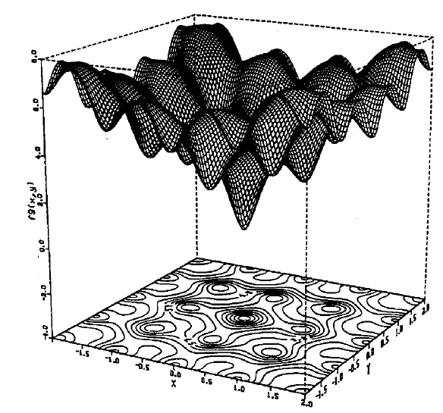
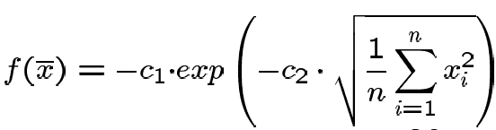

Real valued problems
Many problems occur as real valued problems, e.g. continuous parameter optimisation f : ℜ ^{n} → ℜ
Illustration: Ackley’s function (often used in EC)

Slide 44
Using a GA for Neural Network training in order to increase prediction accuracy (PA)
S-a stabilit o populaţie de cromozomi suficient de largă (50) pentru a asigura variabilitatea populaţiei
Fiecare cromozom conţine un număr de gene, acestea reprezentând de fapt o pondere din cadrul reţelei neurale. Genele aparţinând populaţiei iniţiale de cromozomi sunt iniţializate cu valori aleatoare în intervalul [-1,1].
Algoritmul genetic se desfăşoară după scenariul descris în partea teoretică a lucrării:
  pentru un număr de generaţii stabilit se repetă paşii următori (aprox. 40)
  sunt evaluaţi toţi cromozomii (fitness = PA – prediction accuracy)
  este aplicat operatorul de încrucişare (Crossover)
  este aplicat operatorul de mutaţie (Mutation)
  cel mai performant cromozom din generaţia finală va conţine prin genele sale ponderile reţelei antrenate static

Slide 45
GA for Neural Network training – software implementation
Clasa CGeneticLearn - conţine întregul mecanism pentru antrenarea unei reţele neurale folosind un algoritm genetic. Este nevoie de o populaţie de 50 de cromozomi, fiecare cromozom conţinând un număr de gene. Aceste informaţii sunt stocate în vectorul bidimensional gene. De asemenea, au fost implementate funcţii pentru fiecare operaţie specifică algoritmilor genetici:
  pentru evaluarea cromozomilor funcţia calcEvals(). În cadrul acestei funcţii genele corespunzătoare fiecărui cromozom sunt introduse ca ponderi într-o reţea neurală în vedere predicţionării salturilor dintr-un trace. Rezultatul, acurateţea predicţiei, va constitui evaluarea cromozomului respectiv. Valorile obţinute în urma evaluărilor vor fi stocate în vectorul Eval (pentru supravietuirea elitista).
  pentru încrucişarea a doi cromozomi funcţia Reproduce(), pentru încrucişarea tuturor cromozomilor funcţia Cross() şi Mutate() pentru efectuarea de mutaţii.
  În final este implementată şi funcţia Run() în care pentru un număr de generaţii, stabilit de utilizator, sunt calculate evaluările cromozomilor (calcEvals()), cromozomii sunt încrucişaţi (Cross()), şi apoi li se aplică operatorul genetic de mutaţie (Mutate()). Înainte de a se încheia funcţia Run() este selectat cromozomul cel mai bun şi genele sale aplicate în locul ponderilor reţelei neurale (m_nntw→SetPonds(gene[index])).

Slide 46
GA for Neural Network training – software implementation (class)
#define NR_CRO 50
class CGeneticLearn : public CLearningAlg {
private:
...
long unsigned HRG;
long unsigned HRLTable[1024];
int nrno_l1; int nrno_l2; // number of neurons on Level 1 and Level 2
int nrp_l1; int nrp_l2; // number of wights on Level 1 and Level 2
double gene[NR_CRO][500];
int nrGen;
void Simulate(CString file);
void Reproduce(int i1,int i2,int j1, int j2);
void Cross();
void Mutate();
void calcEvals();
void Init();
public:
CString str;
CGeneticLearn(CNetw* m_nntw,CProjView* view,CString file,bool* done);
virtual ~CGeneticLearn();
void Run();
};

Slide 47
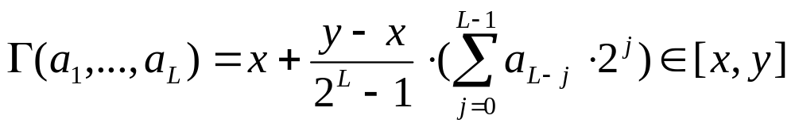
Mapping real values on bit strings
z ∈ [x,y] ⊆ ℜ represented by {a₁,…,a_{L}} ∈ {0,1}^{L}
[x,y] → {0,1}^{L} must be invertible (one phenotype per genotype)
Γ: {0,1}^{L} → [x,y] defines the representation
Only 2^{L} values out of infinite are represented
L determines possible maximum precision of solution
High precision → long chromosomes (slow evolution)

Slide 48
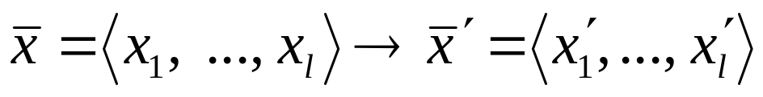
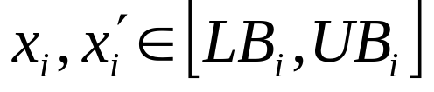
Floating point mutations 1
General scheme of floating point mutations
Uniform mutation:
A mutation operator that replaces the value of the chosen gene with a uniform random value selected between the user-specified upper and lower bounds for that gene. This mutation operator can only be used for integer and float genes.
Analogous to bit-flipping (binary) or random resetting (integers)

Slide 49
Floating point mutations 2
Non-uniform mutations:
  Many methods proposed,such as time-varying range of change etc.
  Most schemes are probabilistic but usually only make a small change to value
  Most common method is to add random deviate to each variable separately, taken from N(0, σ) Gaussian distribution and then curtail to range
  Standard deviation σ controls amount of change (2/3 of deviations will lie in range (- σ to + σ)

Slide 50
Crossover operators for real valued GAs
Discrete:
  each allele value in offspring z comes from one of its parents (x,y) with equal probability: z_{i} = x_{i} or y_{i}
  Could use n-point or uniform
Intermediate (or convex)
  exploits idea of creating children “between” parents (hence a.k.a. arithmetic recombination)
  z_{i} = α x_{i} + (1 - α) y_{i} where α : 0 ≤ α ≤ 1.
  The parameter α can be:
    constant: uniform arithmetical crossover
    variable (e.g. depend on the age of the population)
    picked at random every time

Slide 51
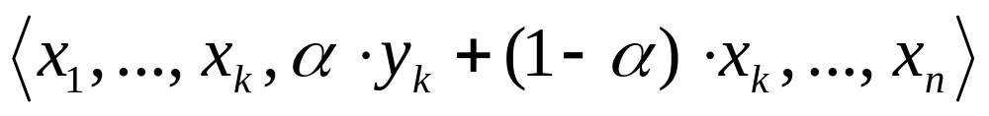
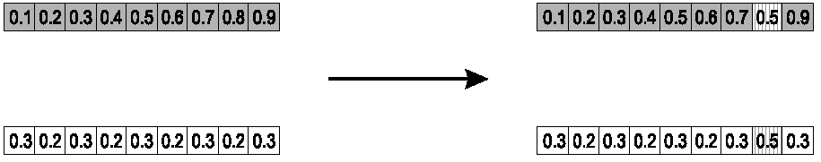
Single arithmetic crossover
Parents: ⟨x₁,…,x_{n} ⟩ and ⟨y₁,…,y_{n}⟩
Pick a single gene (k) at random,
child₁ is:
reverse for other child. e.g. with α = 0.5

Slide 52
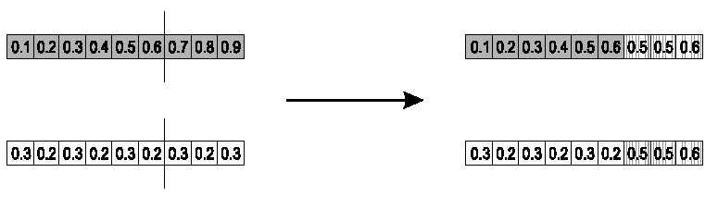
Simple arithmetic crossover
Parents: ⟨x₁,…,x_{n} ⟩ and ⟨y₁,…,y_{n}⟩
Pick random gene (k) after this point mix values
child₁ is:
reverse for other child. e.g. with α = 0.5

Slide 53
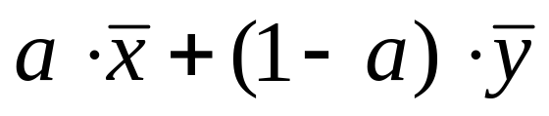
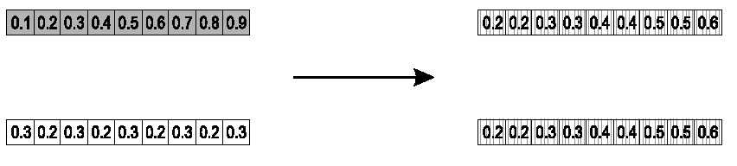
Whole arithmetic crossover
Most commonly used
Parents: ⟨x₁,…,x_{n} ⟩ and ⟨y₁,…,y_{n}⟩
child₁ is:
reverse for other child. e.g. with a = 0.5

Slide 54
Permutation Representations
Ordering/sequencing problems form a special type
Task is (or can be solved by) arranging some objects in a certain order
  Example: sort algorithm: important thing is which elements occur before others (order)
  Example: Travelling Salesman Problem (TSP) : important thing is which elements occur next to each other (adjacency)
These problems are generally expressed as a permutation:
  if there are n variables then the representation is as a list of n integers, each of which occurs exactly once

Slide 55
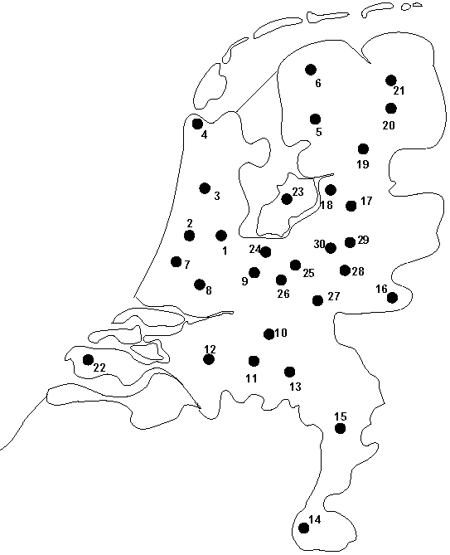
Permutation representation: TSP example
Problem:
  Given n cities
  Find a complete tour with minimal length
Encoding:
  Label the cities 1, 2, … , n
  One complete tour is one permutation (e.g. for n =4 [1,2,3,4], [3,4,2,1] are OK)
Search space is BIG:
for 30 cities there are 30! ≈ 10³² possible tours

Slide 56
Mutation operators for permutations
Normal mutation operators lead to inadmissible solutions
  e.g. bit-wise mutation : let gene i have value j
  changing to some other value k would mean that k occurred twice and j no longer occurred
Therefore must change at least two values
Mutation parameter now reflects the probability that some operator is applied once to the whole string, rather than individually in each position

Slide 57
Insert Mutation for permutations
Pick two allele values at random
Move the second to follow the first, shifting the rest along to accommodate
Note that this preserves most of the order and the adjacency information

Slide 58
Swap mutation for permutations
Pick two alleles at random and swap their positions
Preserves most of adjacency information (4 links broken), disrupts order more
Notes:
Pastreaza informatii de adiacenta dar perturba ordinea genelor

Slide 59
Inversion mutation for permutations
Pick two alleles at random and then invert the substring between them.
Preserves most adjacency information (only breaks two links) but disruptive of order information

Slide 60
Scramble mutation for permutations
Pick a subset of genes at random
Randomly rearrange the alleles in those positions
(note subset does not have to be contiguous)

Slide 61
Crossover operators for permutations
“Normal” crossover operators will often lead to inadmissible solutions
Many specialised operators have been devised which focus on combining order or adjacency information from the two parents
1 2 3 4 5
1 2 3 2 1
5 4 3 2 1
5 4 3 4 5

Slide 62
Order 1 crossover
Idea is to preserve relative order that elements occur
Informal procedure:
  1. Choose an arbitrary part from the first parent
  2. Copy this part to the first child
  3. Copy the numbers that are not in the first part, to the first child:
    starting right from cut point of the copied part,
    using the order of the second parent
    and wrapping around at the end
  4. Analogous for the second child, with parent roles reversed

Slide 63
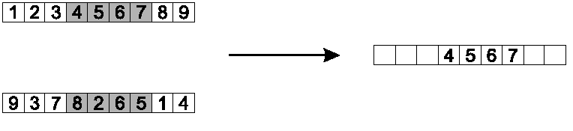
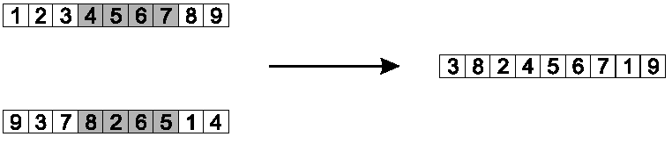
Order 1 crossover example
Copy randomly selected set from first parent
Copy rest from second parent in order 1,9,3,8,2

Slide 64
PMX (Partially matched crossover)
PMX may be viewed as a crossover of permutations, that quarantees that all positions are found exactly once in each offspring.
PMX proceeds as follows:
1. The two chromosomes are aligned.
2. Two crossing sites are selected uniformly at random along the strings, defining a matching section.
3. The matching section is used to effect a cross through position-by-position exchange operation.
4. Alleles are moved to their new positions in the offspring.

Slide 65
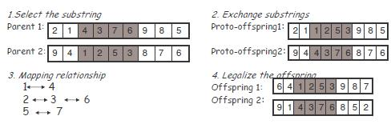
PMX Algorithm
Select a substring uniformly in two parents at random.
Exchange these two substrings to produce proto-offspring.
Determine the mapping relationship according to these two substrings.
Legalize proto-offspring with the mapping relationship.

Slide 66
Partially Mapped Crossover (PMX)
Informal procedure for parents P1 and P2:
Choose random segment and copy it from P1
Starting from the first crossover point look for elements in that segment of P2 that have not been copied
For each of these i look in the offspring to see what element j has been copied in its place from P1
Place i into the position occupied j in P2, since we know that we will not be putting j there (as is already in offspring)
If the place occupied by j in P2 has already been filled in the offspring k, put i in the position occupied by k in P2
Having dealt with the elements from the crossover segment, the rest of the offspring can be filled from P2.
Second child is created analogously

Slide 67
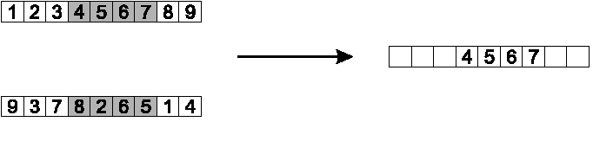
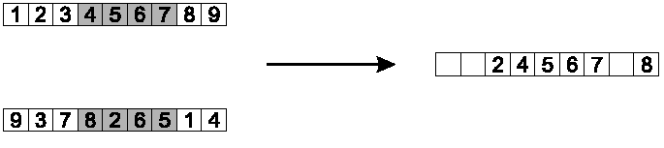
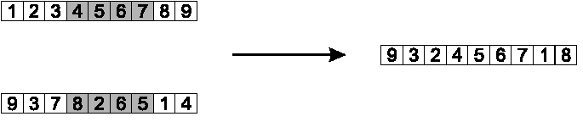
PMX example
Step 1
Step 2
Step 3

Slide 68
Cycle crossover
Basic idea:
Each allele comes from one parent together with its position.
Informal procedure:
1. Make a cycle of alleles from P1 in the following way.
  (a) Start with the first allele of P1.
  (b) Look at the allele at the same position in P2.
  (c) Go to the position with the same allele in P1.
  (d) Add this allele to the cycle.
  (e) Repeat step b through d until you arrive at the first allele of P1.
2. Put the alleles of the cycle in the first child on the positions they have in the first parent.
3. Take next cycle from second parent

Slide 69
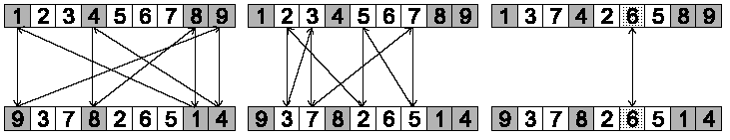
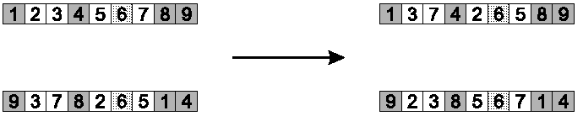
Cycle crossover example
Step 1: identify cycles
Step 2: copy alternate cycles into offspring

Slide 70
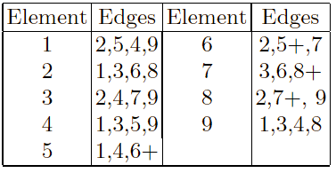
Edge Recombination
Works by constructing a table listing which edges are present in the two parents, if an edge is common to both, mark with a +
e.g. [1 2 3 4 5 6 7 8 9] and [9 3 7 8 2 6 5 1 4]

Slide 71
Edge Recombination 2
Informal procedure once edge table is constructed
1. Pick an initial element at random and put it in the offspring
2. Set the variable current element = entry
3. Remove all references to current element from the table
4. Examine list for current element:
  If there is a common edge, pick that to be next element
  Otherwise pick the entry in the list which itself has the shortest list
  Ties are split at random
5. In the case of reaching an empty list:
  Examine the other end of the offspring is for extension
  Otherwise a new element is chosen at random

Slide 72
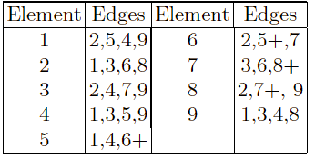
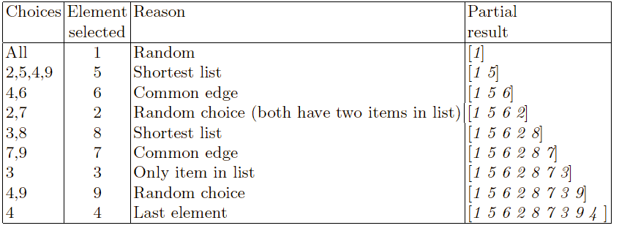
Edge Recombination example

Slide 73
Multiparent recombination
Recall that we are not constricted by the practicalities of nature
Noting that mutation uses 1 parent, and “traditional” crossover 2, the extension to a>2 is natural to examine
Been around since 1960s, still rare but studies indicate useful
Three main types:
  Based on allele frequencies, e.g., p-sexual voting generalising uniform crossover
  Based on segmentation and recombination of the parents, e.g., diagonal crossover generalising n-point crossover
  Based on numerical operations on real-valued alleles, e.g., center of mass crossover, generalising arithmetic recombination operators

Slide 74
Population Models
SGA uses a Generational model:
  each individual survives for exactly one generation
  the entire set of parents is replaced by the offspring
At the other end of the scale are Steady-State models:
  one offspring is generated per generation,
  one member of population replaced,
Generation Gap
  the proportion of the population replaced
  1.0 for GGA, 1/pop_size for SSGA

Slide 75
Fitness Based Competition
Selection can occur in two places:
  Selection from current generation to take part in mating (parent selection)
  Selection from parents + offspring to go into next generation (survivor selection)
Selection operators work on whole individual
  i.e. they are representation-independent
Distinction between selection
  operators: define selection probabilities
  algorithms: define how probabilities are implemented

Slide 76
Implementation example: SGA
Expected number of copies of an individual i
E(n_{i} ) = f(i) / ⟨f⟩
(μ = pop.size, f(i) = fitness of i, ⟨f⟩ avg. fitness in pop.)
⟨f⟩ = Σf(i) / μ
Roulette wheel algorithm:
  Given a probability distribution, spin a 1-armed wheel n times to make n selections
  No guarantees on actual value of n_{i}
Baker’s SUS algorithm (Stochastic universal sampling):
  n evenly spaced arms on wheel and spin once
  Guarantees floor(E(n_{i} ) ) ≤ n_{i} ≤ ceil(E( n_{i} ) )
Notes:
Stochastic universal sampling (SUS) is a technique used in genetic algorithms for selecting potentially useful solutions for recombination. It was introduced by James Baker.
SUS is a development of fitness proportionate selection with minimum use of stochastic process; exhibits no bias and minimal spread. Where fitness proportionate selection chooses several solutions from the population by repeated random sampling, SUS uses a single random value to sample all of the solutions by choosing them at evenly spaced intervals.
Described as an algorithm, pseudocode for SUS looks like:
RWS(population, f)
Ptr := 0
for p in population
if Ptr < f and Ptr + fitness of p > f
return p
Ptr := Ptr + fitness of p
SUS(population, N)
F := total fitness of population
Start := random number between 0 and F/N
Ptrs := [Start + i*F/N | i in [0..N-1]]
return [RWS(i) | i in Ptrs]

Slide 77
SUS algorithm (stochastic universal sampling)
Stochastic universal sampling provides zero bias and minimum spread.
The individuals are mapped to contiguous segments of a line, such that each individual's segment is equal in size to its fitness exactly as in roulette-wheel selection.
Here equally spaced pointers are placed over the line as many as there are individuals to be selected.
Consider NPointer the number of individuals to be selected, then the distance between the pointers are 1/NPointer and the position of the first pointer is given by a randomly generated number in the range [0, 1/NPointer].

Slide 78
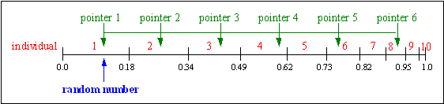
SUS algorithm (continued)
For 6 individuals to be selected, the distance between the pointers is 1/6=0.167.
Sample of 1 random number in the range [0, 0.167]: (e.g. 0.1)
After selection the mating population consists of the individuals: 1, 2, 3, 4, 6, 8.
SUS ensures a selection of offspring which is closer to what is deserved then roulette wheel selection.

Slide 79
Fitness-Proportionate Selection
Problems include
  One highly fit member can rapidly take over if rest of population is much less fit: Premature Convergence
  At end of runs when fitnesses are similar, lose selection pressure
  Highly susceptible to function transposition
Scaling can fix last two problems
  Windowing: f’(i) = f(i) - β ^{t}
    where β is worst fitness in this (last n) generations
  Sigma Scaling: f’(i) = max( f(i) – (⟨ f ⟩ - c • σ_{f} ), 0.0)
    where c is a constant, usually 2.0

Slide 80
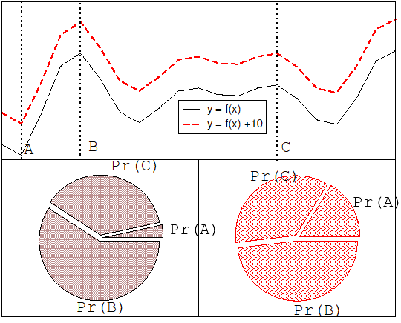
Function transposition for FPS

Slide 81
Rank – Based Selection
Attempt to remove problems of FPS by basing selection probabilities on relative rather than absolute fitness
Rank population according to fitness and then base selection probabilities on rank where fittest has rank μ (or n – number of individuals) and worst rank 1
This imposes a sorting overhead on the algorithm, but this is usually negligible compared to the fitness evaluation time

Slide 82

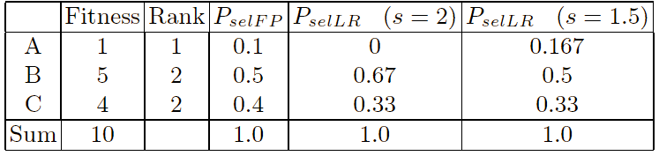
Linear Ranking
Parameterised by factor s: 1.0 < s ≤ 2.0
  measures advantage of best individual
  r_{i} the rank of individual i (descending sorting).
  in GGA this is the number of children allotted to it
Simple 3 member example
Notes:
Linear Ranking – Selectia bazata pe ordonare
Se inlocuieste cu atentie r1=3 (cel mai fittest), r3=1 (cel mai slab individ)➔prin scalare de regula individul slab va avea prob. de selectie 0 iar cel mai puternic 2/s.

Slide 83
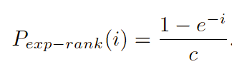
Exponential Ranking
Linear Ranking is limited to selection pressure
Exponential Ranking can allocate more than 2 copies to fittest individual
Normalise constant factor c according to population size

Slide 84
Binary tournament
Binary tournament is run to determine a relative fitness ranking. Initially the entire population is in the tournament.
Two members are selected at random to compete against each other with only the winner of the competition progressing to the next level of the tournament .
When the tournament is over, the relative fitness of each member of the population is awarded according to the level of the tournament it has reached.

Slide 85
Tournament Selection
All methods above rely on global population statistics
  Could be a bottleneck esp. on parallel machines
  Relies on presence of external fitness function which might not exist: e.g. evolving game players
Informal Procedure:
  Pick k members at random then select the best of these
  Repeat to select more individuals

Slide 86
Tournament Selection 2
Probability of selecting i will depend on:
  Rank of i
  Size of sample k
    higher k increases selection pressure
  Whether contestants are picked with replacement
    Picking without replacement increases selection pressure
  Whether fittest contestant always wins (deterministic) or this happens with probability p
For k = 2, time for fittest individual to take over population is the same as linear ranking with s = 2 • p

Slide 87
Survivor Selection
Most of methods above used for parent selection
Survivor selection can be divided into two approaches:
  Age-Based Selection
    e.g. SGA
    In SSGA can implement as “delete-random” (not recommended) or as first-in-first-out (a.k.a. delete-oldest)
  Fitness-Based Selection
    Using one of the methods above or

Slide 88
Two Special Cases
Elitism
  Widely used in both population models (GGA, SSGA)
  Always keep at least one copy of the fittest solution so far
GENITOR: a.k.a. “delete-worst”
  From Whitley’s original Steady-State algorithm (he also used linear ranking for parent selection)
  Rapid takeover : use with large populations or “no duplicates” policy

Slide 89
Example application of order based GAs: JSSP
Precedence constrained job shop scheduling problem
J is a set of jobs.
O is a set of operations
M is a set of machines
Able ⊆ O × M defines which machines can perform which operations
Pre ⊆ O × O defines which operation should precede which
Dur : ⊆ O × M → IR defines the duration of o ∈ O on m ∈ M
The goal is now to find a schedule that is:
Complete: all jobs are scheduled
Correct: all conditions defined by Able and Pre are satisfied
Optimal: the total duration of the schedule is minimal

Slide 90
Precedence constrained job shop scheduling GA
Representation: individuals are permutations of operations
Permutations are decoded to schedules by a decoding procedure
  take the first (next) operation from the individual
  look up its machine (here we assume there is only one)
  assign the earliest possible starting time on this machine, subject to
    machine occupation
    precedence relations holding for this operation in the schedule created so far
fitness of a permutation is the duration of the corresponding schedule (to be minimized)
use any suitable mutation and crossover
use roulette wheel parent selection on inverse fitness
Generational GA model for survivor selection
use random initialisation

Slide 91
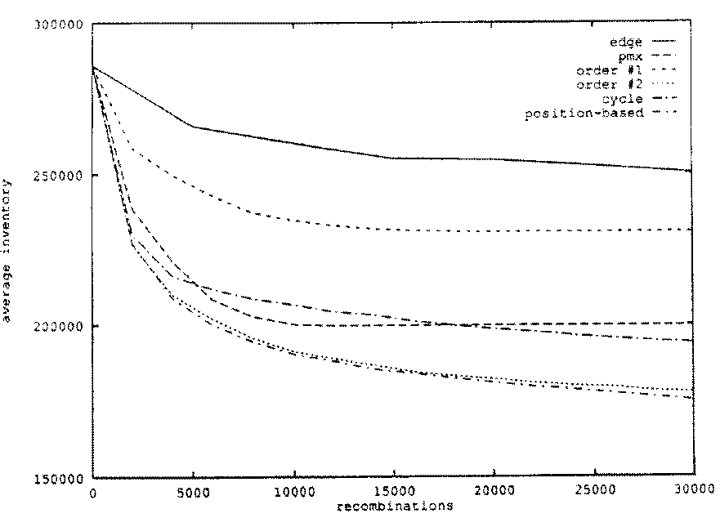
JSSP example: operator comparison

Slide 92
MEMETIC ALGORITHMS
Memetic algorithm introduced by Moscato and Norman in 1992 is an improved variant of genetic algorithm.
It takes the concept of evolution as in genetic algorithm.
However, while genetic algorithm is based on biological evolution, memetic algorithm is based on cultural evolution or idea evolution. In the evolution of ideas, an idea may be improved not only by recombination from others, but also by adaptation from itself.

Slide 93
A meme
A meme, a unit of information in memetic algorithm can be improved by the individual holding it before it is passed on.
A meme differs from a gene in that as it is passed between individuals, each individual adapts the meme as it see best whereas genes are passed unchanged.
A basic memetic algorithm, is then, an evolution algorithm incorporated with some local search technique.

Slide 94
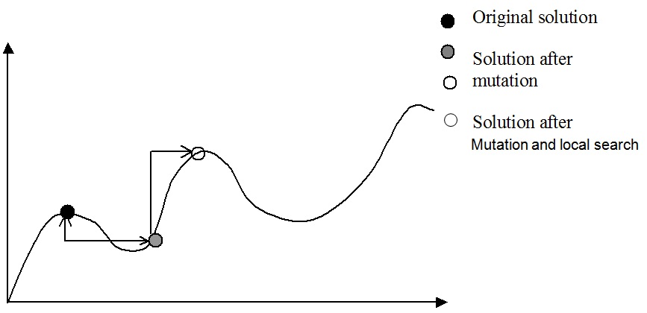
An Example Memetic Operation

Slide 95
Memetic Algorithm
Normally, the local search technique is hill-climbing and the evolutionary operators are only mutation operators.
In genetic algorithm, while the mutation creates new genes for the population, the crossover operator orients seeking the best solution from the genes in the population.
In memetic algorithm, this orientation is achieved by local search. Local search reduces the search space and reaches to high quality solution faster.

Slide 96
Optimized Simulated Annealing for Network-on-Chip Application Mapping
Simulating Annealing (SA) is a tree search technique that combines hill climbing with a random walk in order to yield efficiency and also completeness. The hill climbing algorithm never makes downhill moves so it is guaranteed to be incomplete (because it can get stuck in a local maximum). On the other hand, moving to a successor tree node, chosen randomly from all the possible successors, is very inefficient but more complete. Simulated Annealing reduces to Hill Climbing.
The idea behind this algorithm comes from metallurgy, where annealing is the process used to temper or harden metals and glass by heating them to a high temperature and then gradually cooling them, thus allowing the material to coalesce into a low-energy crystalline state.
Using Optimized Simulated Annealing algorithm as a mutation operator it obtain a hybrid algorithm: an Evolutionary Algorithm which incorporates a Simulated Annealing technique [Ciprian Radu].
OSA performs a context-aware mapping and outputs two cores which must be swapped.
Using domain-knowledge, the Optimized Simulated Annealing (OSA) algorithm performs a dynamic and implicit core clustering and limits the number of iterations per annealing temperature based on the given application and network.

Slide 97
Outline of a Memetic Algorithm
create initial population
repeat
1. take each individual in turn:
Choose a mutation method
Apply mutation operator to chosen individuals
Apply hill-climbing to individual just created.
Insert it into the population.
2. select a half of them to reduce the population to its original size.
until termination condition is true
Memetic Algorithms have been shown to be orders of magnitude faster and more accurate than EAs on some problems, and are the “state of the art” on many problems

