Slide 1

Quasi – Deterministic
Parallel Programming with LVars
MASTER SEMINAR WS 2014/15
Nishanth Nagendra
MSc. Informatics

Slide 2
AGENDA
Introduction
LVars
Lvish
Implementation
Performance
Limitations
Conclusion

Slide 3
INTRODUCTION
What is parallel programming?
  Writing programs such that they can run on parallel hardware.
Why?
  Speed up your code. Today, your computer (and probably even your smart phone) have one or more CPUs that have multiple processing cores.
Existing parallel programming models: Many !!!
  Scala, CnC, LabView, Bloom, Verilog, Clojure, Parlog, Concurrent haskell, Cilk, C++ AMP, CoArray Fortran, Ateji PX etc.
Notes:
There are several types of parallelism that can be mentioned here but we restrict ourselves to some of them and especially those which are of interest for us concerning this topic.

Slide 4
Non-determinism
  A challenge faced in parallel programming!!!
  Parallel tasks interact unpredictably, exposing schedule non-determinism.
  Deterministic by construction parallel programming models ensure that the observable results of programs are the same on every run.
Example to demonstrate nondeterminism.
let _ = put lv 3 in [write 3 in lv]
let par v = get lv [read from lv]
_ = put lv 4 [write 4 in lv]
in v [final value is v]
  “let par” expression has fork-join semantics.
  “_” refers to an anonymous variable.

Slide 5
Why Deterministic models are needed?
  Provides freedom from hard to reproduce non-deterministic bugs.
  Deterministic semantics simplifies reasoning, debugging, and testing parallel software.
Traditional approach for enforcing determinism?
  Single assignment models[IVars] (Underlying theme of such models is monotonicity).
  IVar based models : Haskell monad-par library, INTEL CnC(Concurrent Collections), Concurrent ML(as SyncVars).
  Other models:
    No-shared-state parallelism[Data parallel Haskell, River Trail API for Java script],
    Data-flow parallelism[Kahn Process Networks, StreamIt is based on KPN],
    Imperative-disjoint parallelism[Deterministic parallel java].
Notes:
Deterministic semantics helps us with debugging and testing the code.
If we are sure that we guarantee deterministic semantics then the sequential version of this code can be tested for correctness and we can be sure that the parallel version of this code will run.

Slide 6
Limitations of existing single-assignment models.
  Previous example would be invalid [writing 3 and 4 into lv].
  Writing the same value twice is not allowed as below.
let par _ = put lv 4 [write 4 in lv] Use case: {Bitwise trie data structure
_ = put lv 4 [write 4 in lv] write strings “0”, “1111” and “1100”
in lv [final value is lv] in parallel}
  Another example
let par _ = put lv (4, ⊥) [write 4 in the 1st component of the pair lv]
_ = put lv (⊥, 3) [write 3 in the 2nd component of the pair lv]
in lv [final value is the pair lv which should be (4,3)]
  There is a need to generalize the single assignment model to admit such kind of programs but retain determinism.
  Motivating example: Graph traversal(Connected graph of v) Examples of models we just saw are unable to solve such kind of problems efficiently or express them in parallel.
Notes:
Example that illustrates why we need to write the same value twice is a so called “bitwise trie data structure”
Write “1100” and “1111” using 2 different threads and do a “put” into a bitwise trie data structure.
Whichever thread reaches the topmost Ivar first will write 1 and then the other thread will reach there and complain. Solution would be to check for emptiness and then write. This, however cannot be done with Ivar where checking for emptiness will result in blocking. First thread will try to check for emptiness and then block, second thread will also do the same and then block. So both will continue to block indefinitely.

Slide 7
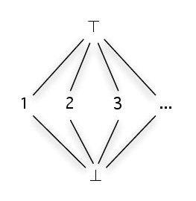
LVar : Shared memory location whose contents can only grow bigger over time.
  User specified Lattice. Supports the notion of monotonicity.
  Write operation is the least upper bound of the current and the new value. [put operation provides write semantics]
  Multiple writes[Commuting] allowed only if they are monotonically increasing with respect to a user specified lattice.
  IVars turn out to be a special case of LVars.
  Example: 1⊔1=1, 1⊔2=⊤, ⊥⊔ 2= 2 ⊥ ⊑ x, for ∀ x∈S, where S={1,2,3...}
Notes:
In the endeavor to generalize IVars model, multiple monotonic writes are allowed but for reads, they are no longer exact reads meaning they do not give you the exact value but rather an under approximation or a lower bound. This is the trade off we accept to provide deterministic semantics in comparison to IVar to allow multiple monotonic write operations.
We will see in LVish that by relaxing this model a little more we can read the exact contents of LVar but allow some non determinism to creep in.

Slide 8
  Only monotonic writes are insufficient !!!
  Blocking threshold reads necessary to ensure determinism, get operation provides this semantics.
  get operation reads one of a set{threshold set} of lower bounds on the LVar value that are given as an extra argument to get.
  Information can never be removed.

Slide 9
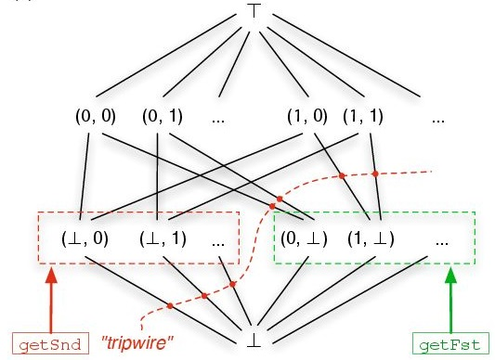
let par _ = putFst lv 0 [write (0,⊥) in lv] _ = putSnd lv 1 [write (⊥,1) in lv] x = getSnd lv in x returns 1
  For getSnd lv, the threshold set is {(⊥,0), (⊥,1), (⊥,2), …}
  Threshold set is pairwise incompatible, else it will break determinism.
  Informally, the second entry of lv can only be written to once, no more than one state from the set {(⊥,0), (⊥,1), (⊥,2), …} can ever be reached.
  getSnd lv can unblock and return 1 anytime after the second entry of lv has been written, regardless of whether the first entry has been written yet.
Notes:
To provide a safe under approximation or a lower bound we would need to specify a threshold set and return that lower bound. This ensures determinism.
Operations are provided in terms of components of the pairs. If we want to operate directly on the whole pair then it cannot be modeled in the form of a lattice and such threshold read operations. For a threshold read, one cannot find a proper threshold set to provide if we want to read the full pair.
A possibility would be to provide a flat lattice with all possible pairs of natural number values which is not really useful and does not extend Ivars.
This now extends IVars as you can see because we are able to write component wise and hence multiple times to the LVar.

Slide 10
Monotonically increasing writes + threshold reads = deterministic parallelism
For lemmas, proofs, semantics and other formalism details, please refer to the original paper.
Key to the proof of determinism is the Frame rule : {p} C {q} ⟹ {p* r} C {q* r}
  <S, e> ⟹ <S', e'> then <S⊔R, e> ⟹ <S'⊔R, e'>
  R is some other store resulting from some other independently running computation and framing on to S.
Notes:
Frame rule has been used in program verification since 15 yrs.

Slide 11
Limitation of LVar model
Lacks generality : Problems such as unordered graph traversal are not expressible using this model.
Computations rely on negative information about a monotonic data structure[i.e. On the absence of certain writes to the data structure.]
In LVar model, asking whether a node is in the set results in blocking. How to lift this restriction while retaining determinism?
Solution: LVish - Extension of the LVar model
Notes:
Drawbacks:
Threshold reads are like expecting some writes to happen and it is difficult to predict them.
Cannot read the exact contents
Cannot check if some content is absent

Slide 12
LVish
This model is an extension to LVar.
  First, it provides event handlers, a mechanism for attaching a callback function to an LVar that runs asynchronously, whenever events arrive(changes to the state of an LVar) .
  Second, a primitive for freezing an LVar, which means: once an LVar is frozen, any further writes will throw an exception.
  It now becomes possible to discover exact value of LVar, learning both positive and negative information about it without blocking.
  Freezing does not commute with writes. Satisfies the property of “Quasi Determinism”.

Slide 13
addHandler lv {1, 3, 5,...} (λx.put lv x + 1)
  Registers a handler for lv executing the callback function for each odd number that lv is at or above in the event set.
  let par _ = put lv 0 _ = put lv 1 _ = addHandler lv {0,1} (λx.if x = 0 then put lv 2) in get lv {2} [Can result in non-determinism]
  Here the lattice is a set of natural numbers with ≤ ordering where least upper bound is the max function.
  Event sets are a mathematical modeling tool only.
  Quiescence: determine when event handlers have reached a quiescent state.
    Detecting quiescence is crucial for implementing fix-point computations.
    This model includes handler pools which are groups of event handlers whose collective quiescence can be tested.

Slide 14
  Quiesce: Blocking operation until all of the callbacks in a particular handler pool are done running.
    Is it Monotonic? No!!! [But no risk to quasi determinism].
    Safe practice!!! Quiesce before freezing.
  Freezing(non-blocking read) introduces quasi determinism.
  LVish library provides a function runParThenFreeze which ensures that all the writes have completed before freeze can happen then the computation will be deterministic.
An Lvar state is now a pair (d, frz) where d is an element of some application-specific set D and frz(short for freeze) is a status bit for either true or false.
  Every element of D is freezable except ⊤.

Slide 15
  We can lift the partial order defined before on elements to pairs now of the form (d, frz) obeying the below rules:
    (d, false) ⊑_{p} (d', false) exactly when d⊑d'
    (d, true) ⊑_{p} (d', true) exactly when d=d'
    (d, false) ⊑_{p} (d', true) exactly when d⊑d'
    (d, true) ⊑_{p} (d', false) exactly when d' = ⊤
Quasi-Determinism for Lvish.
  Refer to the original paper for the formal proof and details.
  Uses the frame property again but with some additional restrictions.
Monotonically increasing writes + Threshold reads + Freeze = Quasi Determinism

Slide 16
LVish a Haskell library for parallel programming with LVars
http://hackage.haskell.org/package/lvish
Adopts the basic approach of the par-monad Haskell library(used IVars)
LVish: Provides: par monad, a thread scheduler, handler pools and event handlers.
  Infrastructure does not guarantee quasi determinism, data structure authors must provide this.
  Programs run only inside the par monad allowing only Lvish-sanctioned effects to provide compile time guarantees of determinism and quasi determinism.
  Several functions available for running par computations.
  runPar, runParThenFreeze

Slide 17
Lvish Code
traverse g startNode = do
seen <- newEmptySet [new LVar]
h <- newHandler seen [register the handler]
(\node -> do [callback function definition]
mapM (\v -> insert v seen)
(neighbors g node)
return ())
insert startNode seen [Trigger the event handlers]
quiesce h [block until all handlers complete]
freeze seen
Can be replaced by return seen if
RunParThenFreeze is used to run traverse function

Slide 18
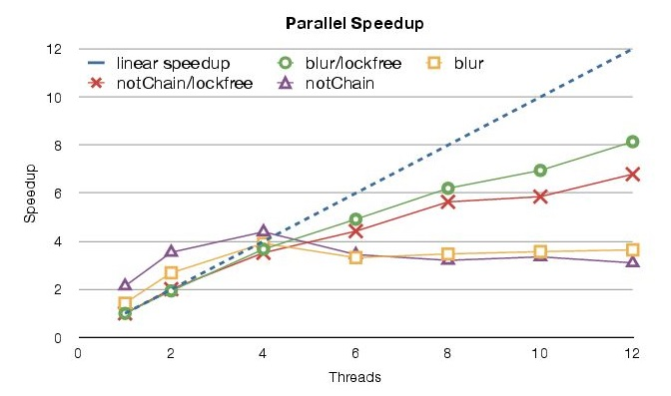
Performance of LVish

Slide 19
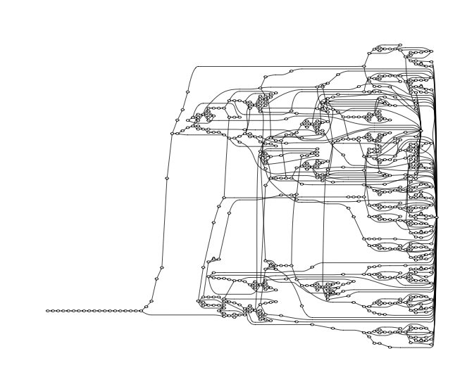
K-CFA study[for k=2]

Slide 20
LIMITATIONS
From a recent paper by the co-author
  LVish side effects are only monotonic updates. If a data structure needs to be updated multiple times then it has to happen out of place resulting in additional memory allocation and turning out to be inefficient relative to their in place versions.
  Blocking get semantics could slow down the performance until the dependency is met. A retry/abort feature has been proposed as a solution towards this. LVish operations are idempotent, Retry and blocking have same semantics.
  Overhead in going through the scheduler repeatedly.

Slide 21
CONCLUSION
Subsumes many of the existing single assignment models and provides a general model widely applicable for larger set of problems.
Extends the existing theme of monotonicity which has been used as an approach towards providing deterministic by construction parallel programming models.
Related work:
  LVar style threshold reads for CvRDTs(Convergent replicated data types) that are used in a distributed environment.
  Imperative-disjoint parallelism is also now supported in the latest LVish library version.

Slide 22
REFERENCES
Lindsey Kuper, Lattice-based data structures for deterministic parallel and distributed programming. Dissertation, 2014.
Kuper L., Turon A., Krishnaswami N., and Newton R. Freeze after writing: Quasi-deterministic parallel programming with LVars. POPL, Janauary 2014.
Kuper L. and Newton R., Lattice-based data structures for deterministic parallelism. FHPC, September 2013.
Kuper L. and Newton R. Deterministic threshold queries of distributed data structures. Draft, July 2014.
Simon Marlow. Parallel and Concurrent programming in Haskell. O'Reily, 2013.
Lindsey Kuper. Blog. composition.al.
Praveen Narayanan and Ryan R. Newton.Graph algorithms in a guaranteed determinis-tic language. Workshop on Deterministic andCorrectness in Parallel programming (WoDet2014), March 2014.
www.Learnyouahaskell.com, Miran Lipovaca
Haskell, The craft of functional programming, Simon Thompson
Online videos/tutorials, Lambda calculus

Slide 23


