Slide 1

One of these is not like the others: Challenges in anomaly detection
Fred Frost
Lead Data Scientist
SentryOne
4/16/19 ABA Guest Lecture
Notes:
There’s always next time

Slide 2

Who is this guy?
Fred Frost
Improving the quality of life for the Microsoft Data Professional.
SentryOne: solutions that center around our Monitor • Diagnose • Optimize (MDO) methodology. (Plan Explorer, SQL Sentry, etc)
Development and integration of machine learning tools into the S1 platform to provide predictive and prescriptive analytics to our customers
Data Scientist at SentryOne
ffrost@sentryone.com
/fredfrostdata1
@ffrost162

Slide 3
What will we talk about?
Why are we talking about anomaly detection?
We’ll focus somewhat on time series detection, since that is S1’s domain.
Questions to consider:
What do our data look like?
How well do we understand the system that generates the data?
What is the context for an anomaly?
What will the product look like?
Summary

Slide 4
Why Anomaly Detection?
From a business perspective, it’s opportunity:
Statista estimates 27 Billion connected IoT devices in 2019
Logarithmic growth curve suggest 75 Billion by 2025
Pervasive across industries and markets
System Sensors for management, performance and optimization
Security and intrusion detection
Fraud Detection
Medical Diagnosis
Automotive & Transportation Machine Vision
Every one of them will need to recognize and handle anomalies

Slide 5
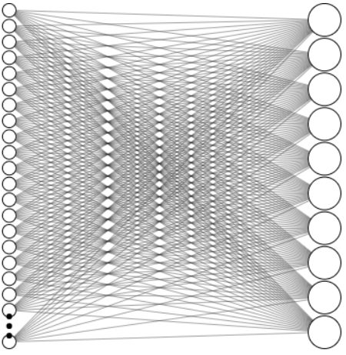
Why Anomaly Detection?
From a math and CS perspective, it’s both broad and deep
Problem diversity
Solution diversity
Constantly evolving challenges
But…
A set of guiding principles exists to connect problems and solutions

Slide 6
Why Anomaly Detection?
When matching a problem to solution, what are the features of the problem that matter?
What do our data look like?
How well do we understand the system that generates the data?
What is the context for an anomaly?
What will the product look like?

Slide 7
Q1: What do our data look like?
Formatting, Origins, and Frequency
Content Format
Images, Text, Videos, Documents, Measures
Data Origin
Transactional, Metadata, Master content, Historical
Data Frequency
On-demand, Real time, Time series

Slide 8
Q1: What do our data look like?
What is the dimensionality of the data?
Univariate
What is the air pressure in my left front tire?
Multidimensional
What is the air pressure in each of my tires, the ambient air temp, and my current speed?
Massively Multidimensional*
What is all the data we have on each car on the road?
*The Curse of Dimensionality

Slide 9
Q1: What do our data look like?
All the labels
Normal class is labeled
No labels
Temp | Pressure | Label
100 | 38 | Normal
90 | 37 | Normal
95 | 39 | Normal
100 | 22 | Anomaly
Temp | Pressure | Label
100 | 38 | Normal
90 | 37 | Normal
95 | 39 | Normal
Temp | Pressure | Label
100 | 38
90 | 37
95 | 39
100 | 22
Supervised
Semi-Supervised
Unsupervised
But where do these labels come from?
Notes:
Role of expertise in providing labels and reducing dimensionality by making the correct simplifying assumptions

Slide 10
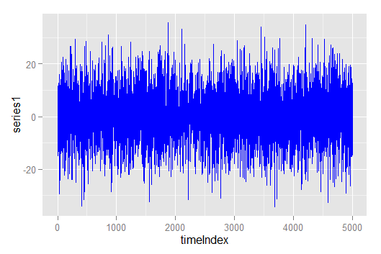
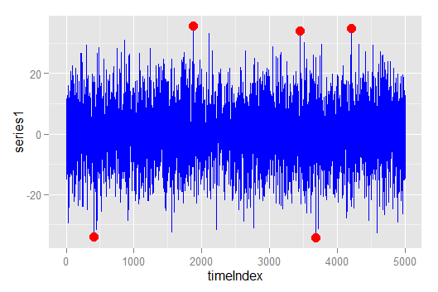
Q2: How well do we understand the system generating the data?
What does an outlier in my system look like?
Is it simply an extreme value?

Slide 11
Q2: How well do we understand the system generating the data?
Consider a set of univariate, unordered values
X = {1,2,3,13,50,87,88,89}
Which points have the most “outlierness”?
Then consider an ordered time series for an additive process
Y = {1,2,3,13,50,87,88,89}
Now which points have the most “outlierness”?

Slide 12
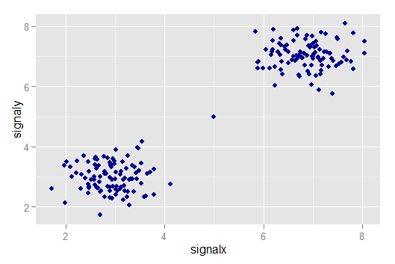
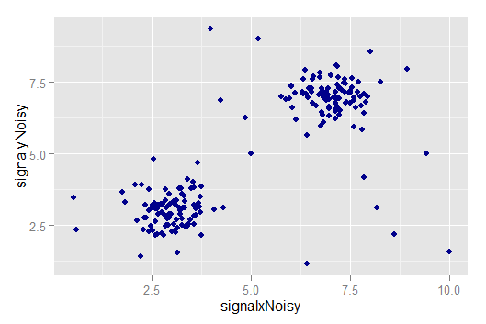
Q2: How well do we understand the system generating the data?
How noisy is my system?
Not very
Noise large relative to separation
Notes:
Quiet state vs active state

Slide 13
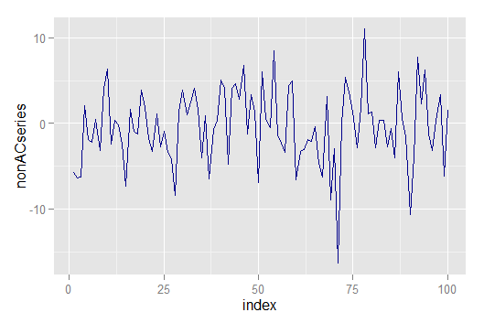
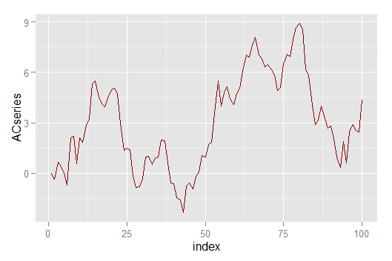
Q2: How well do we understand the system generating the data?
Is the data independent and identically distributed (IID)?
Or is it autocorrelated?

Slide 14
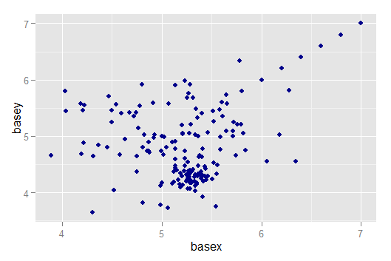
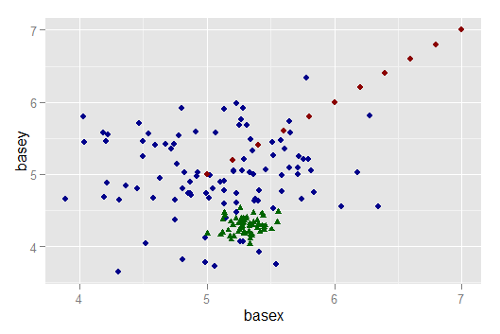
Q2: How well do we understand the system generating the data?
Which points are outliers?
Does this help?
Anomaly detection is about the process by which the actual data points are generated

Slide 15
Q2: How well do we understand the system generating the data?
Statistical Methods
Do I understand the distributions of values within the series?
Is it possible to detect useful anomalies with the right statistical approach?
Instance Based Methods
Do I understand how many system states there are?
Can I choose an appropriate measure of distance or similarity between points?
Model Based Methods (Single Class + Generative)
Do I have a model that does a good job in reconstructing or fitting the observed data?
When my model doesn’t fit, is that a signal based anomaly, or a bad model?

Slide 16
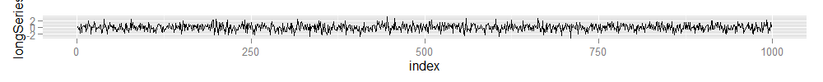
Q3: What is the context for an anomaly?
Streaming analytics- minimal context Quick turnaround while insights are fresh
Offline analytics – Full contextual basis for analysis Identification of long term trends

Slide 17


Q3: What is the context for an anomaly?
Vertical Analysis
Horizontal Analysis
Notes:
Engine Temp Example – Warm engine may not be bad at all, but if it’s warm given that the workload has been light, there may be an issue. Maybe the car is on fire. Or maybe it’s sitting in the sun.
Warm engine during your commute- fine. Warm engine at 3 AM, might be on fire again, or maybe you’re travelling overnight on a road trip

Slide 18
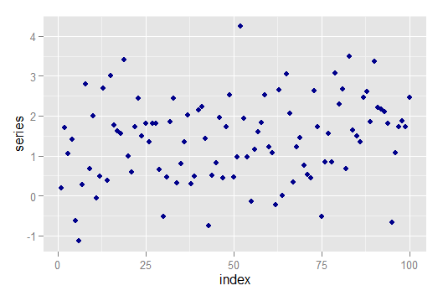
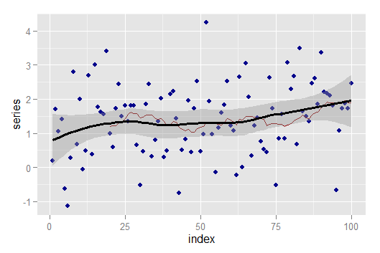
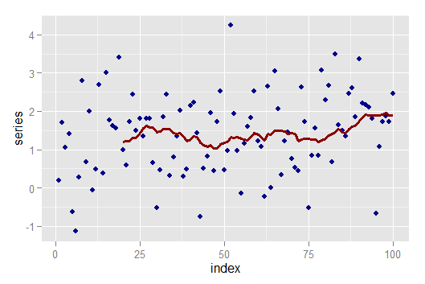
Q3: What is the context for an anomaly?
Can we do some smoothing or do we need to provide results on raw data?
No Smoothing
Loess smoothing
Simple moving average

Slide 19
Q4: What will the product look like?
What is the DS process flow?
EDA
Model
Eval
Delivery?

Slide 20
Q4: What will the product look like?
What is the DS process flow?
Collect and
Identify Data
EDA
Design the Solution
Model
Define the Problem
Update and Maintain
Collect Feedback (user + model performance)
Communicate Interpret and Use
Deploy
Eval

Slide 21
Q4: What will the product look like?
Do we move the code to the data, or the data to the code?
Moving Data to Code:
Cloud computing via AWS, Azure, IBM Cloud
Permits scaling via containerization, high levels of parallelism
Only pay for compute when it’s active
Traditional ETL Jobs with SSIS, Pentaho, Informatica
Data is moved from system to system for analysis
Infrastructure cost
Moving Code to Data:
Apache Hadoop, ML Services in Database, code as data
Code containers are distributed over nodes containing stored data
Data Locality improves performance

Slide 22




Q4: What will the product look like?
Do model training and inference happen in the same place, or different places?
Is the user accessing a web application that is served data from a central location where the analytical heavy lifting occurs? e.g. Alexa/Echo, for now.
Model Training and Inference in the cloud
Is the small bank unwilling to use public cloud or permit regular external model updates?
Model Training and Inference done locally
Can a self-driving car rely on cloud architecture to respond to sudden environmental changes?
Intermittent
Model training in the cloud, with local model inference –
Edge architecture
Connectivity

Slide 23
Q4: What will the product look like?
Are any technology solutions ruled out or preferred because of data concerns?
Limits on local processing:
Too much data to store or process locally, limits streaming windows
Processing requires context granted by other sensors in the system
Limits on cloud processing:
Latency, reliability, security
What is bigger: the analytical process or the data required to sustain it?
Limits on edge architecture:
Not all solutions fit in this model
Requires representation of completed model that data can interact with

Slide 24
Summary
Choosing the “right” solution to an anomaly detection problem depends on the following:
The character of your data
How much clarity you have with respect to how the system transforms inputs into outputs
What types of anomalies you need to detect
The type of product you will deliver
Key Takeaways:
Anomaly Detection is more than finding extreme values.
Product delivery is a necessary part of the Data Science pipeline.
Notes:
1: Type, Origin, Quality, dimensionality, labels, statistical properties
2: Deeper look at what defines an outlier, system states, noise, and baselines
3: Temporal Context, vertical vs horizontal, smoothing
4: DS process, vision to product, Data to code, locality of inference/training, limitations

