Slide 1
Stock Performance VBA Analyzer
By
Huang Yee Wai

Slide 2
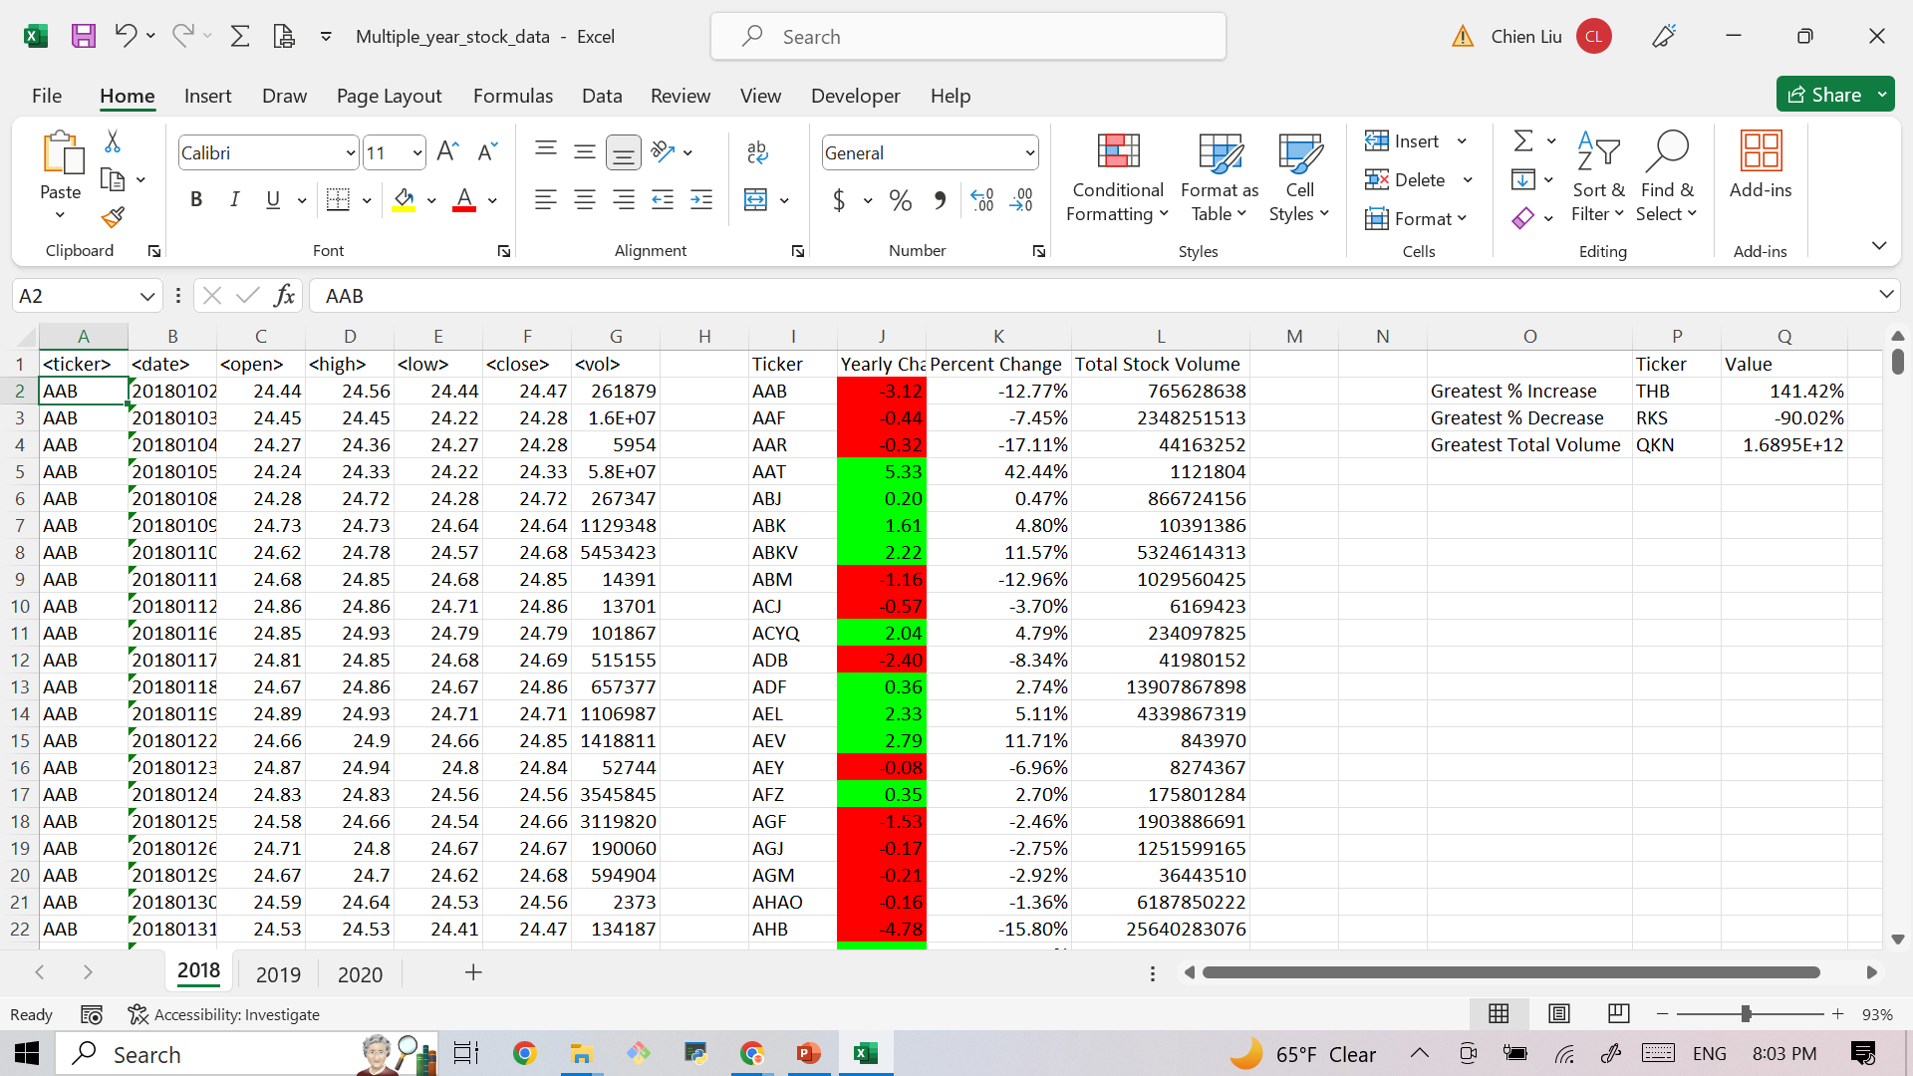

Slide 3
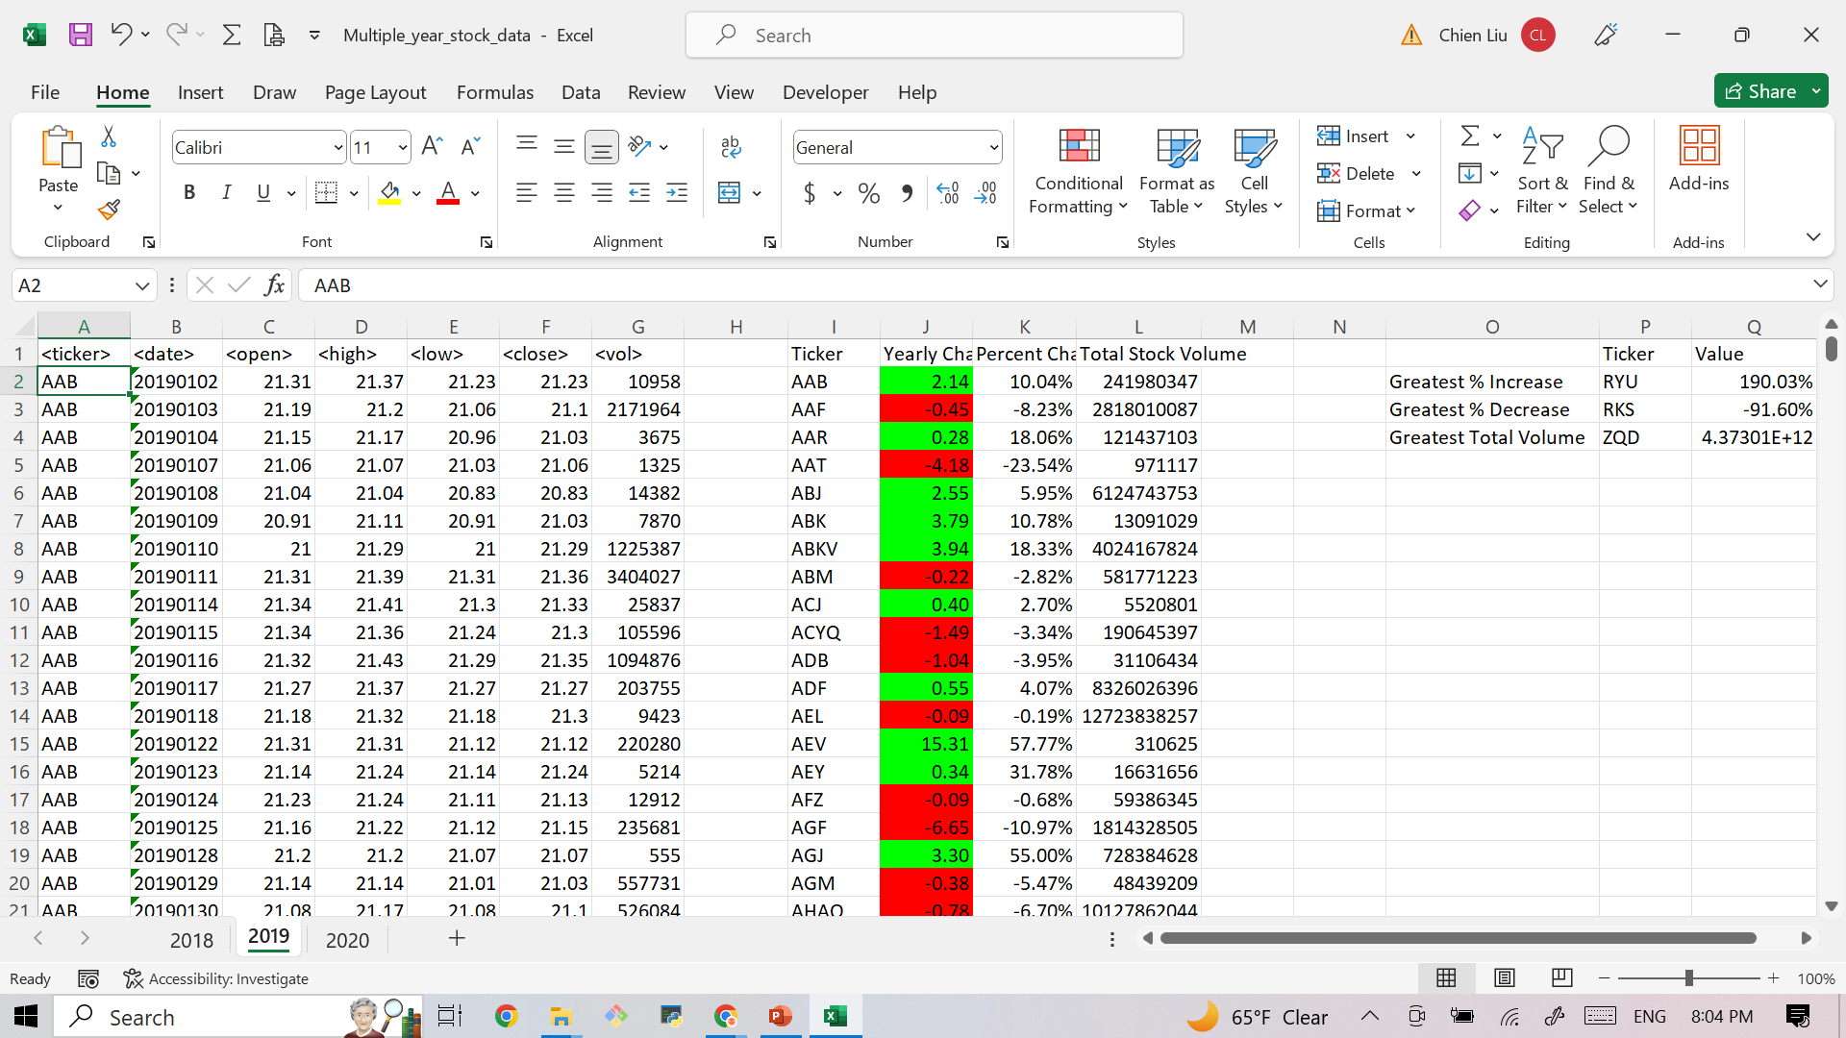

Slide 4
