Slide 1
CS3230 – Design and Analysis of Algorithms (S2 AY2024/25)
Lecture 2: Recurrences and Master Theorem

Slide 2
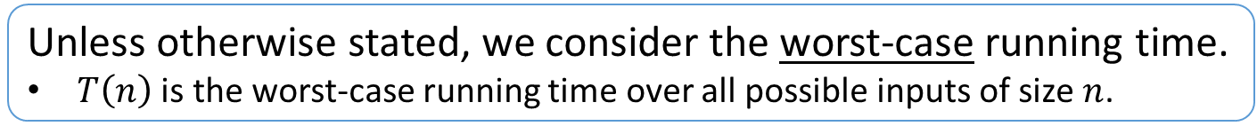

Analyzing the running time of an algorithm
Goal: For a given algorithm $𝒜$, analyze the asymptotic running time $T\left(n\right)$ as a function of the input size $n$.
Time complexity
Unless otherwise stated, we consider the worst-case running time.
$T\left(n\right)$ is the worst-case running time over all possible inputs of size $n$.

Slide 3

Analyzing the running time of an algorithm
recursive
Goal: For a given algorithm $𝒜$, analyze the asymptotic running time $T\left(n\right)$ as a function of the input size $n$.
Step $1$: Derive a recurrence.
Step $2$: Solve the recurrence.

Slide 4


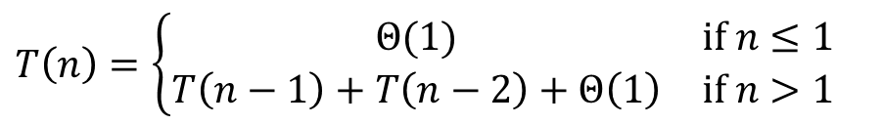
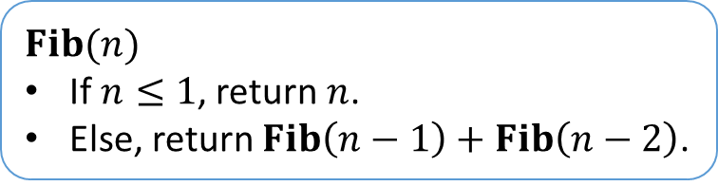
Analyzing the running time of an algorithm
recursive
Goal: For a given algorithm $𝒜$, analyze the asymptotic running time $T\left(n\right)$ as a function of the input size $n$.
Step $1$: Derive a recurrence.
Step $2$: Solve the recurrence.
$$Fib(n)$$
If $n≤1$, return $n$.
Else, return $Fib\left(n−1\right)+Fib\left(n−2\right)$.
Step $1$
$$T\left(n\right)=\left\{\begin{matrix}Θ(1) & if n≤1 \\ T\left(n−1\right)+T\left(n−2\right)+Θ\left(1\right) & if n>1\end{matrix}\right.$$
Step $2$
$$T\left(n\right)∈Ω\left(2^{n/2}\right)$$

Slide 5
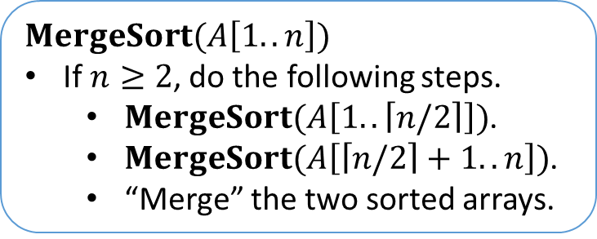
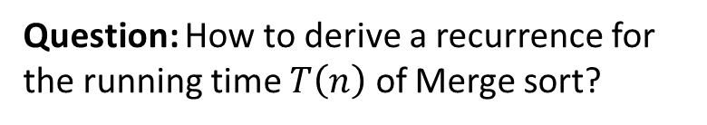

Merge sort
$$T\left(n\right)$$
$$MergeSort(A\left[1..n\right])$$
If $n≥2$, do the following steps.
$MergeSort(A\left[1..\left\lceil n/2\right\rceil \right])$.
$MergeSort(A\left[\left\lceil n/2\right\rceil +1..n\right])$.
“Merge” the two sorted arrays.
Question: How to derive a recurrence for the running time $T\left(n\right)$ of Merge sort?
We omit the details.
VisuAlgo (Merge sort): https://visualgo.net/en/sorting?mode=Merge

Slide 6

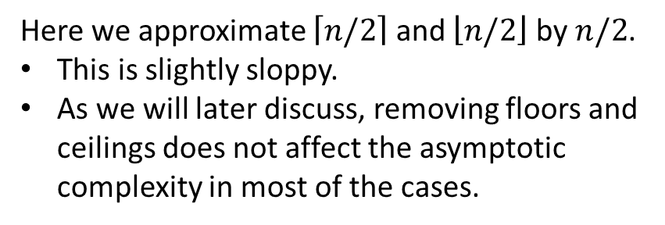
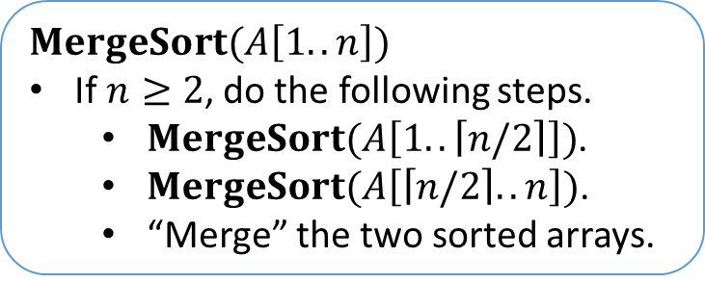


Merge sort
$$T\left(n\right)$$
$$MergeSort(A\left[1..n\right])$$
If $n≥2$, do the following steps.
$MergeSort(A\left[1..\left\lceil n/2\right\rceil \right])$.
$MergeSort(A\left[\left\lceil n/2\right\rceil ..n\right])$.
“Merge” the two sorted arrays.
$$Θ\left(1\right)$$
$$T\left(n/2\right)$$
Here we approximate $\left\lceil n/2\right\rceil$ and $\left\lfloor n/2\right\rfloor$ by $n/2$.
This is slightly sloppy.
As we will later discuss, removing floors and ceilings does not affect the asymptotic complexity in most of the cases.
$$T\left(n/2\right)$$
VisuAlgo (Merge sort): https://visualgo.net/en/sorting?mode=Merge

Slide 7

Merge sort
$$\left[1, 5, 7\right], \left[2, 4, 6\right], \left[1, 2, 4, 5, 6, 7\right]$$
$$\left[1, 5, 7\right], \left[2, 4, 6\right], \left[1, 2, 4, 5, 6, 7\right]$$
$$T\left(n\right)$$
$$MergeSort(A\left[1..n\right])$$
If $n≥2$, do the following steps.
$MergeSort(A\left[1..\left\lceil n/2\right\rceil \right])$.
$MergeSort(A\left[\left\lceil n/2\right\rceil ..n\right])$.
“Merge” the two sorted arrays.
$$\left[1, 5, 7\right], \left[2, 4, 6\right], \left[1, 2, 4, 5, 6, 7\right]$$
$$Θ\left(1\right)$$
$$T\left(n/2\right)$$
$$T\left(n/2\right)$$
$$\left[1, 5, 7\right], \left[2, 4, 6\right], \left[1, 2, 4, 5, 6, 7\right]$$
$$Θ\left(n\right)$$
$$\left[1, 5, 7\right], \left[2, 4, 6\right], \left[1, 2, 4, 5, 6, 7\right]$$
$$\left[1, 5, 7\right], \left[2, 4, 6\right], \left[1, 2, 4, 5, 6, 7\right]$$
$$\left[1, 5, 7\right], \left[2, 4, 6\right], \left[1, 2, 4, 5, 6, 7\right]$$
VisuAlgo (Merge sort): https://visualgo.net/en/sorting?mode=Merge

Slide 8
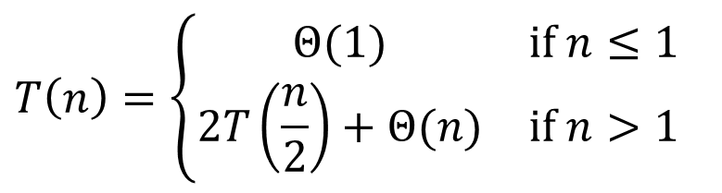
Merge sort
$$T\left(n\right)$$
$$MergeSort(A\left[1..n\right])$$
If $n≥2$, do the following steps.
$MergeSort(A\left[1..\left\lceil n/2\right\rceil \right])$.
$MergeSort(A\left[\left\lceil n/2\right\rceil ..n\right])$.
“Merge” the two sorted arrays.
$$Θ\left(1\right)$$
$$T\left(n\right)=\left\{\begin{matrix}Θ(1) & if n≤1 \\ 2T\left(\frac{n}{2}\right)+Θ(n) & if n>1\end{matrix}\right.$$
$$T\left(n/2\right)$$
$$T\left(n/2\right)$$
$$Θ\left(n\right)$$
VisuAlgo (Merge sort): https://visualgo.net/en/sorting?mode=Merge

Slide 9
Merge sort
Base case
$$T\left(n\right)$$
$$MergeSort(A\left[1..n\right])$$
If $n≥2$, do the following steps.
$MergeSort(A\left[1..\left\lceil n/2\right\rceil \right])$.
$MergeSort(A\left[\left\lceil n/2\right\rceil ..n\right])$.
“Merge” the two sorted arrays.
$$Θ\left(1\right)$$
$$T\left(n\right)=\left\{\begin{matrix}Θ(1) & if n≤1 \\ 2T\left(\frac{n}{2}\right)+Θ(n) & if n>1\end{matrix}\right.$$
$$T\left(n/2\right)$$
$$T\left(n/2\right)$$
$$Θ\left(n\right)$$
Inductive step
Note: We often omit stating the base case because $T\left(n\right)$ is $Θ\left(1\right)$ whenever $n∈O\left(1\right)$.
The precise constant does not matter in most of the cases.
VisuAlgo (Merge sort): https://visualgo.net/en/sorting?mode=Merge

Slide 10

Solving a recurrence
How to solve a given recurrence:
Merge sort: $T\left(n\right)=2T\left(\frac{n}{2}\right)+Θ(n)$
Four methods:
Telescoping
Substitution
Recursion tree
Master theorem

Slide 11
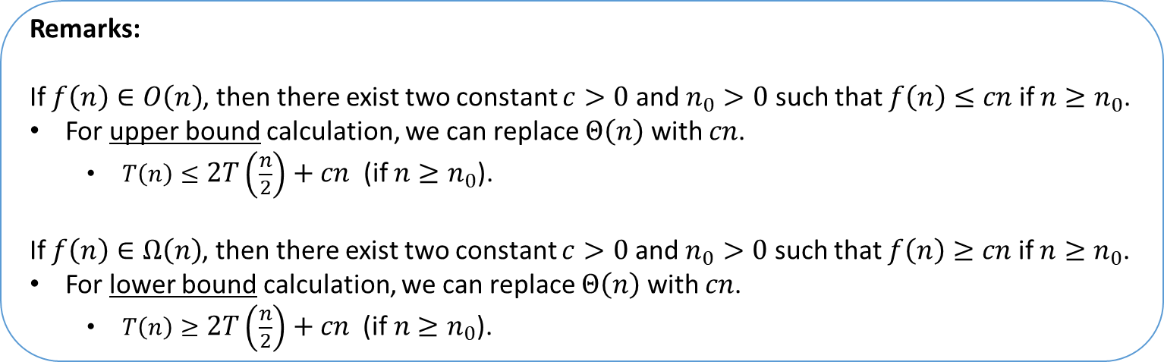

Solving a recurrence
How to solve a given recurrence:
Merge sort: $T\left(n\right)=2T\left(\frac{n}{2}\right)+Θ(n)$
Remarks:
If $f\left(n\right)∈O\left(n\right)$, then there exist two constant $c>0$ and $n_{0}>0$ such that $f\left(n\right)≤cn$ if $n≥n_{0}$.
For upper bound calculation, we can replace $Θ\left(n\right)$ with $cn$.
$T\left(n\right)≤2T\left(\frac{n}{2}\right)+cn$ (if $n≥n_{0}$).
If $f\left(n\right)∈Ω\left(n\right)$, then there exist two constant $c>0$ and $n_{0}>0$ such that $f\left(n\right)≥cn$ if $n≥n_{0}$.
For lower bound calculation, we can replace $Θ\left(n\right)$ with $cn$.
$T\left(n\right)≥2T\left(\frac{n}{2}\right)+cn \text{(}\text{if} n≥n_{0}\text{).}$

Slide 12

Telescoping series
An example:
$$\sum_{k=1}^{n}{\frac{1}{k\left(k+1\right)}}=\sum_{k=1}^{n}{\left(\frac{1}{k}−\frac{1}{k+1}\right)}=\left(\frac{1}{1}−\frac{1}{2}\right)+\left(\frac{1}{2}−\frac{1}{3}\right)+…+\left(\frac{1}{n−1}−\frac{1}{n}\right)+\left(\frac{1}{n}−\frac{1}{n+1}\right)=1−\frac{1}{n+1}$$

Slide 13

Telescoping method
Goal: Solve the recurrence $T\left(n\right)=\left\{\begin{matrix}Θ(1) & if n≤1 \\ 2T\left(\frac{n}{2}\right)+n & if n>1\end{matrix}\right.$
For the sake of simplicity, we omit $Θ\left(⋅\right)$ here and assume that $n=2^{k}$ for some integer $k≥0$.

Slide 14



Telescoping method
$$\frac{T\left(n\right)}{n}=\frac{T\left(\frac{n}{2}\right)}{\frac{n}{2}}+1$$
$$\frac{T\left(\frac{n}{2}\right)}{\frac{n}{2}}=\frac{T\left(\frac{n}{4}\right)}{\frac{n}{4}}+1$$
$$\frac{T\left(\frac{n}{4}\right)}{\frac{n}{4}}=\frac{T\left(\frac{n}{8}\right)}{\frac{n}{8}}+1$$
$$⋮$$
$$\frac{T\left(2\right)}{2}=\frac{T\left(1\right)}{1}+1$$
Goal: Solve the recurrence $T\left(n\right)=\left\{\begin{matrix}Θ(1) & if n≤1 \\ 2T\left(\frac{n}{2}\right)+n & if n>1\end{matrix}\right.$
$\log{n}$

Slide 15

Telescoping method
$$\frac{T\left(n\right)}{n}=\frac{T\left(\frac{n}{2}\right)}{\frac{n}{2}}+1$$
$$\frac{T\left(\frac{n}{2}\right)}{\frac{n}{2}}=\frac{T\left(\frac{n}{4}\right)}{\frac{n}{4}}+1$$
$$\frac{T\left(\frac{n}{4}\right)}{\frac{n}{4}}=\frac{T\left(\frac{n}{8}\right)}{\frac{n}{8}}+1$$
$$⋮$$
$$\frac{T\left(2\right)}{2}=\frac{T\left(1\right)}{1}+1$$
Goal: Solve the recurrence $T\left(n\right)=\left\{\begin{matrix}Θ(1) & if n≤1 \\ 2T\left(\frac{n}{2}\right)+n & if n>1\end{matrix}\right.$
$$\frac{T(n)}{n}=\frac{T(1)}{1}+\log{n}$$
$$T\left(n\right)∈Θ\left(n\log{n}\right)$$
$\log{n}$

Slide 16

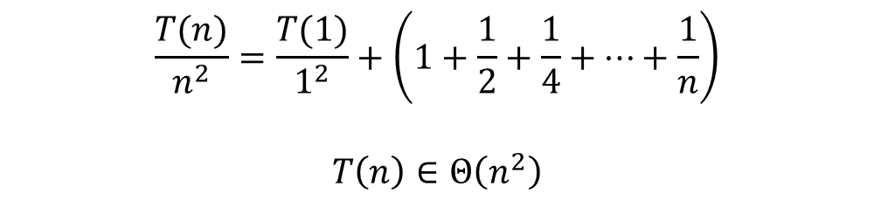

Telescoping method
$$\frac{T\left(n\right)}{n^{2}}=\frac{T\left(\frac{n}{2}\right)}{{\left(\frac{n}{2}\right)}^{2}}+\frac{1}{n}$$
$$\frac{T\left(\frac{n}{2}\right)}{{\left(\frac{n}{2}\right)}^{2}}=\frac{T\left(\frac{n}{4}\right)}{{\left(\frac{n}{4}\right)}^{2}}+\frac{2}{n}$$
$$\frac{T\left(\frac{n}{4}\right)}{{\left(\frac{n}{4}\right)}^{2}}=\frac{T\left(\frac{n}{8}\right)}{{\left(\frac{n}{8}\right)}^{2}}+\frac{4}{n}$$
$$⋮$$
$$\frac{T\left(2\right)}{2^{2}}=\frac{T\left(1\right)}{1^{2}}+1$$
Goal: Solve the recurrence $T\left(n\right)=\left\{\begin{matrix}Θ(1) & if n≤1 \\ 4T\left(\frac{n}{2}\right)+n & if n>1\end{matrix}\right.$
$$\frac{T(n)}{n^{2}}=\frac{T(1)}{1^{2}}+\left(1+\frac{1}{2}+\frac{1}{4}+…+\frac{1}{n}\right)$$
$$T\left(n\right)∈Θ\left(n^{2}\right)$$
$\log{n}$

Slide 17

Substitution method
Step $1$: Guess a solution.
Step $2$: Verify your solution by induction.

Slide 18
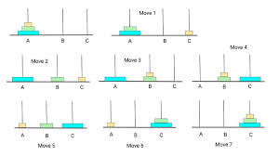
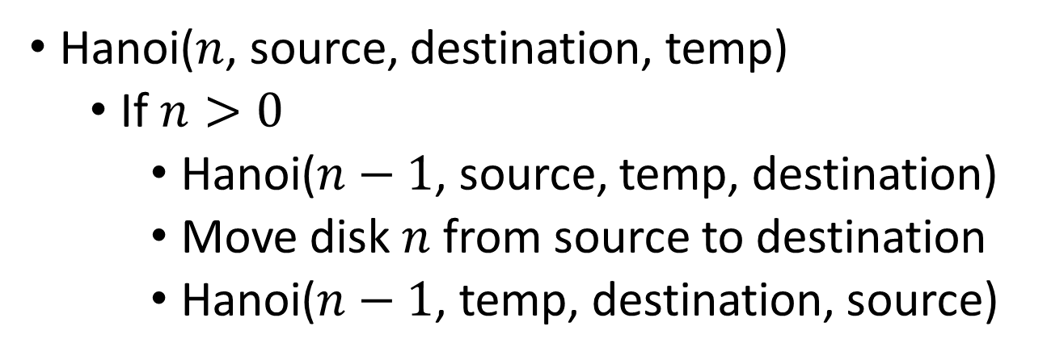
Tower of Hanoi
Hanoi($n$, source, destination, temp)
If $n>0$
Hanoi($n−1$, source, temp, destination)
Move disk $n$ from source to destination
Hanoi($n−1$, temp, destination, source)

Slide 19

Analysis:
$T(n)=2T(n−1)+1$
$T(0)=0$
Prove: $T(n)=2^{n} −1$
Base Cases: $T(0)=0, T(1)=1$
Induction Step:
$T\left(n\right)=2T\left(n−1\right)+1=2⋅ (2^{n−1}−1)+1=2^{n}−1$

Slide 20

Substitution method
Goal: Solve the recurrence $T\left(n\right)=\left\{\begin{matrix}c & if n≤1 \\ 4T\left(\left\lfloor \frac{n}{2}\right\rfloor \right)+n & if n>1\end{matrix}\right.$

Slide 21

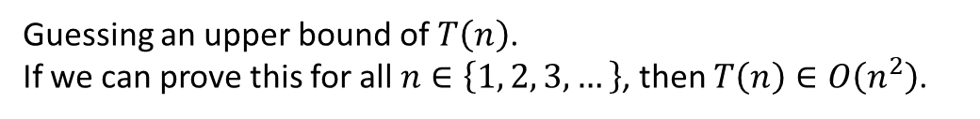
Substitution method
Goal: Solve the recurrence $T\left(n\right)=\left\{\begin{matrix}c & if n≤1 \\ 4T\left(\left\lfloor \frac{n}{2}\right\rfloor \right)+n & if n>1\end{matrix}\right.$
Induction hypothesis: $T\left(n\right)≤\left(c+1\right)n^{2}−n$.
Guessing an upper bound of $T\left(n\right)$.
If we can prove this for all $n∈\left\{1, 2, 3, …\right\}$, then $T\left(n\right)∈O\left(n^{2}\right)$.

Slide 22

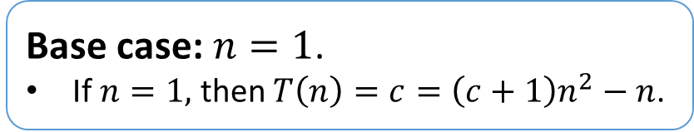
Substitution method
Goal: Solve the recurrence $T\left(n\right)=\left\{\begin{matrix}c & if n≤1 \\ 4T\left(\left\lfloor \frac{n}{2}\right\rfloor \right)+n & if n>1\end{matrix}\right.$
Induction hypothesis: $T\left(n\right)≤\left(c+1\right)n^{2}−n$.
Base case: $n=1$.
If $n=1,$ then $T\left(n\right)=c=\left(c+1\right)n^{2}−n$.

Slide 23



Substitution method
Goal: Solve the recurrence $T\left(n\right)=\left\{\begin{matrix}c & if n≤1 \\ 4T\left(\left\lfloor \frac{n}{2}\right\rfloor \right)+n & if n>1\end{matrix}\right.$
Induction hypothesis: $T\left(n\right)≤\left(c+1\right)n^{2}−n$.
Base case: $n=1$.
If $n=1,$ then $T\left(n\right)=c=\left(c+1\right)n^{2}−n$.
Inductive step: $n≥2$.
$$T\left(n\right)=4T\left(\left\lfloor \frac{n}{2}\right\rfloor \right)+n$$
$$T\left(n\right)≤4\left(c+1\right){\left\lfloor \frac{n}{2}\right\rfloor }^{2}−4\left\lfloor \frac{n}{2}\right\rfloor +n$$
$$T\left(n\right)≤4\left(c+1\right){\left(\frac{n}{2}\right)}^{2}−4\left(\frac{n}{2}\right)+n$$
$$T\left(n\right)=\left(c+1\right)n^{2}−n$$
Induction hypothesis: $T\left(\left\lfloor \frac{n}{2}\right\rfloor \right)≤\left(c+1\right){\left\lfloor \frac{n}{2}\right\rfloor }^{2}−\left\lfloor \frac{n}{2}\right\rfloor$.
The function $\left(c+1\right)x^{2}−x$ is increasing when $x≥1$.
Therefore, $T\left(n\right)∈O\left(n^{2}\right)$.

Slide 24

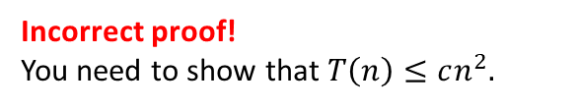

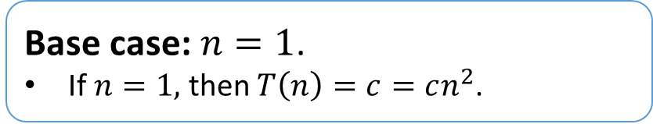

A common mistake
Goal: Solve the recurrence $T\left(n\right)=\left\{\begin{matrix}c & if n≤1 \\ 4T\left(\left\lfloor \frac{n}{2}\right\rfloor \right)+n & if n>1\end{matrix}\right.$
Induction hypothesis: $T\left(n\right)≤cn^{2}$.
Base case: $n=1$.
If $n=1,$ then $T\left(n\right)=c=cn^{2}$.
Inductive step: $n≥2$.
$$T\left(n\right)=4T\left(\left\lfloor \frac{n}{2}\right\rfloor \right)+n$$
$$T\left(n\right)=4c{\left\lfloor \frac{n}{2}\right\rfloor }^{2}+n$$
$$T\left(n\right)∈O\left(n^{2}\right)$$
Induction hypothesis: $T\left(\left\lfloor \frac{n}{2}\right\rfloor \right)≤c{\left\lfloor \frac{n}{2}\right\rfloor }^{2}$.
Incorrect proof!
You need to show that $T\left(n\right)≤cn^{2}.$

Slide 25

Recursion tree
Goal: Solve the recurrence $T\left(n\right)=\left\{\begin{matrix}Θ(1) & if n≤1 \\ 2T\left(\frac{n}{2}\right)+cn & if n>1\end{matrix}\right.$
VisuAlgo (Recursion tree): https://visualgo.net/en/recursion

Slide 26
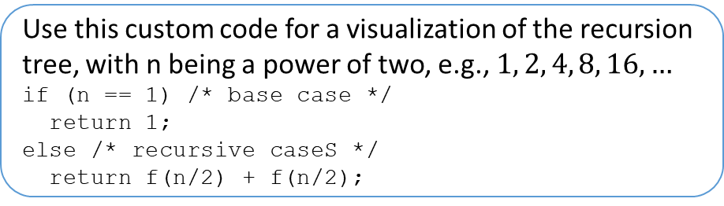
Recursion tree
Goal: Solve the recurrence $T\left(n\right)=\left\{\begin{matrix}Θ(1) & if n≤1 \\ 2T\left(\frac{n}{2}\right)+cn & if n>1\end{matrix}\right.$
Use this custom code for a visualization of the recursion tree, with n being a power of two, e.g., $1, 2, 4, 8, 16, …$
if (n == 1) /* base case */
return 1;
else /* recursive caseS */
return f(n/2) + f(n/2);
VisuAlgo (Recursion tree): https://visualgo.net/en/recursion

Slide 27

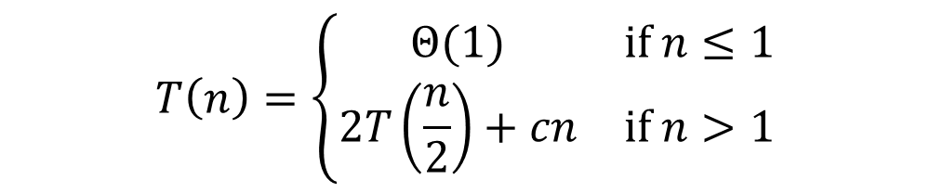



Recursion tree
$$T\left(n\right)=\left\{\begin{matrix}Θ(1) & if n≤1 \\ 2T\left(\frac{n}{2}\right)+cn & if n>1\end{matrix}\right.$$
$$cn$$
$$T\left(n\right)=2T\left(\frac{n}{2}\right)+cn$$
$$T\left(n/2\right)$$
$$T\left(n/2\right)$$
VisuAlgo (Recursion tree): https://visualgo.net/en/recursion

Slide 28







Recursion tree
$$T\left(n\right)=\left\{\begin{matrix}Θ(1) & if n≤1 \\ 2T\left(\frac{n}{2}\right)+cn & if n>1\end{matrix}\right.$$
$$cn$$
$$T\left(n\right)=2T\left(\frac{n}{2}\right)+cn$$
$$cn/2$$
$$cn/2$$
$$T\left(\frac{n}{2}\right)=2T\left(\frac{n}{4}\right)+\frac{cn}{2}$$
$$T\left(n/4\right)$$
$$T\left(n/4\right)$$
$$T\left(n/4\right)$$
$$T\left(n/4\right)$$
VisuAlgo (Recursion tree): https://visualgo.net/en/recursion

Slide 29




























Recursion tree
$$T\left(n\right)=\left\{\begin{matrix}Θ(1) & if n≤1 \\ 2T\left(\frac{n}{2}\right)+cn & if n>1\end{matrix}\right.$$
$$cn$$
$$T\left(n\right)=2T\left(\frac{n}{2}\right)+cn$$
$$cn/2$$
$$cn/2$$
$$T\left(\frac{n}{2}\right)=2T\left(\frac{n}{4}\right)+\frac{cn}{2}$$
$$cn/4$$
$$cn/4$$
$$cn/4$$
$$cn/4$$
$$T\left(\frac{n}{4}\right)=2T\left(\frac{n}{8}\right)+\frac{cn}{4}$$
$$…$$
$$…$$
$$…$$
$$…$$
$$…$$
$$…$$
$$…$$
$$…$$
$$T\left(1\right)$$
$$T\left(1\right)$$
$$T\left(1\right)$$
$$T\left(1\right)$$
$$T\left(1\right)$$
$$T\left(1\right)$$
$$T\left(1\right)$$
$$T\left(1\right)$$
$$T\left(1\right)$$
$$T\left(1\right)$$
$$T\left(1\right)$$
$$T\left(1\right)$$
$$T\left(1\right)$$
$$T\left(1\right)$$
$$T\left(1\right)$$
$$T\left(1\right)$$
VisuAlgo (Recursion tree): https://visualgo.net/en/recursion

Slide 30






Recursion tree
$$T\left(n\right)=\left\{\begin{matrix}Θ(1) & if n≤1 \\ 2T\left(\frac{n}{2}\right)+cn & if n>1\end{matrix}\right.$$
$$cn$$
$$cn$$
$$cn/2$$
$$cn/2$$
$$cn$$
$$cn/4$$
$$cn/4$$
$$cn/4$$
$$cn/4$$
$$cn$$
$\log{n}$ levels
$$…$$
$$…$$
$$…$$
$$…$$
$$…$$
$$…$$
$$…$$
$$…$$
$$cn$$
$$T\left(1\right)$$
$$T\left(1\right)$$
$$T\left(1\right)$$
$$T\left(1\right)$$
$$T\left(1\right)$$
$$T\left(1\right)$$
$$T\left(1\right)$$
$$T\left(1\right)$$
$$T\left(1\right)$$
$$T\left(1\right)$$
$$T\left(1\right)$$
$$T\left(1\right)$$
$$T\left(1\right)$$
$$T\left(1\right)$$
$$T\left(1\right)$$
$$T\left(1\right)$$
$n$ leaves
VisuAlgo (Recursion tree): https://visualgo.net/en/recursion

Slide 31



Recursion tree
$$T\left(n\right)=\left\{\begin{matrix}Θ(1) & if n≤1 \\ 2T\left(\frac{n}{2}\right)+cn & if n>1\end{matrix}\right.$$
$$cn\log{n}∈Θ\left(n\log{n}\right)$$
$$T\left(n\right)=cn\log{n}+nT\left(1\right)∈Θ\left(n\log{n}\right)$$
$$cn$$
$$cn$$
$$cn/2$$
$$cn/2$$
$$cn$$
$$cn/4$$
$$cn/4$$
$$cn/4$$
$$cn/4$$
$$cn$$
$\log{n}$ levels
$$…$$
$$…$$
$$…$$
$$…$$
$$…$$
$$…$$
$$…$$
$$…$$
$$cn$$
$$T\left(1\right)$$
$$T\left(1\right)$$
$$T\left(1\right)$$
$$T\left(1\right)$$
$$T\left(1\right)$$
$$T\left(1\right)$$
$$T\left(1\right)$$
$$T\left(1\right)$$
$$T\left(1\right)$$
$$T\left(1\right)$$
$$T\left(1\right)$$
$$T\left(1\right)$$
$$T\left(1\right)$$
$$T\left(1\right)$$
$$T\left(1\right)$$
$$T\left(1\right)$$
$$nT\left(1\right)∈Θ\left(n\right)$$
$n$ leaves
VisuAlgo (Recursion tree): https://visualgo.net/en/recursion

Slide 32
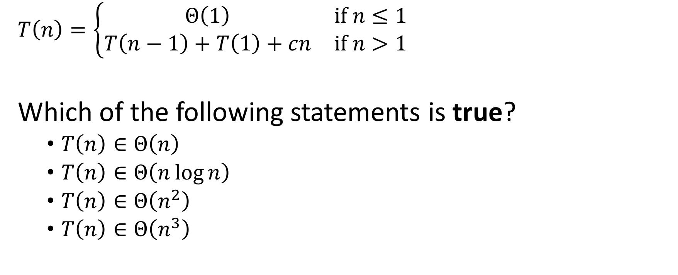
Question
$T\left(n\right)=\left\{\begin{matrix}Θ\left(1\right) & if n≤1 \\ T\left(n−1\right)+T\left(1\right)+cn & if n>1\end{matrix}\right.$
Which of the following statements is true?
$T\left(n\right)∈Θ\left(n\right)$
$T\left(n\right)∈Θ\left(n\log{n}\right)$
$T\left(n\right)∈Θ\left(n^{2}\right)$
$T\left(n\right)∈Θ\left(n^{3}\right)$

Slide 33














Answer
$$cn$$
$$c\left(n−1\right)$$
$$T\left(1\right)$$
$T\left(n\right)=\left\{\begin{matrix}Θ\left(1\right) & if n≤1 \\ T\left(n−1\right)+T\left(1\right)+cn & if n>1\end{matrix}\right.$
$$T\left(n\right)=n⋅T\left(1\right)+c\left(2+3+⋯+\left(n−1\right)+n\right)$$
$$T\left(n\right)∈Θ\left(n^{2}\right)$$
$$c\left(n−2\right)$$
$$T\left(1\right)$$
$$c\left(n−3\right)$$
$$T\left(1\right)$$
$$T\left(1\right)$$
$$Θ\left(n\right)$$
$$Θ\left(n^{2}\right)$$
$c(2$)
$$T\left(1\right)$$
$$T\left(1\right)$$
VisuAlgo (Worst-case analysis of quick sort): https://visualgo.net/en/recursion?example=QuickSort

Slide 34

Question
Who is the Master of Algorithms pictured below?
Robert Floyd
Richard Karp
Donald Knuth
Alan Turing

Slide 35
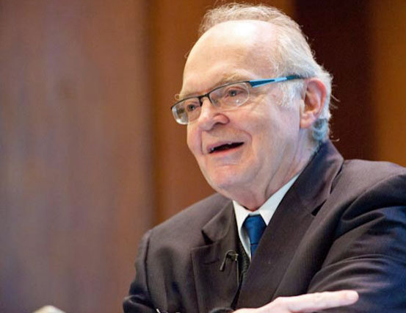
Answer
Donald Knuth
1974 Turing Award (at the age of 36).
Author of The Art of Computer Programming.
Creator of the TeX computer typesetting system.
The father of the analysis of algorithms.
He contributed to the development of the rigorous analysis of the computational complexity of algorithms and systematized formal mathematical techniques for it. In the process, he also popularized the asymptotic notation.
Source: https://en.wikipedia.org/wiki/Donald_Knuth

Slide 36
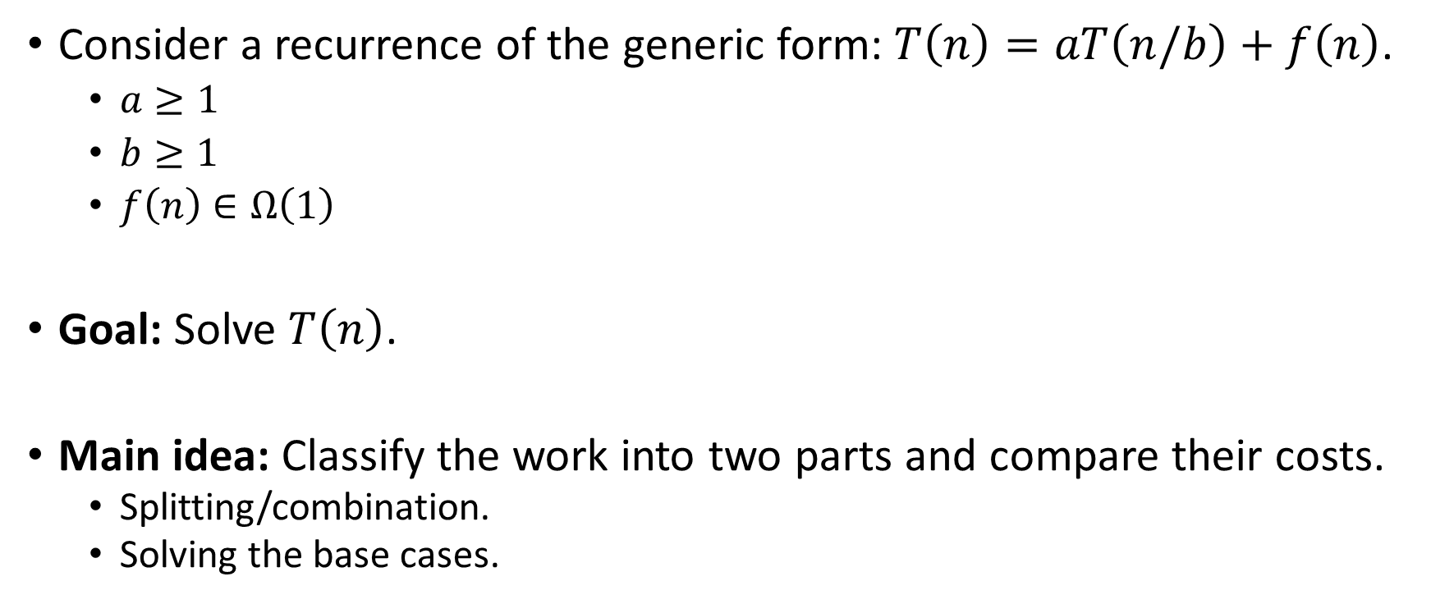
Solving a recurrence of the generic form
Consider a recurrence of the generic form: $T\left(n\right)=aT\left(n/b\right)+f\left(n\right)$.
$a≥1$
$b≥1$
$f\left(n\right)∈Ω\left(1\right)$
Goal: Solve $T\left(n\right)$.
Main idea: Classify the work into two parts and compare their costs.
Splitting/combination.
Solving the base cases.

Slide 37
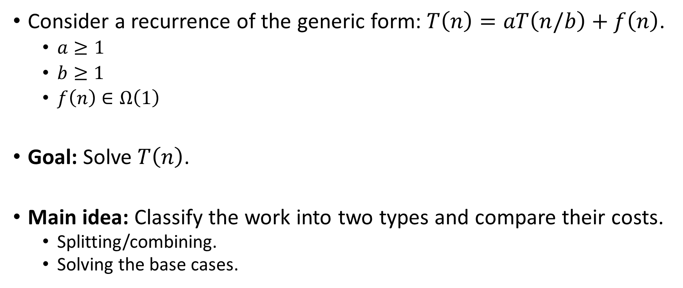
Solving a recurrence of the generic form
Consider a recurrence of the generic form: $T\left(n\right)=aT\left(n/b\right)+f\left(n\right)$.
$a≥1$
$b≥1$
$f\left(n\right)∈Ω\left(1\right)$
Goal: Solve $T\left(n\right)$.
Main idea: Classify the work into two types and compare their costs.
Splitting/combining.
Solving the base cases.

Slide 38








































Two types of work
Splitting/combining:
Split a problem into sub-problems.
Combine the solutions of subproblems.
$$T\left(n\right)=cn\log{n}+nT\left(1\right)∈Θ\left(n\log{n}\right)$$
$$cn\log{n}∈Θ\left(n\log{n}\right)$$
$$cn$$
$$cn$$
$$cn/2$$
$$cn/2$$
$$cn$$
$$cn/4$$
$$cn/4$$
$$cn/4$$
$$cn/4$$
$$cn$$
$\log{n}$ levels
$$…$$
$$…$$
$$…$$
$$…$$
$$…$$
$$…$$
$$…$$
$$…$$
$$cn$$
$$T\left(1\right)$$
$$T\left(1\right)$$
$$T\left(1\right)$$
$$T\left(1\right)$$
$$T\left(1\right)$$
$$T\left(1\right)$$
$$T\left(1\right)$$
$$T\left(1\right)$$
$$T\left(1\right)$$
$$T\left(1\right)$$
$$T\left(1\right)$$
$$T\left(1\right)$$
$$T\left(1\right)$$
$$T\left(1\right)$$
$$T\left(1\right)$$
$$T\left(1\right)$$
$$nT\left(1\right)∈Θ\left(n\right)$$
$n$ leaves
Solving the base cases:
The cost is linear in the number of leaves.

Slide 39

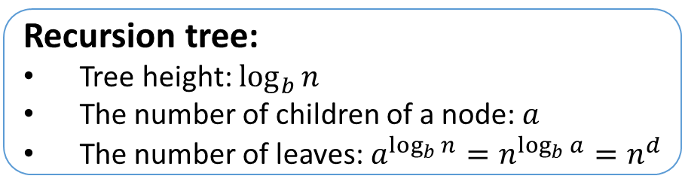
Two types of work
Consider a recurrence of the generic form: $T\left(n\right)=aT\left(n/b\right)+f\left(n\right)$.
Solving the base cases
Splitting/combining
The number of leaves $=n^{d}$, where $d=\log_{b}{a}$ is the critical exponent.
Recursion tree:
Tree height: $\log_{b}{n}$
The number of children of a node: $a$
The number of leaves: $a^{\log_{b}{n}}=n^{\log_{b}{a}}=n^{d}$

Slide 40
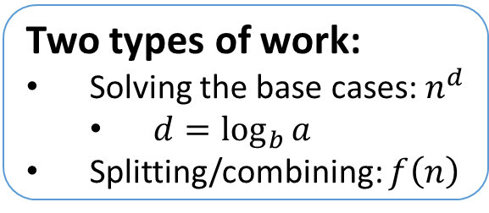


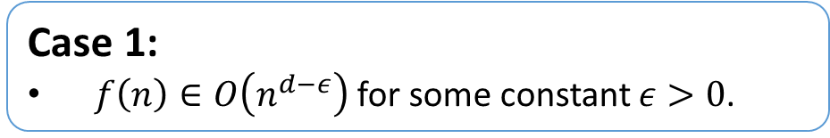
Master theorem
Two types of work:
Solving the base cases: $n^{d}$
$d=\log_{b}{a}$
Splitting/combining: $f\left(n\right)$
Dominant term
Consider a recurrence of the generic form: $T\left(n\right)=aT\left(n/b\right)+f\left(n\right)$.
Case 1:
$f\left(n\right)∈O\left(n^{d−ε}\right)$ for some constant $ε>0$.
$$T\left(n\right)∈Θ\left(n^{d}\right)$$

Slide 41
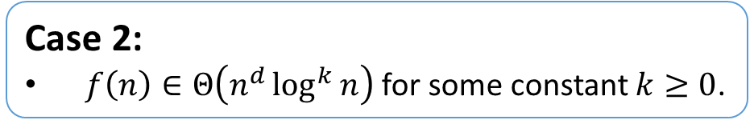

Master theorem
Two types of work:
Solving the base cases: $n^{d}$
$d=\log_{b}{a}$
Splitting/combining: $f\left(n\right)$
Comparable
Consider a recurrence of the generic form: $T\left(n\right)=aT\left(n/b\right)+f\left(n\right)$.
Case 1:
$f\left(n\right)∈O\left(n^{d−ε}\right)$ for some constant $ε>0$.
$$T\left(n\right)∈Θ\left(n^{d}\right)$$
Case 2:
$f\left(n\right)∈Θ\left(n^{d}\log^{k}{n}\right)$ for some constant $k≥0$.
$$T\left(n\right)∈Θ\left(n^{d}\log^{k+1}{n}\right)$$

Slide 42
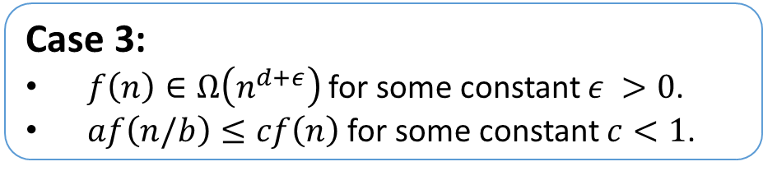

Master theorem
Two types of work:
Solving the base cases: $n^{d}$
$d=\log_{b}{a}$
Splitting/combining: $f\left(n\right)$
Dominant term
Consider a recurrence of the generic form: $T\left(n\right)=aT\left(n/b\right)+f\left(n\right)$.
Case 1:
$f\left(n\right)∈O\left(n^{d−ε}\right)$ for some constant $ε>0$.
$$T\left(n\right)∈Θ\left(n^{d}\right)$$
Case 2:
$f\left(n\right)∈Θ\left(n^{d}\log^{k}{n}\right)$ for some constant $k≥0$.
$$T\left(n\right)∈Θ\left(n^{d}\log^{k+1}{n}\right)$$
Case 3:
$f\left(n\right)∈Ω\left(n^{d+ε}\right)$ for some constant $ε >0$.
$af\left(n/b\right)≤cf\left(n\right)$ for some constant $c<1$.
$$T\left(n\right)∈Θ\left(f\left(n\right)\right)$$
A regularity condition ensuring that the splitting/combining cost $f\left(n\right)$at the top level of recursion is the dominant term.

Slide 43

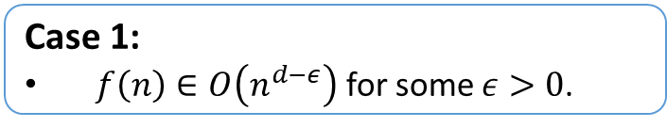






Examples
Two types of work:
Solving the base cases: $n^{d}$
$d=\log_{b}{a}$
Splitting/combining: $f\left(n\right)$
Dominant term
Consider a recurrence of the generic form: $T\left(n\right)=aT\left(n/b\right)+f\left(n\right)$.
Critical exponent: $d=\log_{b}{a}$
Case 1:
$f\left(n\right)∈O\left(n^{d−ε}\right)$ for some $ε>0$.
Solve: $T\left(n\right)=4T\left(n/2\right)+n$.
$a=4$
$b=2$
$d=\log_{b}{a}=2$
$f\left(n\right)=n∈O\left(n^{d−ε}\right)$ for $ε=1$
Case 1 $→$ $T\left(n\right)∈Θ\left(n^{2}\right)$
$$T\left(n\right)∈Θ\left(n^{d}\right)$$
Case 2:
$f\left(n\right)∈Θ\left(n^{d}\log^{k}{n}\right)$ for some $k≥0$.
$$T\left(n\right)∈Θ\left(n^{d}\log^{k+1}{n}\right)$$
Case 3:
$f\left(n\right)∈Ω\left(n^{d+ε}\right)$ for some $ε >0$.
$af\left(n/b\right)≤cf\left(n\right)$ for some $c<1$.
$$T\left(n\right)∈Θ\left(f\left(n\right)\right)$$
Regularity condition
VisuAlgo (Master theorem): https://visualgo.net/en/recursion?example=MT1L2 – you can change $n,a,b,f\left(n\right)$

Slide 44

Examples
Two types of work:
Solving the base cases: $n^{d}$
$d=\log_{b}{a}$
Splitting/combining: $f\left(n\right)$
Comparable
Consider a recurrence of the generic form: $T\left(n\right)=aT\left(n/b\right)+f\left(n\right)$.
Critical exponent: $d=\log_{b}{a}$
Case 1:
$f\left(n\right)∈O\left(n^{d−ε}\right)$ for some $ε>0$.
Solve: $T\left(n\right)=2T\left(n/2\right)+n$.
$a=2$
$b=2$
$d=\log_{b}{a}=1$
$f\left(n\right)=n∈Θ\left(n^{d}\log^{k}{n}\right)$ for $k=0$
Case 2 $→$ $T\left(n\right)∈Θ\left(n\log{n}\right)$
$$T\left(n\right)∈Θ\left(n^{d}\right)$$
Case 2:
$f\left(n\right)∈Θ\left(n^{d}\log^{k}{n}\right)$ for some $k≥0$.
$$T\left(n\right)∈Θ\left(n^{d}\log^{k+1}{n}\right)$$
Case 3:
$f\left(n\right)∈Ω\left(n^{d+ε}\right)$ for some $ε >0$.
$af\left(n/b\right)≤cf\left(n\right)$ for some $c<1$.
$$T\left(n\right)∈Θ\left(f\left(n\right)\right)$$
Regularity condition
VisuAlgo (Master theorem): https://visualgo.net/en/recursion?example=MT1L2 – you can change $n,a,b,f\left(n\right)$

Slide 45


Question
Question: $T\left(n\right)=4T\left(\frac{n}{2}\right)+n^{3}$ satisfies which case of the master theorem?
$T\left(n\right)=aT\left(n/b\right)+f\left(n\right)$.
Critical exponent: $d=\log_{b}{a}$
Case 1.
Case 2.
Case 3.
None of the above.
Case 1:
$f\left(n\right)∈O\left(n^{d−ε}\right)$ for some $ε>0$.
$$T\left(n\right)∈Θ\left(n^{d}\right)$$
Case 2:
$f\left(n\right)∈Θ\left(n^{d}\log^{k}{n}\right)$ for some $k≥0$.
$$T\left(n\right)∈Θ\left(n^{d}\log^{k+1}{n}\right)$$
Case 3:
$f\left(n\right)∈Ω\left(n^{d+ε}\right)$ for some $ε >0$.
$af\left(n/b\right)≤cf\left(n\right)$ for some $c<1$.
$$T\left(n\right)∈Θ\left(f\left(n\right)\right)$$
Regularity condition
VisuAlgo (Master theorem): https://visualgo.net/en/recursion?example=MT1L2 – you can change $n,a,b,f\left(n\right)$

Slide 46

Answer
Two types of work:
Solving the base cases: $n^{d}$
$d=\log_{b}{a}$
Splitting/combining: $f\left(n\right)$
Dominant term
Consider a recurrence of the generic form: $T\left(n\right)=aT\left(n/b\right)+f\left(n\right)$.
Critical exponent: $d=\log_{b}{a}$
Case 1:
$f\left(n\right)∈O\left(n^{d−ε}\right)$ for some $ε>0$.
Solve: $T\left(n\right)=4T\left(n/2\right)+n^{3}$.
$a=4$
$b=2$
$d=\log_{b}{a}=2$
$f\left(n\right)=Ω\left(n^{d+ε}\right)$ for $ε=1$
Regularity condition:
$af\left(n/b\right)=\frac{n^{3}}{2}≤cn^{3}=cf\left(n\right)$ for $c=\frac{1}{2}$
Case 3 $→$ $T\left(n\right)∈Θ\left(n^{3}\right)$
$$T\left(n\right)∈Θ\left(n^{d}\right)$$
Case 2:
$f\left(n\right)∈Θ\left(n^{d}\log^{k}{n}\right)$ for some $k≥0$.
$$T\left(n\right)∈Θ\left(n^{d}\log^{k+1}{n}\right)$$
Case 3:
$f\left(n\right)∈Ω\left(n^{d+ε}\right)$ for some $ε >0$.
$af\left(n/b\right)≤cf\left(n\right)$ for some $c<1$.
$$T\left(n\right)∈Θ\left(f\left(n\right)\right)$$
Regularity condition
VisuAlgo (Master theorem): https://visualgo.net/en/recursion?example=MT1L2 – you can change $n,a,b,f\left(n\right)$

Slide 47


Remarks
The master theorem does not cover all recurrences of the generic form:
$T\left(n\right)=aT\left(n/b\right)+f\left(n\right)$.
Example:
$T\left(n\right)=T\left(n/2\right)+2^{\sqrt{\log{n}}}$.
Critical exponent: $d=\log_{b}{a}=0$.
$f\left(n\right)=2^{\sqrt{\log{n}}}∉O\left(n^{0−ε}\right)\text{ → }\text{Not} \text{C}\text{ase}\text{ 1}$.
$f\left(n\right)=2^{\sqrt{\log{n}}}∉Θ\left(n^{0}{\text{log}}^{k}n\right)$ for any $k0$ → Not Case 2.
$f\left(n\right)=2^{\sqrt{\log{n}}}∉Ω\left(n^{0+ε}\right)$ → Not Case 3.

Slide 48

Remarks
The master theorem does not cover all recurrences of the generic form:
$T\left(n\right)=aT\left(n/b\right)+f\left(n\right)$.
Example:
$T\left(n\right)=T\left(n/2\right)+2^{\sqrt{\log{n}}}$.
Exercise:
$T\left(n\right)∈Θ\left(2^{\sqrt{\log{n}}}⋅\sqrt{\log{n}}\right)$
Critical exponent: $d=\log_{b}{a}=0$.
$f\left(n\right)=2^{\sqrt{\log{n}}}∉O\left(n^{0−ε}\right)\text{ → }\text{Not} \text{C}\text{ase}\text{ 1}$.
$f\left(n\right)=2^{\sqrt{\log{n}}}∉Θ\left(n^{0}{\text{log}}^{k}n\right)$ for any $k0$ → Not Case 2.
$f\left(n\right)=2^{\sqrt{\log{n}}}∉Ω\left(n^{0+ε}\right)$ → Not Case 3.
Indeed, all three cases are not applicable.

Slide 49









Remarks
Regularity condition
$af\left(n/b\right)≤cf\left(n\right)$
The condition $f\left(n\right)∈Ω\left(n^{d+ε}\right)$ is redundant in Case 3.
$\frac{a}{c}f\left(n/b\right)≤f\left(n\right)$
Critical exponent: $d=\log_{b}{a}$
${\left(\frac{a}{c}\right)}^{i}f\left(1\right)≤f\left(b^{i}\right)$
Case 3:
$f\left(n\right)∈Ω\left(n^{d+ε}\right)$ for some $ε >0$.
$af\left(n/b\right)≤cf\left(n\right)$ for some $c<1$.
Regularity condition
$$Ω\left(n^{d+ε}\right)∋n^{\log_{b}\left(\frac{a}{c}\right)}f\left(1\right)={\left(\frac{a}{c}\right)}^{\log_{b}{n}}f\left(1\right)≤f\left(n\right)$$
$$ε=\log_{b}\left(\frac{a}{c}\right)−\log_{b}{a}>0$$
$$n=b^{i}$$

Slide 50







































Proof of the master theorem
Critical exponent: $d=\log_{b}{a}$
Case 3: $f\left(n\right)∈Ω\left(n^{d+ε}\right)$ for some $ε >0$.
$af\left(n/b\right)≤cf\left(n\right)$ for some $c<1$.
Goal: $T\left(n\right)∈Θ\left(f\left(n\right)\right)$
$$f\left(n\right)$$
$$f\left(n\right)$$
$$a$$
$$af\left(n/b\right)$$
$$f\left(n/b\right)$$
$$f\left(n/b\right)$$
$$a$$
$$a$$
$$a^{2}f\left(n/b^{2}\right)$$
$$f\left(n/b^{2}\right)$$
$$f\left(n/b^{2}\right)$$
$$f\left(n/b^{2}\right)$$
$$f\left(n/b^{2}\right)$$
$$a$$
$$a$$
$$a$$
$$a$$
$\log_{b}{n}$ levels
$$…$$
$$…$$
$$…$$
$$…$$
$$…$$
$$…$$
$$…$$
$$…$$
$$T\left(1\right)$$
$$T\left(1\right)$$
$$T\left(1\right)$$
$$T\left(1\right)$$
$$T\left(1\right)$$
$$T\left(1\right)$$
$$T\left(1\right)$$
$$T\left(1\right)$$
$$T\left(1\right)$$
$$T\left(1\right)$$
$$T\left(1\right)$$
$$T\left(1\right)$$
$$T\left(1\right)$$
$$T\left(1\right)$$
$$T\left(1\right)$$
$$T\left(1\right)$$
$n^{d}=n^{\log_{b}{a}}$ leaves

Slide 51

Proof of the master theorem
Critical exponent: $d=\log_{b}{a}$
Case 3: $f\left(n\right)∈Ω\left(n^{d+ε}\right)$ for some $ε >0$.
$af\left(n/b\right)≤cf\left(n\right)$ for some $c<1$.
Goal: $T\left(n\right)∈Θ\left(f\left(n\right)\right)$
$$f\left(n\right)$$
$$f\left(n\right)$$
$$a$$
$$af\left(n/b\right)$$
$$f\left(n/b\right)$$
$$f\left(n/b\right)$$
$$a$$
$$a$$
$$a^{2}f\left(n/b^{2}\right)$$
$$f\left(n/b^{2}\right)$$
$$f\left(n/b^{2}\right)$$
$$f\left(n/b^{2}\right)$$
$$f\left(n/b^{2}\right)$$
$$a$$
$$a$$
$$a$$
$$a$$
$\log_{b}{n}$ levels
$$…$$
$$…$$
$$…$$
$$…$$
$$…$$
$$…$$
$$…$$
$$…$$
$$T\left(1\right)$$
$$T\left(1\right)$$
$$T\left(1\right)$$
$$T\left(1\right)$$
$$T\left(1\right)$$
$$T\left(1\right)$$
$$T\left(1\right)$$
$$T\left(1\right)$$
$$T\left(1\right)$$
$$T\left(1\right)$$
$$T\left(1\right)$$
$$T\left(1\right)$$
$$T\left(1\right)$$
$$T\left(1\right)$$
$$T\left(1\right)$$
$$T\left(1\right)$$
$n^{d}=n^{\log_{b}{a}}$ leaves
Solving the base cases: The cost is $n^{d}T\left(1\right)∈o\left(f(n)\right)$.

Slide 52

Proof of the master theorem
Critical exponent: $d=\log_{b}{a}$
Case 3: $f\left(n\right)∈Ω\left(n^{d+ε}\right)$ for some $ε >0$.
$af\left(n/b\right)≤cf\left(n\right)$ for some $c<1$.
Goal: $T\left(n\right)∈Θ\left(f\left(n\right)\right)$
Splitting/combining:
$$f\left(n\right)$$
$$f\left(n\right)$$
$$a$$
$$af\left(n/b\right)$$
$$f\left(n/b\right)$$
$$f\left(n/b\right)$$
$$a$$
$$a$$
$$a^{2}f\left(n/b^{2}\right)$$
$$f\left(n/b^{2}\right)$$
$$f\left(n/b^{2}\right)$$
$$f\left(n/b^{2}\right)$$
$$f\left(n/b^{2}\right)$$
$$a$$
$$a$$
$$a$$
$$a$$
$\log_{b}{n}$ levels
$$…$$
$$…$$
$$…$$
$$…$$
$$…$$
$$…$$
$$…$$
$$…$$
$$T\left(1\right)$$
$$T\left(1\right)$$
$$T\left(1\right)$$
$$T\left(1\right)$$
$$T\left(1\right)$$
$$T\left(1\right)$$
$$T\left(1\right)$$
$$T\left(1\right)$$
$$T\left(1\right)$$
$$T\left(1\right)$$
$$T\left(1\right)$$
$$T\left(1\right)$$
$$T\left(1\right)$$
$$T\left(1\right)$$
$$T\left(1\right)$$
$$T\left(1\right)$$
Just need to show that this part is $Θ\left(f\left(n\right)\right)$.
$n^{d}=n^{\log_{b}{a}}$ leaves
Solving the base cases: The cost is $n^{d}T\left(1\right)∈o\left(f(n)\right)$.

Slide 53






Proof of the master theorem
Critical exponent: $d=\log_{b}{a}$
Case 3: $f\left(n\right)∈Ω\left(n^{d+ε}\right)$ for some $ε >0$.
$af\left(n/b\right)≤cf\left(n\right)$ for some $c<1$.
Goal: $T\left(n\right)∈Θ\left(f\left(n\right)\right)$
Splitting/combining:
Splitting/combining:
$$f\left(n\right)$$
$$af\left(n/b\right)$$
$$≤cf(n)$$
$$a^{2}f\left(n/b^{2}\right)$$
$$≤c^{2}f(n)$$
$\log_{b}{n}$ levels
……
$$\left(1+c+c^{2}+⋯\right)<\frac{1}{1−c}$$
$$…$$
$Ω\left(f\left(n\right)\right)∋f\left(n\right)≤$overall cost $≤f\left(n\right)⋅\left(1+c+c^{2}+⋯\right)∈O\left(f\left(n\right)\right)$
Just need to show that this part is $Θ\left(f\left(n\right)\right)$.
$\log_{b}{n}$ terms

Slide 54


Proof of the master theorem
Critical exponent: $d=\log_{b}{a}$
Case 1: $f\left(n\right)∈O\left(n^{d−ε}\right)$ for some $ε>0$.
Goal: $T\left(n\right)∈Θ\left(n^{d}\right)$
$$f\left(n\right)$$
$$a$$
$$f\left(n/b\right)$$
$$f\left(n/b\right)$$
$$a$$
$$a$$
$$f\left(n/b^{2}\right)$$
$$f\left(n/b^{2}\right)$$
$$f\left(n/b^{2}\right)$$
$$f\left(n/b^{2}\right)$$
$$a$$
$$a$$
$$a$$
$$a$$
$\log_{b}{n}$ levels
$$…$$
$$…$$
$$…$$
$$…$$
$$…$$
$$…$$
$$…$$
$$…$$
$$T\left(1\right)$$
$$T\left(1\right)$$
$$T\left(1\right)$$
$$T\left(1\right)$$
$$T\left(1\right)$$
$$T\left(1\right)$$
$$T\left(1\right)$$
$$T\left(1\right)$$
$$T\left(1\right)$$
$$T\left(1\right)$$
$$T\left(1\right)$$
$$T\left(1\right)$$
$$T\left(1\right)$$
$$T\left(1\right)$$
$$T\left(1\right)$$
$$T\left(1\right)$$
$n^{d}=n^{\log_{b}{a}}$ leaves

Slide 55

Proof of the master theorem
Critical exponent: $d=\log_{b}{a}$
Case 1: $f\left(n\right)∈O\left(n^{d−ε}\right)$ for some $ε>0$.
Goal: $T\left(n\right)∈Θ\left(n^{d}\right)$
$$f\left(n\right)$$
$$a$$
$$f\left(n/b\right)$$
$$f\left(n/b\right)$$
$$a$$
$$a$$
$$f\left(n/b^{2}\right)$$
$$f\left(n/b^{2}\right)$$
$$f\left(n/b^{2}\right)$$
$$f\left(n/b^{2}\right)$$
$$a$$
$$a$$
$$a$$
$$a$$
$\log_{b}{n}$ levels
$$…$$
$$…$$
$$…$$
$$…$$
$$…$$
$$…$$
$$…$$
$$…$$
$$T\left(1\right)$$
$$T\left(1\right)$$
$$T\left(1\right)$$
$$T\left(1\right)$$
$$T\left(1\right)$$
$$T\left(1\right)$$
$$T\left(1\right)$$
$$T\left(1\right)$$
$$T\left(1\right)$$
$$T\left(1\right)$$
$$T\left(1\right)$$
$$T\left(1\right)$$
$$T\left(1\right)$$
$$T\left(1\right)$$
$$T\left(1\right)$$
$$T\left(1\right)$$
$n^{d}=n^{\log_{b}{a}}$ leaves
Solving the base cases: The cost is already $n^{d}T\left(1\right)∈Θ\left(n^{d}\right)$.

Slide 56

Proof of the master theorem
Critical exponent: $d=\log_{b}{a}$
Case 1: $f\left(n\right)∈O\left(n^{d−ε}\right)$ for some $ε>0$.
Goal: $T\left(n\right)∈Θ\left(n^{d}\right)$
Splitting/combining:
$$f\left(n\right)$$
$$f\left(n\right)$$
$$a$$
$$af\left(n/b\right)$$
$$f\left(n/b\right)$$
$$f\left(n/b\right)$$
$$a$$
$$a$$
$$a^{2}f\left(n/b^{2}\right)$$
$$f\left(n/b^{2}\right)$$
$$f\left(n/b^{2}\right)$$
$$f\left(n/b^{2}\right)$$
$$f\left(n/b^{2}\right)$$
$$a$$
$$a$$
$$a$$
$$a$$
$\log_{b}{n}$ levels
$$…$$
$$…$$
$$…$$
$$…$$
$$…$$
$$…$$
$$…$$
$$…$$
$$…$$
$$T\left(1\right)$$
$$T\left(1\right)$$
$$T\left(1\right)$$
$$T\left(1\right)$$
$$T\left(1\right)$$
$$T\left(1\right)$$
$$T\left(1\right)$$
$$T\left(1\right)$$
$$T\left(1\right)$$
$$T\left(1\right)$$
$$T\left(1\right)$$
$$T\left(1\right)$$
$$T\left(1\right)$$
$$T\left(1\right)$$
$$T\left(1\right)$$
$$T\left(1\right)$$
Just need to show that this part is $O\left(n^{d}\right)$.
$n^{d}=n^{\log_{b}{a}}$ leaves
Solving the base cases: The cost is already $n^{d}T\left(1\right)∈Θ\left(n^{d}\right)$.

Slide 57




Proof of the master theorem
Critical exponent: $d=\log_{b}{a}$
Case 1: $f\left(n\right)∈O\left(n^{d−ε}\right)$ for some $ε>0$.
Goal: $T\left(n\right)∈Θ\left(n^{d}\right)$
Splitting/combining:
$$f\left(n\right)$$
$$≤cn^{d−ε}$$
$$≤ac{\left(\frac{n}{b}\right)}^{d−ε}$$
$$af\left(n/b\right)$$
$$≤a^{2}c{\left(\frac{n}{b^{2}}\right)}^{d−ε}$$
$$a^{2}f\left(n/b^{2}\right)$$
$\log_{b}{n}$ levels
$$∃n_{0}>0 and ∃c>0$$
$$such that f\left(n\right)≤cn^{d−ε}$$
$$…$$
Just need to show that this part is $O\left(n^{d}\right)$.

Slide 58


Proof of the master theorem
Critical exponent: $d=\log_{b}{a}$
Case 1: $f\left(n\right)∈O\left(n^{d−ε}\right)$ for some $ε>0$.
Goal: $T\left(n\right)∈Θ\left(n^{d}\right)$
Splitting/combining:
$$f\left(n\right)$$
$$≤cn^{d−ε}$$
$$≤ac{\left(\frac{n}{b}\right)}^{d−ε}$$
$$af\left(n/b\right)$$
$$=cn^{d−ε}⋅ab^{ε−d}$$
$$≤a^{2}c{\left(\frac{n}{b^{2}}\right)}^{d−ε}$$
$$=cn^{d−ε}⋅{\left(ab^{ε−d}\right)}^{2}$$
$$a^{2}f\left(n/b^{2}\right)$$
$\log_{b}{n}$ levels
$$∃n_{0}>0 and ∃c>0$$
$$such that f\left(n\right)≤cn^{d−ε}$$
$$…$$
Just need to show that this part is $O\left(n^{d}\right)$.

Slide 59



Proof of the master theorem
Critical exponent: $d=\log_{b}{a}$
Case 1: $f\left(n\right)∈O\left(n^{d−ε}\right)$ for some $ε>0$.
Goal: $T\left(n\right)∈Θ\left(n^{d}\right)$
Splitting/combining:
$$f\left(n\right)$$
$$≤cn^{d−ε}$$
$$≤ac{\left(\frac{n}{b}\right)}^{d−ε}$$
$$af\left(n/b\right)$$
$$=cn^{d−ε}⋅ab^{ε−d}$$
$$=cn^{d−ε}⋅b^{ε}$$
$$≤a^{2}c{\left(\frac{n}{b^{2}}\right)}^{d−ε}$$
$$=cn^{d−ε}⋅{\left(ab^{ε−d}\right)}^{2}$$
$$a^{2}f\left(n/b^{2}\right)$$
$$=cn^{d−ε}⋅b^{2ε}$$
$\log_{b}{n}$ levels
$$∃n_{0}>0 and ∃c>0$$
$$such that f\left(n\right)≤cn^{d−ε}$$
$$b^{d}=a$$
$$…$$
Just need to show that this part is $O\left(n^{d}\right)$.

Slide 60

Proof of the master theorem
Critical exponent: $d=\log_{b}{a}$
Case 1: $f\left(n\right)∈O\left(n^{d−ε}\right)$ for some $ε>0$.
Goal: $T\left(n\right)∈Θ\left(n^{d}\right)$
Splitting/combining:
$$f\left(n\right)$$
$$≤cn^{d−ε}$$
$$≤ac{\left(\frac{n}{b}\right)}^{d−ε}$$
$$af\left(n/b\right)$$
$$=cn^{d−ε}⋅ab^{ε−d}$$
$$=cn^{d−ε}⋅b^{ε}$$
$$≤a^{2}c{\left(\frac{n}{b^{2}}\right)}^{d−ε}$$
$$=cn^{d−ε}⋅{\left(ab^{ε−d}\right)}^{2}$$
$$a^{2}f\left(n/b^{2}\right)$$
$$=cn^{d−ε}⋅b^{2ε}$$
$\log_{b}{n}$ levels
$$∃n_{0}>0 and ∃c>0$$
$$such that f\left(n\right)≤cn^{d−ε}$$
$$b^{d}=a$$
$$…$$
Overall cost:
$$O\left(n^{d−ε}\right)⋅\left(1+b^{ε}+b^{2ε}+⋯\right)=O\left(n^{d−ε}\right)⋅O\left(b^{ε\log_{b}{n}}\right)=O\left(n^{d−ε}\right)⋅O\left(n^{ε}\right)=O\left(n^{d}\right)$$
Just need to show that this part is $O\left(n^{d}\right)$.
$\log_{b}{n}$ terms

Slide 61


Proof of the master theorem
Critical exponent: $d=\log_{b}{a}$
Case 2: $f\left(n\right)∈Θ\left(n^{d}\log^{k}{n}\right)$ for some $k≥0$.
Goal: $T\left(n\right)∈Θ\left(n^{d}\log^{k+1}{n}\right)$
$$f\left(n\right)$$
$$a$$
$$f\left(n/b\right)$$
$$f\left(n/b\right)$$
$$a$$
$$a$$
$$f\left(n/b^{2}\right)$$
$$f\left(n/b^{2}\right)$$
$$f\left(n/b^{2}\right)$$
$$f\left(n/b^{2}\right)$$
$$a$$
$$a$$
$$a$$
$$a$$
$\log_{b}{n}$ levels
$$…$$
$$…$$
$$…$$
$$…$$
$$…$$
$$…$$
$$…$$
$$…$$
$$T\left(1\right)$$
$$T\left(1\right)$$
$$T\left(1\right)$$
$$T\left(1\right)$$
$$T\left(1\right)$$
$$T\left(1\right)$$
$$T\left(1\right)$$
$$T\left(1\right)$$
$$T\left(1\right)$$
$$T\left(1\right)$$
$$T\left(1\right)$$
$$T\left(1\right)$$
$$T\left(1\right)$$
$$T\left(1\right)$$
$$T\left(1\right)$$
$$T\left(1\right)$$
$n^{d}=n^{\log_{b}{a}}$ leaves

Slide 62

Proof of the master theorem
Critical exponent: $d=\log_{b}{a}$
Case 2: $f\left(n\right)∈Θ\left(n^{d}\log^{k}{n}\right)$ for some $k≥0$.
Goal: $T\left(n\right)∈Θ\left(n^{d}\log^{k+1}{n}\right)$
$$f\left(n\right)$$
$$a$$
$$f\left(n/b\right)$$
$$f\left(n/b\right)$$
$$a$$
$$a$$
$$f\left(n/b^{2}\right)$$
$$f\left(n/b^{2}\right)$$
$$f\left(n/b^{2}\right)$$
$$f\left(n/b^{2}\right)$$
$$a$$
$$a$$
$$a$$
$$a$$
$\log_{b}{n}$ levels
$$…$$
$$…$$
$$…$$
$$…$$
$$…$$
$$…$$
$$…$$
$$…$$
$$T\left(1\right)$$
$$T\left(1\right)$$
$$T\left(1\right)$$
$$T\left(1\right)$$
$$T\left(1\right)$$
$$T\left(1\right)$$
$$T\left(1\right)$$
$$T\left(1\right)$$
$$T\left(1\right)$$
$$T\left(1\right)$$
$$T\left(1\right)$$
$$T\left(1\right)$$
$$T\left(1\right)$$
$$T\left(1\right)$$
$$T\left(1\right)$$
$$T\left(1\right)$$
$n^{d}=n^{\log_{b}{a}}$ leaves
Solving the base cases: The cost is $n^{d}T\left(1\right)∈o\left(n^{d}\log^{k+1}{n}\right)$.

Slide 63

Proof of the master theorem
Critical exponent: $d=\log_{b}{a}$
Case 2: $f\left(n\right)∈Θ\left(n^{d}\log^{k}{n}\right)$ for some $k≥0$.
Goal: $T\left(n\right)∈Θ\left(n^{d}\log^{k+1}{n}\right)$
Splitting/combining:
$$f\left(n\right)$$
$$f\left(n\right)$$
$$a$$
$$af\left(n/b\right)$$
$$f\left(n/b\right)$$
$$f\left(n/b\right)$$
$$a$$
$$a$$
$$a^{2}f\left(n/b^{2}\right)$$
$$f\left(n/b^{2}\right)$$
$$f\left(n/b^{2}\right)$$
$$f\left(n/b^{2}\right)$$
$$f\left(n/b^{2}\right)$$
$$a$$
$$a$$
$$a$$
$$a$$
$\log_{b}{n}$ levels
$$…$$
$$…$$
$$…$$
$$…$$
$$…$$
$$…$$
$$…$$
$$…$$
$$T\left(1\right)$$
$$T\left(1\right)$$
$$T\left(1\right)$$
$$T\left(1\right)$$
$$T\left(1\right)$$
$$T\left(1\right)$$
$$T\left(1\right)$$
$$T\left(1\right)$$
$$T\left(1\right)$$
$$T\left(1\right)$$
$$T\left(1\right)$$
$$T\left(1\right)$$
$$T\left(1\right)$$
$$T\left(1\right)$$
$$T\left(1\right)$$
$$T\left(1\right)$$
Need to show that this part is $Θ\left(n^{d}\log^{k+1}{n}\right)$.
$n^{d}=n^{\log_{b}{a}}$ leaves
Solving the base cases: The cost is $n^{d}T\left(1\right)∈o\left(n^{d}\log^{k+1}{n}\right)$.

Slide 64



Proof of the master theorem
Critical exponent: $d=\log_{b}{a}$
Case 2: $f\left(n\right)∈Θ\left(n^{d}\log^{k}{n}\right)$ for some $k≥0$.
Goal: $T\left(n\right)∈Θ\left(n^{d}\log^{k+1}{n}\right)$
Splitting/combining:
$$f\left(n\right)$$
$$∈Θ(n^{\log_{b}{a}}\log^{k}{n})=Θ\left(n^{d}\log^{k}{n}\right)$$
$$∈a⋅Θ\left({\left(\frac{n}{b}\right)}^{\log_{b}{a}}\log^{k}{\frac{n}{b}}\right)=Θ\left(n^{\log_{b}{a}}\log^{k}{\frac{n}{b}}\right)=Θ\left(n^{d}\log^{k}{\frac{n}{b}}\right)$$
$$af\left(n/b\right)$$
$$∈a^{2}⋅Θ\left({\left(\frac{n}{b^{2}}\right)}^{\log_{b}{a}}\log^{k}{\frac{n}{b^{2}}}\right)=Θ\left(n^{\log_{b}{a}}\log^{k}{\frac{n}{b^{2}}}\right)=Θ\left(n^{d}\log^{k}{\frac{n}{b^{2}}}\right)$$
$$a^{2}f\left(n/b^{2}\right)$$
$\log_{b}{n}$ levels
……
$$…$$
Need to show that this part is $Θ\left(n^{d}\log^{k+1}{n}\right)$.

Slide 65


Proof of the master theorem
Critical exponent: $d=\log_{b}{a}$
Case 2: $f\left(n\right)∈Θ\left(n^{d}\log^{k}{n}\right)$ for some $k≥0$.
Goal: $T\left(n\right)∈Θ\left(n^{d}\log^{k+1}{n}\right)$
Splitting/combining:
$$f\left(n\right)$$
$$∈Θ(n^{\log_{b}{a}}\log^{k}{n})=Θ\left(n^{d}\log^{k}{n}\right)$$
$$∈a⋅Θ\left({\left(\frac{n}{b}\right)}^{\log_{b}{a}}\log^{k}{\frac{n}{b}}\right)=Θ\left(n^{\log_{b}{a}}\log^{k}{\frac{n}{b}}\right)=Θ\left(n^{d}\log^{k}{\frac{n}{b}}\right)$$
$$af\left(n/b\right)$$
$$∈a^{2}⋅Θ\left({\left(\frac{n}{b^{2}}\right)}^{\log_{b}{a}}\log^{k}{\frac{n}{b^{2}}}\right)=Θ\left(n^{\log_{b}{a}}\log^{k}{\frac{n}{b^{2}}}\right)=Θ\left(n^{d}\log^{k}{\frac{n}{b^{2}}}\right)$$
$$a^{2}f\left(n/b^{2}\right)$$
$\log_{b}{n}$ levels
……
$$…$$
$\log^{k}{n}+\log^{k}{\frac{n}{b}}+\log^{k}{\frac{n}{b^{2}}}+⋯={\left(\log{n}\right)}^{k}+{\left(\log{n}−\log{b}\right)}^{k}+$ ${\left(\log{n}−2\log{b}\right)}^{k}+⋯∈Θ\left({\left(\log{n}\right)}^{k+1}\right)$
Overall cost: $Θ\left(n^{d}\right)⋅\left(\log^{k}{n}+\log^{k}{\frac{n}{b}}+\log^{k}{\frac{n}{b^{2}}}+⋯\right)=Θ(n^{d}\log^{k+1}{n})$
Need to show that this part is $Θ\left(n^{d}\log^{k+1}{n}\right)$.
$\log_{b}{n}$ terms, half of them being at least ${\left(\frac{1}{2}\right)}^{k}\log^{k}{n}$

Slide 66


Floors and ceilings
In the master theorem, floors and ceilings within the recursive subproblem sizes do not affect the asymptotic growth of the function.
Optional readings:
Section 4.7 of CLRS 4e “Akra–Bazzi recurrences.”
William Kuszmaul and Charles E. Leiserson. “Floors and Ceilings in Divide-and-Conquer Recurrences.” Symposium on Simplicity in Algorithms (SOSA 2021). https://epubs.siam.org/doi/10.1137/1.9781611976496.15
$$T\left(n\right)=\left\{\begin{matrix}Θ(1) & if n≤1 \\ 2T\left(\frac{n}{2}\right)+Θ(n) & if n>1\end{matrix}\right.$$
$$T\left(n\right)=\left\{\begin{matrix}Θ(1) & if n≤1 \\ T\left(\left\lceil \frac{n}{2}\right\rceil \right)+T\left(\left\lfloor \frac{n}{2}\right\rfloor \right)+Θ(n) & if n>1\end{matrix}\right.$$

Slide 67
Acknowledgement
The slides are modified from previous editions of this course and similar course elsewhere.
List of credits:
Surender Baswana
Diptarka Chakraborty
Yi-Jun Chang
Erik Demaine
Steven Halim
Sanjay Jain
Wee Sun Lee
Charles Leiserson
Hon Wai Leong
Warut Suksompong
Wing-Kin Sung

