Slide 1
Test report
Database MySQL index test
For 1/10/100/1000 amount of simultaneous requests. Results represented with and
without database index. Two plots for every option – latency and throughput.

Slide 2
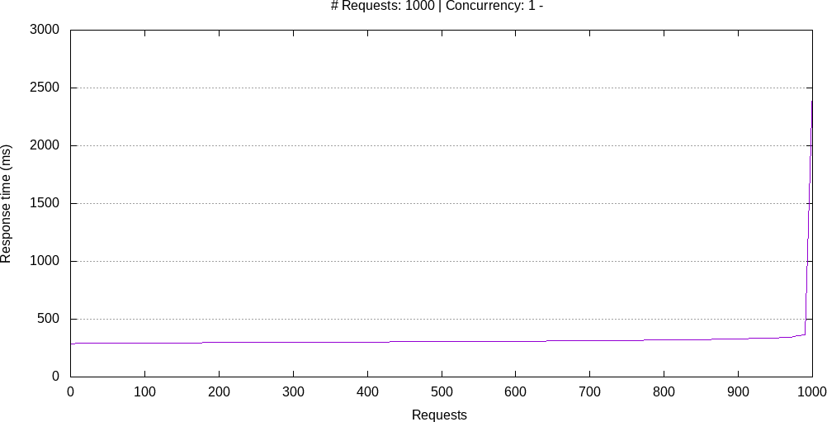
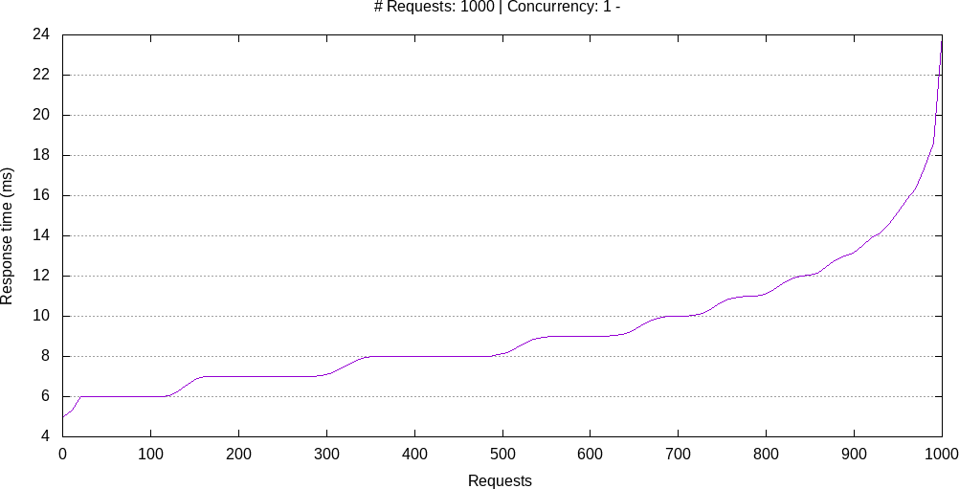
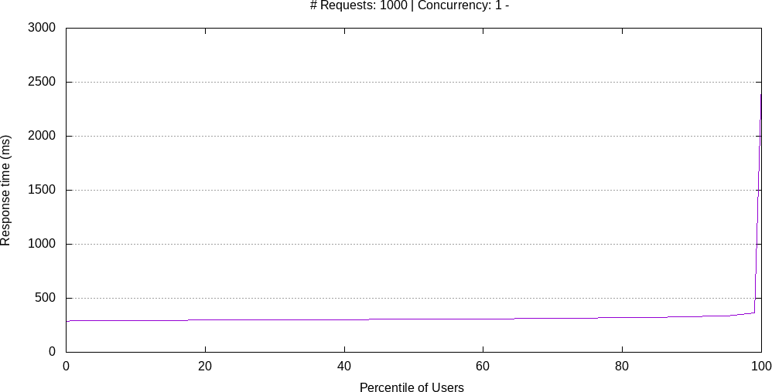
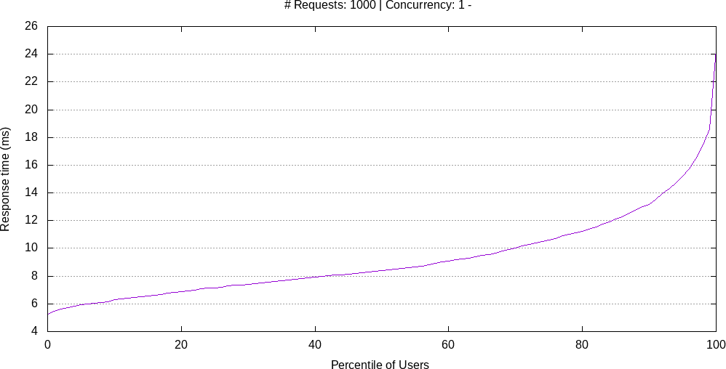
1 thread
Use index: no
Use index: yes

Slide 3
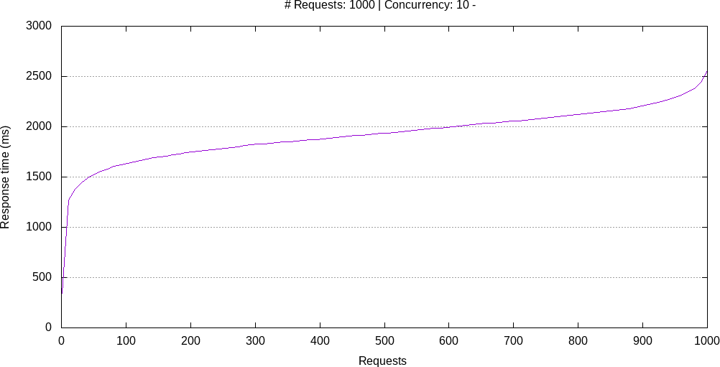
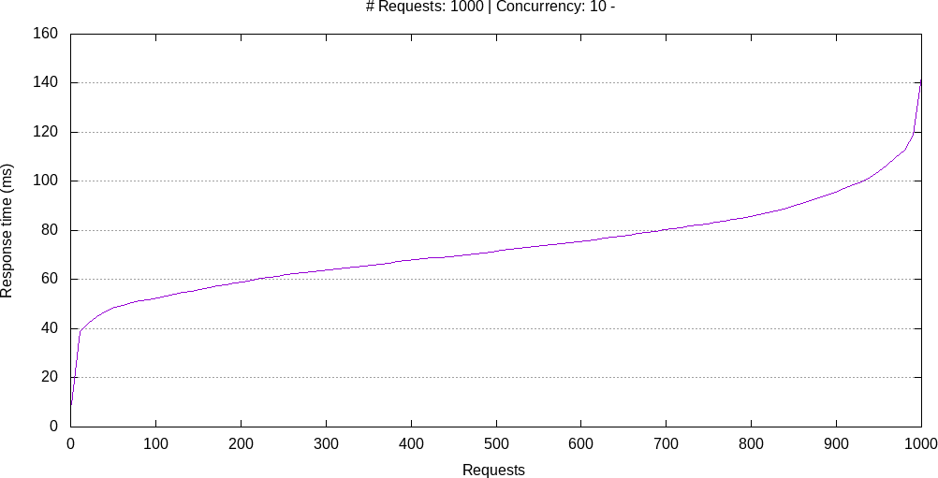
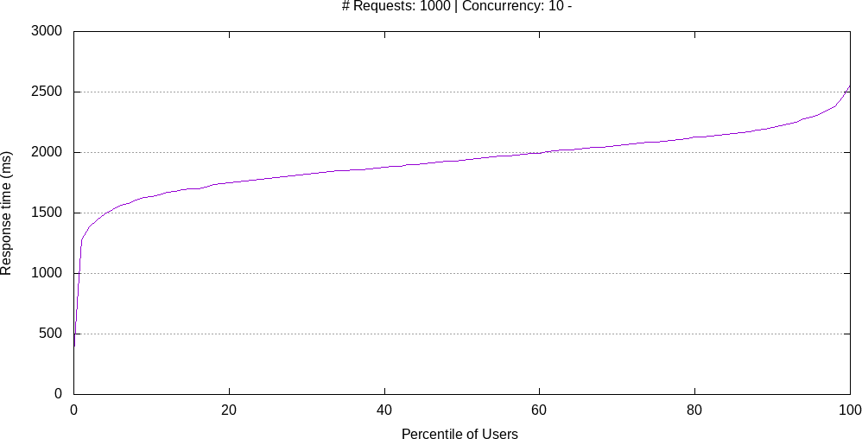
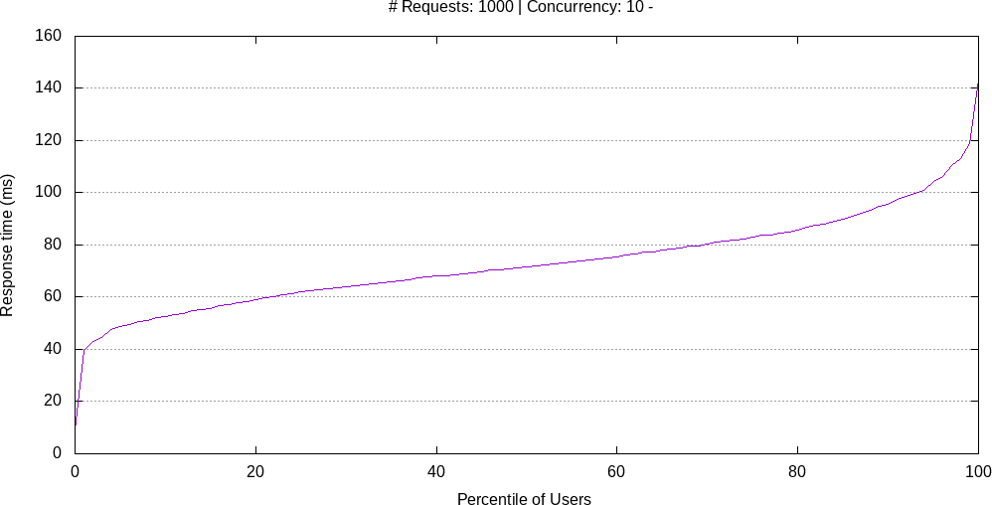
10 thread
Use index: no
Use index: yes

Slide 4
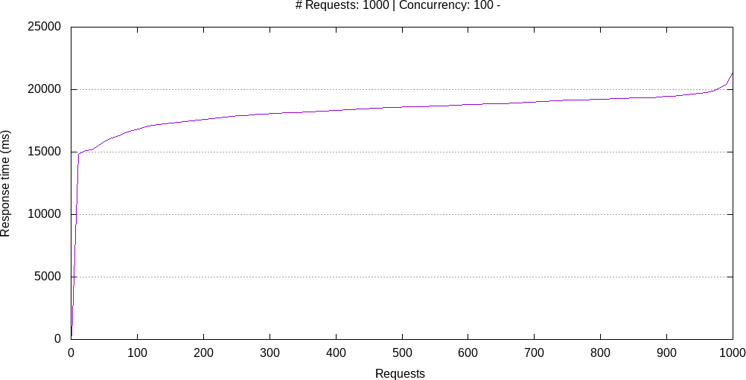
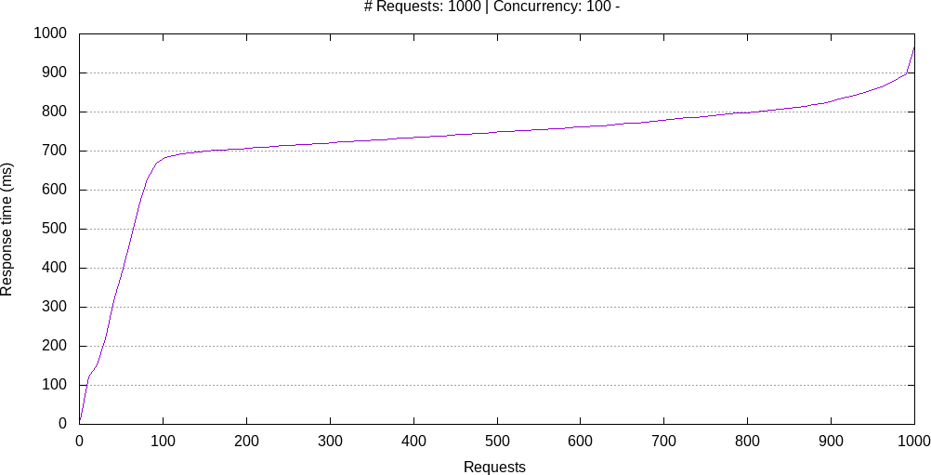
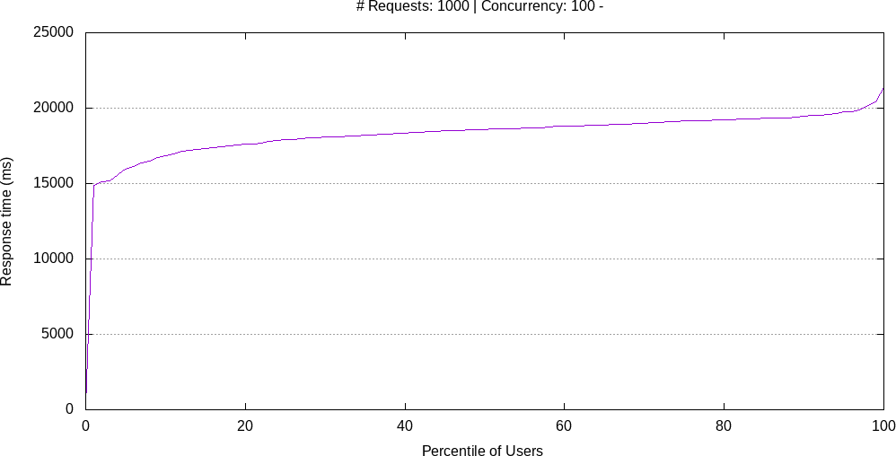
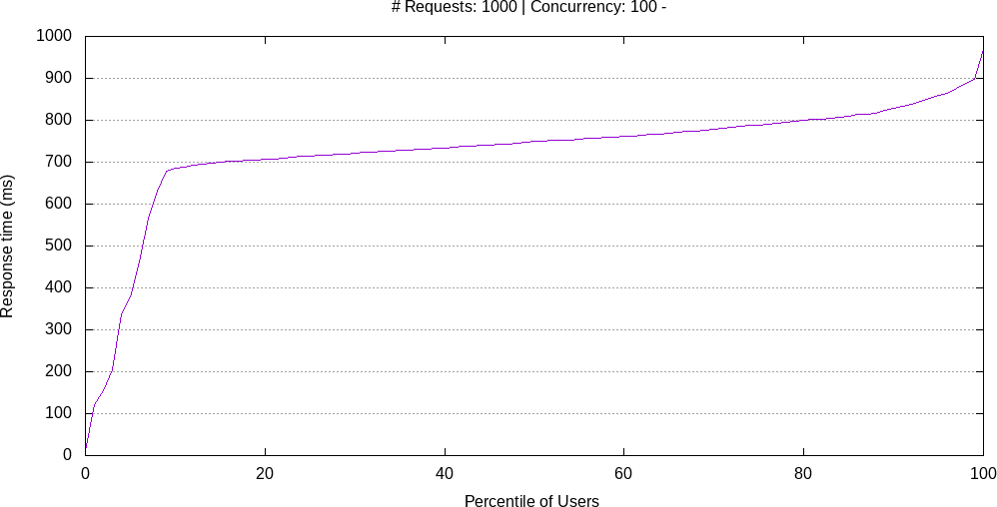
100 thread
Use index: no
Use index: yes

Slide 5
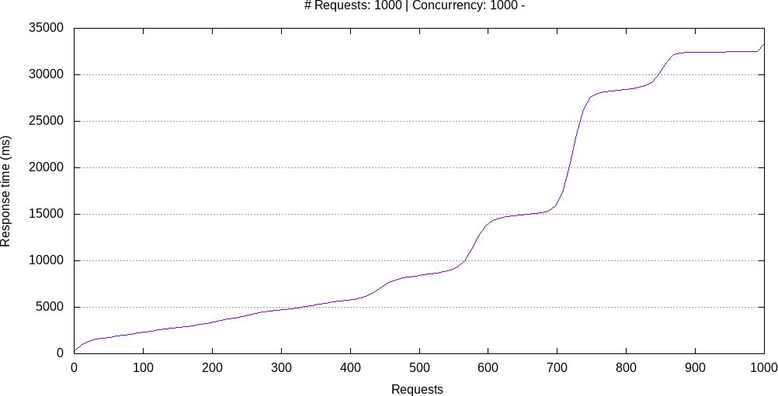
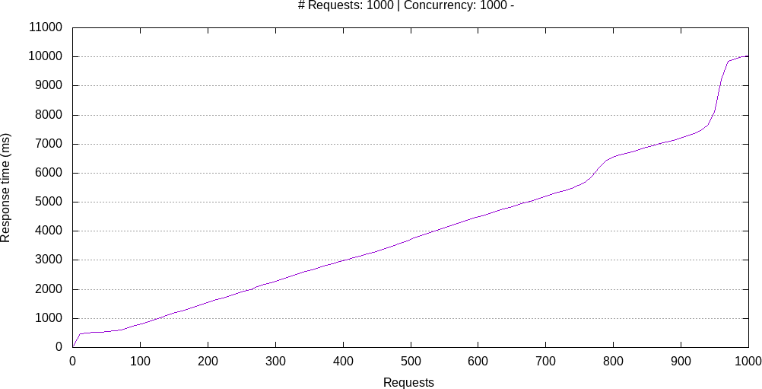
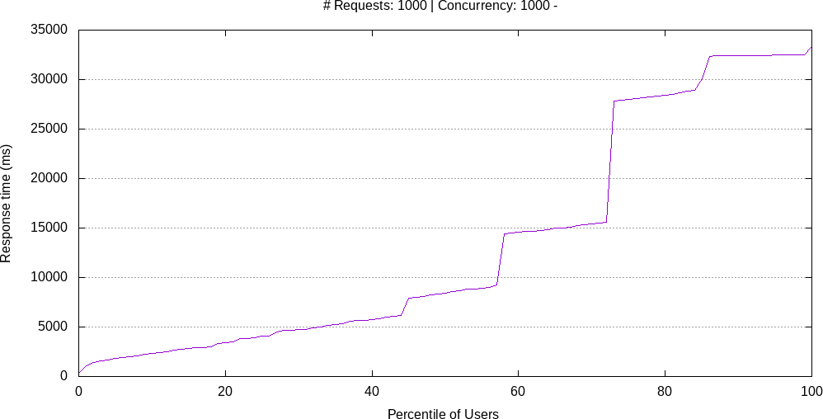
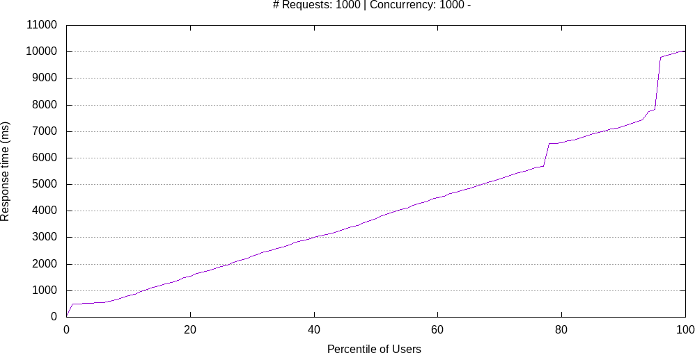
1000 thread
Use index: no
Use index: yes

Slide 6
Queries
Query for add index
CREATE INDEX profile_fname_sname ON profile(fname, sname)
Explain output
mysql> explain SELECT crid, fname, sname, age, gender, hob, city FROM profile WHERE fname LIKE 'Ave' and sname LIKE 'Che' ORDER BY crid;
+----+-------------+---------+------------+-------+---------------------+---------------------+---------+------+------+----------+---------------------------------------+
| id | select_type | table | partitions | type | possible_keys | key | key_len | ref | rows | filtered | Extra |
+----+-------------+---------+------------+-------+---------------------+---------------------+---------+------+------+----------+---------------------------------------+
| 1 | SIMPLE | profile | NULL | range | profile_fname_sname | profile_fname_sname | 1204 | NULL | 1 | 100.00 | Using index condition; Using filesort |
+----+-------------+---------+------------+-------+---------------------+---------------------+---------+------+------+----------+---------------------------------------+
1 row in set, 1 warning (0.03 sec)
Why index was chosen like that?
Because necessary search based on fname and sname. And fname has first place in select query.

