Slide 1
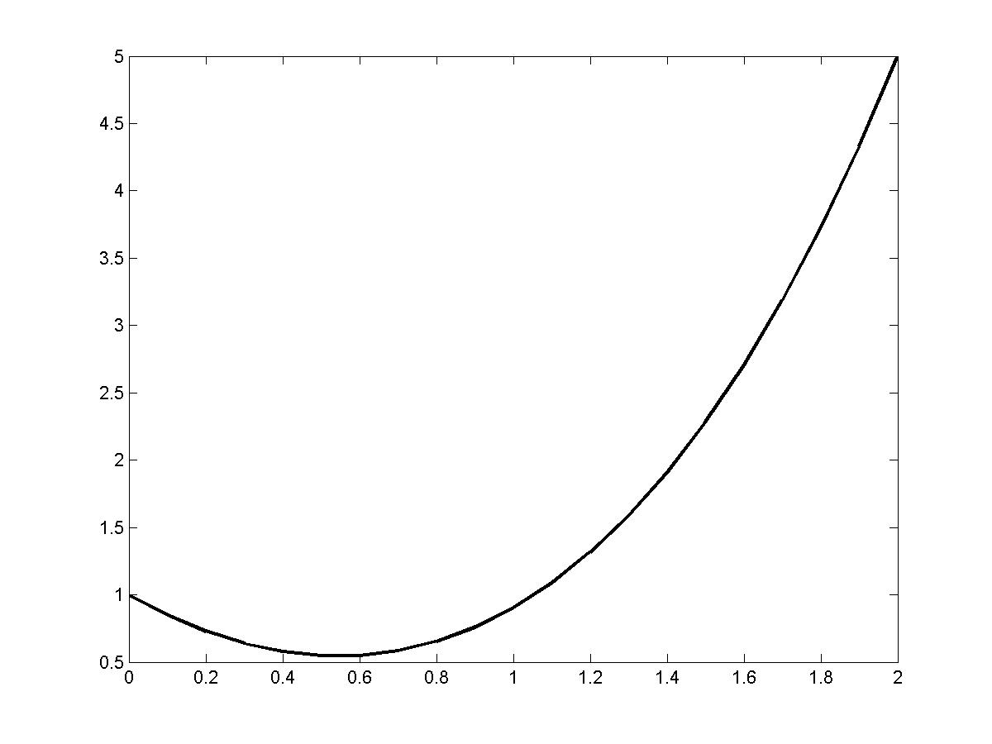
Problem 1

Slide 2
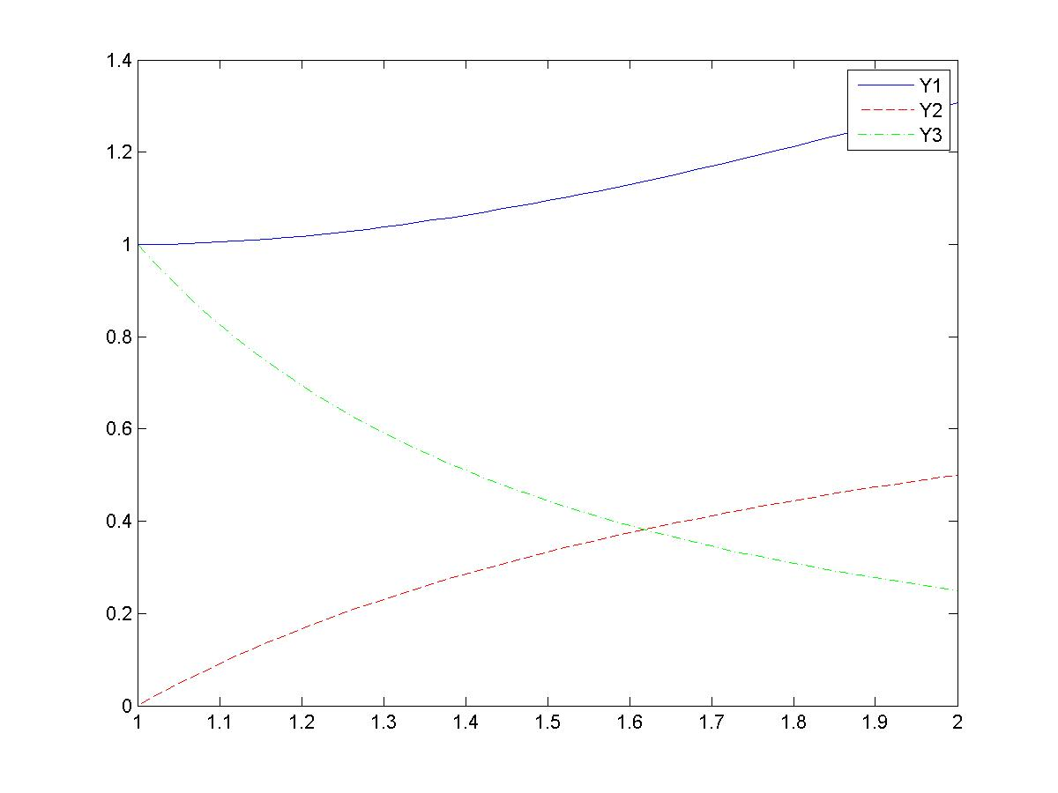
Problems 2 and 3

Slide 3
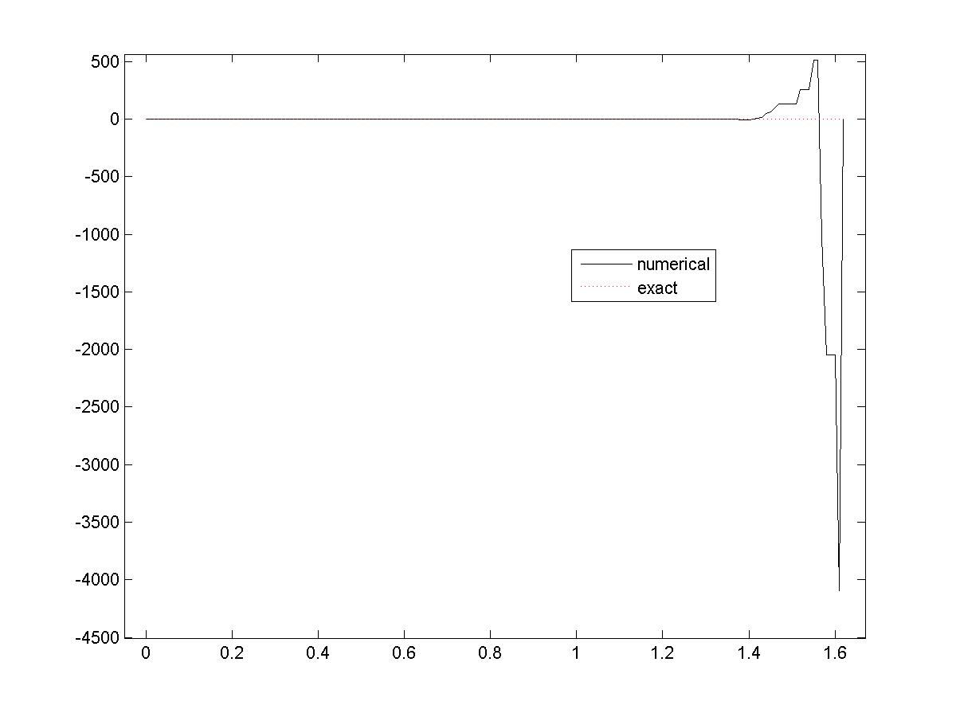
Problem 4
Note: This is obtained for h=0.01 using the mod. Euler method.
The numerical solution is very sensitive to h and
is probably also sensitive to the method used.

Slide 4
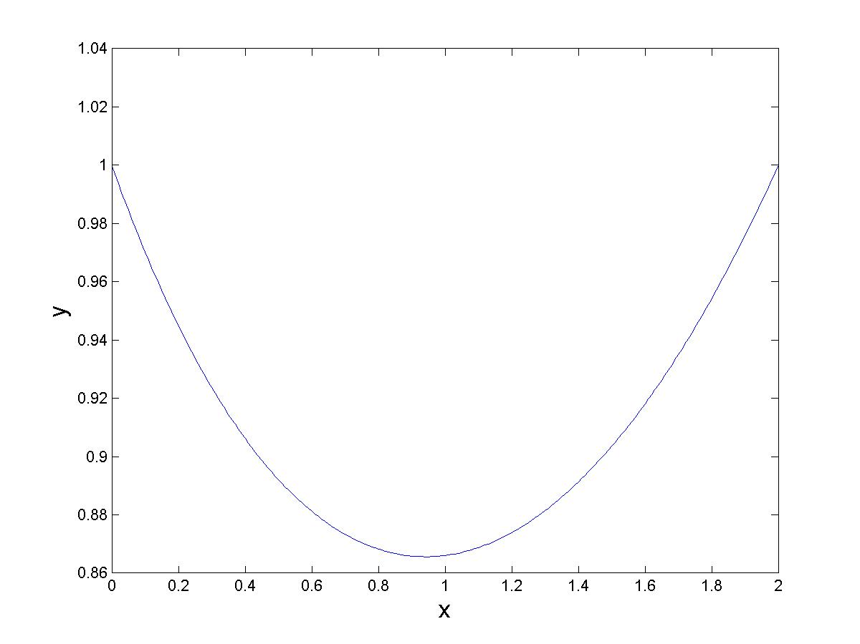
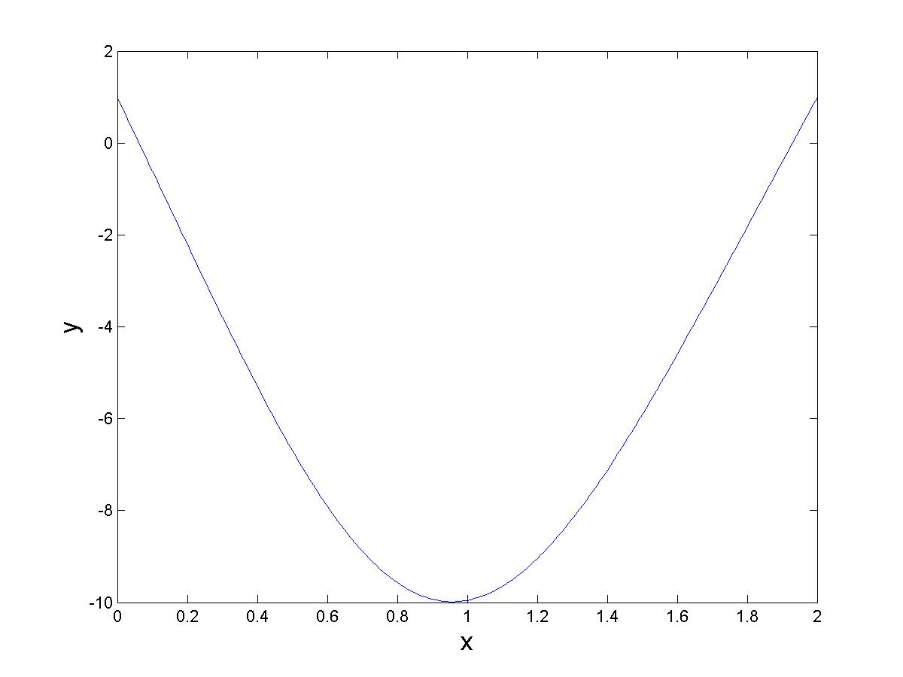
Problem 5
shallow solution
deep solution

Slide 5
For Problem 6,
you should find lambda = 1
and y = 0.5*sech(x).

