Slide 1

TIVIDY
A GENERIC workflow management system

Slide 2
A REUSABLE WORKFLOW ENGINE
A reusable workflow engine is a software system that allows you to define, execute, and manage a sequence of tasks
that can be reused for different purposes without having to rewrite the whole entire process each time.
Example: A university has to process thousands of applications of students. This is done using a certain order of actions. So instead of writing a new program for each application, the university can use a reusable workflow engine to execute the same general steps for applications.

Slide 3
Chosen scenarios of our choice
Scenario 1: Insurance Claim
From the time an insurance claim application is received, we demonstrate how it should be handled using our design. Moving seamlessly from submission and validation to assignment and payout.
Scenario II: Manufacturing
Given raw materials, we illustrate how a product is formed through a series of steps that are predefined.
Notes:
Njabulo takes over, after this

Slide 4
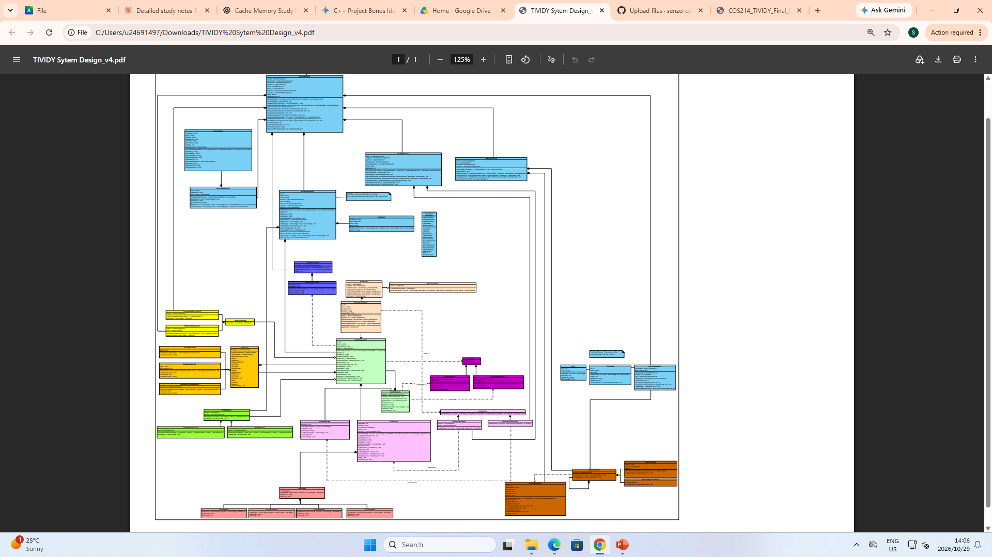

Slide 5
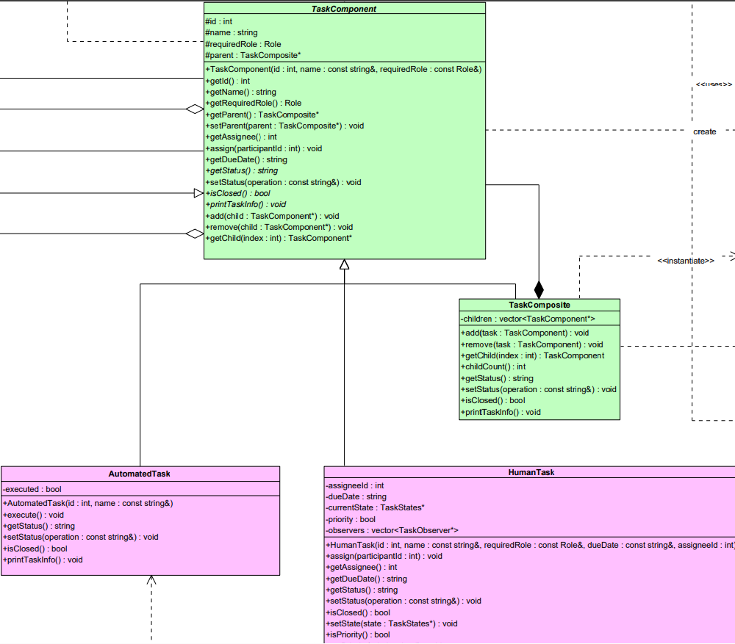
COMPOSITE PATTERN OVERVEIW
Composite: Enables a main task to have sub tasks inside it, that must me attended to for the main task to be fulfilled.

Slide 6
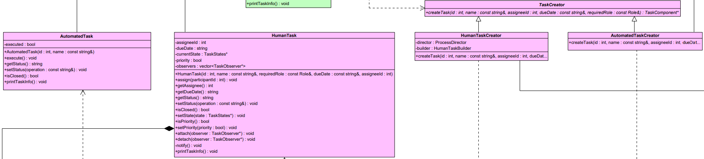
FACTORY METHOD PATTERN OVERVIEW
Factory Method: Produces tasks, based on how they should be handled. It will create two tasks, namely HumanTask and an AutomatedTask using their respective concrete factories.

Slide 7
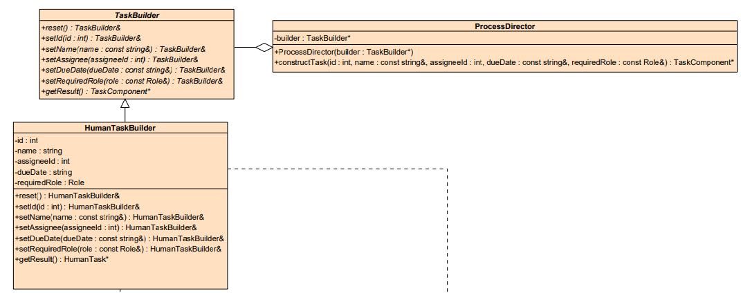
BUILDER PATTERN OVERVIEW
Builder: For the task to be executed, it needs to built step by step. So, the Builder creates the execution flow of sub-tasks in order to fulfill the main task.

Slide 8
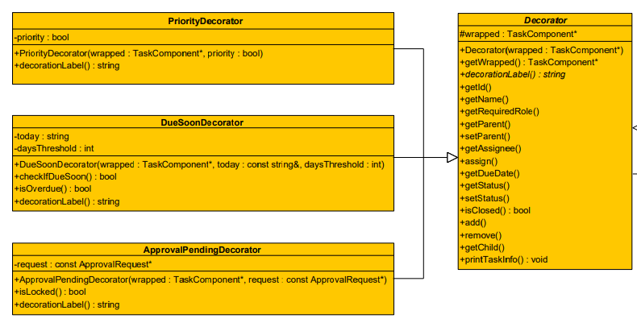
Decorator pattern overview
Decorator: Wraps a task based on certain requirements. Ours focus on if a task is a priority, or it is pending approval, or if it is due soon.

Slide 9
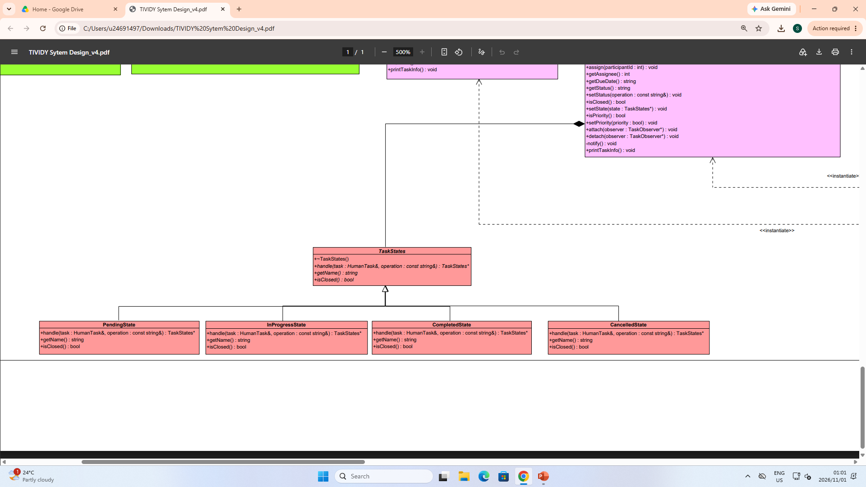
State pattern overview
State: Identifies the stages a task can be in for its lifecycle, namely PendingState, InProgessState, Completed State, and CancelledState.

Slide 10
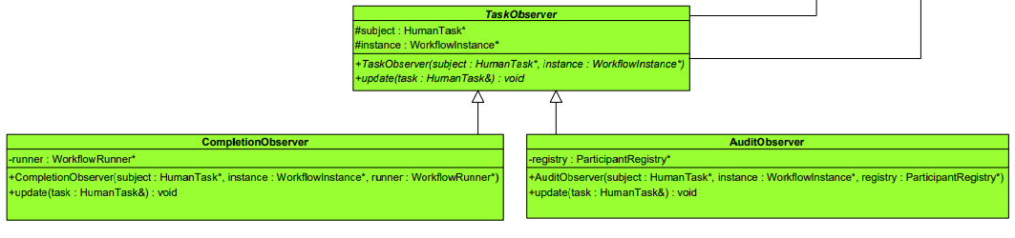
Observer design pattern
Observer: It uses the Iterator to notify relevant participants when a task has been completed or when an audit for task is needed.

Slide 11
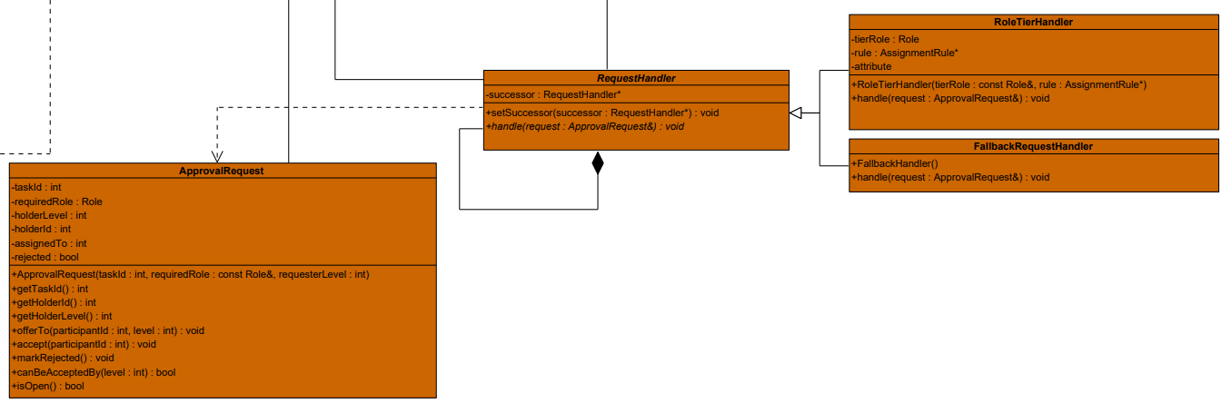
CHAIN OF RESPONSIBILITY PATTERN OVERVIEW
Chain of Responsibility: Handles the cases where a currently assigned participant can not handle the task, so it is passed on to the handler participant in the chain to handle the task.

Slide 12
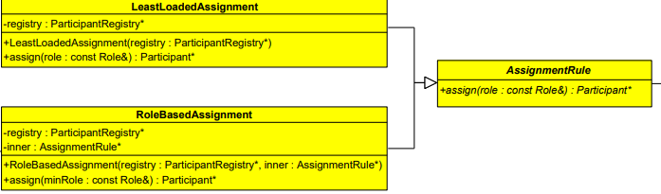
STRATEGY DESIGN PATTERN
Strategy: Gives two interchangeable algorithms for assignment rules, which based on participants with the least number of tasks assigned or on which participant is fit to perform the task based on their roles.

Slide 13
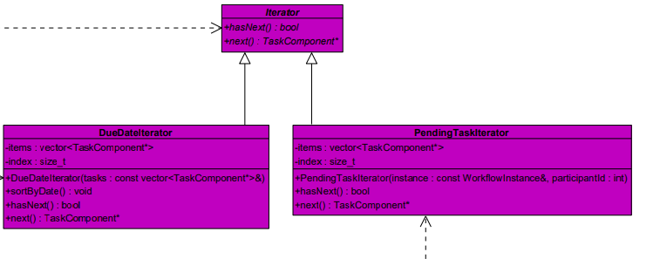
Iterator pattern overview
Iterator: Iterates on tasks and checks their due dates against a particular date while also checking if a task is pending approval or not.

Slide 14
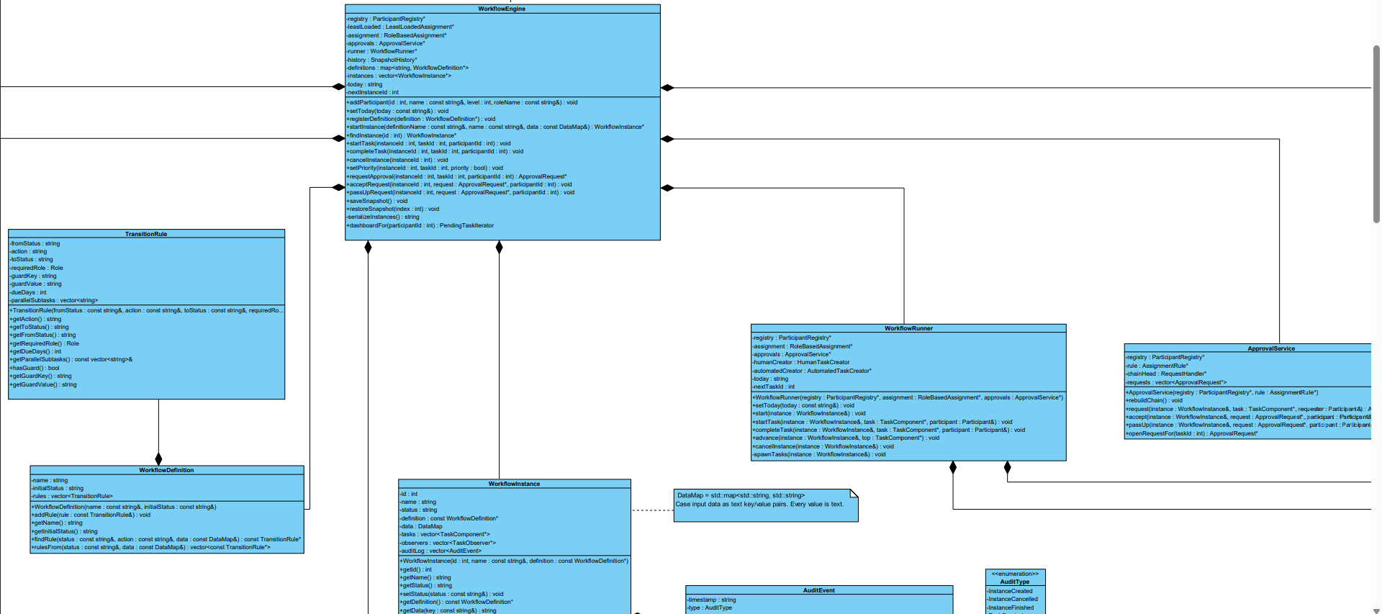
Façade pattern overview
Façade: It provides a simple entry point to the system. Does not limit on where should user go, instead it gives a simple path to navigating the system while also allowing any direction paths the user wishes to take, if necessary.

Slide 15
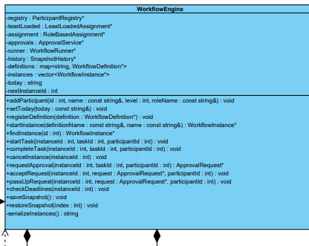
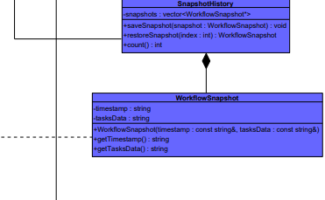
Memento pattern overview
Memento: Helps to restore a task back to its saved snapshots, when needed so. Possibly in cases of cancellation or an undo is needed.

Slide 16
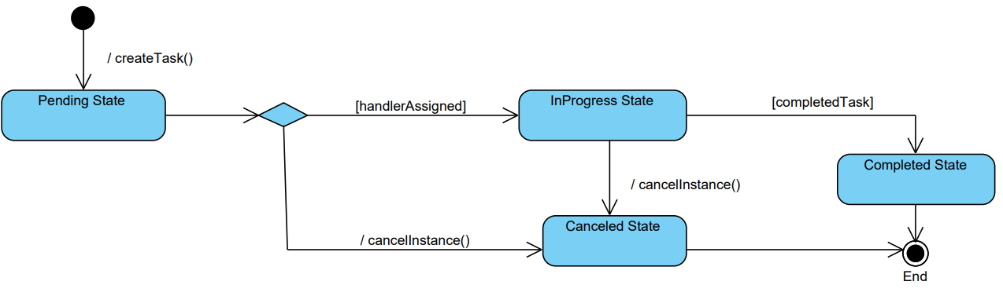
STATE DIAGRAM
Notes:
Livhu takes over on escalation or approval sequence diagram

Slide 17
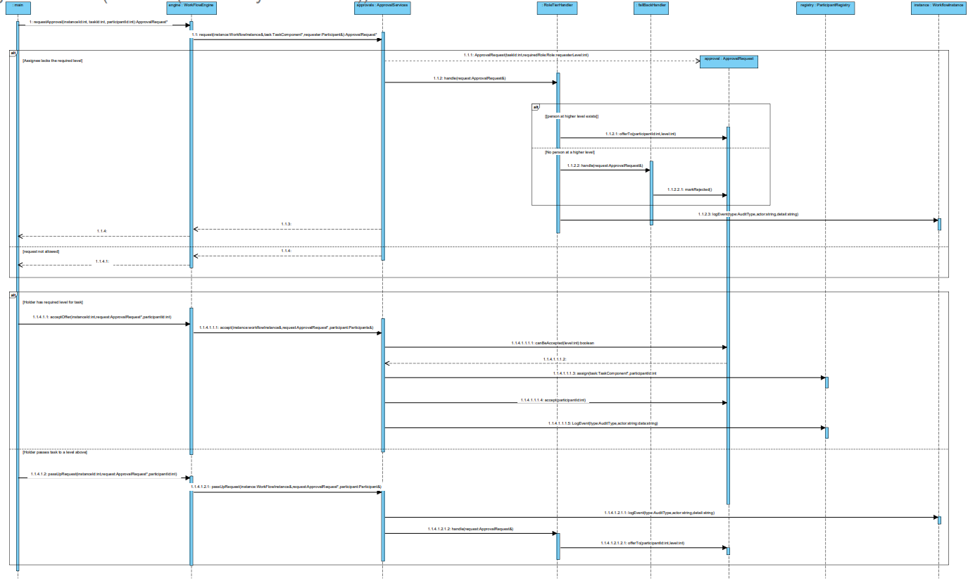
Notes:
Liam takes over on response to task sequence diagram

Slide 18
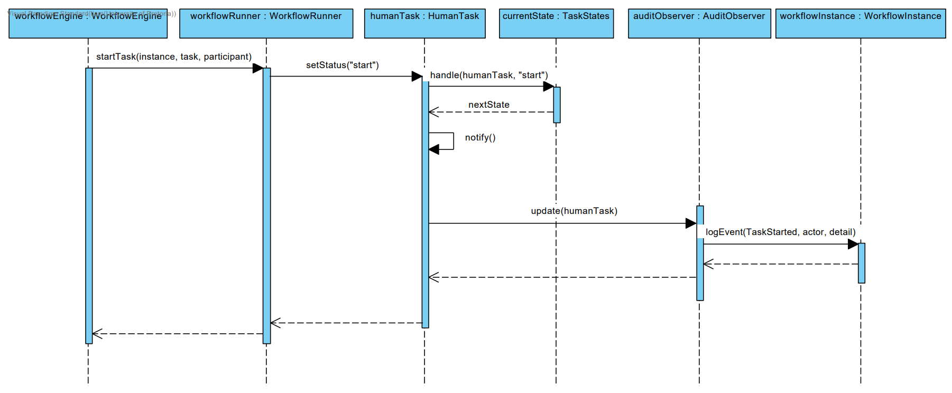
Notes:
Navela takes over on generic workflow activity diagram

Slide 19
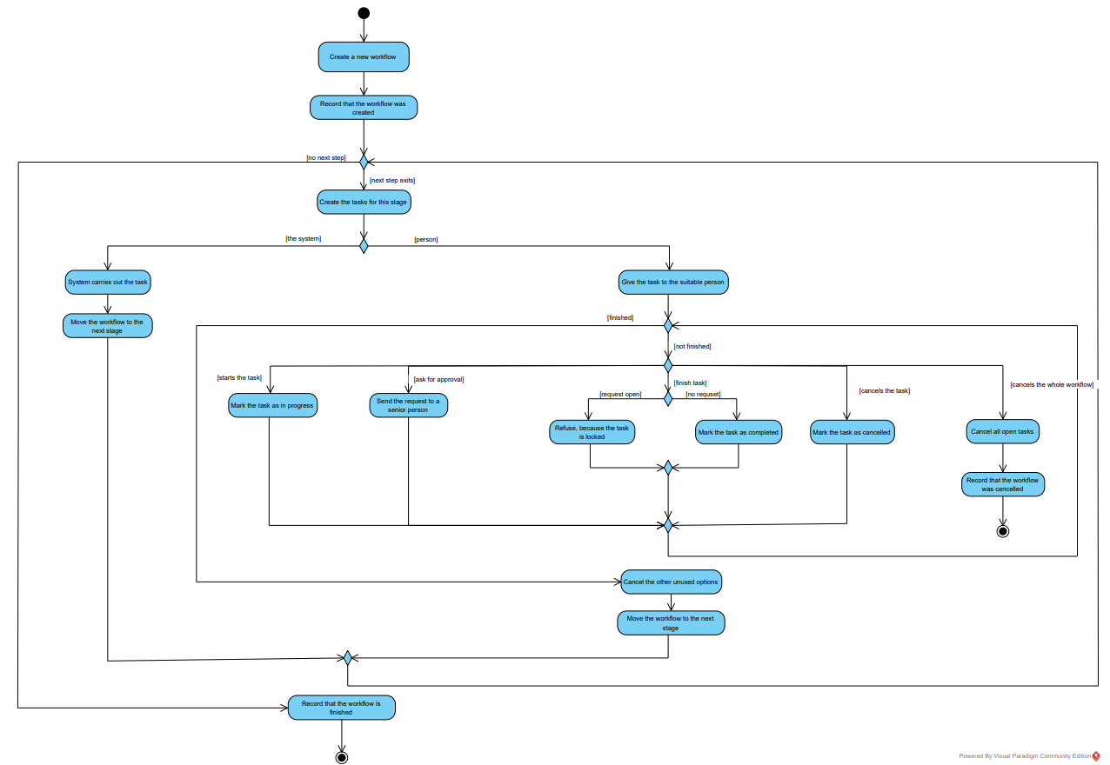
Notes:
Senzo takes over on TIVIDY Activity Diagram

Slide 20
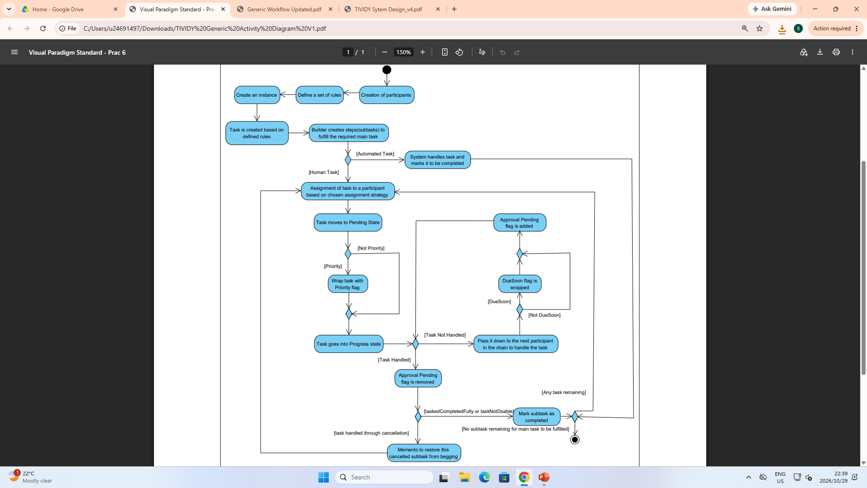
Notes:
Teballo takes over on Insurance Claim based scenario activity diagram

Slide 21
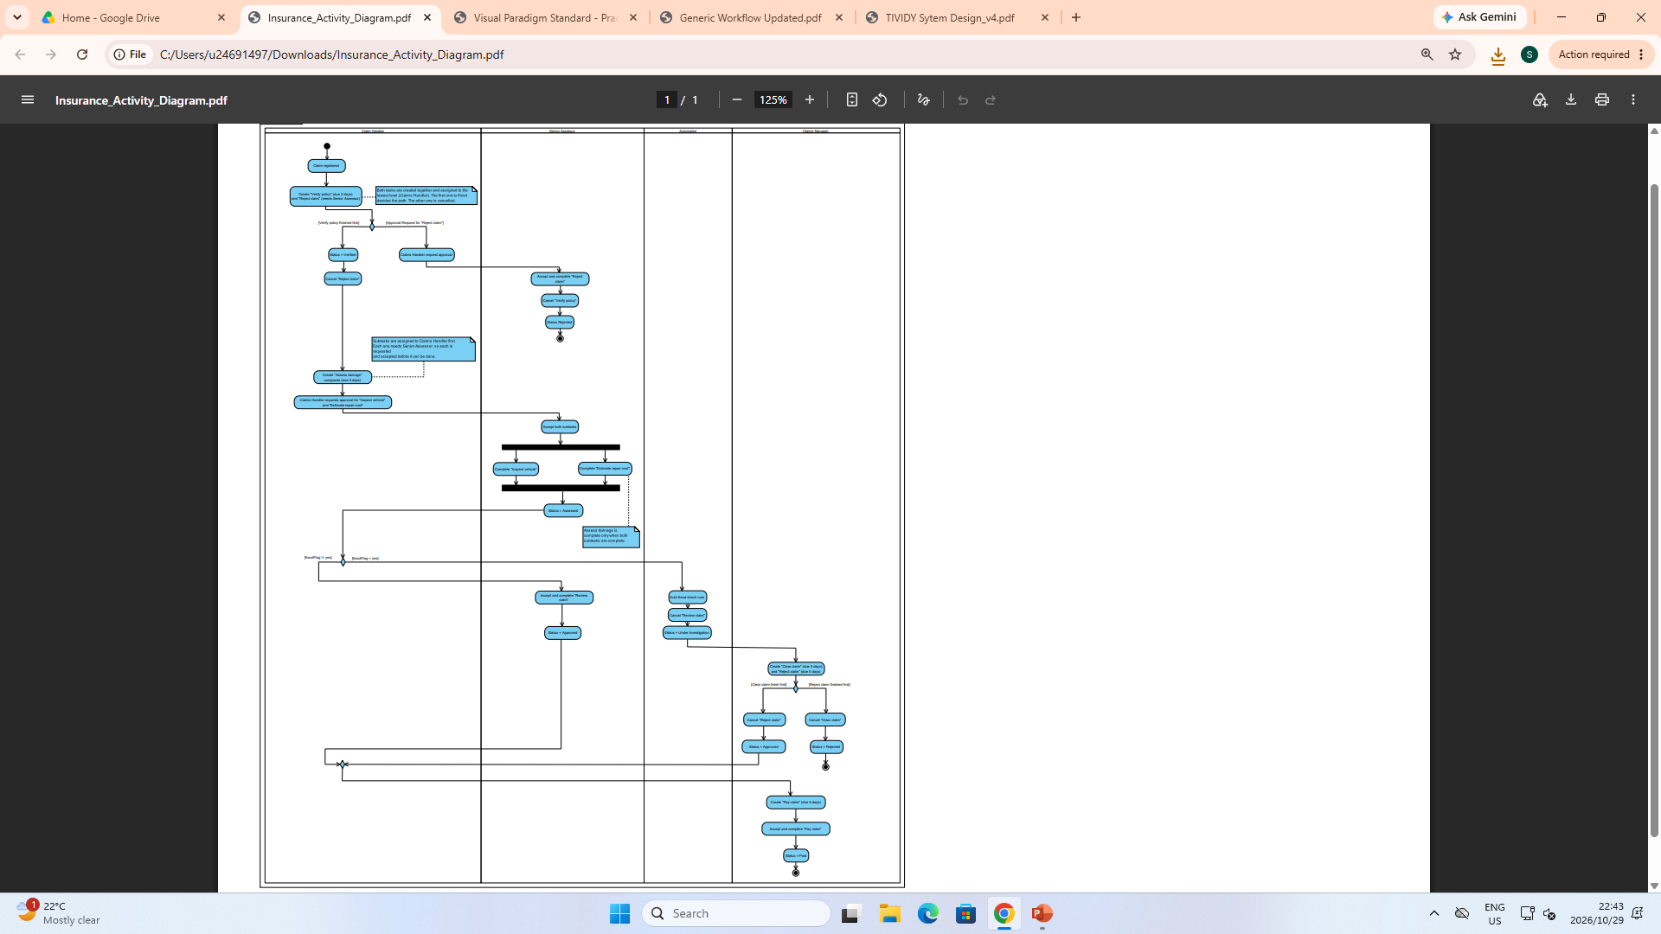
Notes:
Lwandiso takes over on Manufacturing based scenario activity diagram

Slide 22
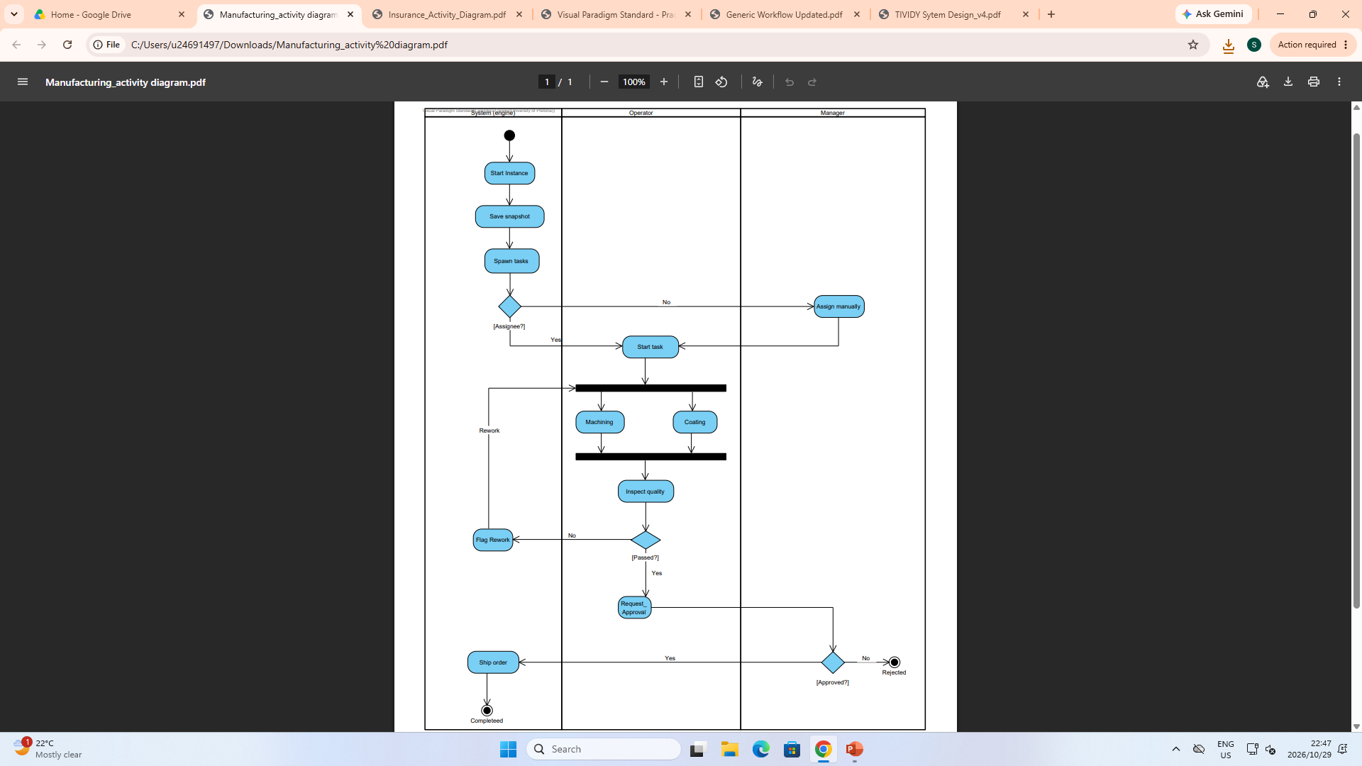
Notes:
Lwandiso does his bonus mark overview for 1 min or less

Slide 23
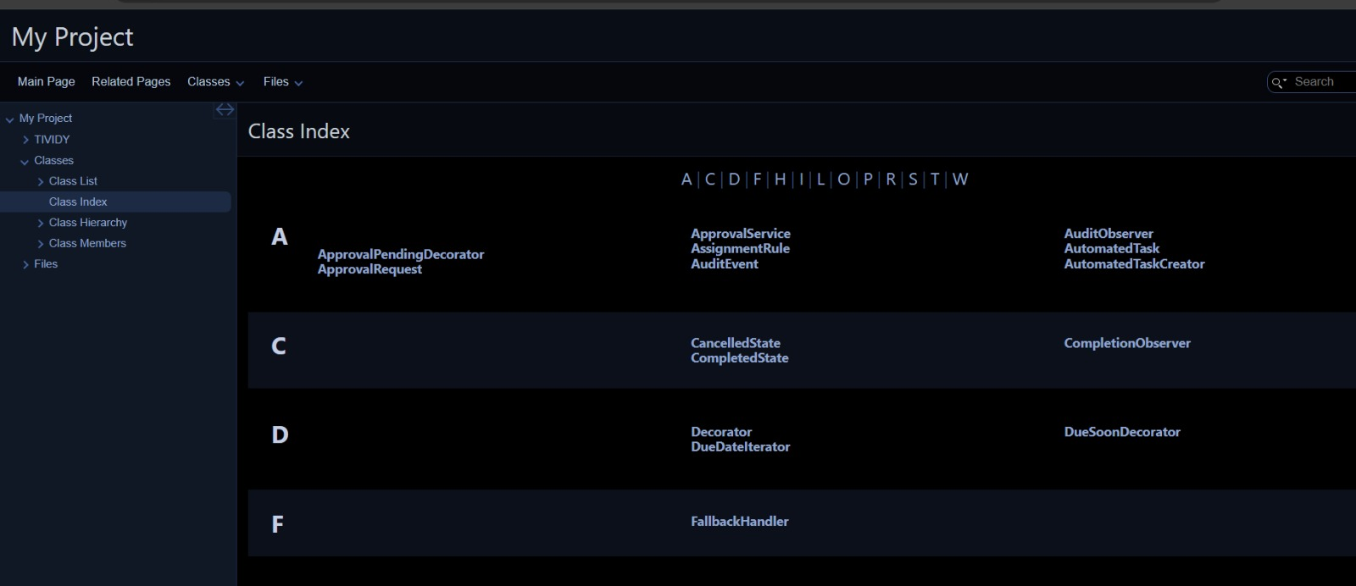
DOCKER (BONUS MARKS)

Slide 24
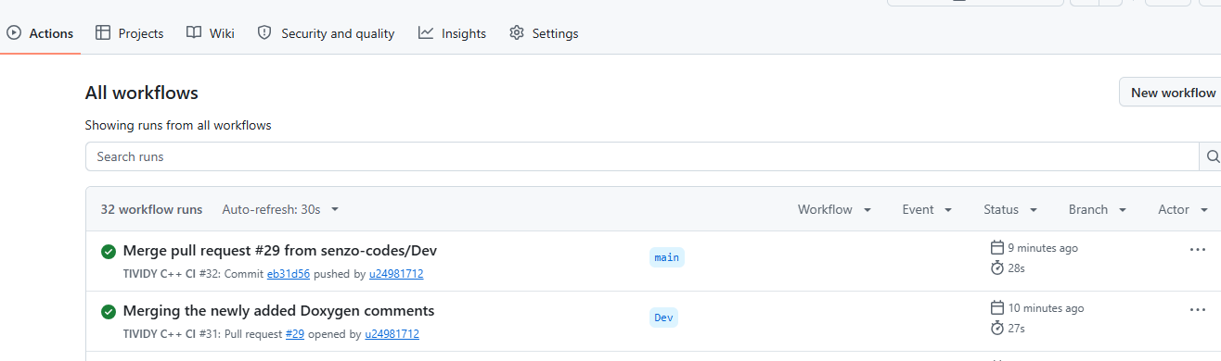
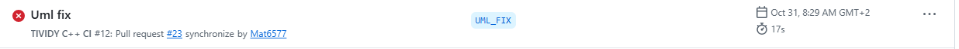
GITHUB ACTIONS CI/CD PIPELINE (BONUS WORK)
Notes:
Teballo and Njabulo do the live demonstration

Slide 25


