Slide 1
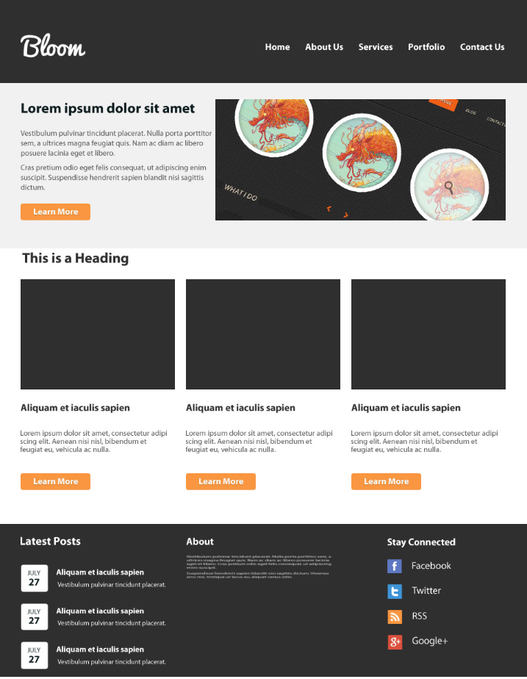
1
자바25기서홍익
3
2
영역 | 태그 | 아이디또는 클레스명 | 크기
1 | article
2header | section | id="header" | width: 100%; height: 150px;
3header | div | id="headerWrap" | width: 1230px; height: 150px;
4main | main | id="main" | width: 100%; height: 350px;
5main | section | id="mainWrap"
6 content | div | id="content" | width: 100%;
6-1 | div | id="conBlockLeft" | width: 280px; height: 430px;
6-2 | div | id="conBlockCenter" | width: 280px; height: 430px;
6-3 | div | id="conBlockRight" | width: 280px; height: 430px;
7 | div | id="footer" | width: 100%; height: 300px;
8 | div | Id=“footerContainer” | width: 1230px; height: 300px;
8-1 | div | id="footerBlockLeft" | width: 380px; height: 300px;
8-2 | div | id="footerBlockCenter" | width: 380px; height: 300px;
8-3 | div | id="footerBlockRight" | width: 380px; height: 300px;
5
4
6
5
6-1
6-2
6-3
8
8-3
7
8-1
8-2

