Slide 1
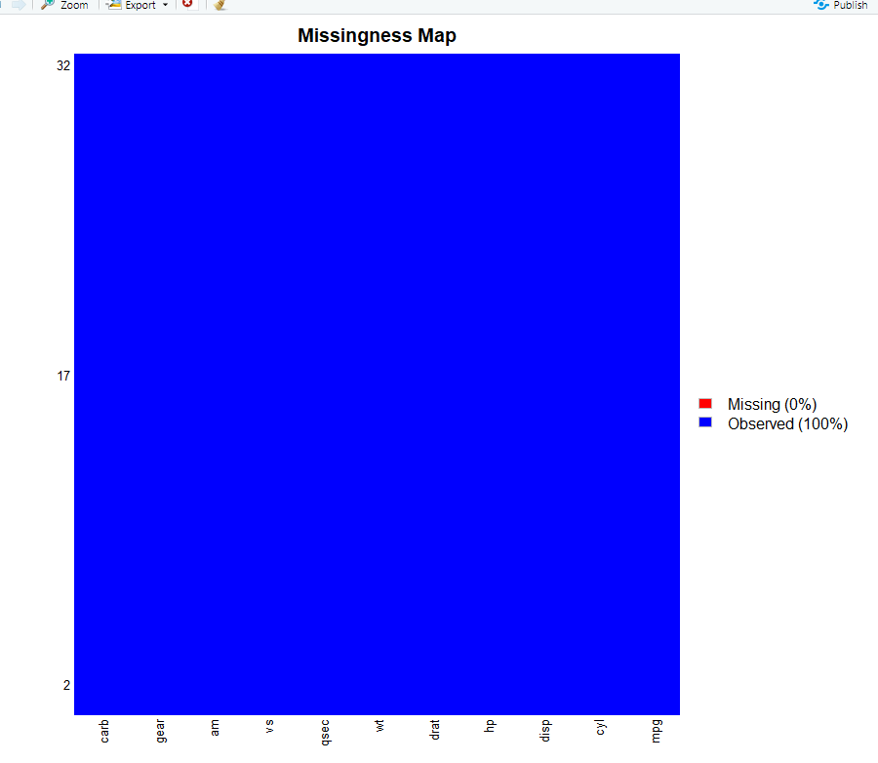
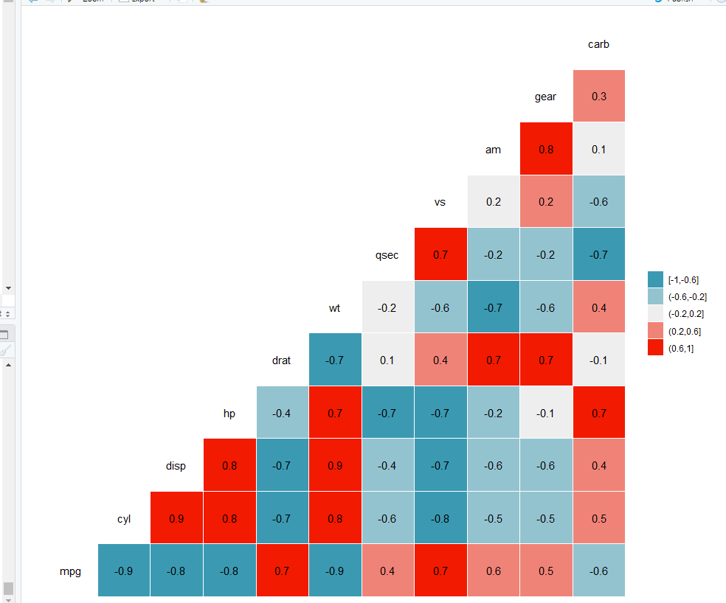
1. mtcars

Slide 2
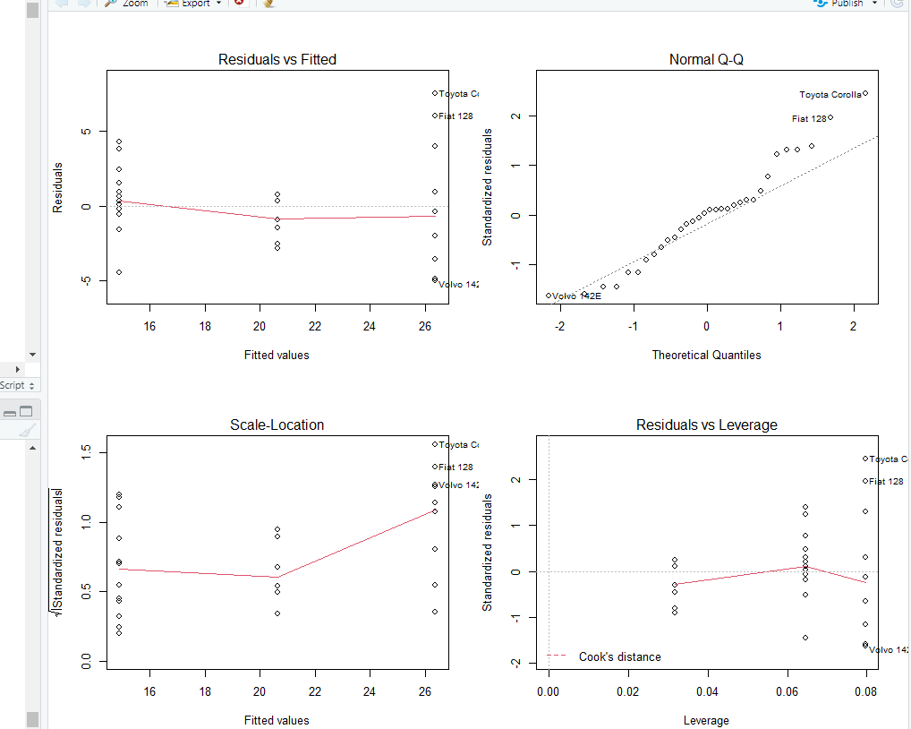
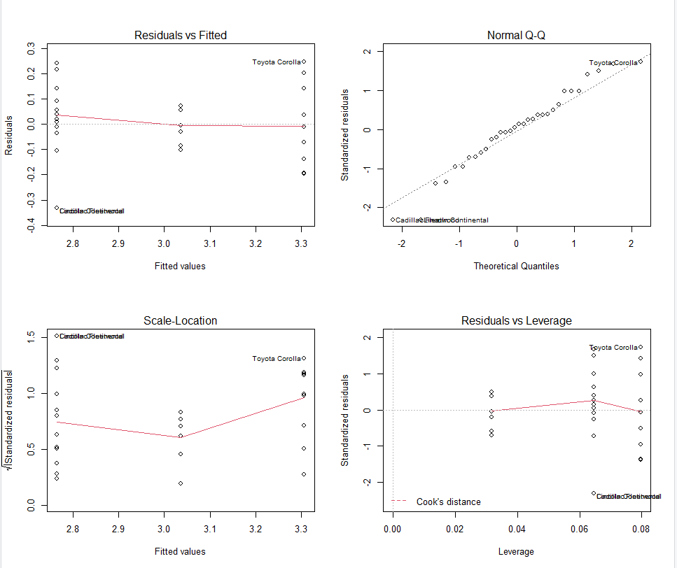
1. mtcars(mpg~cyl, log(mpg+1)~cyl)

Slide 3
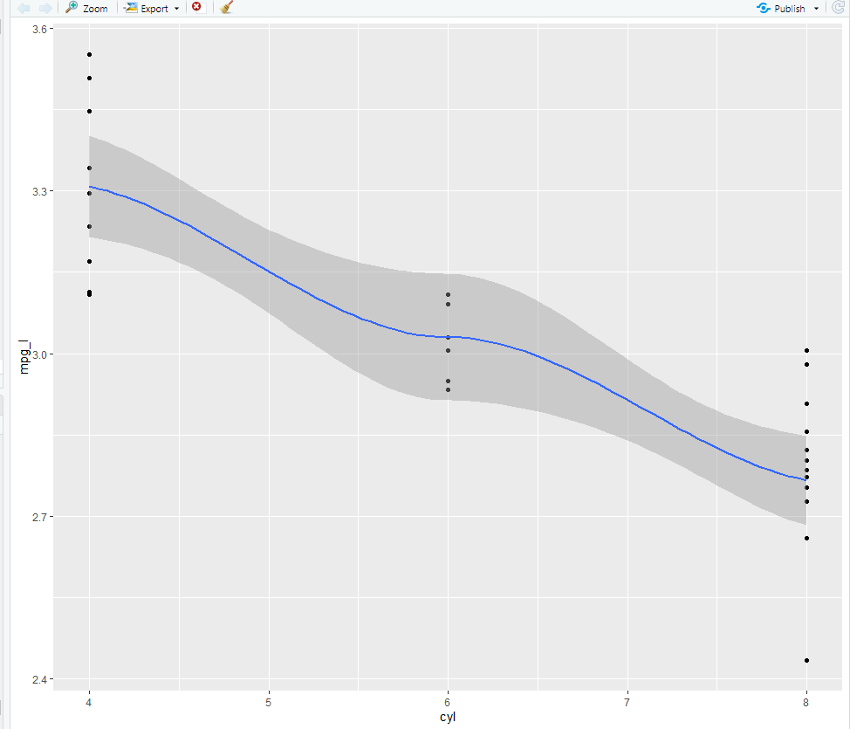
1. mtcars(mpg~cyl, log(mpg+1)~cyl)

Slide 4
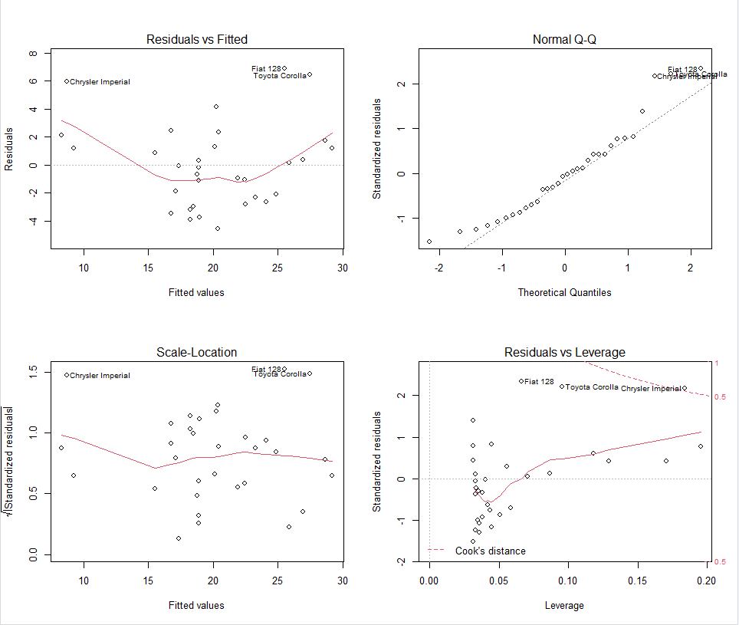
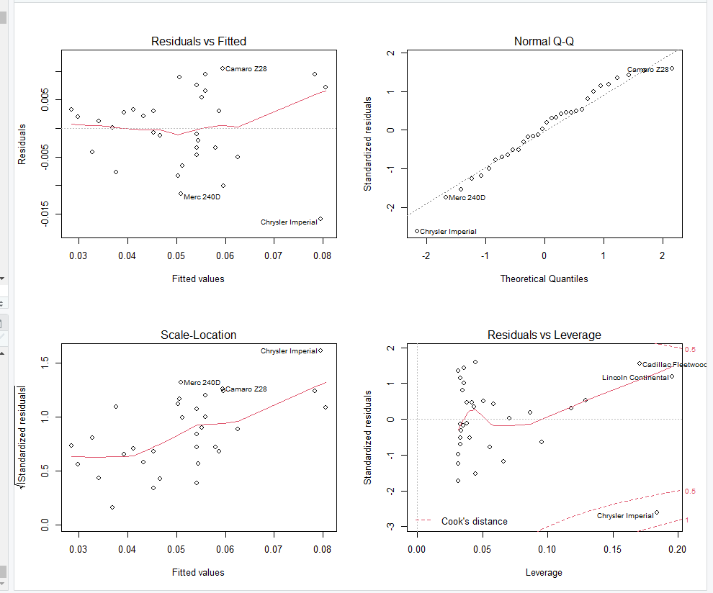
1. mtcars(mpg~wt, 1/(mpg+1)~wt)

Slide 5
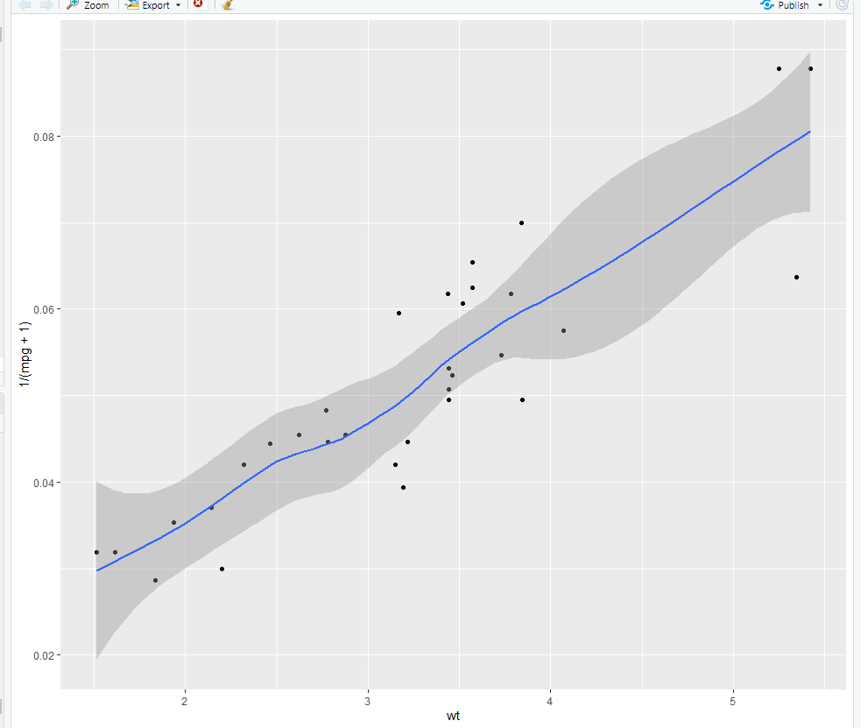
1. mtcars(mpg~wt, 1/(mpg+1)~wt)

Slide 6
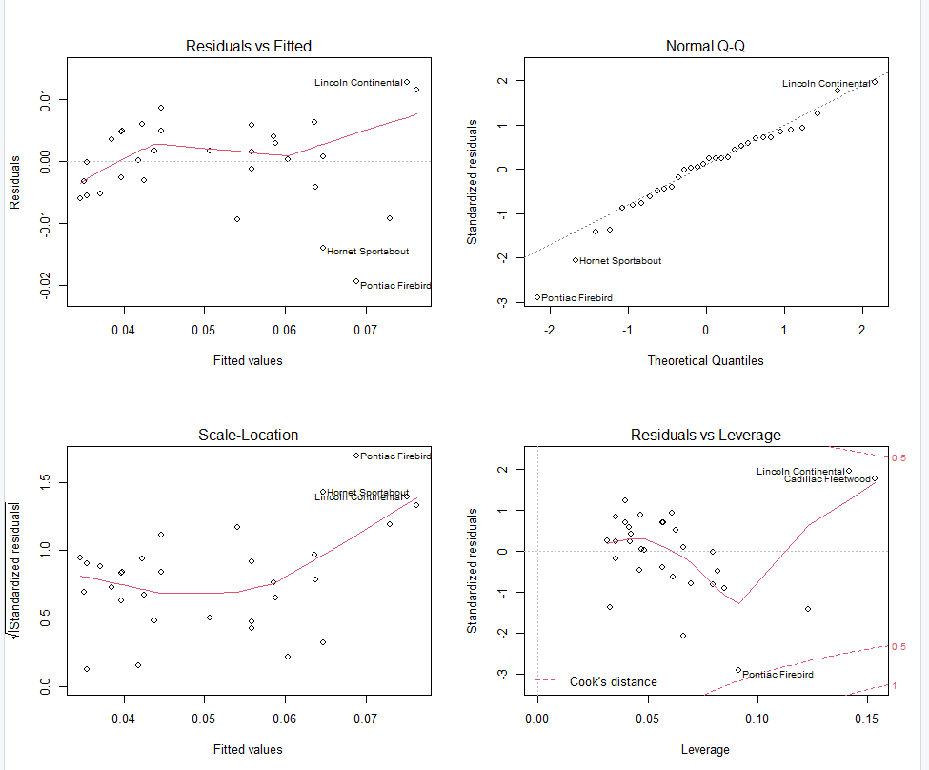
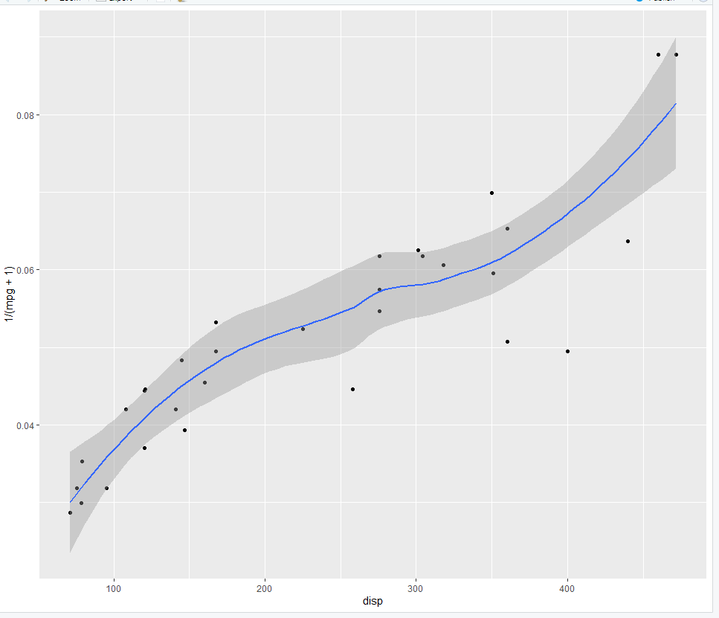
1. mtcars(1/(mpg+1)~disp)

Slide 7
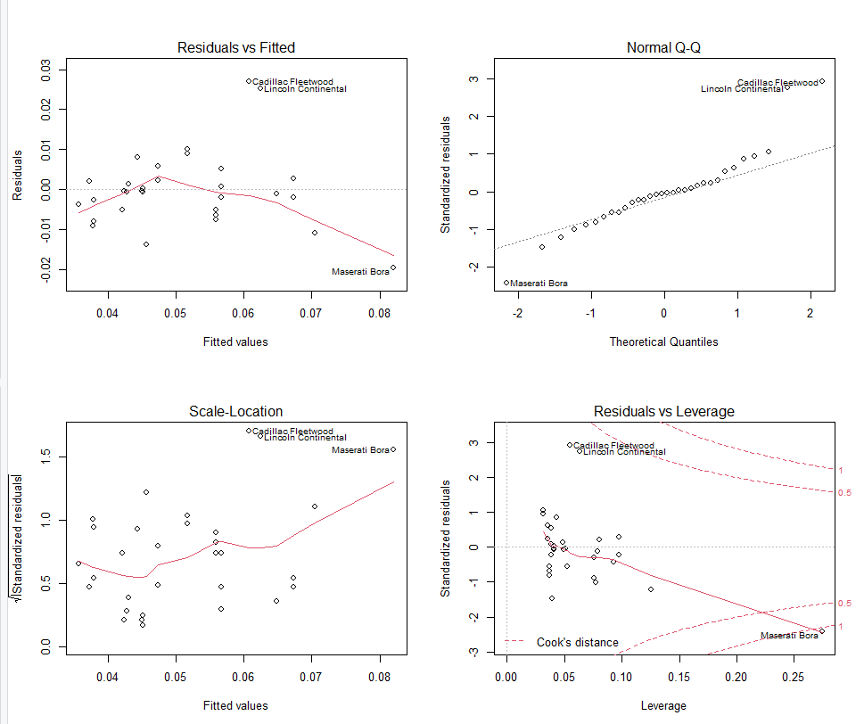
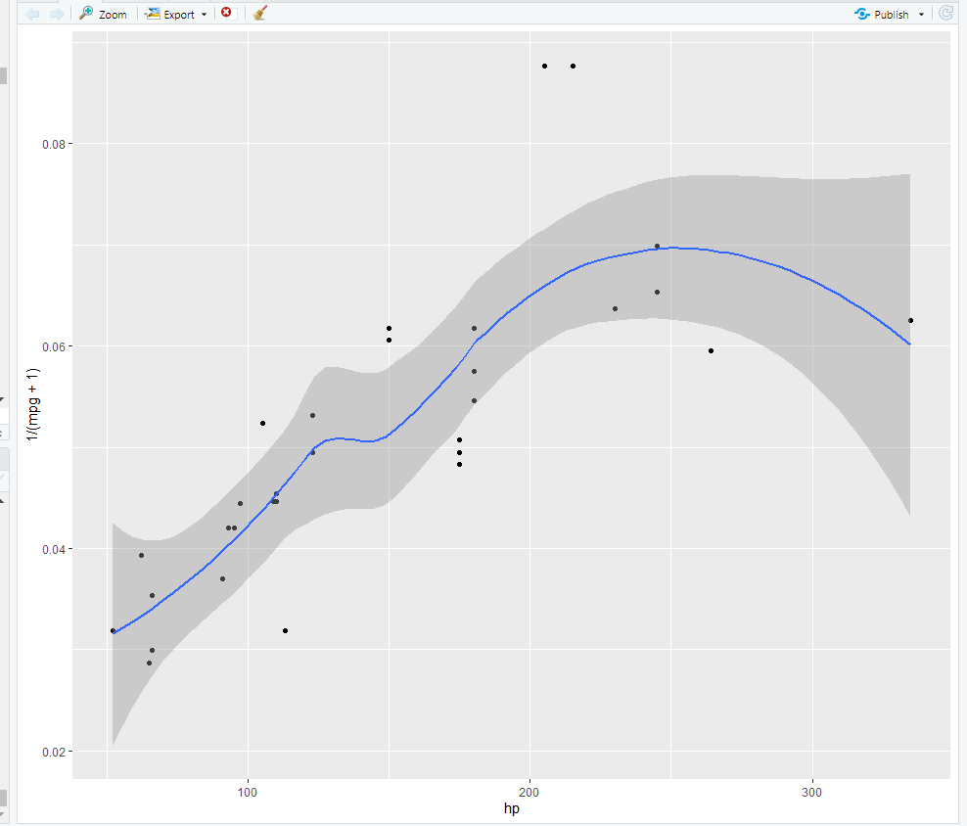
1. mtcars(1/(mpg+1)~hp)

Slide 8
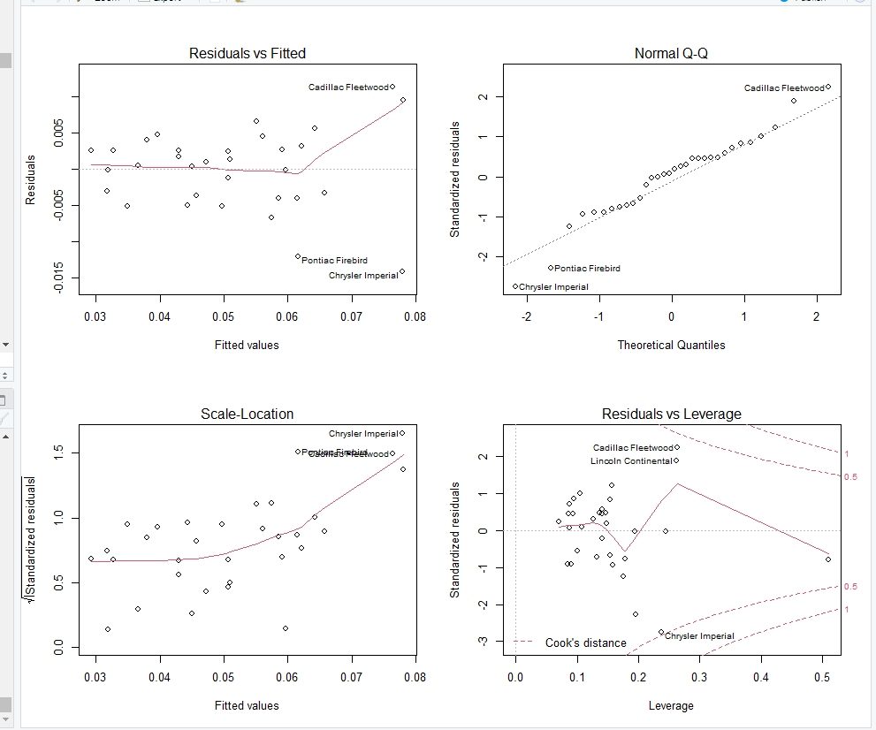
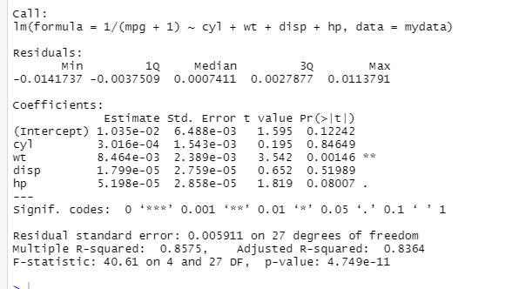

1. mtcars (model1<-lm(1/(mpg+1)~cyl+wt+disp+hp,mydata) #모델평가: AIC=-2ln(L) +2k, 낮을수록 좋음 #AIC:-231.

Slide 9
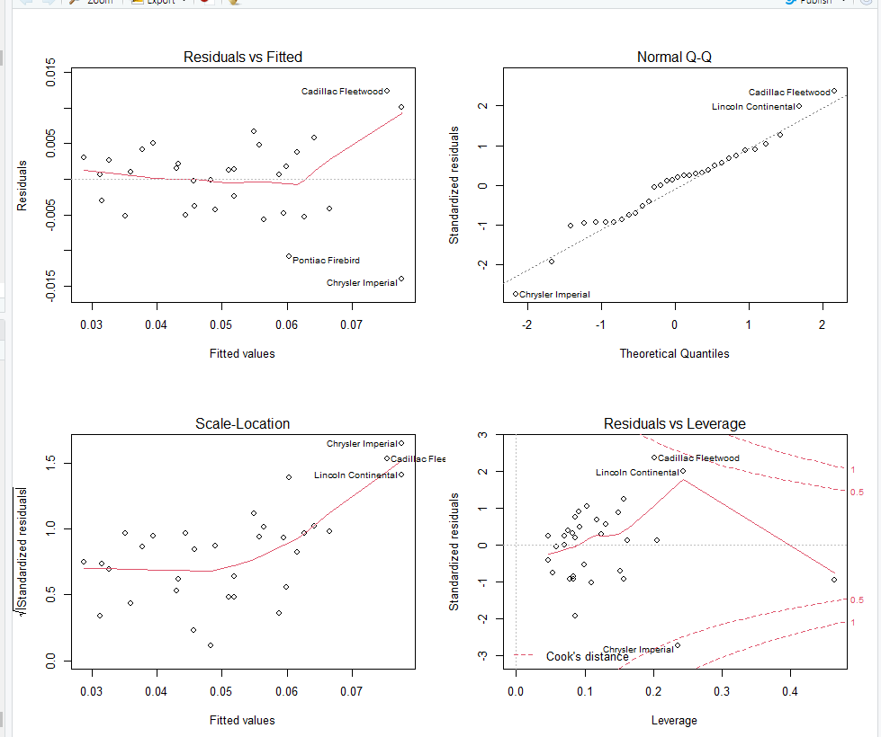

1. mtcars: 아웃라이어 전처리 model2<-lm(1/(mpg+1)~cyl+wt+hp,mydata) AIC:-246.

Slide 10
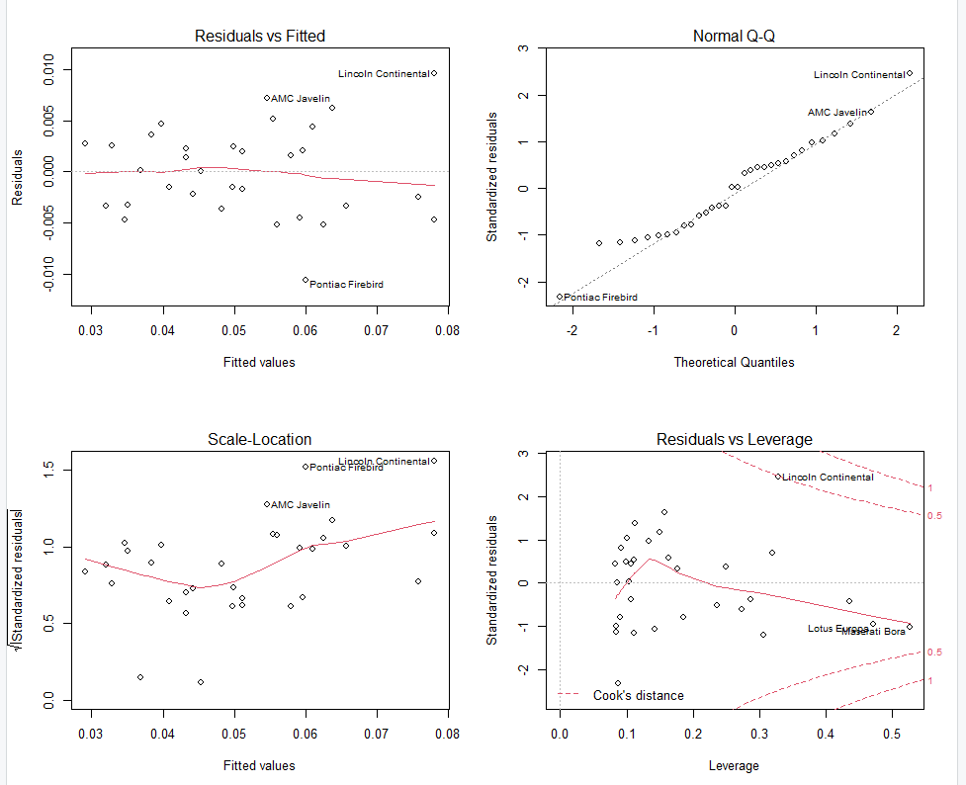
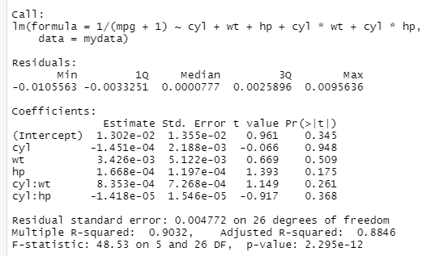
1. mtcars: 아웃라이어 전처리 model3<-lm(1/(mpg+1)~cyl+wt+hp+cyl*wt+cyl*hp,mydata) #AIC:-244

Slide 11
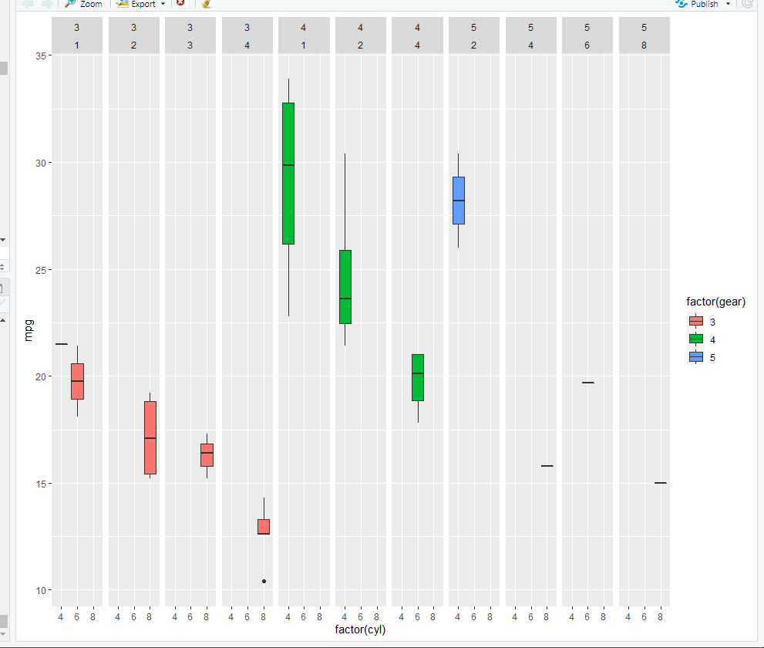
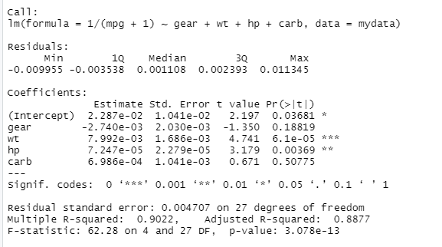
1. mtcars(cyl~gear+carb=> cyl대신 gear, carb ) model4<-lm(1/(mpg+1)~gear+wt+hp+carb,mydata) #AIC:-246

Slide 12
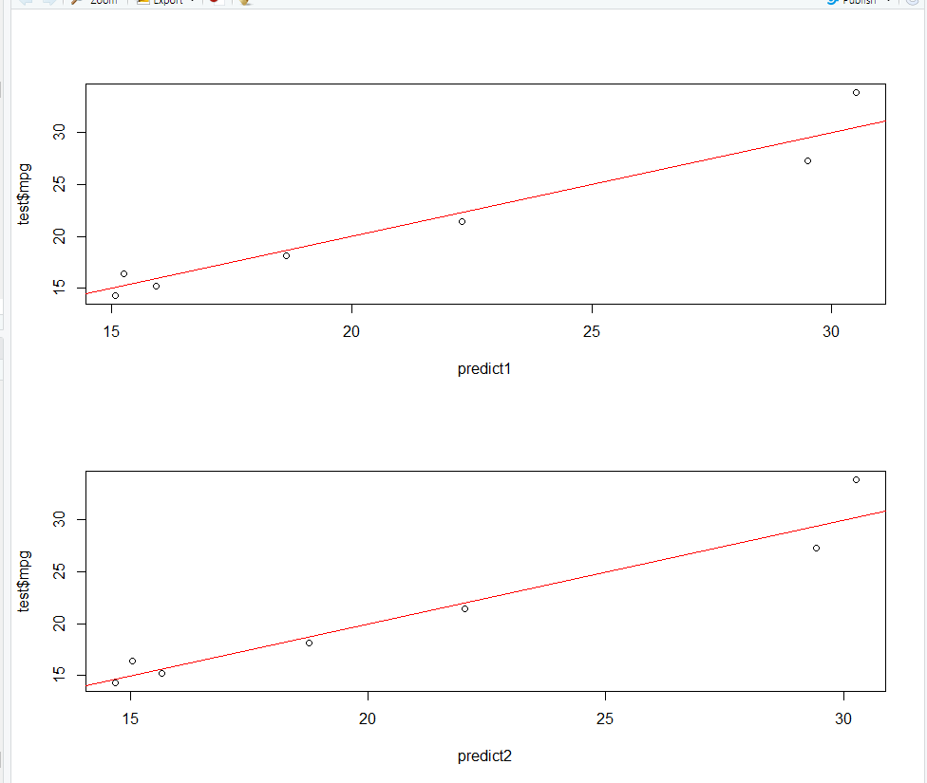
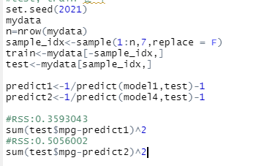
1. Mtcars # best model: 1/(mpg+1)~cyl+wt+hp #AIC:-246
모델1
1/(mpg+1)~cyl+wt+hp
rss =>0.3593
모델4 :
1/(mpg+1)~gear+carb+wt+hp
rss=>0.5056
모델1이 best

