Slide 1
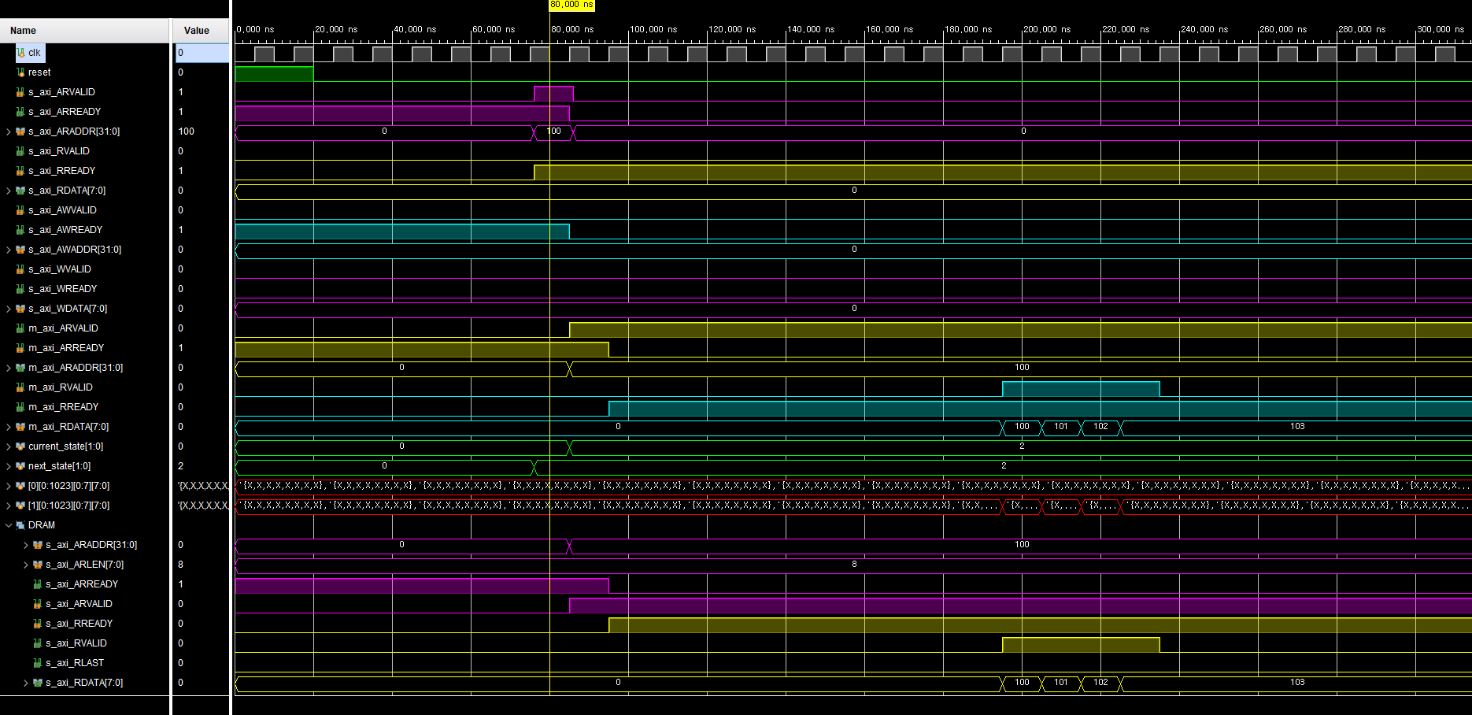
Cache Controller
READ
HOST request to RAM
DATA READ
(ADDR:100)

Slide 2
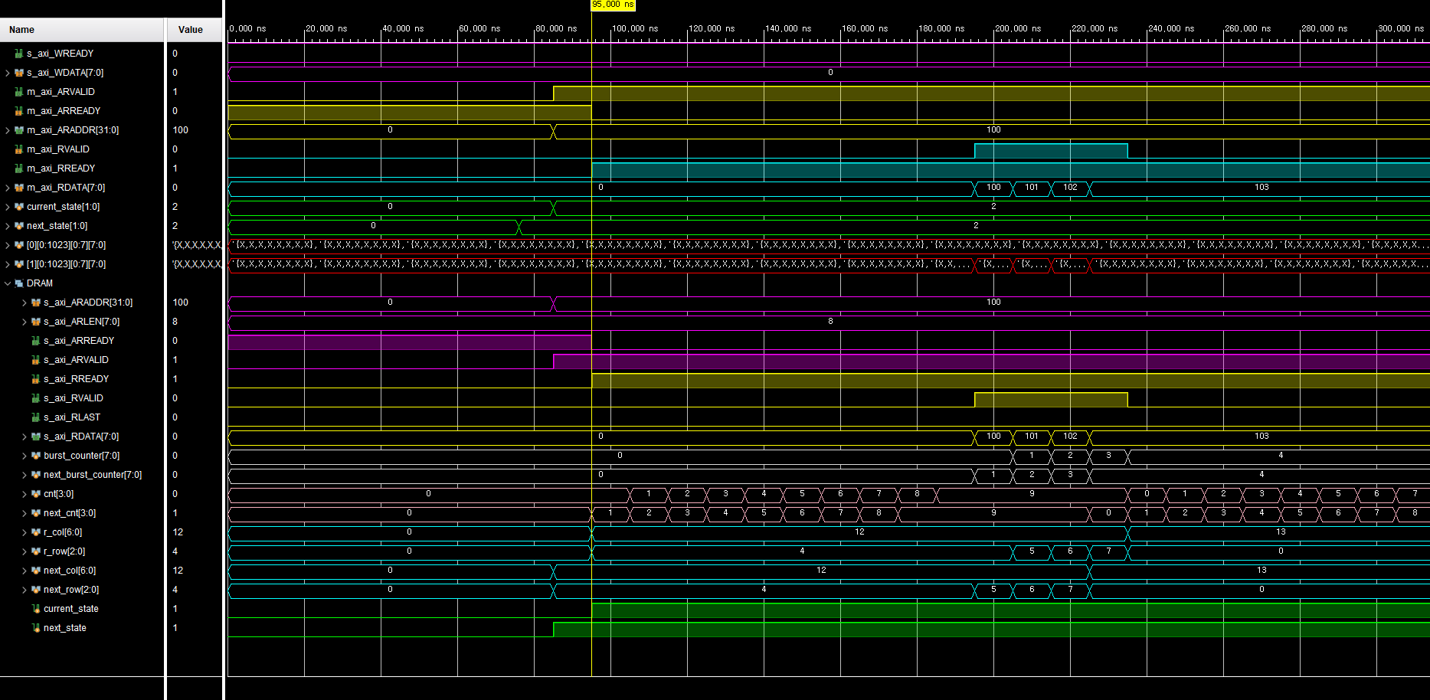
Cache Controller
READ
SRAM request to DRAM
DELAY 10 cycle
(DRAM access penalty)

Slide 3
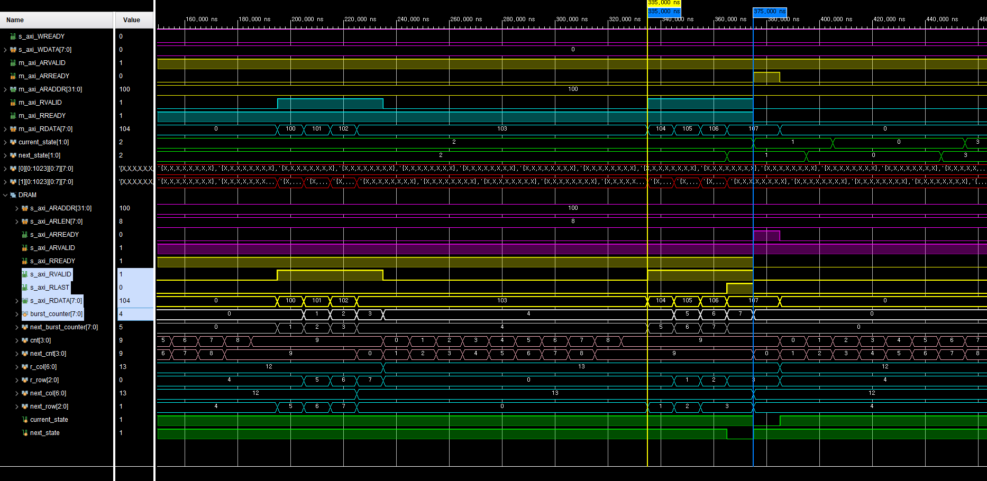
Cache Controller
READ
DRAM burst read
DATA Transaction
DRAM to SRAM
DRAM burst read
DATA Transaction
DRAM to SRAM

Slide 4
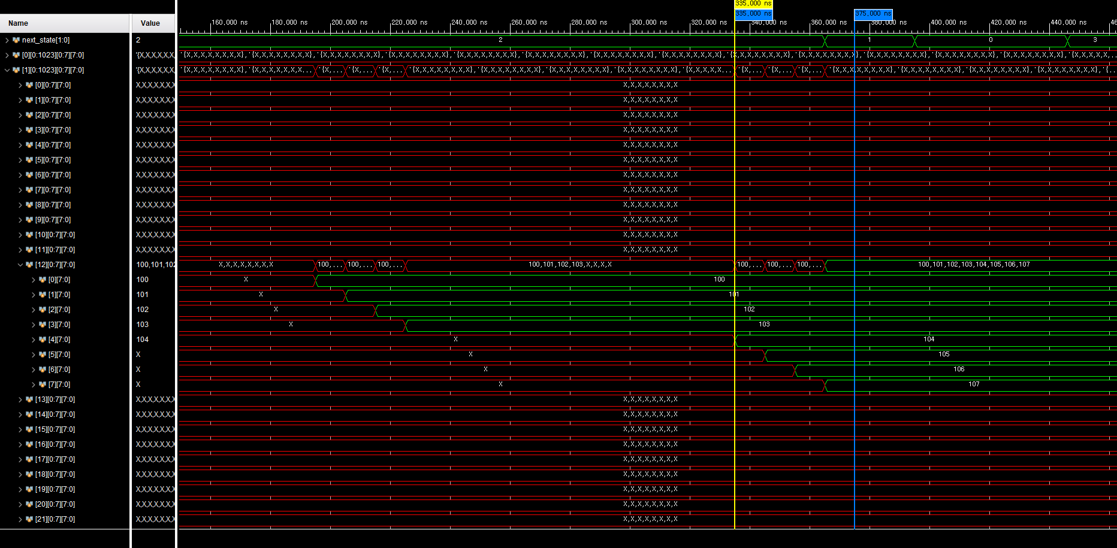
Cache Controller
READ
Updated SRAM

Slide 5
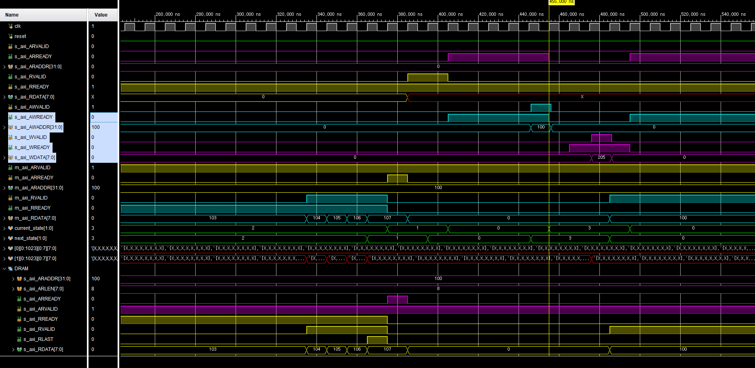
Cache Controller
WRITE
HOST request to SRAM
WRITE DATA (to SRAM)
(ADDR: 100)
DATA : 205 (Decimal)

Slide 6
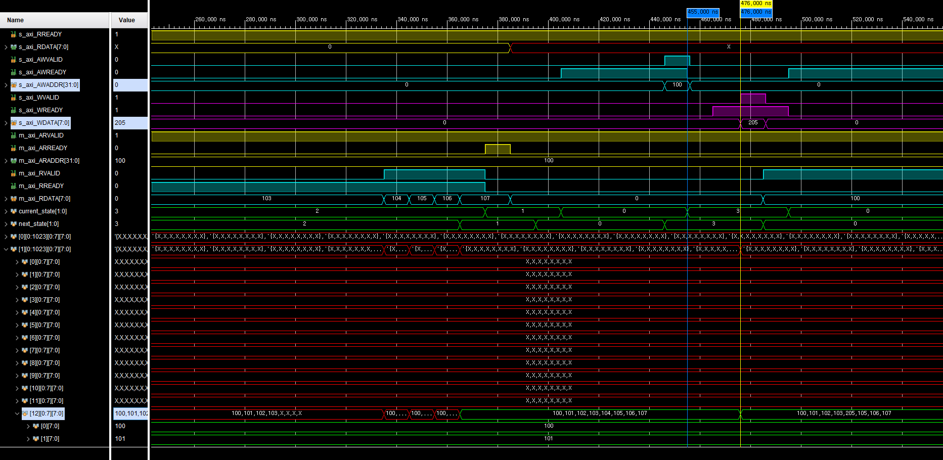
Cache Controller
WRITE
Updated SRAM

