Slide 1

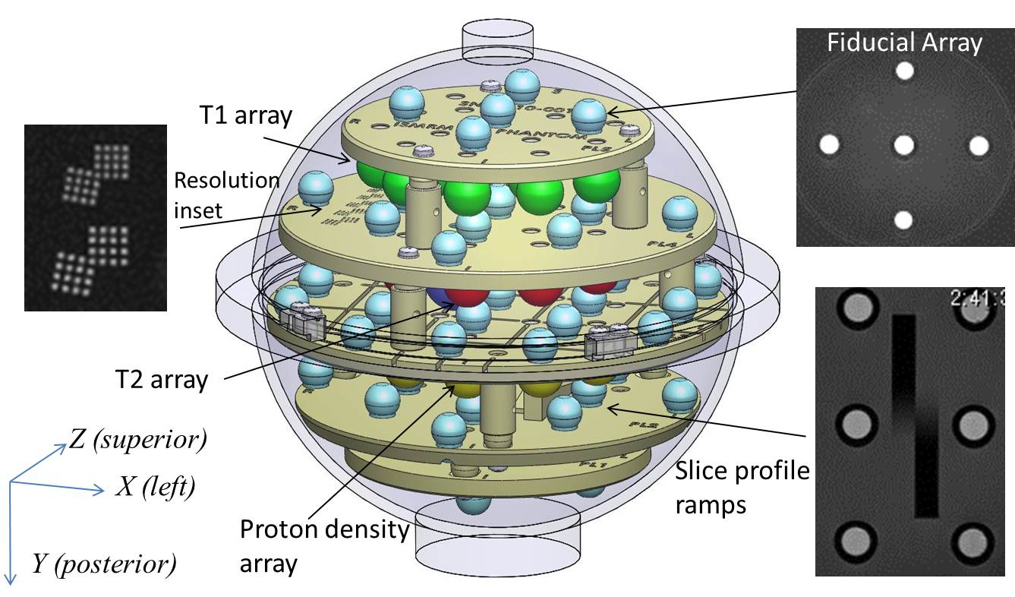
MRI BioMarker Measurement Service
NIST, 325 Broadway, Boulder CO, 80027
https://www.nist.gov/programs-projects/magnetic-resonance-imaging-mri-biomarker-measurement-service

