Slide 1
Introducing Unsupervised learning
Scott O’Hara
Metrowest Developers Machine Learning Group
02/17/2021

Slide 2
References
The material for this talk is primarily drawn from the notes, slides and lectures of the courses below:
Applied Machine Learning in Python
University of Michigan, Prof. Kevin Collins Thompson
https://www.coursera.org/learn/python-machine-learning/home/welcome
Machine Learning: Clustering & Retrieval
University of Washington, Profs. Emily Fox & Carlos Guestrin
https://www.coursera.org/learn/ml-regression/home/welcome
The Hundred-Page Machine Learning Book (Ch. 9)
Andriy Burkov
http://themlbook.com/

Slide 3
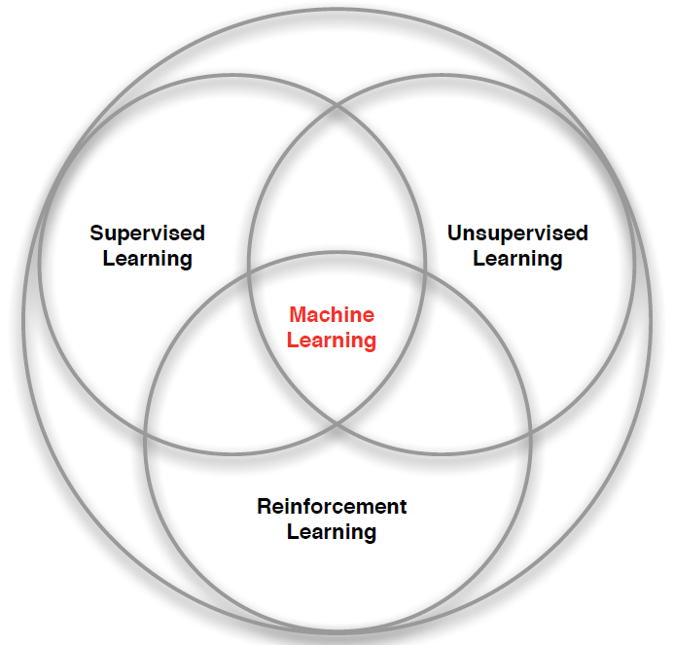
3 Types of Machine Learning
Supervised Learning – Learn a function from labeled data that maps input attributes to an output label e.g., linear regression, decision trees, SVMs.
Unsupervised Learning – Learn patterns in unlabeled data e.g., principle component analysis or clustering algorithms such as K-means, HAC, or Gaussian mixture models.
Reinforcement Learning – An agent learns to maximize rewards while acting in an uncertain environment.
Credit: image borrowed from lecture slides David Silver, DeepMind, “Introduction to Reinforcement Learning

Slide 4
What is Unsupervised Learning?
Unsupervised learning involves tasks that operate on datasets without labeled responses or target values.
The goal is to discover interesting structure or information in the dataset.
Reference: Applied Machine Learning in Python. Coursera. University of Michigan, Prof. Kevin Collins Thompson

Slide 5
Applications of unsupervised learning
Visualize structure of a complex dataset.
Density estimation to predict probabilities of events.
Compress and summarize the data.
Extract features for supervised learning.
Discover important clusters or outliers.
Reference: Applied Machine Learning in Python. Coursera. University of Michigan, Prof. Kevin Collins Thompson

Slide 6
Four Kinds of unsupervised learning
Density Estimation
Model the probability density function of the unknown probability distribution from which the dataset has been drawn.
Dimensionality Reduction
Finds an approximate version of a dataset using fewer features while retaining some meaningful properties of the original data.
Outlier Detection
Detect the examples in the dataset that are very different from what a typical example in the dataset looks like.
Clustering
The task of grouping a set of objects in such a way that objects in the same group (called a cluster) are more like each other than to those in other groups (clusters).
References:
The Hundred-Page Machine Learning Book. Andriy Burkov.
Applied Machine Learning in Python. Coursera. University of Michigan, Prof. Kevin Collins Thompson
Cluster analysis, https://en.wikipedia.org/w/index.php?title=Cluster_analysis&oldid=1002271612 (last visited Jan. 27, 2021).
Dimensionality reduction, https://en.wikipedia.org/w/index.php?title=Dimensionality_reduction&oldid=1002754996 (last visited Jan. 27, 2021).

Slide 7
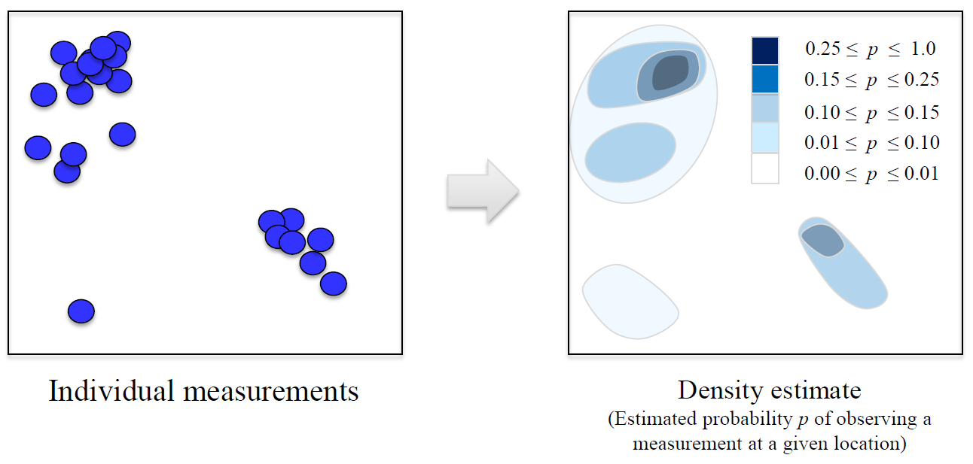
Density Estimation
Source: Applied Machine Learning in Python. Coursera. University of Michigan, Prof. Kevin Collins Thompson

Slide 8
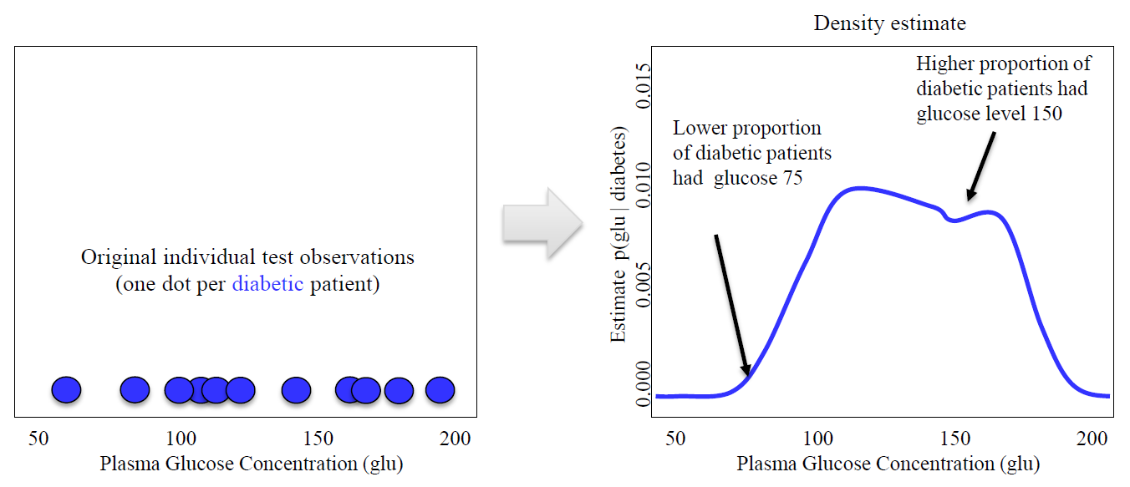
Density Estimation Example
Source: Applied Machine Learning in Python. Coursera. University of Michigan, Prof. Kevin Collins Thompson

Slide 9
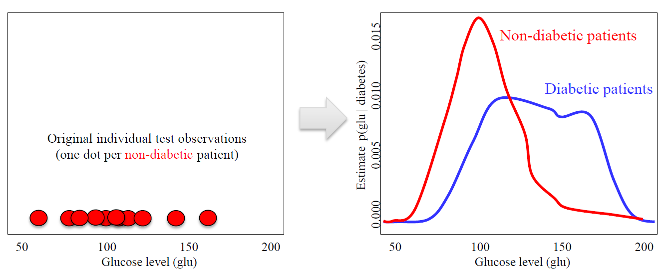
Density Estimation Example
Source: Applied Machine Learning in Python. Coursera. University of Michigan, Prof. Kevin Collins Thompson

Slide 10
Density Estimation Techniques
Histograms
Kernel Density Estimation
etc.
Source: Density estimation, https://en.wikipedia.org/w/index.php?title=Density_estimation&oldid=991862330 (last visited Jan. 27, 2021).

Slide 11
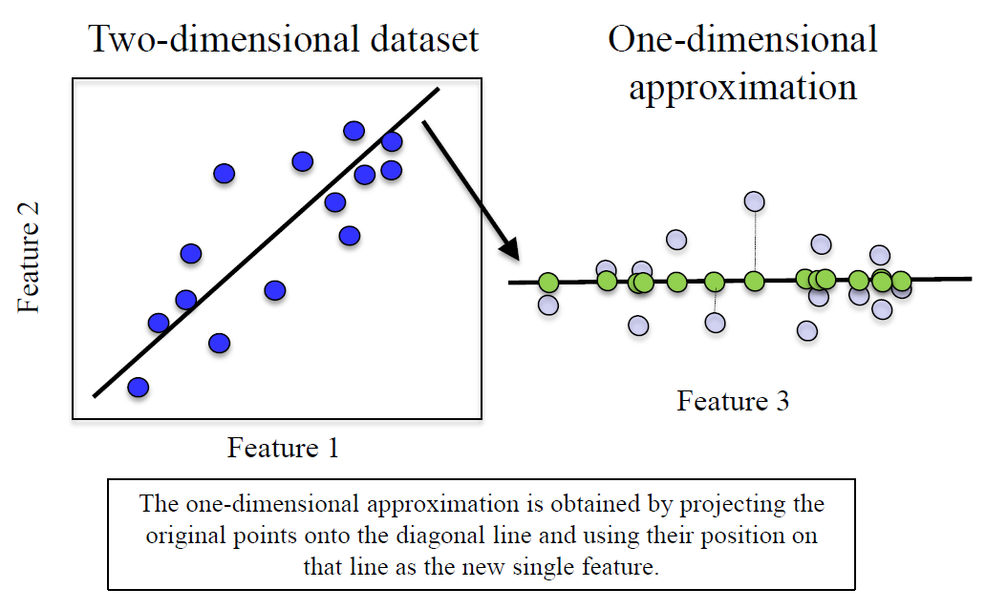
Dimensionality Reduction
Finds an approximate version of your dataset using fewer features.
Used for exploring and visualizing a dataset to understand grouping or relationships
Often visualized using a 2-dimensional scatterplot
Also used for compression, finding features for supervised learning
Source: Applied Machine Learning in Python. Coursera. University of Michigan, Prof. Kevin Collins Thompson

Slide 12
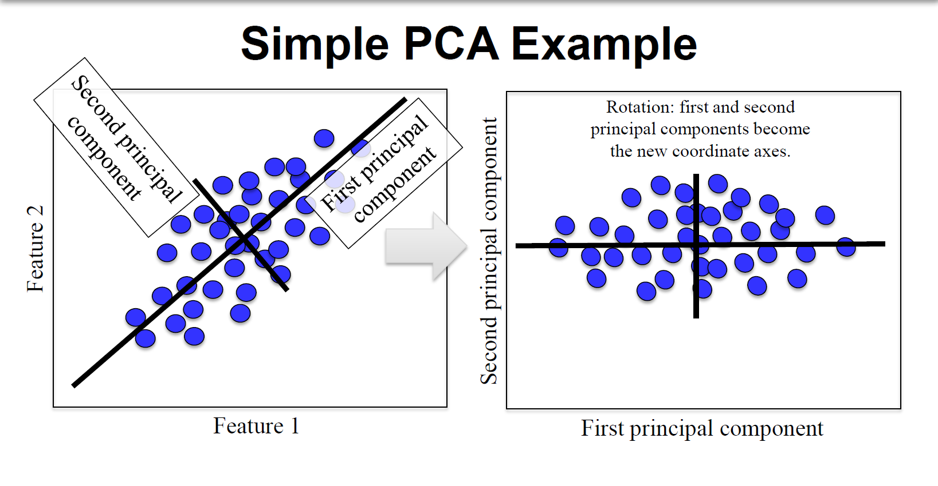
Source: Applied Machine Learning in Python. Coursera. University of Michigan, Prof. Kevin Collins Thompson

Slide 13

Outlier Detection
Outlier detection is the problem of detecting the examples in the dataset that are very
different from what a typical example in the dataset looks like.
Reference: The Hundred-Page Machine Learning Book. Ch 9. Andriy Burkov.
Image from: A Brief Overview of Outlier Detection Techniques, https://towardsdatascience.com/a-brief-overview-of-outlier-detection-techniques-1e0b2c19e561 (last visited Jan. 27, 2021).

Slide 14
Outlier detection Algorithms
Many outlier detection algorithms are adapted from more general clustering algorithms.
One-Class Algorithms:
One-class gaussian
One-class mixture of gaussians.
One-class K-means
One-class KNN
One-class SVM
Autoencoder
Source: Density estimation, https://en.wikipedia.org/w/index.php?title=Density_estimation&oldid=991862330 (last visited Jan. 27, 2021).

Slide 15
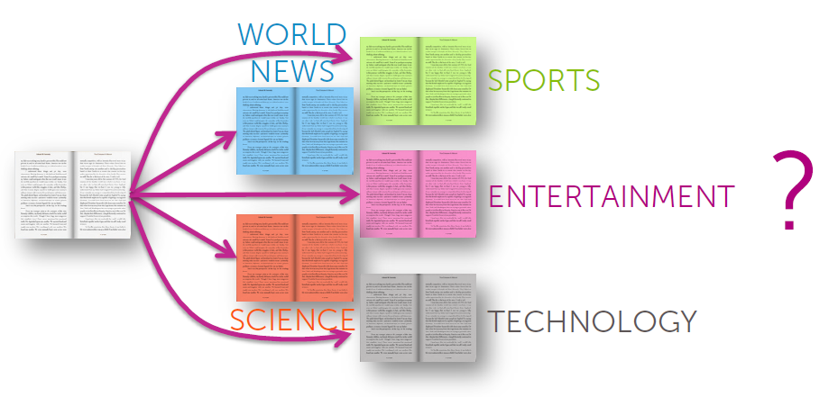
A Supervised Learning Task
But what if you don’t have labels?
Source: Machine Learning: Clustering & Retrieval
University of Washington, Profs. Emily Fox & Carlos Guestrin

Slide 16
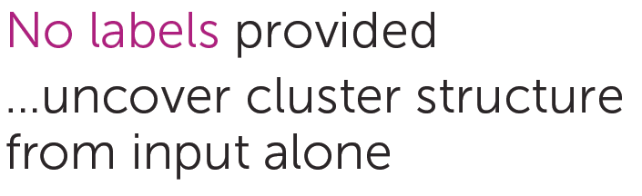
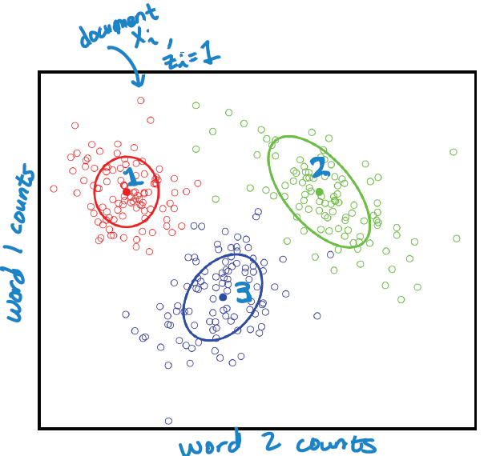
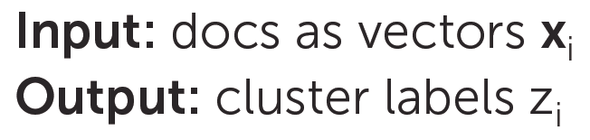
An Unsupervised Learning Task
Source: Machine Learning: Clustering & Retrieval
University of Washington, Profs. Emily Fox & Carlos Guestrin

Slide 17
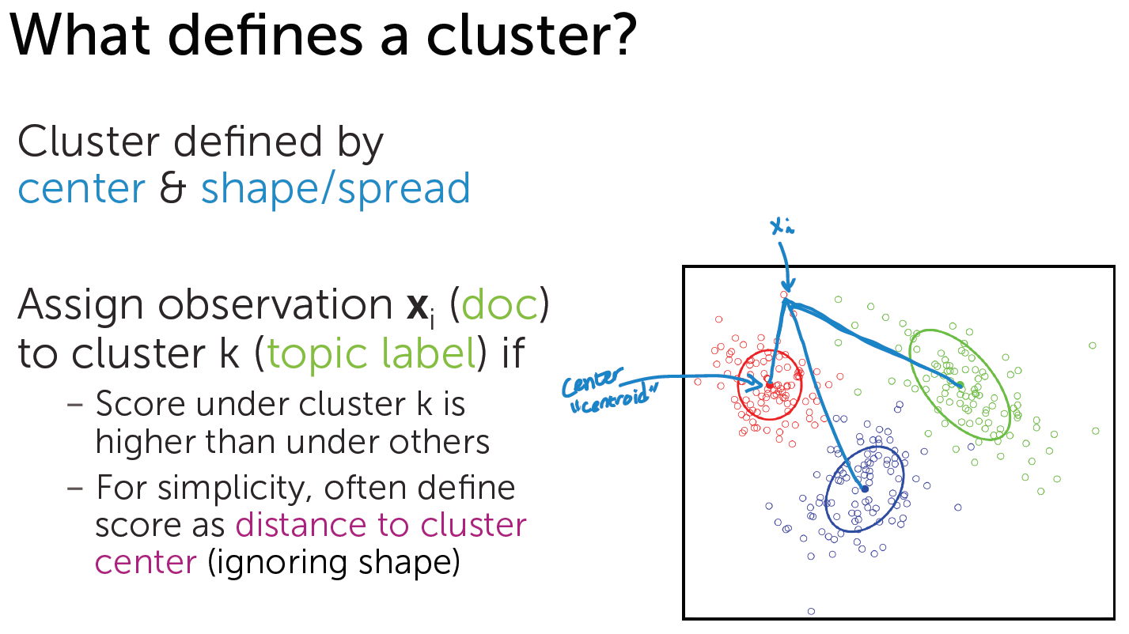
Source: Machine Learning: Clustering & Retrieval
University of Washington, Profs. Emily Fox & Carlos Guestrin

Slide 18
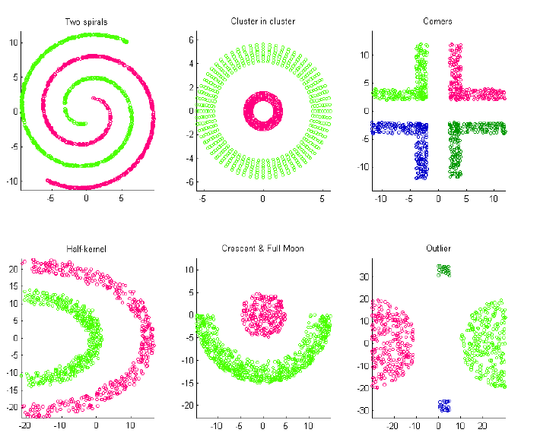
Challenging Clusters
Source: Machine Learning: Clustering & Retrieval
University of Washington, Profs. Emily Fox & Carlos Guestrin

Slide 19
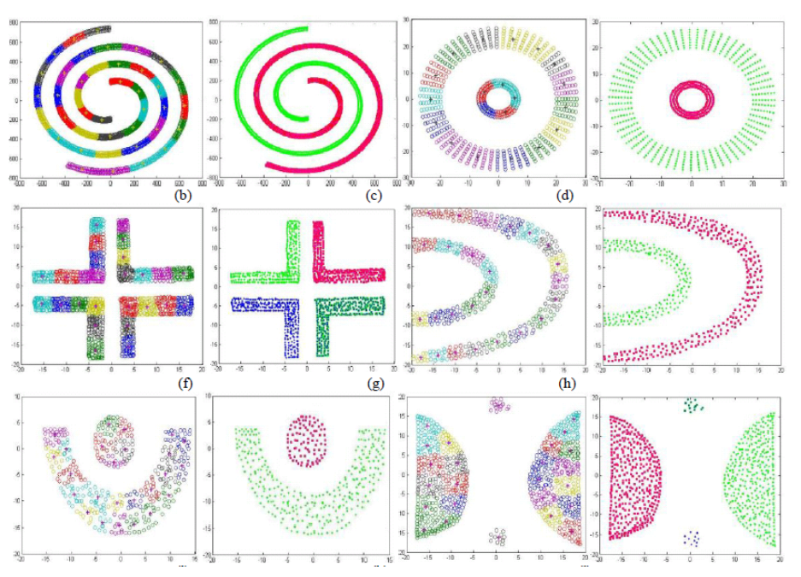
More Challenging Clusters
Source: Machine Learning: Clustering & Retrieval
University of Washington, Profs. Emily Fox & Carlos Guestrin

Slide 20
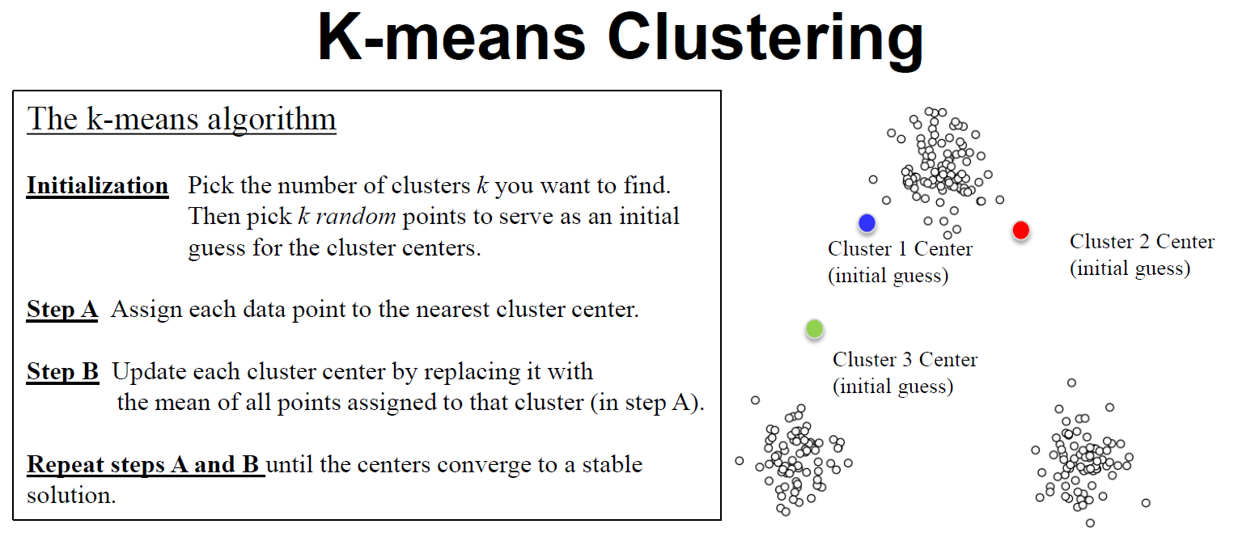
Source: Applied Machine Learning in Python. Coursera. University of Michigan, Prof. Kevin Collins Thompson

Slide 21
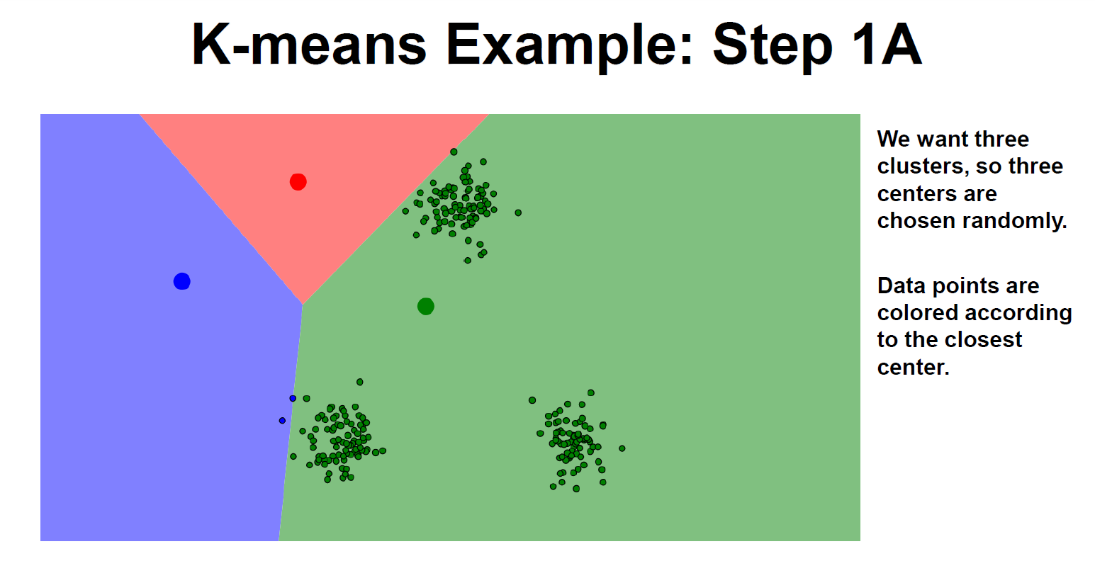
Source: Applied Machine Learning in Python. Coursera. University of Michigan, Prof. Kevin Collins Thompson

Slide 22
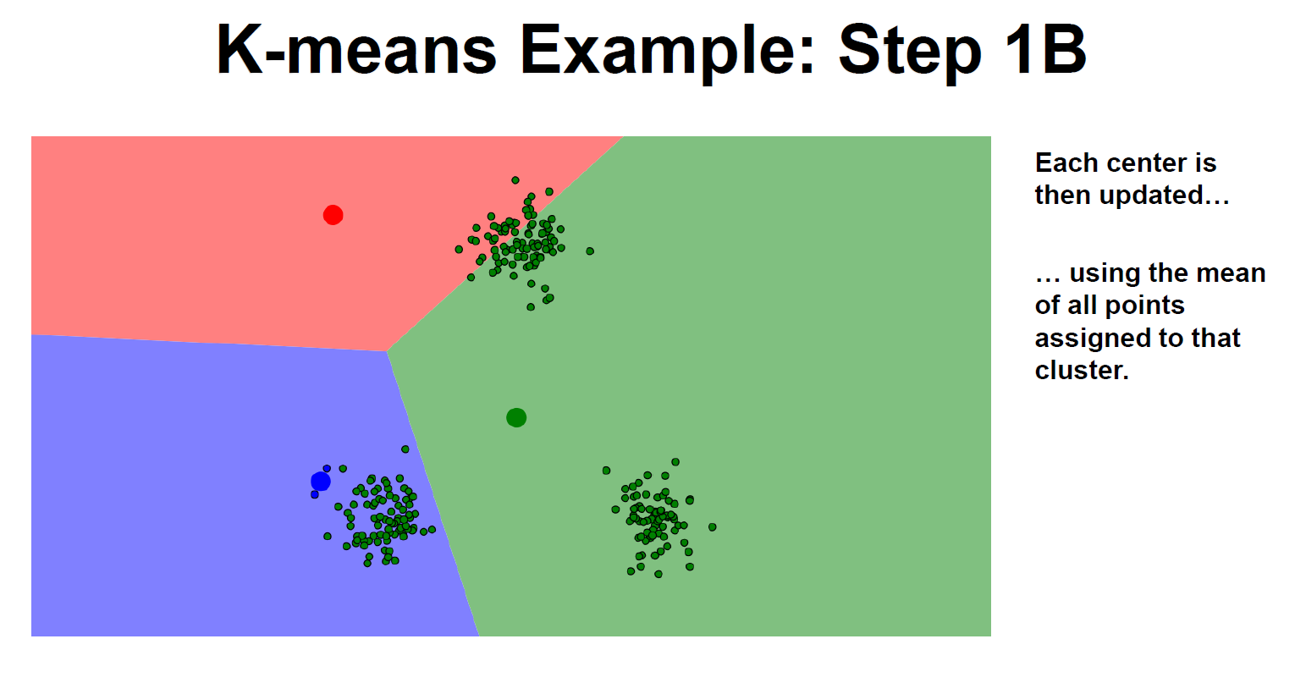
Source: Applied Machine Learning in Python. Coursera. University of Michigan, Prof. Kevin Collins Thompson

Slide 23
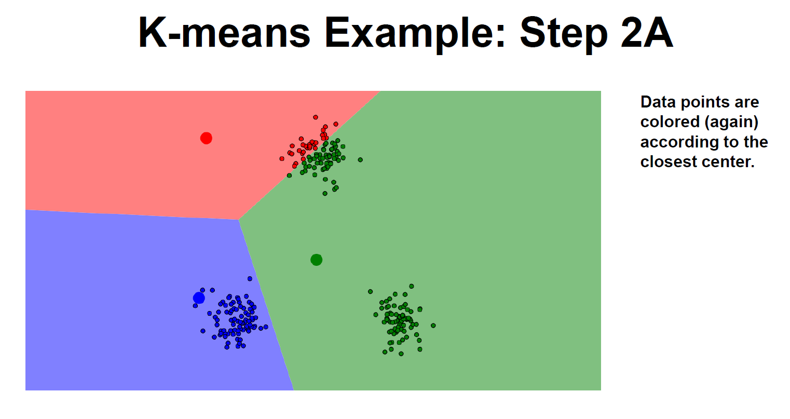
Source: Applied Machine Learning in Python. Coursera. University of Michigan, Prof. Kevin Collins Thompson

Slide 24
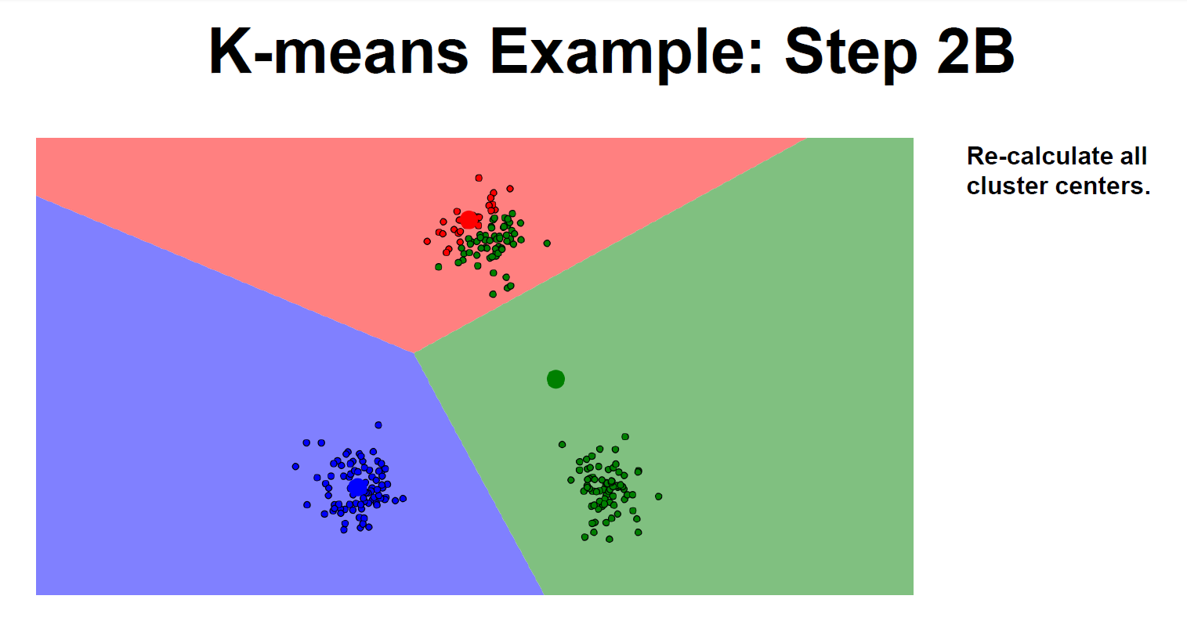
Source: Applied Machine Learning in Python. Coursera. University of Michigan, Prof. Kevin Collins Thompson

Slide 25
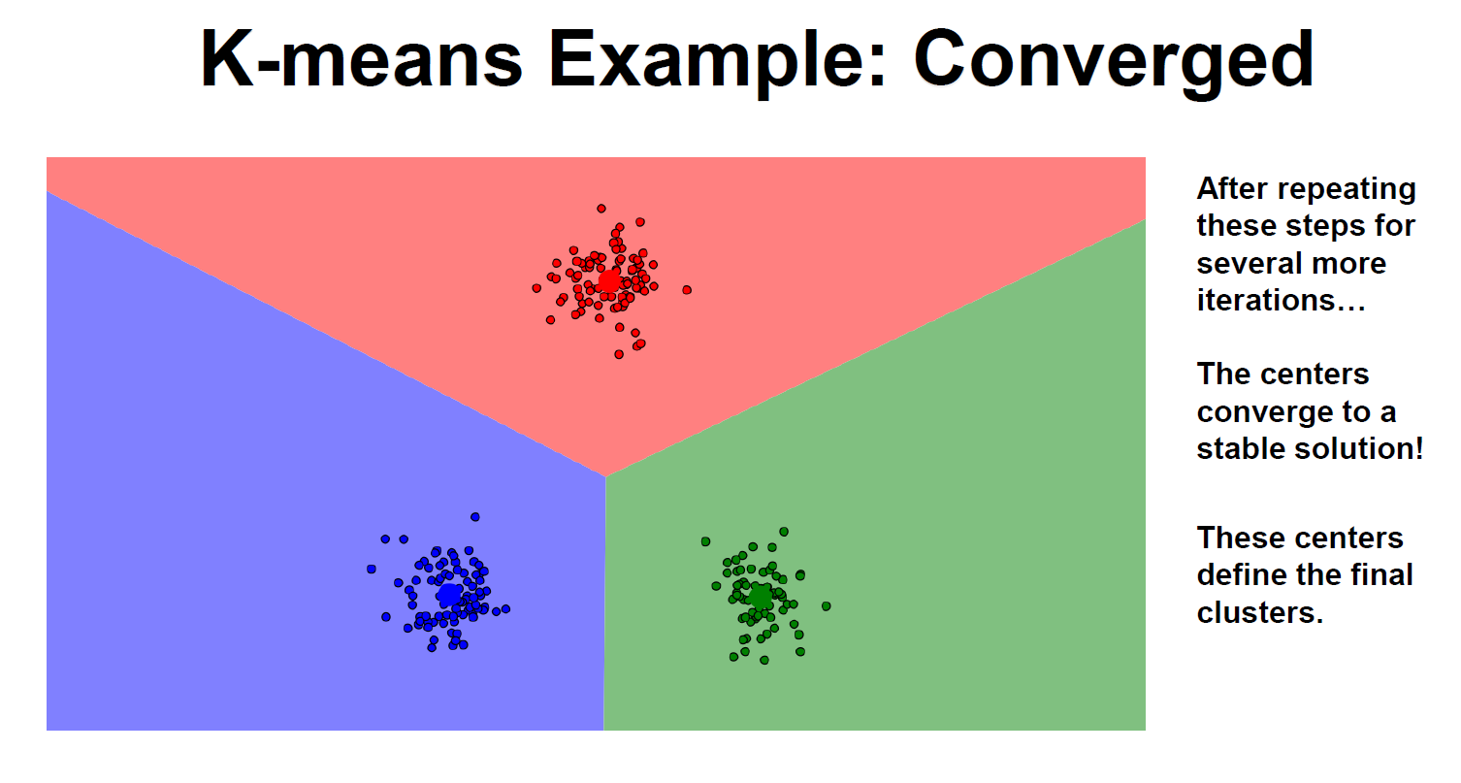
Source: Applied Machine Learning in Python. Coursera. University of Michigan, Prof. Kevin Collins Thompson

Slide 26
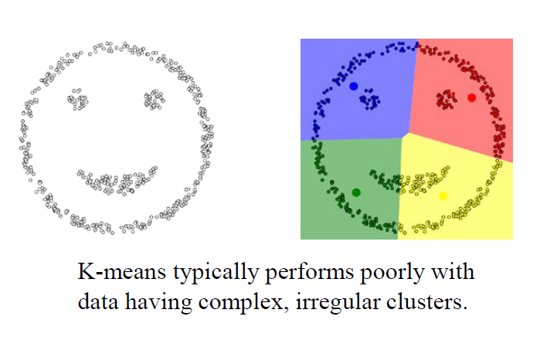
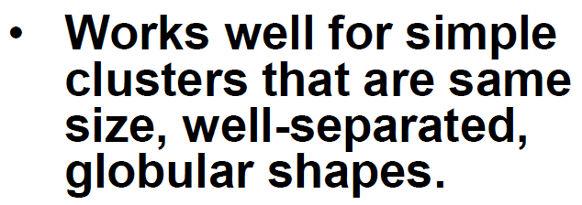
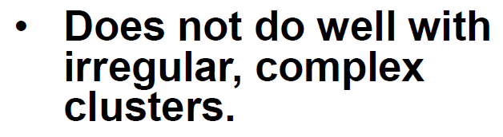
Limitations of K-Means
Source: Applied Machine Learning in Python. Coursera. University of Michigan, Prof. Kevin Collins Thompson

Slide 27
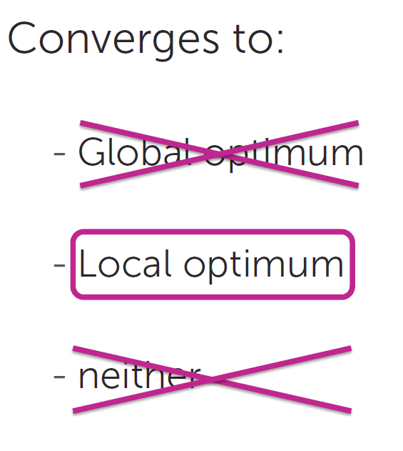
Convergence of K-Means
Reference: Machine Learning: Clustering & Retrieval
University of Washington, Profs. Emily Fox & Carlos Guestrin

Slide 28
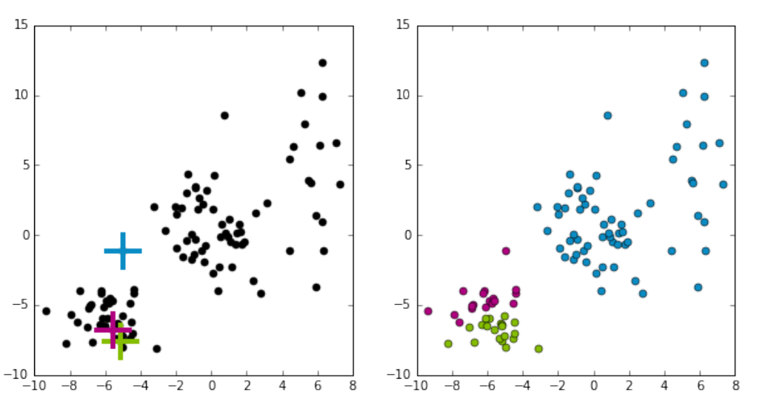
Convergence of K-Means to Local Optimum
Source: Machine Learning: Clustering & Retrieval
University of Washington, Profs. Emily Fox & Carlos Guestrin

Slide 29
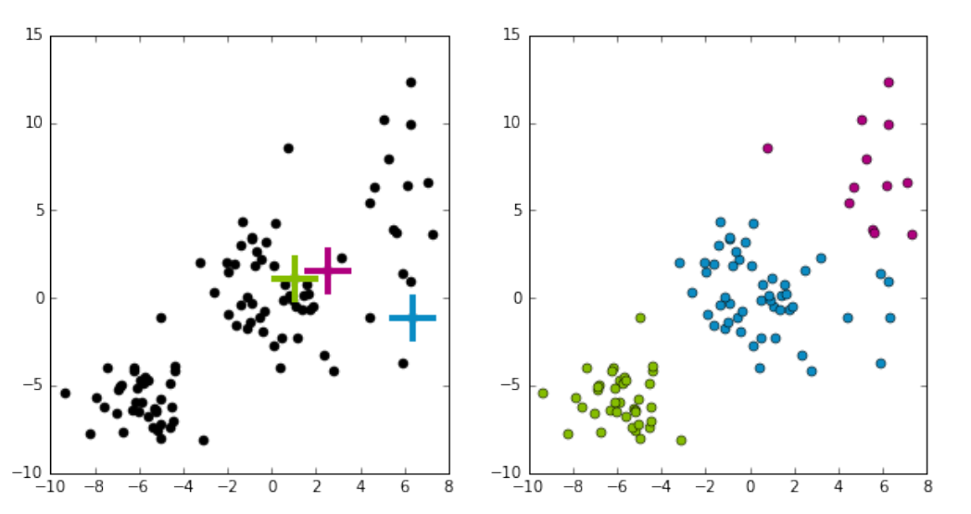
Convergence of K-Means to Local Optimum
Source: Machine Learning: Clustering & Retrieval
University of Washington, Profs. Emily Fox & Carlos Guestrin

Slide 30
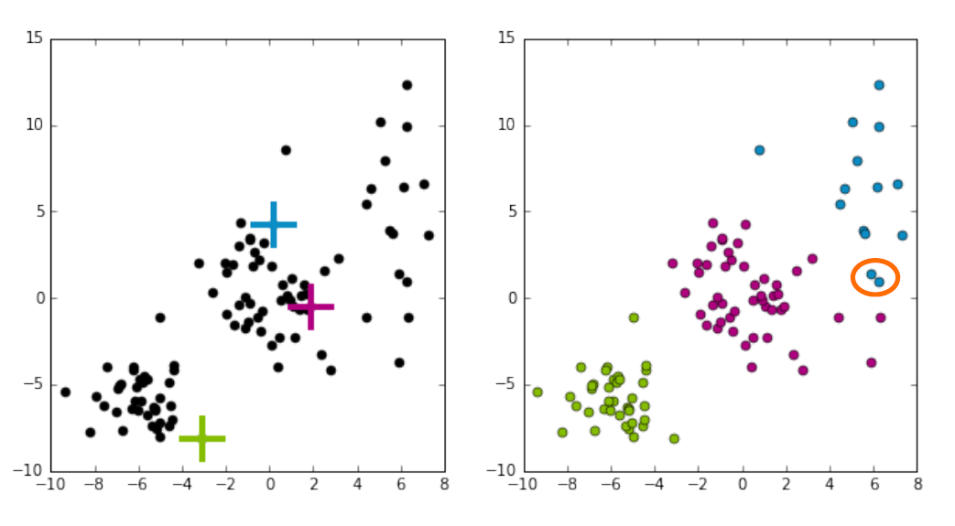
Convergence of K-Means to Local Optimum
Source: Machine Learning: Clustering & Retrieval
University of Washington, Profs. Emily Fox & Carlos Guestrin

Slide 31
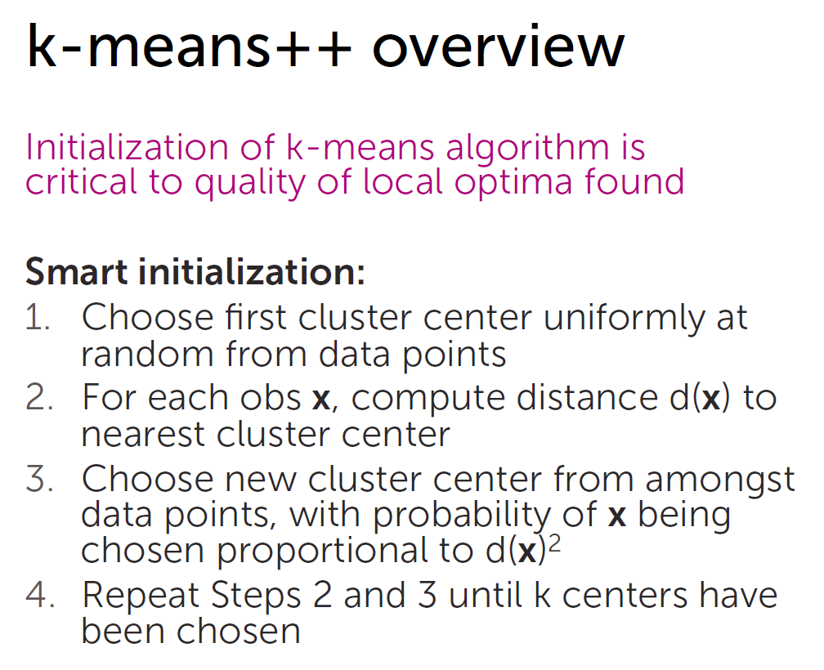
Smart initialization with k-means++
Reference: Machine Learning: Clustering & Retrieval
University of Washington, Profs. Emily Fox & Carlos Guestrin

Slide 32
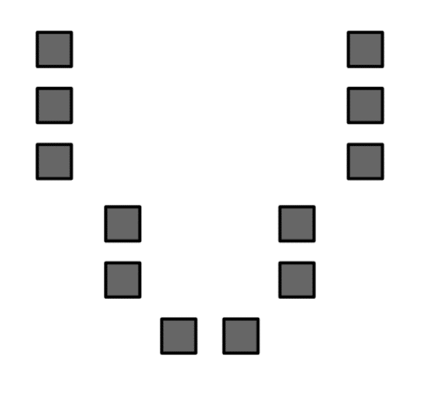
k-means++ Visualized
Reference: Machine Learning: Clustering & Retrieval
University of Washington, Profs. Emily Fox & Carlos Guestrin

Slide 33
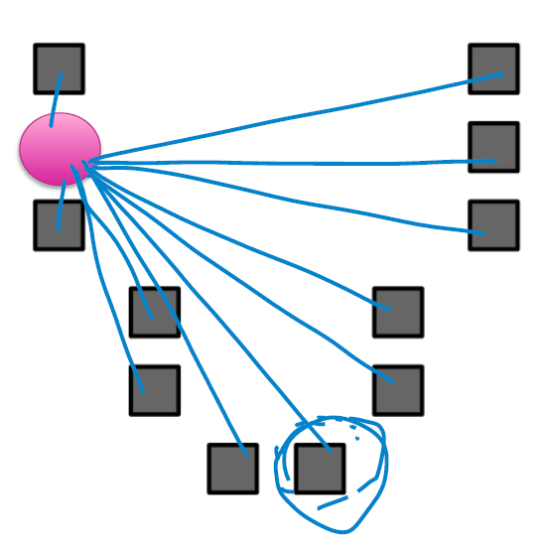
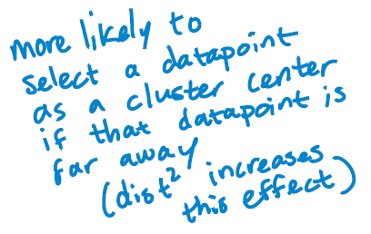
k-means++ Visualized
Reference: Machine Learning: Clustering & Retrieval
University of Washington, Profs. Emily Fox & Carlos Guestrin

Slide 34
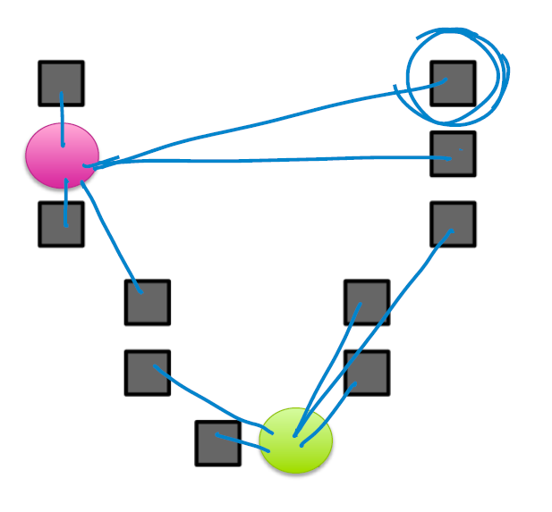
k-means++ Visualized
Reference: Machine Learning: Clustering & Retrieval
University of Washington, Profs. Emily Fox & Carlos Guestrin

Slide 35
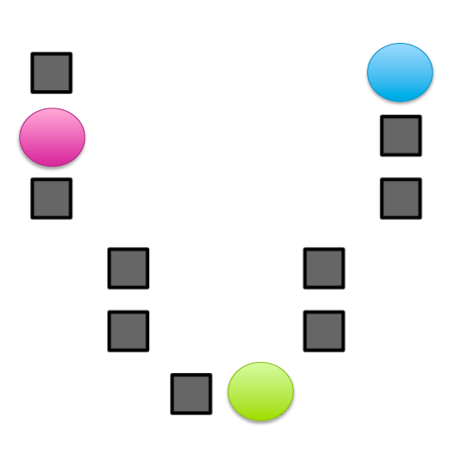
k-means++ Visualized
Reference: Machine Learning: Clustering & Retrieval
University of Washington, Profs. Emily Fox & Carlos Guestrin

Slide 36
Future Topics
Density Estimation Topics
Histograms
Kernel Density Estimation
Dimensionality Reduction
Principal Component Analysis (PCA)
t-SNE
UMAP
Autoencoders
Outlier Detection Topics
One-Class Classifier Learning
Autoencoders
Clustering Topics
Hierarchical Agglomerative Clustering
Gaussian Mixture Model
DBSCAN
HDBSCAN*
Cross-validation
Deep Neural Network Approaches
References:
The Hundred-Page Machine Learning Book. Andriy Burkov.
Applied Machine Learning in Python. Coursera. University of Michigan, Prof. Kevin Collins Thompson
Cluster analysis, https://en.wikipedia.org/w/index.php?title=Cluster_analysis&oldid=1002271612 (last visited Jan. 27, 2021).
Dimensionality reduction, https://en.wikipedia.org/w/index.php?title=Dimensionality_reduction&oldid=1002754996 (last visited Jan. 27, 2021).

Slide 37
Introducing Unsupervised learning
Scott O’Hara
Metrowest Developers Machine Learning Group
02/17/2021

Slide 38
New Talk
Reference: Machine Learning: Clustering & Retrieval
University of Washington, Profs. Emily Fox & Carlos Guestrin
Reference: The Hundred-Page Machine Learning Book. Andriy Burkov.
Reference: Applied Machine Learning in Python. Coursera. University of Michigan, Prof. Kevin Collins Thompson

