Slide 1
Developing A Simple Reinforcement Learning Program Using RL-Glue
Scott O’Hara
Metrowest Developers Machine Learning Group
09/02/2020

Slide 2
References
Sample-based Learning Methods (M. White and A. White), University of Alberta, Alberta Machine Intelligence Institute, Coursera.
https://www.coursera.org/learn/sample-based-learning-methods/
Reinforcement learning: An Introduction R. S. Sutton and A. G. Barto, Second edition. Cambridge, Massachusetts: The MIT Press, 2018.
Reinforcement Learning David Silver - University College London / Google DeepMind, 2015.
https://www.davidsilver.uk/teaching/

Slide 3
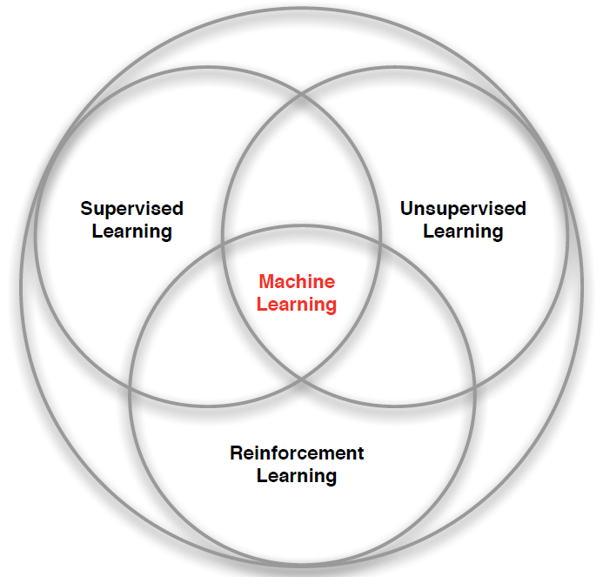
What is Reinforcement Learning (RL)?
“Reinforcement learning is a kind of unsupervised supervised learning”
– Rich Sutton
Supervised Learning – Learn a function from labeled data that maps input attributes to an output.
Unsupervised Learning – Find classes, patterns or generalizations in unlabeled data.
Reinforcement Learning –An agent learns to maximize rewards while acting in an uncertain environment.
Credit: image borrowed from lecture slides David Silver, DeepMind, “Introduction to Reinforcement Learning

Slide 4
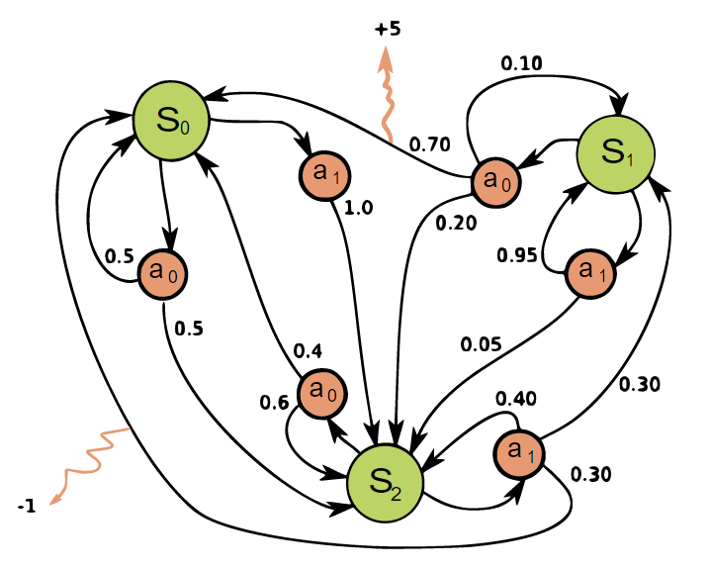

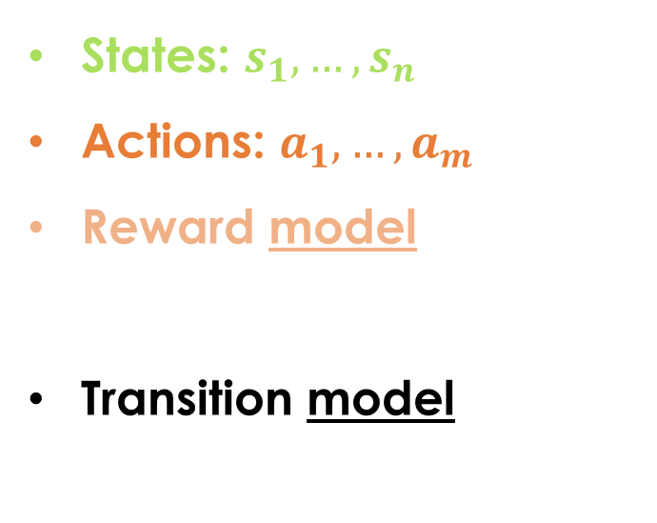
RL Problems are often Modeled with a Markov decision process (MDP)
States: $s_{1},…,s_{n}$
Actions: $a_{1},…,a_{m}$
Reward model:
$R\left(s,a,s′\right)∈R$
Transition model:
$T\left(s,a,s′\right)=$ $P\left(s′ | s, a\right)$
+5
0.5
<https://en.wikipedia.org/w/index.php?title=Markov_decision_process&oldid=975754122> [accessed 02 September 2020]

Slide 5
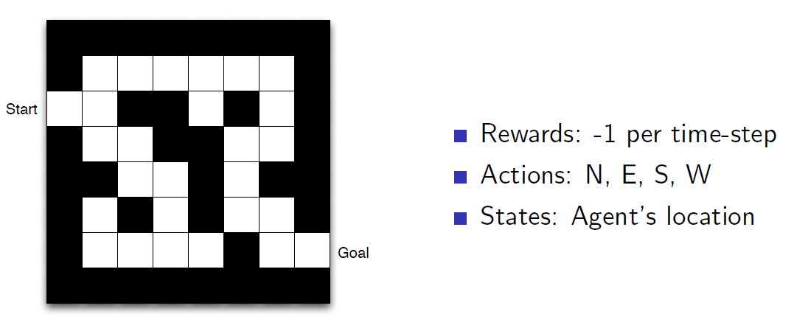
Maze Example
Credit: Reinforcement Learning, David Silver, University College London / Google DeepMind, 2015.

Slide 6
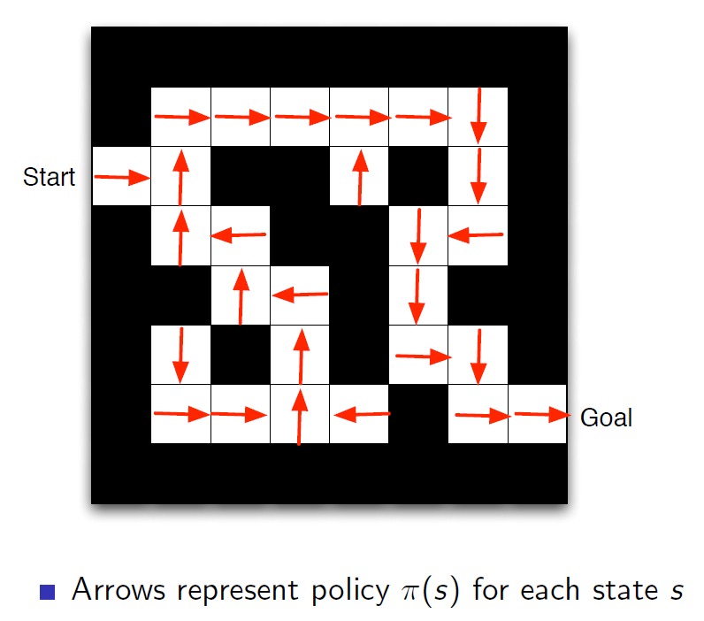
Maze Example: Policy
Credit: Reinforcement Learning, David Silver, University College London / Google DeepMind, 2015.

Slide 7
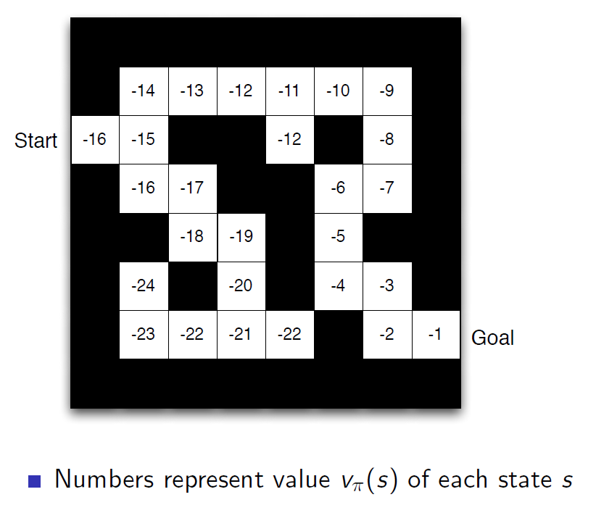
Maze Example: Value Function
Credit: Reinforcement Learning, David Silver, University College London / Google DeepMind, 2015.

Slide 8

The Reinforcement Learning Problem
Agent
State: s’
Reward: r
Actions: a
Environment
Agent must learn to act to maximize expected rewards in the environment.
Agent knows the current state s, takes an action a, receives a reward r and observes the next state s’.
$S_{0}, A_{0}, R_{0},S_{1}, A_{1}, R_{2},S_{2}, A_{2}, R_{2},…,S_{n}, A_{n}, R_{n},S_{T}$

Slide 9
Reinforcement Learning algorithms Optimize Value Functions V and Q
The State-Value Function:
V(s) = expected utility of starting in state s and acting optimally thereafter.
The Action-Value Function:
Q(s,a) = expected utility of starting in state s, taking action a, and acting optimally thereafter.
s
s is a state
a
(s, a) is a q-state
s, a
s,a,s’
(s,a,s’) is a transition
s’
Credit: CS188 – Intro to AI, UC Berkeley, ai.berkely.edu
Notes:
Demo just shows V and Q values, snapshots on next slides.

Slide 10
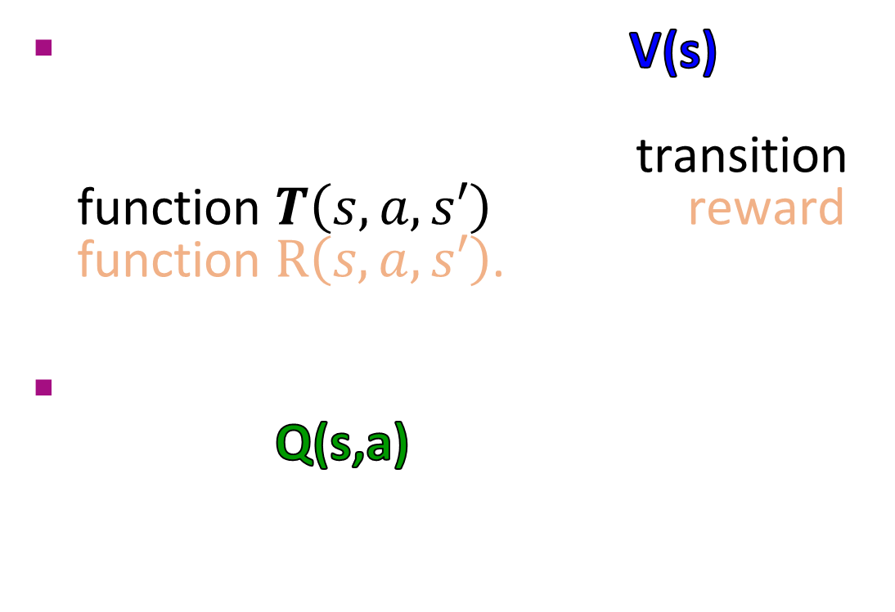
Model-Free RL Algorithms
The state-value function V(s) can be used to make optimal decisions only when used with the transition function $T\left(s,a,s′\right)$ and the reward function $R\left(s,a,s′\right)$.
Fortunately, the action-value function Q(s,a) can be computed directly without the transition and reward functions.
s
s is a state
a
(s, a) is a q-state
s, a
s,a,s’
(s,a,s’) is a transition
s’
Credit: CS188 – Intro to AI, UC Berkeley, ai.berkely.edu
Notes:
Demo just shows V and Q values, snapshots on next slides.

Slide 11
Model-Free Algorithms
RL algorithms that compute the Q function directly are called model-free algorithms.
Sarsa and Q-Learning are two examples of model-free algorithms that use temporal difference (TD) learning to compute the Q function directly.
With TD-Learning:
You make a prediction about what will happen next.
You wait to see what happens.
You learn by comparing what happens to what you predicted and adjusting your decision policy accordingly.

Slide 12
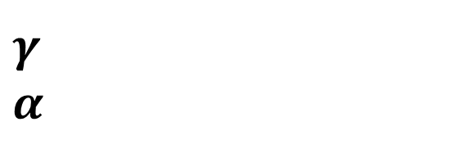
r
a
a’
SARSA Update Rule
. . .
. . .
S
S’
Q_{k}(s,a)
γQ_{k}(s’,a’)
$$Q_{k+1}\left(s,a\right)←Q_{k}\left(s,a\right)+α\left[r+γQ_{k}\left(s′,a′\right)−Q_{k}\left(s,a\right)\right]$$
$γ$ – discount rate.
$α$ – learning rate.
The Future
(The Target)
The Present
(The Prediction)
Credit: Sample-based Learning Methods (M. White and A. White), University of Alberta, Alberta Machine Intelligence Institute, Coursera.

Slide 13
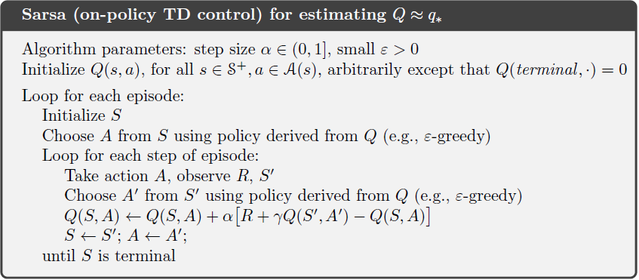

SARSA Algorithm

Slide 14
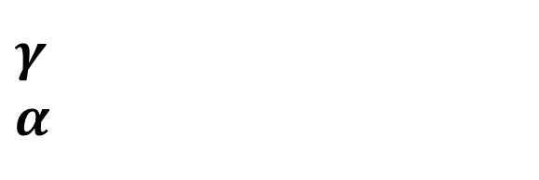
r
a
a’
Q-Learning Update Rule
. . .
. . .
S
S’
Q_{k}(s,a)
γmax_{a’} Q_{k}(s’,a’)
$$Q_{k}\left(s,a\right)←Q_{k}\left(s,a\right)+α\left[r+γ\max_{a′}{Q_{k}\left(s′,a′\right)}−Q_{k}\left(s,a\right)\right]$$
$γ$ – discount rate.
$α$ – learning rate.
The Future
(The Target)
The Present
(The Prediction)
Credit: Sample-based Learning Methods (M. White and A. White), University of Alberta, Alberta Machine Intelligence Institute, Coursera.

Slide 15
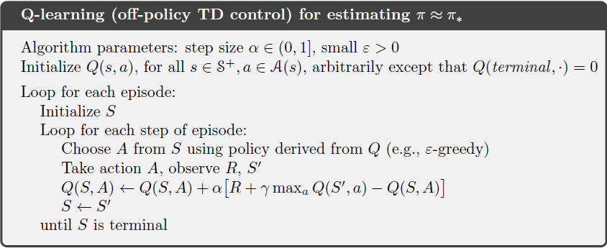
Q-learning Algorithm

Slide 16
How do we Implement the Reinforcement Learning Loop?
Action: a
State: s ← s’
Agent
Environment
State: s’
Reward: r

Slide 17
A Simple Approach: RL-GLUE
3 Python Classes:
RLGlue
BaseEnvironment
BaseAgent
In 3 Files:
rl_glue.py
environment.py
agent.py
Obtained from the Reinforcement Learning Specialization on Coursera.
Credit: Sample-based Learning Methods (M. White and A. White), University of Alberta, Alberta Machine Intelligence Institute, Coursera.

Slide 18
RL-GLUE (Historic)
Originally developed by Brian Tanner and Adam White, colleagues of Rich Sutton, author of Reinforcement Learning: An Introduction.
Some old links, most obsolete, some broken.
http://incompleteideas.net/rlai.cs.ualberta.ca/RLAI/rlai.html
https://sites.google.com/a/rl-community.org/rl-glue
https://code.google.com/archive/p/rl-glue/
Another version of RL-Glue in Python
NOT the Coursera version.
https://github.com/amarack/python-rl

Slide 19
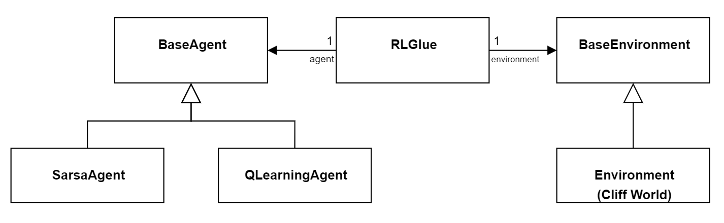
Implementing the RL Loop with RLGlue
Action: a
State: s ← s’
Agent
Environment
State: s’
Reward: r

Slide 20
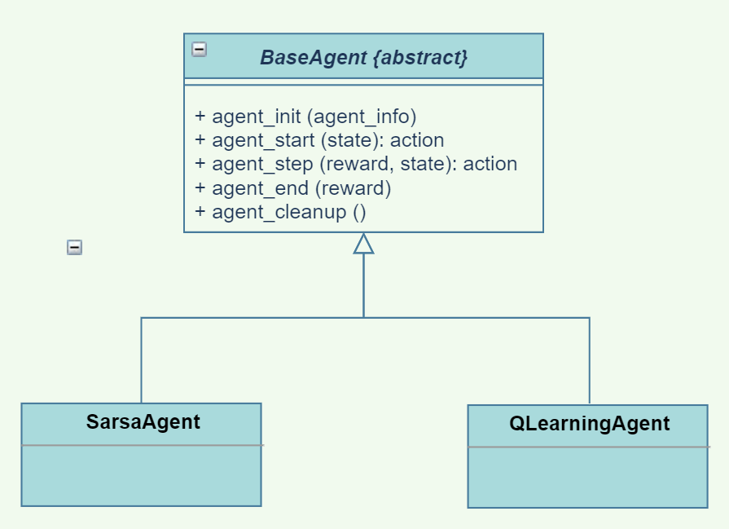
The BASE AGENT Class
agent_init (info) – setup agent when experiment first starts.
agent_start(state): action – process first state from environment and return an action.
agent_step (reward, state): action – process reward and state from environment and return an action.
agent_end (reward) – process final reward after terminal state is reached.
agent_cleanup () – cleanup after agent is finished.

Slide 21
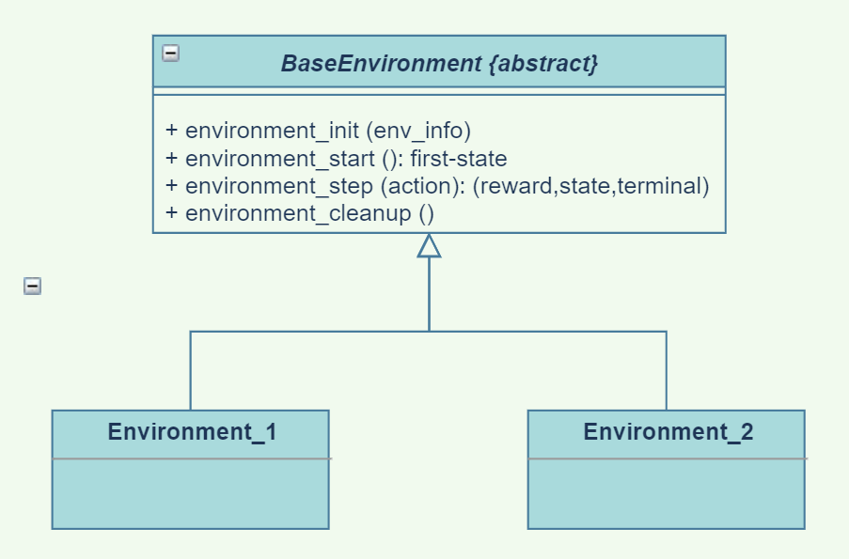
The BASE Environment Class
environment_init (info) – setup environment when experiment first starts.
environment_start(): first-state – return initial state.
environment_step (action): (reward,state,terminal) – given an action, return a reward, the next state, and a Boolean indicating whether the state is terminal.
environment_cleanup () – cleanup after agent is finished.

Slide 22
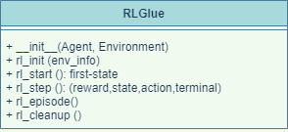
The RLGLUE Class
__init__(Agent, Environment) – RLGlue creates an agent object and an environment object.
rl_init(agent_init_info, env_init_info) – setup environment and agent.
rl_start(): first-state – environment sets the initial state; agent takes its first action; return initial state.
rl_step(): (reward,state,action,term) – environment changes in response to the agent’s action; agent acts in response.
rl_episode() - run an episode.
rl_cleanup() – cleanup after agent is finished.

Slide 23
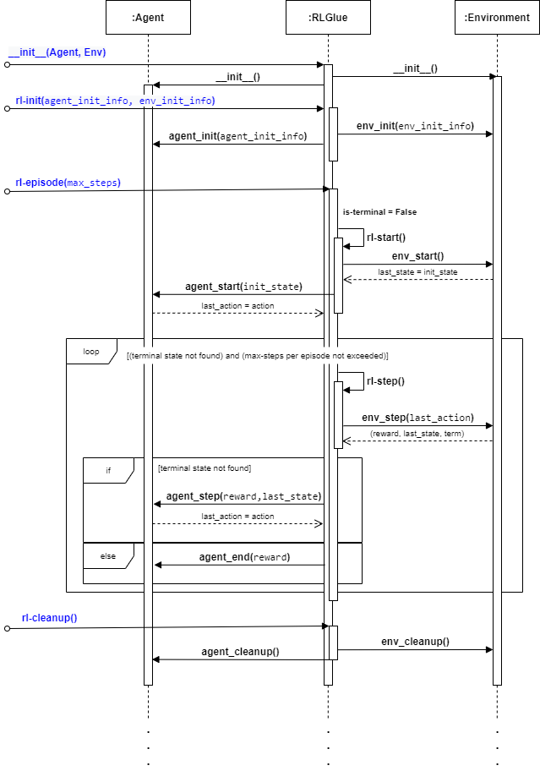
RL-Glue Sequence Diagram
__init__()
rl-init()
rl-episode()*
rl-start()
rl-step()*
rl-cleanup()

Slide 24
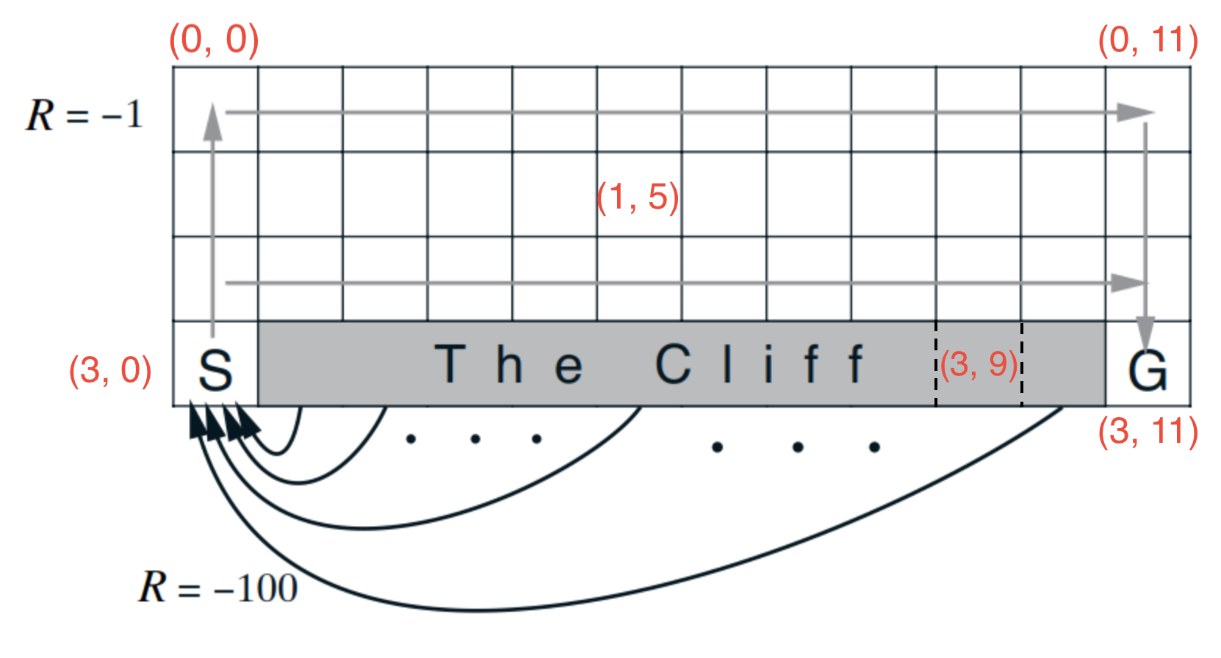
RL Environment: Cliffworld
States: <x, y> locations
Actions: move north, south, east or west.
Reward model:
0 if robot moves to the goal state G where episode finishes.
-100 if robot moves to the cliff.
-1 for every other move.
Transition model:
Robot moves deterministically in the chosen direction: north, south, east or west.
Robot stays put if it moves into a wall.
Robot transitions to the start state if it moves onto the cliff. (NOTE: episode does not finish.)
Discount factor: γ = 1.0
Credit: Sample-based Learning Methods (M. White and A. White), University of Alberta, Alberta Machine Intelligence Institute, Coursera.

Slide 25
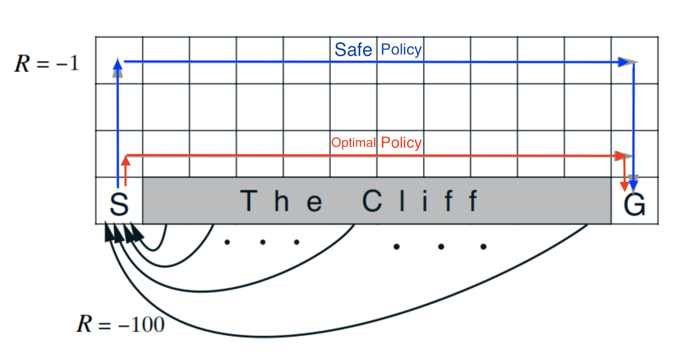
Optimal Vs. “Safe” Policies: Q-learning
Q-learning learns the optimal policy.
However, q-learning must stop exploring and change to complete exploitation mode to take advantage of this.
If q-learning continues to explore (off-policy), it will often get bad results since exploration will lead it to step over the cliff.
Credit: Sample-based Learning Methods (M. White and A. White), University of Alberta, Alberta Machine Intelligence Institute, Coursera.

Slide 26
Optimal Vs. “Safe” Policies: SARSA
SARSA learns the safe policy since it learns the policy it actually does.
However, SARSA learns slowly since it doesn’t take full advantage of the knowledge it has of state-action values.
Credit: Sample-based Learning Methods (M. White and A. White), University of Alberta, Alberta Machine Intelligence Institute, Coursera.

Slide 27
choosing an action: exploration vs exploitation
How should an agent choose an action? An obvious answer is simply to follow the current policy. However, this is often not the best way to improve your model.
Exploit: use your current model to maximize the expected utility now.
Explore: choose an action that will help you improve your model.

Slide 28
Look at the Following Files:
agent.py
environment.py
rl_glue.py
cliffworld_env.py
cliffwalk_annotated.png
Simple-RL-Glue-Demo.ipynb

Slide 29
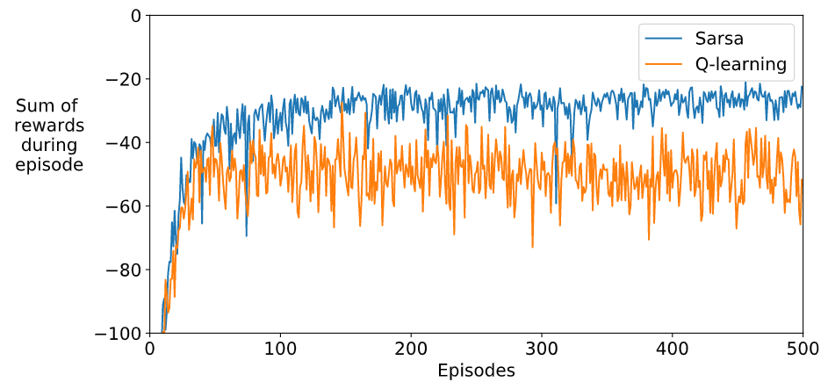
SARSA vs. Q-Learning Rewards
100 runs / 500 episodes per run.
Average the sum of rewards for each episode over 100 runs.
Credit: Sample-based Learning Methods (M. White and A. White), University of Alberta, Alberta Machine Intelligence Institute, Coursera.

Slide 30
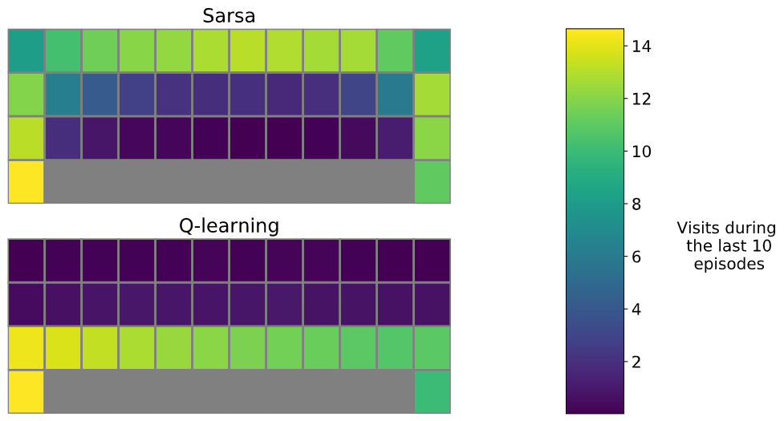
Q-Learning vs. SARSA
100 runs / 500 episodes per run.
Average the number of visits to a state during the last 10 episodes over 100 runs.
Credit: Sample-based Learning Methods (M. White and A. White), University of Alberta, Alberta Machine Intelligence Institute, Coursera.

Slide 31
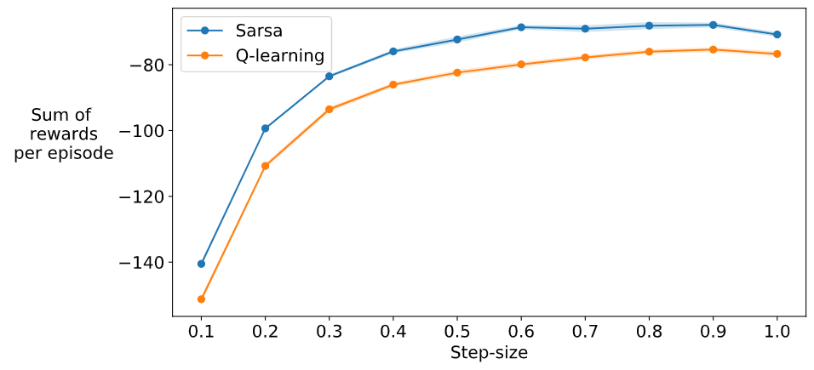
Step-Size: SARSA vs. Q-Learning vs. Expected SARSA
100 runs / 100 episodes per run.
Average the sum of rewards for each episode over 100 runs for each step-size.
Credit: Sample-based Learning Methods (M. White and A. White), University of Alberta, Alberta Machine Intelligence Institute, Coursera.

Slide 32
CONCLUSIONS: Implementing Reinforcement Learning Applications
The basic RL algorithms are a simple loop with incremental updates of the value functions and/or the policy and an internal model.
An RL implementation must fill-out the details of the agent and the environment and keep these representations separate.
A clean RL design:
Makes the interaction between an agent and its environment explicit.
Enables testing and experimentation by allowing different agents and environments to be substituted in a single framework.

Slide 33
CONCLUSIONS: Sarsa vs. Q-Learning
Q-Learning will learn the optimal policy for an MDP but cannot fully exploit it unless it stops exploring.
If Q-Learning continues to explore, the total value per episode will be sub-optimal.
The Sarsa algorithm can “play it safe” since it learns the policy it actually carries out.

Slide 34
Future Work: Investigate RL Frameworks
OpenAI Gym
Google Dopamine
RLLib
Keras-RL
etc., etc.
See Phil Winder of Winder Research:
https://winderresearch.com/a-comparison-of-reinforcement-learning-frameworks-dopamine-rllib-keras-rl-coach-trfl-tensorforce-coach-and-more/

Slide 35
Developing A Simple Reinforcement Learning Application Using RL-Glue
Scott O’Hara
Metrowest Developers Machine Learning Group
09/02/2020

