Slide 1
Developing A Simple Reinforcement Learning Application Using RL-Glue
Scott O’Hara
Metrowest Developers Machine Learning Group
09/02/2020

Slide 2
References
Sample-based Learning Methods (M. White and A. White), University of Alberta, Alberta Machine Intelligence Institute, Coursera.
https://www.coursera.org/learn/sample-based-learning-methods/
Reinforcement learning: An Introduction R. S. Sutton and A. G. Barto, Second edition. Cambridge, Massachusetts: The MIT Press, 2018.
Reinforcement Learning David Silver - University College London / Google DeepMind, 2015.
https://www.davidsilver.uk/teaching/

Slide 3
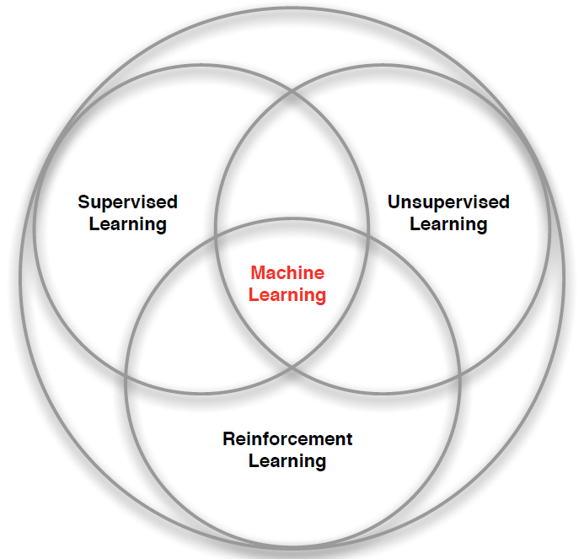
What is Reinforcement Learning?
“Reinforcement learning is a kind of unsupervised supervised learning”
– Rich Sutton
Supervised Learning – Learn a function from labeled data that maps input attributes to an output.
Unsupervised Learning – Find classes, patterns or generalizations in unlabeled data.
Reinforcement Learning –An agent learns to maximize rewards while acting in an uncertain environment.
Credit: image borrowed from lecture slides David Silver, DeepMind, “Introduction to Reinforcement Learning

Slide 4

The Reinforcement Learning Problem
Agent
State: s’
Reward: r
Actions: a
Environment
Agent must learn to act to maximize expected rewards.
Agent knows the current state s, takes an action a, receives a reward r and observes the next state s’.
$S_{0}, A_{0}, R_{0},S_{1}, A_{1}, R_{2},S_{2}, A_{2}, R_{2},…,S_{n}, A_{n}, R_{n},S_{T}$
Agent has no access to the reward model r(s,a,s’) or the transition model T(s,a,s’).

Slide 5
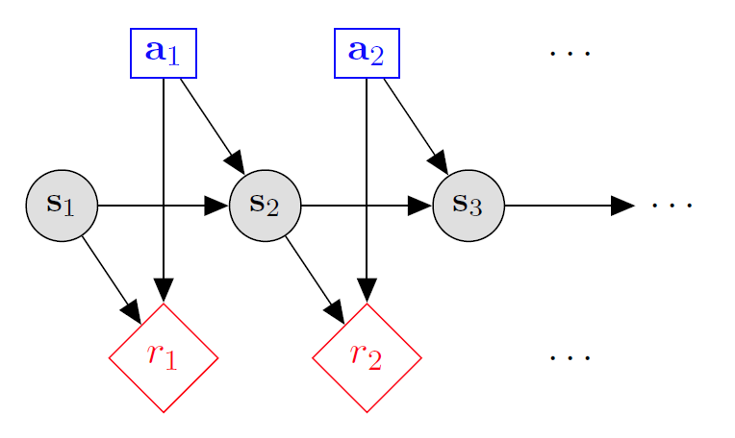

Markov decision processes
States: $s_{1},…,s_{n}$
Actions: $a_{1},…,a_{m}$
Reward model:
$R\left(s,a,s′\right)∈R$
Transition model:
$T\left(s,a,s′\right)=$ $P\left(s′ | s, a\right)$
Discount factor: $γ∈\left[0,1\right]$
<https://en.wikipedia.org/w/index.php?title=Markov_decision_process&oldid=855934986> [accessed 11 September 2018]

Slide 6
Quantities to optimize
The value (utility) of a state s:
V(s) = expected utility starting in s and acting optimally thereafter.
The value (utility) of a q-state (s,a):
Q(s,a) = expected utility when taking action a from state s and acting optimally thereafter.
The policy π:
π(a|s) = probability of action a from state s
s
s is a state
a
(s, a) is a q-state
s, a
s,a,s’
(s,a,s’) is a transition
s’
Credit: CS188 – Intro to AI, UC Berkeley, ai.berkely.edu
Notes:
Demo just shows V and Q values, snapshots on next slides.

Slide 7
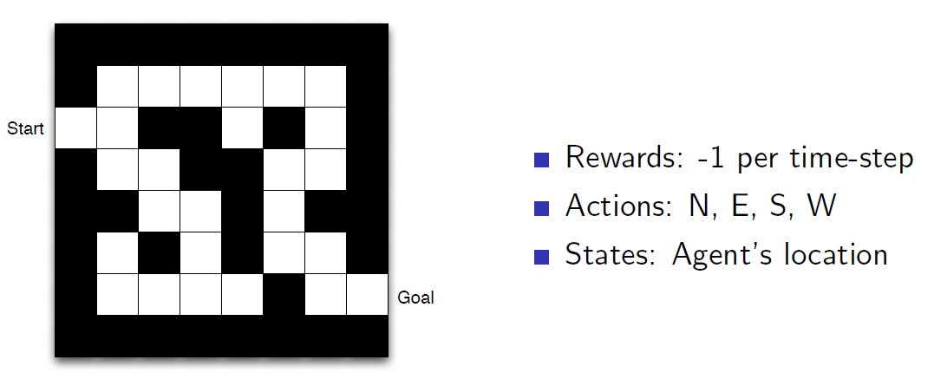
Maze Example
Credit: Reinforcement Learning, David Silver, University College London / Google DeepMind, 2015.

Slide 8
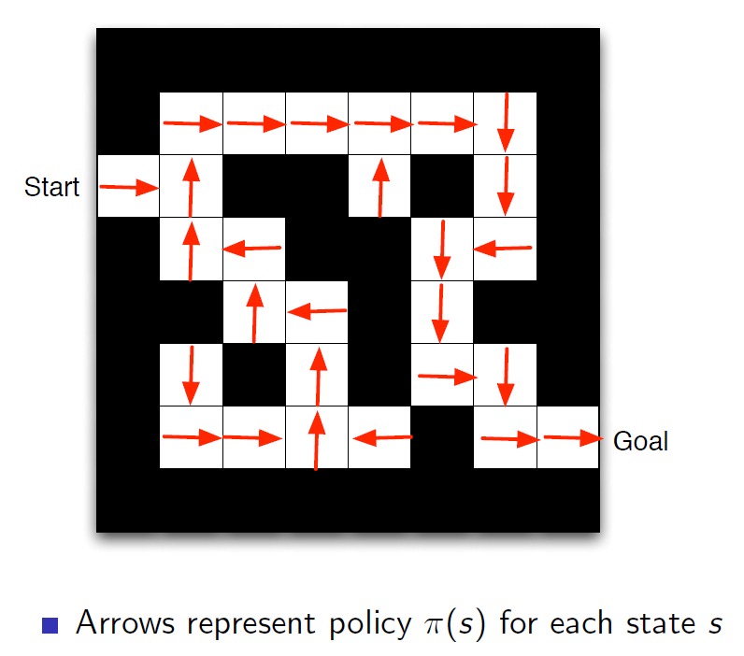
Maze Example: Policy
Credit: Reinforcement Learning, David Silver, University College London / Google DeepMind, 2015.

Slide 9
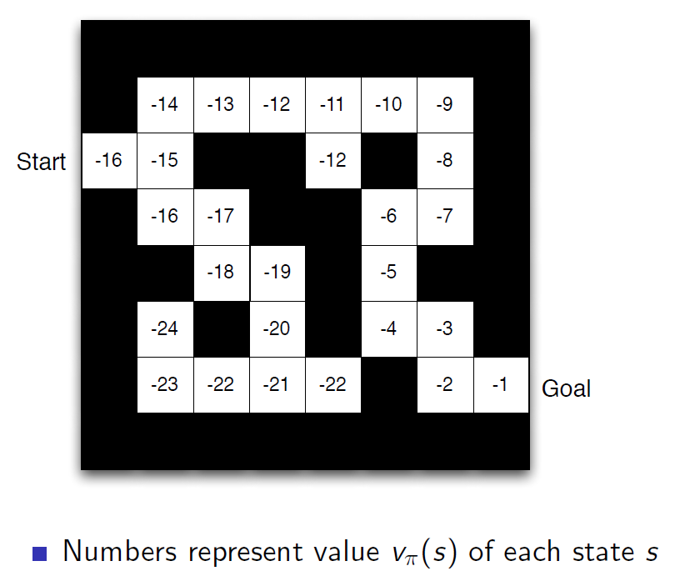
Maze Example: Value Function
Credit: Reinforcement Learning, David Silver, University College London / Google DeepMind, 2015.

Slide 10
Temporal Difference (TD) Learning?
TD-Learning is a kind of prediction learning that takes advantage of the temporal structure of learning to predict.
In prediction learning:
You make a prediction about what will happen next.
You wait to see what happens
You learn by comparing what happens to what you predicted.
Sarsa and Q-Learning are examples of Temporal Difference Learning algorithms.
Credit: Sample-based Learning Methods (M. White and A. White), University of Alberta, Alberta Machine Intelligence Institute, Coursera.

Slide 11

The Reinforcement Learning Problem
Agent
State: s ← s’
State: s’
Reward: r
Action: a
Environment
Agent knows the current state s, takes an action a, receives a reward r and observes the next state s’.
$$S_{0}, A_{0}, R_{0},S_{1}, A_{1}, R_{2},S_{2}, A_{2}, R_{2},…,S_{n}, A_{n}, R_{n},S_{T}$$

Slide 12
r
a
a’
SARSA Update Rule
. . .
. . .
S
S’
Q_{k}(s,a)
γQ_{k}(s’,a’)
$$Q_{k+1}\left(s,a\right)←Q_{k}\left(s,a\right)+α\left[r+γQ_{k}\left(s′,a′\right)−Q_{k}\left(s,a\right)\right]$$
The Future
(The Target)
The Present
(The Prediction)
Credit: Sample-based Learning Methods (M. White and A. White), University of Alberta, Alberta Machine Intelligence Institute, Coursera.

Slide 13
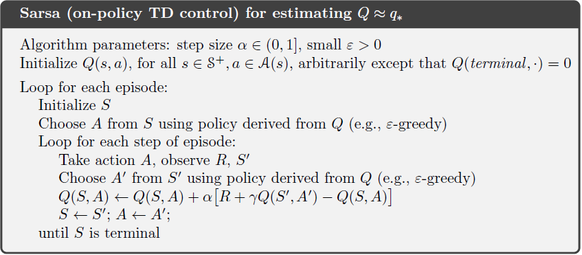

SARSA Algorithm

Slide 14
r
a
a’
Q-Learning Update Rule
. . .
. . .
S
S’
Q_{k}(s,a)
γmax_{a’} Q_{k}(s’,a’)
$$Q_{k}\left(s,a\right)←Q_{k}\left(s,a\right)+α\left[r+γ\max_{a′}{Q_{k}\left(s′,a′\right)}−Q_{k}\left(s,a\right)\right]$$
The Future
(The Target)
The Present
(The Prediction)
Credit: Sample-based Learning Methods (M. White and A. White), University of Alberta, Alberta Machine Intelligence Institute, Coursera.

Slide 15
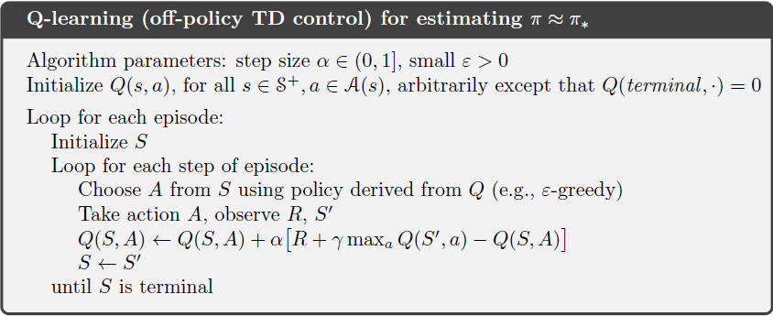
Q-learning Algorithm

Slide 16
The Reinforcement Learning Loop
Action: a
State: s ← s’
Agent
Environment
State: s’
Reward: r

Slide 17
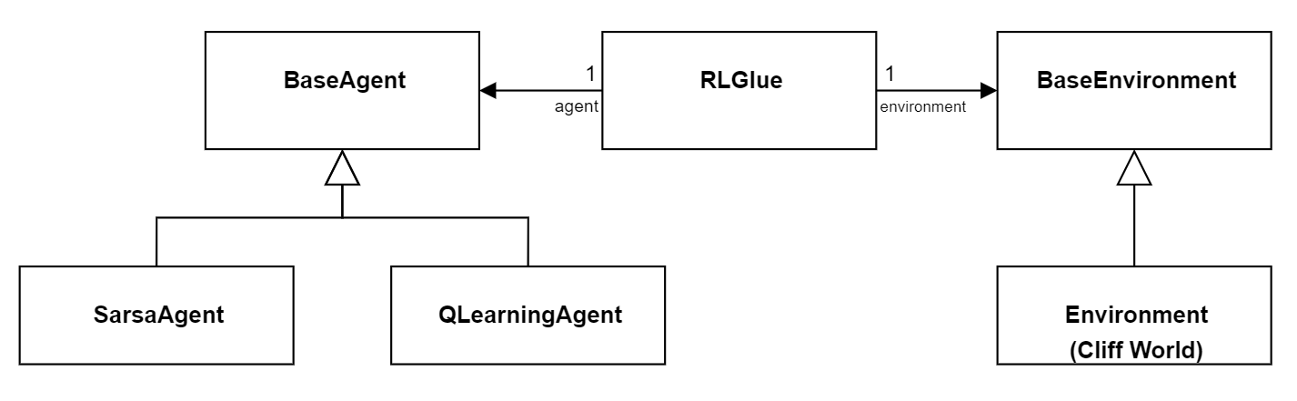
Implementing the RL Loop with RLGlue
Action: a
State: s ← s’
Agent
Environment
State: s’
Reward: r

Slide 18
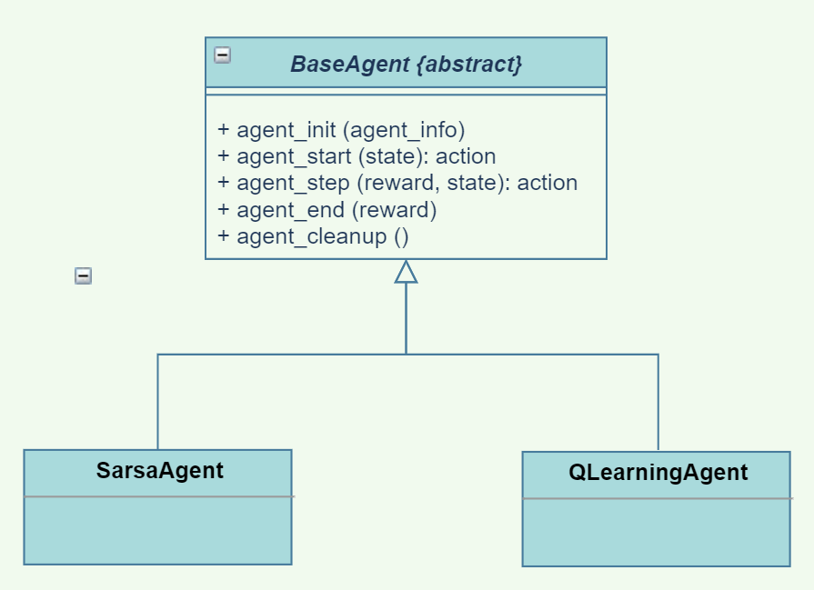
The BASE AGENT Class
agent_init (info) – setup agent when experiment first starts.
agent_start(state): action – process first state from environment and return an action.
agent_step (reward, state): action – process reward and state from environment and return an action.
agent_end (reward) – process final reward after terminal state is reached.
agent_cleanup () – cleanup after agent is finished.

Slide 19
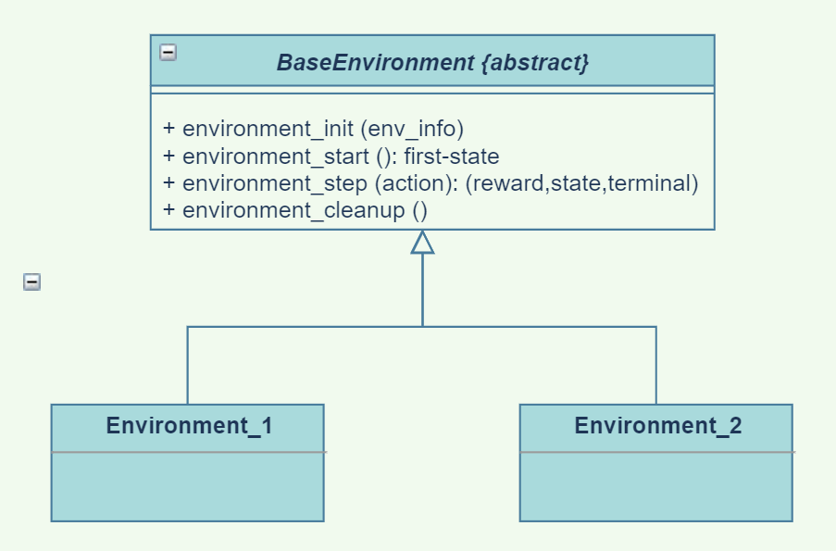
The BASE Environment Class
environment_init (info) – setup environment when experiment first starts.
environment_start(): first-state – return initial state.
environment_step (action): (reward,state,terminal) – given an action, return a reward, the next state, and a Boolean indicating whether the state is terminal.
environment_cleanup () – cleanup after agent is finished.

Slide 20
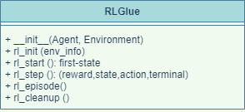
The RLGLUE Class
__init__(Agent, Environment) – RLGlue creates an agent object and an environment object.
rl_init(agent_init_info, env_init_info) – setup environment and agent.
rl_start(): first-state – environment sets the initial state; agent takes its first action; return initial state.
rl_step(): (reward,state,action,term) – environment changes in response to the agent’s action; agent acts in response.
rl_episode() - run an episode.
rl_cleanup() – cleanup after agent is finished.

Slide 21
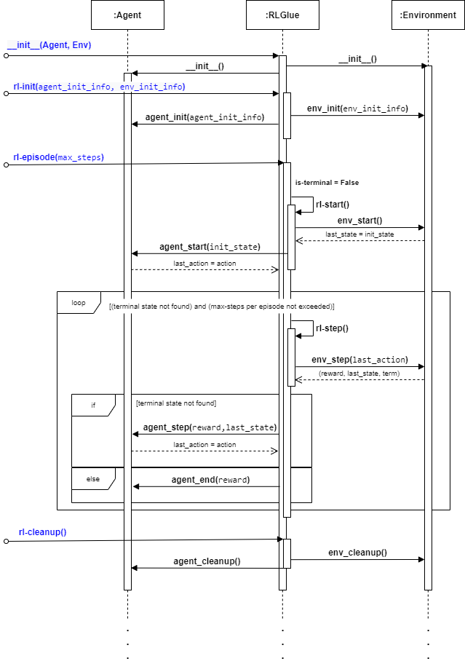
RL-Glue Sequence Diagram
__init__()
rl-init()
rl-episode()*
rl-start()
rl-step()*
rl-cleanup()

Slide 22
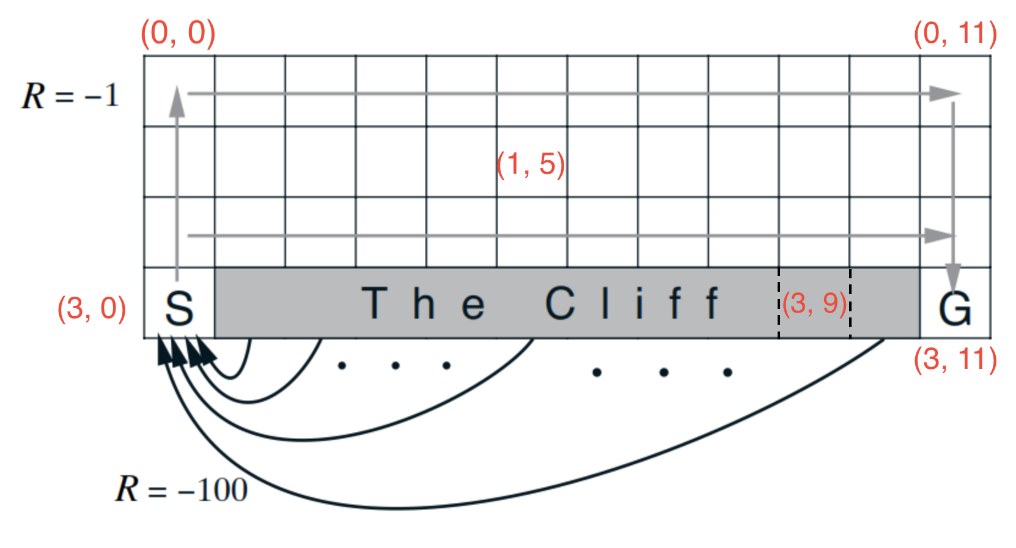
RL Environment: Cliffworld
States: <x, y> locations
Actions: move north, south, east or west.
Reward model:
0 if robot moves to the goal state G where episode finishes.
-100 if robot moves to the cliff.
-1 for every other move.
Transition model:
Robot moves deterministically in the chosen direction: north, south, east or west.
Robot stays put if it moves into a wall.
Robot transitions to the start state if it moves onto the cliff. (NOTE: episode does not finish.)
Discount factor: γ = 1.0
Credit: Sample-based Learning Methods (M. White and A. White), University of Alberta, Alberta Machine Intelligence Institute, Coursera.

Slide 23
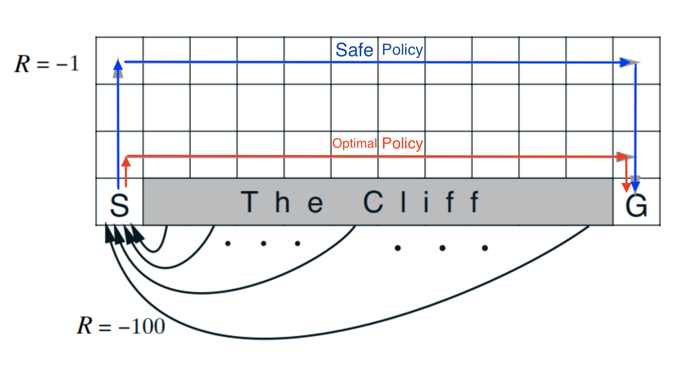
Optimal Vs. “Safe” Policies: Q-learning
Q-learning learns the optimal policy.
However, q-learning must stop exploring and change to complete exploitation mode to take advantage of this.
If q-learning continues to explore (off-policy), it will often get bad results since exploration will lead it to step over the cliff.
Credit: Sample-based Learning Methods (M. White and A. White), University of Alberta, Alberta Machine Intelligence Institute, Coursera.

Slide 24
Optimal Vs. “Safe” Policies: SARSA
SARSA learns the safe policy since it learns the policy it actually does.
However, SARSA learns slowly since it doesn’t take full advantage of the knowledge it has of state-action values.
Credit: Sample-based Learning Methods (M. White and A. White), University of Alberta, Alberta Machine Intelligence Institute, Coursera.

Slide 25
choosing an action: exploration vs exploitation
How should an agent choose an action? An obvious answer is simply to follow the current policy. However, this is often not the best way to improve your model.
Exploit: use your current model to maximize the expected utility now.
Explore: choose an action that will help you improve your model.

Slide 26
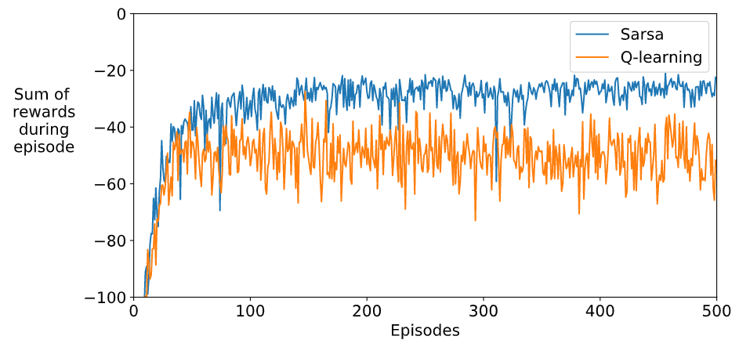
SARSA vs. Q-Learning Rewards
100 runs / 500 episodes per run.
Average the sum of rewards for each episode over 100 runs.
Credit: Sample-based Learning Methods (M. White and A. White), University of Alberta, Alberta Machine Intelligence Institute, Coursera.

Slide 27
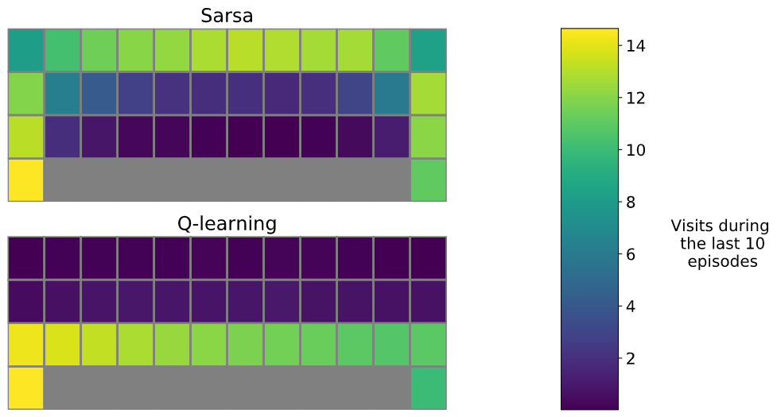
Q-Learning vs. SARSA
100 runs / 500 episodes per run.
Average the number of visits to a state during the last 10 episodes over 100 runs.
Credit: Sample-based Learning Methods (M. White and A. White), University of Alberta, Alberta Machine Intelligence Institute, Coursera.

Slide 28
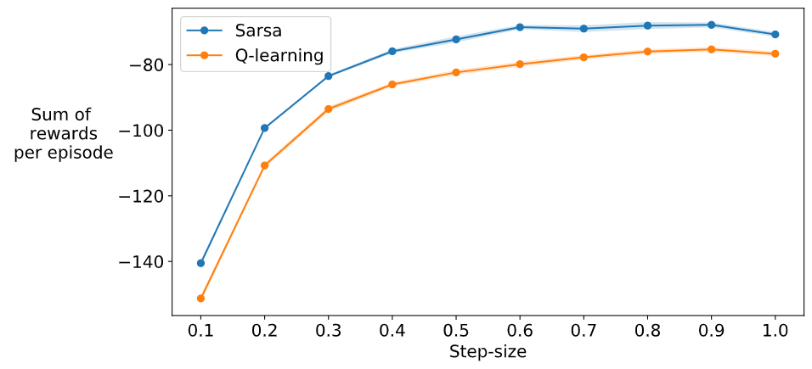
Step-Size: SARSA vs. Q-Learning vs. Expected SARSA
100 runs / 100 episodes per run.
Average the sum of rewards for each episode over 100 runs for each step-size.
Credit: Sample-based Learning Methods (M. White and A. White), University of Alberta, Alberta Machine Intelligence Institute, Coursera.

Slide 29
CONCLUSIONS: Implementing Reinforcement Learning Applications
The basic RL algorithms are a simple loop with incremental updates of the value functions and/or the policy and an internal model.
An RL implementation must fill-out the details of the agent and the environment and keep these representations separate.
A clean RL design:
Makes the interaction between an agent and its environment explicit.
Enables testing and experimentation by allowing different agents and environments to be substituted in a single framework.

Slide 30
CONCLUSIONS: Sarsa vs. Q-Learning
Q-Learning will learn the optimal policy for an MDP but cannot fully exploit it unless it stops exploring.
If Q-Learning continues to explore, the total value per episode will be sub-optimal.
The Sarsa algorithm can “play it safe” since it learns the policy it actually carries out.

Slide 31
Future Work: Investigate RL Frameworks
OpenAI Gym
Google Dopamine
RLLib
Keras-RL
etc., etc.
See Phil Winder of Winder Research:
https://winderresearch.com/a-comparison-of-reinforcement-learning-frameworks-dopamine-rllib-keras-rl-coach-trfl-tensorforce-coach-and-more/

Slide 32
Developing A Simple Reinforcement Learning Application Using RL-Glue
Scott O’Hara
Metrowest Developers Machine Learning Group
09/02/2020

