Slide 1
Gaussian Mixture Models
Scott O’Hara
Metrowest Developers Machine Learning Group
03/17/2021

Slide 2
References
Machine Learning: Clustering & Retrieval
University of Washington, Profs. Emily Fox & Carlos Guestrin
https://www.coursera.org/learn/ml-regression/home/welcome
CS181 course at Harvard University:
CS181 Intelligent Machines: Perception, Learning and Uncertainty, Sarah Finney, Spring 2009
CS181 Intelligent Machines: Perception, Learning and Uncertainty, Prof. David C Brooks, Spring 2011
CS181 – Machine Learning, Prof. David Parkes, Spring 2017. https://harvard-ml-courses.github.io/cs181-web-2017/
Applied Machine Learning in Python
University of Michigan, Prof. Kevin Collins Thompson
https://www.coursera.org/learn/python-machine-learning/home/welcome

Slide 3
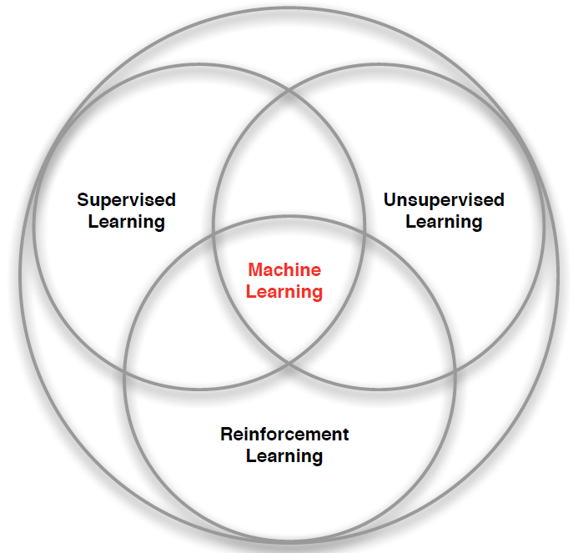
3 Types of Machine Learning
Supervised Learning – Learn a function from labeled data that maps input attributes to an output label e.g., linear regression, decision trees, SVMs.
Unsupervised Learning – Learn patterns in unlabeled data e.g., principle component analysis or clustering algorithms such as K-means, HAC, or Gaussian mixture models.
Reinforcement Learning – An agent learns to maximize rewards while acting in an uncertain environment.
Credit: image borrowed from lecture slides David Silver, DeepMind, “Introduction to Reinforcement Learning

Slide 4
Four Kinds of unsupervised learning
Density Estimation
Model the probability density function of the unknown probability distribution from which the dataset has been drawn.
Dimensionality Reduction
Finds an approximate version of a dataset using fewer features while retaining some meaningful properties of the original data.
Outlier Detection
Detect the examples in the dataset that are very different from what a typical example in the dataset looks like.
Clustering
The task of grouping a set of objects in such a way that objects in the same group (called a cluster) are more like each other than to those in other groups (clusters).
References:
The Hundred-Page Machine Learning Book. Andriy Burkov.
Applied Machine Learning in Python. Coursera. University of Michigan, Prof. Kevin Collins Thompson
Cluster analysis, https://en.wikipedia.org/w/index.php?title=Cluster_analysis&oldid=1002271612 (last visited Jan. 27, 2021).
Dimensionality reduction, https://en.wikipedia.org/w/index.php?title=Dimensionality_reduction&oldid=1002754996 (last visited Jan. 27, 2021).

Slide 5
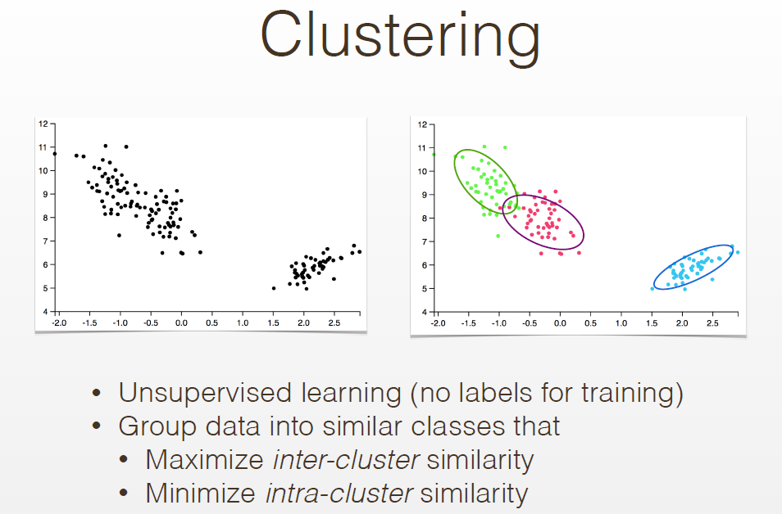

Slide 6
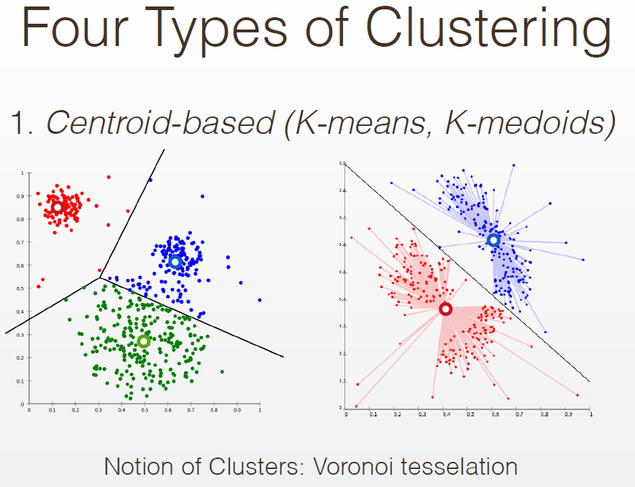

Slide 7
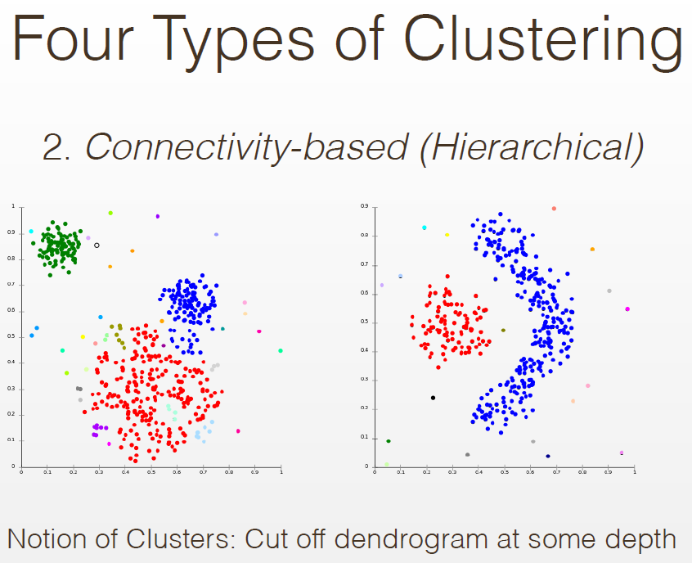

Slide 8
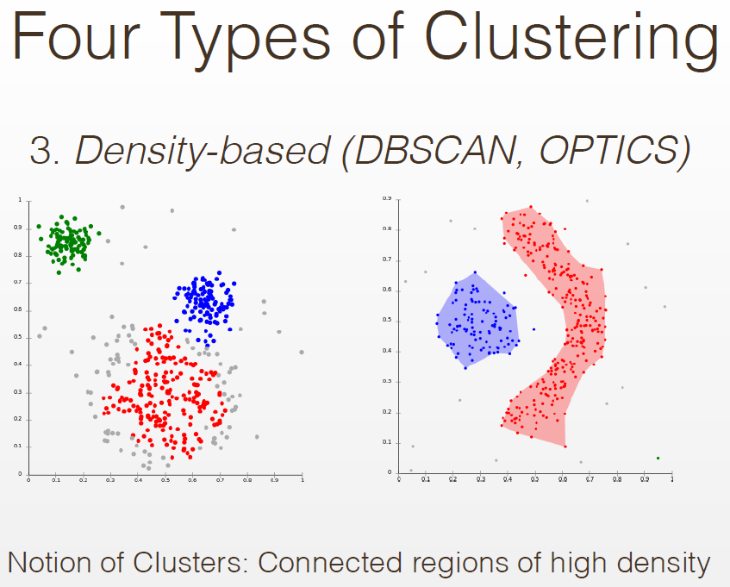

Slide 9
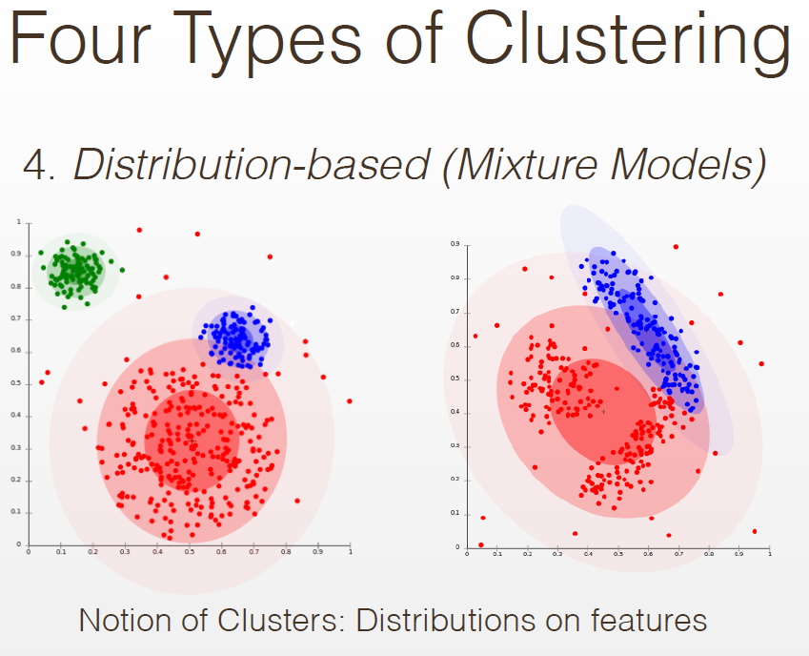

Slide 10
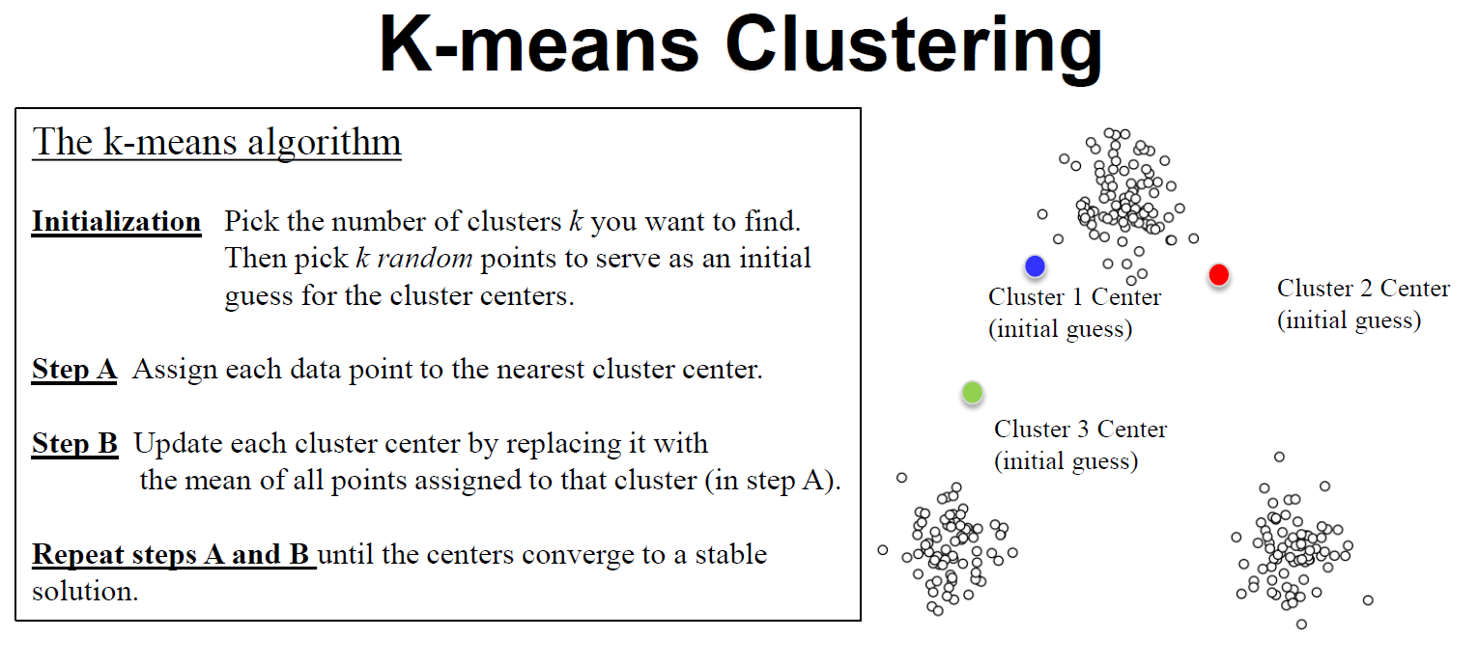
Source: Applied Machine Learning in Python. Coursera. University of Michigan, Prof. Kevin Collins Thompson

Slide 11
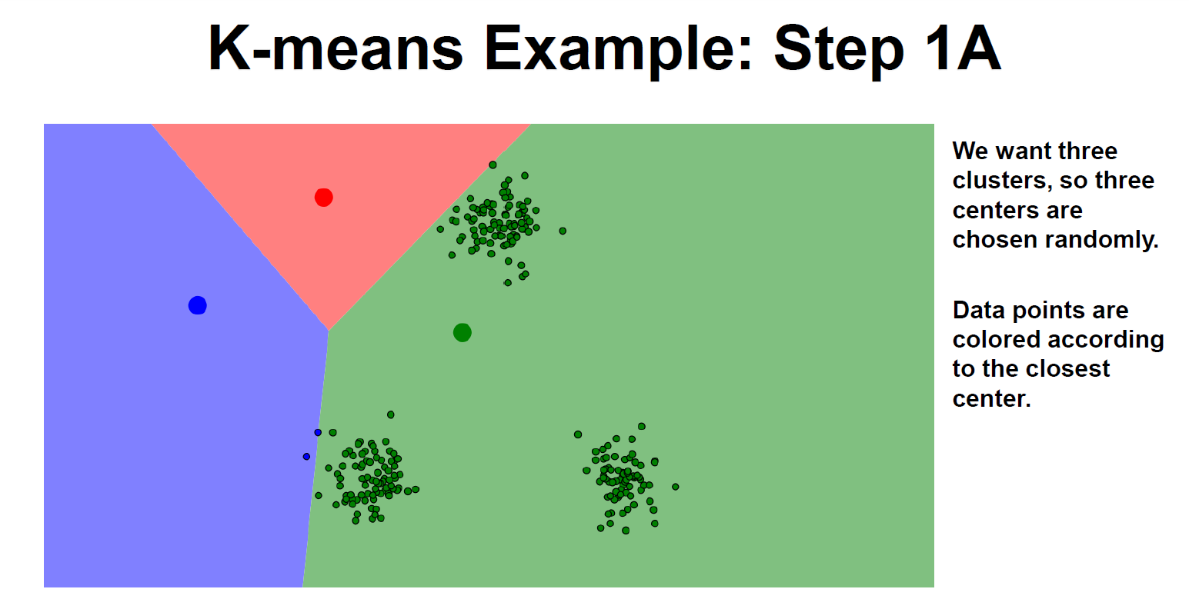
Source: Applied Machine Learning in Python. Coursera. University of Michigan, Prof. Kevin Collins Thompson

Slide 12
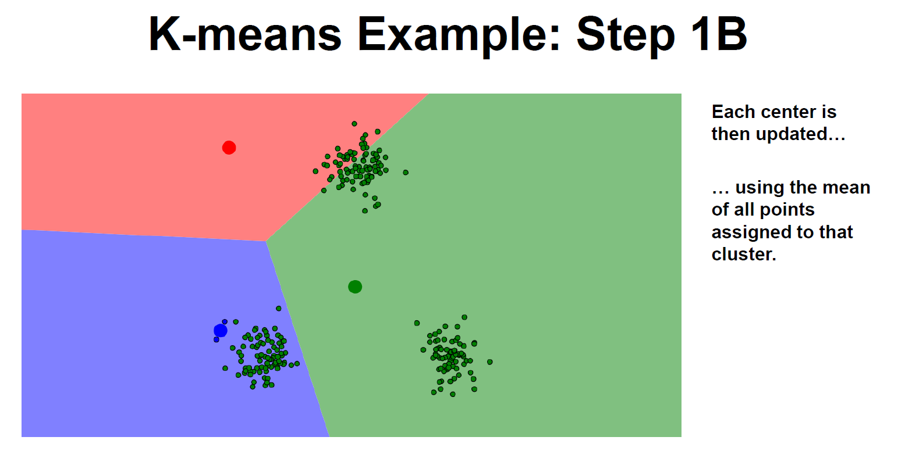
Source: Applied Machine Learning in Python. Coursera. University of Michigan, Prof. Kevin Collins Thompson

Slide 13
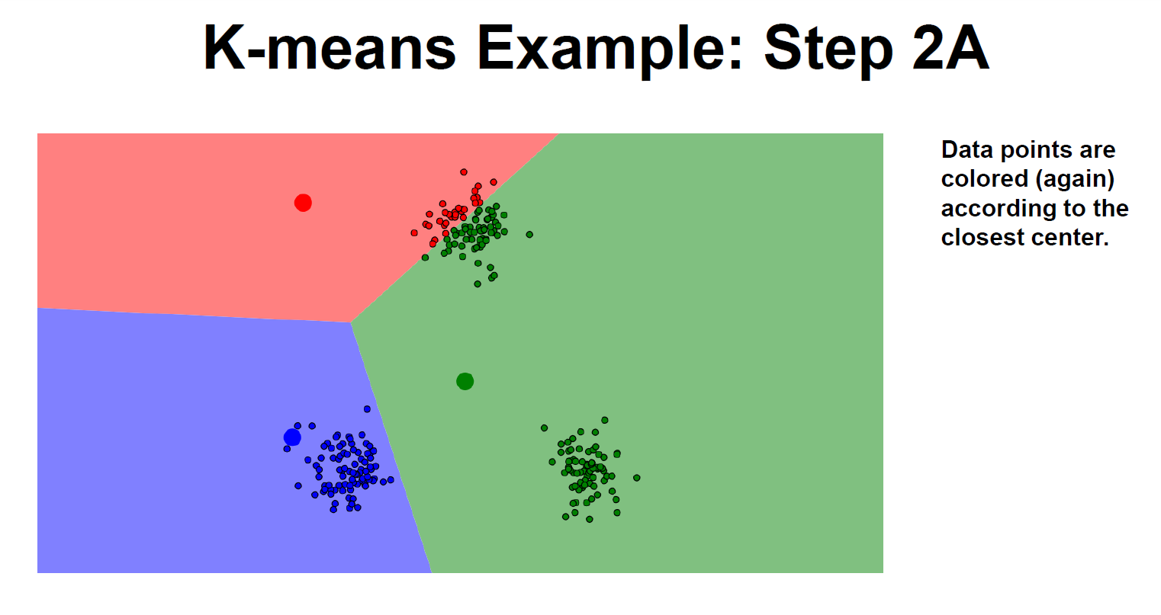
Source: Applied Machine Learning in Python. Coursera. University of Michigan, Prof. Kevin Collins Thompson

Slide 14
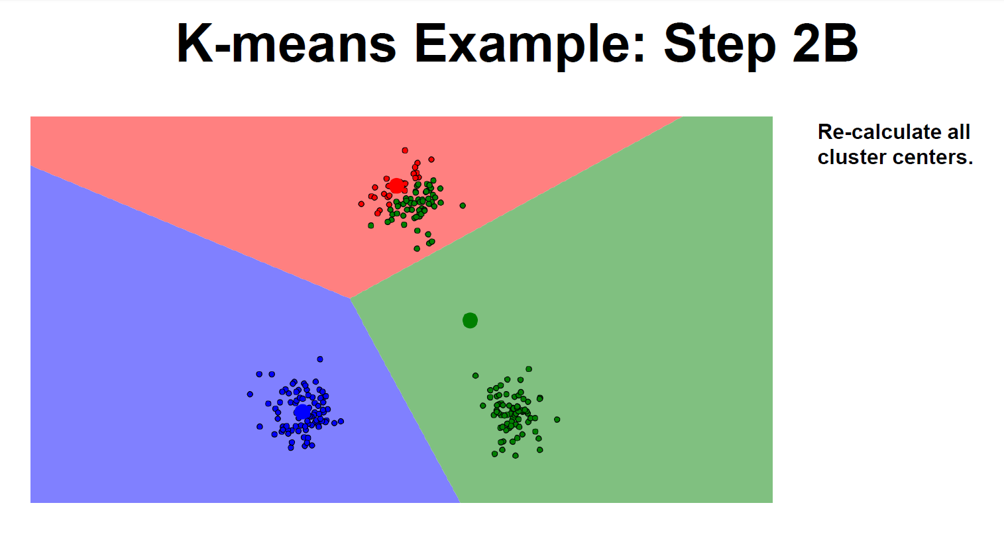
Source: Applied Machine Learning in Python. Coursera. University of Michigan, Prof. Kevin Collins Thompson

Slide 15
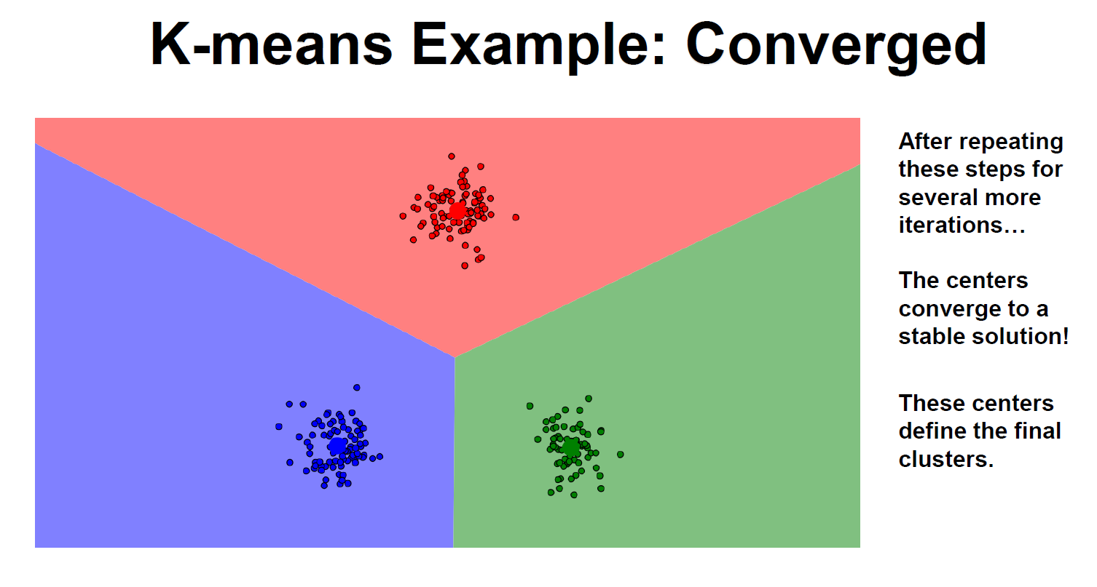
Source: Applied Machine Learning in Python. Coursera. University of Michigan, Prof. Kevin Collins Thompson

Slide 16
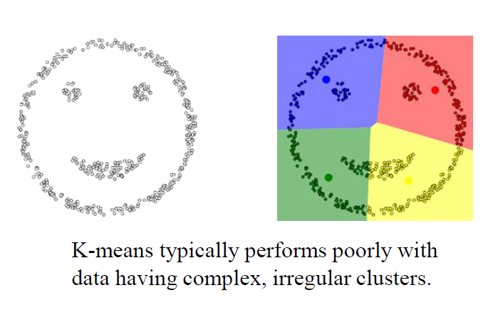
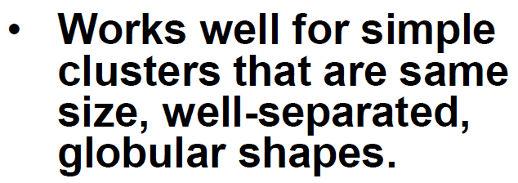
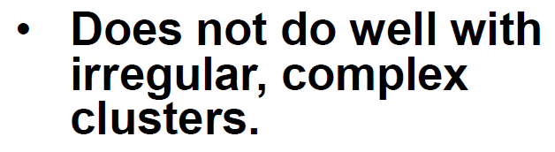
Limitations of K-Means
Source: Applied Machine Learning in Python. Coursera. University of Michigan, Prof. Kevin Collins Thompson

Slide 17
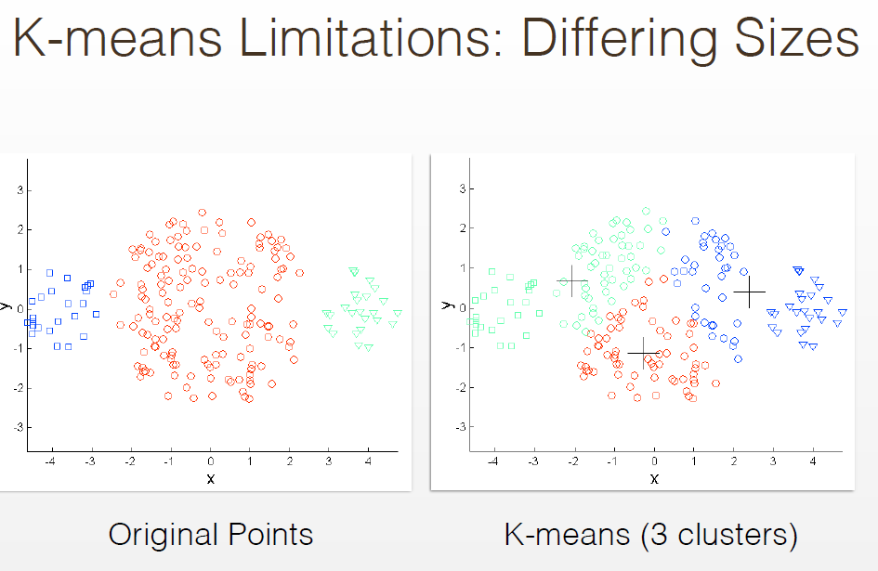

Slide 18
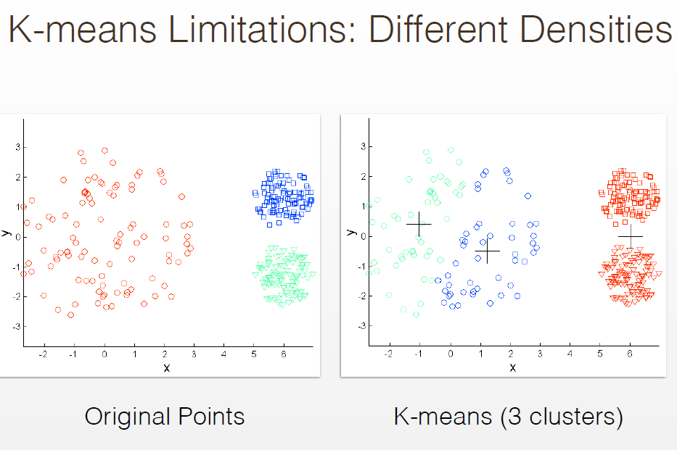

Slide 19
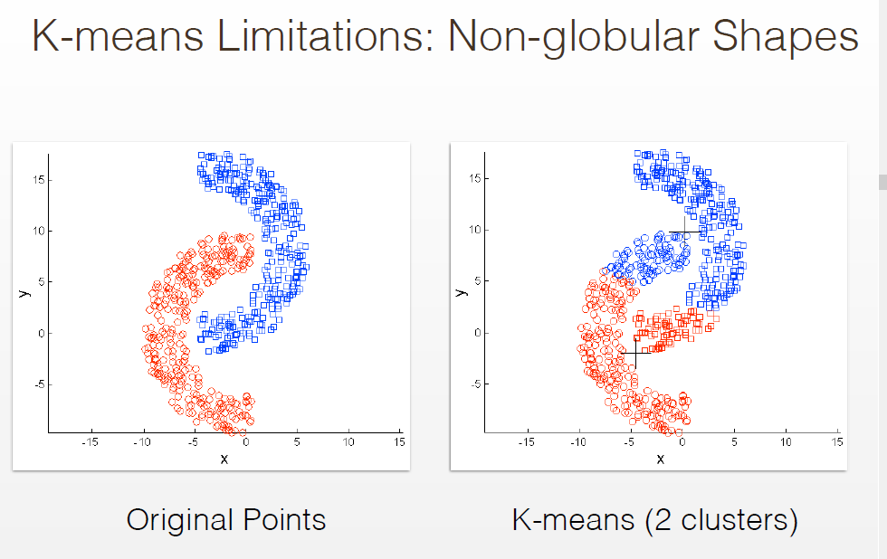

Slide 20
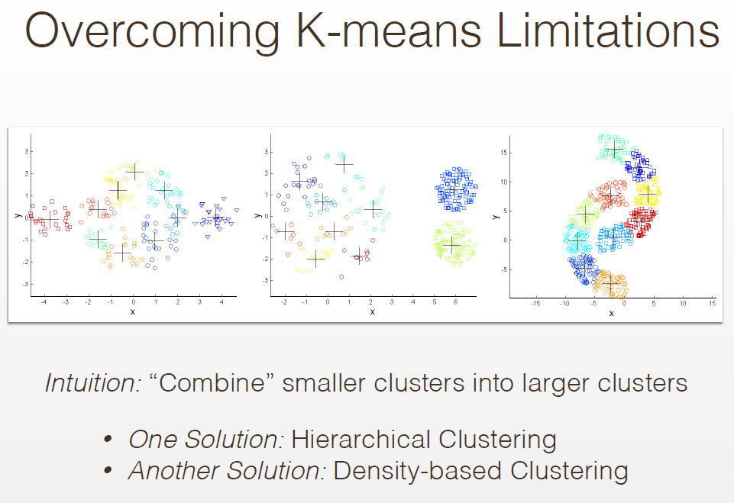
Previously looked at DBSCAN

Slide 21
Future Topics
Clustering Topics
Hierarchical Agglomerative Clustering
HDBSCAN*
Cross-validation
Autoencoders
Density Estimation Topics
Histograms
Kernel Density Estimation
Dimensionality Reduction
Principal Component Analysis (PCA)
t-SNE
UMAP
Autoencoders
Outlier Detection Topics
One-Class Classifier Learning
Autoencoders
Deep Neural Network Approaches
References:
The Hundred-Page Machine Learning Book. Andriy Burkov.
Applied Machine Learning in Python. Coursera. University of Michigan, Prof. Kevin Collins Thompson
Cluster analysis, https://en.wikipedia.org/w/index.php?title=Cluster_analysis&oldid=1002271612 (last visited Jan. 27, 2021).
Dimensionality reduction, https://en.wikipedia.org/w/index.php?title=Dimensionality_reduction&oldid=1002754996 (last visited Jan. 27, 2021).

Slide 22
Gaussian Mixture Models
Scott O’Hara
Metrowest Developers Machine Learning Group
03/17/2021

Slide 23
New Talk
Reference: Machine Learning: Clustering & Retrieval
University of Washington, Profs. Emily Fox & Carlos Guestrin
Reference: The Hundred-Page Machine Learning Book. Andriy Burkov.
Reference: Applied Machine Learning in Python. Coursera. University of Michigan, Prof. Kevin Collins Thompson

