Slide 1



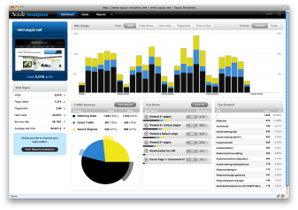
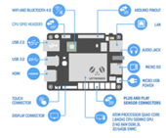
Visualization System
Main System
Web Server
Database
Web Server
HTML5
CSS
JS
jQuery
AJAX
HTTP
DB
Web Application
SQL
SQL
Web Application
DB
Client
R
Analysis
Logging
HTTP
Hive
Visualization
Big Data System
Unstructured data
Linux
IoT 장비
HTML5
CSS
JS
jQuery
AJAX
Analyst

Slide 2
Main System
Web Server
Database
HTML5
CSS
JS
jQuery
AJAX
HTTP
DB
Web Application
SQL
Client
AI System
학습 데이터
IoT 장비

Slide 3
Secondary Namenode
DataNode
TaskTraker
Namenode
JobTraker
192.168.111.120
mainserver
192.168.111.121
secondserver
DataNode
TaskTraker
192.168.111.122
data1server
192.168.111.122
dataserver
192.168.111.122
dataserver
192.168.111.122
dataserver
192.168.111.122
dataserver

Slide 4
Namenode
JobTracker
Secondary
Namenode
Web
Spring
hive
SQL
Datanode
TaskTracker
Mariadb
구조만 저장

Slide 5
Namenode
Secondary
Namenode
Datanode

