Slide 1
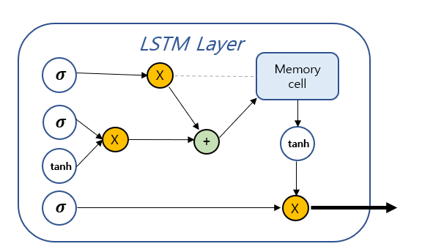
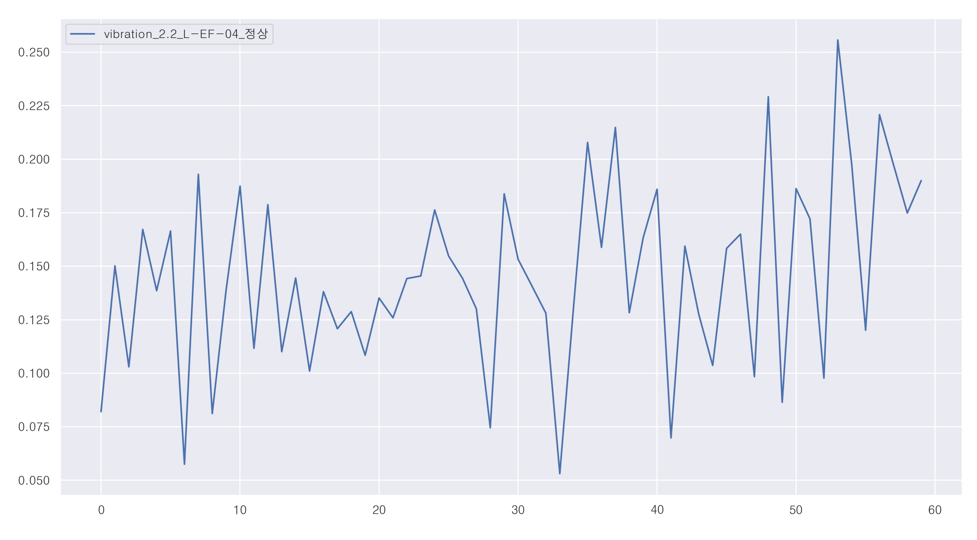
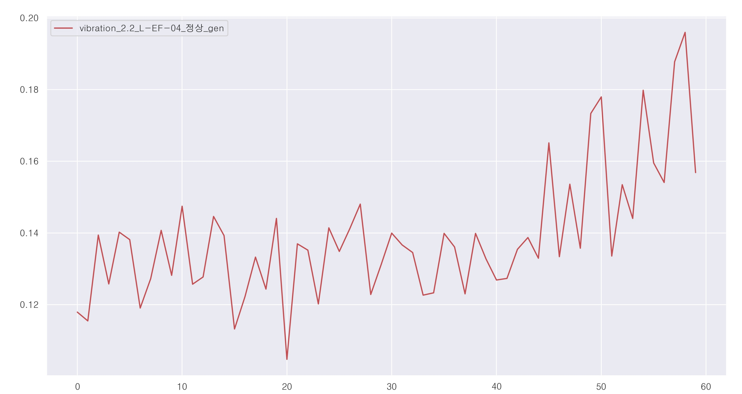
Input
(Batch-size, Input-dim, Timesteps)
Output
(Batch-size, Output-dim, Timesteps)
Timesteps
Latent
z
LSTM
(16)
LSTM
(16)
LSTM
(4)
LSTM
(4)
Timesteps
Input-dim
Output-dim
LSTM-Autoencoder
Batch-size
Batch-size

Slide 2
Input
(batch_size, input_dim, timesteps)
LSTM Layer
𝝈
X
Memory
cell
timesteps
𝝈
X
+
tanh
tanh
𝝈
X
Input_dim
Output
(batch_size, output_dim)
batch_size
Output_dim
batch_size

