Slide 1
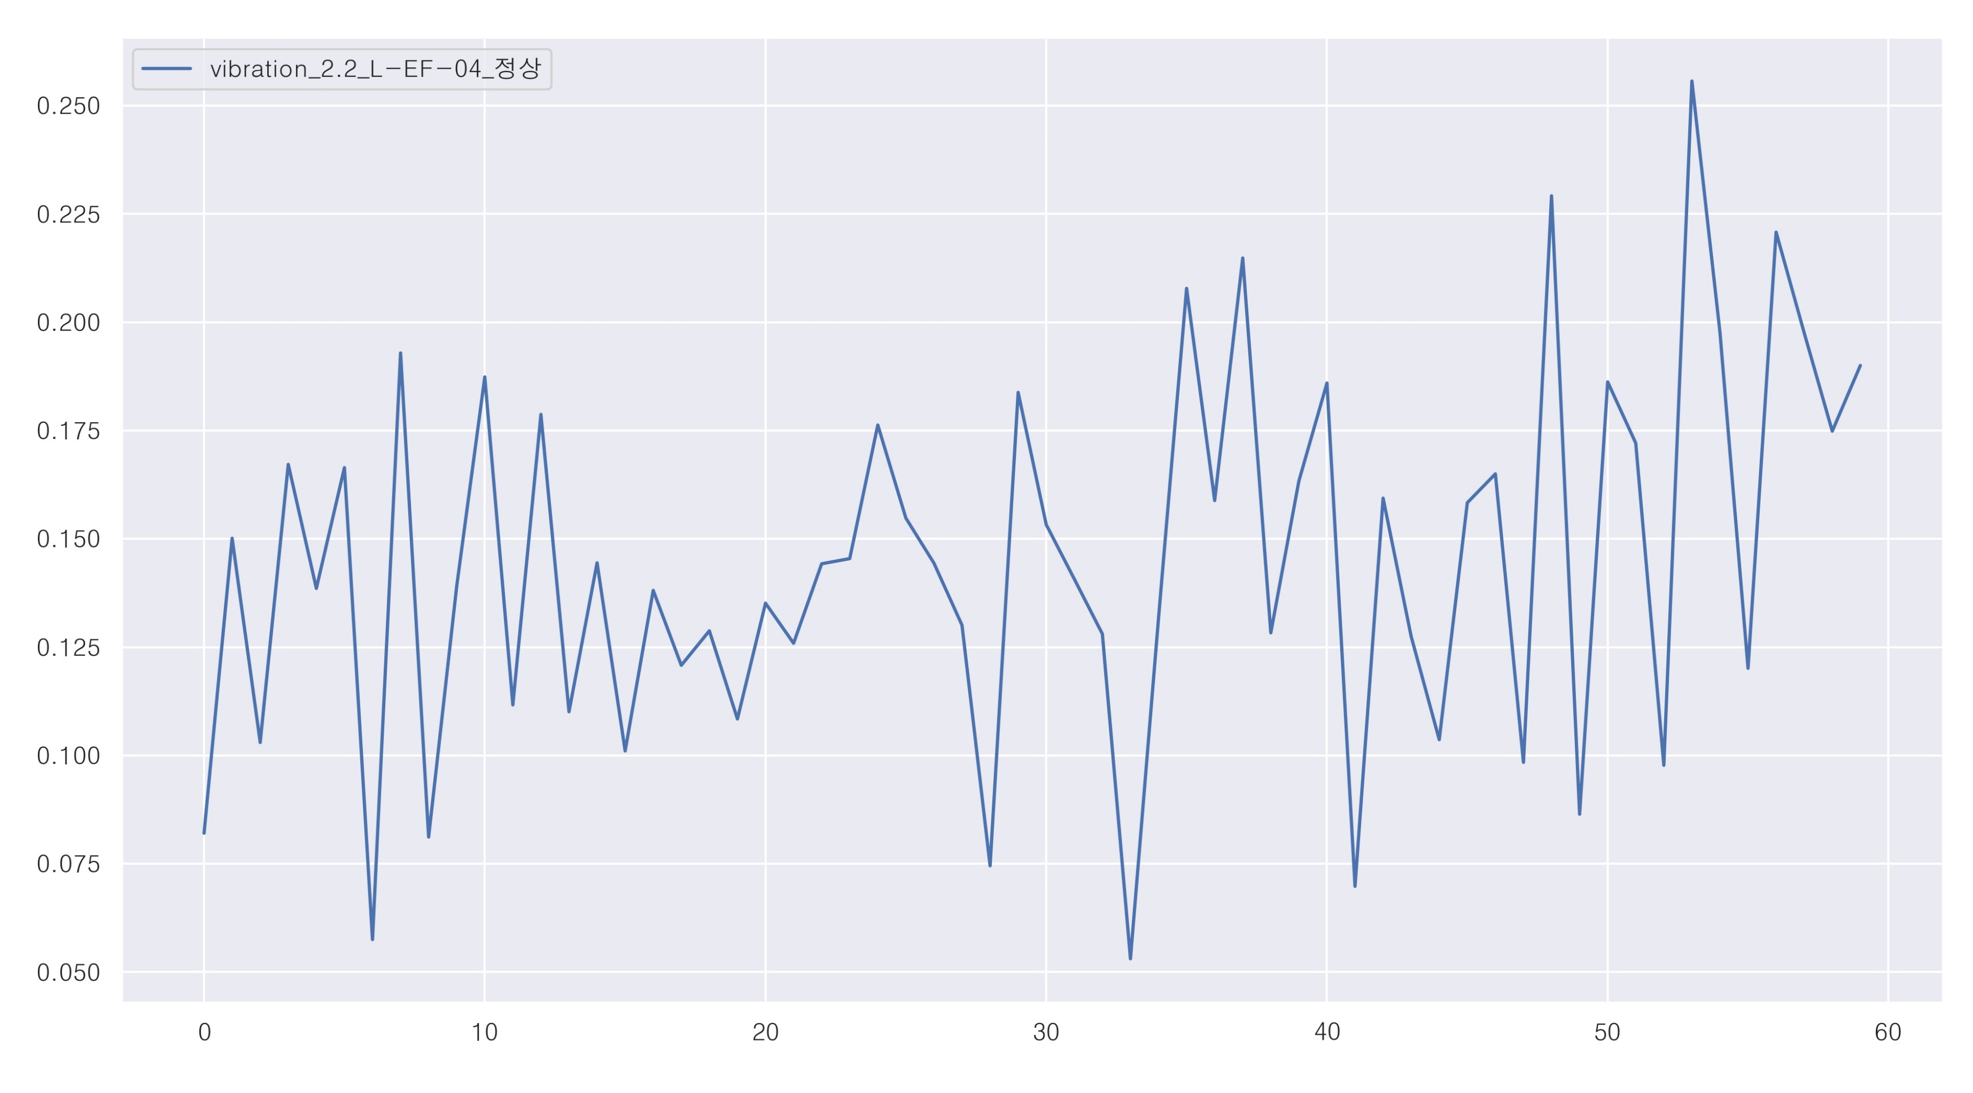
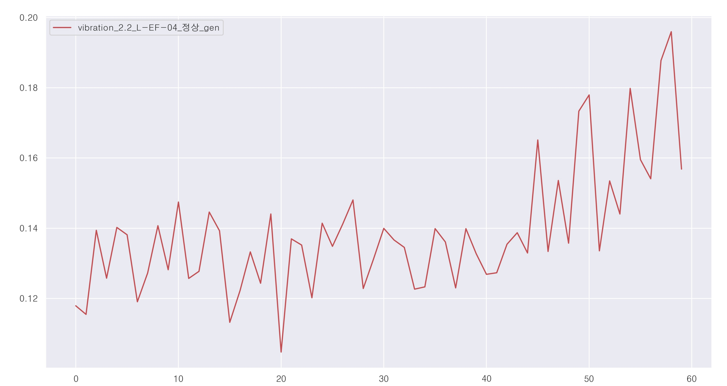
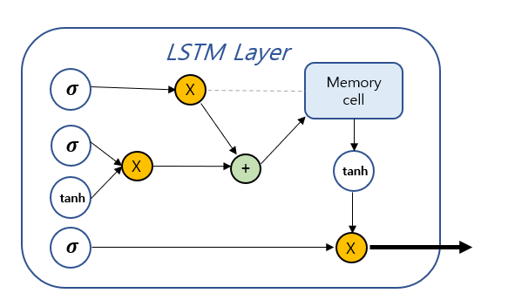
Input
(batch_size, input_dim, timesteps)
Output
(batch_size, output_dim, timesteps)
LSTM
(16)
LSTM
(4)
Latent
z
LSTM
(4)
LSTM
(16)
timesteps
timesteps
Input_dim
output_dim
LSTM-Autoencoder
batch_size
batch_size

Slide 2
Input
(batch_size, input_dim, timesteps)
LSTM Layer
𝝈
X
Memory
cell
timesteps
𝝈
X
+
tanh
tanh
𝝈
X
Input_dim
Output
(batch_size, output_dim)
batch_size
Output_dim
batch_size

