Slide 1


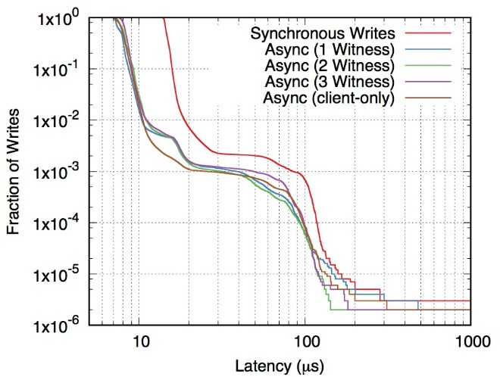

Don't Wait For Sync To Achieve Strong Consistency!
Seo Jin Park and John Ousterhout
OVERVIEW
CLIENT-DRIVEN RECOVERY
FASTER + HIGHER THROUGHPUT
Deterministic updates durable and consistent with asynchronous backup
Server returns to clients before making updates durable.
Use “retries” of RPCs to recover from server crash.
Two ways to recover from crash.
Client-driven retries.
3rd party (witness) driven retries.
Better Performance
Write latency: 15 µs → 7.5 µs
Better throughput: 3x server throughput
New Consistency Model: consistency w/o durability
All reads are consistent
Reads are blocked until data become durable
Client written data should never experience anomaly as long as it is alive.
When a server crashes, client retries previously returned writes.
Write (last two) is lost only if both client and server crash
Client may wait for durability before externalization
Conditional write is still consistent
Non-durable atomic (ACI) transaction
LET’S BACKUP ASYNC
Example
Applications
Client
Data Master(s)
Backups
Client
Data Master(s)
Backups
ramcloud.write(1, “Bob”, “2”);
ramcloud.write(1, “Bill”, “2”);
ramcloud.sync();
printf(“Updated Bob and Bill”);
Things don’t care durability
Split of update / validate client
Many updates before externalization.
Write
Write
Durable Log Write
success
Durable Log Write
Don’t guarantee invariants. App still need to clean up for crashed clients.
success
3RD PARTY-DRIVEN RECOVERY
asynchrony = weak consistency??
State of art: Consistency OR Performance
Async replication + eventual consistency (eg. TAO, Redis)
Sync replication + strong consistency (eg. RAMCloud)
WitnessRecord(index, request){
if (!buf[index].occupied) {
buf[index].occupied = true;
buf[index].data = request;
return true;
} else {
return false;
}
}
Buffer (NVRAM, 1MB)
1 | Write (b, 5)
0
1 | Write(x, 20)
0
We can get: Performace & Strong Consistency & simplicity of Primary-Backup
record(hash(x),
"Write (x,20)")
512 slots
CHALLENGES IN RECOVER BY RETRY
accepted
Witness
Issue 1. Retry may re-execute
Client
If a server crash, an update may or may not be recovered
RIFL (Reusable Infrastructure for Linearizability) [SOSP15] will let server ignore retries for already completed updates
Write(x, 20)
Success
X: 20
Client
Or
Witness
write(x, 20)
X: 20
Master
Backup
success
?
?
Witness detects out-of-order recording and reject.
retry
Master
X: 20
Witness
Key
Rpc Request
CONCLUSIONS
Backups
Witness
x = 10
x = 10
…
Write x = 20
x.value = 20
Crash
Recovery
Client A
Witness and
master receive
RPCs in different
order
Client A
conflict
Hash(x)
Retry RPC requests if a server crashes → strong consistency & durability (for witness) without synchronous backup.
Decoupling durability process from critical path improved performance
Lower latency: 7.5 µs regardless of backup media
Higher throughput: 137kops → 500 kops
RIFL (Reusable Infrastructure for Linearizability) eases design and reasoning of consistency
X: 20
Ok
Write x = 10
x = 20
x = 20
It must succeed
Recovery Master
Client B
x = 10
Client B
x = 10
Accept
Write x = 20
Issue 2. Out-of-order retries
x = 20
x = 20
Ok
Allow 1 not-replicated update per key (overwrites wait for sync of previous value)
Pro: Any deterministic operations can be recovered by retries.
Con: continuously overwritten object can be slow.
Master
Master
10
20
sync
1
2
3
Backup
Backup
10

