Slide 1
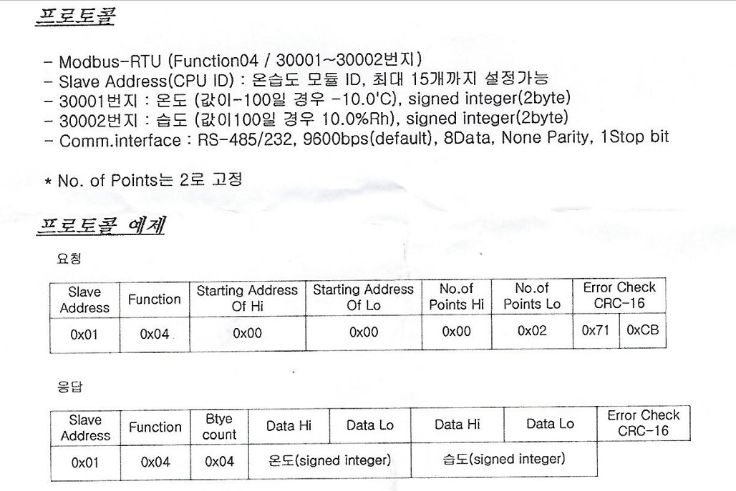

1. 온습도센서 모드버스

Slide 2
온습도센서 통신데이타
[21:59:11.647] : Recv [8 byte] : 01 04 00 00 00 02 71 CB
[21:59:11.669] : Recv [9 byte] : 01 04 04 00 FA 02 08 DB 13
[21:59:14.702] : Recv [8 byte] : 02 04 00 00 00 02 71 F8
[21:59:17.758] : Recv [8 byte] : 03 04 00 00 00 02 70 29
[21:59:20.812] : Recv [8 byte] : 04 04 00 00 00 02 71 9E
[23:24:37.521] : Recv [8 byte] : 01 04 00 00 00 02 71 CB
[23:24:40.577] : Recv [8 byte] : 02 04 00 00 00 02 71 F8
[23:24:40.592] : Recv [9 byte] : 02 04 04 01 F 01 FC F8 AA
[23:24:43.632] : Recv [8 byte] : 03 04 00 00 00 02 70 29
[23:24:46.687] : Recv [8 byte] : 04 04 00 00 00 02 71 9E
[23:38:25.443] : Recv [8 byte] : 01 04 00 00 00 02 71 CB
[23:38:28.500] : Recv [8 byte] : 02 04 00 00 00 02 71 F8
[23:38:31.553] : Recv [8 byte] : 03 04 00 00 00 02 70 29
[23:38:31.569] : Recv [9 byte] : 03 04 04 01 16 01 F6 B9 AA
[23:38:34.609] : Recv [8 byte] : 04 04 00 00 00 02 71 9E
[23:46:52.474] : Recv [8 byte] : 01 04 00 00 00 02 71 CB
[23:46:55.529] : Recv [8 byte] : 02 04 00 00 00 02 71 F8
[23:46:58.584] : Recv [8 byte] : 03 04 00 00 00 02 70 29
[23:47:01.639] : Recv [8 byte] : 04 04 00 00 00 02 71 9E
[23:47:01.661] : Recv [9 byte] : 04 04 04 01 14 02 00 EE 1C

Slide 3
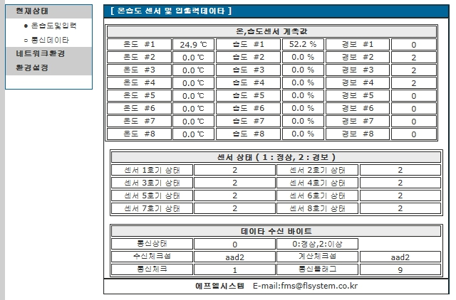
0일때:1 , 1일때:2

Slide 4
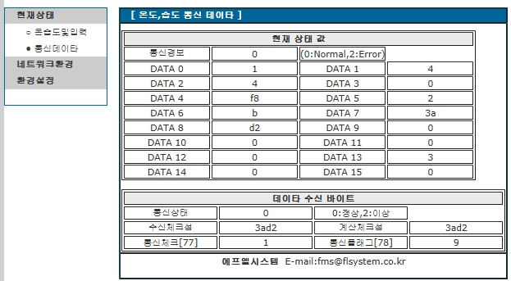

Slide 5
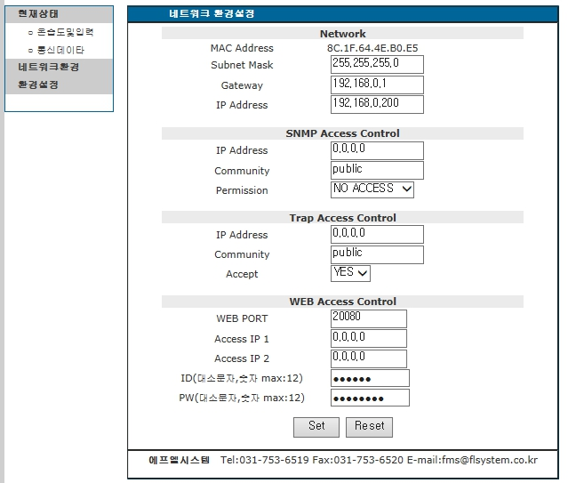

Slide 6
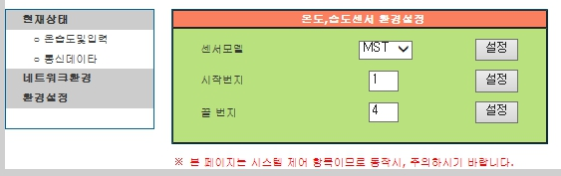
센서모드: 여러센서 중 하나 선택
시작번지 : 모드버스 시작번지, 끝 번지 ( 최대:8개)

