Slide 1
Graph Neural Network
concept & application
Provided by Sumin Lee, summer ML study

Slide 2
Contents
Introduction
: inductive bias
Graph
Graph network
Graph neural network
Its application in chemistry
: molecular interaction

Slide 3
Introduction
What is Intelligence?
Combinatorial generalization !
= “infinite use of finite means”
inductive biases
: assumptions on the structure of the system
structure = entity + relation
Structured approach
“hand-engineering”
explicit
strong bias
a priori approach
“end-to-end”
implicit
weak bias
linear
regression
decision tree
SVM
deep
learning
(Battaglia, et. al., Relational inductive biases, deep learning, and graph networks, 2018)

Slide 4
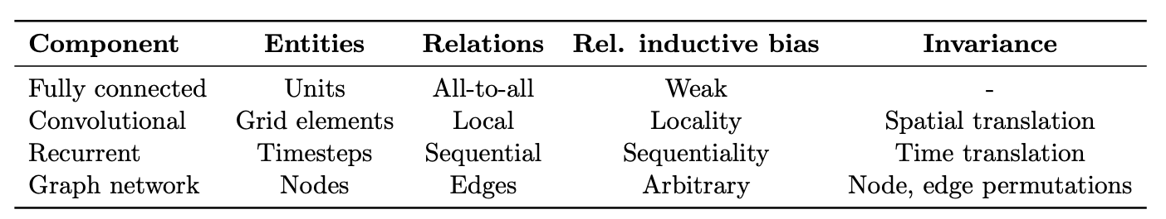
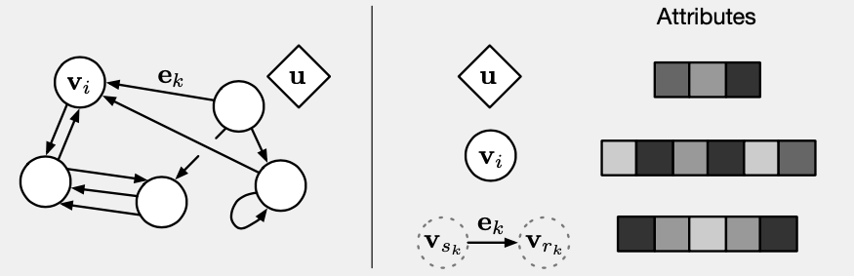
Introduction
structured
a priori
MLP
CNN
RNN
GNN
no assumption
ѡ
ѡ
t
t+1
t+2
locality
trans-invar
sequentiality
time-invar
ϕ, ρ
(Battaglia, et. al., Relational inductive biases, deep learning, and graph networks, 2018)

Slide 5
Graph :definition
node : vi
edge : ek
+ attributed, directed, global attribute
G = (V, E)
(Battaglia, et. al., Relational inductive biases, deep learning, and graph networks, 2018)

Slide 6
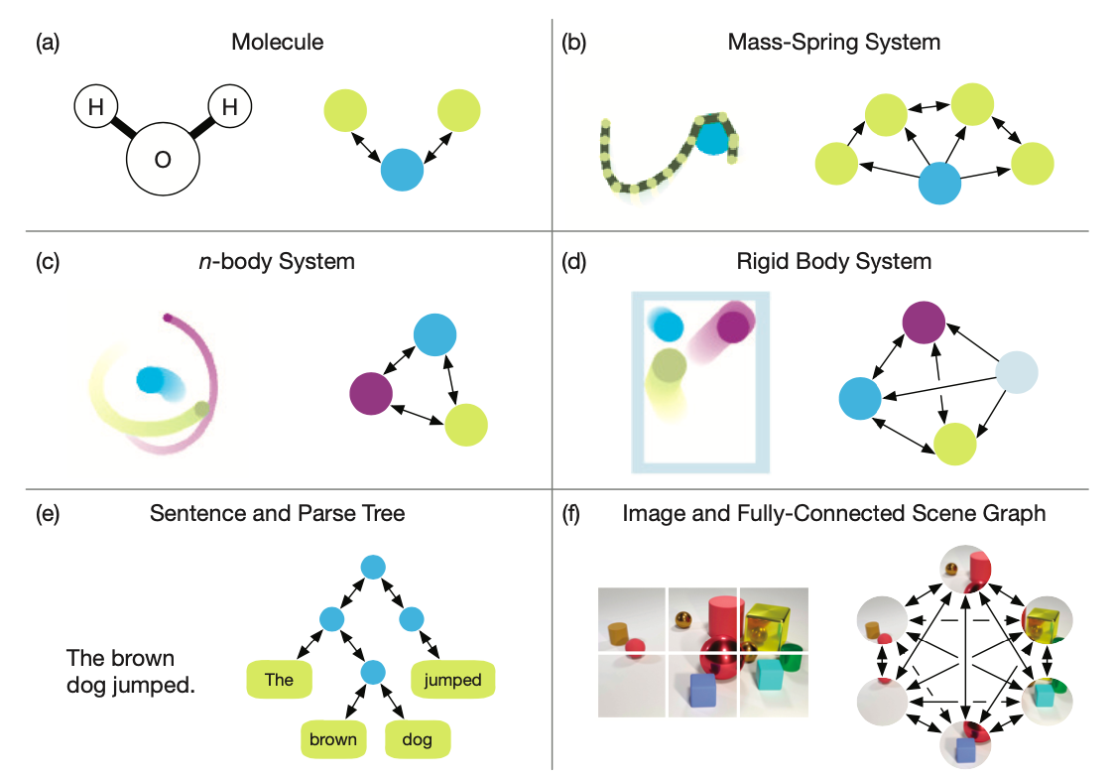
Graph :examples
A Graph is a way to represent a real-world object into a simple model
(Battaglia, et. al., Relational inductive biases, deep learning, and graph networks, 2018)

Slide 7
Graph :advantages
Why we use graph?
“All the entities and relations can be
concatenated into a single vector
and then be fed to MLP as input”
(Battaglia, et. al., Relational inductive biases, deep learning, and graph networks, 2018)

Slide 8
Graph :advantages
Why we use graph?
“All the entities and relations can be
concatenated into a single vector
and then be fed to MLP as input”
“However, that is not efficient nor smart :(
It needs deeeeeep layers
and therefore a lot of data!”
Representing the system as graph (under the inductive bias)
can save TIME and MONEY (VERY IMPORTANT)
(Battaglia, et. al., Relational inductive biases, deep learning, and graph networks, 2018)

Slide 9
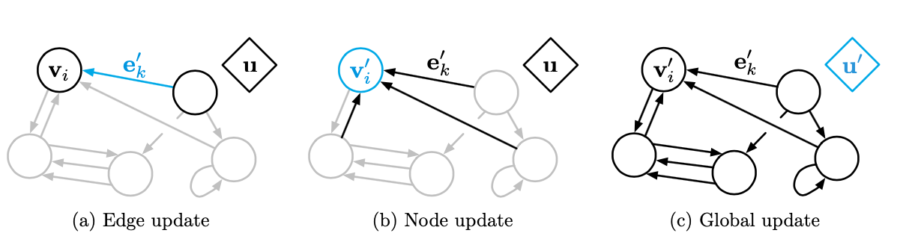
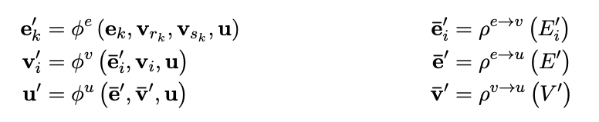
Graph network :definition
Graph network = a function mapping graph to graph
(Battaglia, et. al., Relational inductive biases, deep learning, and graph networks, 2018)

Slide 10
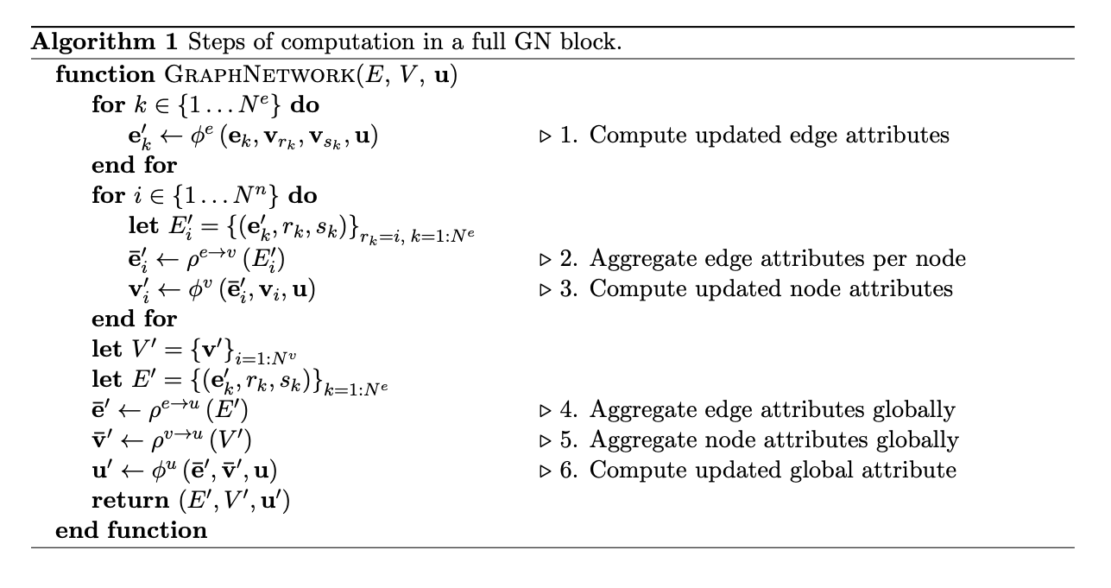
Graph network :definition
(Battaglia, et. al., Relational inductive biases, deep learning, and graph networks, 2018)

Slide 11
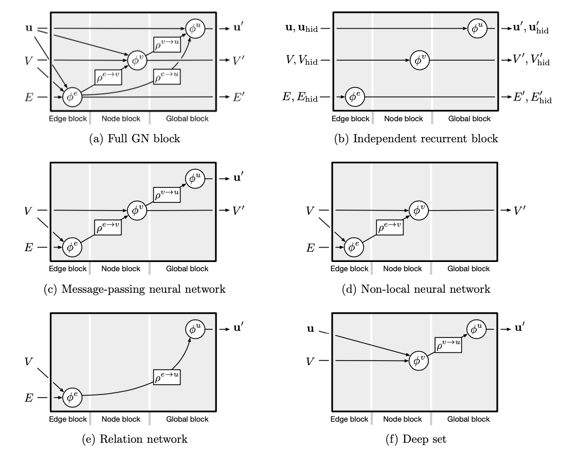
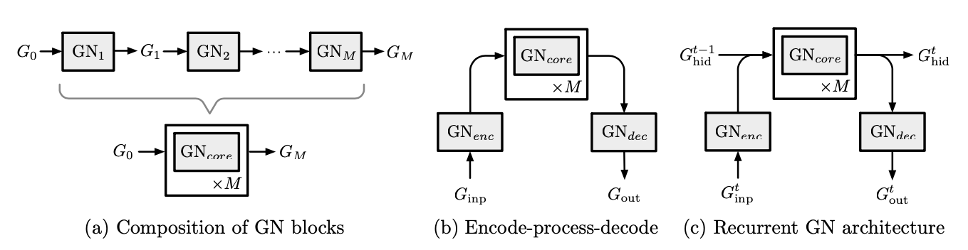
Graph network :configurability
1. flexible representation
2. configurable within-block structure
3. composable multi-block architecture
(Battaglia, et. al., Relational inductive biases, deep learning, and graph networks, 2018)

Slide 12
Graph network : variations
(Battaglia, et. al., Relational inductive biases, deep learning, and graph networks, 2018)

Slide 13
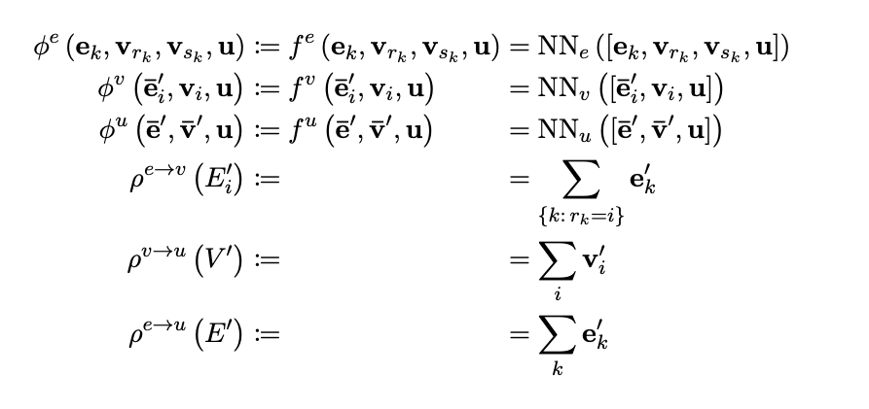
Graph neural network
(Battaglia, et. al., Relational inductive biases, deep learning, and graph networks, 2018)

Slide 14
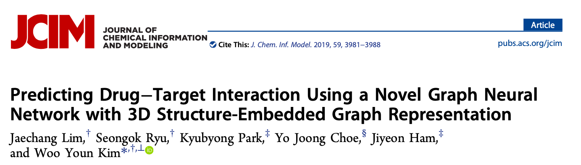
Applications in chemistry

Slide 15
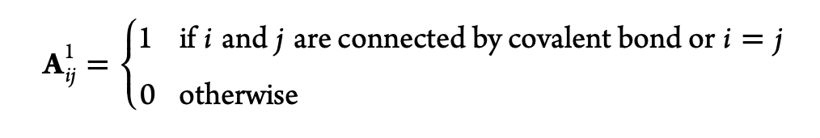
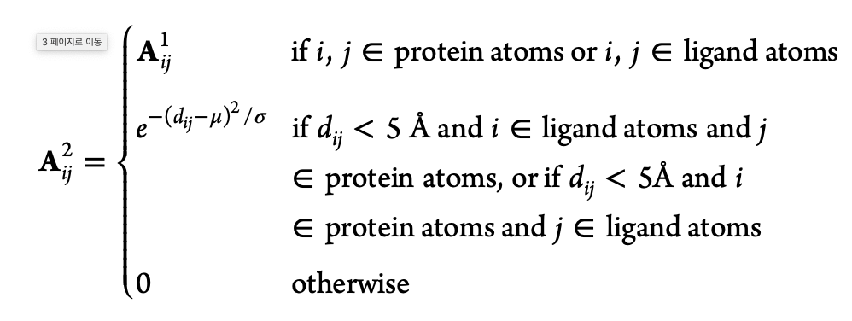
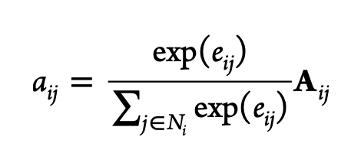
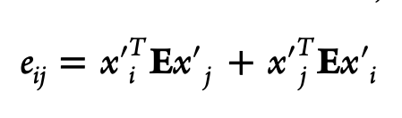
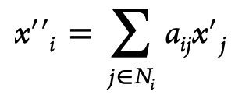
Application : drug-target interaction prediction
3D Structure —> Graph
attention

Slide 16
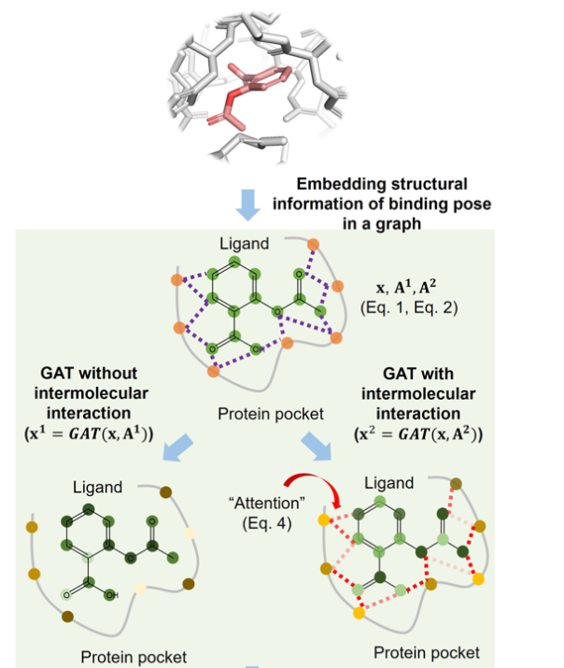
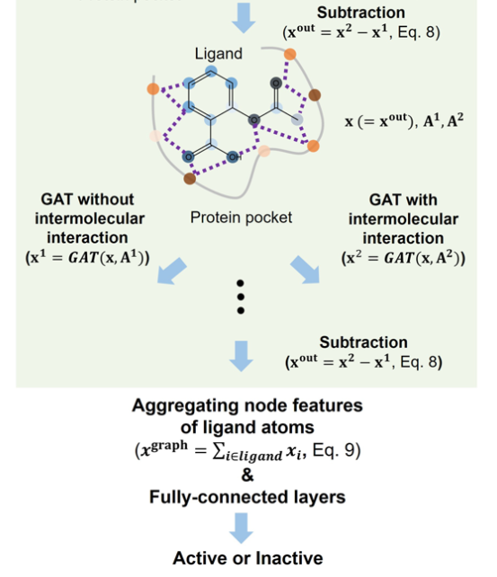

Application : drug-target interaction prediction
gate

Slide 17
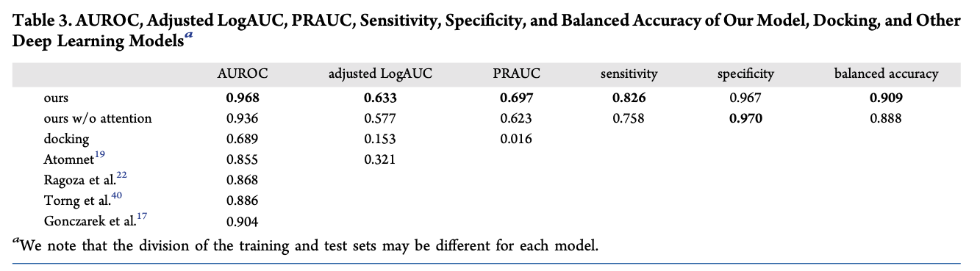
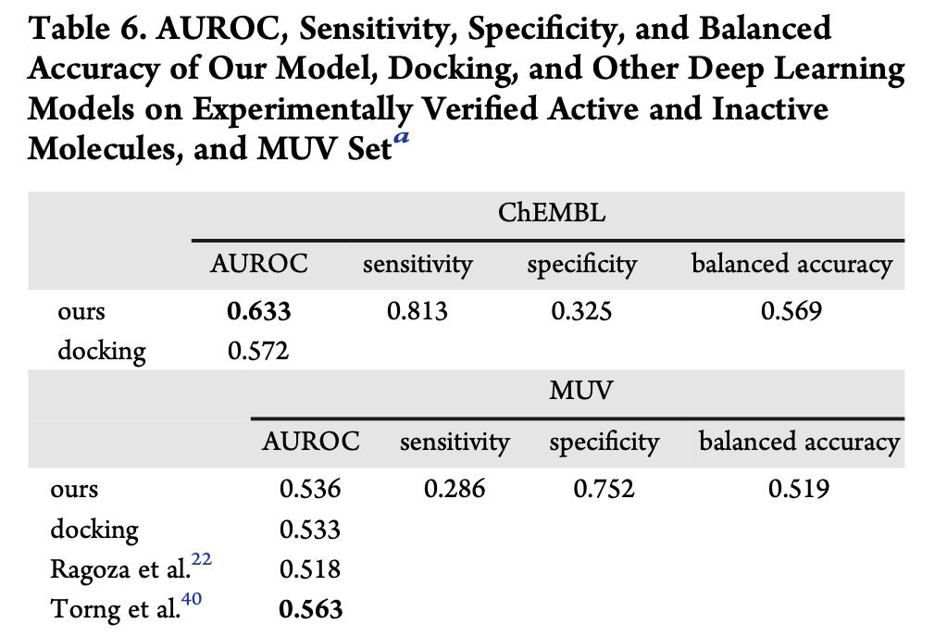
Application : drug-target interaction prediction

