Slide 1
Object Detection: SSD 구현
Seol Ki Hyuk
Integrated Display Electronics & Algorithms (IDEA) Lab.
Kyung Hee University

Slide 2
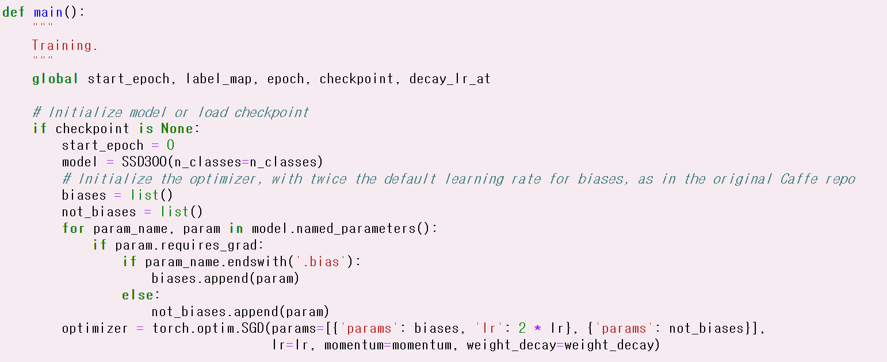
main()

Slide 3
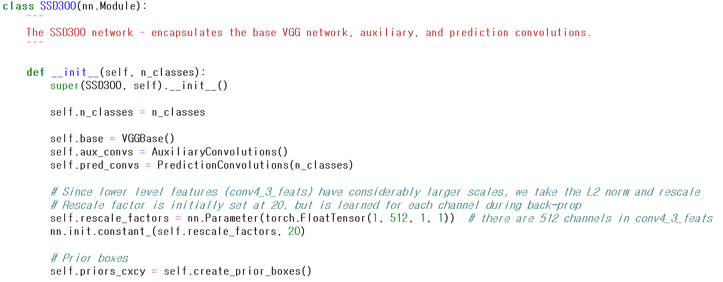
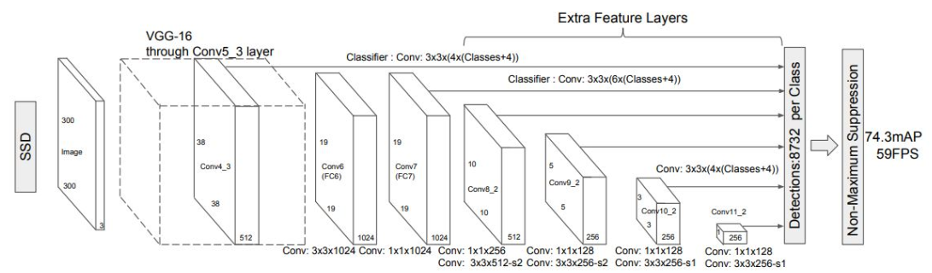
SSD300 (model.py)
ImageNet pretrainded parameter update
VGGBase
Auxiliary
Prediction

Slide 4
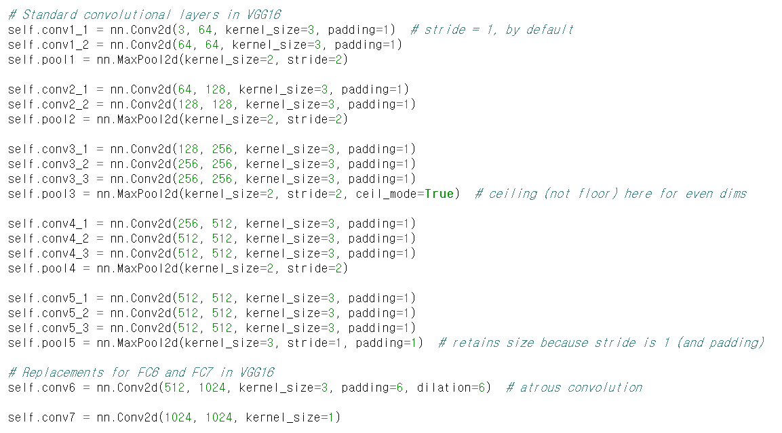

Slide 5
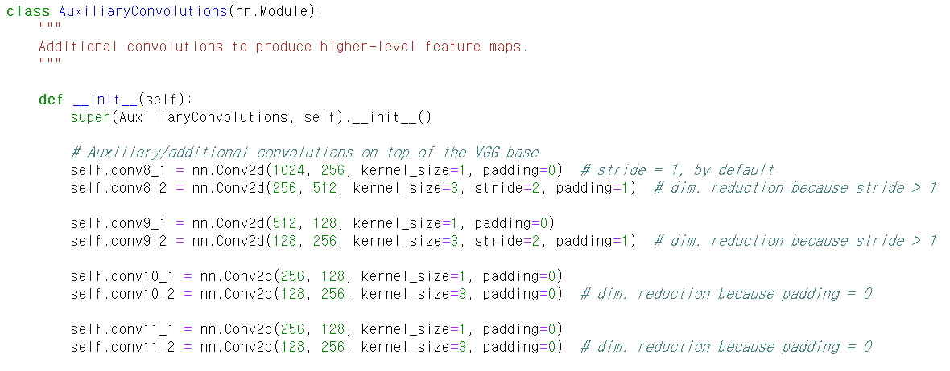

Slide 6
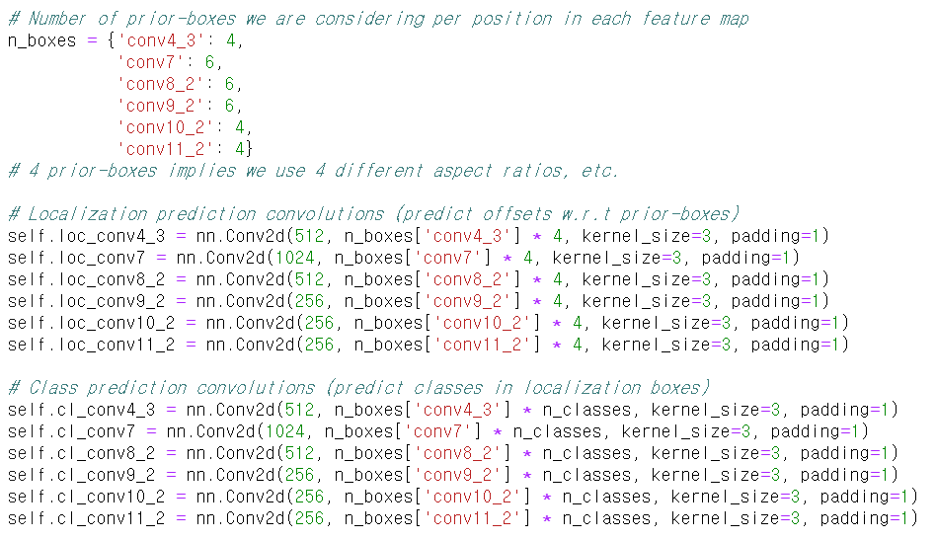

Slide 7
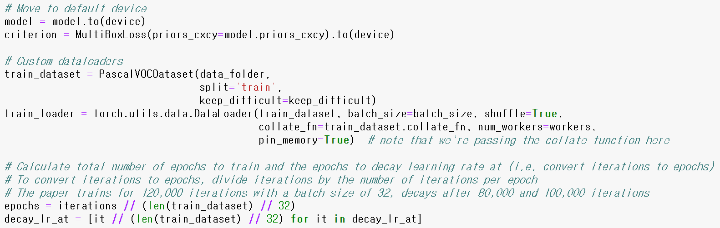

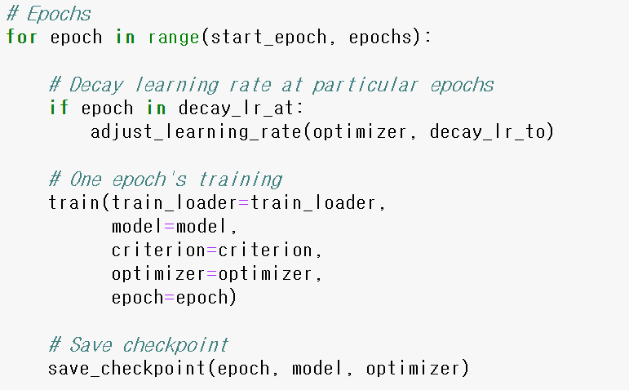
lr decay /10

Slide 8
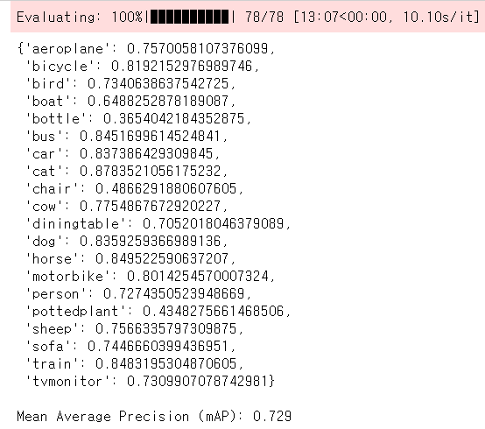
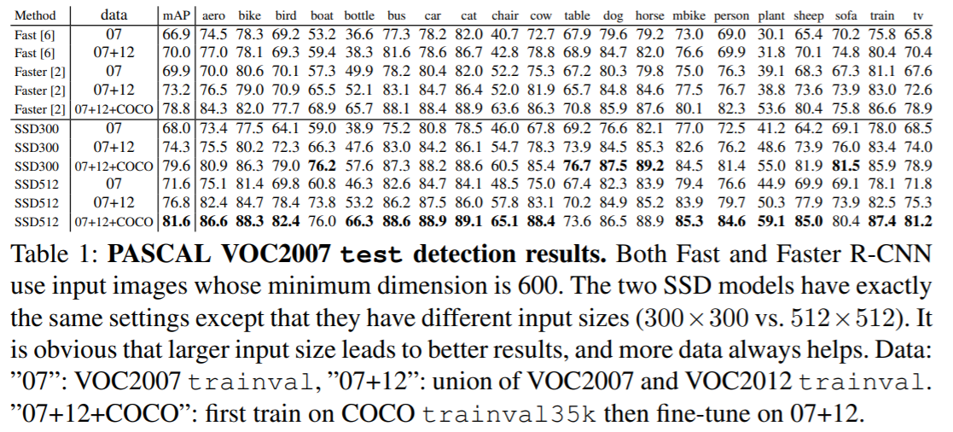

Slide 9
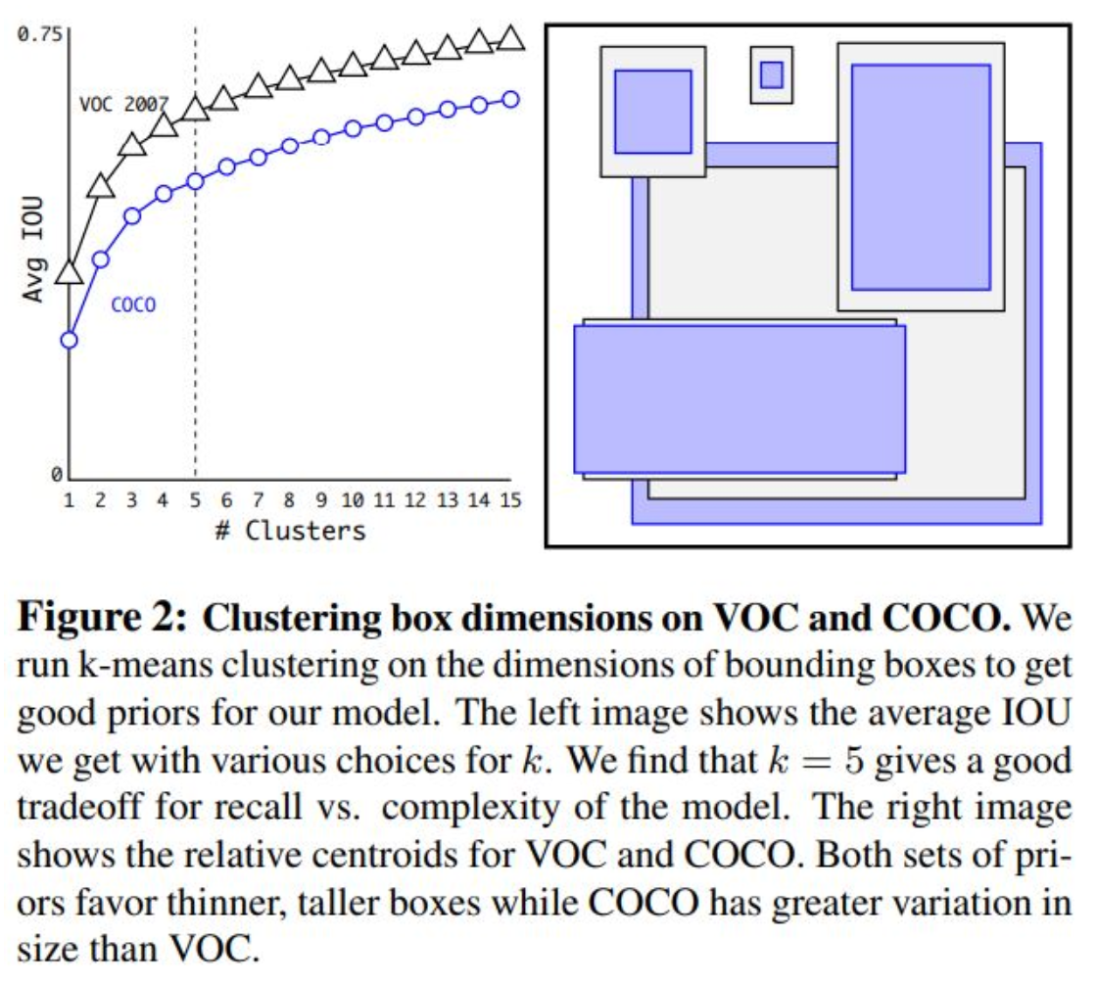
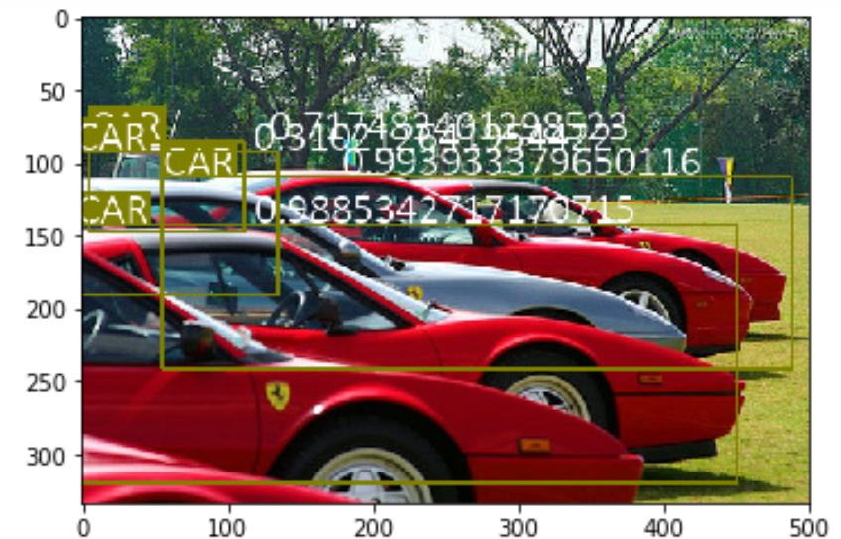
K-means clustering -> network?
NMS -> network?
Deconvolution network 개선 (parallel 구조)

Slide 12
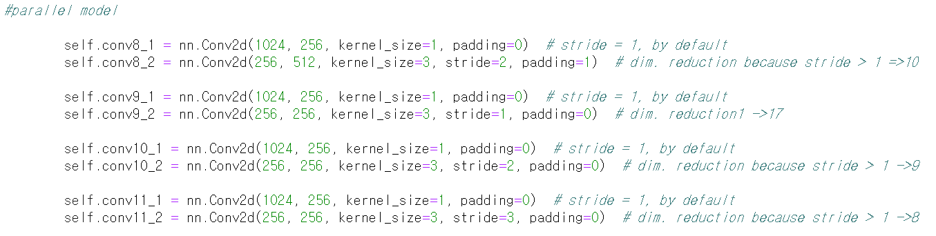
Model 1. Dilation X
최종 feature map size [38, 19, 17, 10, 9, 6]

Slide 13
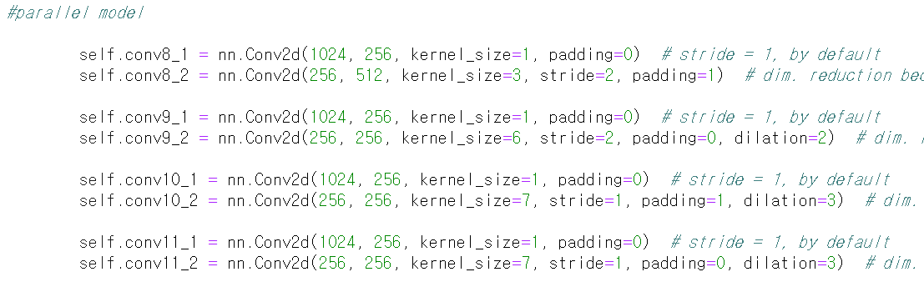
Model 2. Dilation O, 최종 feature map size 원 논문과 동일
최종 feature map size [38, 19, 10, 5, 3, 1]

Slide 15
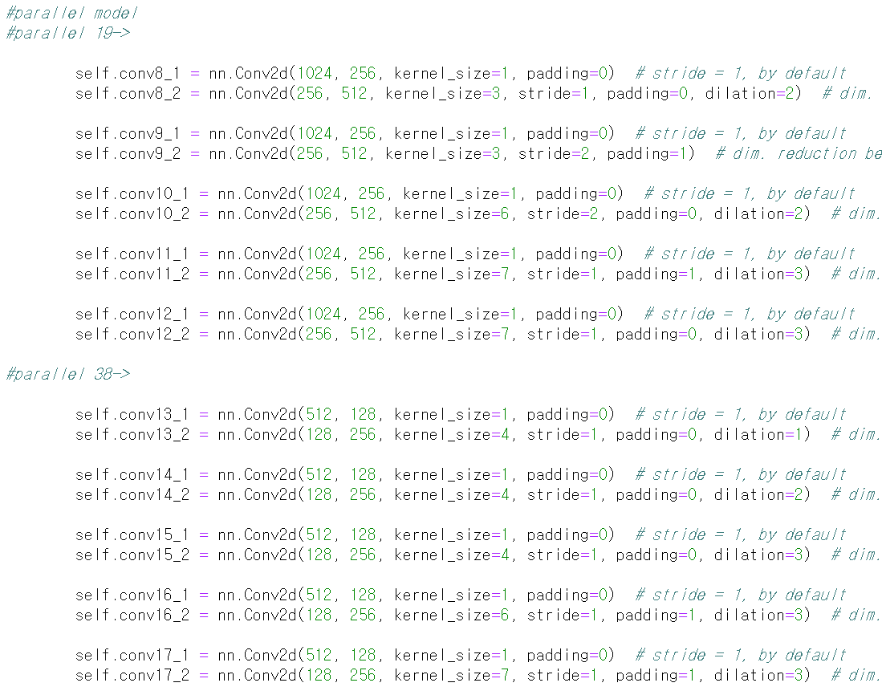
Model 3. Parallel 구조 최대
최종 feature map size [38, 35, 32, 29, 25, 22, 19, 15, 10, 5, 3, 1]

Slide 16
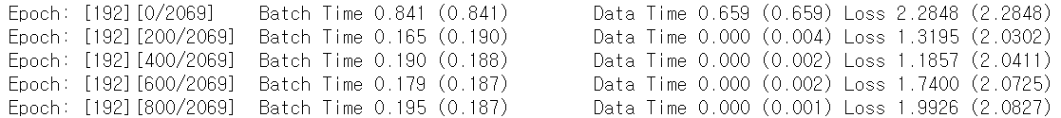
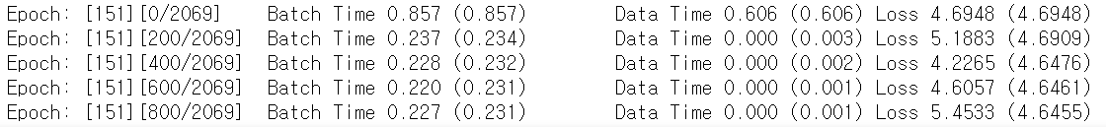
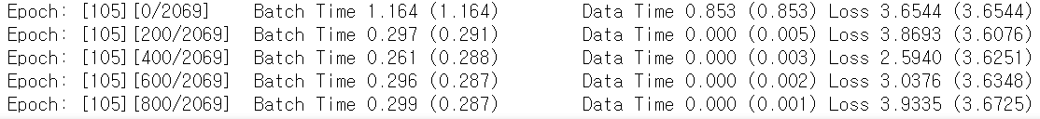
Model 1
Model 2
Model 3

Slide 17
Model 1
Model 2
Model 3

Slide 18
