Slide 2
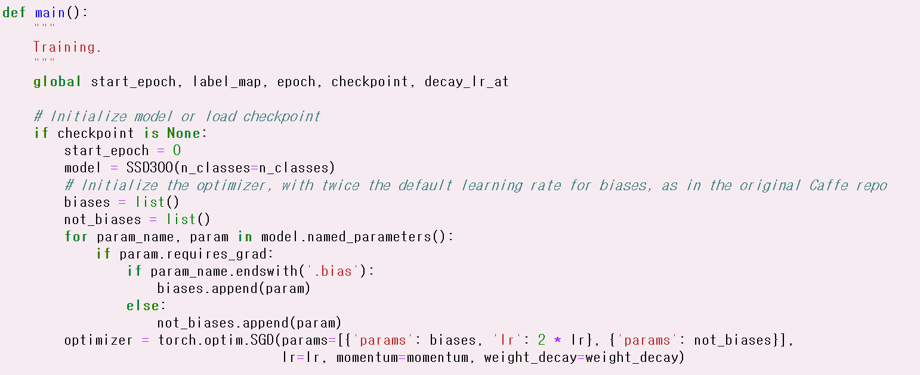
main()

Slide 3
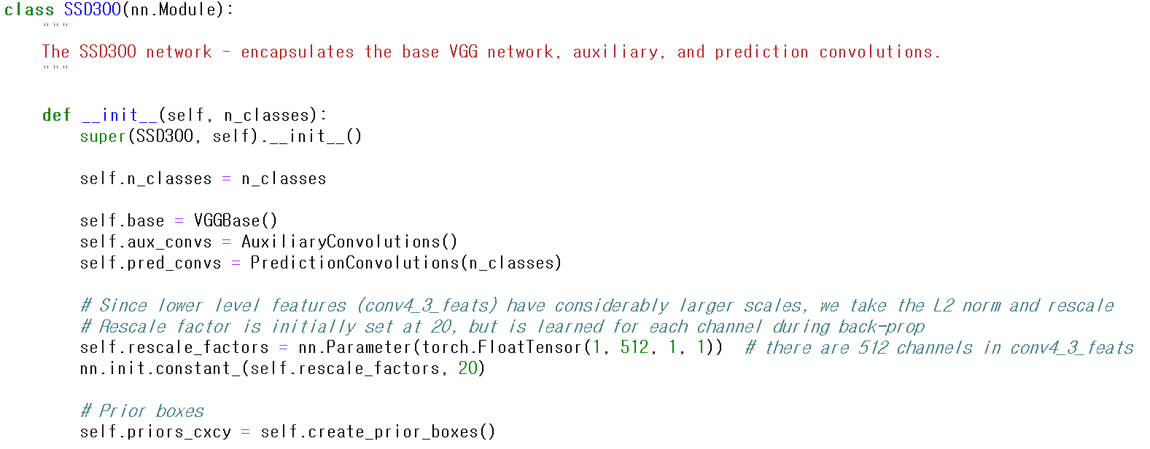
SSD300 (model.py)
ImageNet pretrainded parameter update

Slide 4

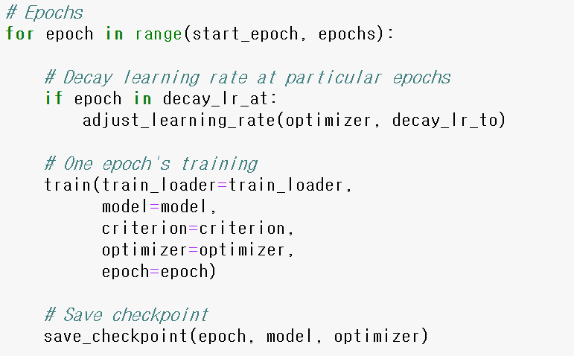
lr decay /10

Slide 5
