Slide 1
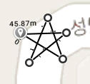
P1: 37.413255, 127.129485
P2: 37.413206, 127.129577
P3: 37.413282, 127.129545
P4: 37.413202, 127.129504
P5: 37.413255, 127.129587
Distance(P1, P2) = 9.42 m
Distance(P2, P3) = 18.1 m
Distance(P3, P4) = 27.71 m
Distance(P4, P5) = 37.13 m
③
①
⑤
④
②

