Slide 1
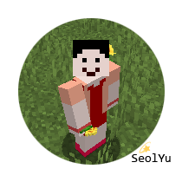






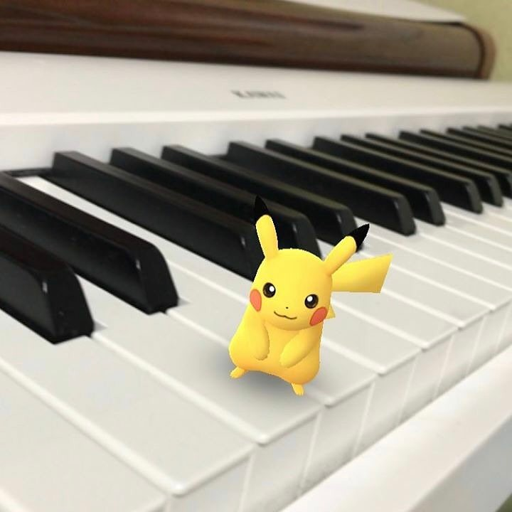






검색
음악
언어/테마
디테일
Seolyu
fe73c7
Seoul, South Korea
명함
fe73c7
기술 스택 그래프
fe73c7
프로젝트
About me / Coding / Artwork / Contact
Web Publisher
Contact

Slide 2


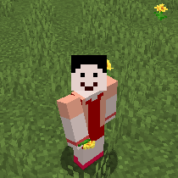
검색
Seolyu
Seoul, South Korea
Web Publisher
About me
Coding
Artwork
Contact
자기소개 / 이력
기술 스택

Slide 3

검색
Seolyu
Seoul, South Korea
Web Publisher
About me
Coding
Artwork
Contact
애완동물 SNS
(TEAM)
프로젝트 2
프로젝트 3

Slide 4

검색
Seolyu
Seoul, South Korea
Web Publisher
About me
Coding
Artwork
Contact
Photoshop/Illustrator
HTML/CSS/JavaScript

Slide 5
검색
Seolyu
Seoul, South Korea
Web Publisher
About me
Coding
Artwork
Contact
Email
SNS

Slide 6
검색
음악
언어/테마
디테일
Seolyu
Seoul, South Korea
About me / Coding / Artwork / Contact
Web Publisher
Contact

