Slide 1
Annotation Tool
Development
revision_2

Slide 2
Interface & Function

Slide 3
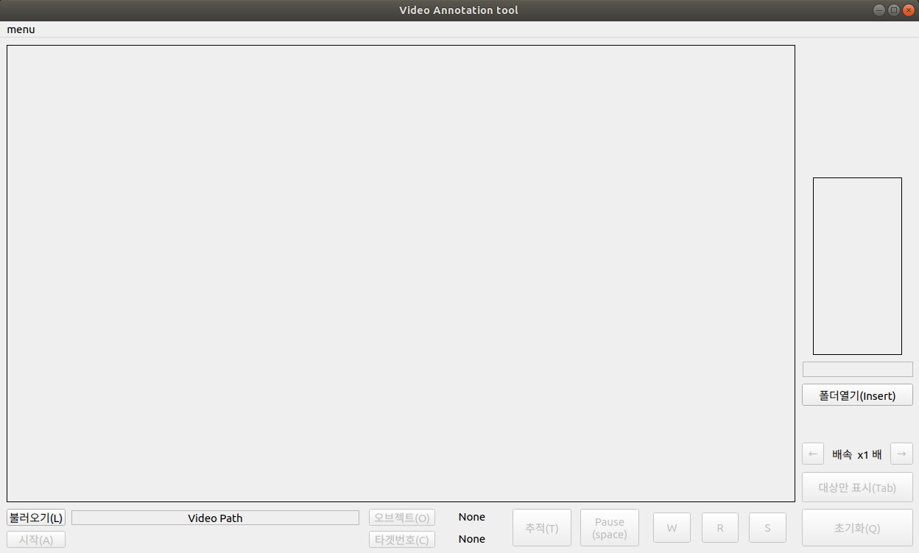
Interface & Function

Slide 4
Interface & Function

Slide 5
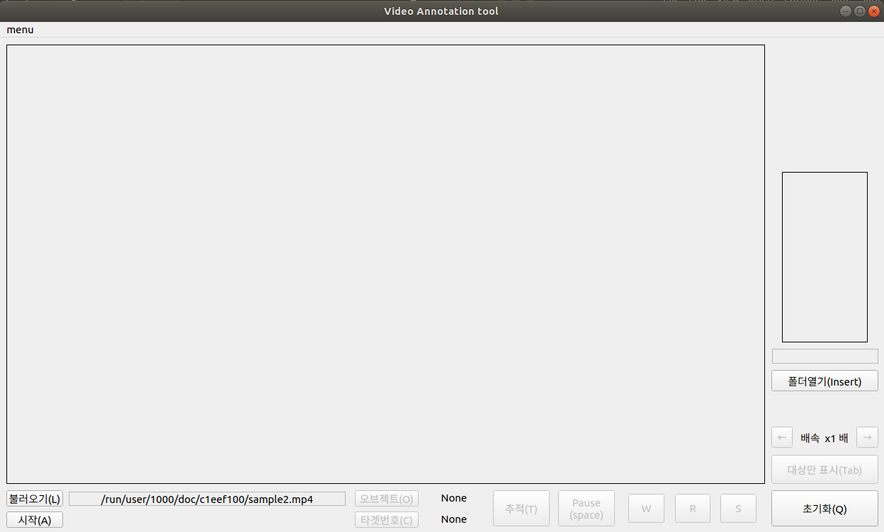
Interface & Function

Slide 6
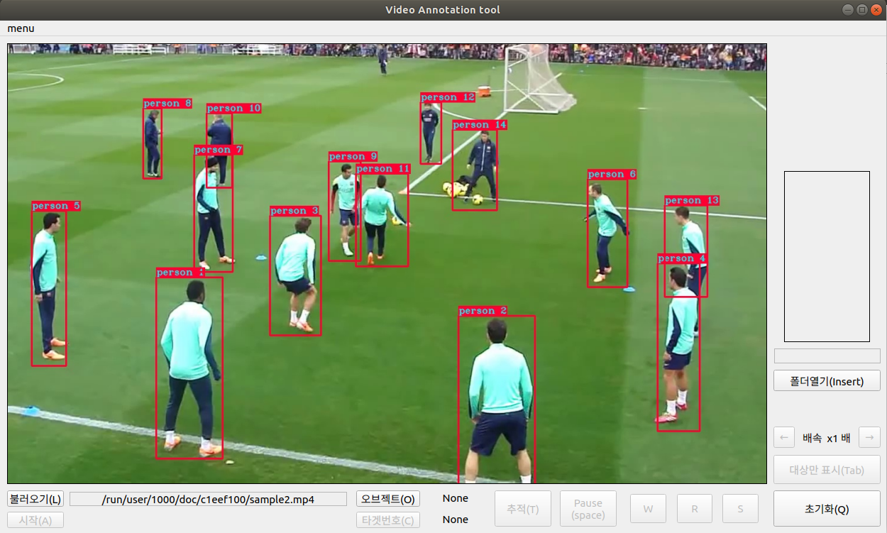
Interface & Function

Slide 7
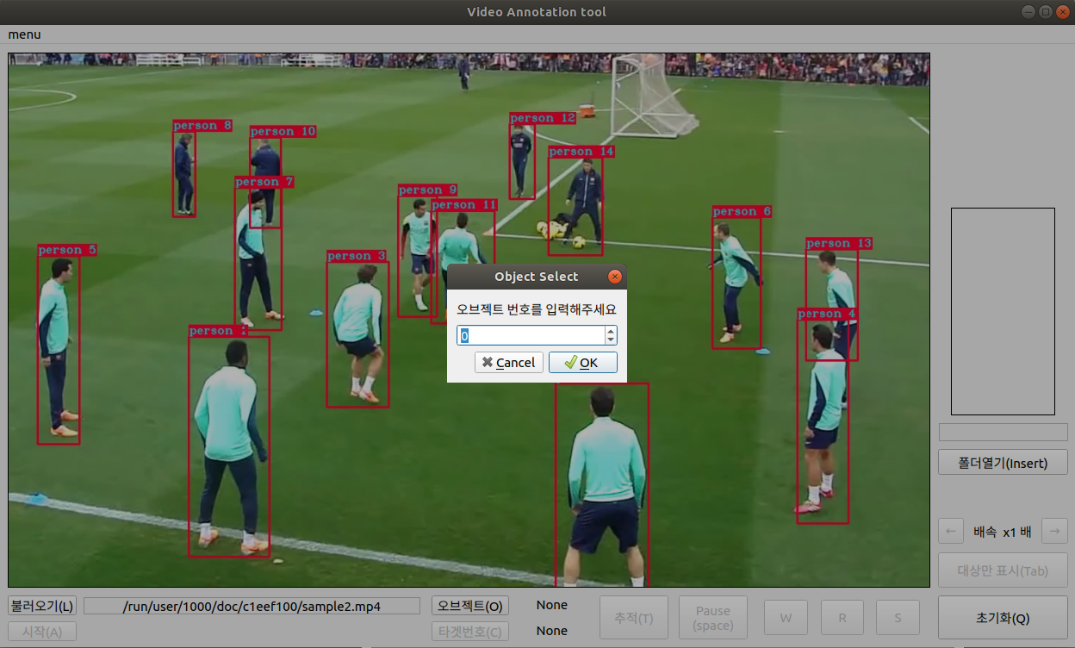
Interface & Function

Slide 8

Interface & Function

Slide 9
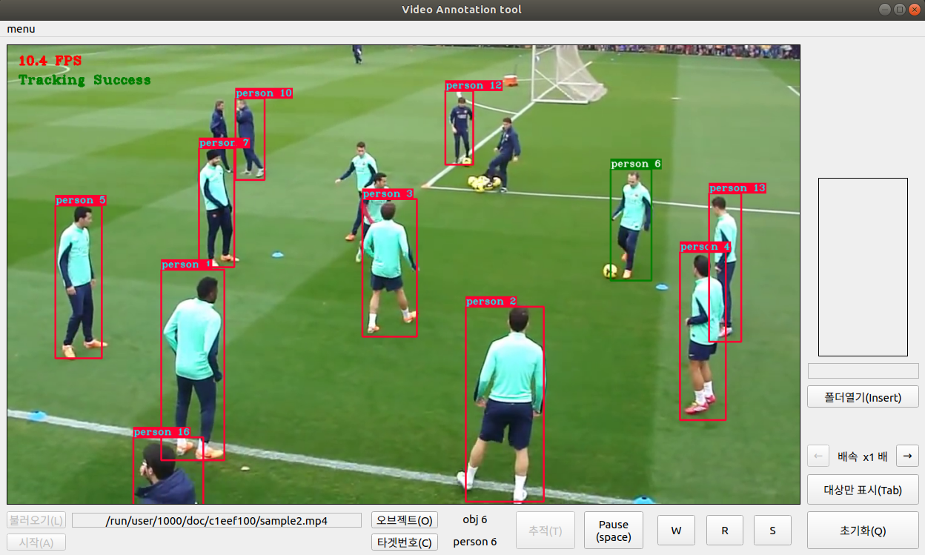
Interface & Function

Slide 10
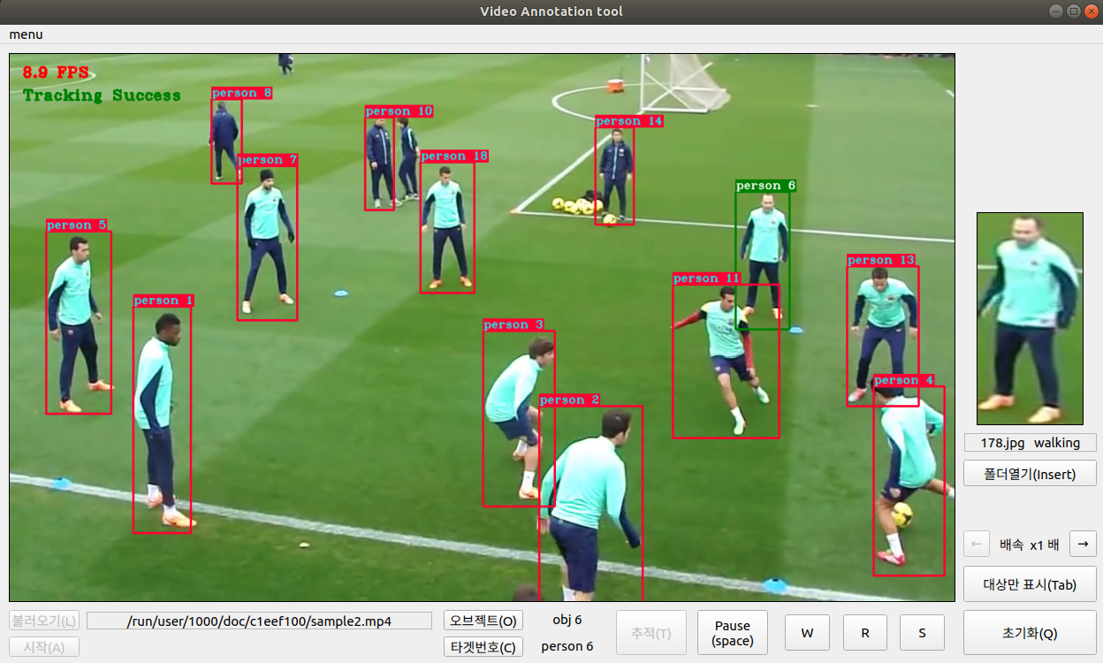
Interface & Function

Slide 11
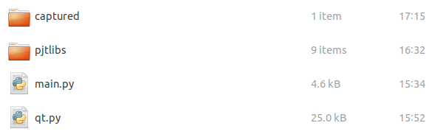
Interface & Function

Slide 12
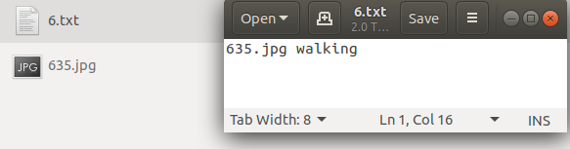
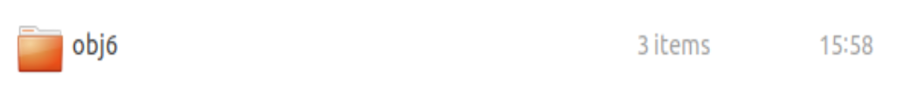
Interface & Function

Slide 13
Interface & Function

Slide 14
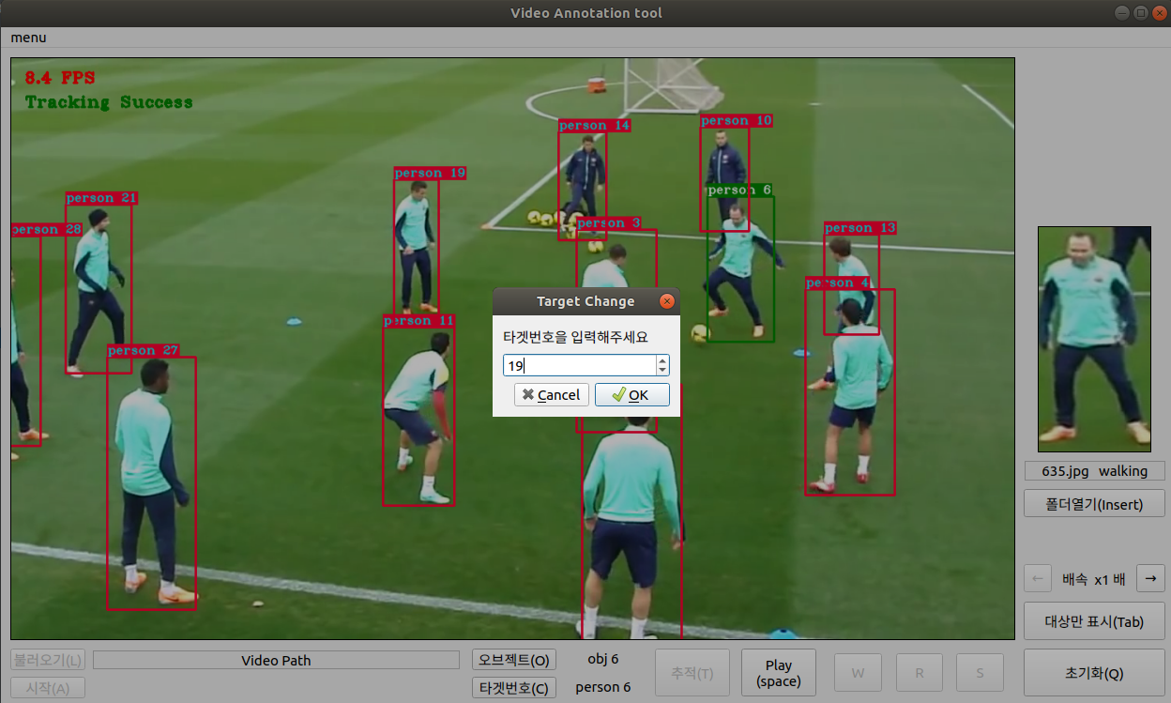
Interface & Function

Slide 15
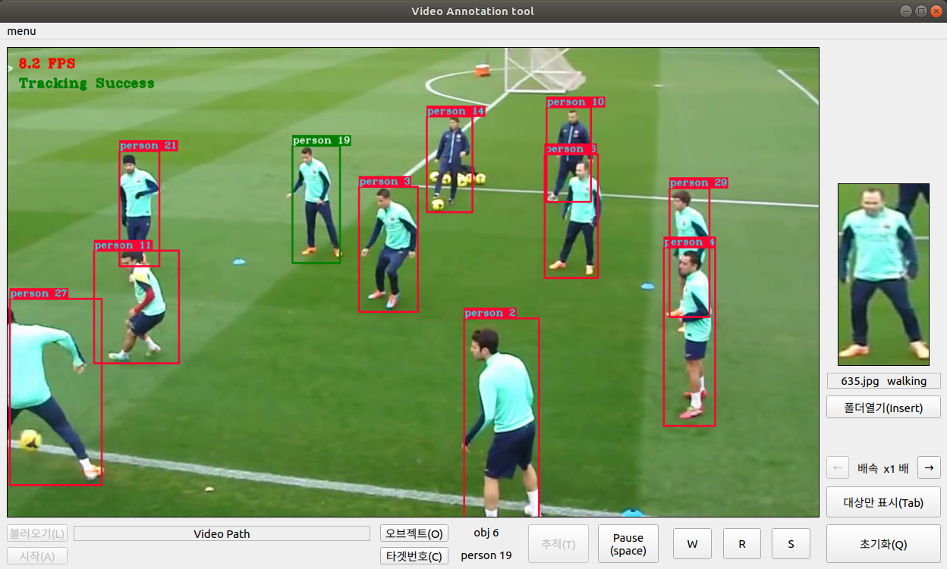
Interface & Function

Slide 16
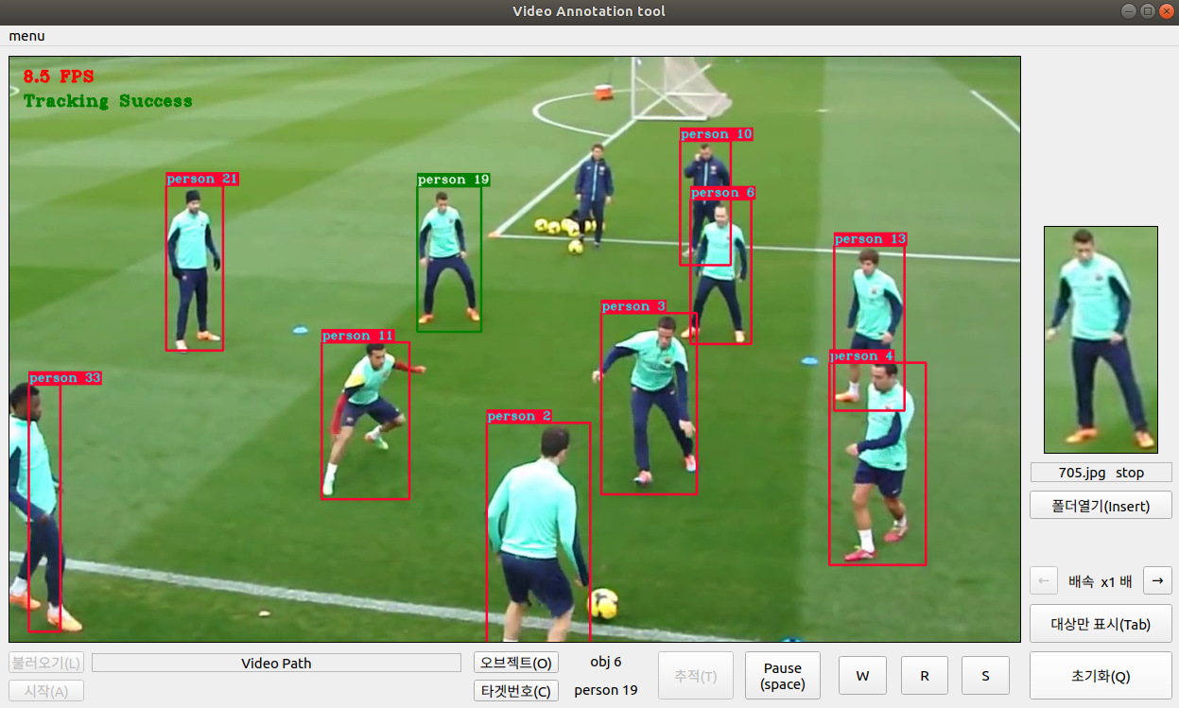
Interface & Function

Slide 17
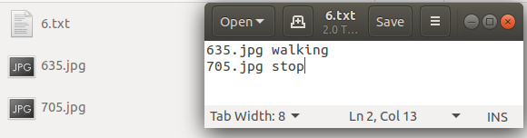
Interface & Function

Slide 18
Interface & Function

Slide 19
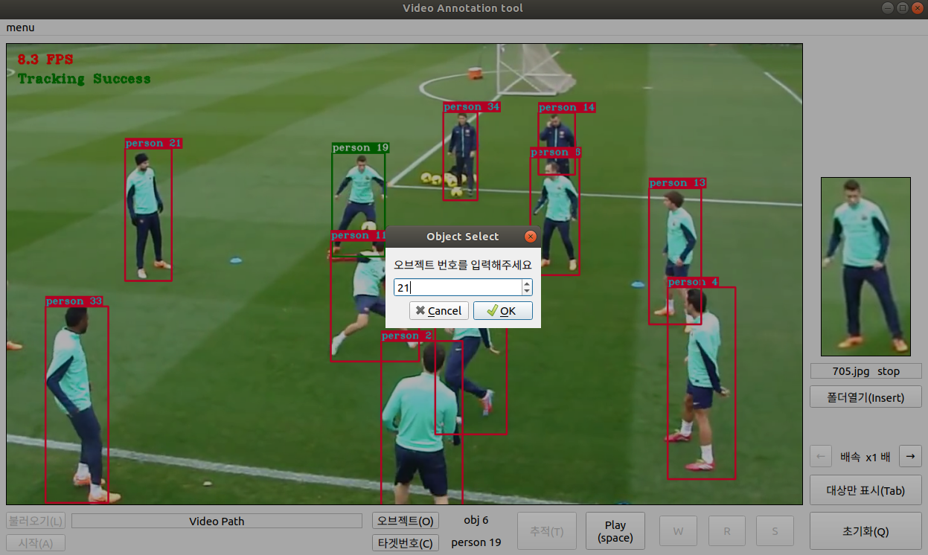
Interface & Function

Slide 20
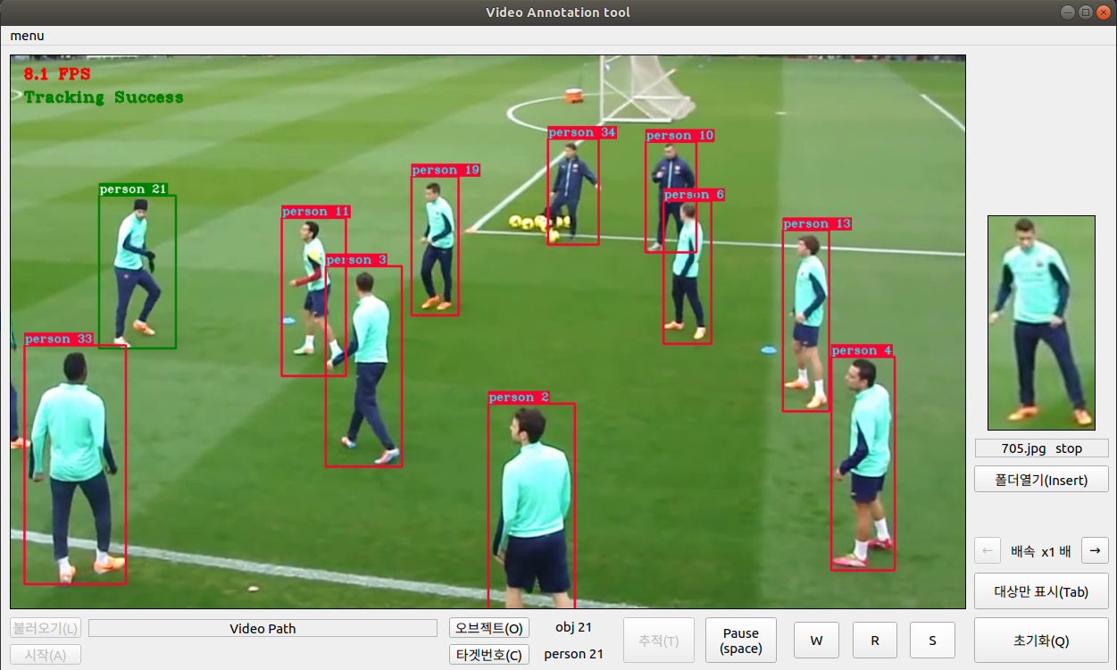
Interface & Function

Slide 21
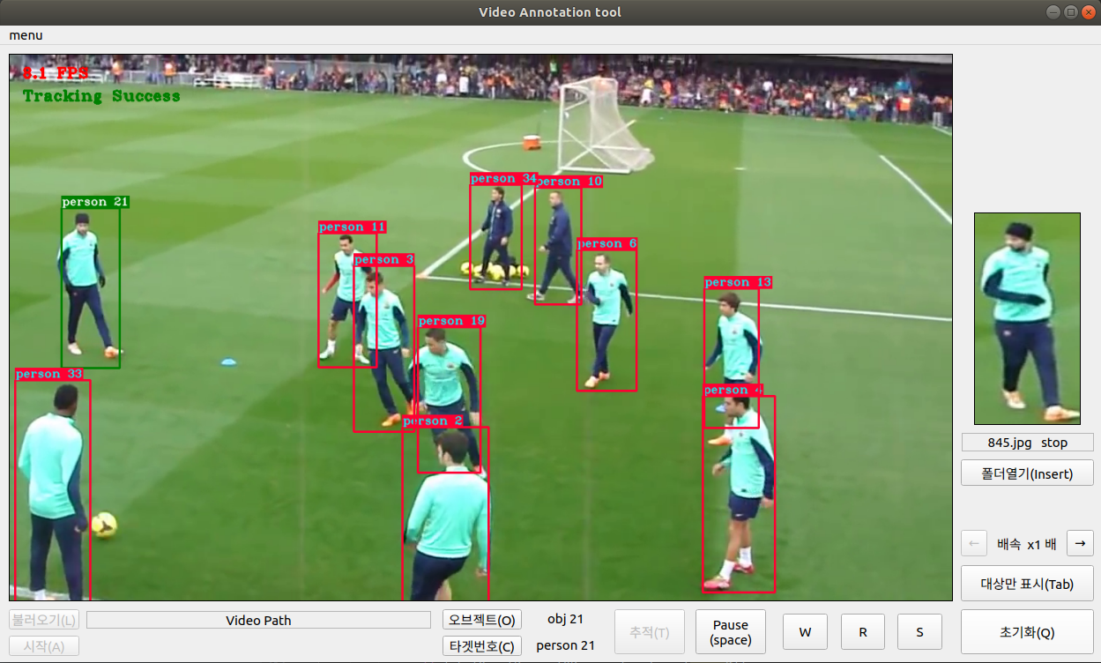
Interface & Function

Slide 22

Interface & Function

Slide 23
Interface & Function

Slide 24
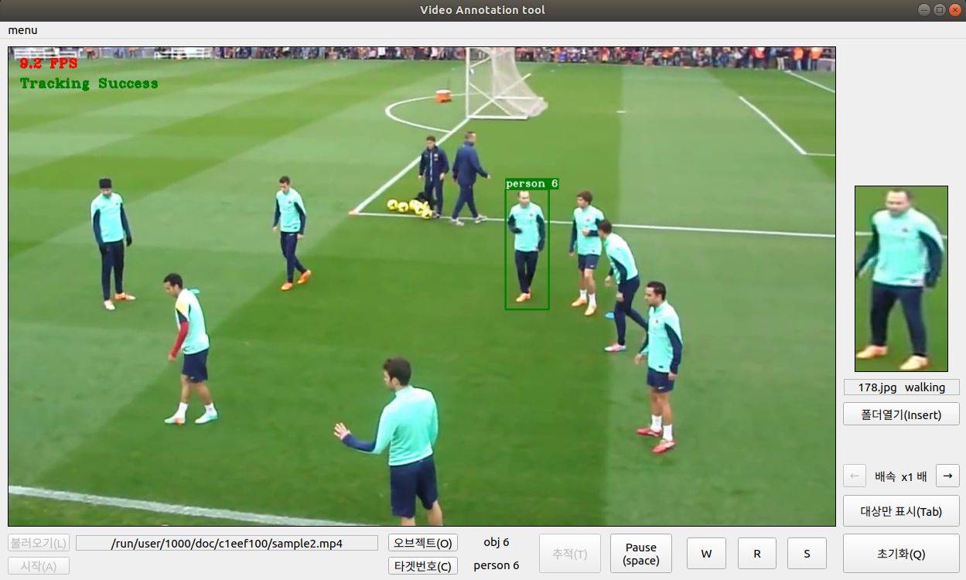
Interface & Function

Slide 25
Interface & Function

Slide 26
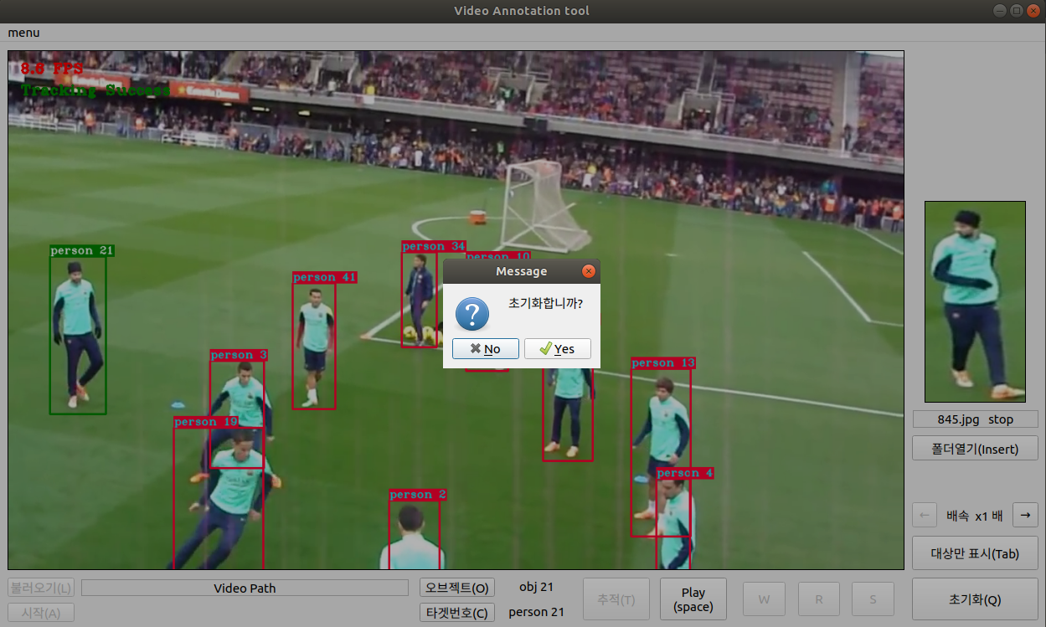
Interface & Function

Slide 27

Interface & Function

Slide 28
Interface & Function

Slide 29
Interface & Function

Slide 30
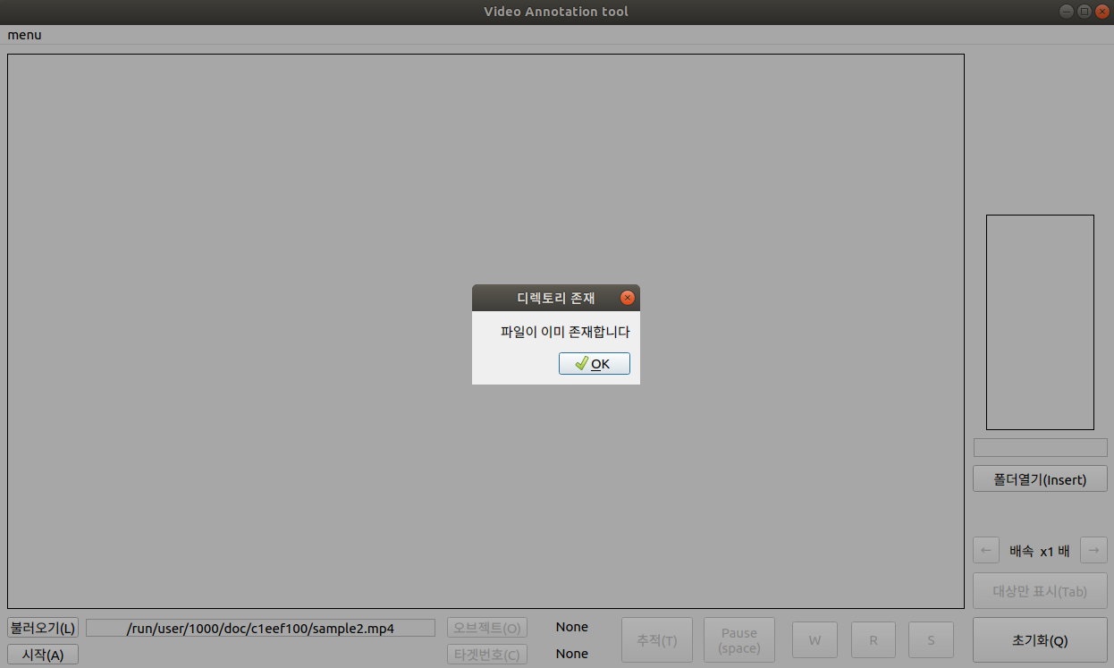
Interface & Function

Slide 31
Interface & Function
Empty here

Slide 32
END.
Github repository
https://github.com/seomk97/annotool/tree/pyonly
Reference
https://github.com/pythonlessons/TensorFlow-2.x-YOLOv3

