Slide 1
게임엔진기초 3조 중간발표
Project_SpaceShooter
3조: 장원준 유성호 김건우 신상용 남성유

Slide 2
Table Contents
Project_SpaceShooter / 3조
Development Setting
Game Design
Technology
Future Plan

Slide 3
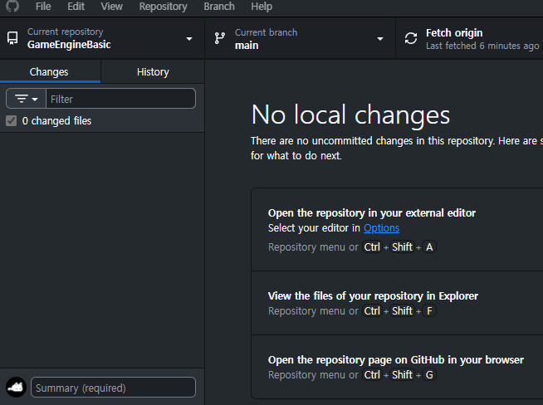


Development Settings
Project_SpaceShooter / 3조
Using Engine - UE 5.4.4
Using Version Control System - Github
Using Collaboration Platform - Discord
Notes:
각 효과에 대한 설명명

Slide 4
GAME DESIGN
Project_SpaceShooter / 3조
IDEA Shooting + Tactic…!!
TARGET USER Player who interested in Tactic_Shooter genre
CORE CONCEPT - Environment Combat System

Slide 5
Environment Combat System
Project_SpaceShooter / 3조
Asteroid Belt
Magnetic Storm
Blackhole

Slide 6
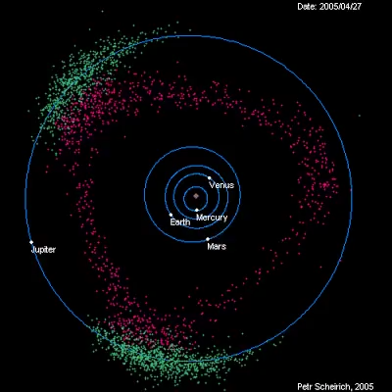
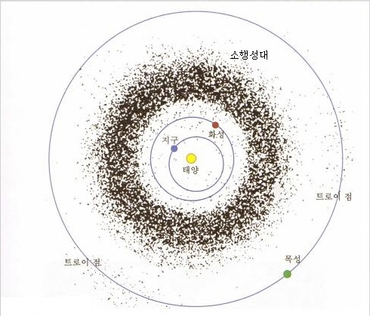
Asteroid Belt
Project_SpaceShooter / 3조
A space where many rocks, metals, and ice fragments float
Notes:
각 효과에 대한 설명명

Slide 7
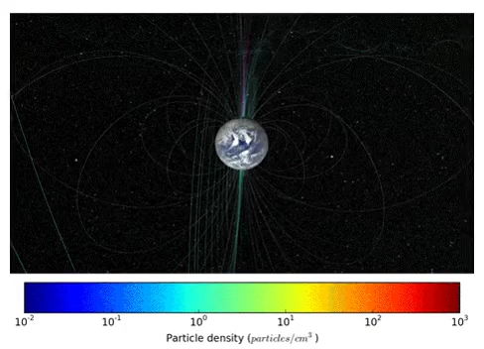
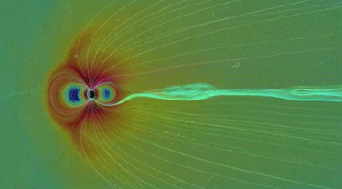
Magnetic Storm
Project_SpaceShooter / 3조
A phenomenon in which the solar wind of the sun is radiated (based on the solar system)
Notes:
각 효과에 대한 설명

Slide 8
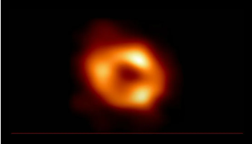
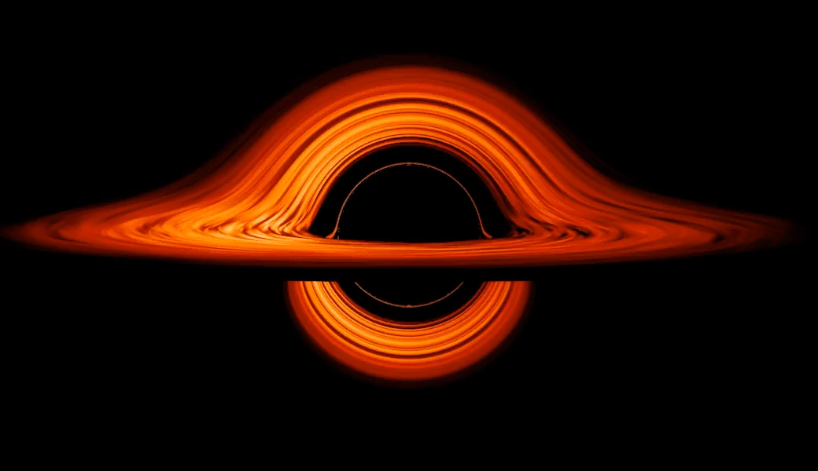
Blackhole
Project_SpaceShooter / 3조
A celestial body whose gravity is so strong that no material information, including light, can escape
Notes:
각 효과에 대한 설명

Slide 9
Code UML
Project_SpaceShooter / 3조
Player
Enemy
UStaticMeshComp
USpringArmComp UCameraComp ShipMovement UShooterComp UHealthComp ShieldComp-USphereComp
USphereComp UStaticMeshComp UFloatingPawnMove AIController UBlackboardComp UShooterComp UHealthComp
Composition
Composition
SharedComponents
UHeathComp
UShooterComp
(via Projectile / Damage event)

Slide 10
Code UML
Project_SpaceShooter / 3조
UShooterComp
ProjectileClass - TSubClassOf<AProjectile>
FireRate
MuzzleLocation - USceneComp
Association
Dependency
UHealthComp
CurrentHealth
CurrentShield
OnHealthChanged - Delegate
AProjectile
CollisionComp - USphereComp
ProjectileMovement
Owner

Slide 11
Enemy BehaviorTree - FindingEnemy
Project_SpaceShooter / 3조
Root
Blackboard Key
SelfActor
Selector
TargetActor
FindPlayer
Distance To Target
ThrottleValue
Rotate
TargetLoc
StrafeVector
IsBoosting

Slide 12
Enemy BehaviorTree - FindingEnemy
Project_SpaceShooter / 3조
Selector
FindPlayer
Rotate
BlackBoard
BlackBoard
BlackBoard
BlackBoard
BlackBoard
Sequence
Sequence
Sequence
Sequence
Set Throttle
Set Throttle
Set Throttle
Shoot
Set Throttle
Shoot

Slide 13
Enemy BehaviorTree - HoveringEnemy
Project_SpaceShooter / 3조
Root
Blackboard Key
SelfActor
Selector
TargetActor
FindPlayer
Distance To Target
ThrottleValue
Rotate
TargetLoc
StrafeVector
IsBoosting

Slide 14
Enemy BehaviorTree - Hovering
Project_SpaceShooter / 3조
Simple Parallel
Selector
FindPlayer
Rotate
Wait
Shoot
Sequence
Sequence
Hovering
Shoot

Slide 15
감사합니다
Project_SpaceShooter / 3조

