Slide 1
V1.0
교과안내 _ ENG

Slide 2

Project Name | Prepared By | Data | Subject
YEE | 고해진 | 2005-05-27 | 화면설계
Explanatory Notes
Symbol | Description | Symbol | Description
 | 서브타이틀, 컨텐츠타이틀, 2Dpepth 페이지 타이틀, 3Depth 페이지 타이틀…. |  | DB연계
 | Visual |  | 팝업 링크
 | 버튼 |  | 링크 페이지
 | 페이지내 컨텐트의 중요도 표지 P1, P2, P3, P4.. (주요 페이지에서 사용) |  | 새창링크
 | 컨텐츠 설명 |  | 블릿, 아이콘
st
ct
t2
t3
DB
PL
L1
P1
NL1
1
B
I
Title Guide
Symbol | Description
■ | 1th Title
▣ | 2th Title
□ | 3th Title
● | 4th Title
⊙ | 5th Title

Slide 3
Project Name | Prepared By | Data | Subject
YEE | 고해진 | 2005-05-27 | 화면설계
Document Recode
Ver | Amendment / Addition Detail | Write Data | Prepared | Agreement | Due Date
1.0 | 교과안내 | 2005.05.27

Slide 4

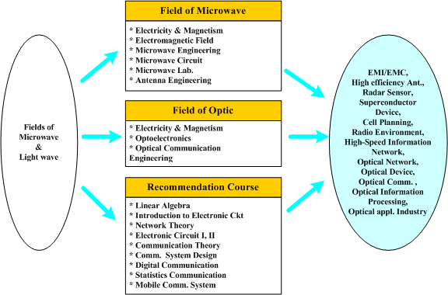

Menu Root
History Map 참조
Prepared By | Title (Frame bar)
고해진 | Younsei University School of Electrical & Electronic Engineering
Page Description
분야소개
Reference Link
http://ee.yonsei.ac.kr/main.php?v_menu=000100020030&v_ck=new
Description
http://ee.yonsei.ac.kr/main.php?v_menu=000100020030&v_ck=new 4 Depth Navigation (가이드에 따른 코딩)
Home | Korean | Sitemap | Contact Us |
| Introduction | Curriculum | Graduate Admission | Research |
| Undergraduate | Graduate |
Curriculum
Younsei University School of Electrical & Electronic Engineering
Curriculum
 | Undergraduate
 | ▶Areas of Study
 | ▶Curriculum Tree
 | ▶Course Opening
 | ▶Undergraduate Study
 | ▶Originality Study
 | ▶CEO Lecture
 | Graduate
Home> Curriculum>Undergraduate>Areas of Study>Microwaves & Optics
■ Areas of Study
▣ Microwaves & Optics
ABEEK
| Microwaves & Optics | Communication and Signal Processing | Computer and Circuit Design |
| Semiconductor and Electrical and Electronic Material | System and Control |
Undergraduate
Study
2
Originality Study
1
Yonsei
Univ.
Microwave and lightwave engineering is a field of study, which becomes the core technology for the wired and wireless communication in the future generation. In the undergraduate curriculum, courses for electromagnetics, microwave engineering, and photonics among others are presently offered. The field of microwave engineering is related to the technology development such as the modem transforming the signal from the baseband into the high frequency and the wireless transmitters and receivers involving antennas and high-frequency circuits for which an expertise on the design, analysis, and implementation is required.
Students develop the basic knowledge in mathematics such as calculus, linear algebra, and differential equations and computer science with languages such C++ as well as to develop skills in basic electronic device and circuit theory for component and system designs. Students also learn experimental skills with hands-on experience on the implementation, test, and analysis to supplement the theoretical understanding. A laboratory course in the microwave engineering is currently provided in the undergraduate curriculum.
The lightwave engineering enables stable transmission and reception of data with large capacity at high speed for the information age, enabling the high-speed communication network in the present and future generations into the 21st century. With the basic concept of the light and photonic devices, the system engineering in the areas of the light network and communication systems is put into practice.
The field of microwave and lightwave engineering in having to apply the communication principles requires a course work in the communication theory, digital communication, wireless communication, and communication laboratory.
Link
1
2
3
4
5
Home | Korean | Sitemap | Contact Us |
Quick Link
Copyright(c)2005 Yonsei University, School of Electrical and Electronic Engineering. All right Reserved
Yonsei University 134 Sinchon-dong, Seodaemun-gu, Seoul 120-749, Korea / 82-2-2123-2860

Slide 5
Field of Microwave
Electricity & Magnetism
Electromagnetic Field
Microwave Engineering
Microwave Circuit
Microwave Lab.
Antenna Engineering
Field of Optic
Field of Microwave
&
Lightwave
Electricity & Magnetism
Optoelectronics
Optical Communication Engineering
Recommendation Course
Linear Algebra
Introduction to Electronic Ckt
Network Theory
Electronic Circuit I, II
Communication Theory
Comm. System Design
Digital Communication
Statistics Communication
Mobile Comm. System
EMI/EMC
High efficiency Ant.,
Radar Sensor,

Slide 6
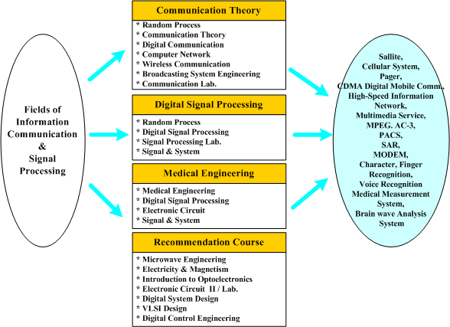
Menu Root
History Map 참조
Prepared By | Title (Frame bar)
고해진 | Younsei University School of Electrical & Electronic Engineering
Page Description
분야소개
Reference Link
http://ee.yonsei.ac.kr/main.php?v_menu=000100020030&v_ck=new
Description
http://ee.yonsei.ac.kr/e_images/img_e_menu_2-4-4.gif
Home | Korean | Sitemap | Contact Us |
| Introduction | Curriculum | Graduate Admission | Research |
| Undergraduate | Graduate |
Curriculum
Younsei University School of Electrical & Electronic Engineering
Curriculum
 | Undergraduate
 | ▶Areas of Study
 | ▶Curriculum Tree
 | ▶Course Opening
 | ▶Undergraduate Study
 | ▶Originality Study
 | ▶CEO Lecture
 | Graduate
Home> Curriculum>Undergraduate>Areas of Study> Communication and Signal Processing
■ Areas of Study
▣ Communication and Signal Processing
ABEEK
| Microwaves & Optics | Communication and Signal Processing | Computer and Circuit Design |
| Semiconductor and Electrical and Electronic Material | System and Control |
Undergraduate
Study
Originality Study
1
Yonsei
Univ.
The fields of communication and signal processing encompass the communication theory and digital signal processing being the cornerstones of next generation communication technology and high-tech electronic system. The undergraduate curriculums in this field are mainly divided into the communication theory, the digital signal processing and the medical electronics system. In the analog and digital communication courses, students acquire the communication theory, learning about the modem which is the basic of communication. Also by learning the basic mathematics involved in the random process, students can understand the structures and evaluate the performance characteristics of modems. Students learn various applicable communication technologies: the mobile communication for the field of wireless communication, the wired and computer communication for the field of computer network, and the integrated communication and broadcast for the broadcasting system.
In the field of signal processing, the basic theories of the signal interpretation in order to maximize the extraction of information and its transmittal effectiveness are taught. Students learn the basic features of signals and interpretation methods in the signal and system course. Also in the probabilities and random process course, the students learn the statistical methods of signal interpretation and modeling. Especially, students learn the principles and interpretation of voice and acoustic signals in the acoustics engineering course and study the principles and methods of processing various signals through the digital system in the digital signal processing course. Students complement all the theoretic work with the signal processing laboratory course.
In the field of medical engineering, students learn the concepts of electrophysiology, medical instrumentation, biomedical signal processing, medical materials, biomechanics, rehabilitation engineering, artificial organs, and medical imaging. Also the man-machine interface and the interplay with various areas in electronics are explored.
Link
1
2
3
4
5
Home | Korean | Sitemap | Contact Us |
Quick Link
Copyright(c)2005 Yonsei University, School of Electrical and Electronic Engineering. All right Reserved
Yonsei University 134 Sinchon-dong, Seodaemun-gu, Seoul 120-749, Korea / 82-2-2123-2860

Slide 7
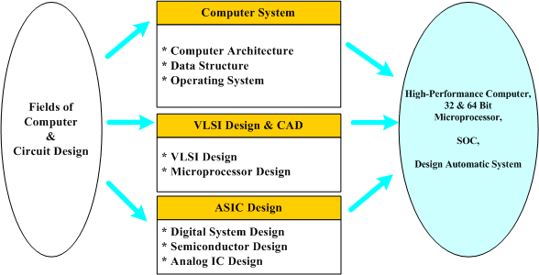
Menu Root
History Map 참조
Prepared By | Title (Frame bar)
고해진 | Younsei University School of Electrical & Electronic Engineering
Page Description
분야소개
Reference Link
http://ee.yonsei.ac.kr/main.php?v_menu=000100020030&v_ck=new
Description
http://ee.yonsei.ac.kr/e_images/img_e_menu_2-4-5.gif
Home | Korean | Sitemap | Contact Us |
| Introduction | Curriculum | Graduate Admission | Research |
| Undergraduate | Graduate |
Curriculum
Younsei University School of Electrical & Electronic Engineering
Curriculum
 | Undergraduate
 | ▶Areas of Study
 | ▶Curriculum Tree
 | ▶Course Opening
 | ▶Undergraduate Study
 | ▶Originality Study
 | ▶CEO Lecture
 | Graduate
Home> Curriculum>Undergraduate>Areas of Study> Computer and Circuit Design
■ Areas of Study
▣ Computer and Circuit Design
ABEEK
| Microwaves & Optics | Communication and Signal Processing | Computer and Circuit Design |
| Semiconductor and Electrical and Electronic Material | System and Control |
Undergraduate
Study
Originality Study
1
Yonsei
Univ.
The discipline of computer and circuit design can be divided into the areas of computer system, very large scale integrated (VLSI) circuit design and computer aided design (CAD), and application specific integrated circuit (ASIC). In the area of computer system, students learn the basic structure and the operating principles of the various components constituting PC, mid- and high-end computers, and super computers and design various computer systems. Between the hardware and the software of the computer system, the hardware is emphasized. Especially, the structure and the operating principles of the microprocessor as the brain of computers are taught.
In the VLSI design and CAD areas, very large scale integrated circuits are designed and CAD methodology and software to process such design automatically. The scale in the VLSI involve integration of electronic circuits with several hundred thousands of transistors on a semiconductor chip of only about the size of 1~3㎠. Students learn various theories and technologies to perform such design using the CAD software tools.
The application specific integrated circuit (ASIC) design having been the center of research attention since the late 1980s is a specialized VLSI design discipline. By designing the chip specifically suited for various communication and industrial systems, a small-sized, high performance, and low cost implementation becomes possible. Along with the research and development in the design process, the acquisition of intellectual properties is an important issue. Since most electronic systems will include many VLSI and ASIC chips in the 21st century, the research and development in this field will be very important and promising.
Link
1
2
3
4
5
Home | Korean | Sitemap | Contact Us |
Quick Link
Copyright(c)2005 Yonsei University, School of Electrical and Electronic Engineering. All right Reserved
Yonsei University 134 Sinchon-dong, Seodaemun-gu, Seoul 120-749, Korea / 82-2-2123-2860

Slide 8
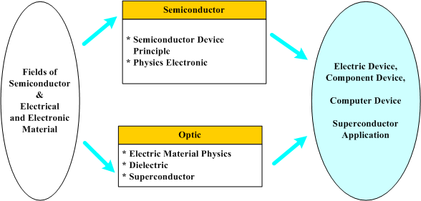
Menu Root
History Map 참조
Prepared By | Title (Frame bar)
고해진 | Younsei University School of Electrical & Electronic Engineering
Page Description
분야소개
Reference Link
http://ee.yonsei.ac.kr/main.php?v_menu=000100020030&v_ck=new
Description
http://ee.yonsei.ac.kr/e_images/img_e_menu_2-4-7.gif
Home | Korean | Sitemap | Contact Us |
| Introduction | Curriculum | Graduate Admission | Research |
| Undergraduate | Graduate |
Curriculum
Younsei University School of Electrical & Electronic Engineering
Curriculum
 | Undergraduate
 | ▶Areas of Study
 | ▶Curriculum Tree
 | ▶Course Opening
 | ▶Undergraduate Study
 | ▶Originality Study
 | ▶CEO Lecture
 | Graduate
Home> Curriculum>Undergraduate>Areas of Study>Semiconductor and Electrical and Electronic Material
■ Areas of Study
▣ Semiconductor and Electrical and Electronic Material
ABEEK
| Microwaves & Optics | Communication and Signal Processing | Computer and Circuit Design |
| Semiconductor and Electrical and Electronic Material | System and Control |
Undergraduate
Study
Originality Study
1
Yonsei
Univ.
The field of semiconductor and electrical and electronic material is divided into semiconductor and electrical and electronic material fields. The field of semiconductor is further subdivided into device theory (semiconductor engineering) and physical electronics. The semiconductor engineering deals with functional logic of semiconductor devices such as diodes and transistors, and its manufacturing methods. The physical electronics field deals with basic physics of electronic engineering and electronic applications of physics for quantum mechanical interpretation. The field of electrical and electronic material is divided into electrical material properties, dielectric substance and superconductor. Theories of electrical material properties focus on characteristics of electric materials such as metal, semiconductor, dielectric substance, and magnetic substance. Students are also expected to acquire basic knowledge in application area. The dielectric substance engineering deals with theories and application of dielectric substance and piezoelectric ceramic, materials used for sensors, ultrasound equipments and etc. The fundamental superconducting and its application deal with principles of superconductor in which the electric resistance becomes zero with a goal of acquiring basic knowledge in application area such as magnetic levitation train, electric power savings and etc.
Link
1
2
3
4
5
Home | Korean | Sitemap | Contact Us |
Quick Link
Copyright(c)2005 Yonsei University, School of Electrical and Electronic Engineering. All right Reserved
Yonsei University 134 Sinchon-dong, Seodaemun-gu, Seoul 120-749, Korea / 82-2-2123-2860

Slide 9
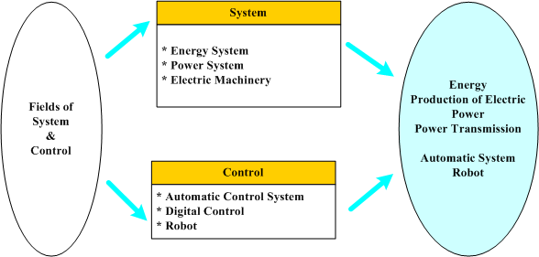
Menu Root
History Map 참조
Prepared By | Title (Frame bar)
고해진 | Younsei University School of Electrical & Electronic Engineering
Page Description
분야소개
Reference Link
http://ee.yonsei.ac.kr/main.php?v_menu=000100020030&v_ck=new
Description
http://ee.yonsei.ac.kr/e_images/img_e_menu_2-4-6.gif
Home | Korean | Sitemap | Contact Us |
| Introduction | Curriculum | Graduate Admission | Research |
| Undergraduate | Graduate |
Curriculum
Younsei University School of Electrical & Electronic Engineering
Curriculum
 | Undergraduate
 | ▶Areas of Study
 | ▶Curriculum Tree
 | ▶Course Opening
 | ▶Undergraduate Study
 | ▶Originality Study
 | ▶CEO Lecture
 | Graduate
Home> Curriculum>Undergraduate>Areas of Study> System and Control
■ Areas of Study
▣ System and Control
ABEEK
| Microwaves & Optics | Communication and Signal Processing | Computer and Circuit Design |
| Semiconductor and Electrical and Electronic Material | System and Control |
Undergraduate
Study
Originality Study
1
Yonsei
Univ.
The fields of system and control is divided into system and control fields. The system field is further subdivided into the energy system, electric power system and electric devices (electric motor, generator, and transformer). In Introduction to Energy System, students are expected to understand mathematical interpretation and control methods of a system as a basic study on the mechanical-electrical energy system along with electric power. Based on those understanding, students should acquire knowledge in the field of electric power system and electric devices and control. Electric power system is helpful in overall understanding about mathematical interpretation, interpretation on defects, and stability interpretation of single-phase and 3-phase electric power system fields. In the field of electrical device and control, students should learn about alternating equipment of transformer, electric motor and generator, functioning logic, speed and strength control. The control field is divided into automatic control system, digital control and robot. Automatic control system is a basic study, which is helpful for understanding in fundamental or application of robot control, electrical and electronic system automation, and stability interpretation. Digital control is about transforming analog signals into digital signals and applying it to automatic control systems, handling interpretation in time and frequency domain of digital control signals along with knowledge in system designing. Robot and electrostatic engineering deals with the dynamics of robot and force control, motor control and computer connection methods using microprocessors.
Link
1
2
3
4
5
Home | Korean | Sitemap | Contact Us |
Quick Link
Copyright(c)2005 Yonsei University, School of Electrical and Electronic Engineering. All right Reserved
Yonsei University 134 Sinchon-dong, Seodaemun-gu, Seoul 120-749, Korea / 82-2-2123-2860

Slide 10
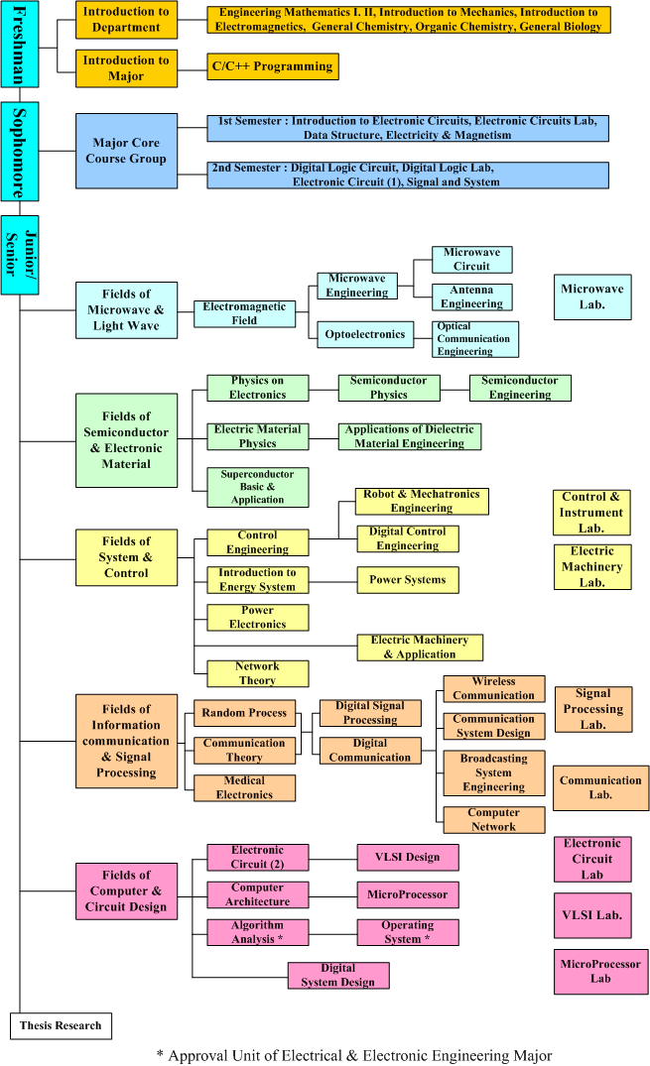
Menu Root
History Map 참조
Prepared By | Title (Frame bar)
고해진 | Younsei University School of Electrical & Electronic Engineering
Page Description
과목군 트리
Reference Link
http://ee.yonsei.ac.kr/main.php?v_menu=000100020020&v_ck=new
Description
상세그림 : http://ee.yonsei.ac.kr/e_images/img_e_menu_2-1-2.gif
Home | Korean | Sitemap | Contact Us |
| Introduction | Curriculum | Graduate Admission | Research |
| Undergraduate | Graduate |
Curriculum
Younsei University School of Electrical & Electronic Engineering
Curriculum
 | Undergraduate
 | ▶Areas of Study
 | ▶Curriculum Tree
 | ▶Course Opening
 | ▶Undergraduate Study
 | ▶Originality Study
 | ▶CEO Lecture
 | Graduate
Home> Curriculum>Undergraduate>Curriculum Tree
■ School of Electrical and Electronic Engineering Course Tree
ABEEK
Undergraduate
Study
Originality Study
Yonsei
Univ.
Link
1
2
3
4
5
Home | Korean | Sitemap | Contact Us |
Quick Link
Copyright(c)2005 Yonsei University, School of Electrical and Electronic Engineering. All right Reserved
Yonsei University 134 Sinchon-dong, Seodaemun-gu, Seoul 120-749, Korea / 82-2-2123-2860

Slide 11
Menu Root
History Map 참조
Prepared By | Title (Frame bar)
고해진 | Younsei University School of Electrical & Electronic Engineering
Page Description
학사일정표
Reference Link
http://ee.yonsei.ac.kr/main.php?v_menu=000100020040&v_ck=new
Description
Home | Korean | Sitemap | Contact Us |
| Introduction | Curriculum | Graduate Admission | Research |
| Undergraduate | Graduate |
Curriculum
Younsei University School of Electrical & Electronic Engineering
Curriculum
 | Undergraduate
 | ▶Areas of Study
 | ▶Curriculum Tree
 | ▶Course Opening
 | ▶Undergraduate Study
 | ▶Originality Study
 | ▶CEO Lecture
 | Graduate
Home> Curriculum>Undergraduate> Course Opening
■ Course Opening
ABEEK
▣ Subject Opening Table
School Year | First Semester | Second Semester
Sophomore | - Data Structure - Introduction to Electronic Circuits - Electricity & Magnetism - Electronic Circuit Lab. | - Digital Logic Circuit - Signal and System - Electronic Circuit (1) - Electromagnetic Field - Digital Logic Lab.
Junior/Senior | - Microwave Engineering - Optoelectronics - Electric Material Physics - Probability and Random Variables - Communication Theory - Computer Architecture - Electronic Circuit (2) - Electronic Circuit Lab. | - Microwave Circuit - Optical Communication Engineering - Superconductor Basic and Application - Physics on Electronics - Control Engineering - Introduction to Energy System - Network Theory - Digital Communication - Microwave Engineering - Microwave Lab. - Microprocessor Lab.
Senior | - Semiconductor Physics - Power electronics - Power Systems - Digital Control Engineering - Digital Signal Processing - Digital System Design - VLSI Design - Communication Lab. - Signal Processing Lab. - VLSI Lab. - Thesis Research | - Antenna Engineering - Semiconductor Engineering - Applications of Dielectric Material Engineering - Electric Machinery and Application - Wireless Communication - Broadcasting System Engineering - Computer Network - Medical Electronics - Electric Machinery Lab. - Thesis Research
Undergraduate
Study
Originality Study
Yonsei
Univ.
Link
1
2
3
4
5
☞ 다음페이지에 계속

Slide 12
Curriculum
 | Undergraduate
 | ▶Areas of Study
 | ▶Curriculum Tree
 | ▶Course Opening
 | ▶Undergraduate Study
 | ▶Originality Study
 | ▶CEO Lecture
 | Graduate
Menu Root
History Map 참조
Prepared By | Title (Frame bar)
고해진 | Younsei University School of Electrical & Electronic Engineering
Page Description
학사일정표
Reference Link
http://ee.yonsei.ac.kr/main.php?v_menu=000100020040&v_ck=new
Description
▣ Approval Subject from opening subject of other major
Opening School | Number | Subject
School of Mechanical Engineering | DP100 | Robot & Mechatronics Engineering
School of Computer & Indurstrial Engineering | DP253 | Algorithm Analysis
School of Computer & Indurstrial Engineering | DP053 | Operation System
ABEEK
Undergraduate
Study
Originality Study
Yonsei
Univ.
Link
1
2
3
4
5
Home | Korean | Sitemap | Contact Us |
Quick Link
Copyright(c)2005 Yonsei University, School of Electrical and Electronic Engineering. All right Reserved
Yonsei University 134 Sinchon-dong, Seodaemun-gu, Seoul 120-749, Korea / 82-2-2123-2860

Slide 13
Menu Root
History Map 참조
Prepared By | Title (Frame bar)
고해진 | Younsei University School of Electrical & Electronic Engineering
Page Description
졸업연구소개 - 신규
Reference Link
Description
소개 컨텐트 없음
Home | Korean | Sitemap | Contact Us |
| Introduction | Curriculum | Graduate Admission | Research |
| Undergraduate | Graduate |
Curriculum
Younsei University School of Electrical & Electronic Engineering
Curriculum
 | Undergraduate
 | ▶Areas of Study
 | ▶Curriculum Tree
 | ▶Course Opening
 | ▶Undergraduate Study
 | ▶Originality Study
 | ▶CEO Lecture
 | Graduate
Home> Curriculum>Undergraduate>Undergraduate Study
■ Undergraduate Study
ABEEK
Undergraduate
Study
Originality Study
Yonsei
Univ.
Link
1
2
3
4
5
Home | Korean | Sitemap | Contact Us |
Quick Link
Copyright(c)2005 Yonsei University, School of Electrical and Electronic Engineering. All right Reserved
Yonsei University 134 Sinchon-dong, Seodaemun-gu, Seoul 120-749, Korea / 82-2-2123-2860

Slide 14
Menu Root
History Map 참조
Prepared By | Title (Frame bar)
고해진 | Younsei University School of Electrical & Electronic Engineering
Page Description
창의연구 프로그램 소개
Reference Link
Description
영문 컨텐트 없음
Home | Korean | Sitemap | Contact Us |
| Introduction | Curriculum | Graduate Admission | Research |
| Undergraduate | Graduate |
Curriculum
Younsei University School of Electrical & Electronic Engineering
Curriculum
 | Undergraduate
 | ▶Areas of Study
 | ▶Curriculum Tree
 | ▶Course Opening
 | ▶Undergraduate Study
 | ▶Originality Study
 | ▶CEO Lecture
 | Graduate
Home> Curriculum>Undergraduate>Originality Study
■ Originality Study
ABEEK
“전기전자 창의 연구”란 복합적 산업 구조가 요구하는 시스템 설계 능력을 갖춘 인력을 양성하기 위해 연세대학교 공과대학 주관으로 진행되는 프로그램입니다.
1. 배경 및 필요성
- 복합적 산업구조가 요구하는 시스템 설계능력을 갖춘 인력 양성 필요
- 산업체 현장의 경험을 통한 현장 적응 능력을 갖춘 인력 양성
2. 목적
- 종합적인 시스템 설계 능력을 지닌 창의적이고 우수한 공학인력 양성
- 이론 위주에서 탈피한 산업 현장의 수요를 반영한 교육 프로그램 개발
- 현실성 있는 기획 및 설계 능력 배양
- 학부 교육을 정리할 수 있는 마무리 과정 제공
3. 대상 및 참여 인원
- 학부 3, 4학년
4. 구성
- 한 팀은 3 ~ 5인으로 구성
- 각 팀 별 지도 교수 1인
- 전체 프로그램 담당 교수 1인
5. 연구 주제 선정 과정
- 학생들이 제안하는 과제
- 팀 지도 교수가 제안하는 과제
- 산업체 제공 과제
* 산업체 제공 과제의 경우 관심 산업체(연구소 포함)와 협정을 통해 주어진 주제를 방학 동안 인턴 사원으로 산업체 현장에서 연구 기회 제공
6. 연구지원
- 선발된 팀에 대해 연구에 필요한 자금을 지원
Undergraduate
Study
Originality Study
Yonsei
Univ.
Link
1
2
3
4
5
Home | Korean | Sitemap | Contact Us |
Quick Link
Copyright(c)2005 Yonsei University, School of Electrical and Electronic Engineering. All right Reserved
Yonsei University 134 Sinchon-dong, Seodaemun-gu, Seoul 120-749, Korea / 82-2-2123-2860

Slide 15
Menu Root
History Map 참조
Prepared By | Title (Frame bar)
고해진 | Younsei University School of Electrical & Electronic Engineering
Page Description
강좌소개
Reference Link
Description
컨텐트 요청
Home | Korean | Sitemap | Contact Us |
| Introduction | Curriculum | Graduate Admission | Research |
| Undergraduate | Graduate |
Curriculum
Younsei University School of Electrical & Electronic Engineering
Curriculum
 | Undergraduate
 | ▶Areas of Study
 | ▶Curriculum Tree
 | ▶Course Opening
 | ▶Undergraduate Study
 | ▶Originality Study
 | ▶CEO Lecture
 | Graduate
Home> Curriculum>Undergraduate>CEO Lecture
■ CEO Lecture
ABEEK
Undergraduate
Study
Originality Study
Yonsei
Univ.
Link
1
2
3
4
5
Home | Korean | Sitemap | Contact Us |
Quick Link
Copyright(c)2005 Yonsei University, School of Electrical and Electronic Engineering. All right Reserved
Yonsei University 134 Sinchon-dong, Seodaemun-gu, Seoul 120-749, Korea / 82-2-2123-2860

Slide 16
Menu Root
History Map 참조
Prepared By | Title (Frame bar)
고해진 | Younsei University School of Electrical & Electronic Engineering
Page Description
구성과 과정
Reference Link
http://ee.yonsei.ac.kr/main.php?v_menu=000200030010&v_ck=new
Description
교과구성+교과과정+분야별교과목명
Home | Korean | Sitemap | Contact Us |
| Introduction | Curriculum | Graduate Admission | Research |
| Undergraduate | Graduate |
Curriculum
Younsei University School of Electrical & Electronic Engineering
Curriculum
 | Undergraduate
 | Graduate
 | ▶Overview
 | ▶Areas of Study
Home> Curriculum>Graduate>Overview
■ Overview
ABEEK
The curriculum of the school of electrical and electronic engineering of Yonsei University has a new course system where the relationships of the several majors are taken into account. Furthermore, the curriculum provides a broader range of choices for students. Course schedules for the following years are provided in order to help students to make their study plans.
▣ Curriculum Organization
The curriculums for the graduate program are divided into three groups: core group, major group, and special topic group. In addition, there also are individual research and common groups.
▣ Opening period
Undergraduate
Study
Originality Study
Yonsei
Univ.
Core Group
Major Group
Special topic Group
Individual research & common Groups
Division | Features | Proposed opening period
Core Group | - pre-requisite courses for major groups as core subjects of corresponding major areas. - 1-2 courses for each major | Opened every or every other semesters
Major Group | - In-depth courses for each major - May be prerequisites for other courses | Opened every 3-4 semesters
Special Topic Group | - Advanced topics dealing with new technology or latest research | Opened every 3-6 semesters
Link
1
2
3
4
5
☞ 다음페이지에 계속

Slide 17
Curriculum
 | Undergraduate
 | Graduate
 | ▶Overview
 | ▶Areas of Study
▣ Management Plan
The school of electrical and electronic engineering makes no distinction between master's courses and doctoral courses in order to provide students flexibility in choosing courses. In order to help students to make their study plans, the course schedule for the following years is posted. Furthermore, we have the following special courses to meet a diverse need of students:
1. Experts (every semester): To provide information on the latest research and industrial technology
2. Practical courses: technical writing and patent application
3. Flexible course offering: Offering new courses to accommodate new technological advancement
4. Research guide course: To conduct research under the guidance of the advisor
5. Research guidance courses: Seminars inviting experts on the latest research or industry
Menu Root
History Map 참조
Prepared By | Title (Frame bar)
고해진 | Younsei University School of Electrical & Electronic Engineering
Page Description
구성과 과정
Reference Link
http://ee.yonsei.ac.kr/main.php?v_menu=000200030010&v_ck=new
Description
각 상세 보기 페이지 링크
ABEEK
Undergraduate
Study
Originality Study
Yonsei
Univ.
Link
1
2
3
4
5
▲TOP
Home | Korean | Sitemap | Contact Us |
Quick Link
Copyright(c)2005 Yonsei University, School of Electrical and Electronic Engineering. All right Reserved
Yonsei University 134 Sinchon-dong, Seodaemun-gu, Seoul 120-749, Korea / 82-2-2123-2860

Slide 18
Menu Root
History Map 참조
Prepared By | Title (Frame bar)
고해진 | Younsei University School of Electrical & Electronic Engineering
Page Description
신규구성
Reference Link
Description
각 상세 보기 페이지 링크
Home | Korean | Sitemap | Contact Us |
| Introduction | Curriculum | Graduate Admission | Research |
| Undergraduate | Graduate |
Curriculum
Younsei University School of Electrical & Electronic Engineering
Curriculum
 | Undergraduate
 | Graduate
 | ▶Overview
 | ▶Areas of Study
Home> Curriculum>Graduate>Areas of Study >Major Group
■ Areas of Study
▣ Major Group
ABEEK
| Major Group | Individual research & common Groups |
Undergraduate
Study
The department of electrical and electronic engineering is offering about 170 courses for the masters and doctoral programs. The curriculum is further divided in accordance with the 9 fields of majors. Detailed information on the offered courses is as follows
Originality Study
Fields | Curriculum Contents
Microwaves & Optics
Communication System
Computer Network
Signal Processing
Medical Engineering
Computer System
VLSI
Control & Electric Energy System
Electronic Material, Semiconductor & Superconductor Application
Yonsei
Univ.
Link
1
2
3
4
5
Home | Korean | Sitemap | Contact Us |
Quick Link
Copyright(c)2005 Yonsei University, School of Electrical and Electronic Engineering. All right Reserved
Yonsei University 134 Sinchon-dong, Seodaemun-gu, Seoul 120-749, Korea / 82-2-2123-2860

Slide 19
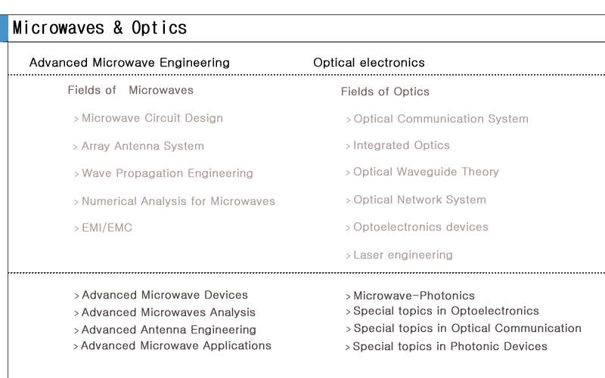
Menu Root
History Map 참조
Prepared By | Title (Frame bar)
고해진 | Younsei University School of Electrical & Electronic Engineering
Page Description
신규구성
Reference Link
Description
현재 분야와 상태 표시, 확인 클릭시 해당 페이지 이동 각 이미지 images/bunya-en-1.gif images/bunya-en-2.gif images/bunya-en-3.gif images/bunya-en-4.gif images/bunya-en-5.gif images/bunya-en-6.gif images/bunya-en-7.gif images/bunya-en-8.gif images/bunya-en-9.gif
Home | Korean | Sitemap | Contact Us |
| Introduction | Curriculum | Graduate Admission | Research |
| Undergraduate | Graduate |
Curriculum
Younsei University School of Electrical & Electronic Engineering
Curriculum
 | Undergraduate
 | Graduate
 | ▶Overview
 | ▶Areas of Study
Home> Curriculum>Graduate>Areas of Study >Major Group
■ Areas of Study
▣ Major Group
ABEEK
| Major Group | Individual research & common Groups |
Undergraduate
Study
1
Fields
Microwaves & Optics
Originality Study
2
Yonsei
Univ.
Link
1 | 교과안내>대학원>분야소개> 각 분야 페이지 링크
2
3
4
5
Home | Korean | Sitemap | Contact Us |
Quick Link
Copyright(c)2005 Yonsei University, School of Electrical and Electronic Engineering. All right Reserved
Yonsei University 134 Sinchon-dong, Seodaemun-gu, Seoul 120-749, Korea / 82-2-2123-2860

Slide 20
Menu Root
History Map 참조
Prepared By | Title (Frame bar)
고해진 | Younsei University School of Electrical & Electronic Engineering
Page Description
Reference Link
http://ee.yonsei.ac.kr/main.php?v_menu=000200030010&v_ck=new
Description
Log-In | English | Sitemap | Contact Us |
학부
대학원
| 소개 | 교과안내 | | 연구활동 | 커뮤니티 | 정보마당 |
입학안내 | 수강유의사항 | 학업지도 | 장학금안내 | 졸업요건 |
학사안내
Younsei University School of Electrical & Electronic Engineering
Curriculum
 | Undergraduate
 | Graduate
 | ▶Overview
 | ▶Areas of Study
Home> Curriculum>Graduate>Areas of Study >Individual research & common Groups
■ Areas of Study
▣ Individual research & common Groups
ABEEK
| Major Group | Individual research & common Groups |
Undergraduate
Study
① Individual Research
This is a 2 unit course evaluated with grades A,B and C(+,,0, -). The student should choose a topic after consultation with his/her advisor and conduct research for one semester. Taking "Individual Research" for three semesters is equivalent to taking two regular courses of 3 units. When this course is offered in the spring semester, the student must attend "Engineering Management Workshop". When this course is offered in the fall semester, the student must attend more than half of "Expert Seminars".
② Thesis Writing
This course is about thesis-writing . In other words, the student can apply for graduation only in the semester, where the student is taking this course. This course is 1 unit course and grade is given in Pass/Nonpass depending on the final evaluation on the thesis. From 2001, the student should take this course in order to graduate.
③ Technical Writing and Communication
This is a 3 unit major course with grades of A, B and C (+, 0, -). This course deals with technical writing in English and presentation skill.
④ Engineering Management Workshop
During the first semester of every school year, we invite instructors from leading companies for one-day workshop on project management. Students who are enrolled in "Personal Research Guidance" must attend this workshop.
⑤ Expert Seminar
During the second semester of every school year, we invite experts, who provide for the 6 to 10 seminars. Students who are enrolled in Personal Research Guidance must attend more than half of this seminars.
Originality Study
Yonsei
Univ.
Link
1 | http://www3.yonsei.ac.kr:8888/grad/v2/kr/
2
3
4
5
Home | Korean | Sitemap | Contact Us |
Quick Link
Copyright(c)2005 Yonsei University, School of Electrical and Electronic Engineering. All right Reserved
Yonsei University 134 Sinchon-dong, Seodaemun-gu, Seoul 120-749, Korea / 82-2-2123-2860

