Slide 1
CRM Sales Opportunities Analysis
Presented by: Tang Seong Fatt
Date: 27Jun2025
Course/Project: Capstone Project – CRM Sales Opportunities
Notes:
Good morning/afternoon. Today I'll be presenting my capstone project analyzing CRM sales opportunities data. This project demonstrates my understanding of the complete data analysis process, from data cleaning to advanced DAX calculations and interactive dashboard design. We'll explore B2B sales pipeline performance for a computer hardware company and uncover actionable business insights.

Slide 2
Content
Project Overview & Objectives
Understanding Our Data Sources
Data Architecture & Structure
Data Quality Assessment
Data Cleaning Strategy
DAX Calculations - Calculated Columns
DAX Measures - Core Metrics
Executive Dashboard Walkthrough
Sales Team Performance Analysis
Product & Market Analysis
Customer & Account Intelligence
Advanced Analytics Implementation
Business Insights & Recommendations
Technical Skills Demonstrated
Conclusion & Next Steps

Slide 3
Project Overview & Objectives
- Dataset:
B2B Sales Pipeline (Computer Hardware Company)
- Scope:
4 data tables, sales opportunities, accounts, products, teams
- Key Questions:
- How is each sales team performing?
- Are any sales agents lagging behind?
- Quarter-over-quarter trends identification
- Product win rate analysis
Notes:
This project focuses on a comprehensive analysis of sales pipeline data. The dataset contains four interconnected tables representing real-world CRM data structure. My analysis addresses four critical business questions that any sales organization would want answered. This demonstrates my ability to translate business requirements into analytical solutions.

Slide 4
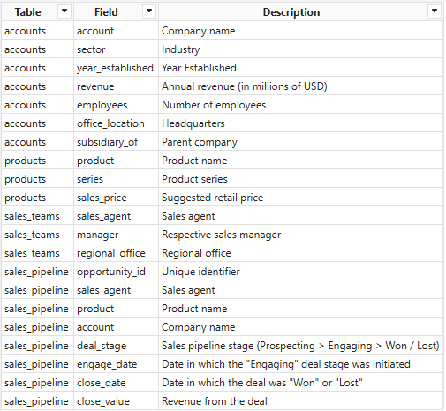
Understanding Our Data Sources
Notes:
Our analysis began by thoroughly understanding the available data. We were provided with four distinct but related datasets: the sales_pipeline, which details every sales opportunity; accounts, giving us context about our customers; products, outlining what we sell; and sales_teams, defining our sales organizational structure. This comprehensive set of tables allowed us to link various aspects of the sales process, from the initial lead to the final deal outcome. Examining the CRM Data Dictionary was crucial in clarifying the meaning and purpose of each field.

Slide 5
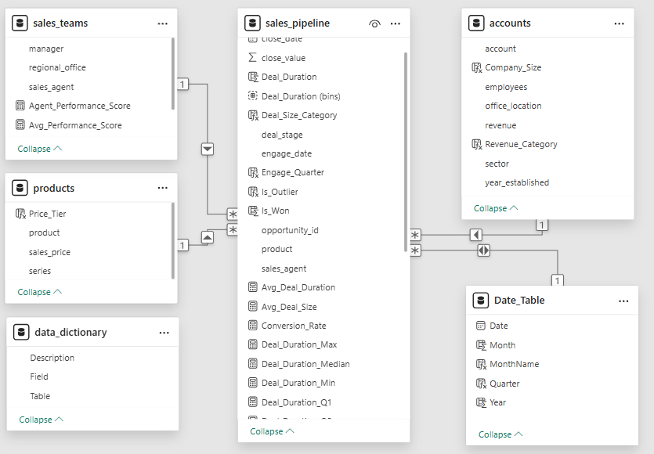
Data Architecture & Structure
Notes:
Understanding data structure is crucial for effective analysis. I've identified the relationships between tables and how they connect through foreign keys. This foundational work enables proper data modeling in Power BI and ensures accurate calculations across related tables. With our data clean, we moved to building the data model. This involved establishing clear relationships between our tables, forming what's often referred to as a star schema, with our sales_pipeline as the central fact table. We linked sales_pipeline to our dimension tables: sales_teams, products, and accounts, always ensuring a One-to-Many relationship. A crucial addition was the creation of a dedicated Date Dimension table. This is vital for enabling advanced time intelligence calculations, like Quarter-over-Quarter growth. Through this process, we solidified our understanding of how proper data modeling impacts the accuracy and performance of our DAX measures.

Slide 6
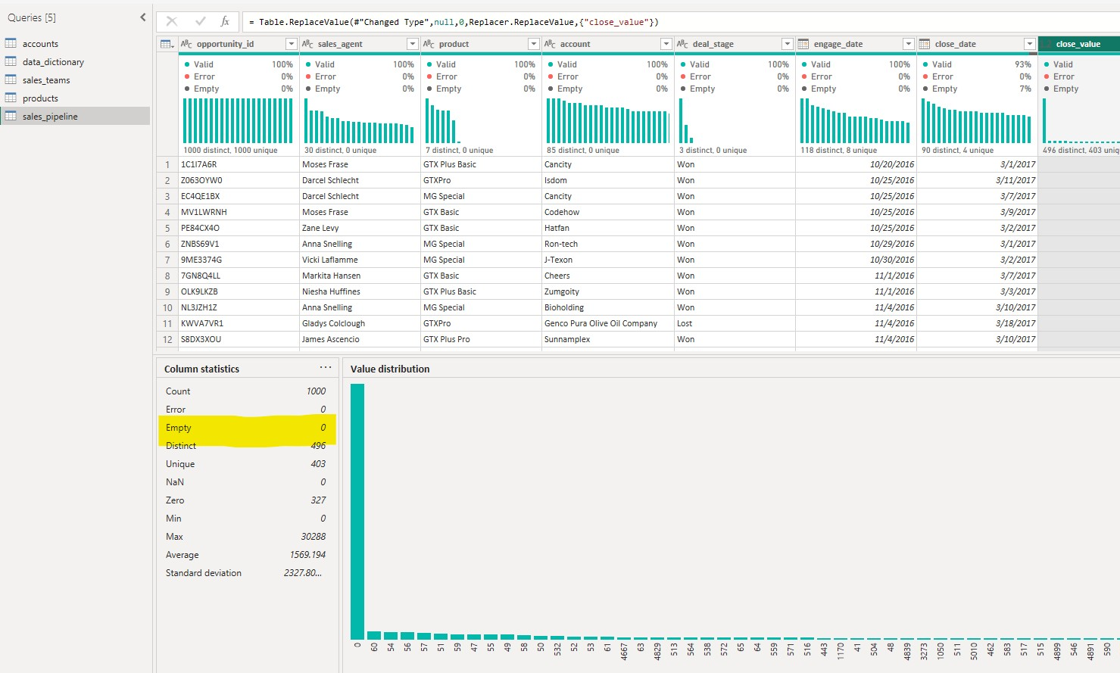
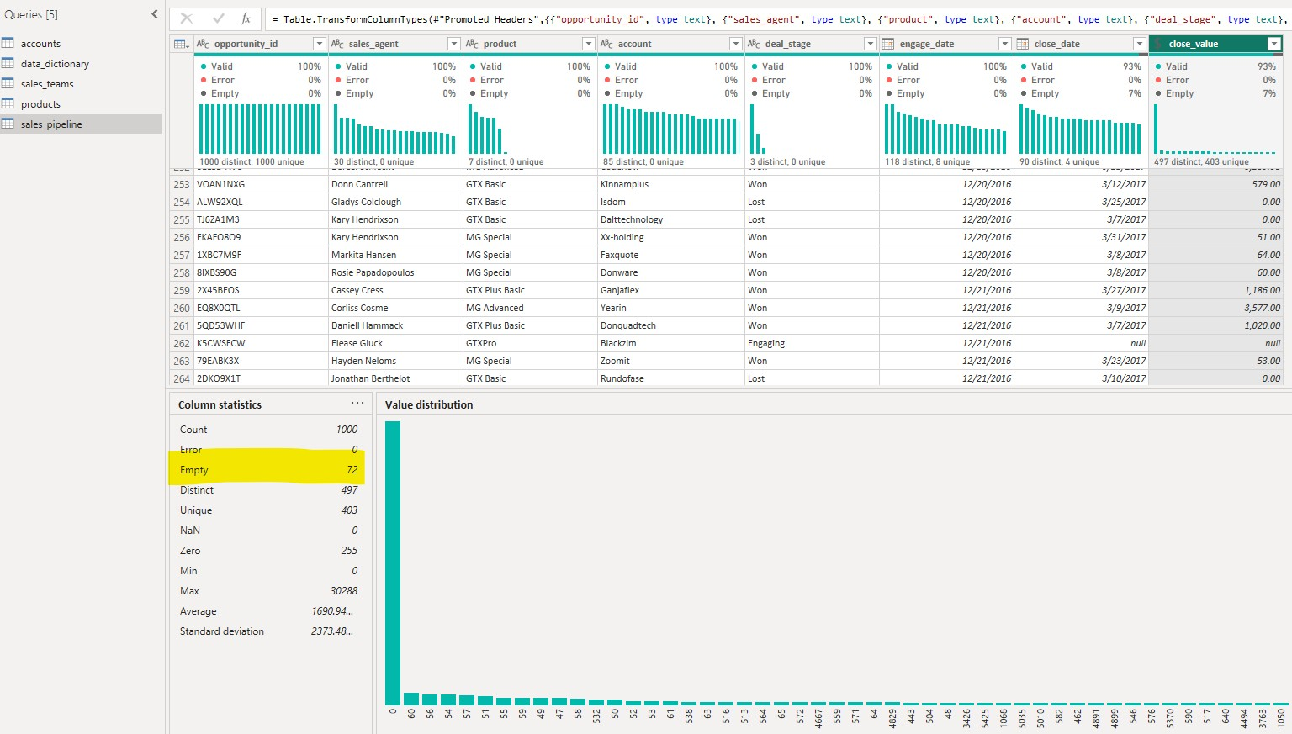
Data Quality Assessment
Notes:
Data quality assessment is my first priority in any analytics project. I've identified several issues that could impact analysis accuracy. Missing values, outliers, and data consistency issues must be addressed before building dashboards. This demonstrates my understanding that good analysis starts with clean data.

Slide 7
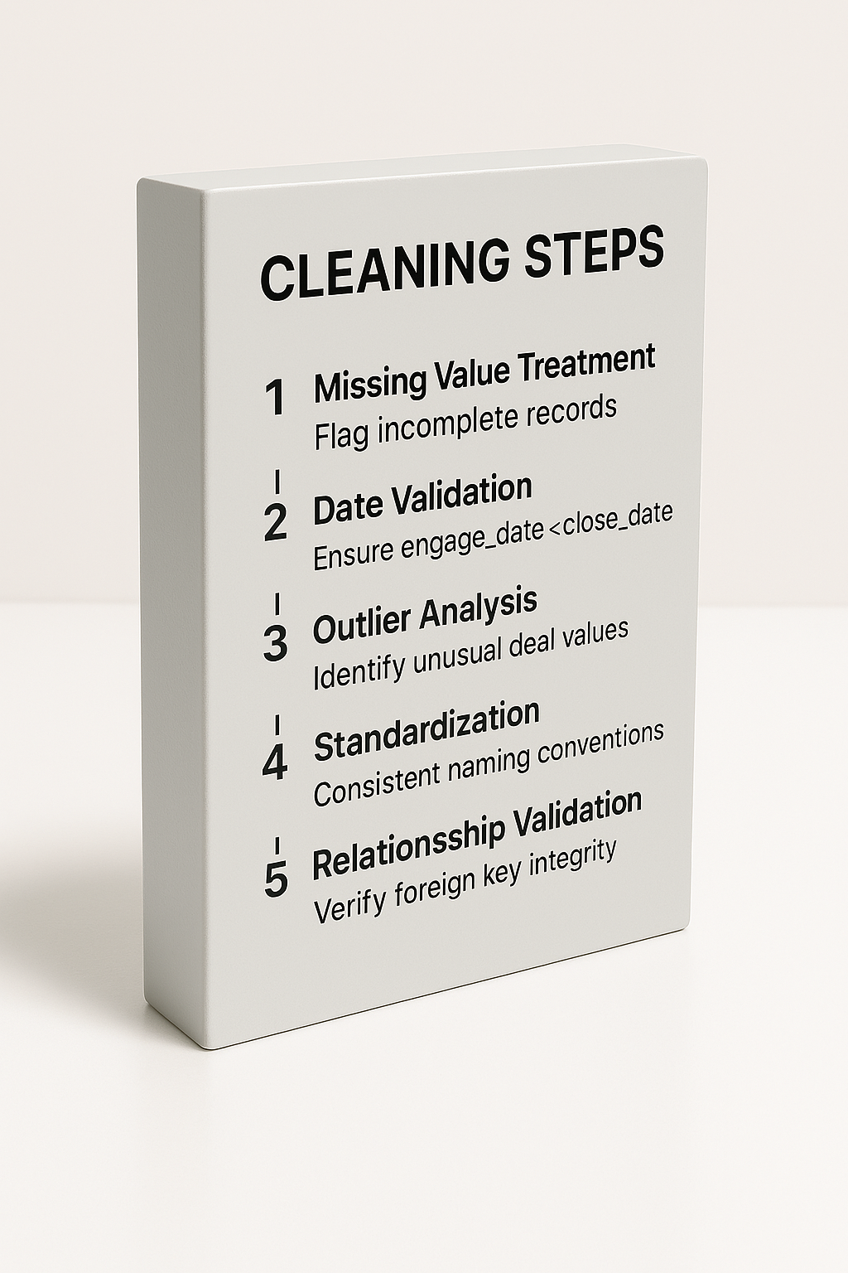
Data Cleaning Strategy
Cleaning Steps:
1. Missing Value Treatment:
Flag incomplete records
2. Date Validation:
Ensure engage_date < close_date
3. Outlier Analysis:
Identify unusual deal values
4. Standardization:
Consistent naming conventions
5. Relationship Validation:
Verify foreign key integrity
Notes:
My data cleaning approach is systematic and thorough. Each step addresses specific quality issues while preserving data integrity. I use both automated validation rules and manual inspection to ensure comprehensive cleaning. This methodical approach reflects industry best practices I've learned.

Slide 8
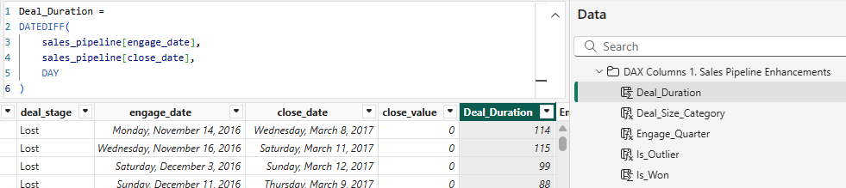
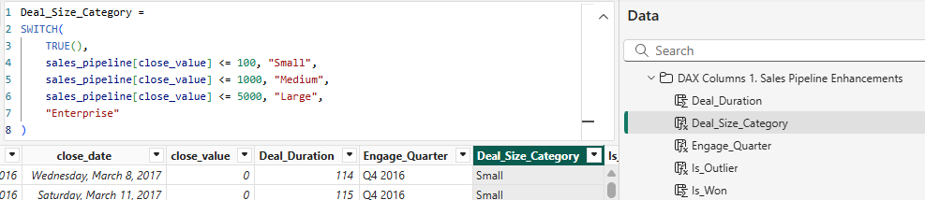
DAX Calculations - Calculated Columns
Notes:
Calculated columns enhance our data model with business-relevant categorizations and time intelligence. These columns enable sophisticated analysis and filtering capabilities. I've chosen calculations that align with typical sales analysis requirements, demonstrating my understanding of business context in technical implementation.

Slide 9
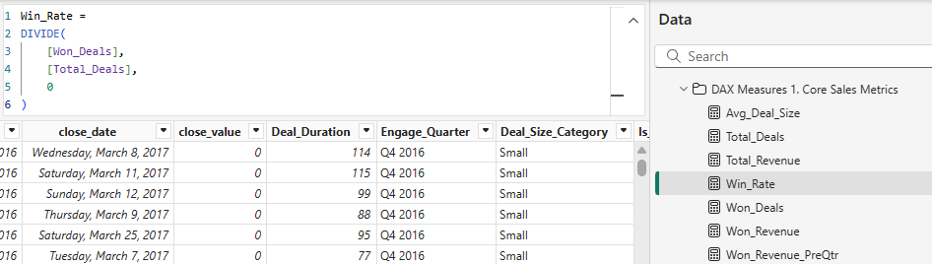
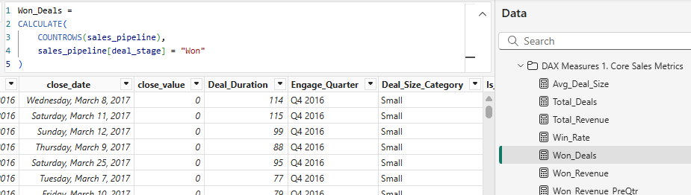
DAX Measures - Core Metrics
Notes:
DAX measures provide dynamic calculations that respond to user interactions and filters. These core metrics form the foundation of our analytics. I've implemented error handling with DIVIDE functions and created measures that work across different visualization contexts, showing my understanding of DAX evaluation context.

Slide 10
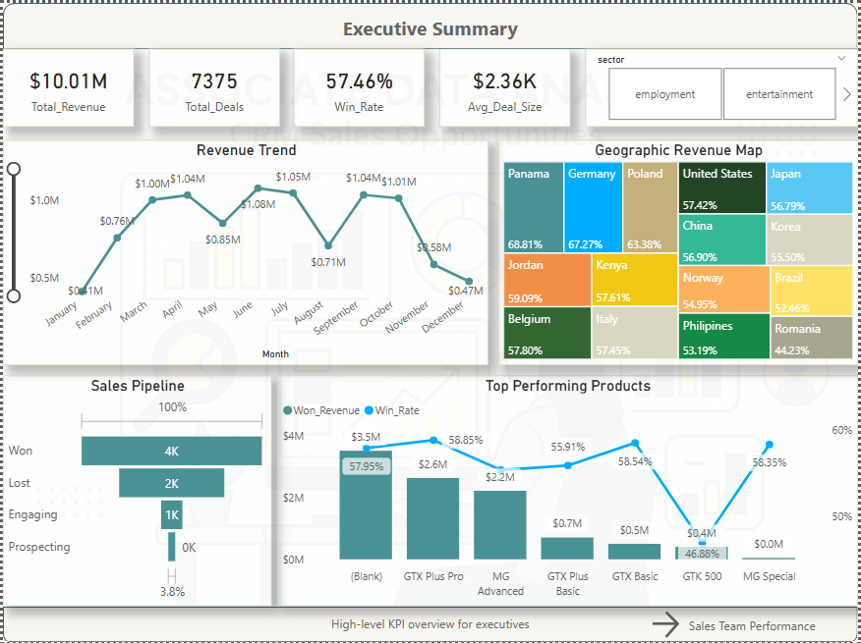
Executive Dashboard Walkthrough
Dashboard 1 Features:
- KPI cards for immediate impact
- Revenue trend analysis
- Sales pipeline funnel
- Top performing products
- Geographic distribution
[Dashboard Screenshot]
Notes:
The executive dashboard provides immediate answers to senior management's key questions. High-level KPIs are prominently displayed, with supporting visualizations providing context. The layout follows the 'inverted pyramid' journalism principle—most important information first. This demonstrates my ability to communicate with C-level stakeholders.

Slide 11
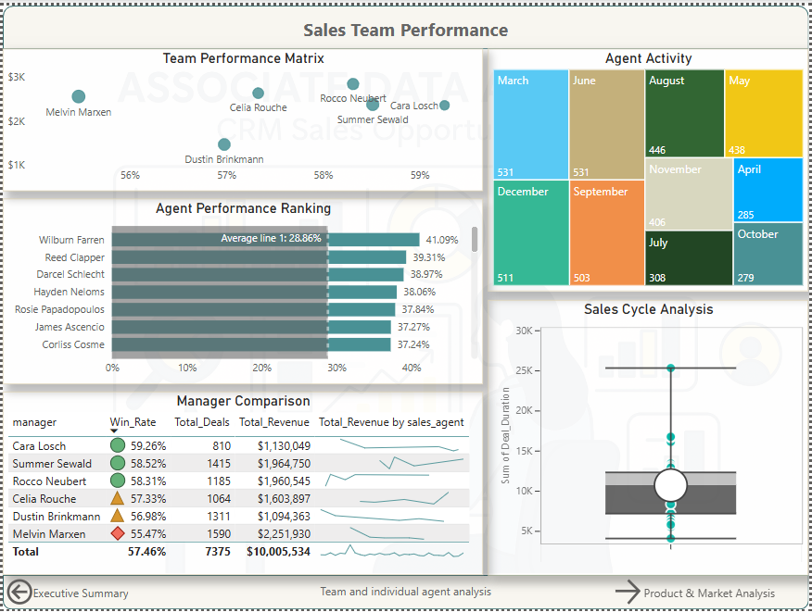
Sales Team Performance Analysis
Key Insights Discovered:
- Performance variation between agents
- Team vs individual contributions
- Sales cycle efficiency differences
- Manager effectiveness comparison
[Performance Matrix Chart]
Notes:
Sales team analysis reveals both individual and systemic performance patterns. I've created visualizations that identify top performers while also highlighting development opportunities. This balanced approach shows how analytics can support both recognition and improvement initiatives. The insights here could drive coaching and training decisions.

Slide 12
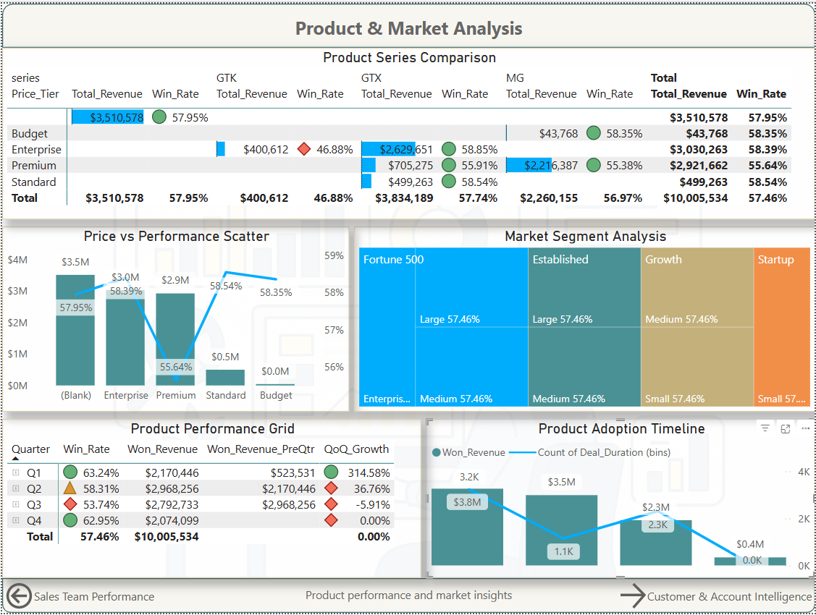
Product & Market Analysis
Product Analysis Results:
- GTX series dominates revenue
- Significant price-performance variations
- Market segment preferences
- Product adoption trends
[Product Performance Matrix]
Notes:
Product analysis reveals important strategic insights about market positioning and portfolio performance. The data shows clear patterns in customer preferences and price sensitivity. These insights could inform product development, pricing strategies, and sales focus areas. This demonstrates how data analysis directly supports strategic business decisions.

Slide 13
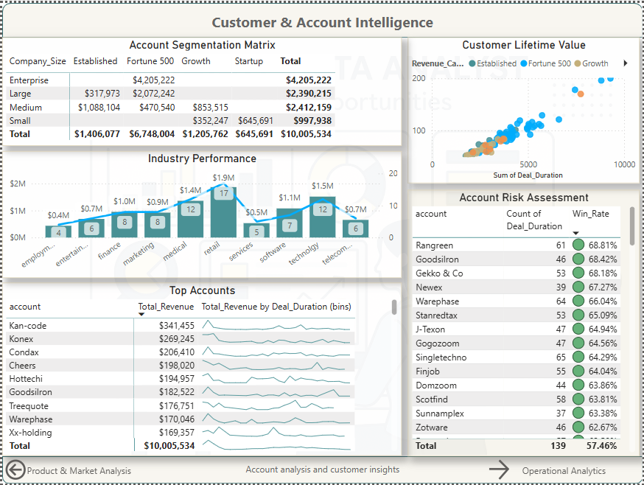
Customer & Account Intelligence
Notes:
We found that Fortune 500 and medium-sized companies bring in the most revenue—over $10 million total. This tells us where to focus.
Retail and technology industries are the strongest, while telecom and services show room to grow.
Longer deal durations, especially with established clients, lead to higher revenue—so we should build long-term relationships.
The overall win rate is 57%, with some accounts performing much better than others. We should improve our targeting strategy.
Top clients like Kan-code and Konex are high earners and should be prioritized.
Overall, this dashboard helps us target the right customers and industries to grow our business."

Slide 14
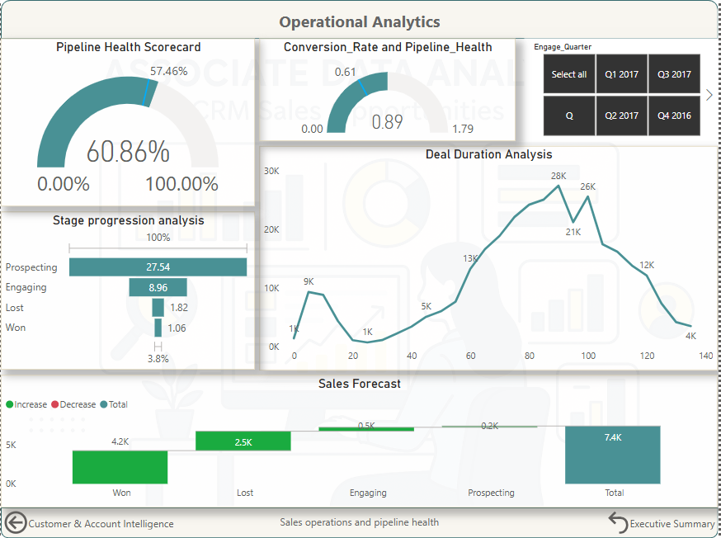
Advanced Analytics Implementation
Sophisticated Calculations:
- Agent Performance Score: Weighted performance metrics
- Pipeline Health Score: Multi-factor assessment
- Conversion Funnel: Stage progression analysis
- Time Intelligence: Period comparisons and trends
Notes:
Advanced analytics separate basic reporting from true business intelligence. These calculations combine multiple factors to provide (nuanced insights = detail understanding). The performance scoring methodology I've developed could be implemented in real sales organizations to objectively evaluate team members.

Slide 15
Business Insights & Recommendations
Key Findings:
1. Team Performance:
Variation suggests training opportunities
2. Product Focus:
GTX series drives majority of revenue
3. Sales Cycle:
Efficiency improvements possible
4. Market Segments:
Technology sector shows highest potential
Actionable Recommendations:
- Implement performance coaching for underperforming agents
- Focus sales efforts on high-value product lines
- Streamline sales process to reduce cycle time
Notes:
Analytics value is realized through actionable insights, not just pretty charts. Each recommendation is data-driven and addresses specific business challenges identified in my analysis. These suggestions demonstrate my ability to translate technical analysis into business strategy. This business acumen combined with technical skills makes me valuable as a data professional.

Slide 16
Technical Skills Demonstrated
Competencies Showcased:
- Data Modeling:
Proper table relationships and star schema
- DAX Mastery:
Complex calculations and time intelligence
- Visualization Design:
User-focused dashboard creation
- Business Analysis:
Requirements translation to technical solutions
- Project Management:
Systematic approach to complex analysis
Notes:
This project demonstrates the full spectrum of skills required for modern data analysis roles. From technical DAX programming to business strategy, I've shown competency across the entire analytics value chain. My systematic approach and attention to both technical accuracy and business relevance reflect the professional standards expected in data roles.

Slide 17
Conclusion & Next Steps
Project Achievements:
- Comprehensive data analysis pipeline
- Production-ready dashboard suite
- Actionable business recommendations
- Scalable analytical framework
Learning Outcomes:
- Enhanced DAX proficiency
- Dashboard design best practices
- Business intelligence methodology
- Stakeholder communication skills
Future Applications:
Ready to apply these skills in professional data analyst role
Notes:
This capstone project represents the culmination of my data analytics learning journey. I've demonstrated not just technical proficiency, but also the business thinking and communication skills essential for success as a data professional. The comprehensive approach I've taken—from data quality assessment through strategic recommendations—mirrors real-world project requirements. I'm confident in my ability to bring immediate value to a data analyst role, combining technical expertise with business acumen to drive organizational success through data-driven insights.

Slide 18
Executive Summary Dashboard
Purpose: This is the "big picture" dashboard, giving a quick overview of the overall sales performance. It's like the cover page of a report, highlighting key results.
Why these charts?
Top Metric Cards (Total Revenue, Total Deals, Win Rate, Avg. Deal Size): These are like key performance indicators (KPIs). They instantly show the most important numbers at a glance. We use them for immediate understanding of the current state.
Revenue Trend (Line/Bar Chart): This chart shows how revenue has changed over time (month by month). A line helps visualize the trend easily, and bars can show the exact amount for each period.
Geographic Revenue Map (Heatmap/Table): This visualizes where revenue is coming from geographically. The colors or varying shades quickly show which regions are performing better or worse, helping to identify strong markets or areas needing attention.
Sales Pipeline (Bar Chart): This shows where deals are in the sales process (e.g., Prospecting, Engaging, Won). It helps understand the health of the pipeline and how many deals are in each stage.
Top Performing Products (Bar/Line Chart): This identifies which products are generating the most revenue and their associated win rates. It helps in understanding product effectiveness.
How to Interpret:
Overall: Look at the top metric cards first to get a general idea of performance (e.g., "Are we hitting our revenue targets?").
Trends: Check the "Revenue Trend" to see if revenue is growing, declining, or stable. A dip might indicate an issue, while a steady upward trend is positive.
Where to focus: The "Geographic Revenue Map" and "Top Performing Products" tell you where sales are happening and what is selling well, guiding strategic decisions on market focus or product promotion.
Pipeline Health: The "Sales Pipeline" shows if there are enough deals in the early stages to sustain future sales. A thin pipeline in "Prospecting" could be a future problem.
Notes:
The executive dashboard provides immediate answers to senior management's key questions. High-level KPIs are prominently displayed, with supporting visualizations providing context. The layout follows the 'inverted pyramid' journalism principle—most important information first. This demonstrates my ability to communicate with C-level stakeholders.

Slide 19
Sales Team Performance Dashboard
Purpose: This dashboard zooms in on the sales team's performance, allowing managers to understand individual and team effectiveness.
Why these charts?
Team Performance Matrix (Scatter Plot/Bubble Chart): This helps to compare sales agents based on their performance (e.g., win rate vs. deals won). It allows quick identification of high performers and those who might need coaching.
Agent Performance Ranking (Bar Chart): This ranks individual sales agents based on a specific metric (e.g., win rate or total revenue). It provides a clear leaderboard.
Agent Activity (Stacked Bar/Tree Map): This shows how active agents are across different months or stages. It helps to understand workload distribution and identify busy periods for agents.
Manager Comparison (Table): This table directly compares the performance of different sales managers on key metrics like win rate, total deals, and revenue. It's excellent for peer comparison and identifying best practices.
Sales Cycle Analysis (Box Plot/Whisker Plot): This chart shows the distribution of time it takes to close deals. It helps identify if deals are taking too long or if there's a wide variance, which can indicate inefficiencies.
How to Interpret:
Identify Stars and Strugglers: The "Team Performance Matrix" and "Agent Performance Ranking" immediately highlight who is performing well and who might need support or training.
Manager Effectiveness: The "Manager Comparison" table shows which managers are leading their teams to better results.
Process Efficiency: The "Sales Cycle Analysis" helps understand how long it takes to close deals. A very wide box plot or long whiskers might suggest inconsistent sales processes or bottlenecks.
Notes:
Sales team analysis reveals both individual and systemic performance patterns. I've created visualizations that identify top performers while also highlighting development opportunities. This balanced approach shows how analytics can support both recognition and improvement initiatives. The insights here could drive coaching and training decisions.

Slide 20
Product & Market Analysis Dashboard
Purpose: This dashboard focuses on product performance within different market segments, helping to optimize product strategies and market targeting.
Why these charts?
Product Series Comparison (Table/Bar Chart): This compares different product series (e.g., GTX vs. MG) across various metrics like total revenue and win rate. It allows for direct comparison of product line success.
Price vs. Performance Scatter (Scatter Plot with Bar Charts): This can show how different price tiers or product configurations perform in terms of win rate and revenue. It helps determine optimal pricing and product offerings.
Market Segment Analysis (Tree Map/Stacked Bar): This breaks down performance by market segments (e.g., Fortune 500, Established, Growth, Startup) and company sizes. It reveals which segments are most profitable or have the highest win rates.
Product Performance Grid (Table): This provides a detailed breakdown of product performance by quarter, including win rates, won revenue, and quarter-over-quarter growth. It's useful for tracking short-term trends.
Product Adoption Timeline (Bar Chart): This shows the adoption or sales of products over time. It helps to understand product lifecycle and market acceptance.
How to Interpret:
Product Strengths: The "Product Series Comparison" and "Product Performance Grid" show which products are driving revenue and have high win rates, indicating success.
Market Opportunities: The "Market Segment Analysis" helps identify the most lucrative market segments to target, or segments where more effort is needed.
Pricing Strategy: The "Price vs. Performance Scatter" can inform pricing adjustments by showing if higher-priced items have acceptable win rates.
Growth Potential: "Product Adoption Timeline" can indicate how quickly new products are gaining traction or if older products are declining.
Notes:
Product analysis reveals important strategic insights about market positioning and portfolio performance. The data shows clear patterns in customer preferences and price sensitivity. These insights could inform product development, pricing strategies, and sales focus areas. This demonstrates how data analysis directly supports strategic business decisions.

Slide 21
Customer & Account Intelligence Dashboard
Purpose: This dashboard provides insights into customer and account performance, helping to identify valuable customers and assess account risk.
Why these charts?
Account Segmentation Matrix (Table): This segments accounts based on criteria like company size, established vs. new, or growth potential. It shows the total revenue generated from each segment.
Customer Lifetime Value (Scatter Plot/Bubble Chart): This visualizes the value of customers over time. It helps identify high-value customers who should be prioritized for retention or upsell.
Industry Performance (Bar Chart): This breaks down revenue or deals by industry. It helps understand which industries are most receptive to the company's offerings.
Account Risk Assessment (Table): This lists accounts and their associated risk factors (e.g., low win rate, long deal duration). It helps identify accounts that might be at risk of churn or require intervention.
Top Accounts (Table/Bar Chart): This simply lists the accounts generating the most revenue or deals, highlighting key clients.
How to Interpret:
Who are our best customers? The "Customer Lifetime Value" and "Top Accounts" clearly show which customers are most valuable.
Where should we focus sales efforts? "Industry Performance" can guide sales teams to focus on industries where they have a strong track record.
Identify potential problems: "Account Risk Assessment" quickly points to accounts that might need attention to prevent loss of business.
Tailor strategies: "Account Segmentation Matrix" helps understand the characteristics of different customer groups, allowing for tailored sales and marketing strategies.
Notes:
We found that Fortune 500 and medium-sized companies bring in the most revenue—over $10 million total. This tells us where to focus.
Retail and technology industries are the strongest, while telecom and services show room to grow.
Longer deal durations, especially with established clients, lead to higher revenue—so we should build long-term relationships.
The overall win rate is 57%, with some accounts performing much better than others. We should improve our targeting strategy.
Top clients like Kan-code and Konex are high earners and should be prioritized.
Overall, this dashboard helps us target the right customers and industries to grow our business."

Slide 22
Operational Analytics Dashboard
Purpose: This dashboard focuses on the health and efficiency of the sales pipeline and operations, helping to identify bottlenecks and forecast future sales.
Why these charts?
Pipeline Health Scorecard (Gauge/Donut Chart): This provides an overall health score for the sales pipeline, often based on a combination of metrics like conversion rates and stage progression. It gives a quick visual indicator of the pipeline's overall strength.
Conversion Rate and Pipeline Health (Gauge/Donut Chart): Similar to the scorecard, this shows specific metrics related to how well leads are converting through the pipeline.
Deal Duration Analysis (Line Chart/Area Chart): This tracks the average time deals spend in each stage or the overall deal duration. It helps identify stages where deals might be getting stuck.
Stage Progression Analysis (Bar Chart): This shows the percentage of deals moving from one stage to the next. It highlights potential bottlenecks where deals are dropping off.
Sales Forecast (Bar Chart with Indicators): This is a critical chart that projects future sales based on current pipeline data. It often includes targets and actuals, showing potential gaps or surpluses.
How to Interpret:
Is our pipeline healthy? The "Pipeline Health Scorecard" provides an immediate answer. A low score indicates issues that need addressing.
Where are the bottlenecks? "Deal Duration Analysis" and "Stage Progression Analysis" pinpoint the specific stages where deals are taking too long or failing to progress, allowing for targeted process improvements.
What can we expect in the future? The "Sales Forecast" is crucial for planning resources, setting expectations, and identifying potential revenue shortfalls or surpluses.
Improve efficiency: If conversion rates are low in a particular stage, it suggests a need for training or process refinement in that area.
Notes:
Advanced analytics separate basic reporting from true business intelligence. These calculations combine multiple factors to provide (nuanced insights = detail understanding). The performance scoring methodology I've developed could be implemented in real sales organizations to objectively evaluate team members.

