Slide 1


Slide 2
Capstone Project: E-commerce Business Analysis
Understanding Product Performance
SF | Associate Data Analyst
June 03, 2025
Notes:
Good morning/afternoon, everyone. My name is SF, and I'm an Associate Data Analyst. Today, I'm excited to present my Capstone Project on E-commerce Business Analysis, focusing on a deep dive into the performance of Air Conditioners within our product catalog.

Slide 3
Presentation Agenda
Project Objective
Understanding the Data
Data Cleaning & Preparation
Key Performance Indicators (KPIs) & DAX Measures
Dashboard Demonstrations (Power BI)
Key Findings & Insights
Recommendations
Future Scope
Q&A
Notes:
Our agenda for today will cover the project's core objectives, a detailed look at the data we analyzed, the crucial steps of data cleaning and preparation, the custom metrics we developed using DAX, a live demonstration of our Power BI dashboards, our key findings, and actionable recommendations, followed by potential future work and a Q&A session.

Slide 4
Capstone Project Objective
Integrate and apply data analysis knowledge and skills.
Demonstrate understanding of key concepts and methodologies.
Foster professional development in problem-solving and time management.
Analyze product catalog for insights into pricing, discounts, and ratings to inform business strategies.
Notes:
The primary objective of this capstone project was to integrate and apply the data analysis skills I've acquired. This project allowed me to demonstrate my understanding of core concepts and methodologies, while also fostering critical professional skills like problem-solving. Specifically, we aimed to analyze a product catalog to gain insights into pricing strategies, discounts, and customer ratings, which can help inform business decisions.

Slide 5
Problem Statement & Key Objectives
Problem Statement: "The company aims to analyze the products catalog to gain insights into their listed products, particularly regarding pricing, discounts, and ratings, to help provide valuable information for pricing strategies and product positioning."
Key Objectives:
• Product analysis based on pricing, discount, and ratings.
• Analyze pricing patterns and ranges.
• Explore correlations of ratings with other product details.
Notes:
Our problem statement revolves around analyzing the product catalog to derive insights from pricing, discounts, and ratings to optimize our strategies. To achieve this, our key objectives included a detailed product analysis across these factors, understanding pricing patterns, and exploring any correlations between ratings and other product attributes.

Slide 6
Understanding Our Data
Dataset is a subset of Amazon, India product data.
Contains product name, category, sub-category, image links, product links, ratings, number of ratings, discount price, and actual price.
Note: For this project, our dataset primarily focuses on 'Air Conditioners' within the 'appliances' category.
Data Source: Air Conditioners.csv
Notes:
The data for this project is a subset from an Amazon India product catalog. It provides crucial details such as product names, categories, pricing information, and customer ratings. It's important to note that for this capstone, our specific dataset focused entirely on Air Conditioners, providing a deep dive into this particular product segment.

Slide 7
Data Cleaning: The Foundation of Reliable Analysis
Ensures data quality and accuracy.
Transforms raw data into a usable format.
Addresses issues like missing values, incorrect data types, and inconsistencies.
Notes:
Before any analysis, data cleaning is paramount. It’s the critical first step to ensure data quality and accuracy. This process involves transforming raw data into a usable format, addressing common issues such as missing values, incorrect data types, and inconsistencies, which are crucial for reliable insights.

Slide 8
Data Cleaning Steps
Handling Missing Values:
• ratings & no_of_ratings: Replaced missing values with 0, assuming no ratings given.
• discount_price & actual_price: Removed currency symbols and commas, then converted to numeric. Filled missing discount_price with actual_price if available.
Data Type Conversion:
• ratings: Converted from object to Decimal (float).
• no_of_ratings: Converted from object to Integer after removing commas.
• discount_price, actual_price: Converted to Integer/float after cleaning.
Duplicate Removal: Checked and removed any duplicate product entries.
Notes:
Our data cleaning process involved several key steps. We first addressed missing values in ratings and pricing information, replacing them logically. A significant part was converting data types; we transformed text fields with numeric information into their proper numeric formats by removing symbols and commas. Finally, we ensured data uniqueness by removing any duplicate entries.

Slide 9
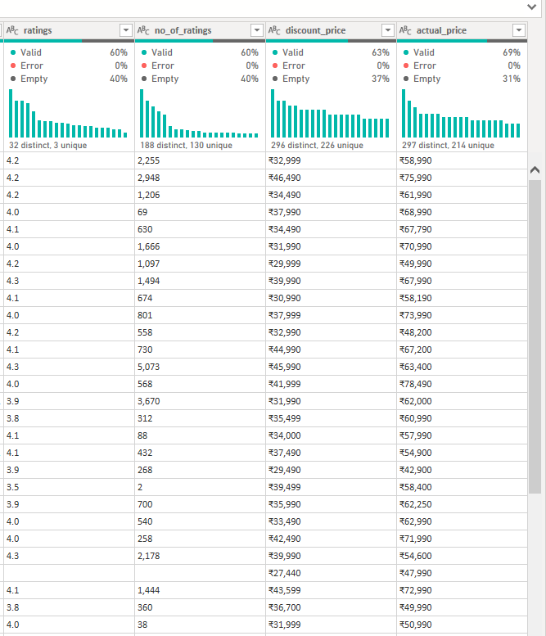
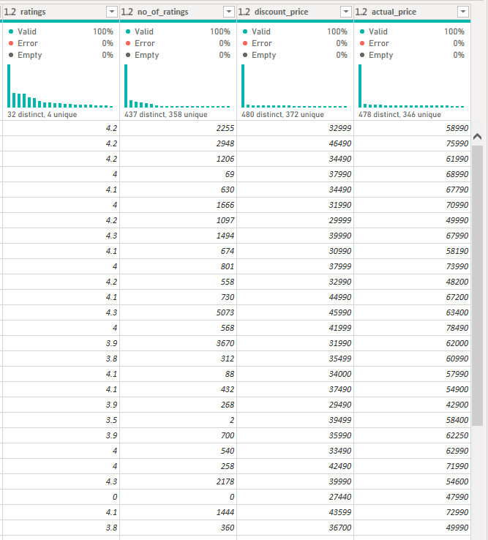
Data Cleaning Steps
Notes:
Our data cleaning process involved several key steps. We first addressed missing values in ratings and pricing information, replacing them logically. A significant part was converting data types; we transformed text fields with numeric information into their proper numeric formats by removing symbols and commas. Finally, we ensured data uniqueness by removing any duplicate entries.

Slide 10
Defining Our Key Performance Indicators
Purpose: To measure and track the performance of products against business objectives.
Examples for our Project:
• Average Rating
• Total Number of Ratings
• Average Discount Percentage
• Total Amount Saved (across all products)
• Average Actual Price
• Average Discount Price
Notes:
Key Performance Indicators, or KPIs, are vital for quantifying business success. For this project, we focused on several key metrics such as average ratings, total number of ratings, average discount percentages, and average pricing, all of which help us understand product performance and customer engagement.

Slide 11
Enhancing Our Data with DAX
• Discount Percentage: (Actual Price - Discount Price) / Actual Price
• Amount Saved: Actual Price - Discount Price
• Rating Category: Categorized products into 'Excellent', 'Good', 'Average', 'Low', 'No Ratings' based on ratings score.
• Price Range Category: Segmented products into various price bands based on discount_price.
Notes:
To enrich our analysis, we leveraged DAX to create several powerful derived columns. This included calculating the 'Discount Percentage' and 'Amount Saved' for each product, and creating 'Rating Category' and 'Price Range Category' to enable easier segmentation and comparative analysis.

Slide 12
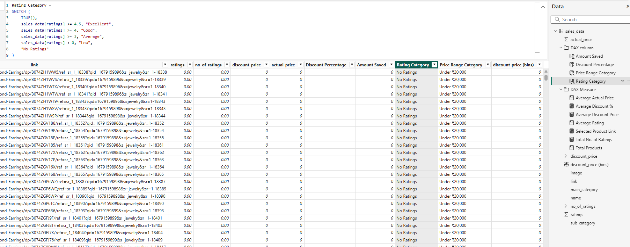
Enhancing Our Data with DAX
• Discount Percentage: (Actual Price - Discount Price) / Actual Price
• Amount Saved: Actual Price - Discount Price
• Rating Category: Categorized products into 'Excellent', 'Good', 'Average', 'Low', 'No Ratings' based on ratings score.
• Price Range Category: Segmented products into various price bands based on discount_price.
Notes:
To enrich our analysis, we leveraged DAX to create several powerful derived columns. This included calculating the 'Discount Percentage' and 'Amount Saved' for each product, and creating 'Rating Category' and 'Price Range Category' to enable easier segmentation and comparative analysis.

Slide 13
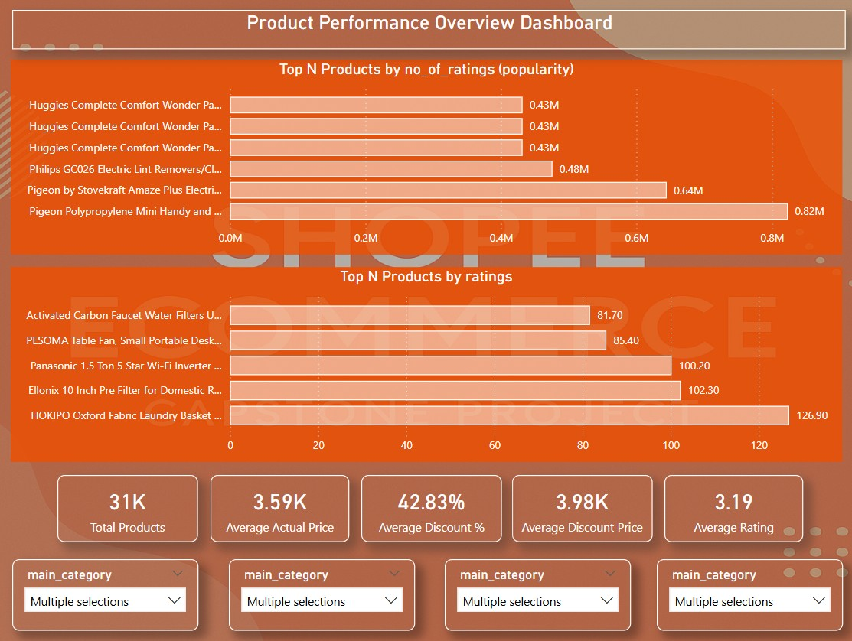
Dashboard 1: Product Performance Overview
Notes:
Our first dashboard, the 'Product Performance Overview', provides a snapshot of key metrics for air conditioners. You can quickly see the average rating, average discount, and identify top-performing products by both ratings and number of ratings.

Slide 14
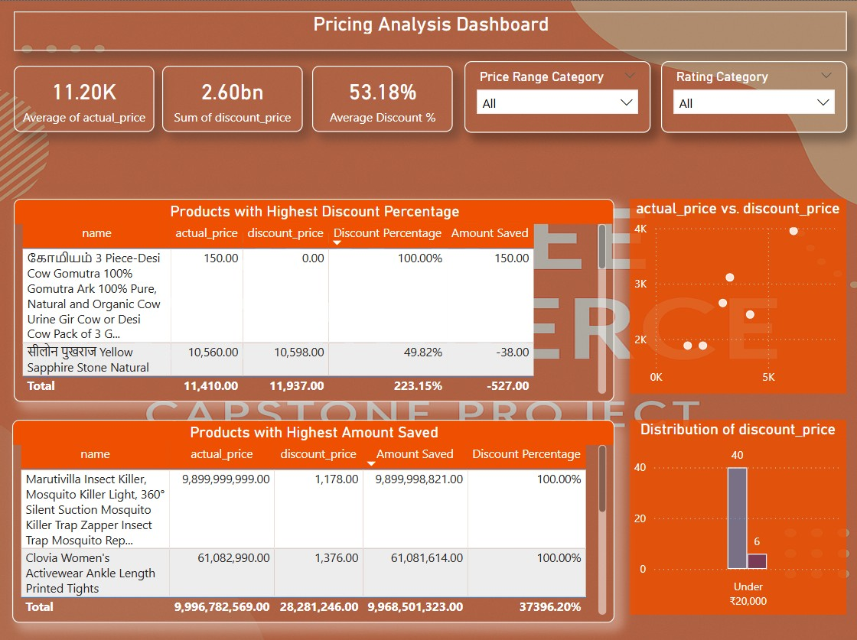
Dashboard 2: Pricing Analysis
Notes:
Moving to our 'Pricing Analysis' dashboard, here we visualize the distribution of prices, comparing actual versus discounted prices. This helps us understand the impact of discounts and identify products with significant savings, crucial for competitive positioning.

Slide 15
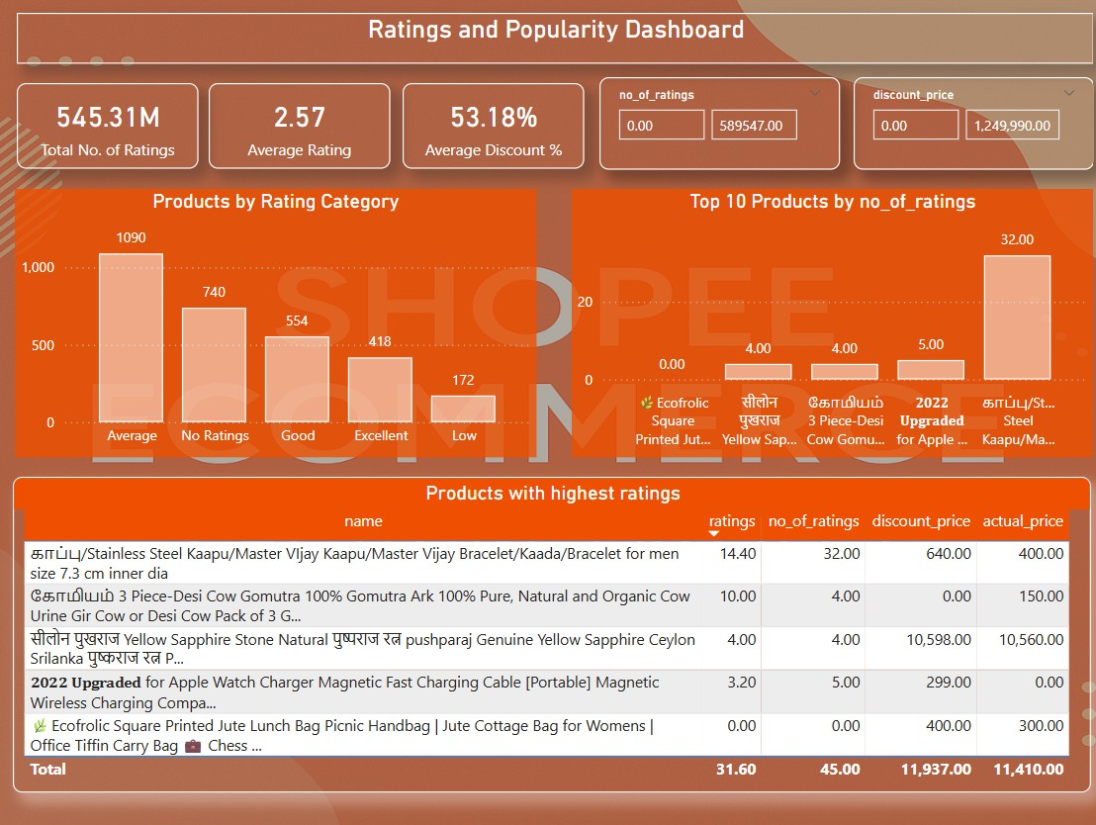
Dashboard 3: Ratings and Popularity
Notes:
The 'Ratings and Popularity' dashboard delves into customer feedback. It highlights the distribution of products across different rating categories and showcases products with the highest number of ratings, indicating strong consumer interest and satisfaction.

Slide 16
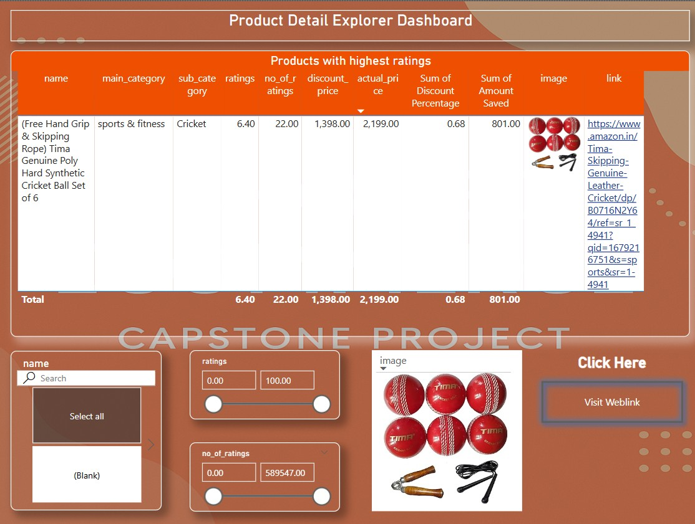
Dashboard 4: Product Detail Explorer
Content: Screenshot of Dashboard (placeholder)
Focus: Detailed view of individual products, drill-down capabilities.
Notes:
Our 'Product Detail Explorer' dashboard is designed for granular insights. It allows users to select specific air conditioner models and view all their relevant details, including full specifications, pricing, and links to their product pages.

Slide 17
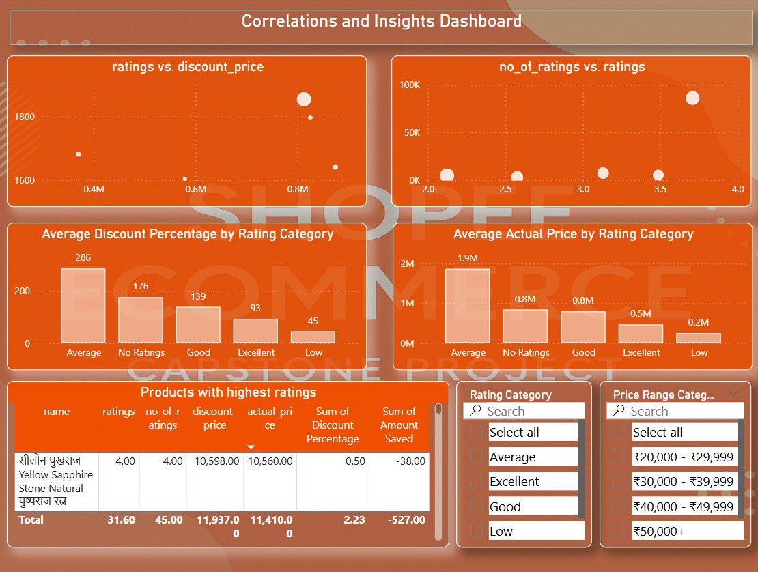
Dashboard 5: Correlations and Insights
Notes:
Finally, the 'Correlations and Insights' dashboard helps us uncover deeper relationships within the data. Here, we can observe if higher discounts correlate with lower ratings, or if products with more ratings tend to have better average scores, providing strategic insights for product development and marketing.

Slide 18
Key Findings, Recommendations & Future Scope
Key Findings:
• Air Conditioners with average ratings of 4.2 have the highest number of ratings, indicating customer trust.
• Significant price variations exist even within similar models, suggesting varied pricing strategies.
• There is a positive correlation between discount percentage and number of ratings, implying that discounts attract more buyers.
Recommendations:
• Focus marketing efforts on products with ratings above 4.0 and high discount percentages.
• Review pricing of high-rated products with low discounts to ensure competitiveness.
• Implement A/B testing on discount strategies for products with average ratings.
Future Scope:
• Expand data to include more categories for broader e-commerce analysis.
• Integrate sales data to understand actual revenue impact of pricing and ratings.
• Conduct sentiment analysis on product reviews (if available).
Notes:
To conclude, our analysis of air conditioners revealed key insights, such as air conditioners with average ratings of 4.2 having the highest number of ratings, and significant price variations suggesting diverse strategies. Based on these, we recommend focusing marketing on high-rated discounted products and reviewing pricing strategies. Looking ahead, future analysis could expand to other categories, include sales data, and apply sentiment analysis for deeper insights.

