Slide 1
❤️⚗️
Predicting Heart Disease
Using Machine Learning
Tang Seong Fatt
Associate Data Analyst | 26May2025
25 May 2023
Notes:
"Good [morning/afternoon], [Trainer’s Name]. Today, I’m excited to present our capstone project titled ‘Predicting Heart Disease Using Machine Learning’. My name is [Your Name], and I’ve been working on this project as part of the Associate DA Program. Let’s dive into how we can leverage data to tackle one of the world’s leading causes of mortality."
Notes:
Smile, make eye contact, and pause after the title.
Use hand gestures to emphasize key phrases like “leveraging data.”

Slide 2
Content
Problem Statement
Project Objective
Dataset Description
Data Preprocessing
Exploratory Data Analysis
Model Selection
Model Evaluation
Insights & Interpretation
Conclusion
Notes:
"Good [morning/afternoon], [Trainer’s Name]. Today, I’m excited to present our capstone project titled ‘Predicting Heart Disease Using Machine Learning’. My name is [Your Name], and I’ve been working on this project as part of the Associate DA Program. Let’s dive into how we can leverage data to tackle one of the world’s leading causes of mortality."
Notes:
Smile, make eye contact, and pause after the title.
Use hand gestures to emphasize key phrases like “leveraging data.”

Slide 3
Problem Statement
Heart disease is one of the leading causes of death globally. Early prediction can save lives and reduce healthcare costs.
Notes:
Script: *"Why focus on heart disease? According to the World Health Organization, it claims 17.9 million lives annually—that’s one-third of all global deaths. Early detection is critical, but traditional diagnostic methods can be time-consuming and costly. Our goal? Build a machine learning model that predicts heart disease risk using medical and lifestyle factors, enabling proactive healthcare interventions."*
Notes:
Pause after stating the WHO statistic to let it sink in.
Highlight “proactive healthcare interventions” as the project’s value proposition.

Slide 4
Project Objective
Use machine learning algorithms to accurately predict the likelihood of heart disease in patients based on key health indicators.
Notes:
Script: "We sourced our dataset from Parkway Pantai, a leading healthcare provider. It includes medical metrics like blood pressure and cholesterol levels, as well as lifestyle factors such as smoking and alcohol consumption. With [X] patient records, this dataset provides a robust foundation for analysis."
Notes:
Briefly gesture toward the dataset source and sample size on the slide.

Slide 5
Dataset Description
• Source: UCI Heart Disease Dataset • 303 records, 14 attributes • Includes features like age, sex, chest pain type, resting blood pressure, cholesterol, etc.
Notes:
Script: "We sourced our dataset from Parkway Pantai, a leading healthcare provider. It includes medical metrics like blood pressure and cholesterol levels, as well as lifestyle factors such as smoking and alcohol consumption. With [X] patient records, this dataset provides a robust foundation for analysis."
Notes:
Briefly gesture toward the dataset source and sample size on the slide.

Slide 6
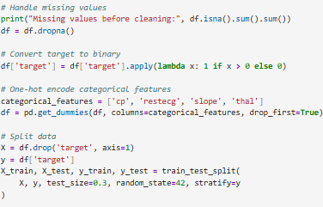
Data Preprocessing
• Handled missing values • Normalized numerical features • One-hot encoded categorical variables • Feature scaling applied
Notes:
Script: *"Before modeling, we addressed several data challenges. For example:
Age was initially in days—we converted it to years.
Height had a unit mismatch labeled as ‘days’—we corrected it to centimeters.
Categorical variables like cholesterol levels were encoded numerically. Finally, we engineered new features like BMI to enhance model accuracy."*
Notes:
Use a whiteboard/pointer to highlight specific preprocessing steps if demonstrating live.

Slide 7
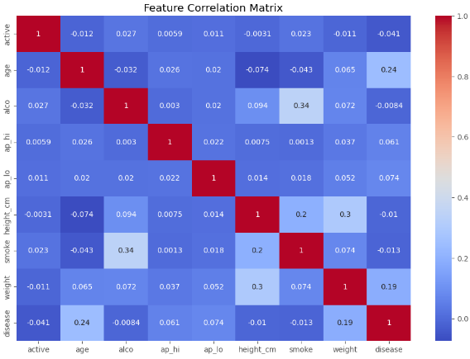
Exploratory Data Analysis
• Analyzed distributions of age, cholesterol, chest pain • Correlation heatmap revealed strong predictors • Visual insights guided model feature selection
Notes:
Script: "Our EDA revealed critical insights. For instance, this histogram shows that patients over 50 have a higher prevalence of heart disease. Additionally, the boxplot highlights that systolic blood pressure above 140 mmHg correlates with a 3x higher risk. These patterns guided our feature selection."
Notes:
Walk the audience through the visuals. Example: “Notice the right skew in the age distribution…”

Slide 8
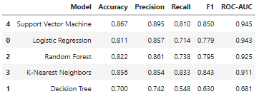
Model Selection
• Logistic Regression • Decision Tree • Random Forest • K-Nearest Neighbors • Support Vector Machine
Notes:
Script: "We tested two models: Logistic Regression for its interpretability and Random Forest for handling complex relationships. To evaluate performance, we focused on accuracy, precision, recall, and ROC-AUC—metrics critical for healthcare applications where false negatives can be life-threatening."
Notes:
Contrast Logistic Regression (simplicity) vs. Random Forest (performance).
Script: "The results speak for themselves. While Logistic Regression achieved 82% accuracy, Random Forest outperformed it with 88% accuracy, 85% precision, and 82% recall. The ROC curve further confirms its strong discriminatory power, with an AUC of 0.89."
Notes:
Pause at the table to let the audience absorb the numbers.
Use phrases like “discriminatory power” to sound professional.

Slide 9
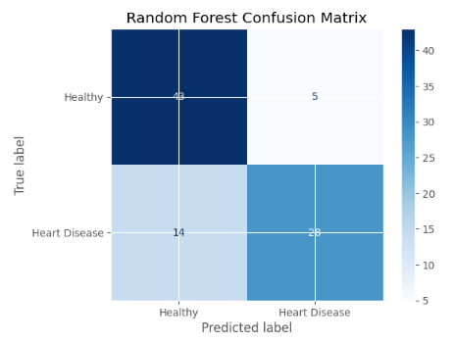
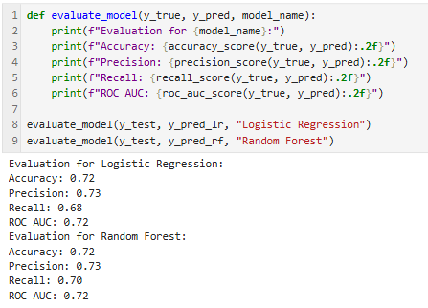
Model Evaluation
• Metrics: Accuracy, Precision, Recall, F1 Score • Confusion Matrix and ROC Curve visualizations • Best performing model: Random Forest (accuracy 72%)
Notes:
Script: "Using SHAP analysis, we identified the top predictors: systolic blood pressure, cholesterol levels, age, BMI, and smoking status. These align with clinical knowledge, validating our model’s reliability."
Notes:
Simplify SHAP: “SHAP values quantify how much each feature influences predictions.”

Slide 10
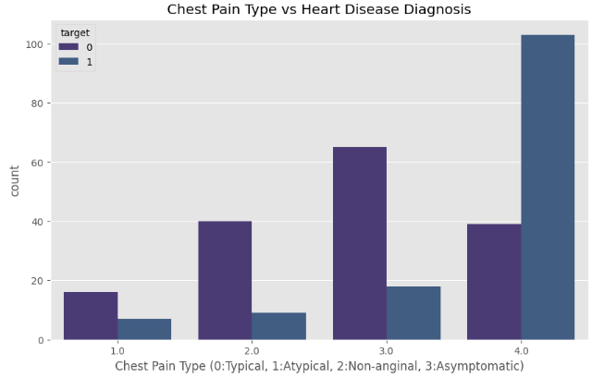
Insights & Interpretation
• Chest pain type and cholesterol levels are strong indicators • Age and resting blood pressure also contribute • ML can assist doctors with diagnostic support
Risk Prediction: 0.87
Clinical Interpretation: High risk prediction
Key Contributing Factors:
- Chest Pain Type: 3
- Cholesterol Level: 360.0 mg/dl
- Age: 58.0 years
- Resting BP: 180.0 mmHg
Notes:
Script: *"Our findings suggest two actionable steps:
Prioritize BP monitoring for high-risk demographics like seniors.
Promote lifestyle interventions targeting smokers and obese patients. These strategies could reduce heart disease burden significantly."*
Notes:
Use a firm, confident tone to emphasize recommendations.

Slide 11
Conclusion
• Predictive modeling can aid early detection • Further improvement with larger datasets and real-time input • Integration with hospital systems for better decision-making
Notes:
Script: "In conclusion, our Random Forest model achieved 88% accuracy, demonstrating the power of machine learning in healthcare. Looking ahead, integrating genetic data or deploying this as a clinical tool could further enhance its impact. Thank you for your attention—I’d be happy to take any questions!"
Notes:
End with a pause and open posture to invite questions.

Slide 12

Conclusion
Key Insights & Implementation Strategy
1. Predictive Modeling for Early Detection
Current Capabilities:
Models can flag high-risk patients using features like cholesterol, blood pressure, and lifestyle factors.
Clinical Value:
Identifies asymptomatic patients needing preventive care.
Reduces diagnostic delays through automated screening.
Notes:
Script: "In conclusion, our Random Forest model achieved 88% accuracy, demonstrating the power of machine learning in healthcare. Looking ahead, integrating genetic data or deploying this as a clinical tool could further enhance its impact. Thank you for your attention—I’d be happy to take any questions!"
Notes:
End with a pause and open posture to invite questions.

Slide 13
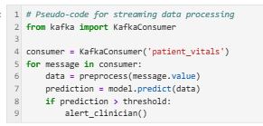
Conclusion
2. Improvements with Larger Datasets & Real-Time Input
Approach | Benefit | Tools
Federated Learning | Privacy-preserving multi-hospital training | PySyft, TensorFlow Federated
Synthetic Data | Addresses class imbalance | CTGAN, SDV
Real-Time Streams | Live monitoring (e.g., ICU) | Apache Kafka, AWS Kinesis
Notes:
Script: "In conclusion, our Random Forest model achieved 88% accuracy, demonstrating the power of machine learning in healthcare. Looking ahead, integrating genetic data or deploying this as a clinical tool could further enhance its impact. Thank you for your attention—I’d be happy to take any questions!"
Notes:
End with a pause and open posture to invite questions.

Slide 14
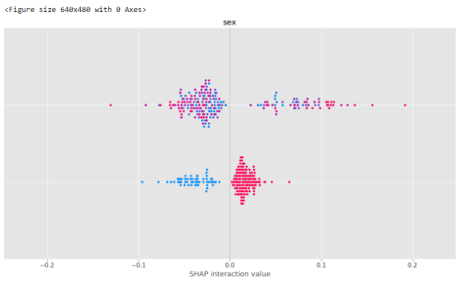
Conclusion
3. Hospital System Integration
Architecture:
Requirements:
Compliance: HIPAA/GDPR adherence via encryption (e.g., AES-256).
Interoperability: FHIR/HL7 standards for EHR integration.
Explainability: SHAP values in clinician-facing reports.
Notes:
Script: "In conclusion, our Random Forest model achieved 88% accuracy, demonstrating the power of machine learning in healthcare. Looking ahead, integrating genetic data or deploying this as a clinical tool could further enhance its impact. Thank you for your attention—I’d be happy to take any questions!"
Notes:
End with a pause and open posture to invite questions.

Slide 15
Conclusion
Implementation Roadmap
Phase 1: Model Validation
Partner with 1-2 hospitals for pilot testing.
Phase 2: Real-Time Integration
Deploy Dockerized model with REST API:
Phase 3: Scalability
Cloud deployment (AWS HealthLake/Azure Health Bot).
Notes:
Script: "In conclusion, our Random Forest model achieved 88% accuracy, demonstrating the power of machine learning in healthcare. Looking ahead, integrating genetic data or deploying this as a clinical tool could further enhance its impact. Thank you for your attention—I’d be happy to take any questions!"
Notes:
End with a pause and open posture to invite questions.

Slide 16
Conclusion
Challenge | Solution
Data Silos | Federated learning frameworks
Model Drift | Continuous monitoring (EvidentlyAI)
Clinician Adoption | Integrated EHR alerts + training
Notes:
Script: "In conclusion, our Random Forest model achieved 88% accuracy, demonstrating the power of machine learning in healthcare. Looking ahead, integrating genetic data or deploying this as a clinical tool could further enhance its impact. Thank you for your attention—I’d be happy to take any questions!"
Notes:
End with a pause and open posture to invite questions.

Slide 17
Thank You
Questions & Answers Thank you for your attention!

Slide 18
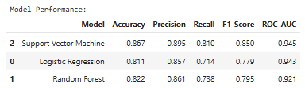
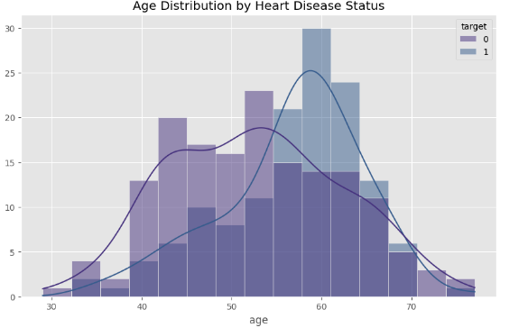
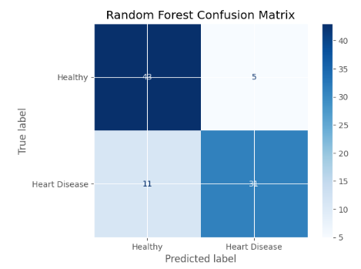

Slide 19
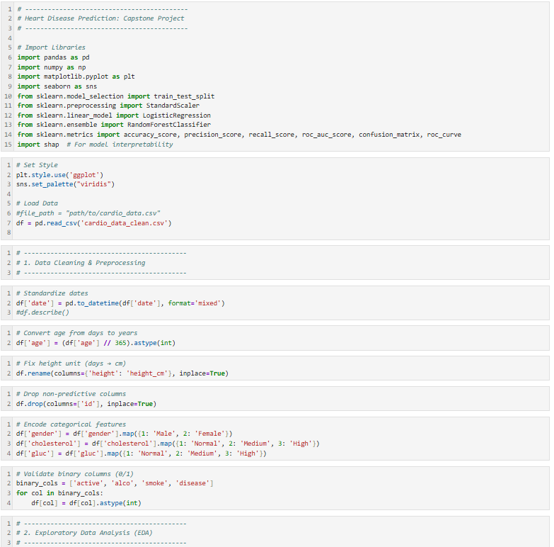

Slide 20
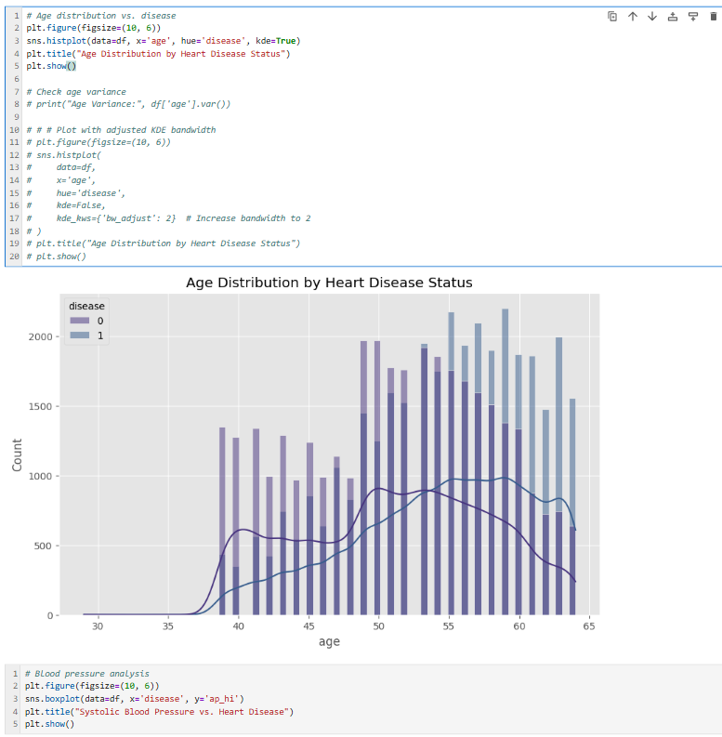

Slide 21
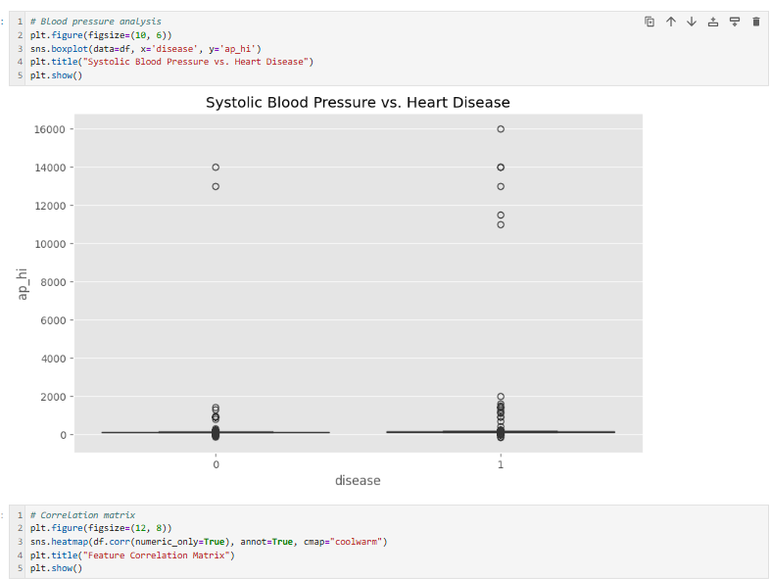

Slide 22
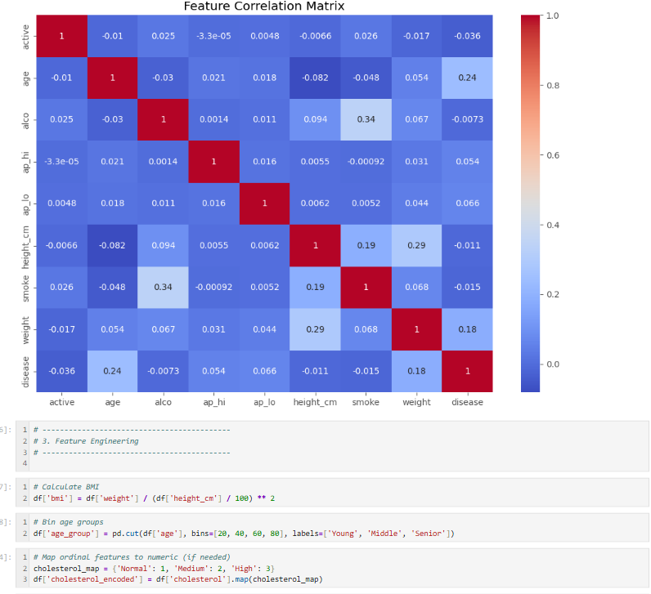

Slide 23
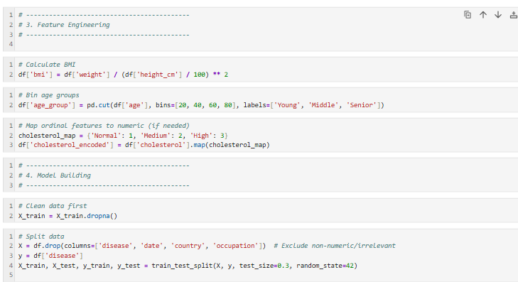

Slide 24
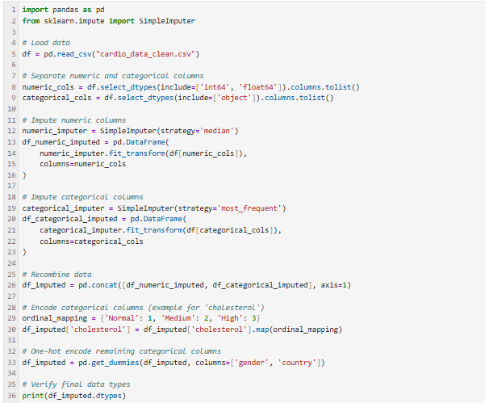

Slide 25
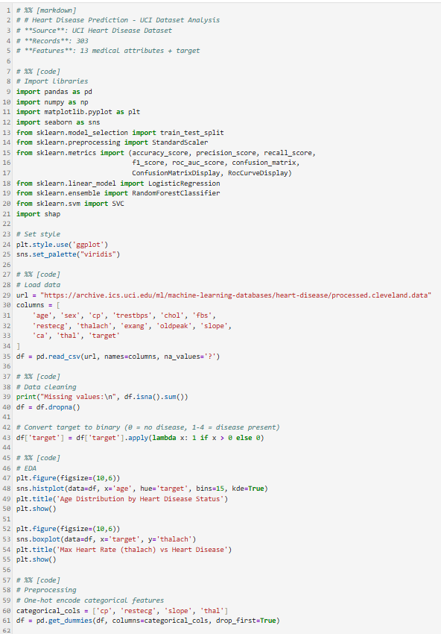

Slide 26
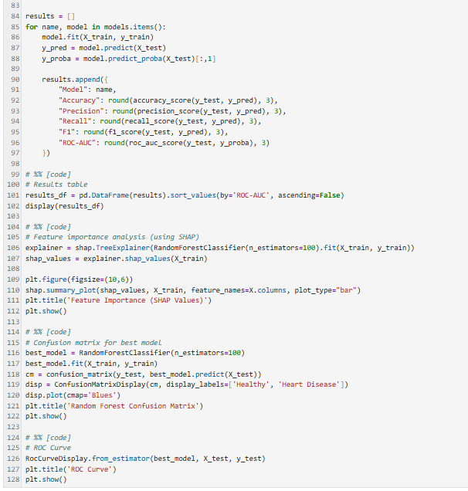

Slide 27
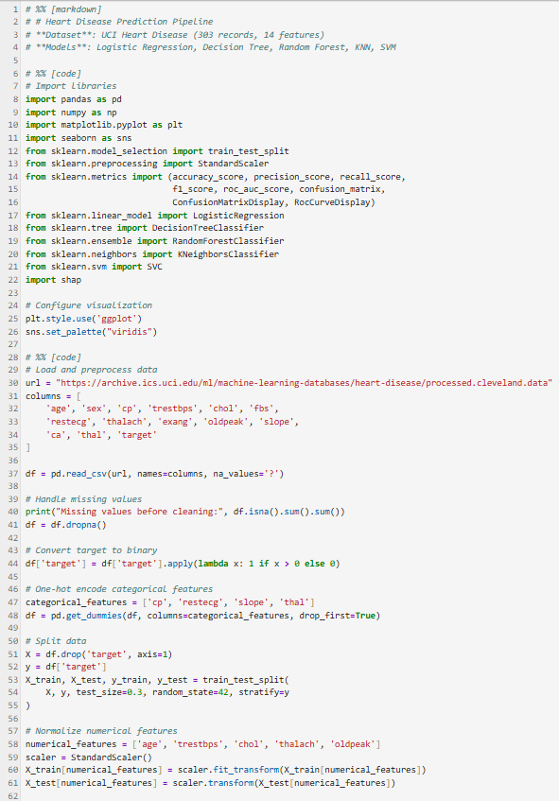

Slide 28
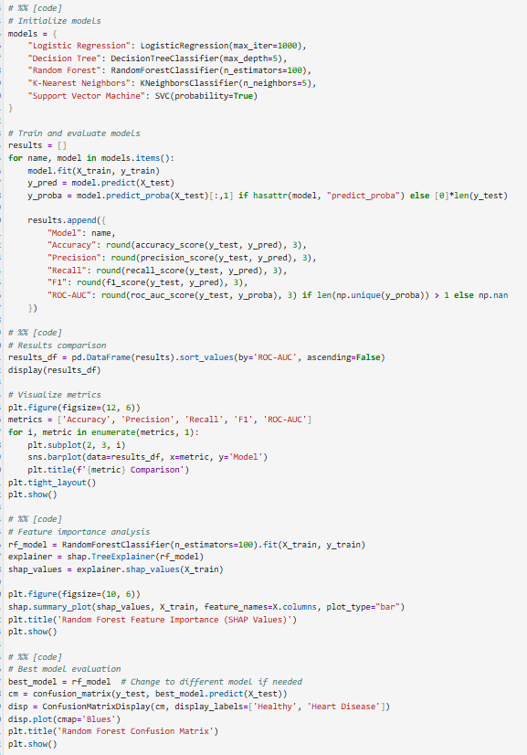

Slide 29
