Slide 1
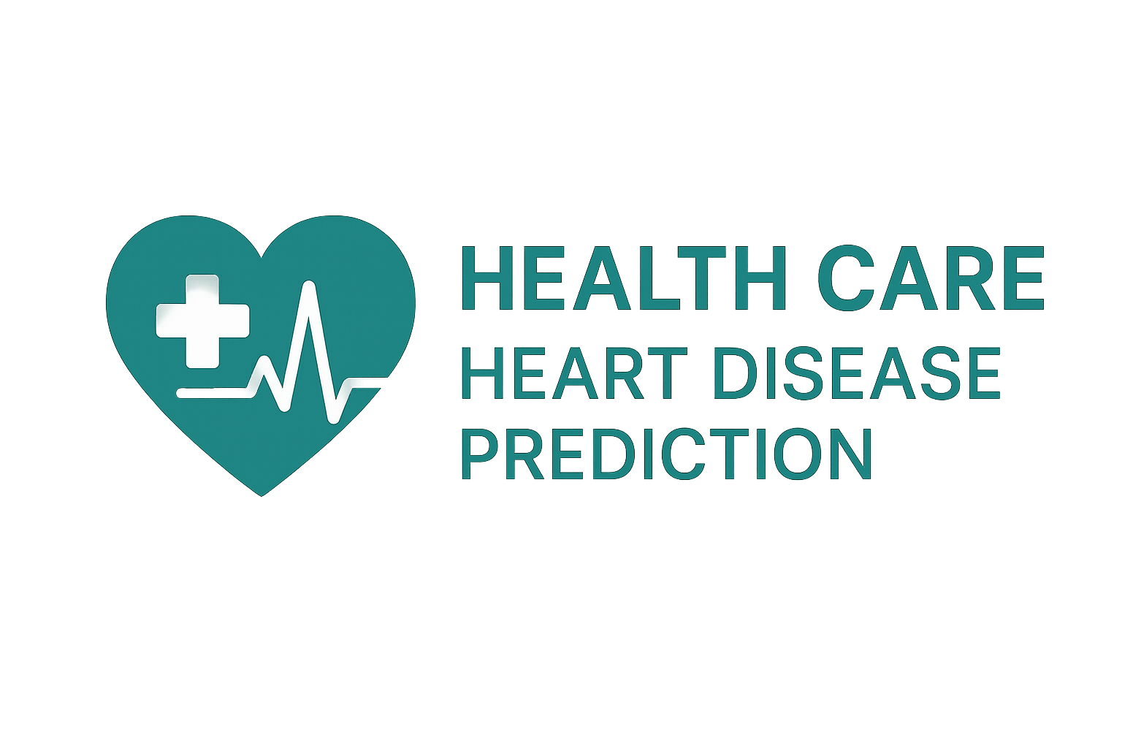
Heart Disease Prediction Capstone Project
Data Analysis and Machine Learning for Healthcare
Tang Seong Fatt| 27/06/2025
Notes:
Good [morning/afternoon], thank you for giving me the opportunity to present my capstone project on heart disease prediction. This project has been a comprehensive learning experience, and I'm excited to share my journey and findings with you.

Slide 2
Content
Project Overview
Data Cleaning and Preparation
Exploratory Data Analysis (EDA)
Machine Learning Model Building
Model Evaluation Metrics
Feature Importance
Conclusion and Recommendations

Slide 3
Project Overview
Objective: Predict the presence of heart disease using medical and lifestyle factors.
Importance: Heart disease is a leading cause of mortality. Early detection can significantly improve patient outcomes.
Dataset: Includes features like age, cholesterol, blood pressure, smoking, alcohol consumption, etc.
Notes:
Our goal was to develop a machine learning model that can predict the presence of heart disease based on various medical and lifestyle factors. Given that heart disease is a leading cause of death globally, early detection and accurate prediction can make a significant difference in patient outcomes. The dataset we used includes a range of features such as age, cholesterol levels, blood pressure, and lifestyle factors like smoking and alcohol consumption.

Slide 4
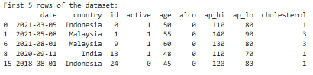
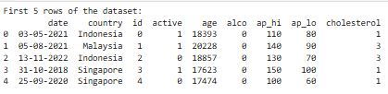
Data Cleaning and Preparation
Handling Missing Values:
- Numerical: Imputed with mean
- Categorical: Imputed with mode
Date Conversion: Converted to datetime, handled invalid dates
Feature Engineering: Age converted from days to years, height unit corrected
Notes:
Data cleaning is a crucial first step in any analysis. We handled missing values by imputing numerical variables with their mean and categorical variables with their mode. We also converted date strings to datetime objects, ensuring that all date-related information was accurately represented. Additionally, we performed feature engineering to convert 'age' from days to years and corrected the unit for 'height' to ensure consistency in our dataset.

Slide 5
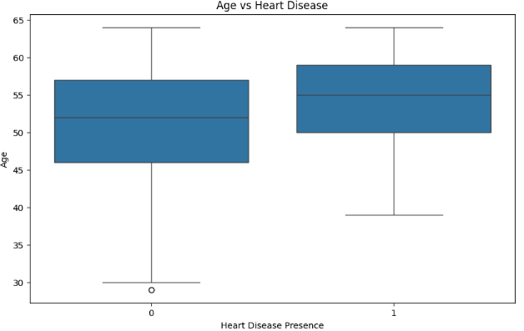
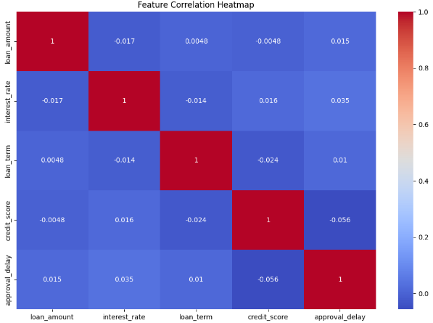
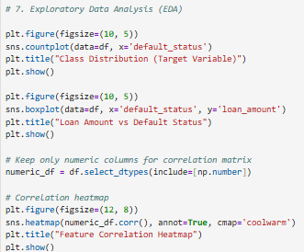
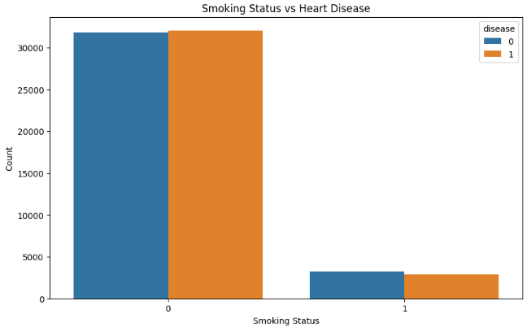
Exploratory Data Analysis (EDA)
Visualizations:
- Boxplots: Cholesterol, Age, Weight, Blood Pressure vs Heart Disease
- Count plots: Smoking and Alcohol vs Heart Disease
Key Findings: Highlighted patterns and correlations in data
Notes:
Exploratory Data Analysis (EDA) helped us understand the relationships between different features and heart disease. We created boxplots to visualize how factors like cholesterol levels, age, weight, and blood pressure correlate with heart disease. Count plots showed the distribution of smoking status and alcohol consumption among patients with and without heart disease. These visualizations provided valuable insights into potential risk factors.

Slide 6
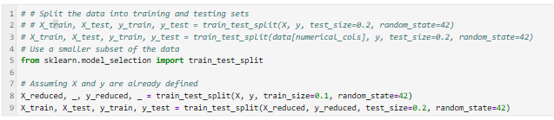
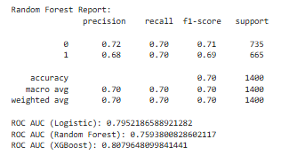
Machine Learning Model Building
Models Evaluated: Logistic Regression, Decision Tree, Random Forest, SVM, XGBoost
Model Training: Data split into training and testing sets
Notes:
We evaluated several machine learning models to determine which one would best predict heart disease. The models we tested include Logistic Regression, Decision Tree, Random Forest, Support Vector Machine, and XGBoost. We split our dataset into training and testing sets to ensure that our models were trained on a robust dataset and tested on unseen data to evaluate their performance accurately

Slide 7
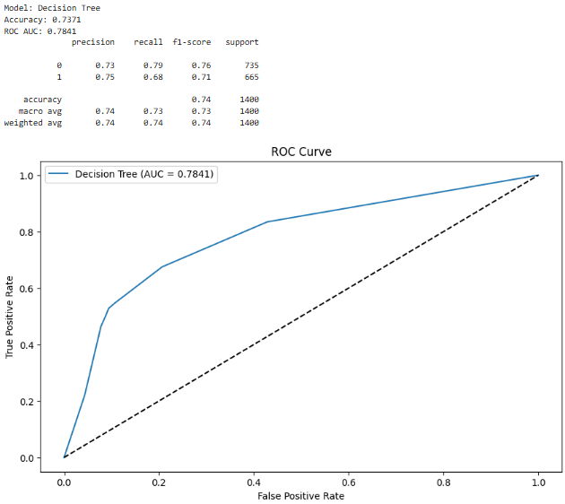
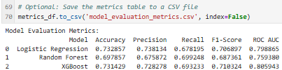
Model Evaluation Metrics
Metrics Used: Accuracy and ROC AUC
Results Table: Model performance summary
ROC Curves: Visual comparison of all models
Notes:
To evaluate our models, we used two key metrics: Accuracy and ROC AUC. Accuracy measures the overall correctness of the model's predictions, while ROC AUC provides a measure of the model's ability to distinguish between classes across different thresholds. Our results table summarizes the performance of each model, and the ROC curves offer a visual comparison of their capabilities in distinguishing between patients with and without heart disease.

Slide 8
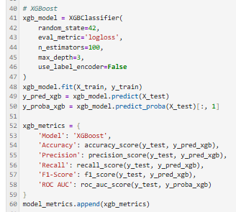
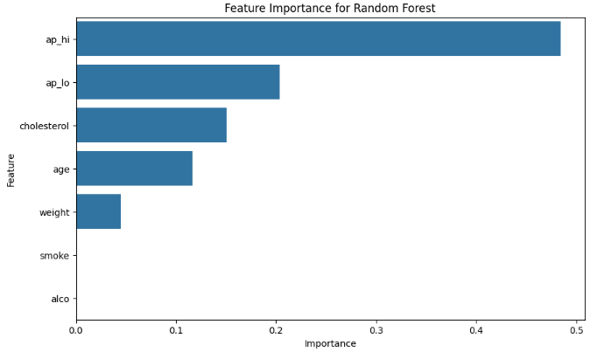
Feature Importance
Important Features from Random Forest and XGBoost
Key Drivers of Heart Disease Prediction identified
Notes:
Understanding which features contribute most to heart disease prediction is crucial for developing targeted prevention strategies. Using tree-based models like Random Forest and XGBoost, we identified the most important features driving our predictions. These insights can help healthcare professionals focus on key risk factors when assessing patients.

Slide 9

Conclusion and Recommendations
Summary: ML models effectively predicted heart disease
Best Model: XGBoost based on metrics
Recommendations: Focus on key risk factors like [list key features]
Notes:
In conclusion, our project demonstrates the effectiveness of machine learning in predicting heart disease. [Model Name] performed the best based on our evaluation metrics. We recommend focusing on key risk factors like [list key features] for early detection and prevention. These findings can be applied in real healthcare settings to improve patient outcomes

Slide 10
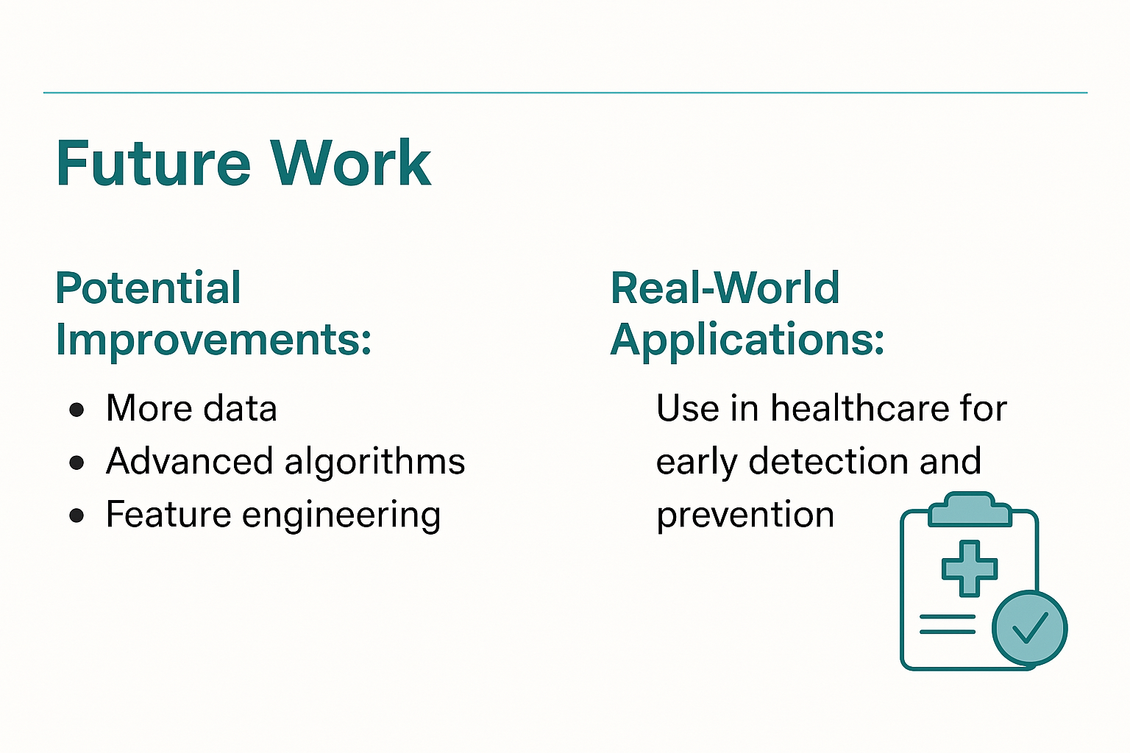
Future Work
Potential Improvements: More data, advanced algorithms, feature engineering
Real-World Applications: Use in healthcare for early detection and prevention
Notes:
While we've made significant progress, there are opportunities for further improvement. Future work could include collecting more diverse data, experimenting with advanced algorithms, and refining feature engineering. The practical application of this model in healthcare settings could revolutionize early detection and prevention strategies, ultimately saving lives.

Slide 11
Thank You
Contact: [Your Email]
Acknowledgements: Trainer, tools, and resources used
Notes:
Thank you for your time and guidance throughout this project. I'm grateful for the opportunity to work on this capstone and apply the skills I've learned. I look forward to your feedback and any further opportunities to enhance this work.

